Slide 1

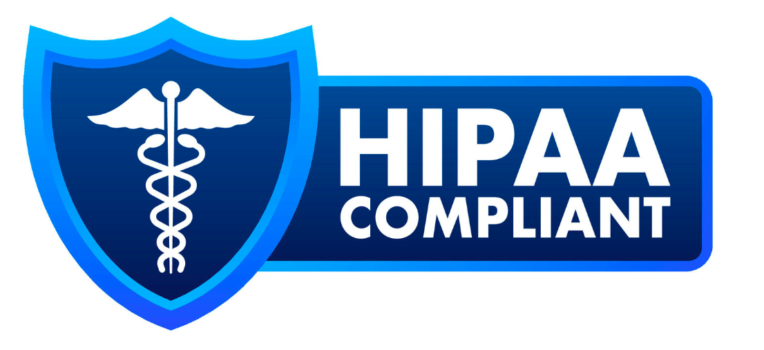
Health Information Protection Policy (HIPP)
Friday 4th April 2025

Slide 2






Importance of a Health Information Protection Policy
Reduces Healthcare Fraud and Abuse
Ensures Patient Data Privacy, Confidentiality & Security
Regulatory Compliance, Ethical & Legal Obligations
Enhances Trust & Patient Confidence
Maintain Data Integrity & Operational Efficiency
Defines Roles, Responsibilities & Security Measures
Effective Risk Assessment and Management

Slide 3
Key Components of HIPP Policy
Privacy Rule Adherence
Security Rule Implementation
Employee Training and Cyber Awareness
Documentation and Audit Preparedness
Breach Response and Notification
Risk Assessment and Management
Addressing Telemedicine & Remote work

Slide 4
Privacy Rule and Safeguards for PHI
Privacy Rule
Patients’ rights
Safeguards for Data Security
Strong encryption standards like AES-256 for maximum security
Keep track of disclosures.
Disclose a minimum amount of information
Notify individuals of the use of their PHI
Ensure data confidentiality by safeguarding PHI.
Access controls- Implement Role-based Access Controls (RBAC)
Strong Authentication Measures- Implement Multi-factor Authentication (MFA).
Data Minimization
Secure Physical Storage
Backup and Disaster Recovery
Audit Controls
Employee Training
Regular Risk Assessments
Secure Communication Channels
Limiting Use and Disclosure

Slide 5
Security Measures for Health Information Systems (ePHI)
Administrative Safeguards
Technical Safeguards
Physical Safeguards
Breach Notification
Report on data breaches within 60 days of discovery (for large breaches) or 60 days of the end of the calendar year (for small breaches)
Regulating bodies
All impacted individuals
In large breaches, the media
Security Management Process
Assigned Security Responsibility
Workforce Security
Information Access Management
Security Awareness and Training
Security Incident Procedures
Contingency Plan
Evaluation
Business Associate Contracts and Other Arrangements
Access Control
Audit Control
Authentication
Transmission Security
Facility Access and Control
Workstation Use and Security
Device and Media Controls

Slide 6
Employee Training & Healthcare-Specific Challenges
Employee Training & Awareness
Telemedicine & Remote work
Require VPN usage when connecting to any network outside the organization’s secure environment
Risk Assessment and Management
Perform comprehensive security risk assessments at least annually
Document all identified vulnerabilities and develop mitigation plans
Test systems through penetration testing and vulnerability scanning
Update security measures based on assessment findings
Implement containerization to separate work and personal data on devices
Provide secure, HIPAA-compliant messaging, Tele-health platforms and documentation apps.
Conduct specialized training for home healthcare staff that addresses the unique security challenges they face in non-clinical environments
Conduct regular security awareness training for all employees
Teach staff to identify phishing attempts and social engineering
Implement policies for proper handling of patient information and reporting potential breaches promptly.
Create a culture of security consciousness
Evaluate AI-powered security monitoring tools
Implement blockchain for secure health information exchange
Develop security protocols for telehealth platforms
Explore zero-trust security architectures
Documentation and Audit Preparedness
To educate staff on HIPAA requirements and best practices for protecting health information and training.
Steps include:
Comprehensive Documentation
Audit Preparedness
Regular Policy Review and Updates
Interoperability Requirements

Slide 7

Insights and Conclusion
Data Protection
Regulatory Compliance
Continuous Monitoring & Training
Incident Response & Recovery Plans
Patient Trust and Organizational Reputation

