Slide 1

Fitlife: Your Ultimate Fitness Companion
A smart, personalised fitness platform designed to help you achieve your health goals — one step at a time.
FITNESS · WELLNESS · TECHNOLOGY

Slide 2
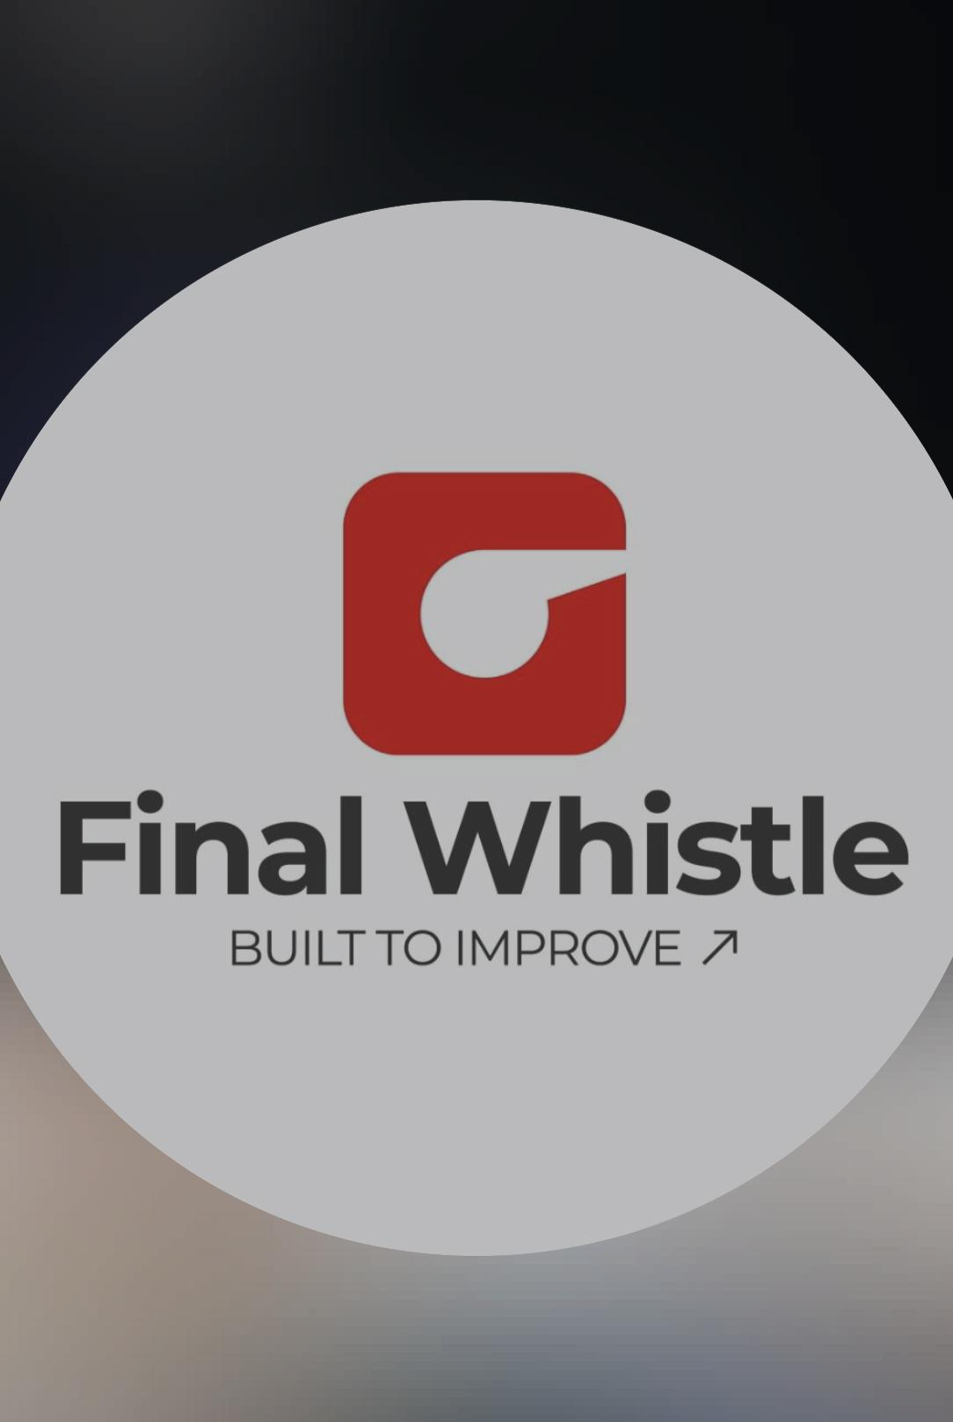


Company Profile
Founded --- 2025
Headquarters -- Pune, India
Services -- Sports tech, Kho-Kho analytics, performance tracking, match insights, talent scouting, fan engagement
Mission -- To transform grassroots sports through technology and data
About -- Final Whistle is a sports-tech platform modernizing traditional sports like Kho-Kho using analytics and digital solutions.

Slide 3

Our Vision: Transforming Health and Wellness
Fitlife was born from a simple belief — everyone deserves access to personalised, science-backed fitness guidance. We bridge the gap between motivation and results by combining smart technology with human-centred design.
🎯 Personalised
📊 Data-Driven
Tailored plans for every body and goal
Insights powered by real-time tracking
🌍 Accessible
Fitness guidance for everyone, everywhere

Slide 4

The Fitness Dilemma: Why Current Solutions Fall Short
Despite a surge in fitness apps and platforms, most users struggle to stay consistent. The problem isn't motivation — it's the tools.
Lack of Personalisation
Poor Progress Tracking
No Holistic Approach
Generic plans ignore individual fitness levels, goals, and limitations.
Fragmented data makes it hard to see real improvement over time.
Most apps focus on workouts alone, neglecting nutrition, sleep, and mental wellness.

Slide 5
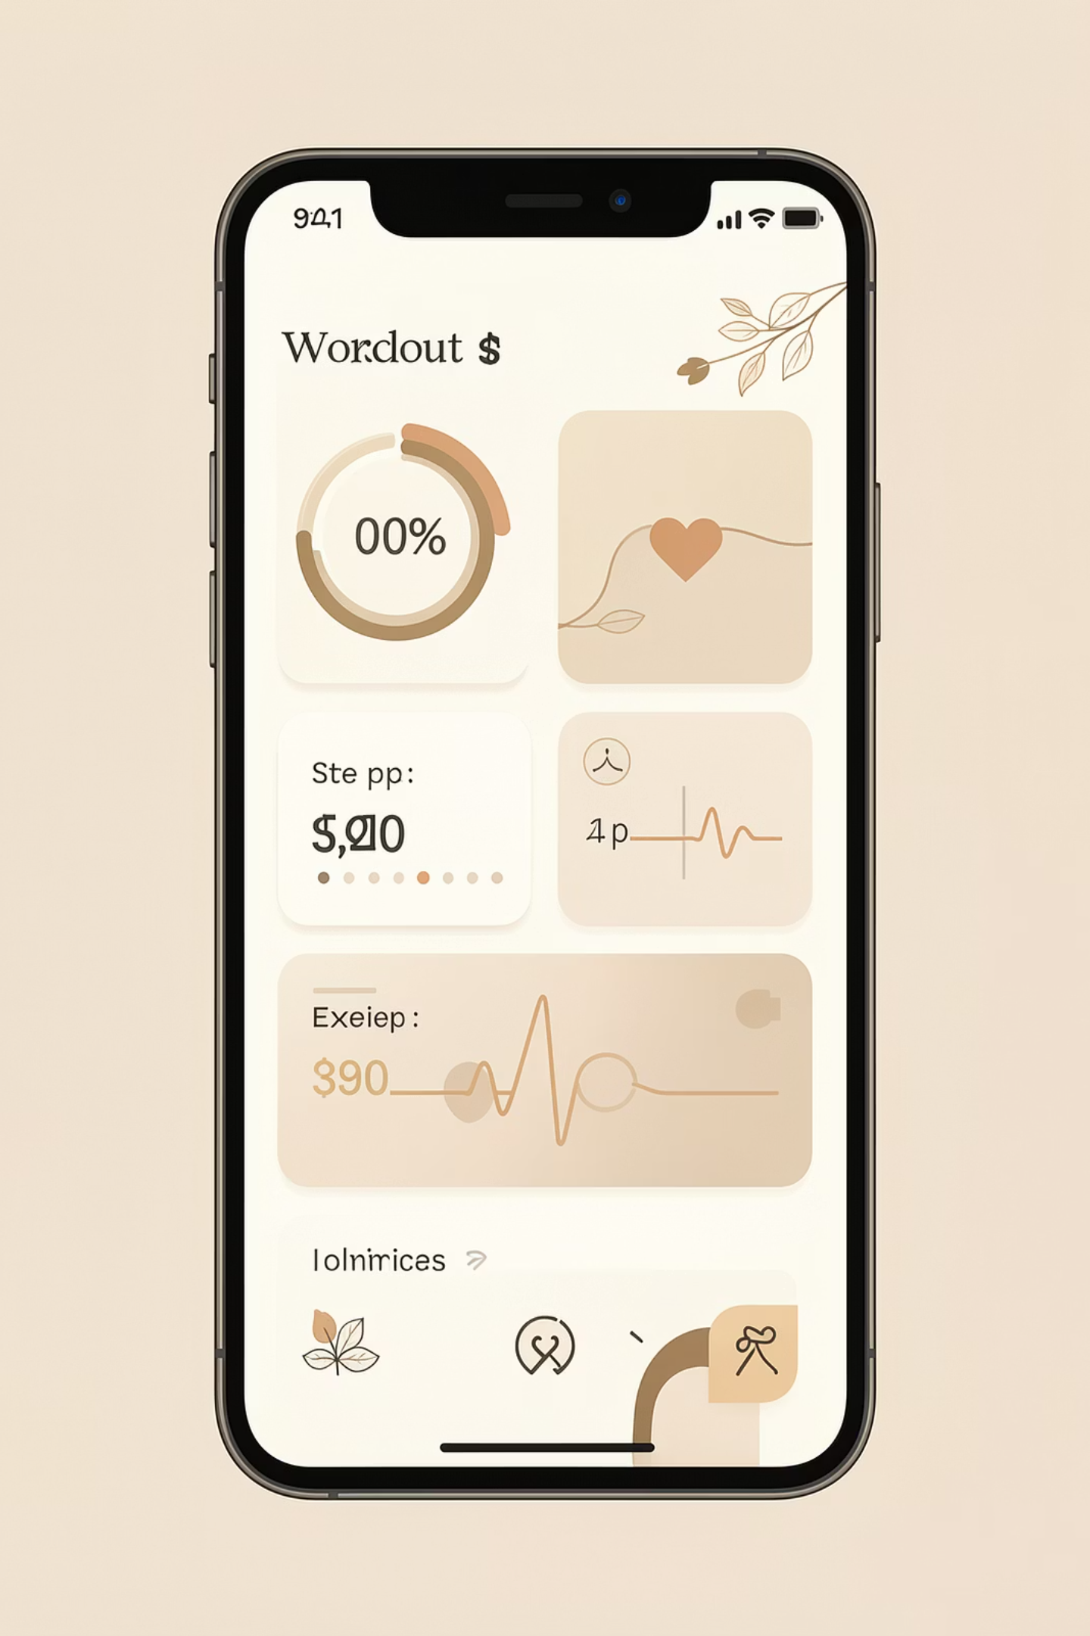
Introducing Fitlife: A Smarter Approach to Wellness
Fitlife is an end-to-end fitness companion that unifies workout planning, nutrition tracking, progress analytics, and community support into one seamless experience.
Smart Workouts
AI-generated routines adapted to your fitness level and schedule.
Nutrition Tracking
Log meals, track macros, and get personalised dietary recommendations.
Progress Analytics
Visual dashboards that celebrate every milestone and highlight areas to improve.
Community Hub
Connect with like-minded individuals, join challenges, and stay accountable.

Slide 6

Our Core Objectives: What Fitlife Aims to Achieve
Data-Driven Insight
Simplified Tracking
Personalised Plans
Habit Formation
Enable informed decisions with analytics
Make health logging effortless
Empower users with tailored programs
Foster sustainable daily routines
Every feature in Fitlife is designed with these four pillars in mind — ensuring the platform delivers real, measurable value to every user from day one.

Slide 7
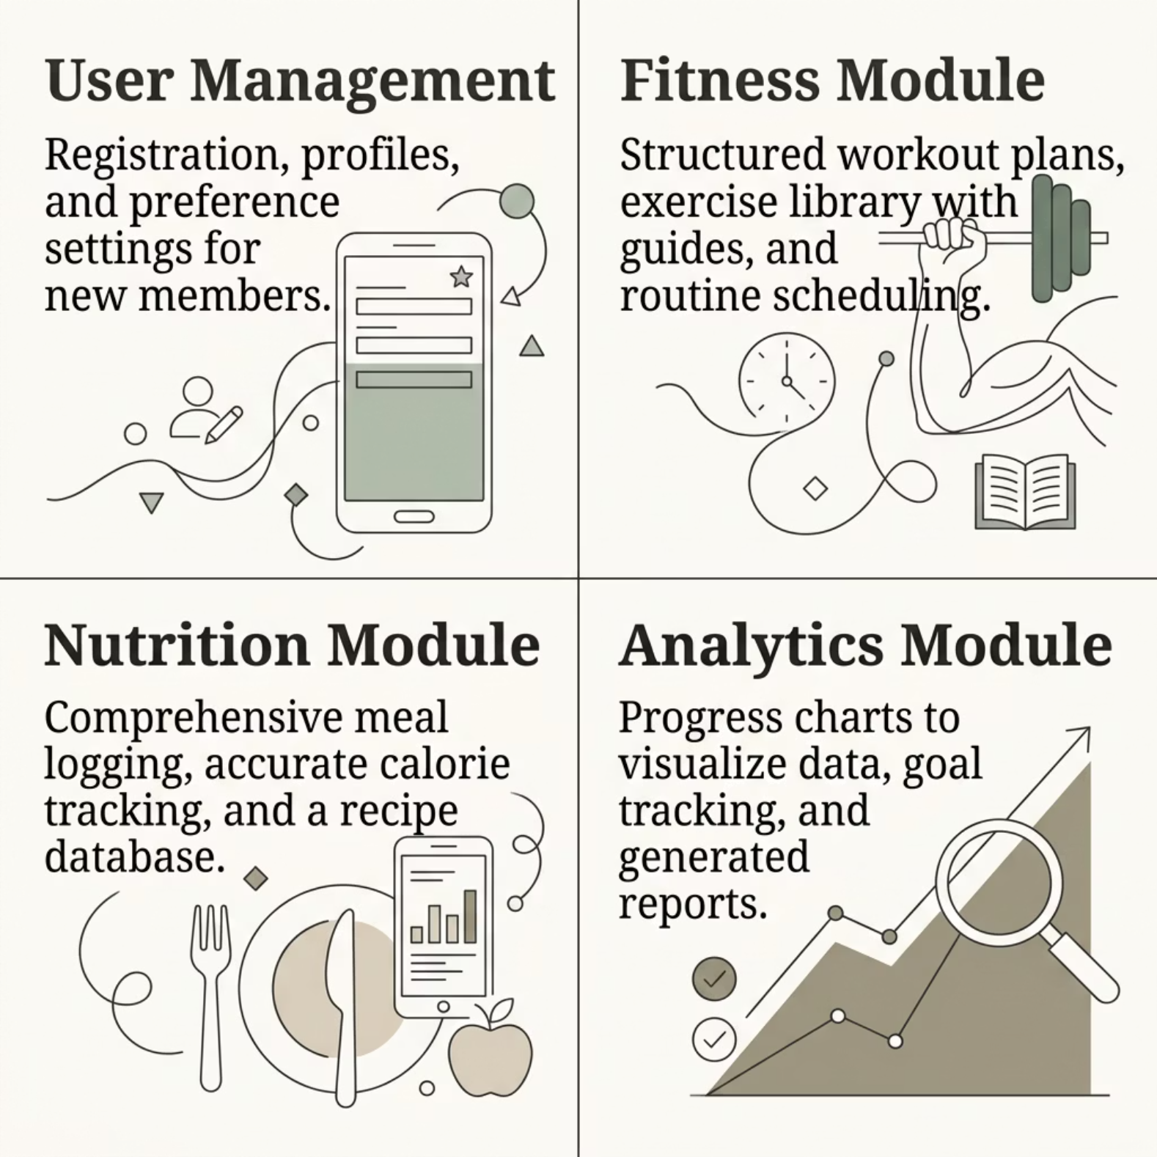


Fitlife's Reach: Defining the Scope of Our Solution
What's In Scope
Fitlife covers the complete fitness journey — from onboarding and goal setting, through daily workouts and meal logging, to long-term progress reviews and community engagement.
Fitlife supports individual users, fitness coaches, and wellness organisations within a single unified platform.

Slide 8
Essential Features: What Makes Fitlife Stand Out
1
2
3
User Authentication & Profiles
Workout Planner
Nutrition & Calorie Tracker
Custom and pre-built routines with video demonstrations and timers.
Food database, barcode scanning, and daily macro breakdowns.
Secure login, detailed fitness profiles, and goal configuration.
4
5
Real-Time Progress Dashboard
Push Notifications & Reminders
Graphs, streaks, and milestone notifications to keep users motivated.
Scheduled alerts for workouts, hydration, and meal times.

Slide 9
Requirement Gathering
Information was collected through user observations, online research, and studying existing fitness applications. The main focus was to understand the common problems faced by users, such as lack of integration, difficulty in tracking progress, and absence of personalized guidance.Based on this, the requirements were divided into two categories:
Functional Requirements:
User registration and loginRecording and tracking workoutsManaging diet/meal plansStoring basic medical informationViewing progress reportsProviding personalized recommendationsChatbot interaction for guidance
2. Non-Functional Requirements:
User-friendly interfaceFast and efficient performanceData accuracy and reliabilitySecurity of user informationSystem scalability and flexibilityThe analysis of these requirements helped in designing a system that is efficient, easy to use, and meets the needs of users effectively.

Slide 10
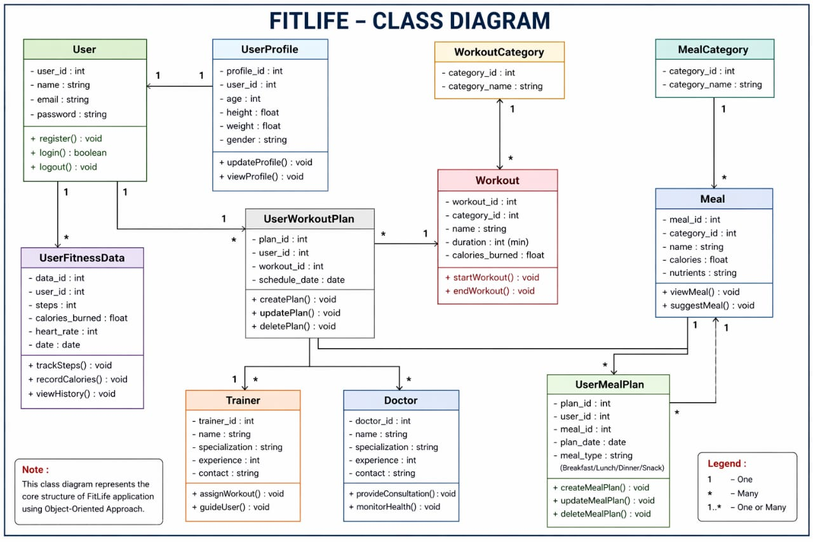
CLASS DIAGRAM

Slide 11
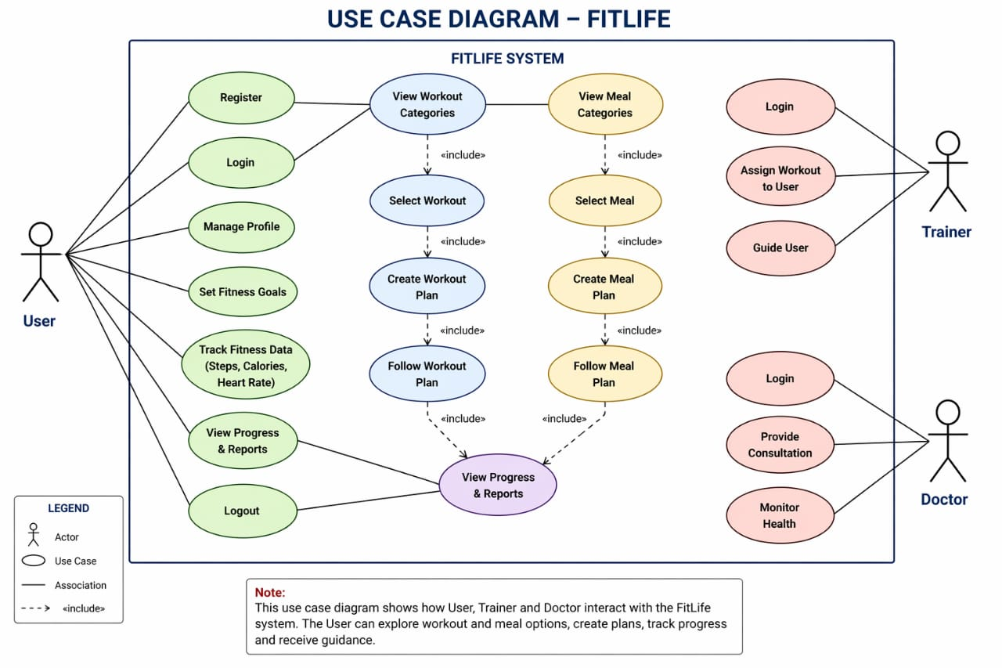

Slide 12
Implementation Strategy
Requirement Analysis: Identify user needs like workout, diet, and health tracking.
Modular Development: Divide system into modules such as user, workout, diet, medical, and chatbot.
Incremental Approach: Develop and integrate modules step by step
Technology Used: HTML, CSS, JavaScript (frontend), PHP (backend), MySQL (database).
Testing: Perform unit, integration, system, and user acceptance testing.
Deployment: Deploy on local server or hosting platform.
Maintenance: Regular updates, bug fixes, and improvements based on feedback.

Slide 13
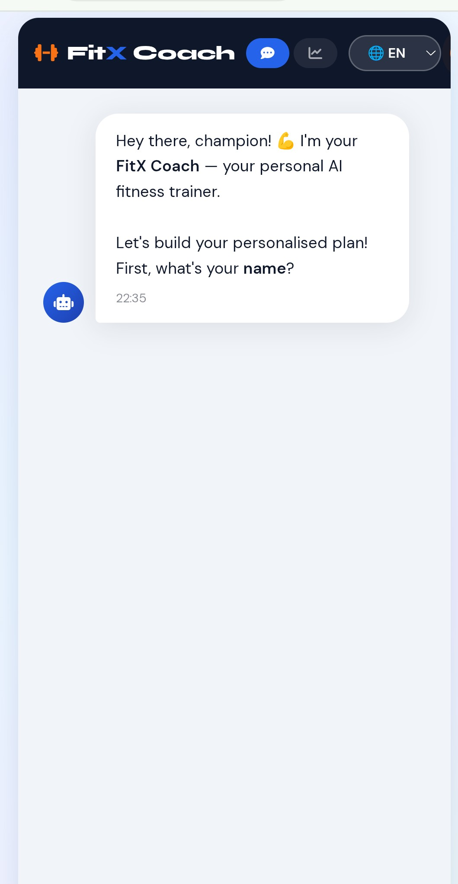
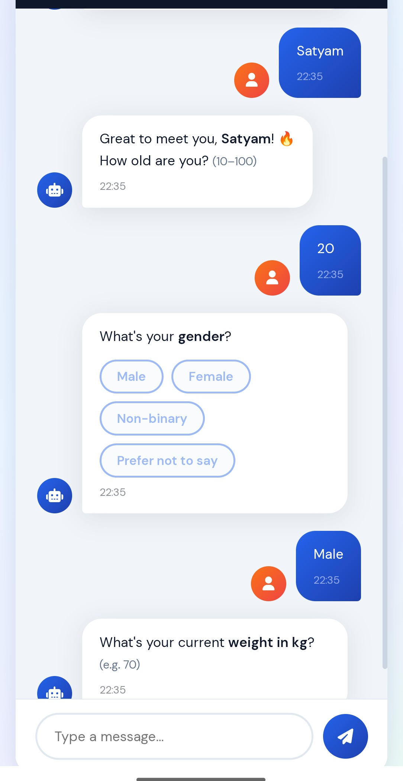
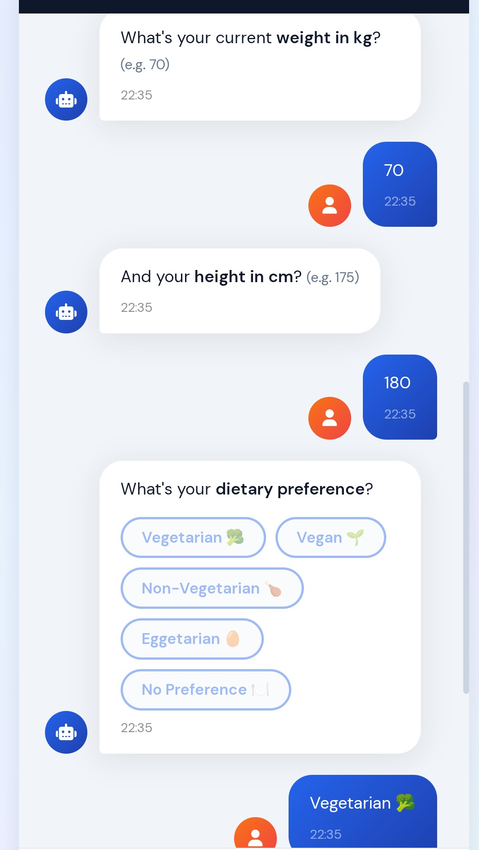
INPUT AND OUTPUT

Slide 14
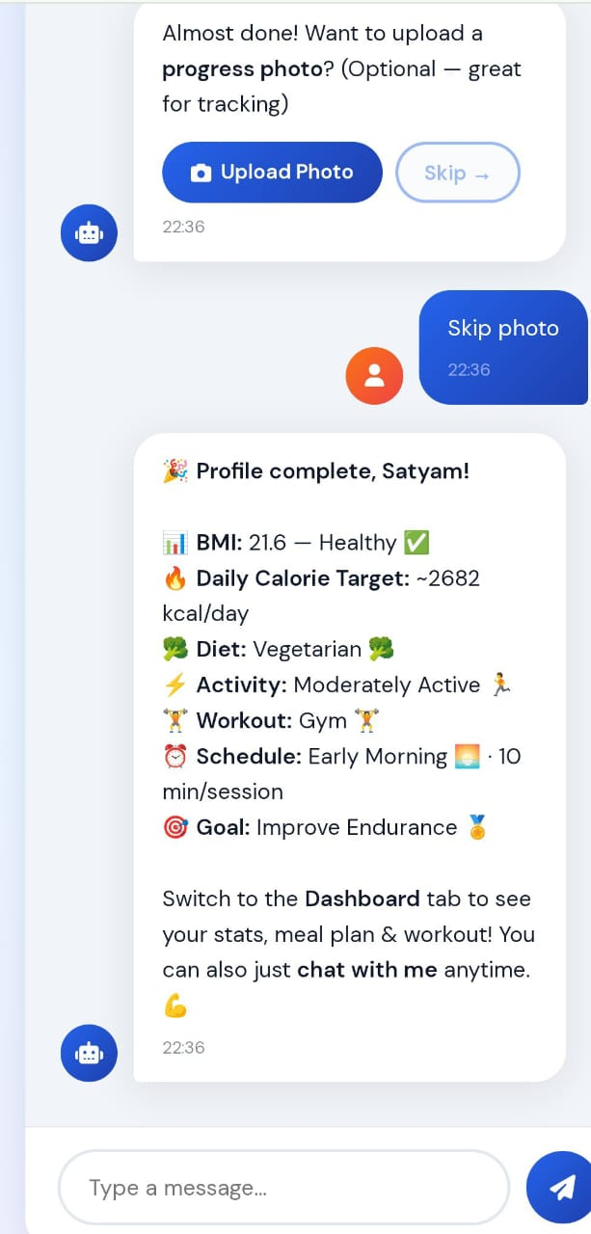
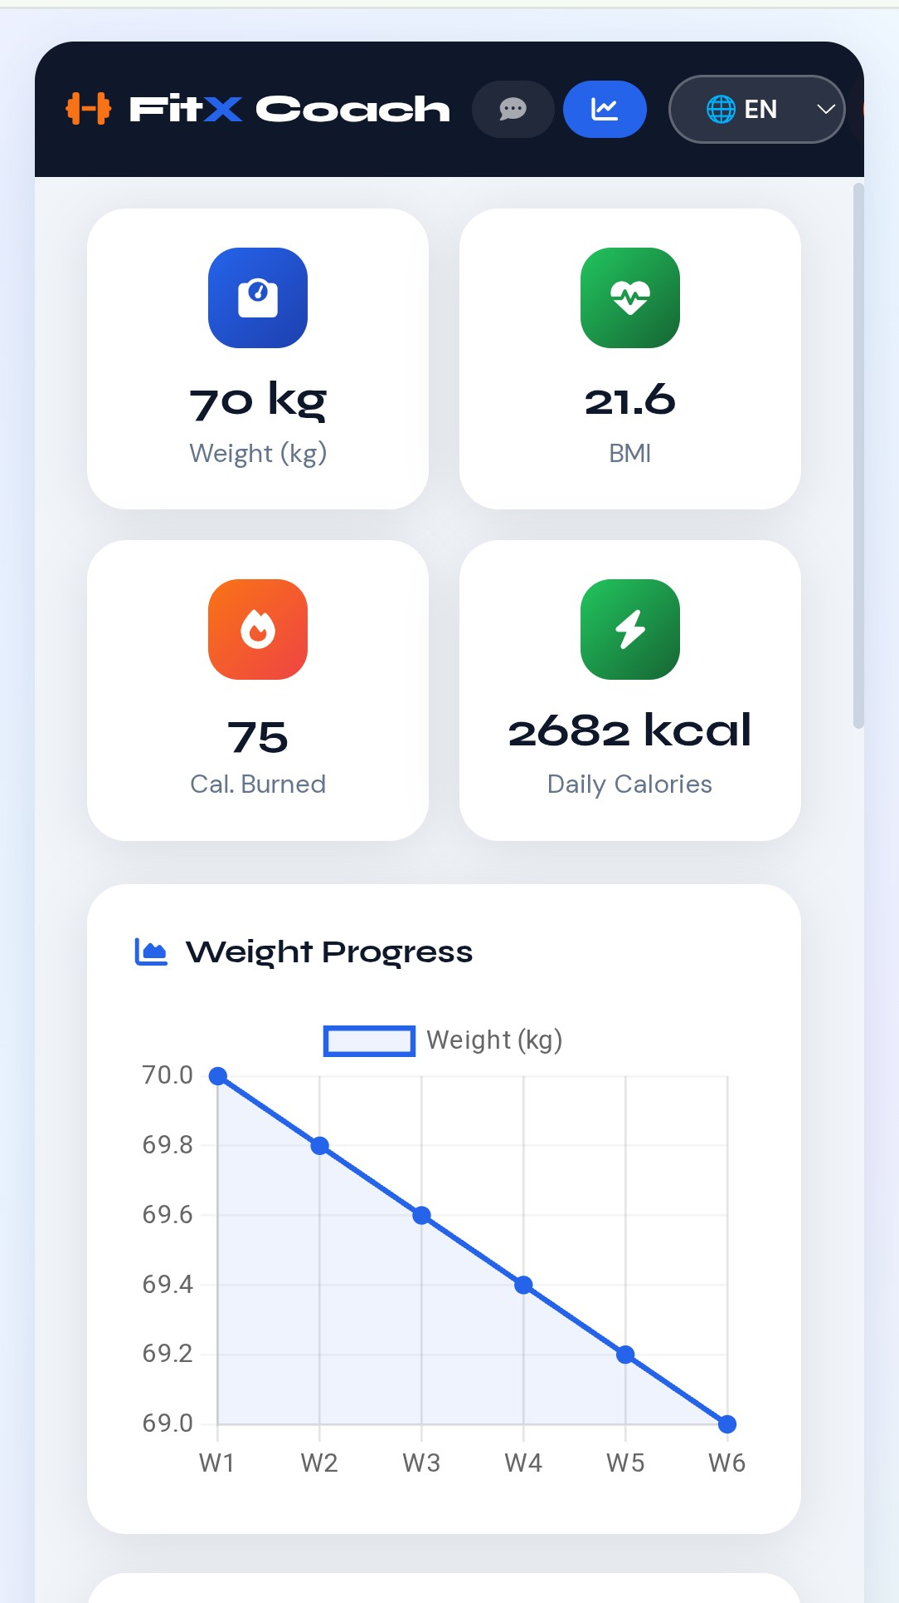

Slide 15
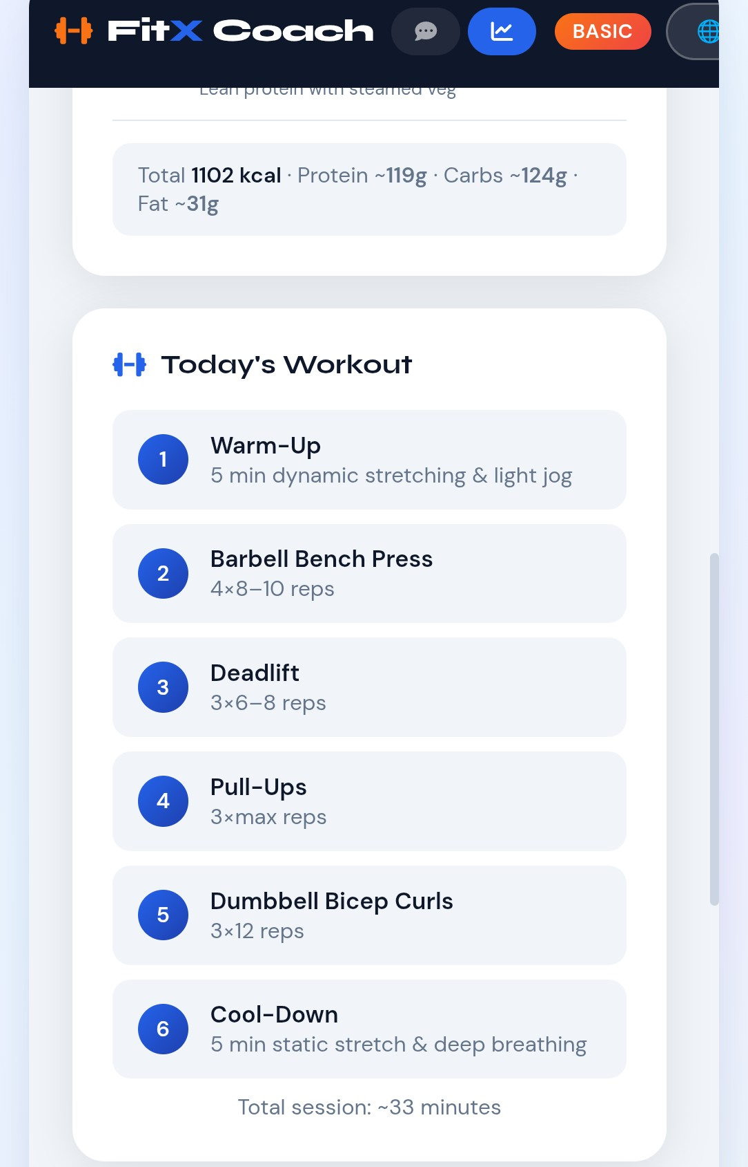
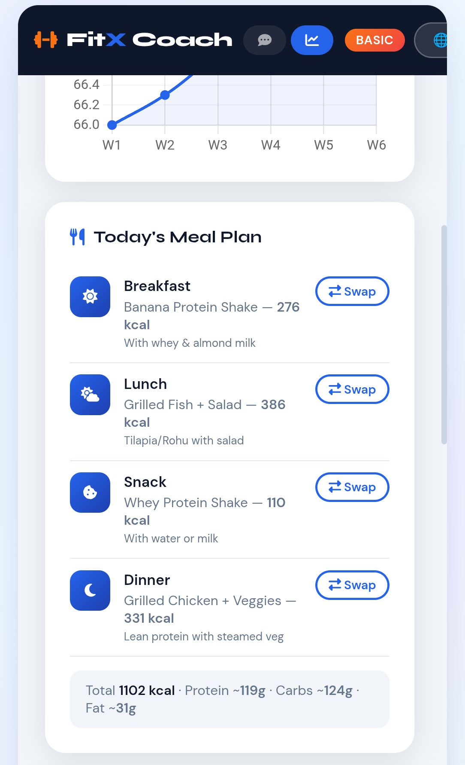

Slide 16
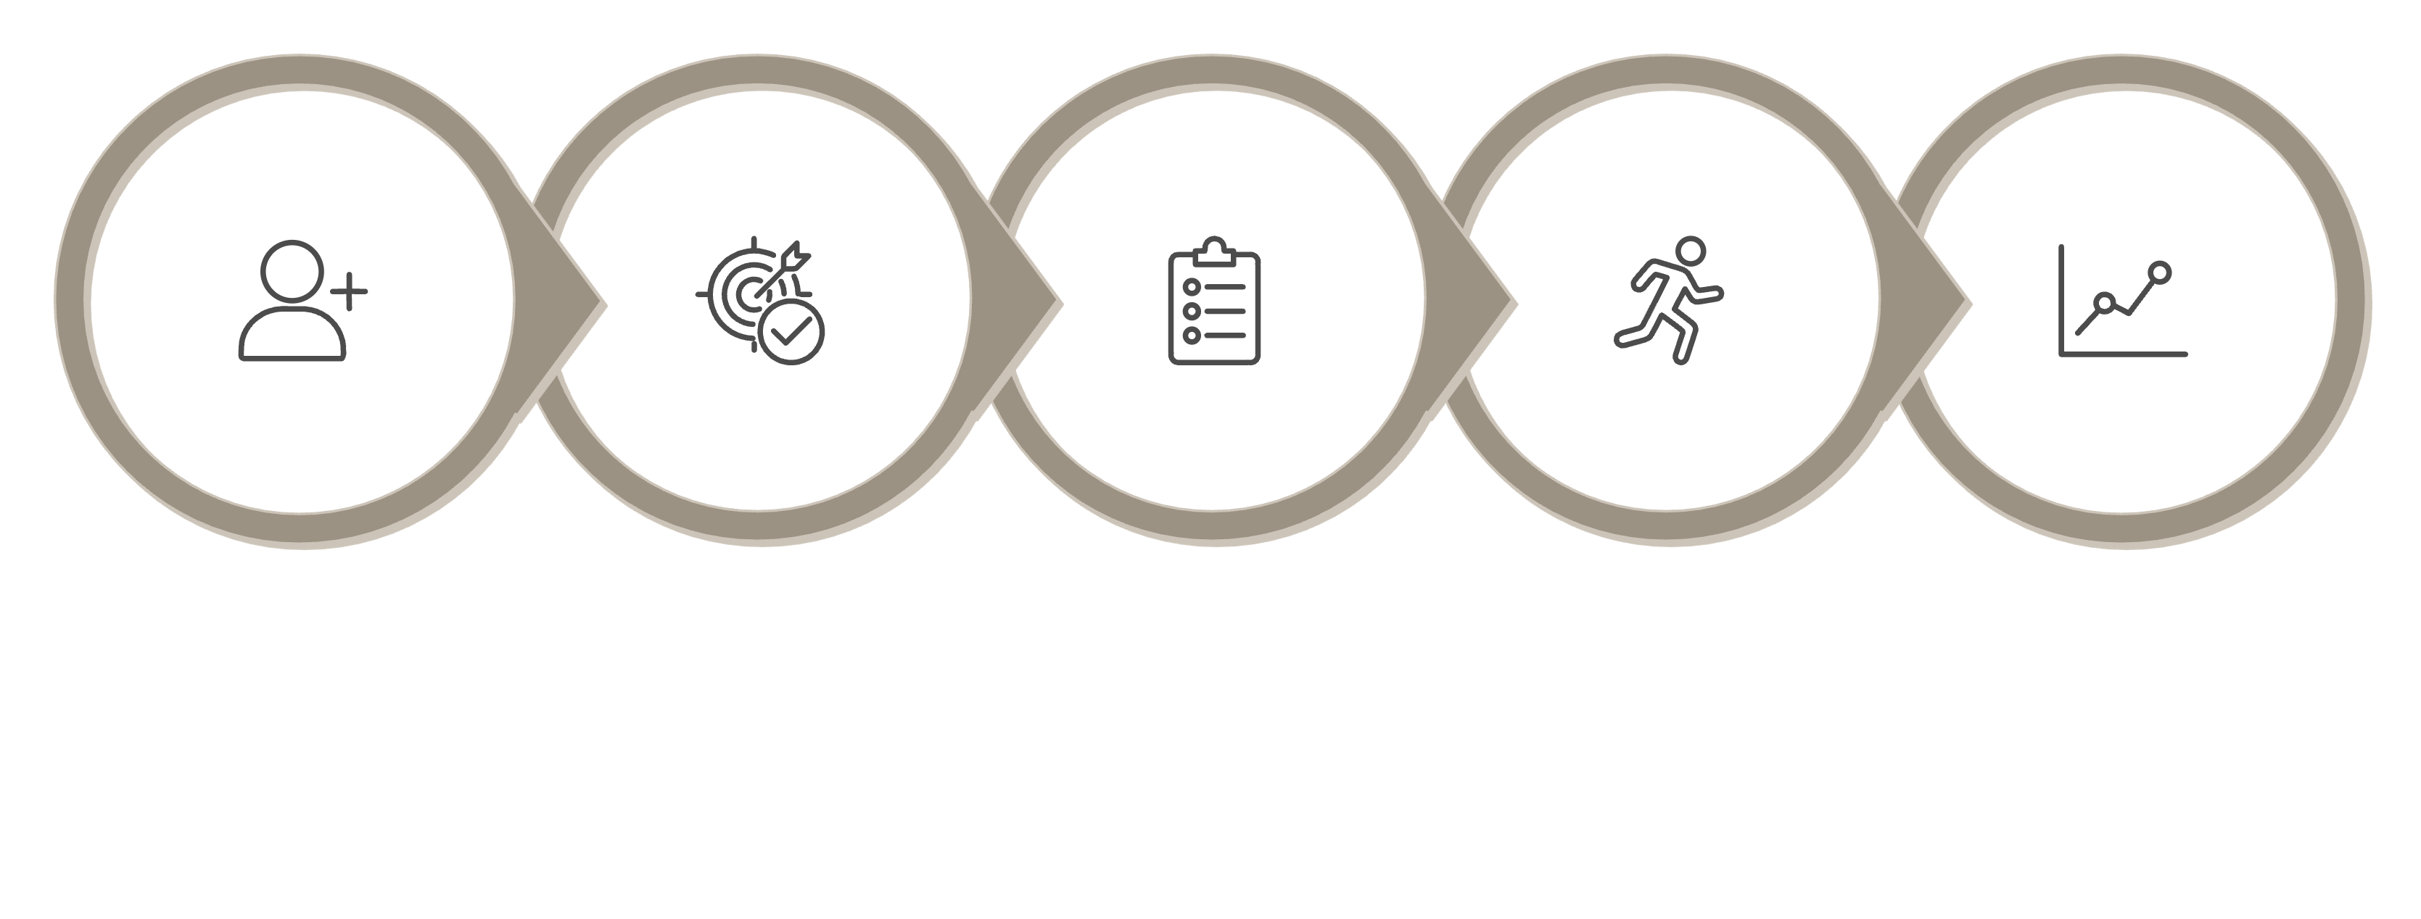
Blueprint for Success: System Architecture & Flow
Track & Adjust
Register
Set Goals
Choose Plan
Log Activity
The system follows a clean client-server architecture. Users interact through the mobile app, which communicates with the backend API. Data is stored securely and processed to deliver personalised recommendations and progress reports in real time.

Slide 17
Conclusion
The FitLife project was successfully developed with the aim of simplifying and improving fitness and health management. The system provides a centralized and user-friendly platform to manage workouts, diet plans, medical records, and overall progress. Through this project, we were able to apply theoretical knowledge into a practical application, enhancing our understanding of web development, system design, and database management. It also helped in improving problem-solving skills and gaining hands-on experience in building a real-world system. Overall, the project achieves its objective of reducing manual effort, improving data organization, and promoting a healthy lifestyle. The system can be further enhanced with advanced features and scalability improvements in the future.

Slide 18

The Road Ahead: Future Enhancements and Growth
Fitlife is just getting started. Our roadmap is designed to evolve with our users and the broader wellness ecosystem.
1
Phase 1 — Launch
Core workout, nutrition, and tracking features live on iOS & Android.
2
Phase 2 — AI Coach
Intelligent recommendations powered by machine learning and user behaviour.
3
Phase 3 — Wearables
Integration with smartwatches and fitness bands for seamless data sync.
4
Phase 4 — Community
Live classes, group challenges, and coach marketplace for a connected ecosystem.

