Slide 1
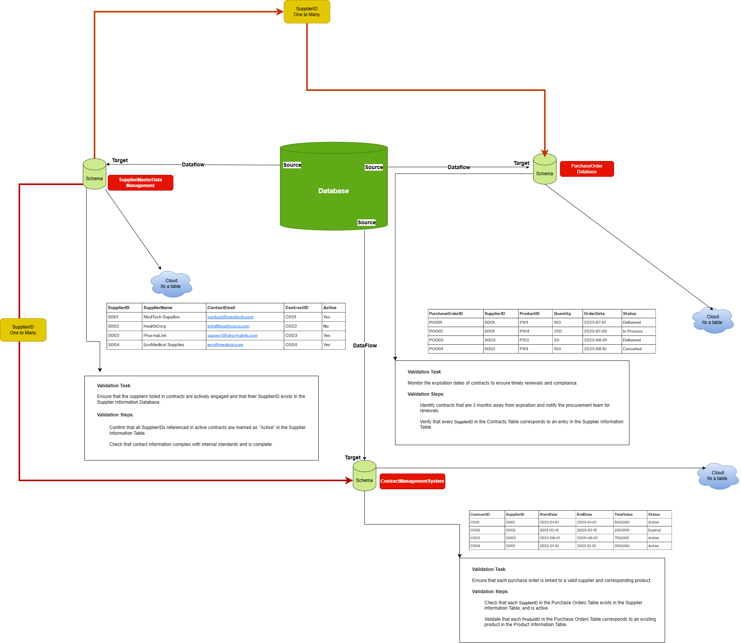

Slide 2
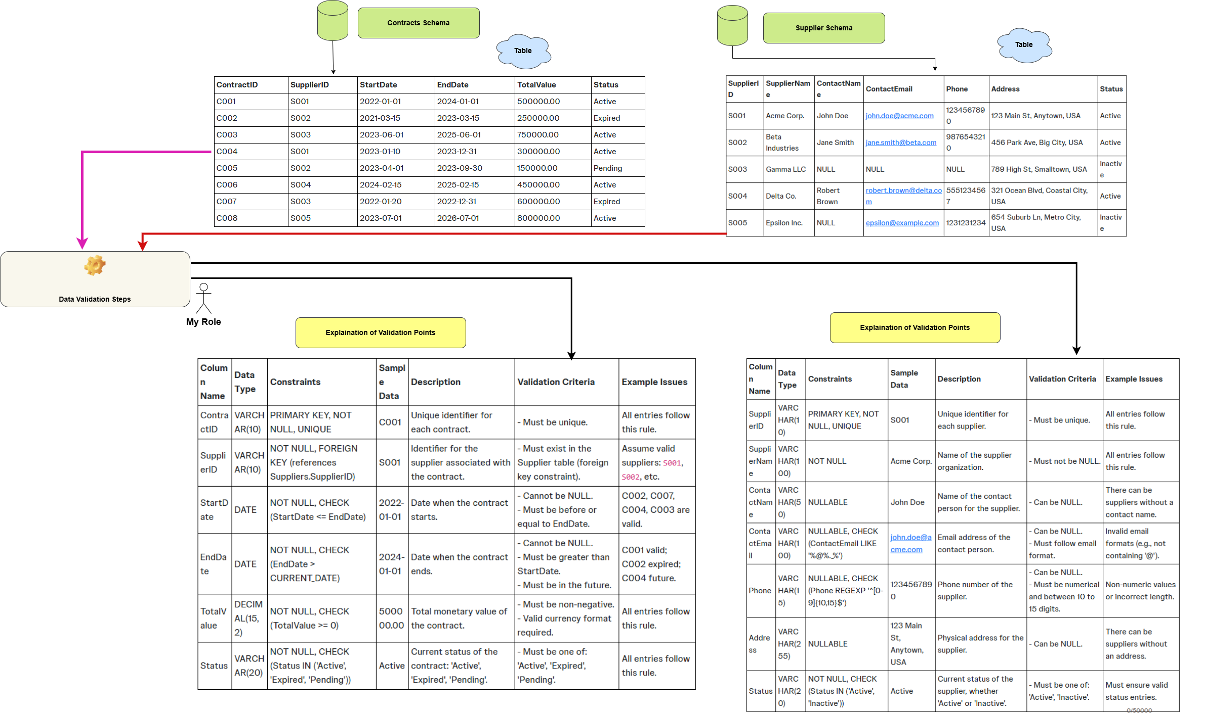

Slide 3
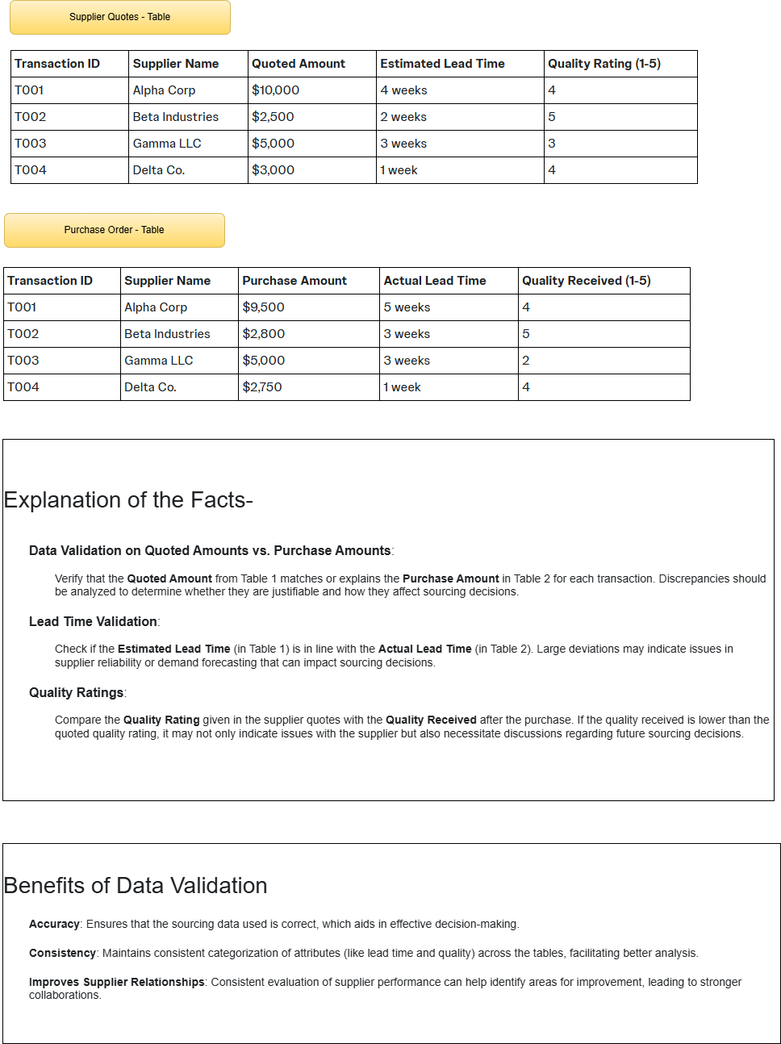

Slide 4
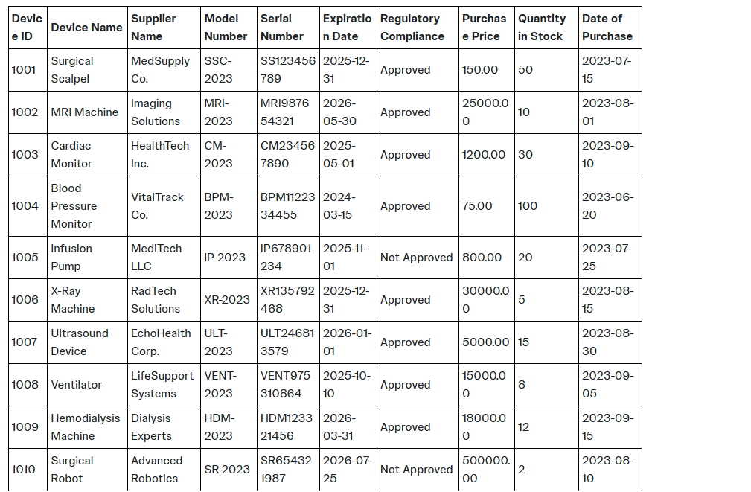
Data table

Slide 5
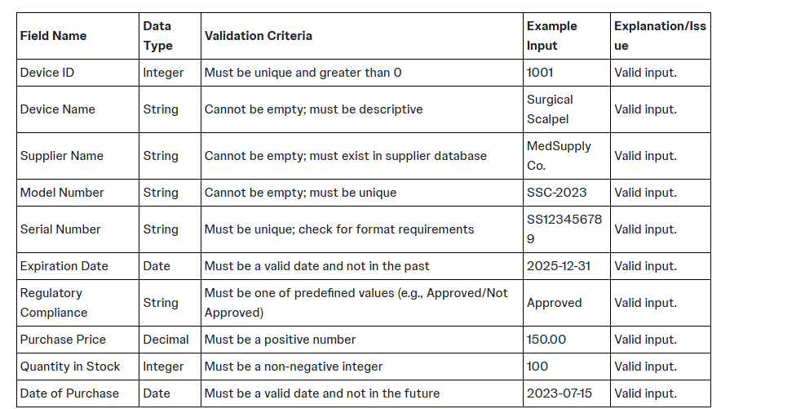
Data Validation -Checks

Slide 6
When it comes to validating data related to medical devices in the sourcing department, several types of data validation techniques can be employed to ensure the accuracy and integrity of the data. Here is a list of different data validation methods that can be applied to each field in your dataset:
1. Uniqueness Validation
Device ID: Check that each Device ID is unique across the dataset.
Serial Number: Ensure that each Serial Number is unique to prevent duplication.
2. Format Validation
Model Number: Validate against a specific regex to ensure it follows a designated alphanumeric format.
Serial Number: Verify that it meets expected character limits and format (e.g., alphanumeric, specific length).
3. Value Constraints
Expiration Date: Check that this date is not in the past (for newly entered records) and follows the correct date format.
Purchase Price: Ensure that the value is a positive decimal number (i.e., greater than 0).
Quantity in Stock: Validate that this is a non-negative integer (i.e., 0 or more).
4. Required Field Validation
Ensure that mandatory fields like Device Name, Supplier Name, Model Number, and Regulatory Compliance are not empty.
5. Referential Integrity
Supplier Name: Verify that the supplier exists in a separate, established suppliers database to maintain consistency.
6. Enumerated Value Validation
Regulatory Compliance: Verify that the value is one of the predefined options, such as “Approved” or “Not Approved”.
7. Logical Consistency
Expiration Date vs. Date of Purchase: Ensure that the Expiration Date is later than the Date of Purchase.
Quantity in Stock: Ensure that stock levels do not exceed realistic values based on purchase records.
8. Range Validation
For fields like Purchase Price, you could implement a maximum allowable value based on company policies or relevant market standards.
9. Data Type Validation
Ensure that data entered matches the specified data type (e.g., integer for Device ID and Quantity in Stock, string for Device Name, float for Purchase Price).
10. Cross-Field Validation
Check that combinations of fields make sense together; for example, if the Regulatory Compliance status is “Not Approved," various downstream processes should not allow further action, such as processing orders.
11. Duplication Check
Implement checks to prevent the re-entry of the same device with the same characteristics if it exists within the current dataset.
12. Trim and Clean Validation
Remove leading/trailing spaces in string fields to prevent issues with comparisons.

