Slide 1
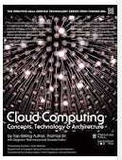
Unit-III
Cloud delivery model: IaaS, PaaS and SaaS, Cloud delivery model with the perspective of cloud provider and the cloud consumer.
The contents has been taken from the book: Cloud Computing: Concepts,
Technology & Architecture
Book by Ricardo Puttini, Thomas Erl,
and Zaigham Mahmood.

Slide 2
A cloud delivery model represents a specific, pre-packaged combination of IT resources offered by a cloud provider. Three common cloud delivery models have become widely established and formalized:
Infrastructure-as-a-Service (IaaS)
Platform-as-a-Service (PaaS)
Software-as-a-Service (SaaS)

Slide 3
Many specialized variations of the three base cloud delivery models have emerged, each comprised of a distinct combination of IT resources. Some examples include:
Storage-as-a-Service
Database-as-a-Service
Security-as-a-Service
Communication-as-a-Service
Integration-as-a-Service
Testing-as-a-Service
Process-as-a-Service

Slide 4
Infrastructure-as-a-Service (IaaS)
This environment can include hardware, network, connectivity, operating systems, and other “raw” IT resources.
The general purpose of an IaaS environment is to provide cloud consumers with a high level of control and responsibility over its configuration and utilization.
The types and brands of the IT resources provided by IaaS products offered by different cloud providers can vary.
IT resources available through IaaS environments are generally offered as freshly initialized virtual instances.
A central and primary IT resource within a typical IaaS environment is the virtual server. Virtual servers are leased by specifying server hardware requirements, such as processor capacity, memory, and local storage space.

Slide 5
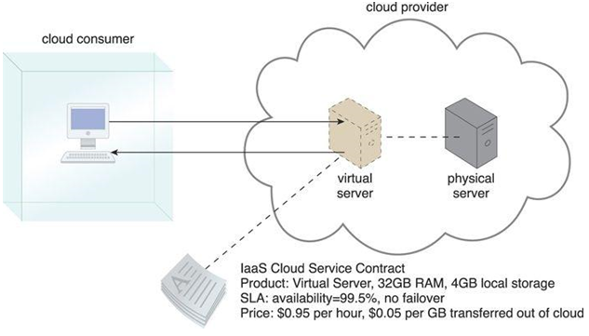
An Example
A cloud consumer is using a virtual server within an IaaS environment. Cloud consumers are provided with a range of contractual guarantees by the cloud provider, pertaining to characteristics such as capacity, performance, and availability

Slide 6
PaaS
The PaaS delivery model represents a pre-defined “ready-to-use” environment typically comprised of already deployed and configured IT resources.
Scenarios:-
The cloud consumer wants to extend on-premise environments into the cloud for scalability and economic purposes.
The cloud consumer uses the ready-made environment to entirely substitute an on-premise environment.
The cloud consumer wants to become a cloud provider and deploys its own cloud services to be made available to other external cloud consumers.

Slide 7
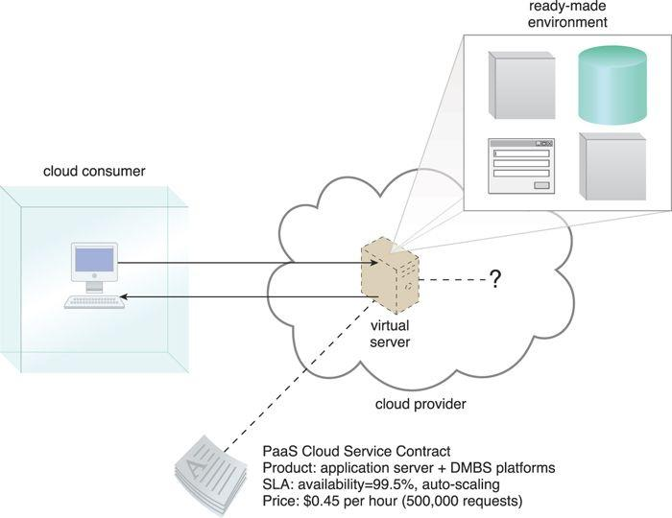
A cloud consumer is accessing a ready-made PaaS environment. The question mark indicates that the cloud consumer is intentionally shielded from the implementation details of the platform

Slide 8
Software-as-a-Service (SaaS)
A software program positioned as a shared cloud service and made available as a “product” or generic utility represents the typical profile of a SaaS offering.
The SaaS delivery model is typically used to make a reusable cloud service widely available (often commercially) to a range of cloud consumers. An entire marketplace exists around SaaS products that can be leased and used for different purposes and via different terms

Slide 9
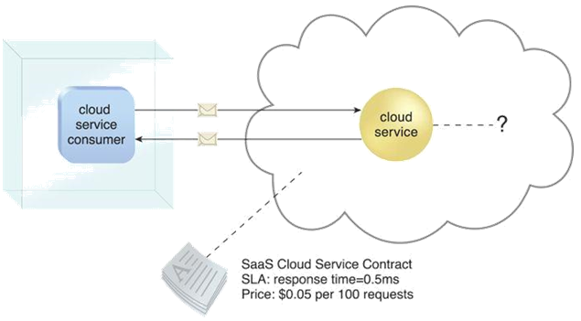
The cloud service consumer is given access the cloud service contract, but not to any underlying IT resources or implementation details.

Slide 10
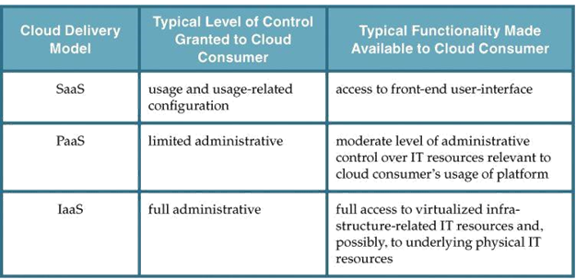
A comparison of typical cloud delivery model control levels.
Typical activities carried out by cloud consumers and cloud providers in relation to the cloud delivery models.

Slide 11
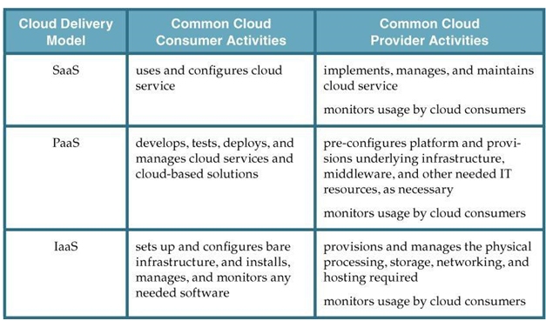
Comparison w.r.t typical responsibilities and usage

Slide 12
Combining Cloud Delivery Models
The three base cloud delivery models comprise a natural provisioning hierarchy, allowing for opportunities for the combined application of the models to be explored. The upcoming sections briefly highlight considerations pertaining to two common combinations.
i. IaaS + PaaS
ii. IaaS + PaaS + SaaS

Slide 13
IaaS + PaaS
(CASE-I )A PaaS environment will be built upon an underlying infrastructure comparable to the physical and virtual servers and other IT resources provided in an IaaS environment. Figure (in next slide) shows how these two models can conceptually be combined into a simple layered architecture.

Slide 14
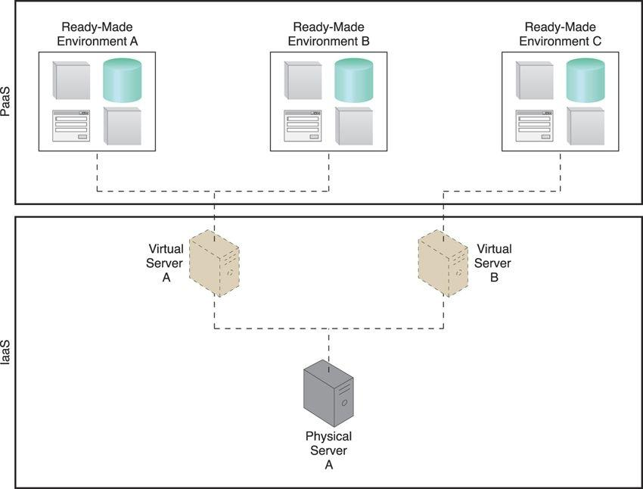
Figure: A PaaS environment based on the IT resources provided by an underlying IaaS environment

Slide 15
(CASE-II) A cloud provider would not normally need to provision an IaaS environment from its own cloud in order to make a PaaS environment available to cloud consumers (see next slide)

Slide 16
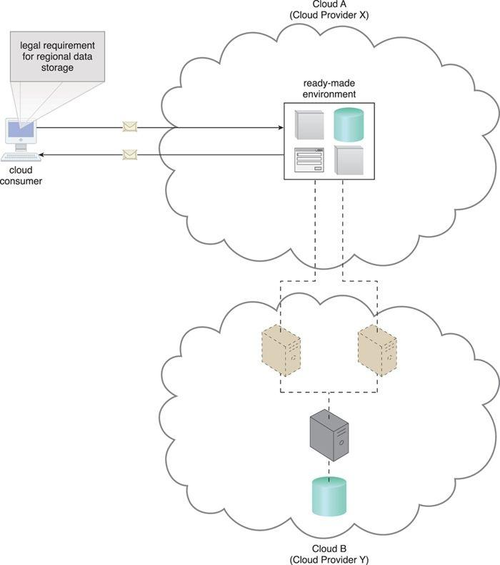
An example of a contract between Cloud Providers X and Y, in which services offered by Cloud Provider X are physically hosted on virtual servers belonging to Cloud Provider Y. Sensitive data that is legally required to stay in a specific region is physically kept in Cloud B, which is physically located in that region.

Slide 17
IaaS + PaaS + SaaS
All three cloud delivery models can be combined to establish layers of IT resources that build upon each other

Slide 18
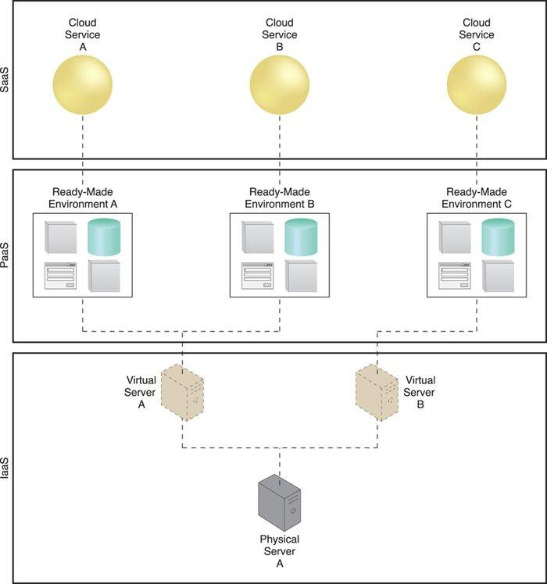
A simple layered view of an architecture comprised of IaaS and PaaS environments hosting three SaaS cloud service implementations.

Slide 19
Key Points
The IaaS cloud delivery model offers cloud consumers a high level of administrative control over “raw” infrastructure-based IT resources
The PaaS cloud delivery model enables a cloud provider to offer a preconfigured environment that cloud consumers can use to build and deploy cloud services and solutions, albeit with decreased administrative control.
SaaS is a cloud delivery model for shared cloud services that can be positioned as commercialized products hosted by clouds.
Different combinations of IaaS, PaaS, and SaaS are possible, depending on how cloud consumers and cloud providers choose to leverage the natural hierarchy established by these base cloud delivery models.

Slide 20
Roles and responsibility
Cloud Provider:Cloud providers normally own the IT resources that are made available for lease by cloud consumers; however, some cloud providers also “resell” IT resources leased from other cloud providers.
A cloud consumer is an organization (or a human) that has a formal contract or arrangement with a cloud provider to use IT resources made available by the cloud provider. Specifically, the cloud consumer uses a cloud service consumer to access a cloud service

Slide 21
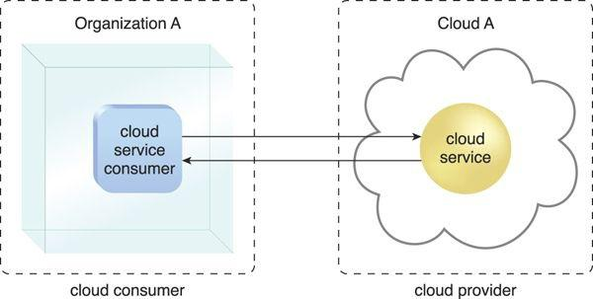

Slide 22
Cloud Resource Administrator
A cloud resource administrator is the person or organization responsible for administering a cloud-based IT resource (including cloud services).
The cloud resource administrator can be (or belong to) the cloud consumer or cloud provider of the cloud within which the cloud service resides. Alternatively, it can be (or belong to) a third-party organization contracted to administer the cloud-based IT resource.

Slide 23
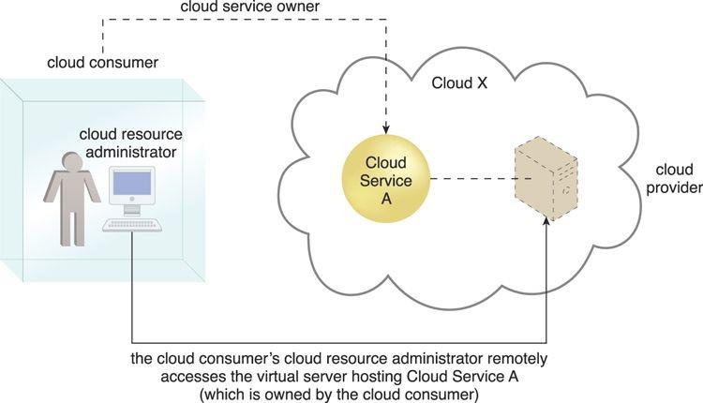
A cloud resource administrator can be with a cloud consumer organization and administer remotely accessible IT resources that belong to the cloud consumer.

Slide 24
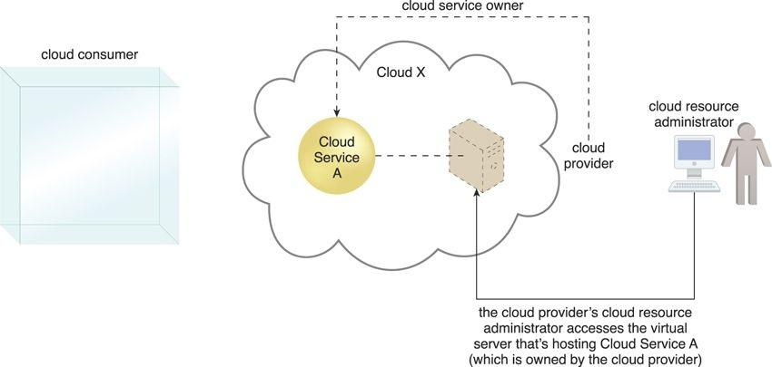
A cloud resource administrator can be with a cloud provider organization for which it can administer the cloud provider’s internally and externally available IT resources.

Slide 25
Additional Roles
Cloud Auditor – A third-party (often accredited) that conducts independent assessments of cloud environments assumes the role of the cloud auditor. The typical responsibilities associated with this role include the evaluation of security controls, privacy impacts, and performance. The main purpose of the cloud auditor role is to provide an unbiased assessment (and possible endorsement) of a cloud environment to help strengthen the trust relationship between cloud consumers and cloud providers.
Cloud Broker – This role is assumed by a party that assumes the responsibility of managing and negotiating the usage of cloud services between cloud consumers and cloud providers. Mediation services provided by cloud brokers include service intermediation, aggregation, and arbitrage.
Cloud Carrier – The party responsible for providing the wire-level connectivity between cloud consumers and cloud providers assumes the role of the cloud carrier. This role is often assumed by network and telecommunication providers.

Slide 26
Trust Boundary
When an organization assumes the role of cloud consumer to access cloud-based IT resources, it needs to extend its trust beyond the physical boundary of the organization to include parts of the cloud environment.

Slide 27
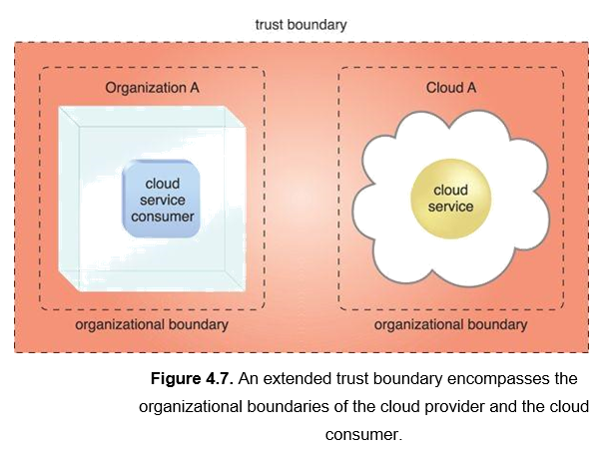

Slide 28
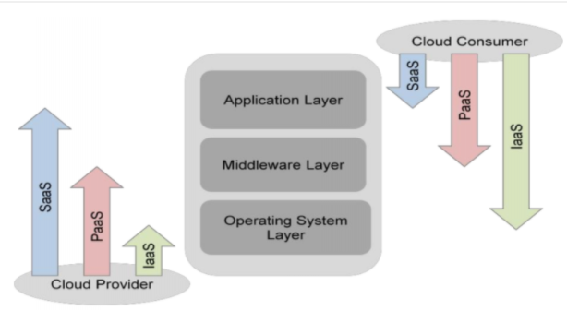
Who manages the layers?
Scope of Controls between Provider and Consumer

Slide 29
The application layer includes software applications targeted at end users or programs. The applications are used by SaaS consumers, or installed/managed/ maintained by PaaS consumers, IaaS consumers, and SaaS providers.
The middleware layer provides software building blocks (e.g., libraries, database, and Java virtual machine) for developing application software in the cloud. The middleware is used by PaaS consumers, installed/managed/maintained by IaaS consumers or PaaS providers, and hidden from SaaS consumers.
The OS layer includes operating system and drivers, and is hidden from SaaS consumers and PaaS consumers. An IaaS cloud allows one or multiple guest OS‟s to run virtualized on a single physical host. Generally, consumers have broad freedom to choose which OS to be hosted among all the OS‟s that could be supported by the cloud provider. The IaaS consumers should assume full responsibility for the guest OS‟s, while the IaaS provider controls the host OS.

Slide 30
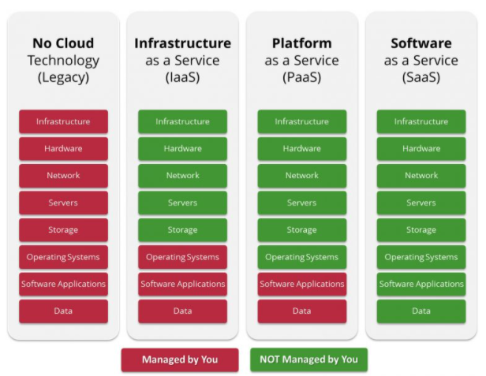
Based on Cloud Service models

Slide 31
References:
https://timesofcloud.com/cloud-tutorial/based-on-cloud-service-models/
cloud computing concepts technology & architecture [Book]
Unit-II End Here

