Slide 1
Chapter 1
Introduction to Cloud Computing

Slide 2
Syllabus of UNIT-1
UNIT-1
Introduction to cloud and virtualization: →Cloud Computing in a Nutshell, Layers and Types of Clouds
→ Desired Formats of Cloud
→Cloud Infrastructure Management, Challenges and Risks.

Slide 3
Technologies such as cluster, grid, and now, cloud computing, have all aimed at allowing access to large amounts of computing power in a fully virtualized manner, by aggregating resources and offering a single system view.
Differences:-
Cluster differs from Cloud and Grid in that a cluster is a group of computers connected by a local area network (LAN), whereas cloud and grid are more wide scale and can be geographically distributed.
Another way to put it is to say that a cluster is tightly coupled, whereas a Grid or a cloud is loosely coupled.

Slide 4
A cluster is tightly coupled, whereas a Grid or a cloud is loosely coupled.
=========================================================
Cloud Computing is For Service Oriented where as Grid Computing is for Application Oriented. ... Cloud computing is providing services over the internet through several servers uses Virtualization. In cloud computing either you can provide service in three types IaaS , PaaS, SaaS.

Slide 5
Cloud Definition
It denotes a model on which a computing infrastructure is viewed as a “cloud,” from which businesses and individuals access applications from anywhere in the world on demand .
By Rajkumar Buyya:-
“Cloud is a parallel and distributed computing system consisting of a collection of inter-connected and virtualised computers that are dynamically provisioned and presented as one or more uniﬁed computing resources based on service-level agreements (SLA) established through negotiation between the service provider and consumers.

Slide 6
Definition of Cloud Computing
A report from the University of California Berkeley summarized the key characteristics of cloud computing as:
(1) The illusion of inﬁnite computing resources;
(2) The elimination of an up-front commitment by cloud users; and
(3) The ability to pay for use ...as needed...

Slide 7
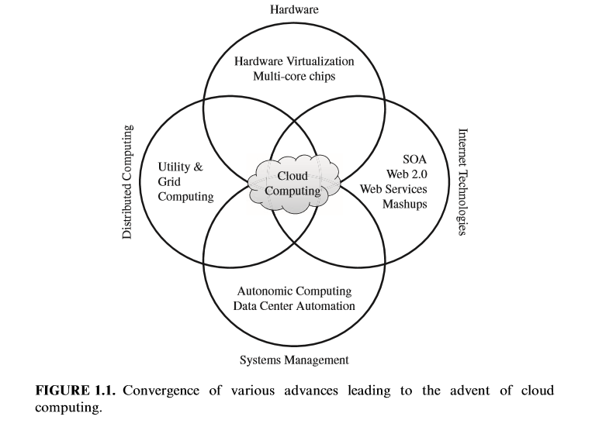
ROOTS OF CLOUD COMPUTING[https://www.researchgate.net/publication/282294494_Cloud_Computing_Based_e-Learning_Opportunities_and_Challenges_for_Tertiary_Institutions_in_Nigeria/figures?lo=1&utm_source=google&utm_medium=organic

Slide 8
SOA, Web Services, Web 2.0, and Mashups
Part of the Software applications glossary: A mash-up (sometimes spelled as one word, mashup) is a Web page or application that integrates complementary elements from two or more sources. Mash-ups are often defined by the type of content that they aggregate.(it’s an application!!!!!!!!)
===================================================
A service-oriented architecture (SOA) is a style of software design where services are provided to the other components by application components, through a communication protocol over a network.(it’s a service!!!!!!!!!)

Slide 9
Utility computing
In utility computing environments, users assign a “utility” value to their jobs, where utility is a ﬁxed or time-varying valuation that captures various QoS constraints (deadline, importance, satisfaction).
The valuation is the amount they are willing to pay a service provider to satisfy their demands. The service providers then attempt to maximize their own utility, where said utility may directly correlate with their profit
=====================================================
Like other types of on-demand computing (such as grid computing), the utility model seeks to maximize the efficient use of resources and/or minimize associated costs. Utility is the packaging of computing resources, such as computation, storage and services, as a metered service.

Slide 10
Hardware virtualization
Cloud computing services are usually backed by large-scale data centers composed of thousands of computers.
Hardware Virtualization can be considered as a perfect fit to overcome most Operational Issues of data centre building and maintenance.

Slide 11
Virtual Machines [https://www.dataveneta.it/en/products/virtual-machines-player]

Slide 12
Hardware Virtualization……continued….
Workload isolation is achieved since all program instructions are fully confined inside a VM, which leads to improvements in security. Better reliability is also achieved because software failures inside one VM do not affect others.
Workload migration, also referred to as application mobility , targets at facilitating hardware maintenance, load balancing, and disaster recovery
A number of VMM (Virtual Machine Monitor) platforms exist that are the basis of many utility or cloud computing environments. The most notable ones, VMWare, Xen, and KVM, are outlined in the following sections.

Slide 13
Xen. The Xen hypervisor started as an open-source project and has served as a base to other virtualization products, both commercial and open-source. It has pioneered the para-virtualization concept, on which the guest operating system, by means of a specialized kernel, can interact with the hypervisor, thus significantly improving performance. In addition to an open-source distribution, Xen currently forms the base of commercial hypervisors of a number of vendors, most notably Citrix XenServer and Oracle VM.

Slide 14
KVM. The Kernel-Based Virtual machine (KVM) is a Linux virtualization subsystem. Is has been part of the mainline Linux kernel since version , thus being natively supported by several distributions. In addition, activities such as memory management and scheduling are carried out by existing kernel features, thus making KVM simpler and smaller than hypervisors that take control of the entire machine.

Slide 15
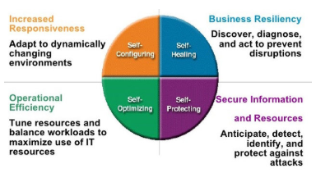
Autonomic Computing https://www.slideshare.net/sandpoonia/9-the-semantic-grid-and-autonomic-grid

Slide 16
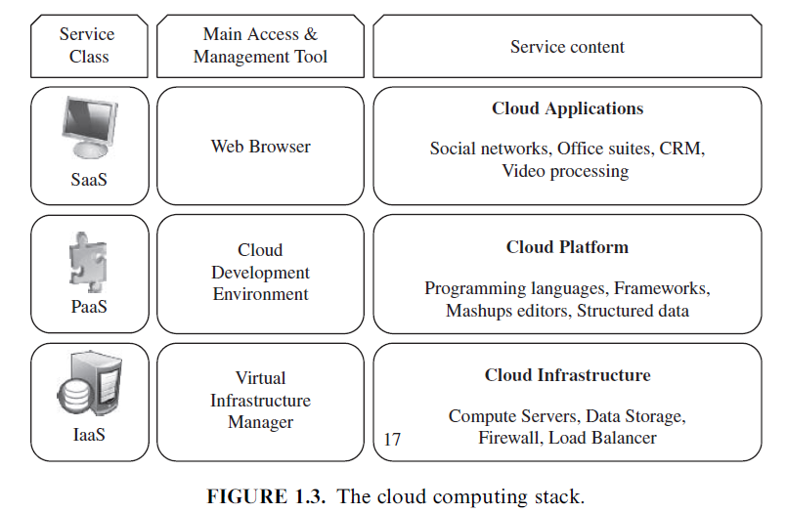
LAYERS AND TYPES OF CLOUDS https://www.researchgate.net/publication/273897590_The_Challenges_of_Cloud_Computing_Management_Information_System_in_Academic_Work/figures?lo=1

Slide 17
Infrastructure as a Service(IaaS)
Offering virtualized resources (computation, storage, and communication) on demand is known as Infrastructure as a Service (IaaS).
A cloud infrastructure enables on-demand provisioning of servers running several choices of operating systems and a customized software stack. Infrastructure services are considered to be the bottom layer of cloud computing systems .
Amazon Web Services mainly offers IaaS, which in the case of its EC2 (Elastic Cloud Compute) service means offering VMs with a software stack that can be customized similar to how an ordinary physical server would be customized.
Users are given privileges to perform numerous activities to the server, such as: starting and stopping it, customizing it by installing software packages, attaching virtual disks to it, and configuring access permissions and firewalls rules etc.

Slide 18
Platform as a Service (PaaS)
A cloud platform offers an environment on which developers create and deploy applications and do not necessarily need to know how many processors or how much memory that applications will be using. In addition, multiple programming models and specialized services (e.g., data access, authentication, and payments) are offered as building blocks to new applications.
Google AppEngine, an example of Platform as a Service, offers a scalable environment for developing and hosting Web applications, which should be written in specific programming languages such as Python or Java, and use the services’ own proprietary structured object data store.

Slide 19
Software as a Service (SaaS)
Applications reside on the top of the cloud stack. Services provided by this layer can be accessed by end users through Web portals. Therefore, consumers are increasingly shifting from locally installed computer programs to on-line software services that offer the same functionally. Traditional desktop applications such as word processing and spreadsheet can now be accessed as a service in the Web. This model of delivering applications, known as Software as a Service (SaaS), alleviates the burden of software maintenance for customers and simplifies development and testing for providers .
Example:- Salesforce.com, which relies on the SaaS model, offers business productivity applications (CRM) that reside completely on their servers, allowing costumers to customize and access applications on demand.

Slide 20
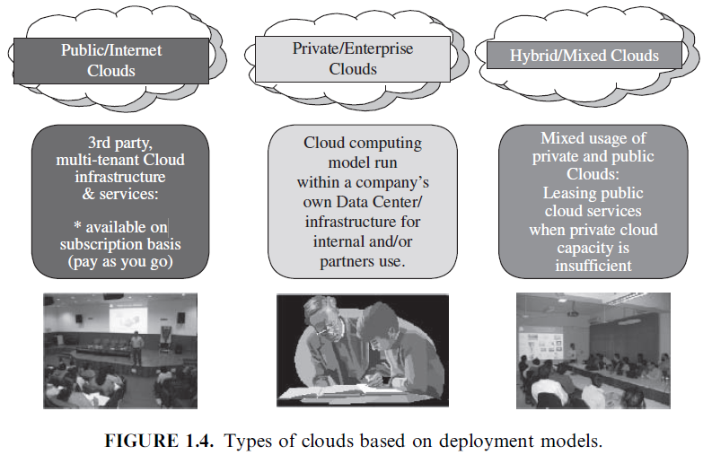
Deployment Model: Cloud Computing https://www.javatpoint.com/types-of-cloud
Public + Private + Community + Hybrid

Slide 21
Deployment Model…….continued
Public cloud as a “cloud made available in a pay-as-you-go manner to the general public” and private cloud as “internal data center of a business or other organization, not made available to the general public.”
A community cloud is “shared by several organizations and supports a specific community that has shared concerns (e.g., mission, security requirements, policy, and compliance considerations) .”
A hybrid cloud takes shape when a private cloud is supplemented with computing capacity from public clouds . The approach of temporarily renting capacity to handle spikes in load is known as “cloud-bursting” A community cloud is “shared by several organizations and supports a specific community that has shared concerns (e.g., mission, security requirements, policy, and compliance considerations) .”
A hybrid cloud takes shape when a private cloud is supplemented with computing capacity from public clouds . The approach of temporarily renting capacity to handle spikes in load is known as “cloud-bursting” .

Slide 22
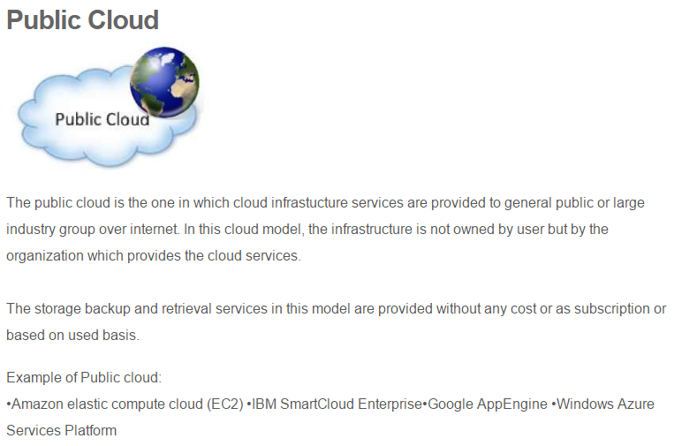

Slide 23
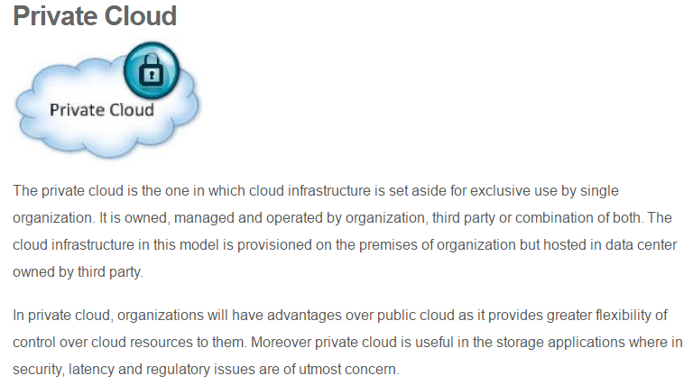
https://www.capgemini.com/gb-en/2018/06/how-hybrid-cloud-is-fueling-digital-transformation/

Slide 24
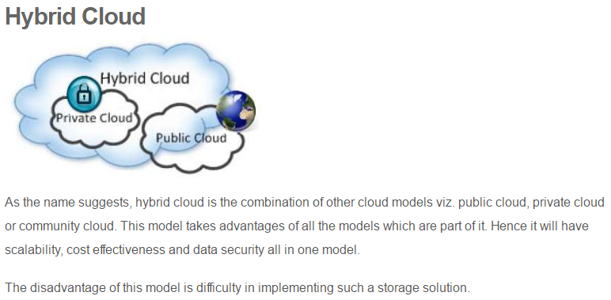
https://www.capgemini.com/gb-en/2018/06/how-hybrid-cloud-is-fueling-digital-transformation/

Slide 25
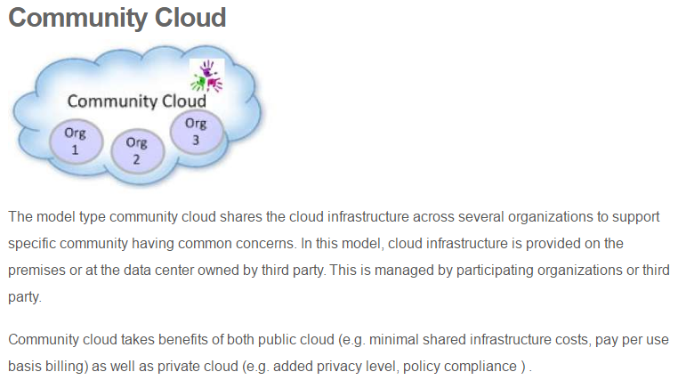
https://www.capgemini.com/gb-en/2018/06/how-hybrid-cloud-is-fueling-digital-transformation/

Slide 26
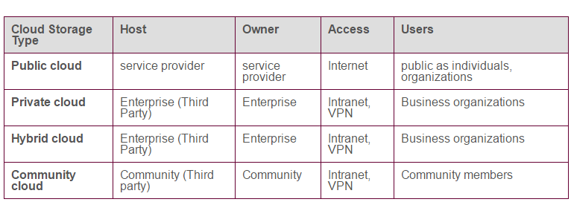
Deployment Model: At a glance

Slide 27
Desired Feature of a Cloud
Certain features of a cloud are essential to enable services that truly represent the cloud computing model and satisfy expectations of consumers, and cloud offerings must be :-
(i) self-service,
(ii) per-usage metered and billed,
(iii) elastic,
and (iv) customizable.

Slide 28
Per usages metering and billing
Cloud computing eliminates up-front commitment by users, allowing them to request and use only the necessary amount. Services must be priced on a short term basis (e.g., by the hour), allowing users to release (and not pay for) resources as soon as they are not needed .
For these reasons, clouds must implement features to allow efficient trading of service such as pricing, accounting, and billing .
Metering should be done accordingly for different types of service (e.g., storage, processing, and bandwidth) and usage promptly reported, thus providing greater transparency.

Slide 29
Elasticity
Cloud computing gives the illusion of infinite computing resources available on demand . Therefore users expect clouds to rapidly provide resources in any quantity at any time. In particular, it is expected that the additional resources can be
(a) provisioned, possibly automatically, when an application load increases and
(b) released when load decreases (scale up and down)

Slide 30
Customization
In a multi-tenant cloud a great disparity between user needs is often the case. Thus, resources rented from the cloud must be highly customizable.
In the case of infrastructure services, customization means allowing users to deploy specialized virtual appliances and to be given privileged (root) access to the virtual servers.
Other service classes (PaaS and SaaS) offer less flexibility and are not suitable for general-purpose computing, but still are expected to provide a certain level of customization.

Slide 31
Cloud Infrastructure Management:-
1) Challenge IaaS providers face when building a cloud infrastructure is managing physical and virtual resources, namely servers, storage, and networks, in a holistic fashion.
VIM - Virtual Infrastructure Management- rapid and dynamic!!!
-> Infrastructure sharing software.
->Virtual infrastructure engine.

Slide 32
Features of VIMs
Virtualization Support. The multi-tenancy aspect of clouds requires multiple customers with disparate requirements to be served by a single hardware infrastructure. Virtualized resources (CPUs, memory, etc.) can be sized and resized with certain flexibility.
Self-Service, On-Demand Resource Provisioning.
This feature enables users to directly obtain services from clouds, such as spawning the creation of a server and tailoring its software, configurations, and security policies, without interacting with a human system administrator. This capability “eliminates the need for more time-consuming, labor-intensive, humandriven procurement processes familiar to many in IT”.

Slide 33
Features of VMs……..continued
3) Multiple Backend Hypervisors. Different virtualization models and tools offer different benefits, drawbacks, and limitations.
This characteristic is more visible in open-source VM managers, which usually provide pluggable drivers to interact with multiple hypervisors . In this direction, the aim of libvirt is to provide a uniform API that VM managers can use to manage domains (a VM or container running an instance of an operating system) in virtualized nodes using standard operations that abstract hypervisor specific calls.

Slide 34
Features of VMs……..continued
4) Storage Virtualization. Virtualizing storage means abstracting logical storage from physical storage. By consolidating all available storage devices in a data center , it allows creating virtual disks independent from device and location.
Storage devices are commonly organized in a storage area network (SAN) and attached to servers via protocols such as Fibre Channel, iSCSI(Internet Small Computer Systems Interface), and NFS; a storage controller provides the layer of abstraction between virtual and physical storage.

Slide 35
Interface to Public Clouds. Researchers have perceived that extending the capacity of a local in-house computing infrastructure by borrowing resources public clouds is advantageous. In this fashion, institutions can make good use of their available resources and, in case of spikes in demand, extra load can be offloaded to rented resources .
A VI manager can be used in a hybrid cloud setup if it offers a driver to manage the life cycle of virtualized resources obtained from external cloud providers. To the applications, the use of leased resources must ideally be transparent.

Slide 36
Virtual Networking. Virtual networks allow creating an isolated network on top of a physical infrastructure independently from physical topology and locations .
A virtual LAN (VLAN) allows isolating traffic that shares a switched network, allowing VMs to be grouped into the same broadcast domain. Additionally, a VLAN can be configured to block traffic originated from VMs from other networks.
Similarly, the VPN (virtual private network) concept is used to describe a secure and private overlay network on top of a public network (most commonly the public Internet).

Slide 37
Dynamic Resource Allocation.
Increased awareness of energy consumption in data centres has encouraged the practice of dynamic consolidating VMs in a fewer number of servers. In cloud infrastructures, where applications have variable and dynamic needs, capacity management and demand prediction are especially complicated.
This fact triggers the need for dynamic resource allocation aiming at obtaining a timely match of supply and demand .
Energy consumption reduction and better management of SLAs can be achieved by dynamically remapping VMs to physical machines at regular intervals. Machines that are not assigned any VM can be turned off or put on a low power state. In the same fashion, overheating can be avoided by moving load away from hotspots .
A number of VI (Virtual Infrastructure) managers include a dynamic resource allocation feature that continuously monitors utilization across resource pools and reallocates available resources among VMs according to application needs.

Slide 38
Virtual Clusters. Several VI managers can holistically manage groups of VMs. This feature is useful for provisioning computing virtual clusters on demand, and interconnected VMs for multi-tier Internet applications.
Reservation and Negotiation Mechanism. When users request computational resources to available at a specific time, requests are termed advance reservations (AR).
This is especially useful in clouds on which resources are scarce(limited); since not all requests may be satisfied immediately, they can benefit of VM placement strategies that support queues, priorities, and advance reservations .

Slide 39
High Availability and Data Recovery. The high availability (HA) feature of VI managers aims at minimizing application downtime and preventing business disruption. A few VI managers accomplish this by providing a failover mechanism, which detects failure of both physical and virtual servers and restarts VMs on healthy physical servers. This style of HA protects from host, but not VM, failures.
For mission critical ( above will not work)applications, when a failover solution involving restarting VMs does not suffice, additional levels of fault tolerance that rely on redundancy of VMs are implemented. In this style, redundant and synchronized VMs (running or in standby) are kept in a secondary physical server. The HA solution monitors failures of system components such as servers, VMs, disks, and network and ensures that a duplicate VM serves the application in case of failures .

Slide 40
Data Recovery…Continued…..
Data backup in clouds should take into account the high data volume involved in VM management. Frequent backup of a large number of VMs, each one with multiple virtual disks attached, should be done with minimal interference in the systems performance.
In this sense, some VI managers offer data protection mechanisms that perform incremental backups of VM images. The backup workload is often assigned to proxies, thus offloading production server and reducing network overhead.

Slide 41
CHALLENGES AND RISKS
Issues to be faced include user privacy
Data security, data lock-in
Availability of service
Disaster recovery
Performance
Scalability
Energy-efficiency
Programmability.

Slide 42
Security, Privacy, and Trust
Security and privacy affect the entire cloud computing stack, since there is a massive use of third-party services and infrastructures that are used to host important data or to perform critical operations. In this scenario, the trust toward providers is fundamental to ensure the desired level of privacy for applications hosted in the cloud.
Legal and regulatory issues also need attention. When data are moved into the Cloud, providers may choose to locate them anywhere on the planet. The physical location of data centers determines the set of laws that can be applied to the management of data.
For example, specific cryptography techniques could not be used because they are not allowed in some countries. Similarly, country laws can impose that sensitive data, such as patient health records, are to be stored within national borders.

Slide 43
Data Lock-In and Standardization
A major concern of cloud computing users is about having their data locked-in by a certain provider. Users may want to move data and applications out from a provider that does not meet their requirements. However, in their current form, cloud computing infrastructures and platforms do not employ standard methods of storing user data and applications. Consequently, they do not interoperate and user data are not portable. The answer to this concern is standardization. In this direction, there are efforts to create open standards for cloud computing.
The Cloud Computing Interoperability Forum (CCIF) was formed by organizations such as Intel, Sun, and Cisco in order to “enable a global cloud computing ecosystem whereby organizations are able to seamlessly work together for the purposes for wider industry adoption of cloud computing technology.” The development of the Unified Cloud Interface (UCI) by CCIF aims at creating a standard programmatic point of access to an entire cloud infrastructure.
In the hardware virtualization sphere, the Open Virtual Format (OVF) aims at facilitating packing and distribution of software to be run on VMs so that virtual appliances can be made portable—that is, seamlessly run on hypervisor of different vendors.

Slide 44
Availability, Fault-Tolerance, and Disaster Recovery
It is expected that users will have certain expectations about the service level to be provided once their applications are moved to the cloud. These expectations include availability of the service, its overall performance, and what measures are to be taken when something goes wrong in the system or its components.
In summary, users seek for a warranty before they can comfortably move their business to the cloud.→ Trust Management in the Cloud
SLAs, which include QoS requirements, must be ideally set up between customers and cloud computing providers to act as warranty. An SLA specifies details of the service to be provided, including availability and performance guarantees. Additionally, metrics must be agreed upon by all parties, and penalties for violating the expectations must also be approved

Slide 45
Resource Management and Energy-Efficiency
→ One important challenge faced by providers of cloud computing services is the efficient management of virtualized resource pools.
Physical resources such as
CPU cores, disk space, and network bandwidth must be sliced and shared among virtual machines running potentially heterogeneous workloads.

Slide 46
CHALLENGES AND RISKS……continued…..
The multi-dimensional nature of virtual machines complicates the activity of finding a good mapping of VMs onto available physical hosts while maximizing user utility. Dimensions to be considered include: number of CPUs, amount of memory, size of virtual disks, and network bandwidth.
Dynamic VM mapping policies may leverage the ability to suspend, migrate, and resume VMs as an easy way of pre-empting low-priority allocations in favor of higher-priority ones.

Slide 47
CHALLENGES AND RISKS……continued…..
Migration of VMs also brings additional challenges such as detecting when to initiate a migration, which VM to migrate, and where to migrate.
In this case, an additional concern is the trade-off between the negative impact of a live migration on the performance and stability of a service and the benefits to be achieved with that migration

Slide 48
CHALLENGES AND RISKS……continued…..
Another challenge concerns the outstanding amount of data to be managed in various VM management activities. Such data amount is a result of particular abilities of virtual machines, including the ability of traveling through space (i.e., migration) and time (i.e., check pointing and rewinding), operations that may be required in load balancing, backup, and recovery scenarios.
In addition, dynamic provisioning of new VMs and replicating existing VMs require efficient mechanisms to make VM block storage devices (e.g., image files) quickly available at selected hosts.

Slide 49
CHALLENGES AND RISKS……continued…..
Data centers consumer large amounts of electricity. According to a data published by HP, 100 server racks can consume 1.3MW of power and another 1.3 MW are required by the cooling system, thus costing USD 2.6 million per year. Besides the monetary cost, data centers significantly impact the environment in terms of CO2 emissions from the cooling systems .
In addition to optimize application performance, dynamic resource management can also improve utilization and consequently minimize energy consumption in data centers. This can be done by judiciously consolidating workload onto smaller number of servers and turning off idle resources

Slide 50
Chapter-I Part-I ends here.
Next part is dedicated to the Virtualization.

