Slide 1
A stateless + stateful web application
Fog and Cloud Computing course - 2020/2021
Alberto Bellumat (Group 1)
Alessandro Gnutti (Group 1)

Slide 2
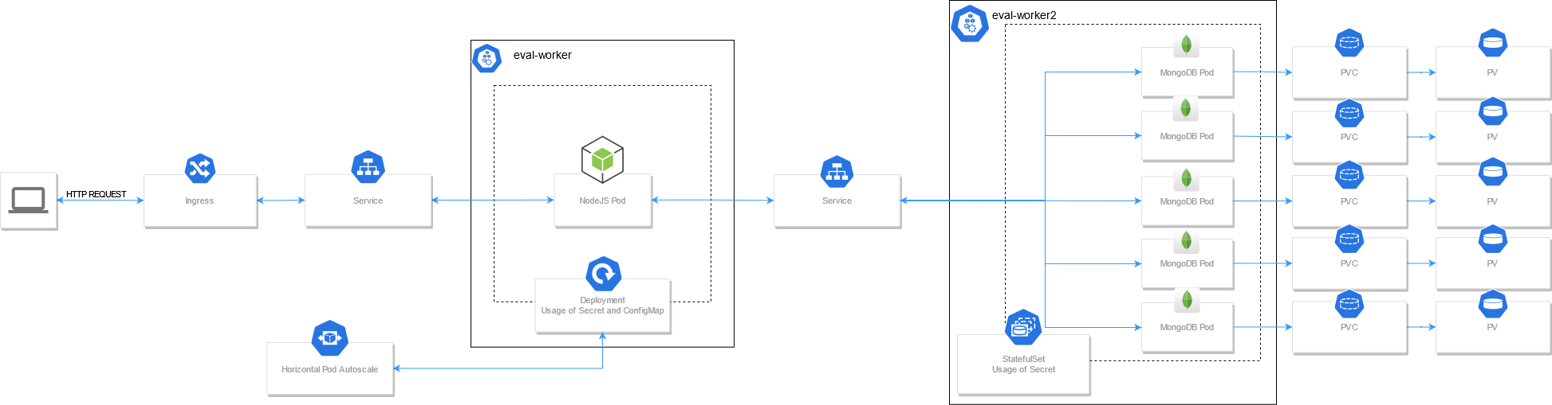
The PaaS Architecture

Slide 3
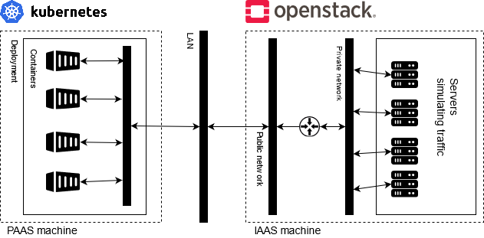
The IaaS Architecture

Slide 4
The Demo
Traffic load incoming from the OpenStack instances
Containers’ update, rollout, rollback
Automatic scaling of NodeJS pods
Scaling of MongoDB pods

Slide 5
Thank you for watching.

