Slide 1

Detection and Classification of Harmful Bots in Social Human-Bot Interaction

Slide 2
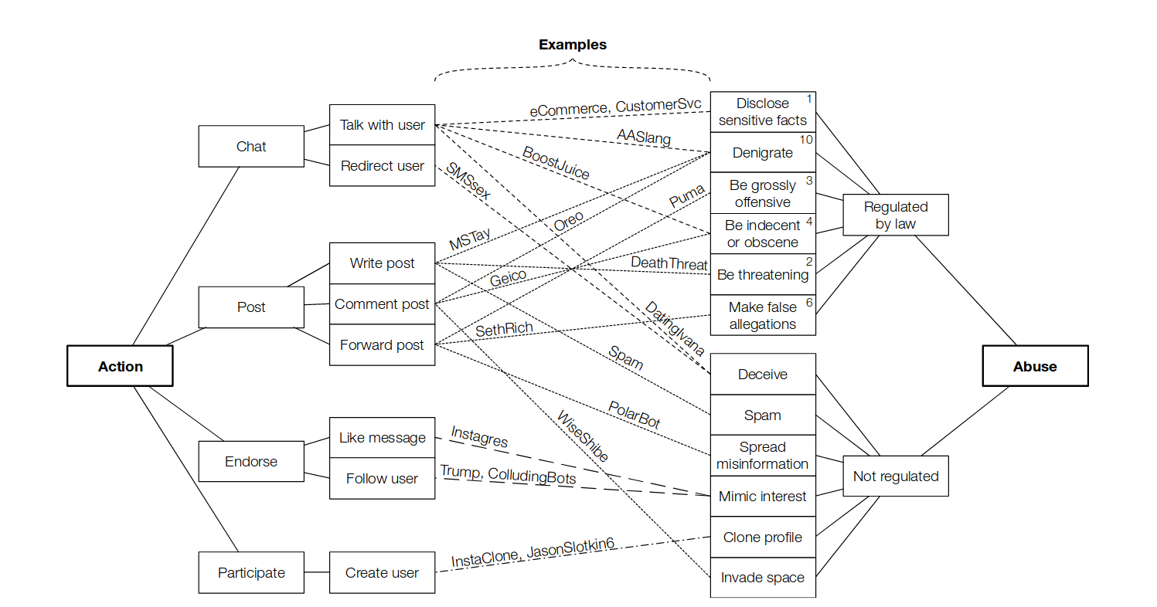
Social bots

Slide 3
Twitter bots

Slide 4
Twitter bots
NSFW
News-spreaders
Spambots
Fake-followers
Genuine

Slide 5
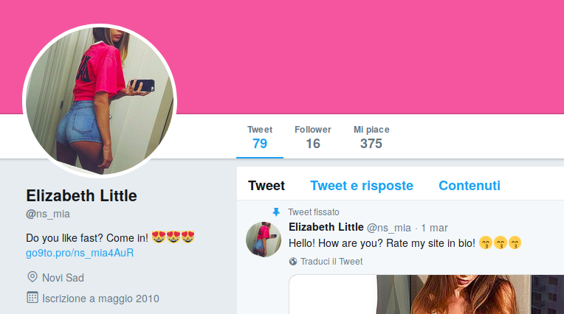
NSFW

Slide 6
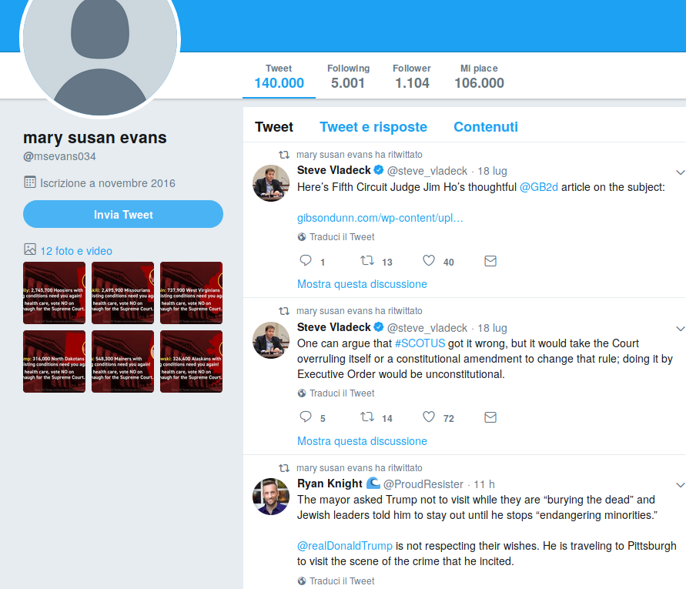
News-spreaders

Slide 7

Spambot

Slide 8
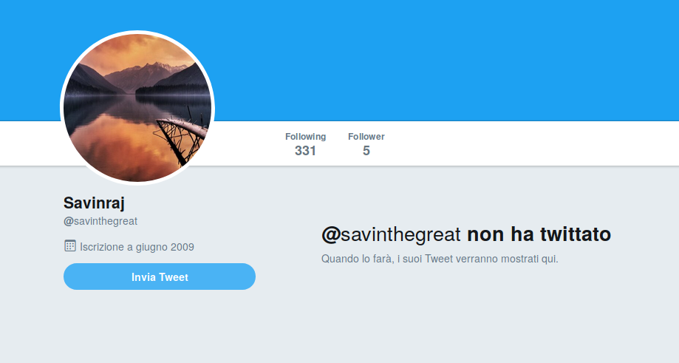
Fake-followers

Slide 9


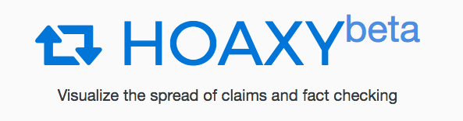
Tools
Twitter API
Botometer API
Hoaxy API

Slide 10

Datasets
Caverlee-2011
  Bots
  Humans
Cresci-2017
  spambots (job offers)
  spambots (mobile app)
  spambots (Amazon products)
  fake followers
  Humans
Varol-2017
  Bots
  Humans
BotBlock
  NSFW bots (adult contents)

Slide 11
Data Collection
NSFW
  Get ids from BotBlock list
  Scrape users and tweets information with Twitter API
Spambots
  From Cresci dataset:
  traditional spambots 1 (generic Spabots)
  social spambots 2 (mobile app)
  social spambots 3 (Amazon products)

Slide 12
Data Collection
Fake-followers
  From Cresci dataset:
  Fake-followers
  followers bought from.
  instakipci.com/
  rantic.com/buy-legit-twitter-followers
Genuine
  From Cresci dataset:
  Genuine

Slide 13
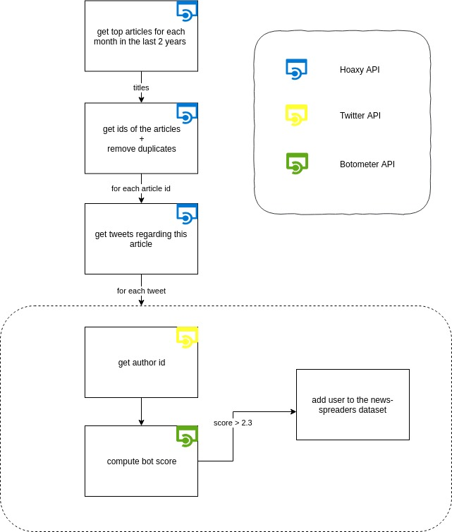
Data Collection
News-spreaders
  Find fake-news tweets (Hoaxy)
  Find authors information (Twitter API)
  Check if authors are bots (Botometer)

Slide 14
Final dataset

Slide 15
Final dataset

Slide 16
Original Features
User Features
  Personal data
  Metadata
  Setting preferences
Tweet Features
  Text
  Media attached
  Mentions
  Source

Slide 17
Features Engineering
4 categories of features added
  Descriptive
  Intrinsic
  Extrinsic
  Image

Slide 18
Descriptive Features
  ”Meta features” related to tweets
  Synthesis statistics and counters
Max, min, avg of tweet lenghts | percentage of retweets, made by user, over its tweets
Max, min, avg number of retweets | percentage of media content incorpored in tweets
Max, min, avg number of likes | percentage of URL links placed inside tweets
Max, min, avg number of hashtag used | percentage of quotes, made by the user, over its tweets
amount of tweets per day ( up to 100)

Slide 19
Intrinsic Features
  Related to monotony of the user
  euclidean distance from a TF-IDF-encoded centroid
Tweets intradistance | Monotony coefficient about tweet texts
URL intradistance | Monotony coefficient about domain promoted

Slide 20
Extrinsic Features
  Features related to common behaviours
  Creation of 5 different dictionaries
  Weighted words in dictionary
  Scores computed according to the use of words belonging to dictionaries
NSFW words score
news spreders words score
spam bots words score
fake followers words score
genuine words score

Slide 21
Image Features
  Related to profile image and attached media
  Scores computed with a CNN trained to indentify NSFW contents
NSFW profile | NSFW evaluation of the profile picture
NSFW average | Average of NSFW scores of the last 10 tweeted media

Slide 22
Features Vector
The final feature vector contains 38 features
  12 default user features
  17 descriptive features
  2 instrinsic features
  5 extrinsic features
  2 image features

Slide 23
Models
The final solution is composed by a stacking ensemble of three different models
  Random Forest multiclass classifier for users
  Naive Bayes text clasifier for tweets
  Random Forest binary classifier (bot or not)

Slide 24
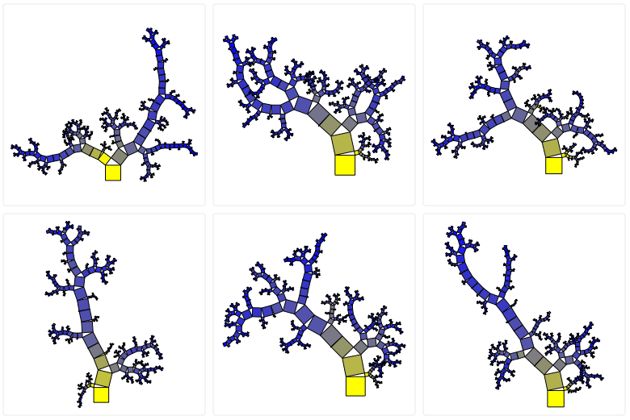
Multiclass classifier
  RandomForestClassifier
  Considers the whole features vector
  Parameters tuning performed with Grid Search
  max_depth = None
  n_estimators = 250
  criterion = “entropy”
  Cross validation score
    f1 = 0.946

Slide 25
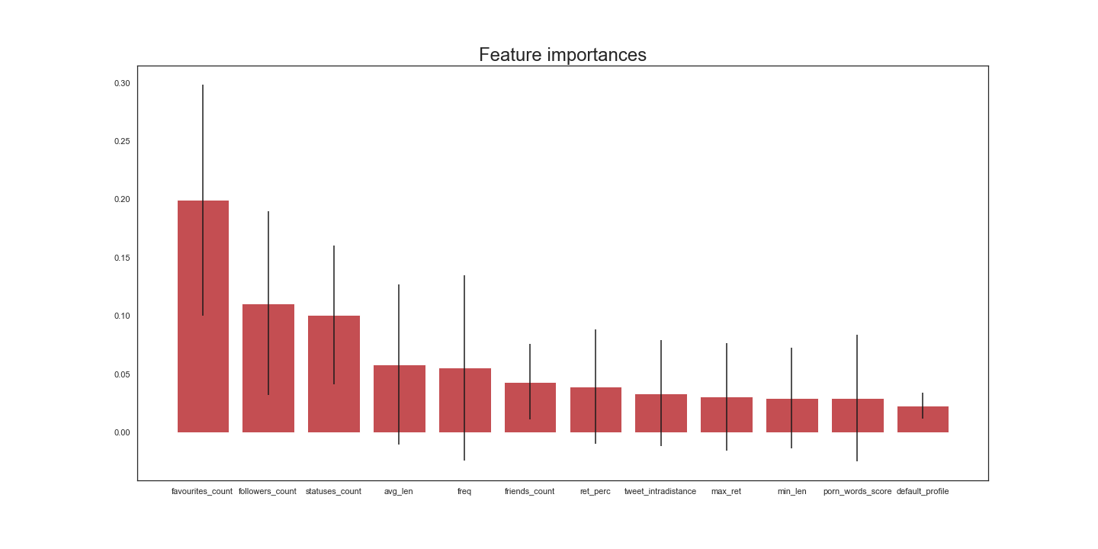
Features Ranking

Slide 26

Binary classifier
  RandomForestClassifier
  Considers the whole features vector except image and extrinsic features
  Parameters tuning performed with Grid Search
  max_depth = None
  n_estimators = 250
  criterion = “entropy”
  Cross validation score
    AUC = 0.936

Slide 27

Text classifier
  Every tweet is labeled with the target of its author
  Considers only tweet texts
  Based on unigrams
  Pipeline
    Stemming
    TF-IDF encoding
    MultinomialNB
  Final prediction over user is computed with the average of the predictions of his tweets
  Cross validation score
    f1 = 0.71

Slide 28
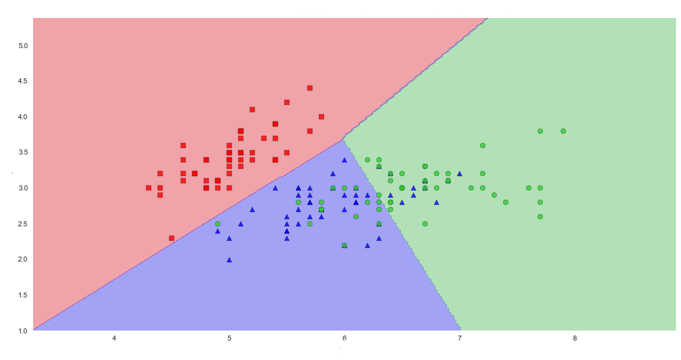
Ensemble
  Stacking with LogisticRegression
  Input data consist in the output probabilities of the other models
  max_iter = 100
  solver = “saga”
  class_weight = “balanced”
  multi_class = “multinomial”
  L1 penality
  cross validation score
    f1 = 0.9734

Slide 29
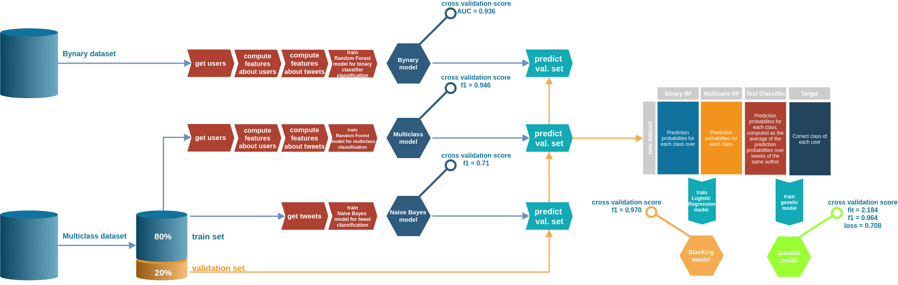
Stacking

Slide 30
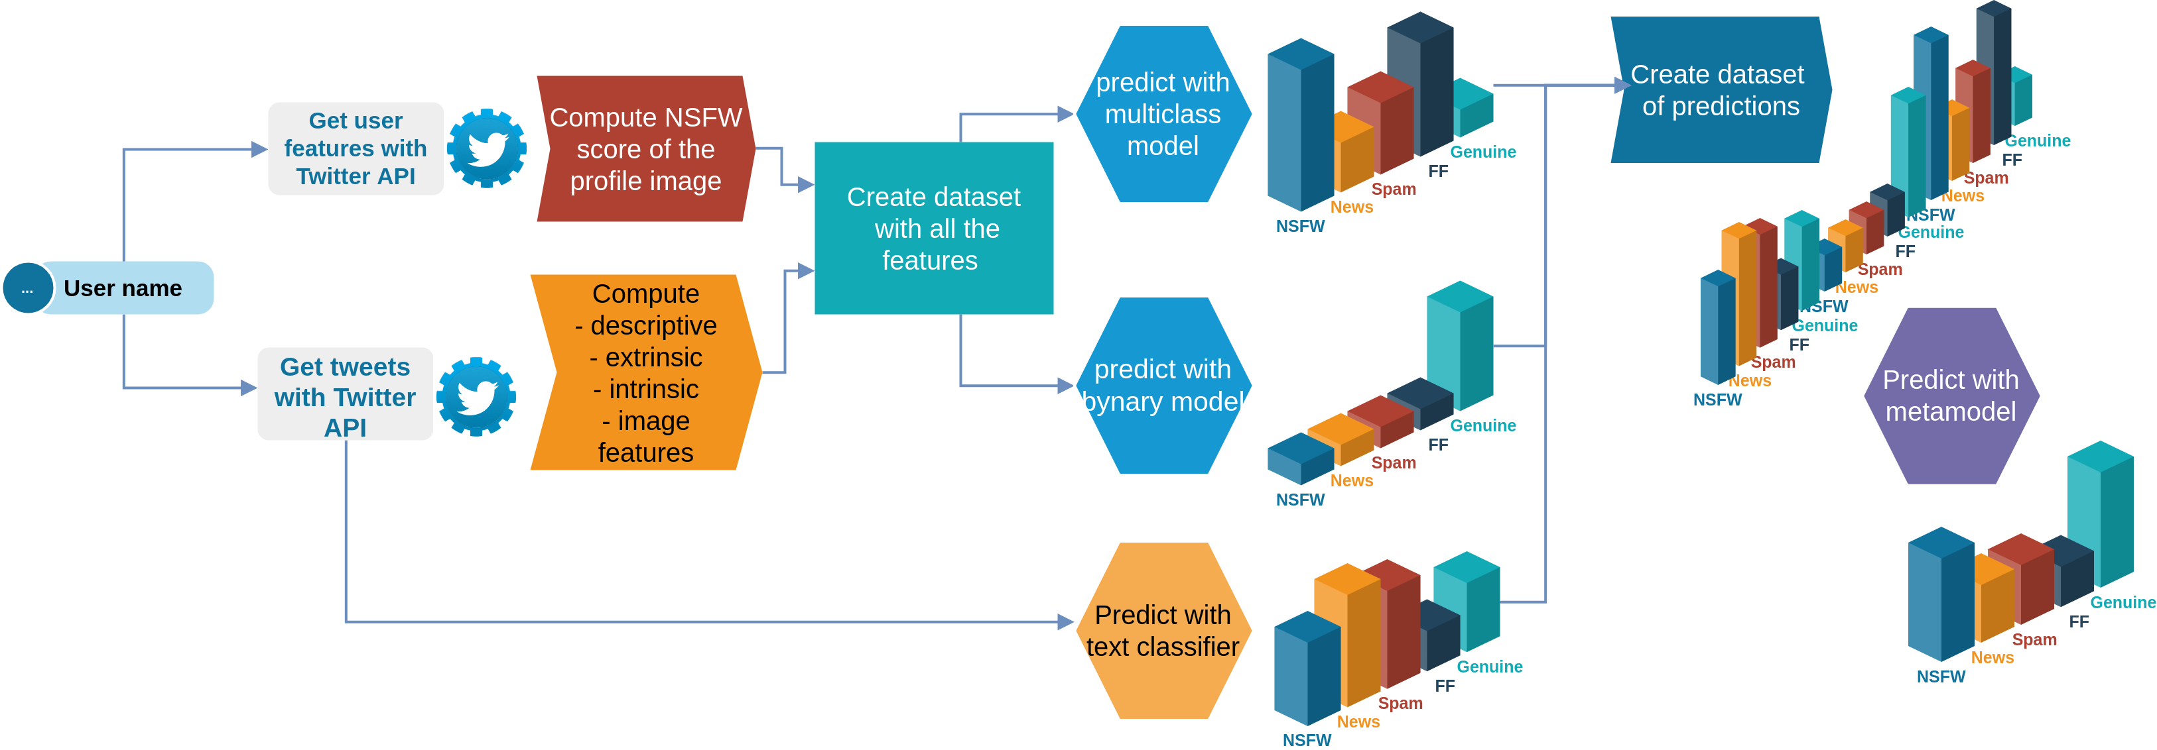
Prediction

Slide 31


Web App
Web service that allows users to classify twitter accounts
Frontend development
  AngularJS
Backend development
  Flask

Slide 32

BotBuster

Slide 33
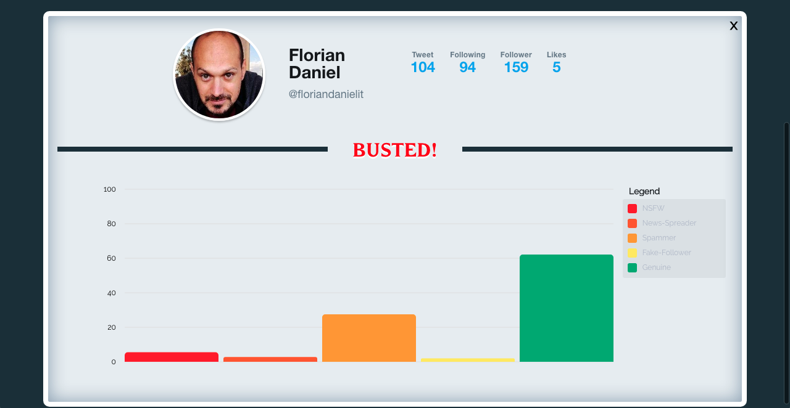
BotBuster

Slide 34
Thanks for your attention

