Slide 1


Titolo presentazione sottotitolo
Milano, XX mese 20XX
Identification and classification of bots on Twitter

Slide 2

Twitter bots

Slide 3
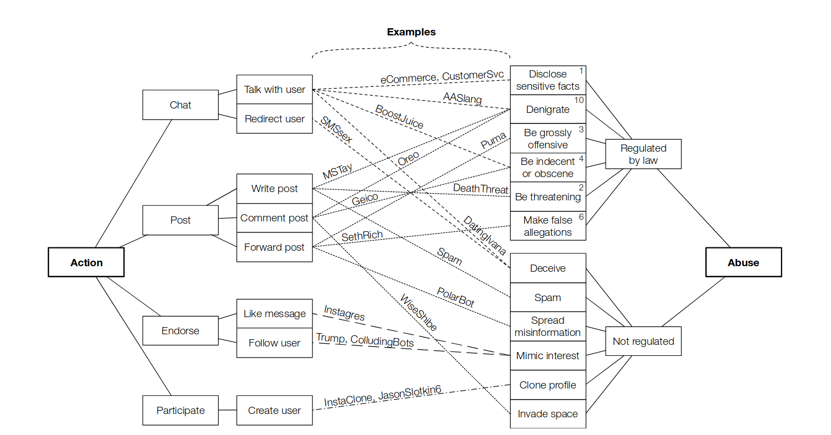
Bot types

Slide 4
Bots on Twitter

Slide 5
Bots on Twitter
NSFW
News-spreaders
Spambots
Fake-followers
Genuine

Slide 6
Data Collection

Slide 7


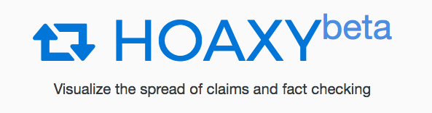
Tools
Twitter API
Botometer API
Hoaxy API

Slide 8
Existing datasets
Caverlee-2011
    Bots
    Humans
Cresci-2017
    spambots (job offers)
    spambots (mobile app)
    Spambots (Amazon products)
    fake followers
    Humans
Varol-2017
    Bots
    Humans
BotBlock
    NSFW bots (adult contents)

Slide 9
NSFW
Get ids from BotBlock list
Scrape users and tweets information with Twitter API

Slide 10
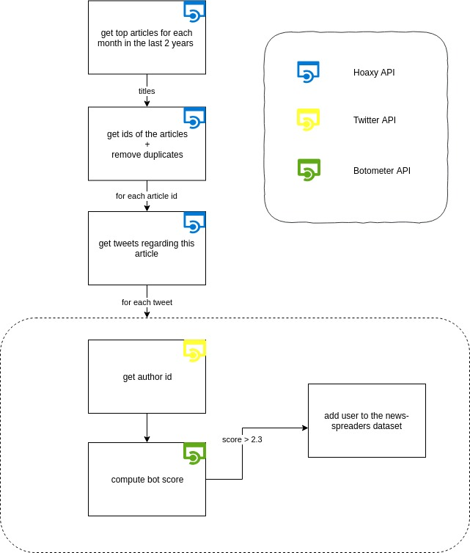
News-spreaders
Find fake-news tweets (Hoaxy)
Find authors information (Twitter API)
Check if authors are bots (Botometer)

Slide 11
Spambots
From Cresci dataset:
  traditional spambots 1 (generic Spabots)
  social spambots 2 (mobile app)
  social spambots 3 (Amazon products)

Slide 12
Fake Followers
From Cresci dataset:
    Fake-followers
followers bought from
    instakipci.com/
    rantic.com/buy-legit-twitter-followers

Slide 13
Genuine
From Cresci dataset:
    Genuine
Each category have been filled with the hand-labeling of the Varol

Slide 14
Features Engineering

Slide 15
Genuine
From Cresci dataset:
    Genuine
Each category have been filled with the hand-labeling of the Varol

