Slide 1

Zomato Restaurant Analysis
Dippu Sai Dinesh
Batch - 484

Slide 2
About me
I am a recent MBA graduate.
I want to be a Data Analyst because I like working with data to solve business problems and support smarter decision-making. My MBA and operations experience helped me understand the importance of data-driven insights.
LinkedIn : https://www.linkedin.com/publicprofile/settings?trk=d_flagship3_profile_self_view_public_profile
Github : https://github.com/dippusaidinesh

Slide 3
Business Problem
The restaurant industry is highly competitive, and businesses often struggle to understand customer preferences, improve ratings, increase online visibility, and identify market opportunities. Using Zomato restaurant data, this project applies web scraping and exploratory data analysis (EDA) to uncover customer trends, restaurant performance patterns, and business growth opportunities for data-driven decision-making.

Slide 4
Objective
Analyze customer satisfaction using restaurant ratings and review patterns.
Identify the most popular cuisines and dining preferences among customers.
Study the relationship between restaurant popularity and customer ratings.
Analyze location-wise restaurant concentration and customer engagement.
Identify premium and high-performing restaurant categories.
Detect hidden growth opportunities through underrated restaurants.
Generate business recommendations using data-driven insights.

Slide 5
Web Scraping Process
• Collected restaurant data from Zomato using web scraping techniques • Used Python libraries like Requests, Beautiful Soup • Extracted restaurant details such as ratings, cuisines, prices, reviews, and locations • Converted scraped data into a structured Pandas Data Frame • Performed data cleaning and preprocessing for analysis • Stored the cleaned dataset for exploratory data analysis (EDA) and visualization

Slide 6
Exploratory Data Analysis (EDA)
• Transformed raw scraped data into a structured analytical format • Converted categorical and textual data into standardized values • Normalized ratings, prices, and review counts for consistency • Created grouped price ranges and rating categories for better visualization • Prepared transformed data for exploratory data analysis (EDA) and business insights

Slide 7
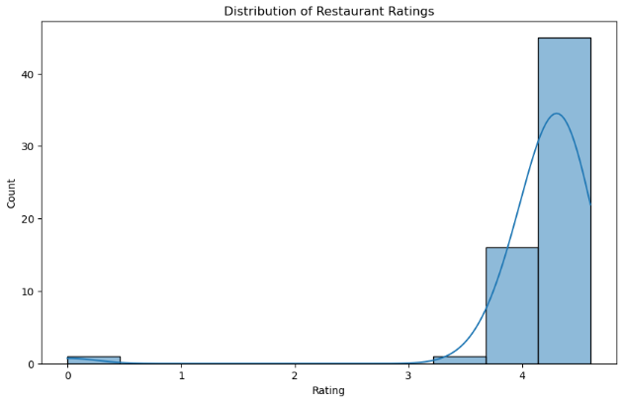
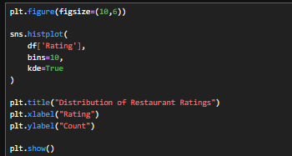
Data Visualization
Insight:
Most restaurants cluster between 4.0–4.5 ratings.

Slide 8
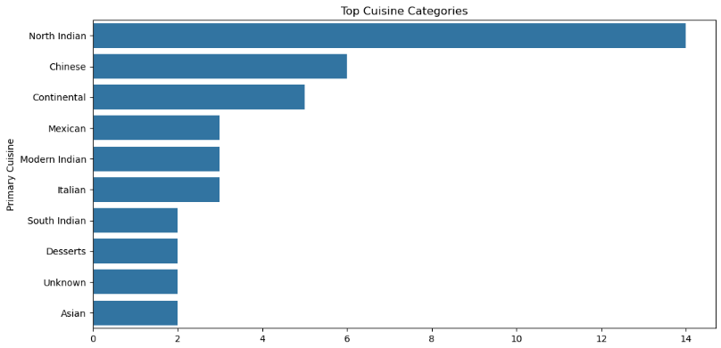
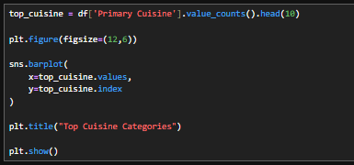
Top Cuisines Objective - Identify dominant cuisine categories.
Insight: North Indian cuisine dominates restaurant offerings.

Slide 9
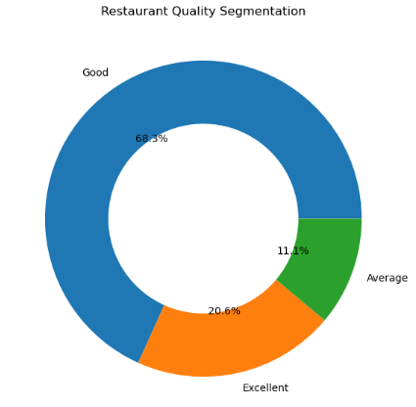
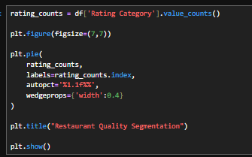
Rating Categories Objective : Segment restaurants by quality tiers.
Insight: Most restaurants fall into the “Good” category.

Slide 10
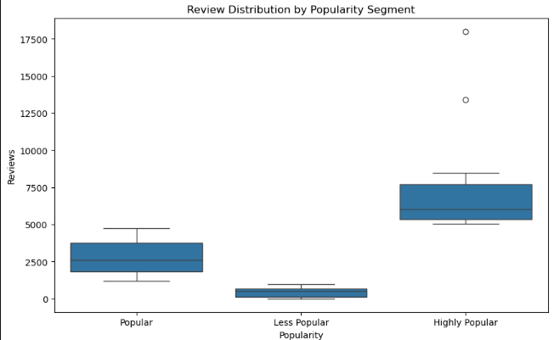
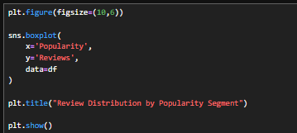
Popularity Category vs Reviews Objective : Analyze review spread across popularity segments.
Insight: Highly popular restaurants show large review variability.

Slide 11
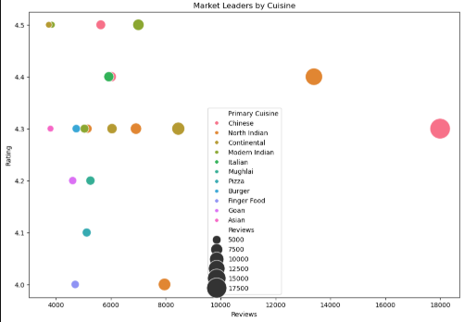
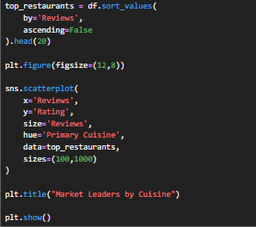
Cuisine + Reviews + Ratings Objective : Identify market leaders.
Insight: Asian and Continental restaurants dominate engagement.

Slide 12
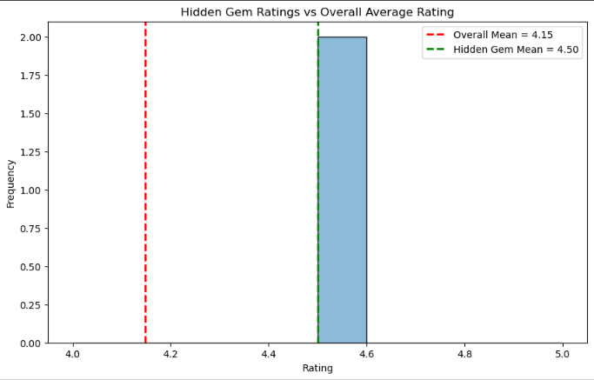
Hypothesis Testing
Hypothesis Testing: Hidden Gem Restaurants
H₀: Hidden Gem ratings are equal to the overall average rating.
H₁: Hidden Gem ratings are higher than the overall average rating.
Overall Mean Rating: 4.15
Hidden Gem Mean Rating: 4.50
Decision: Reject H₀ (if p-value < 0.05)
Hidden Gem restaurants achieve an average rating of 4.50 versus the platform average of 4.15, highlighting under-discovered high-quality restaurants with strong growth potential.

Slide 13
Business Insights
• Most restaurant ratings are concentrated between 4.0–4.5, showing high competition • North Indian cuisine dominates the market with high customer demand • Premium cuisines like Asian and Continental receive higher ratings • High customer reviews do not always indicate high customer satisfaction • Highly rated restaurants with fewer reviews show hidden growth potential • Customer engagement is concentrated among a few popular restaurants • Restaurants offering multiple cuisines attract higher engagement • Prime locations significantly influence restaurant ratings and popularity

Slide 14
Conclusion
This project used web scraping and exploratory data analysis (EDA) to extract valuable insights from Zomato restaurant data. The analysis identified customer preferences, cuisine trends, restaurant popularity patterns, premium dining trends, and hidden growth opportunities. Using univariate, bivariate, and multivariate analysis, the project highlighted the importance of customer satisfaction, online visibility, cuisine strategy, location intelligence, and data-driven decision-making in restaurant business success.

Slide 15
Recommendations
• Improve digital visibility through social media and promotions • Differentiate from competitors using unique menus and premium experiences • Focus on food quality, service, hygiene, and customer satisfaction • Expand premium and fusion cuisine offerings to attract customers • Use customer reviews to improve operations and retention • Diversify menu options to increase customer engagement • Target high-potential locations for future restaurant expansion

Slide 16

THANK YOU

