Slide 1
Chargebacks and Disputes Program Plan
Professional program package: P0 execution, P1 architecture, and metrics targets

Slide 2
P0 Implementation Backlog
Source: 2026-07-05-P0-implementation-backlog.md

Slide 3
P0 Implementation Backlog (1/8)
P0 IMPLEMENTATION BACKLOG (1-2 WEEKS)
Goal
Ship an MVP that demonstrates Airbnb-scale chargeback and dispute product thinking: loss reduction, trust preservation, and policy-safe workflows.
Outcomes (P0)
• End-to-end dispute lifecycle visible from ingestion through closure.
• Policy-timed guardrails for Resolution Center and Host Damage Protection terms.
• Decisioning support by reason code/payment method with explainable recommendations.
• Table-first operational UX for Customer, Merchant, and Admin dashboards.
Workstreams
1. Case Lifecycle Engine
• Add canonical lifecycle states:

Slide 4
P0 Implementation Backlog (2/8)
- Chargeback Ingested
- Representment Recommended
- Representment Submitted
- Pre-Arbitration Eligible
- Pre-Arbitration Submitted
- Final Decision (Won/Lost)
- Recovery Pending (Airbnb -> Guest paid, Merchant clawback pending)
- Closed
• Add transition validation map by payment method and reason code.
• Add terminal-state lock rules and re-open exceptions.
2. Policy Rules Layer

Slide 5
P0 Implementation Backlog (3/8)
• Resolution Center timers:
- 60-day request window from checkout.
- 72-hour discovery flag for refund/rebooking handling.
• Host Damage Protection timers:
- 14-day host-to-guest pursuit requirement.
- 30-day host request submission window.
• Add policy violation flags in case rows and expanded details.
• Add explainers for ineligible requests and required remediation.
3. Reason Code Decisioning (v1)
• Add reason-code playbook object with:
- Recommended action (deflect/settle/represent).

Slide 6
P0 Implementation Backlog (4/8)
- Required evidence checklist.
- Optional evidence boosting win probability.
- Expected win-rate bands by payment method.
• Add per-case recommendation card/table with confidence and expected value.
4. Money Movement Ledger
• Add normalized ledger events:
- Debit/Credit with party, amount, currency, stage, source.
• Show final closure path when Airbnb loses:
- Airbnb credits guest first.
- Merchant clawback/offset posted later.
- Case closes after reconciliation.

Slide 7
P0 Implementation Backlog (5/8)
• Add running balances for Guest, Merchant, Airbnb in expanded case table.
5. Evidence UX (Actionable)
• At each stage line item, allow attaching one or more docs.
• Add “missing evidence” indicator and upload CTA by stage.
• Add sample evidence preview in modal/table row details.
• Add legitimacy flags (missing metadata, low-quality, unverifiable source).
6. Top-Risk KPI Strip (3-Party)
• Add top cards for Airbnb, Merchant, Guest with:
- Win probability (%)
- Exposure at risk ($)
- Suggested documents to improve odds

Slide 8
P0 Implementation Backlog (6/8)
• Add breakdown by reason code and payment method.
Technical Tasks
• Introduce shared utility modules in JS (single source):
- policyRules
- reasonCodeRules
- ledgerEngine
- evidenceRequirements
• Add localStorage schema versioning + migration function.
• Add deterministic demo seed scenarios:3
- Card representment win
- Card representment loss + guest payout + merchant clawback

Slide 9
P0 Implementation Backlog (7/8)
- Klarna auto-closure
- UPI merchant-record-request pending
Validation / Acceptance Criteria
• A case can traverse all lifecycle stages without manual JSON edits.
• Policy deadline breaches are visibly flagged in all 3 dashboards.
• Each expanded case shows table-based timeline + activity + ledger.
• Evidence attachments can be added from each stage row.
• Final-loss path shows Airbnb-to-guest payout and merchant clawback before close.
Demo Script (8-10 min)
1. Ingest chargeback case.
2. Show decisioning recommendation by reason code.

Slide 10
P0 Implementation Backlog (8/8)
3. Add missing evidence and improve win probability.
4. Simulate loss path: guest credit, merchant pullback, close.
5. Show KPI impact and policy compliance trace.

Slide 11
P1 Architecture Roadmap
Source: 2026-07-05-P1-architecture-roadmap.md

Slide 12
P1 Architecture Roadmap (1/8)
P1 ARCHITECTURE ROADMAP (2-6 WEEKS)
Objective
Evolve from demo UI into scalable disputes platform architecture supporting new payment methods, geographies, and verticals.
Target Architecture
1. Domain Services
• Dispute Lifecycle Service
- Owns state machine and transition authorization.
• Decisioning Service
- Rule-based + ML score blending.
- Outputs recommendation, confidence, and expected value.
• Policy Compliance Service

Slide 13
P1 Architecture Roadmap (2/8)
- Encodes deadlines and eligibility constraints.
- Provides deterministic pass/fail reasons.
• Ledger Service
- Immutable financial events + balance projections.
• Evidence Service
- Evidence package completeness scoring.
- Metadata validation and anti-fraud checks.
2. Data Model (Core Entities)
• dispute_case
• dispute_stage_event
• monetary_ledger_event

Slide 14
P1 Architecture Roadmap (3/8)
• evidence_item
• evidence_requirement
• policy_evaluation
• decision_recommendation
• reason_code_rule
• payment_method_rule
• risk_snapshot
3. Decisioning Stack
• Rules-first orchestration:
- Hard policy constraints -> eligibility gating.
- Reason-code/payment-method playbook.

Slide 15
P1 Architecture Roadmap (4/8)
- ML risk/win scores as ranking/prioritization features.
• Add explainability payload:
- top_signals
- missing_signals
- confidence drivers
4. Eventing and Integrations
• Processor webhook ingestion boundary.
• Event bus for stage, evidence, and ledger updates.
• Retry-safe idempotency keys for chargeback events.
• Audit trail for policy-sensitive actions.
5. UX Architecture

Slide 16
P1 Architecture Roadmap (5/8)
• One shared case-expansion renderer with table sections:
- Case Summary Table
- Timeline Activity Table
- Payment/Ledger Table
- Evidence Package Table
• Role overlays only (Customer/Merchant/Admin permissions), not separate logic forks.
Security and Integrity
• Fraud-resistance checks for doctored evidence and inconsistent metadata.
• Role-based permissioning for sensitive actions.
• Immutable financial event append-only model.
• SLA monitoring for response windows.

Slide 17
P1 Architecture Roadmap (6/8)
Observability
• Lifecycle funnel metrics:
- Ingested -> Deflected -> Represented -> Pre-Arb -> Closed
• Win/loss by reason code, processor, payment method, region.
• Alerting:
- deadline at-risk
- failed clawback
- high-loss clusters
Rollout Plan
Phase 1
• Introduce shared domain modules behind existing UI.

Slide 18
P1 Architecture Roadmap (7/8)
• Add schema version and migration support.
Phase 2
• Move lifecycle + policy logic to service abstraction.
• Introduce immutable ledger events and reconciliation checks.
Phase 3
• Plug in score providers (ML + external risk vendors).
• Add experiment framework for deflection and outreach variants.
Success Criteria
• 0 ambiguous stage transitions.
• 100% explainable recommendations for operator actions.
• Reduced manual intervention in evidence collection.

Slide 19
P1 Architecture Roadmap (8/8)
• Lower net loss rate with stable trust and satisfaction indicators.

Slide 20
Metrics and Results
Source: 2026-07-05-metrics-results-slide.md

Slide 21
Metrics and Results (1/4)
METRICS AND RESULTS SLIDE
Title
Building a Holistic Disputes Platform: Loss Reduction + Trust Preservation
Problem
• Chargeback operations were fragmented across lifecycle stages and payment methods.
• Evidence quality and policy timing mismatches caused avoidable losses.
• Limited proactive dispute deflection before escalation.
Product Bet
• Unified dispute lifecycle across ingestion, representment, pre-arb, and recovery.
• Reason-code/payment-method decisioning with policy-aware controls.
• Evidence completeness and financial ledger transparency in one operator flow.

Slide 22
Metrics and Results (2/4)
North-Star Impact (Target)
• Net chargeback loss rate: down 15-25%
• Representment win rate: up 8-12 pts
• Pre-arbitration coverage: up 20-30 pts
• Dispute deflection before chargeback: up 10-18%
• Median time to resolution: down 20-30%
Guardrail Metrics
• Guest attrition risk: no material increase
• Host satisfaction for resolved disputes: improve or hold
• Policy exception rate: down 30%+
• Manual review rate on complete evidence packages: down 25%+

Slide 23
Metrics and Results (3/4)
Segmentation Views
• By reason code
• By payment method (Card, Klarna, UPI)
• By processor
• By geography and product vertical
Example Outcome Narrative
• Introduced reason-code and payment-method decisioning + missing-evidence prompts.
• Improved evidence package completeness before representment submission.
• Reduced avoidable losses while preserving balanced outcomes for hosts and guests.
Slide Footer (Execution)
• Built cross-functionally with Eng, DS, Ops, Trust, and Support.

Slide 24
Metrics and Results (4/4)
• Rolled out in staged experiments with clear kill-switches and policy controls.

Slide 25
Visual Evidence
Operational evidence from customer, merchant, admin, and workflow views

Slide 26
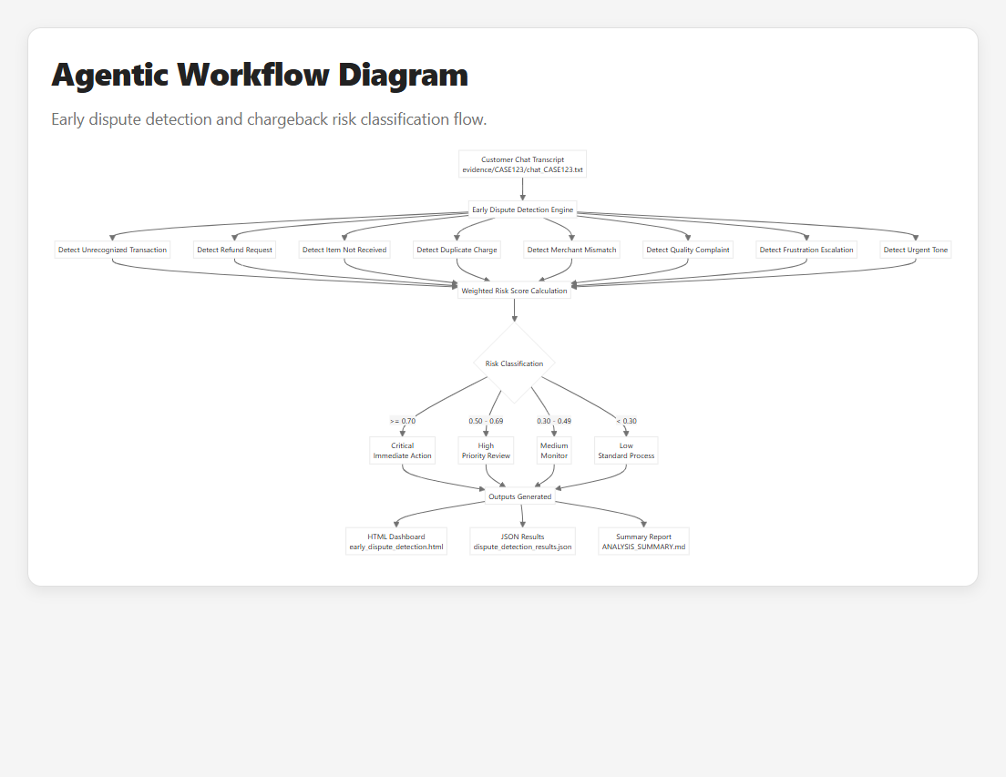
Agentic Workflow Diagram: early-dispute detection and classification flow

Slide 27
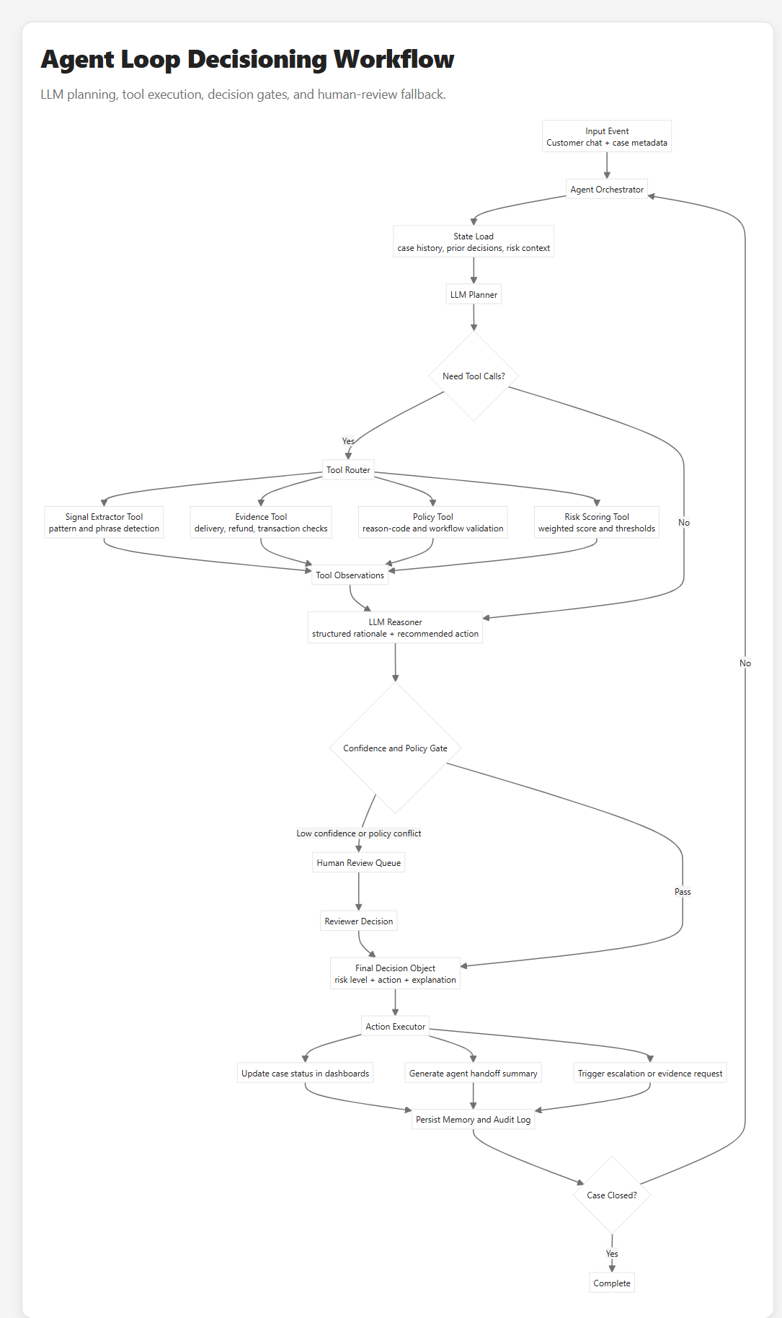
Agent Loop Workflow: LLM planning, tools, and policy gate controls

Slide 28
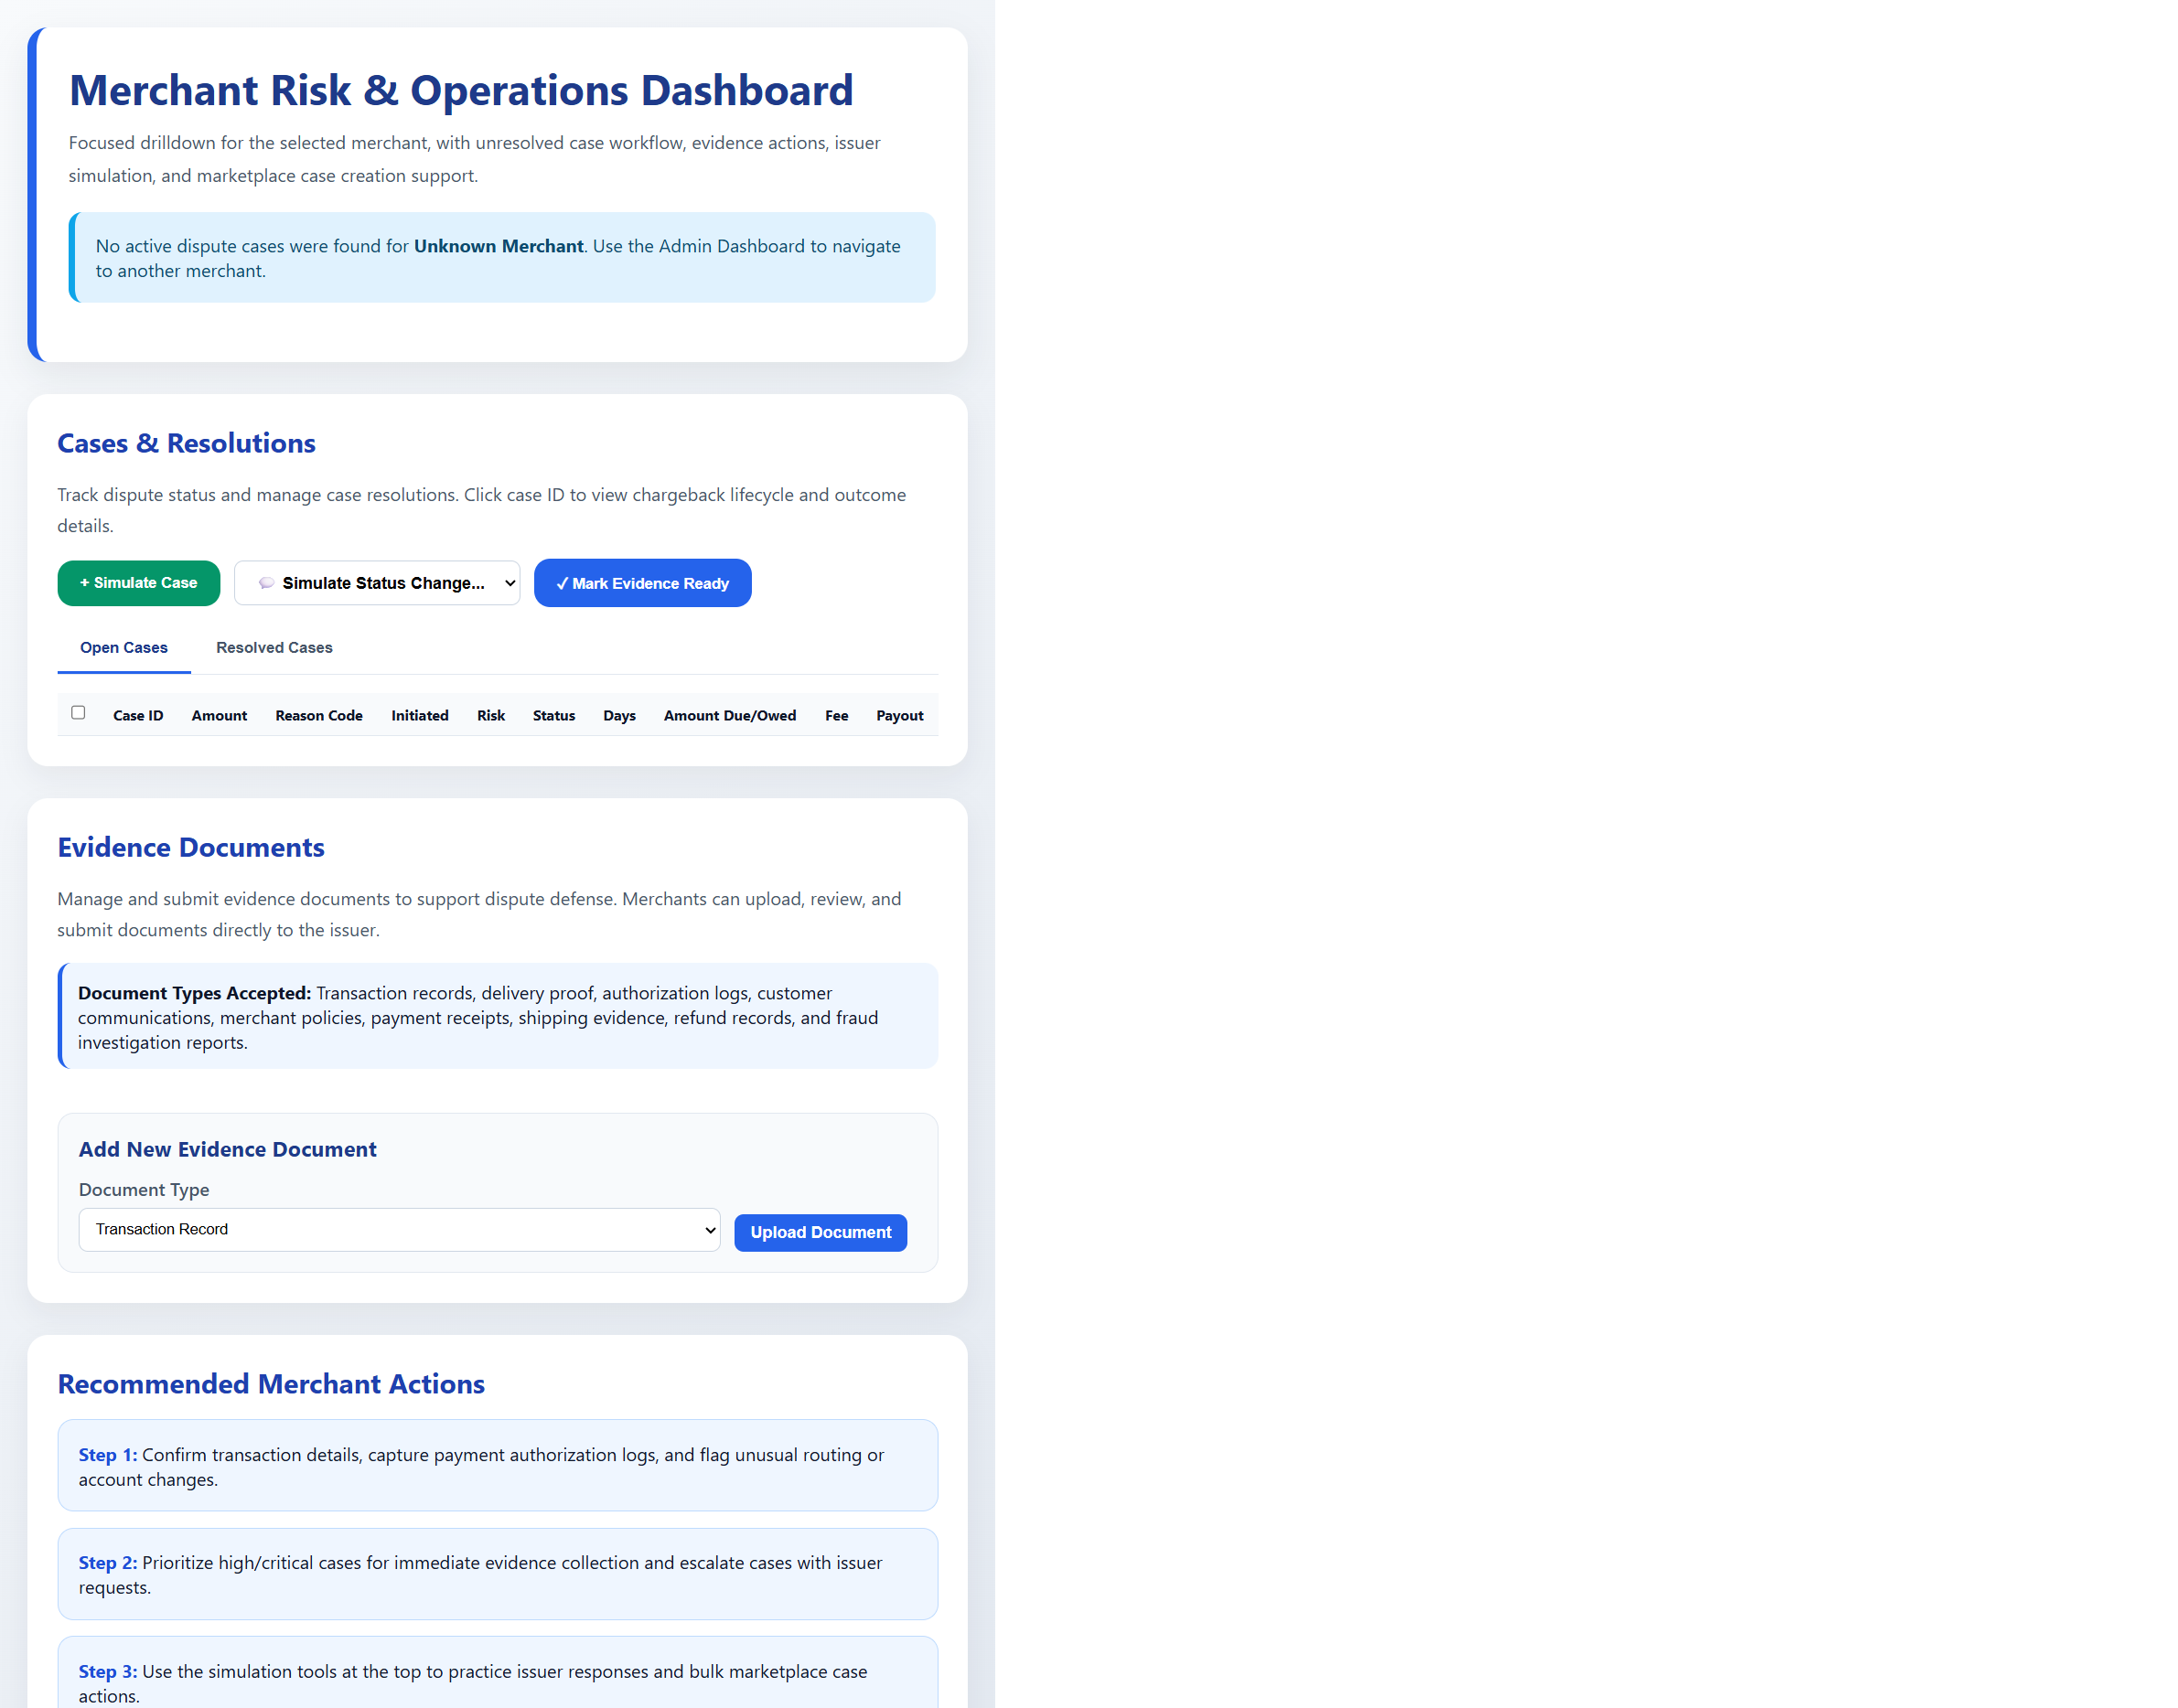
Merchant Risk Dashboard: operations queue, evidence intake, and actions

Slide 29
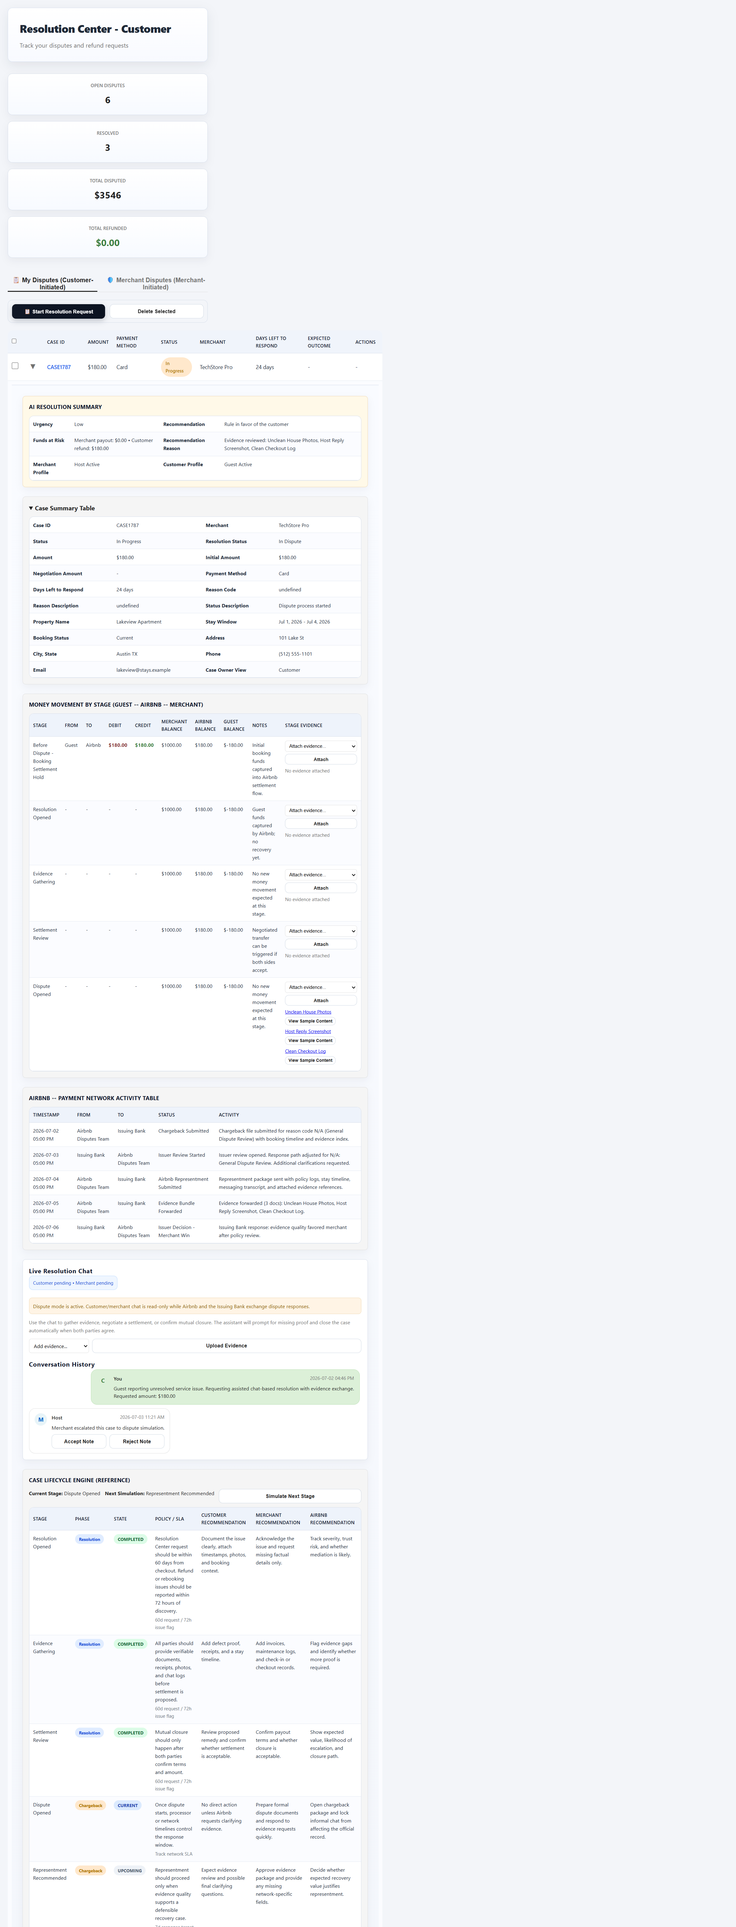
Customer Expanded Case: AI summary, money movement, and lifecycle reference

Slide 30
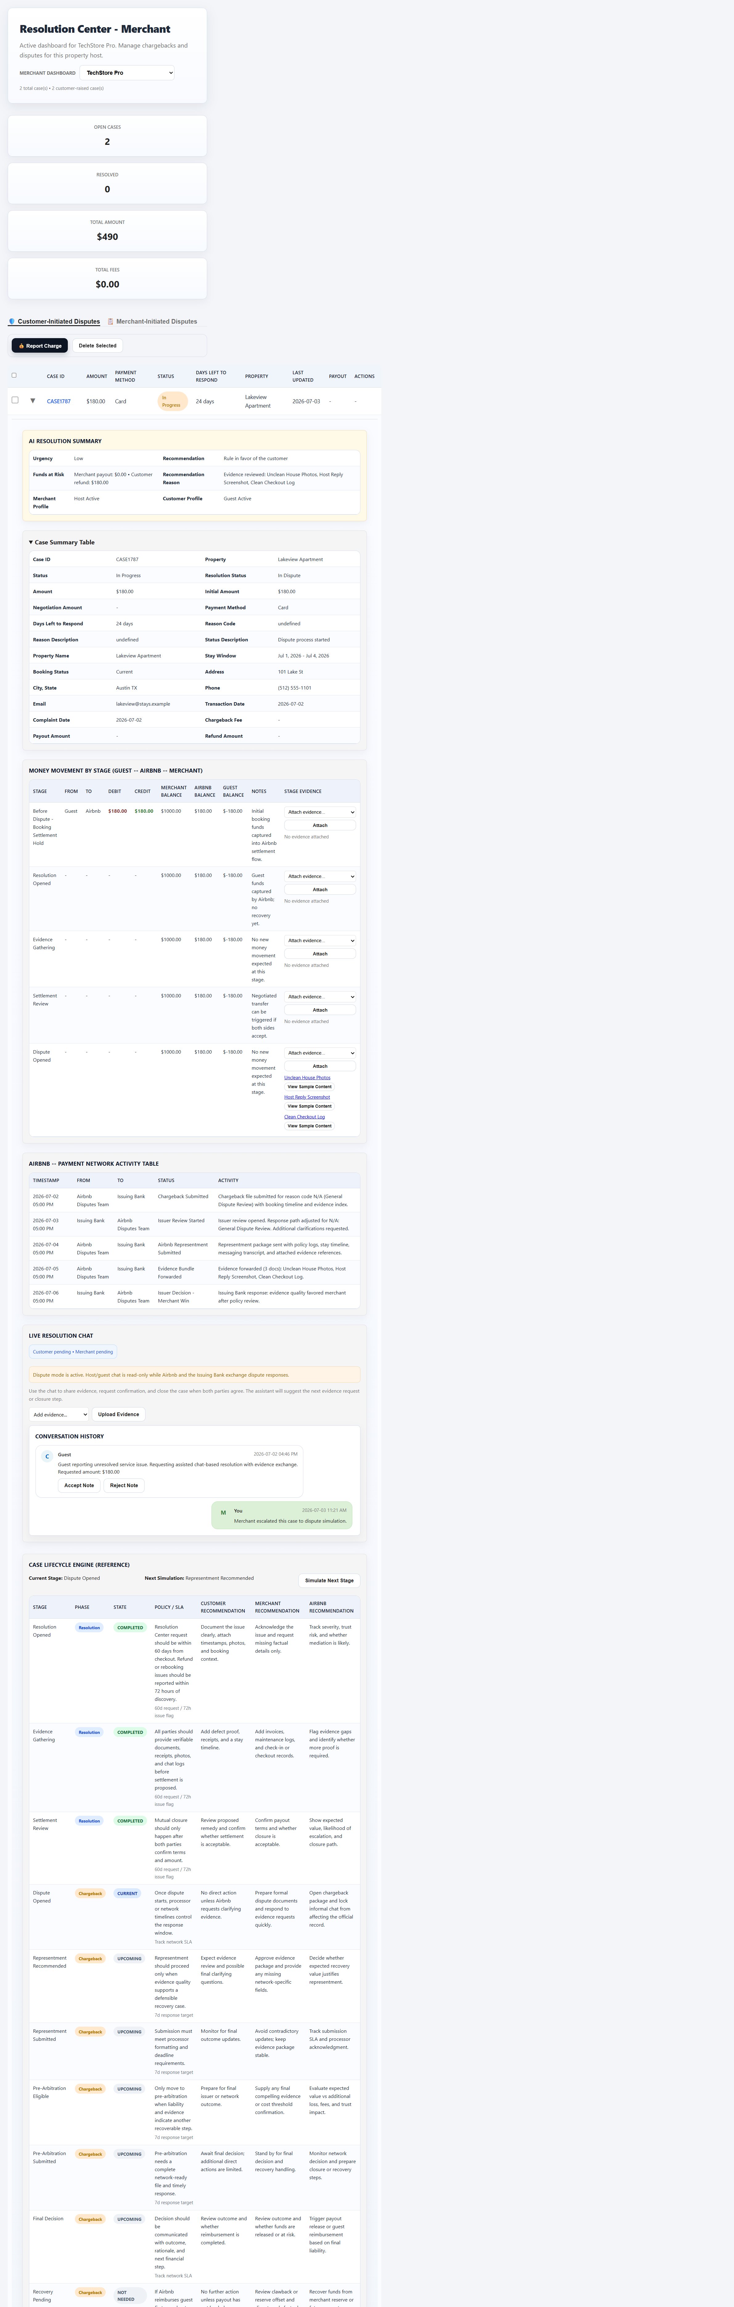
Merchant Expanded Case: recommendation-led investigation and evidence trace

Slide 31
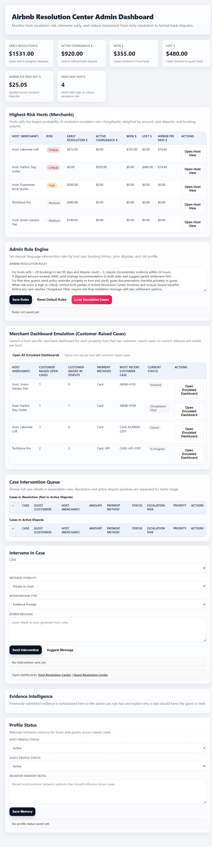
Admin Expanded Case: intervention queue, settlement view, and lifecycle controls

