Slide 1
Early Dispute Detection and Chargeback Management Tool
Presentation Overview | Generated 2026-07-01
Notes:
Introduce this as an end-to-end platform for pre-chargeback detection, resolution workflow, and administrative control.

Slide 2
What This Tool Does
Detects dispute signals before formal chargeback filing
Scores case risk to prioritize operational action
Supports customer and merchant AI-assisted live chat negotiation
Separates disputes from official chargebacks
Enables evidence prompts and automatic closure when both parties agree
Notes:
Explain that early detection plus workflow visibility is the core value proposition.

Slide 3
Core System Components
Data generation layer: structured chargeback records with reason-code fields
Detection layer: chat and evidence signal extraction with weighted risk scoring
Resolution layer: role-specific customer and merchant workflows
Governance layer: admin intervention, policy checks, and escalation controls
Reporting layer: operational dashboards and integration-ready output files
Notes:
Present this as a layered operating model so stakeholders understand ownership by function.

Slide 4
Function Overview (Scripts)
generate_chargeback_dataset.py: creates normalized sample case data for reporting and QA
early_dispute_detection.py: detects early dispute indicators and computes risk classifications
run_analysis.py: orchestrates full execution and regenerates all downstream deliverables
create_tool_overview_pdf.py: produces stakeholder-ready summary PDF with screenshots
create_tool_presentation.py: builds this presentation with theme, visuals, and speaker notes
Notes:
Keep this slide concise and implementation-focused: what each script does and why it exists.

Slide 5
Dispute vs Chargeback Lifecycle
Dispute Stage
Customer or merchant can initiate
Negotiation with notes, evidence, and amount updates
Accept or reject outcomes tracked
Risk level drives response priority
Chargeback Stage
Officially filed at issuer/network level
Reason code validation and evidence arbitration
Admin escalation and resolution outcomes
Final result tracked as won or lost
Notes:
Clarify the lifecycle boundary and why this separation reduces confusion and delays.

Slide 6
Risk and Detection Logic
Risk tiers: Critical, High, Medium, Low
Signal weighting from conversation patterns
Examples: unrecognized transaction, refund demand, non-delivery
Reason-code aware triage for faster routing
High-risk alerts support proactive outreach
Notes:
Mention that thresholds are configurable and should be tuned by merchant segment.

Slide 7
Dashboards and User Views
Customer Resolution Center: active chat, evidence prompts, and settlement response
Merchant Resolution Center: live evidence exchange and representment readiness
Merchant Admin Dashboard: intervention queue, risk segmentation, and policy oversight
Disputes and chargebacks are separated to preserve lifecycle clarity
Visual analytics track risk distribution, case aging, and exposure by status
Notes:
Explain how each interface supports a distinct operational role with clear handoffs.

Slide 8
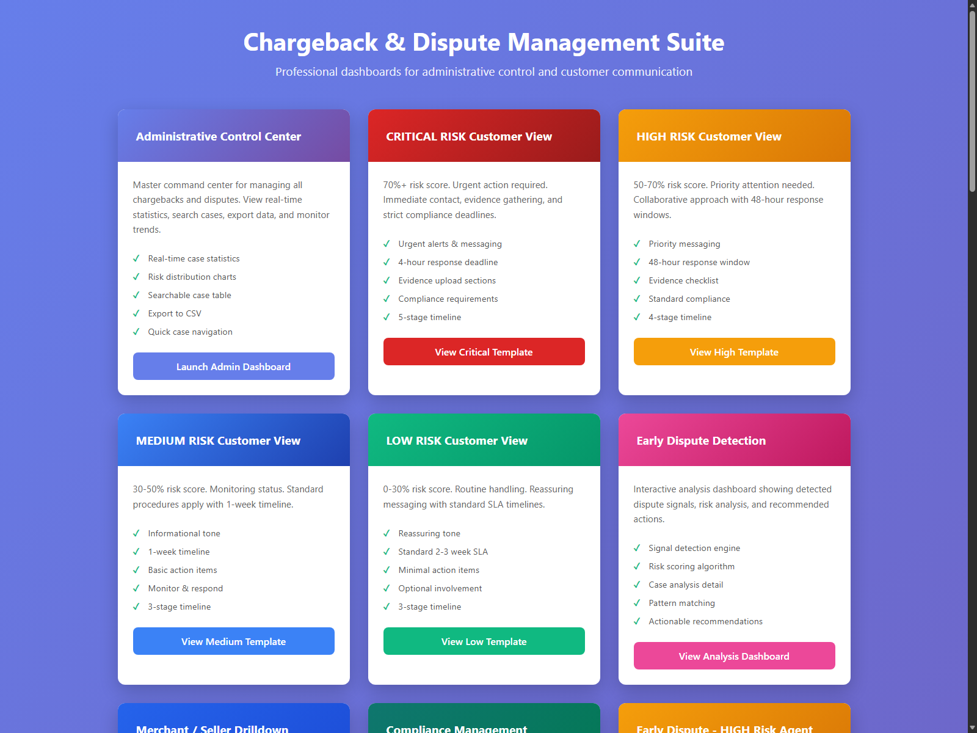
Application Context: Entry and Navigation
Notes:
Use this view to explain the information architecture: role-based entry points and guided navigation to each workflow.

Slide 9
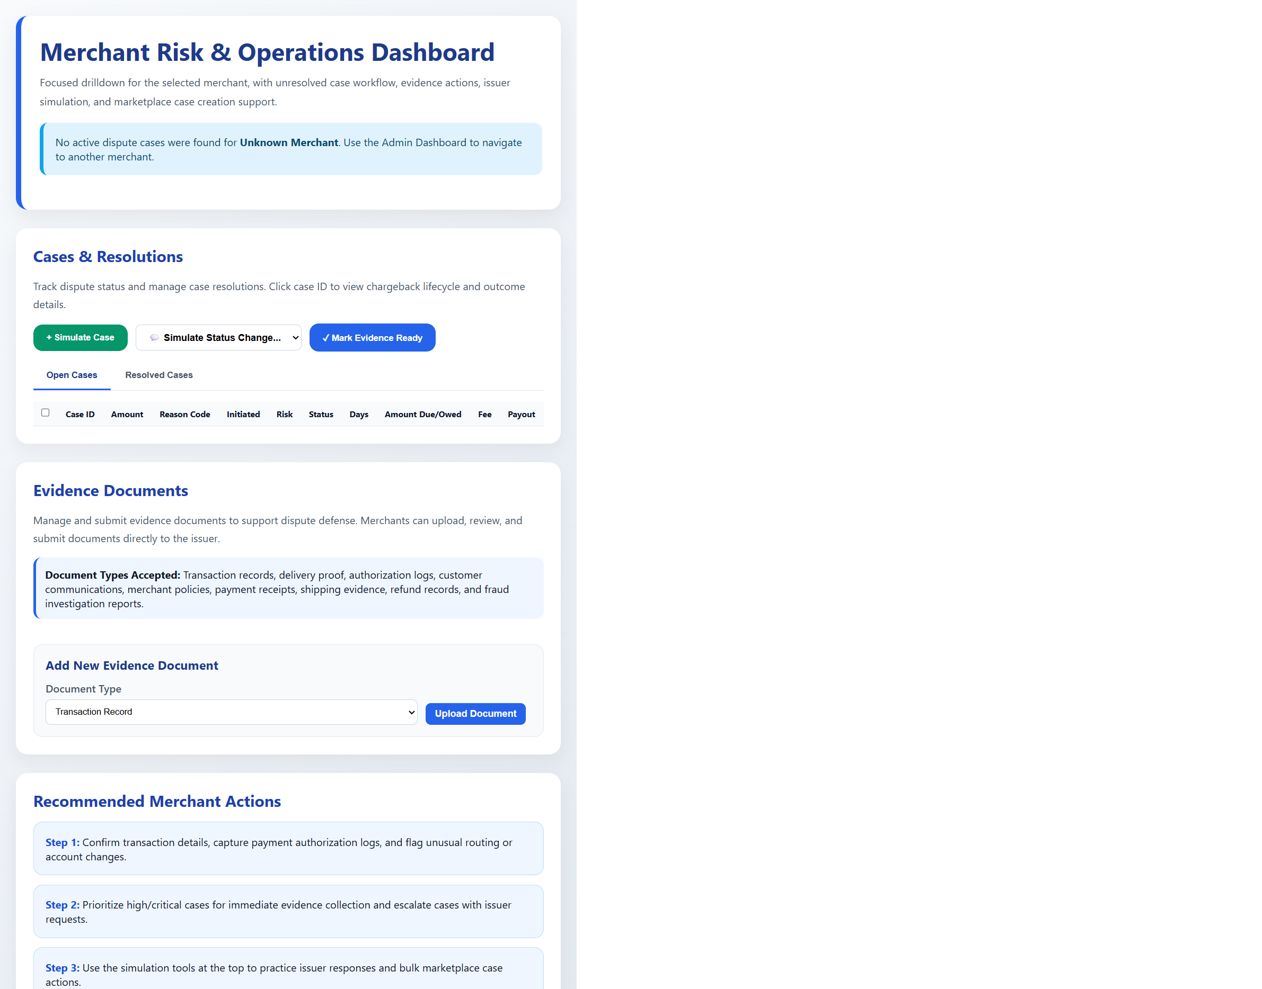
Screenshot: Merchant Admin Dashboard
Notes:
Highlight merchant risk drilldown, workflow controls, evidence readiness actions, and issuer outcome simulation.

Slide 10
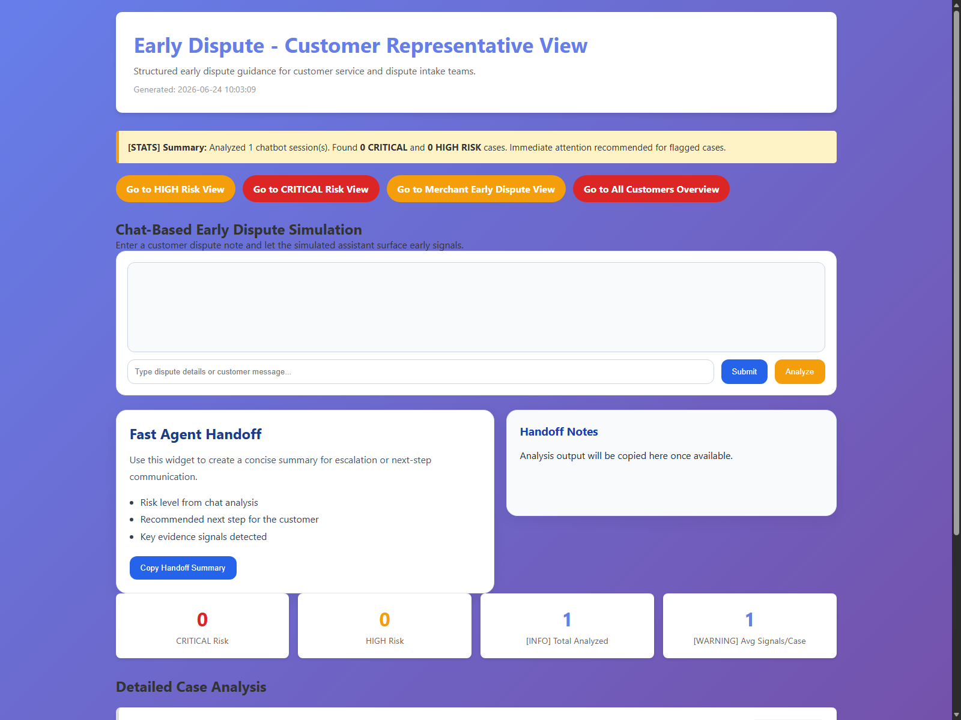
Screenshot: Early Dispute Detection
Notes:
Highlight risk-ranked cases, signal traceability, and triage-ready recommendations for frontline teams.

Slide 11
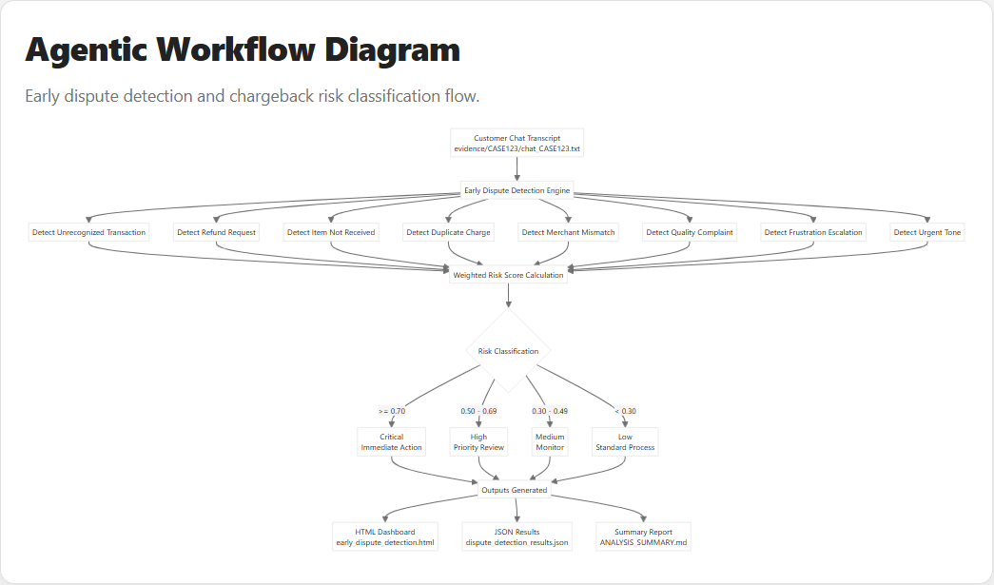
Workflow Diagram: Agentic Detection Flow
Notes:
Walk through the end-to-end logic: chat input, signal detection, weighted scoring, risk classification, and output generation.

Slide 12
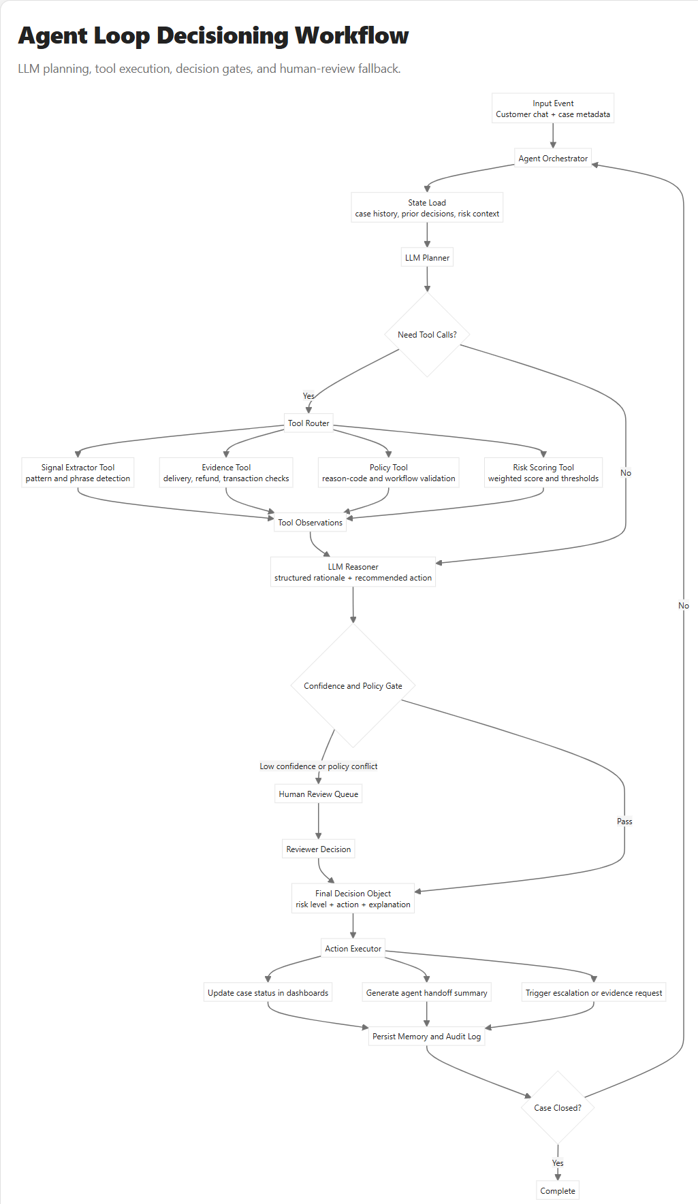
Workflow Diagram: Agent Loop (LLM + Tools)
Notes:
Explain the agent loop: LLM planning, tool execution, confidence/policy gating, human escalation, action execution, and closed-loop state persistence.

Slide 13
Workflow Interpretation
Input context is captured from customer-support conversations and evidence artifacts
Signals are matched once per category to reduce duplicate inflation
Weighted scoring determines priority bands for operational action
Risk levels map directly to response urgency and ownership
AI prompt chips guide evidence collection and confirmation in live chat
Cases auto-close when both parties explicitly agree in the chat flow
Outputs support both daily operations and system integration
Notes:
Frame this as a governance-friendly decision pipeline: transparent, explainable, and actionable.

Slide 14

Screenshot: Resolution Center (Customer)
Notes:
Show customer-side live chat execution with evidence prompts, amount context, and agreement-based closure controls.

Slide 15

Screenshot: Resolution Center (Merchant)
Notes:
Show merchant-side live chat response controls, evidence exchange, and mutual-agreement closure progression.

Slide 16
Outputs and Deliverables
Excel dataset for case operations and audits
Interactive HTML dashboards for daily workflows
JSON output for downstream system integration
Markdown summary for run-level insights
Export-ready reporting for stakeholders
Notes:
Connect each output to its consumer: analyst, operator, or system integration.

Slide 17
Admin Intervention Workflow
Request evidence
Escalate to network review
Mark chargeback won
Mark chargeback lost
Track status and rationale for compliance
Notes:
Stress auditability and policy-driven intervention consistency.

Slide 18
Business Value
Lower chargeback losses via earlier detection
Faster response through risk-based prioritization
Clear accountability across customer, merchant, and admin teams
Improved audit readiness and policy consistency
Scalable process for growing dispute volume
Notes:
Tie business value to measurable KPIs: loss rate, response SLA, and resolution rate.

Slide 19
Next Steps
Add production reason-code policy mappings
Integrate with case management and ticketing tools
Automate daily run scheduling
Track precision, false positives, and recovery rate
Refine intervention thresholds by merchant segment
Notes:
Close with a phased 30/60/90 day rollout recommendation.

