Slide 1
Pointers

Slide 2
Variable
A variable is a named memory location.
Variables provide direct access to its memory location.
A variable has a name, an address, a type,and a value:
"the name identifies the variable to the programmer
"the address specifies where in main memory the variable is located

Slide 3
What is a variable?
"the type specifies how to interpret the data stored in main memory and how long the variable is
"the value is the actual data stored in the variable after if has been interpreted according to a given type

Slide 4
Pointer variable
A pointer is a variable that contains the memory location of another variable.
Syntax:-
type * variable name
You start by specifying the type of data stored in the location identified by the pointer.
The asterisk tells the compiler that you are creating a pointer variable.
Finally you give the name of the variable.

Slide 5
Declaring a Pointer Variable
To declare ptr as an integer pointer:
  int *ptr;
To declare ptr as a character pointer:
  char *ptr;

Slide 6
Accessing a variable through its pointer
Once we declare a pointer variable we must point it to something. We can do this by assigning to the pointer the address of the variable you want to point as in the following example:
ptr=&num;
This places the address where num is stores into the variable ptr. If num is stored in memory 21260 address then the variable ptr has the value 21260.

Slide 7
Address and Pointers
Memory can be conceptualized as a linear set of data locations.
Variables reference the contents of a locations
Pointers have a value of the address of a given location
ADDR1
Contents1
ADDR2
ADDR3
ADDR4
ADDR5
ADDR6
*
*
*
ADDR11
Contents11
*
*
ADDR16
Contents16
Lect 14 P. <number>
Notes:
Engineering H192
Winter 2005
Lecture 14
Instructor:
A computer has two basic types of busses to the memory: an address and data bus. Thus far we have been concerned mainly with the data we store but not its storage location. Pointers allow us to also use the address in which our data is stored in various ways. This conceptualization of memory can be likened to a street with various address where mail is delivered. The mailman delivers the correct data (letters) to the correct address written on each piece of mail.

Slide 8
Pointer Variable
Assume ptr is a pointer variable and x is an integer variable
x
10
ptr
&x
Now ptr can access the value of x.
HOW!!!!
Write: *variable . For example:
Cout<< *ptr;
x = 10
ptr = &x

Slide 9
Variables, Addresses and Pointers
main()
{
int a = 5;
int b = 6;
int *c;
// c points to a
c = &a;
}
Memory Value
a (1001) 5
b (1003) 6
c (1005) 1001

Slide 10
include< stdio.h >
{
int num, *intptr;
float x, *floptr;
char ch, *cptr;
num=123;
x=12.34;
ch=’a’;
intptr=&num;
cptr=&ch;
floptr=&x;
cout<<“Num “<<*intptr,<<“ stored at address “<<intptr;
cout<<“Value “<<*floptr <<“ stored at address “<<floptr;
cout<<“Character <<*cptr <<“stored at address”<<cptr;
}

Slide 11
Run this code
int main()
{
int x;
int *ptr;
x = 10;
ptr = &x;
*ptr = *ptr + 1;
cout<< x;
return 0;
}

Slide 12
Pointer arithmetic
Valid operations on pointers include:
- the sum of a pointer and an integer
- the difference of a pointer and an integer
- pointer comparison
the difference of two pointers.
Increment/decrement in pointers
assignment operator used in pointers

Slide 13
Example
void main()
{
int a=25,b=78,sum;
int *x,*y;
x=&a;
y=&b;
sum= *x + *y;
cout<<“Sum is : ”<<sum;
}

Slide 14
Assignment in pointers
Pointer variables can be "assigned":
int *p1, *p2;
p2 = p1;
  Assigns one pointer to another
  "Make p2 point to where p1 points"
Do not confuse with:
*p1 = *p2;
  Assigns "value pointed to" by p1, to "value
  pointed to" by p2

Slide 15
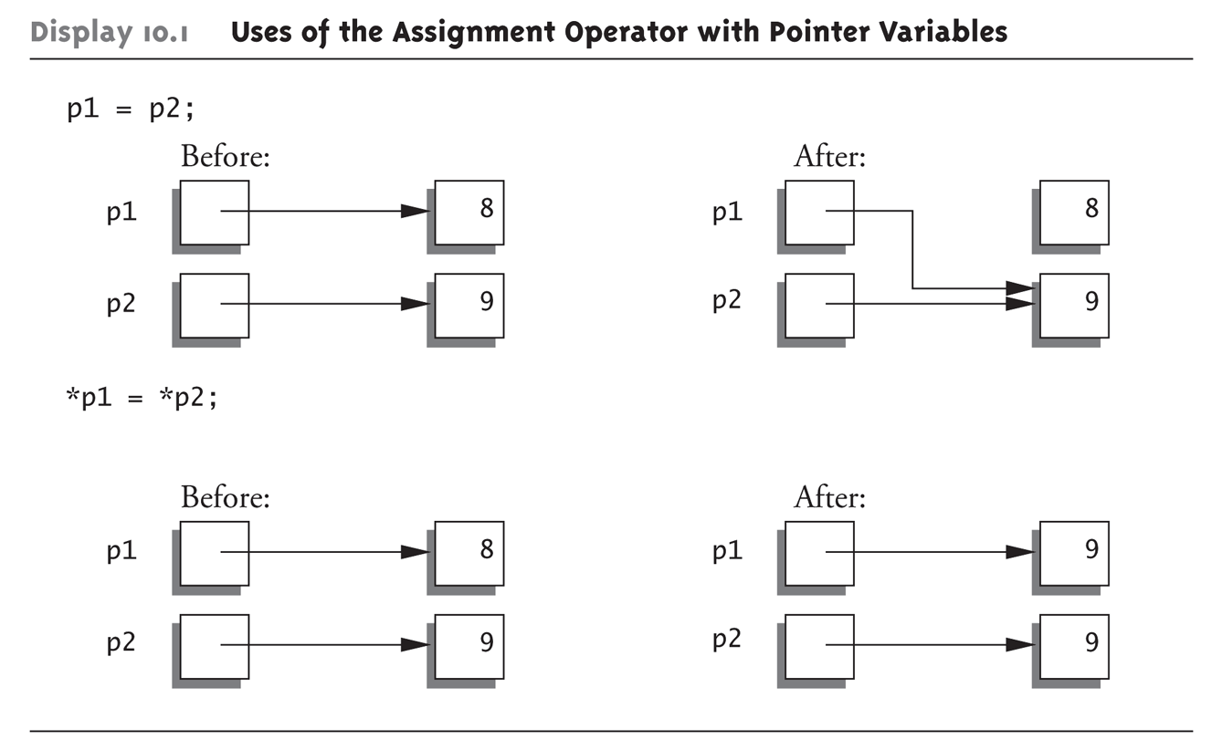
Diagrammatic representation

Slide 16
Comparison in pointers
Two pointers of the same type, p and q, may be compared as long
as both of them point to objects within a single memory block
• Pointers may be compared using the <, >, <=, >=, == , !=
• When you are comparing two pointers, you are comparing the
values of those pointers rather than the contents of memory locations pointed to by these pointers

Slide 17
Increment and decrement
Data Type | Initial address | Operation |  | Address after operation s |  | Required bytes
Int i=2 | 4046 | ++ | -- | 4048 | 4044 | 2bytes
Char c=‘x’ | 4053 | ++ | -- | 4054 | 4042 | 1bytes
Float f=2.2 | 4050 | ++ | -- | 4054 | 4046 | 4bytes
Long l=2 | 4060 | ++ | -- | 4064 | 4056 | 4bytes

Slide 18
You can perform a limited number of arithmetic operations on pointers. These operations are:
Increment and decrement
Addition and subtraction
Comparison
Assignment
The increment (++) operator increases the value of a pointer by the size of the data object the pointer refers to. For example, if the pointer refers to the second element in an array, the ++ makes the pointer refer to the third element in the array.
The decrement (--) operator decreases the value of a pointer by the size of the data object the pointer refers to. For example, if the pointer refers to the second element in an array, the -- makes the pointer refer to the first element in the array.

Slide 19
You can add an integer to a pointer but you cannot add a pointer to a pointer.
If the pointer p points to the first element in an array, the following expression causes the pointer to point to the third element in the same array:
p = p + 2; If you have two pointers that point to the same array, you can subtract one pointer from the other. This operation yields the number of elements in the array that separate the two addresses that the pointers refer to.
You can compare two pointers with the following operators: ==, !=, <, >, <=, and >=.
Pointer comparisons are defined only when the pointers point to elements of the same array. Pointer comparisons using the == and != operators can be performed even when the pointers point to elements of different arrays.
You can assign to a pointer the address of a data object, the value of another compatible pointer or the NULL pointer.

Slide 20
Void pointers
When a variable is declared as being a pointer to type void it is known as a generic pointer.
Since you cannot have a variable of type void, the pointer will not point to any data and therefore cannot be dereferenced.
It is still a pointer though, to use it you just have to typecast it to another kind of pointer first. Hence the term Generic pointer.

Slide 21
This is very useful when you want a pointer to point to data of different types at different times.
Syntax:
  void * variable name;

Slide 22
    void main()
    { int i;
    char c;
    void *data;
    i = 6;
    c = 'a';
    data = &i;
    cout<<"the_data points to the integer value “<< *(int*) data;
    data = &c;
    cout<<"the_data now points to the character “<< *(char*) data;
    }

Slide 23
PROBLEMS WITH POINTERS

Slide 24
DANGLING POINTER
Dangling pointers arise when an object is deleted or deallocated, without modifying the value of the pointer, so that the pointer still points to the memory location of the deallocated memory
As the system may reallocate the previously freed memory to another process, if the original program then dereferences the (now) dangling pointer, unpredictable behavior may result, as the memory may now contain completely different data.

Slide 25
Cause:
deleting an object from memory explicitly or by destroying the stack frame on return does not alter associated pointers. The pointer still points to the same location in memory even though the reference has since been deleted and may now be used for other purposes
.

Slide 26
NULL POINTER
A null pointer is a regular pointer of any pointer type which has a special value that indicates that it is not pointing to any valid reference or memory address. This value is the result of type-casting the integer value zero to any pointer type.
int * p;
p = 0; // p has a null pointer value

Slide 27

Do not confuse null pointers with void pointers. A null pointer is a value that any pointer may take to represent that it is pointing to "nowhere", while a void pointer is a special type of pointer that can point to somewhere without a specific type. One refers to the value stored in the pointer itself and the other to the type of data it points to.

Slide 28
WILD POINTER
Wild pointers arise when a pointer is used prior to initialization to some known state, which is possible in some programming languages. They show the same erratic behaviour as dangling pointers, though they are less likely to stay undetected.
The wild pointer generates garbage memory location and pendent refernce.

Slide 29
Causes:
Pointer declared but not initialized
Pointer alteration
Accessing destroyed data

