Slide 1
INHERITANCE
Order of execution of constructor and destructor during inheritance

Slide 2
Basic points[Order of execution of constructor and destructor during inheritance ]
If a constructor is defined in the base class and derived class, then on creating the object of derived class, base class constructor will be executed first, then derived class constructor will be called.
Order of execution of destructor will be in reverse order as that of the order of execution of constructor
If a base class is having default constructor, then it is optional for derived class to have a default constructor
If a base class is having parameterized constructor, then it is mandatory for derived class to have a parameterized constructor which will pass the parameters to the base class constructor through initializer list.

Slide 3
Order of execution of constructor and destructor during single inheritance[Default constructor in both classes]
#include<iostream>
using namespace std;
class A
{
public:
A()
{
cout<<"\nCalling default base class constructor";
}
~A()
{
cout<<"\nCalling base class destructor";
}
};
class B:public A
{
public:
B()
{
cout<<"\n Calling default derived constructor";
}
~B()
{
cout<<"\nCalling derived class destructor";
}
};
int main()
{
B obj1;
return 0;
}
Output:
Calling default base class constructor
Calling default derived constructor
Calling derived class destructor
Calling base class destructor

Slide 4
Order of execution of constructor and destructor during single inheritance[Parameterized constructor in both classes]
class B:public A
{
int l;
public:
B(int p):A(p)
{
l=p;
cout<<"\nCalling derived class parameterized:"<<l;
}
~B()
{
cout<<"\nCalling derived class destructor";
}
};
int main()
{
B obj2(1);
return 0;
}
Output:
Calling base class parameterized 1
Calling derived class parameterized: 1
Calling derived class destructor
Calling base class destructor
#include<iostream>
using namespace std;
class A
{
int x;
public:
A(int a)
{
x=a;
cout<<"\nCalling base class parameterized "<<x;
}
~A()
{
cout<<"\nCalling base class destructor";
}
};

Slide 5
Order of execution of constructor and destructor during single inheritance[Parameterized and default constructor in both classes]
#include<iostream>
using namespace std;
class A
{
int x;
public:
A()
{
cout<<"\nCalling base class default";
}
A(int a)
{
x=a;
cout<<"\nCalling base class parameterized "<<x;
}
~A()
{
cout<<"\nCalling base class destructor";
}
};
class B:public A
{
int l;
public:
B()
{
cout<<"\nCalling derived class default";
}
B(int p):A(p)
{
l=p;
cout<<"\nCalling derived class parameterized:"<<l;
}
~B()
{
cout<<"\nCalling derived class destructor";
}
};
int main()
{
//B obj1; //Either default/ or parameterized constructor can be called
B obj2(1);
return 0;
}

Slide 6
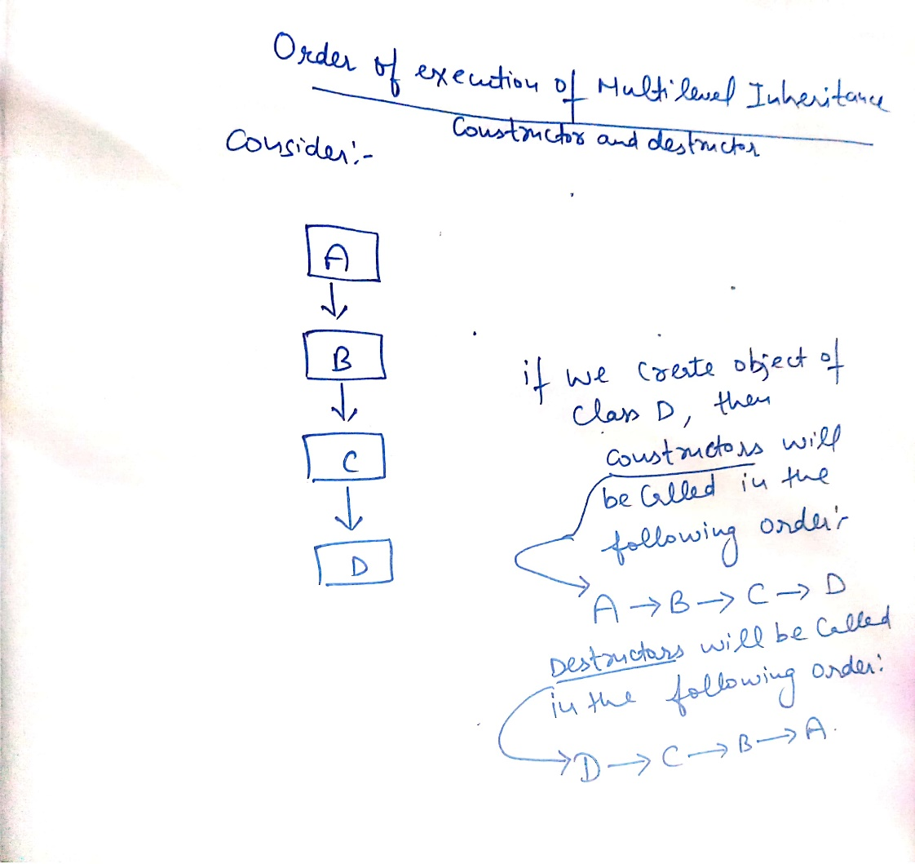
Order of execution of constructor and destructor during Multilevel inheritance

Slide 7
Program-Order of execution of constructor and destructor during Multilevel inheritance
#include<iostream>
using namespace std;
class A
{
int x,y;
public:
A(int r,int s)
{
x=r;
y=s;
cout<<"\nCalling base class constructor:"<<x<<" "<<y;
}
~A()
{
cout<<"\nCalling base class destructor";
}
};
class B:public A
{
int l,m;
public:
B(int p,int q,int r,int s):A(r,s)
{
l=p;
m=q;
cout<<"\nCalling derived class B constructor:"<<l<<" "<<m;
}
~B()
{
cout<<"\nCalling derived B class destructor";
}
};

Slide 8
Program-Order of execution of constructor and destructor during Multilevel inheritance….Continued
class C:public B
{
int n,m;
public:
C(int u,int v,int p,int q,int r,int s):B(p,q,r,s)
{
n=u;
m=v;
cout<<"\nCalling derived class C constructor with values:"<<n<<" "<<m;
}
~C()
{
cout<<"\nCalling derived class C destructor";
}
};
int main()
{
C obj1(1,2,3,4,5,6);
return 0;
}

Slide 9
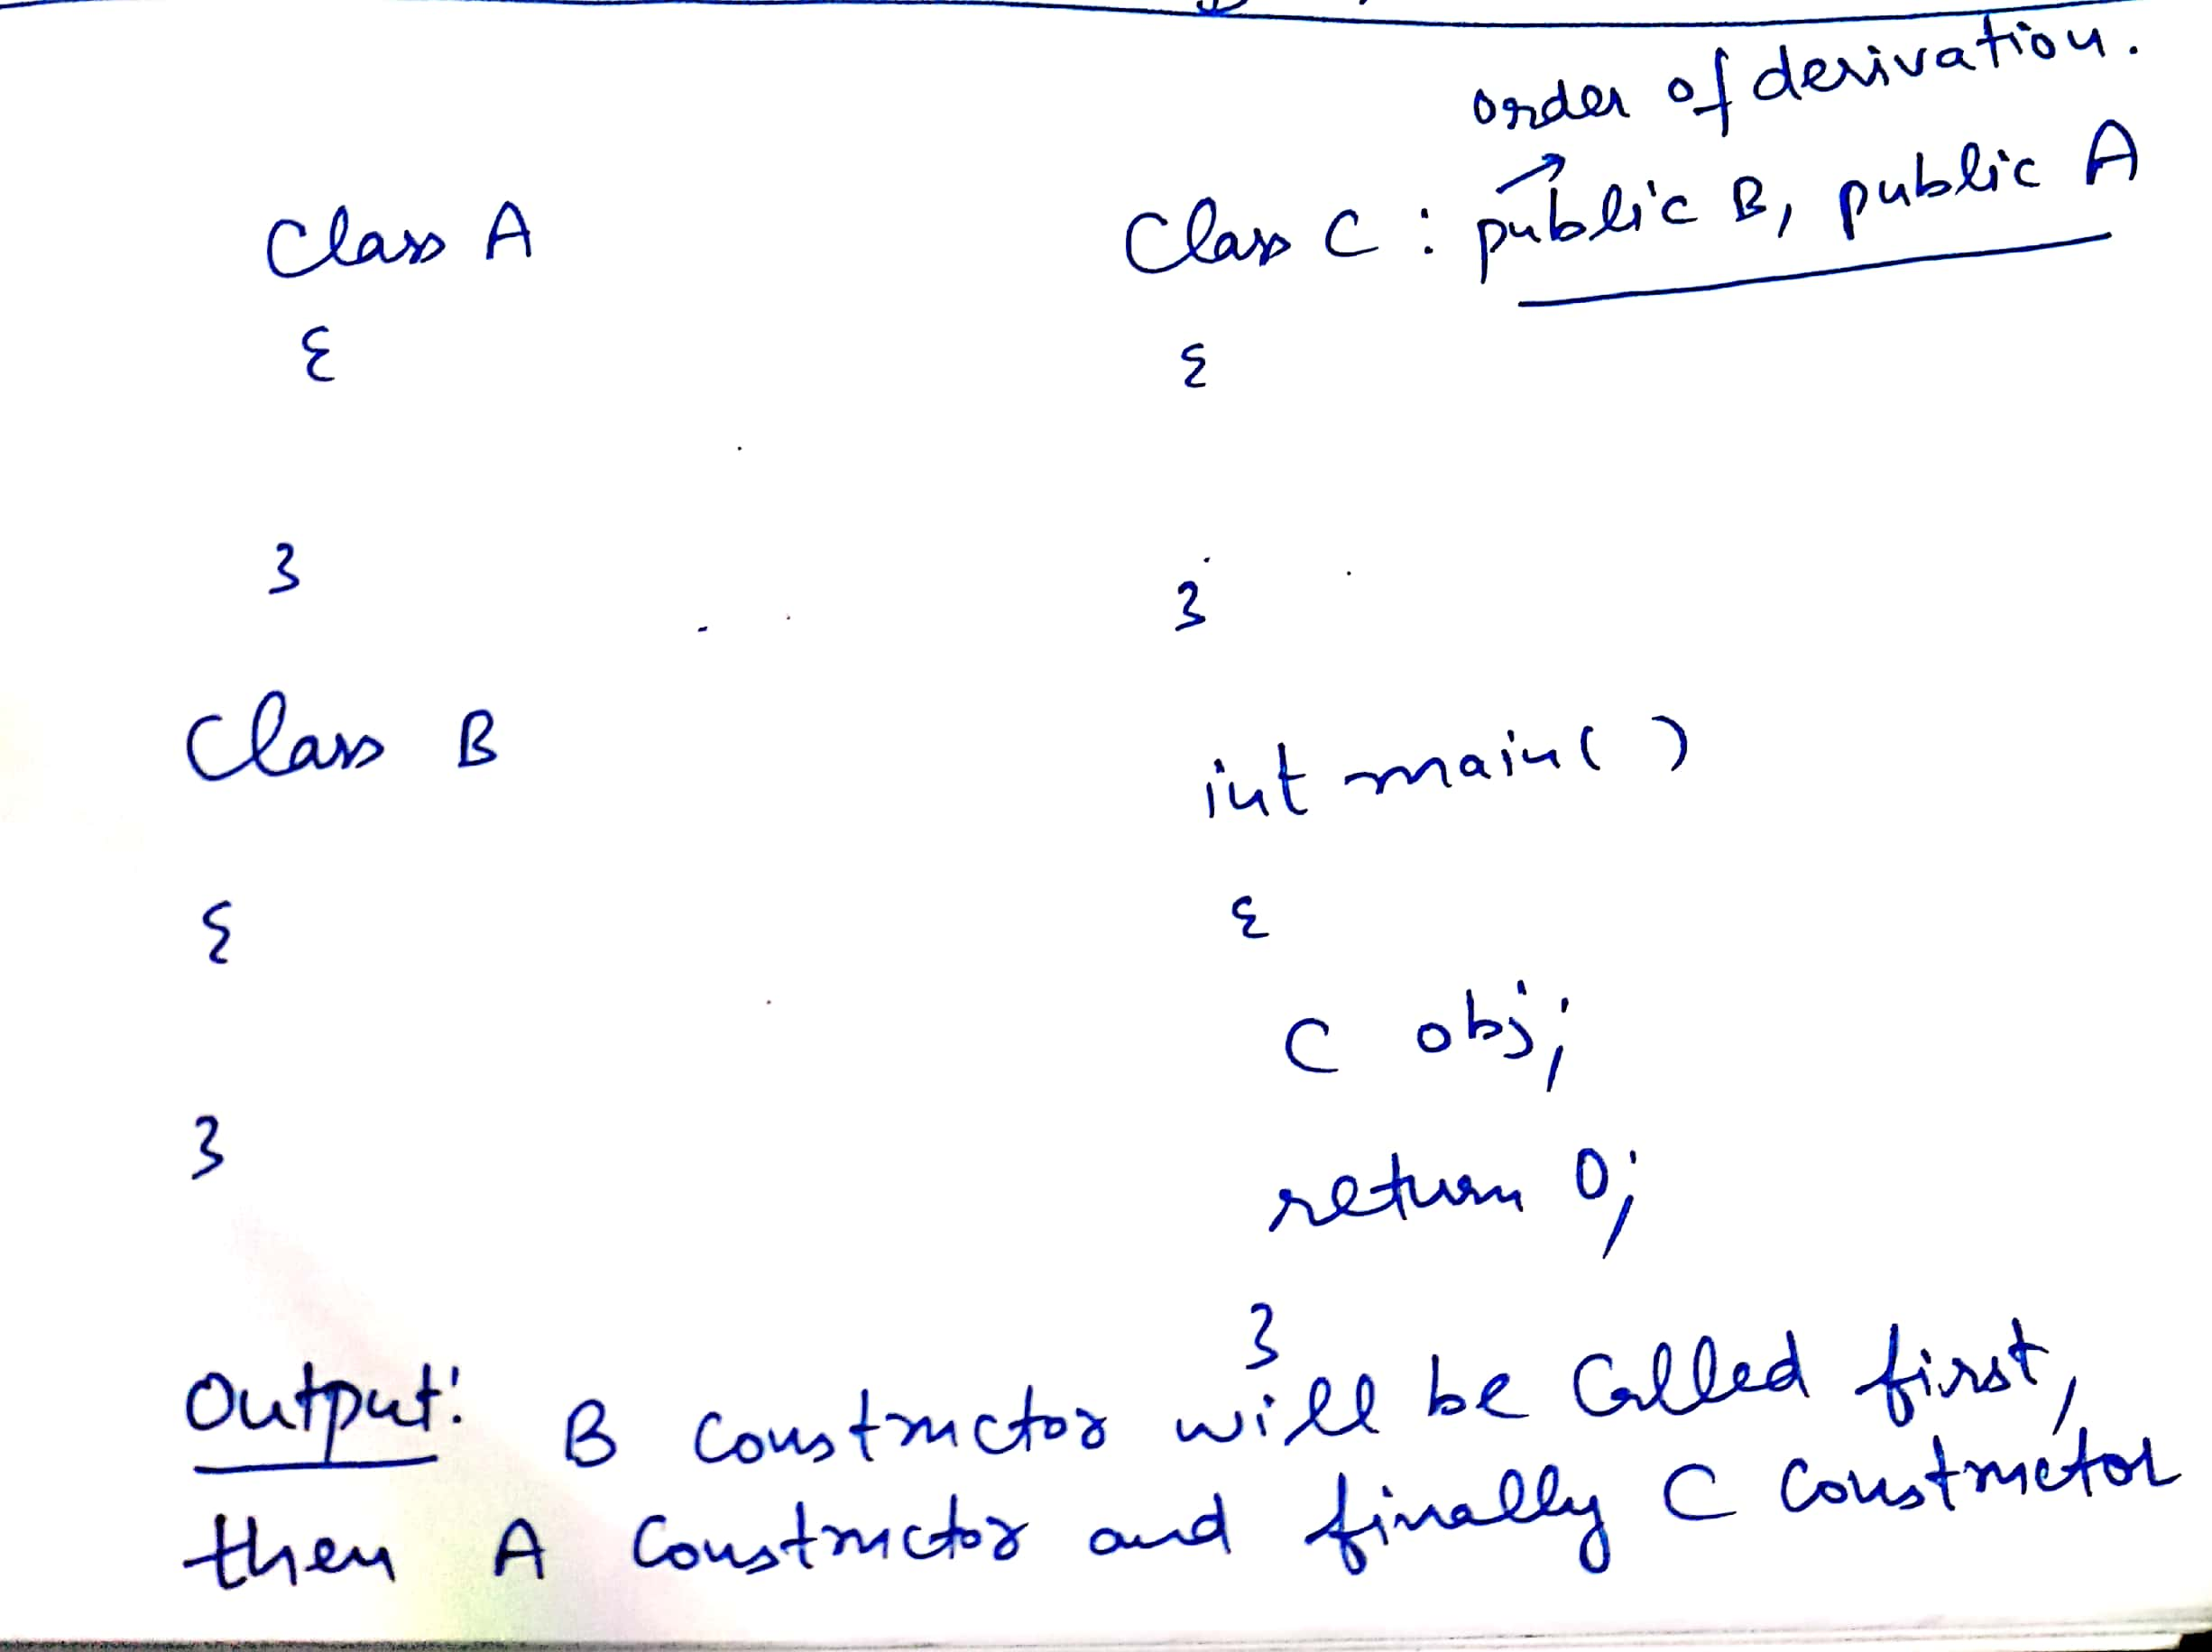
Order of execution of constructor and destructor during Multiple inheritance
Order of execution of constructor during multiple inheritance is dependent upon the order of derivation(or order of inheritance).
Order of execution of destructor will be reverse as that of order of execution of constructor

Slide 10
Order of execution of constructor and destructor during Multiple inheritance…continued…
Class A:public B, virtual C
{
};
Order of execution of constructor
//C() virtual base
//B() ordinary base
//A() derived
If one of the class is inherited in virtual mode, then constructor of that will be executed first and then order of inheritance will be followed and if both are derived in virtual mode, then order of inheritance will be followed(as usual)

Slide 11
Program-Order of execution of constructor and destructor during Multiple inheritance
#include<iostream>
using namespace std;
class M
{
protected:
int m;
public:
M(int x)
{
m=x;
cout<<"\nIn M";
}
};
class N
{
protected:
int n;
public:
N(int y)
{
n=y;
cout<<"\nIn N";
}
};
class P:public M,public N
{
int l;
public:
P(int p,int q,int r):M(r),N(q)
{
l=p;
cout<<"\nIn P";
}
void display()
{
cout<<“\n”<<"m="<<m<<" "<<"n="<<n<<" "<<"l="<<l;
}
};
int main()
{
P obj1(3,2,1);
obj1.display();
return 0;
}
Output:
In M
In N
In P
m=1 n=2 l=3

Slide 12
Order of execution of constructor and destructor during hierarchical inheritance
#include<iostream>
using namespace std;
class M
{
protected:
int m;
public:
M(int x)
{
m=x;
cout<<"\nIn M";
}
};
class N:public M
{
protected:
int n;
public:
N(int y):M(y)
{
n=y;
cout<<"\nIn N";
}
};
class P:public M
{
int l;
public:
P(int p):M(p)
{
l=p;
cout<<"\nIn P";
}
};
int main()
{
N obj1(1);//Output In M,In N
P obj2(2);//Output In M,In P
return 0;
}

