Slide 1



Project on Hostel Management System
Presenters:
DIPRANJAN GUPTA

Slide 2
INTRODUCTION
Based on MySQL database
Project to make the management of hostel related record robust and convenient.
Project is supposed to replace the physical record keeping in the present context with more secure and better technology.

Slide 3
Objectives
To replace the existing physical record keeping system.
To store all the information about the student like name,contact address etc.
To manage all the employees of the hostel properly.
To manage the things like fee information of student properly.

Slide 4
Scope and De-limitation
Even though this project is just about the database at present it has ability to be developed into some well-organized web. With little bit of extra improvement we can further take it to the point where it can help to remove the existing tiresome physical record keeping of the present context in hostel management field.we can further develop it to manage overall all aspect of hostel like canteen information.

Slide 5
Applications
Can be used in managing hostel at large scale with slight modification
Makes the hostel related data storing more convenient and secure
Makes data like student , room availabilityetc easily accessible.

Slide 6
Methodology
Study On present context
Database design
Queries writing

Slide 7
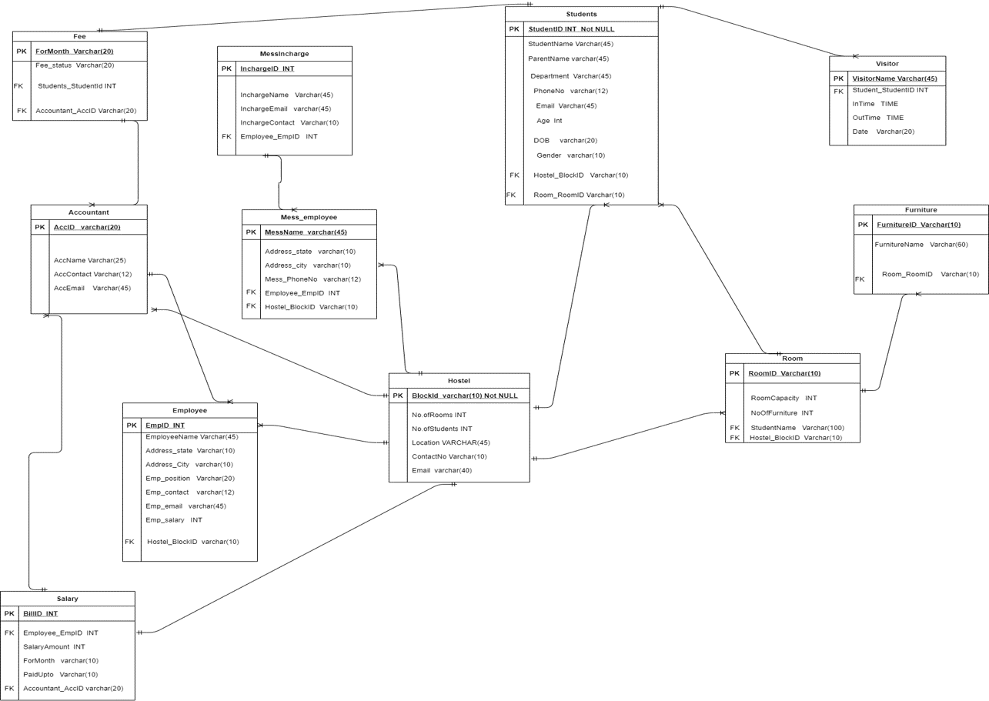
ER Diagram

Slide 8
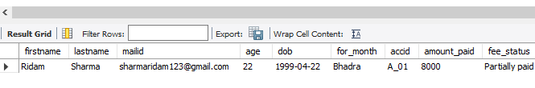
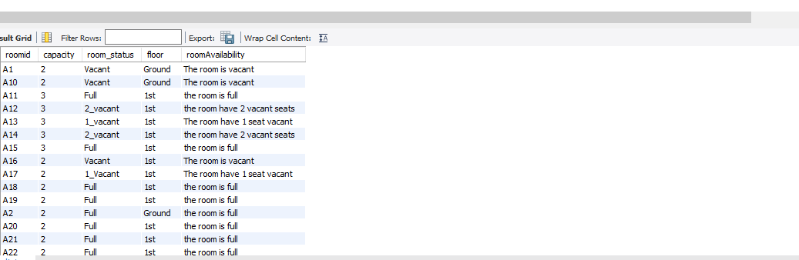
Reports
Check Fee Status of particular student
Checking Room availability of particular Block

Slide 9
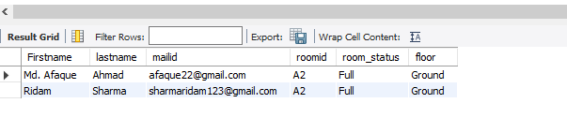
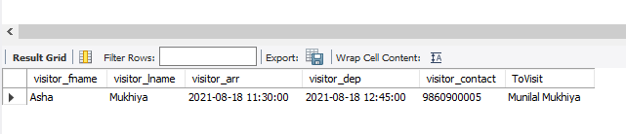
Check student on particular room
Visitor information with name of student whom they visit

Slide 10
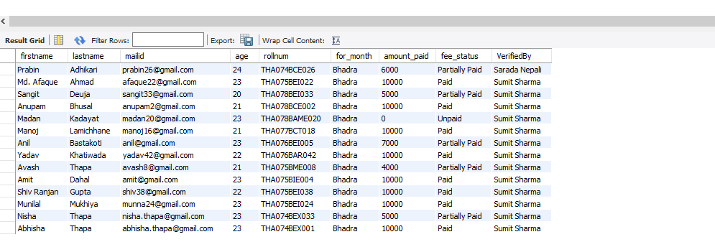
View with use of student,fee and accountant table

Slide 11

Conclusion
With a lot of improvement to made along with lots of knowledge and learning opportunity we carried out this project.
So we want to thank our supervisor Er. Rama Bastola madam for providing us this great opportunity.

