Slide 1
PYTHON 3

Slide 2
BASIC SYNTAX

Slide 3
Python is an interpreted language
You can write programs interactively using the interpreter
You can also write scripts
File extention will be .py [eg. demo.py]
In console the script can be run by python command

Slide 4
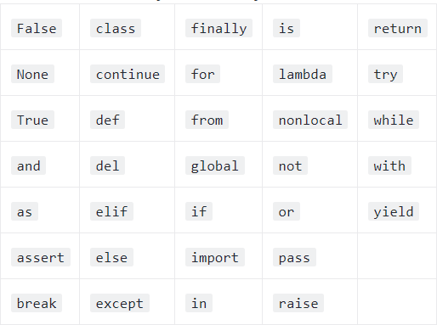
Python Basic Concepts
Identifier
Reserved Words
33 keywords

Slide 5
Lines and Indentation
No semicolon needed at the end of lines
Python does not use braces({}) to indicate blocks of code
Blocks of code are denoted by line indentation
The number of spaces in the indentation is variable, but all statements within the block must be indented the same amount.
A single code block is also called suites
in Python

Slide 6
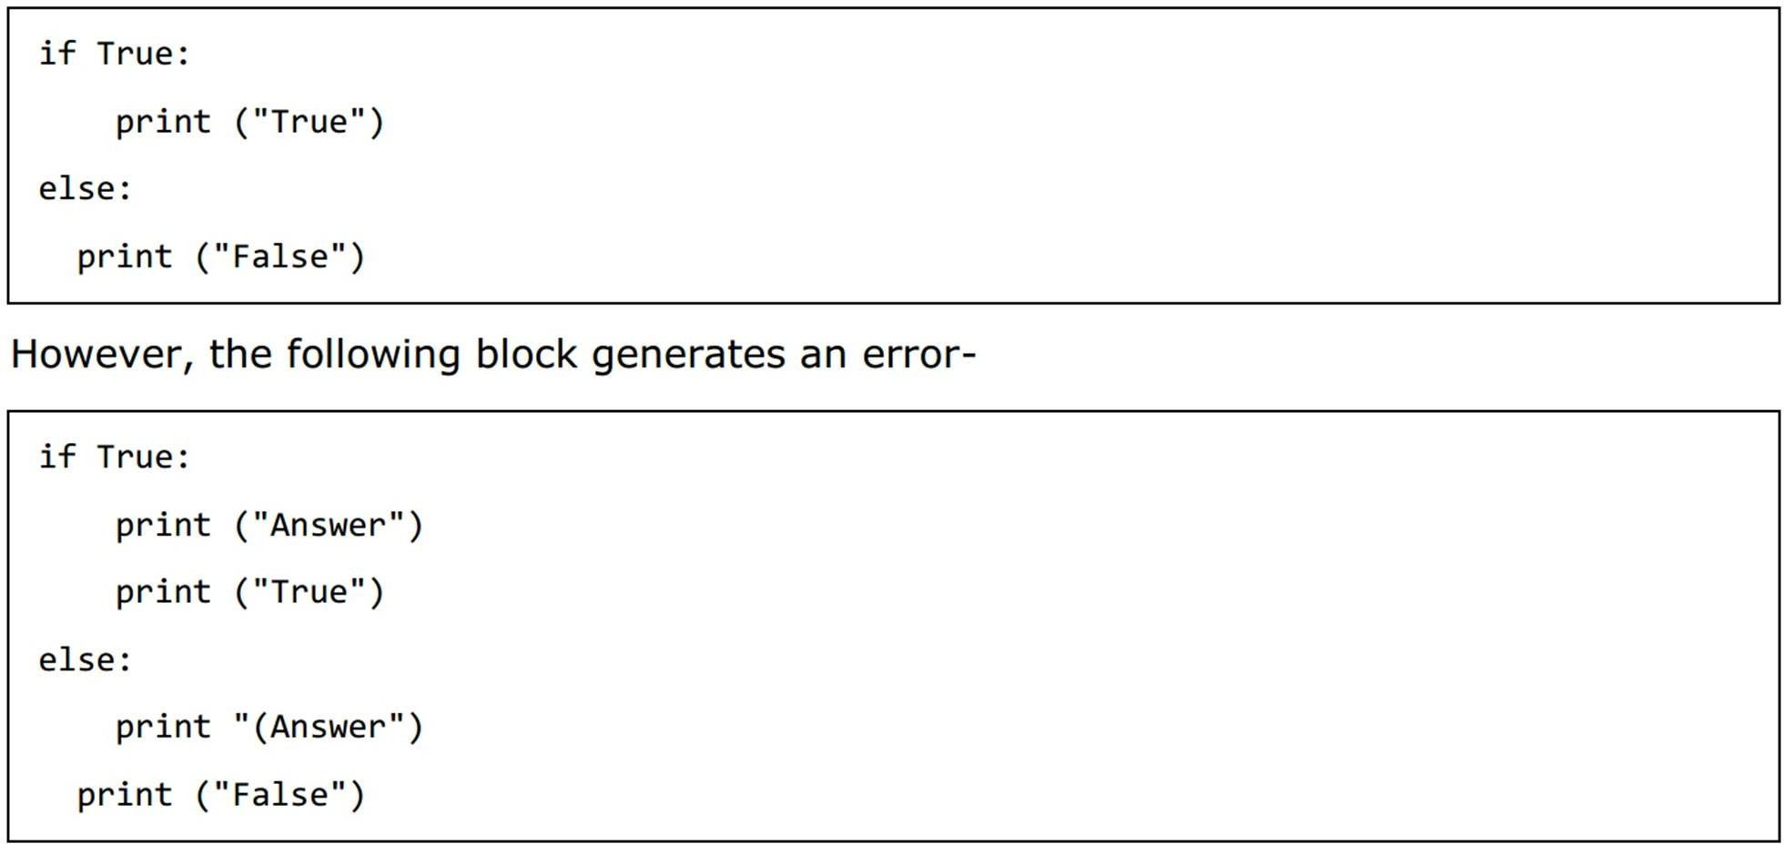
Indentation

Slide 7
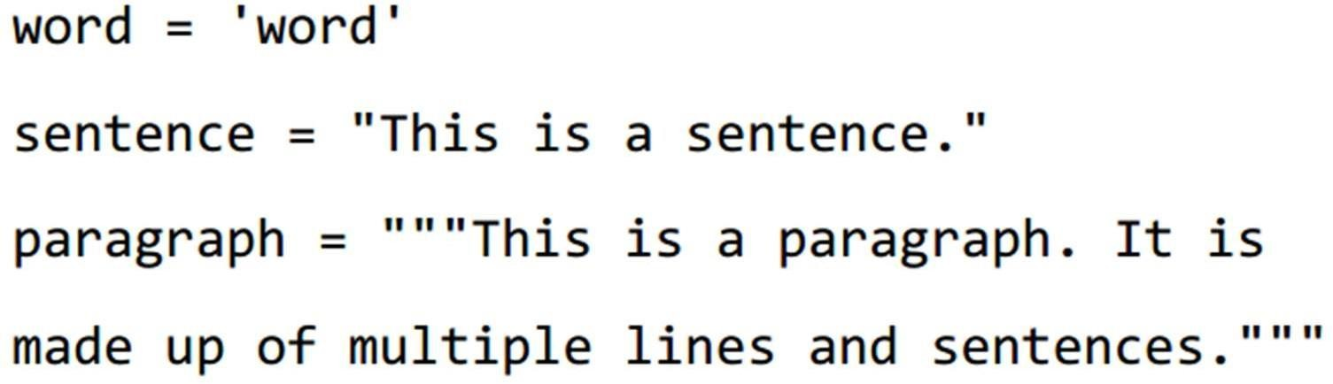
Quotation in Python
Python accepts single ('), double (") and triple (''' or """) quotes to denote string literals
the same type of quote must start and end the string.
The triple quotes are used to span the string across multiple lines.

Slide 8
Comments
Single line comment: #comment
Triple quotes can be utilized for multiple-line commenting.

Slide 9
User Input
input()
– takes the next line from console
input("\n\nPress the enter key to exit.")
By default, input is a string.
n = int(input()) # casts to int

Slide 10
Multiple Statements on a Single Line
The semicolon ( ; ) allows multiple statements on a single line

Slide 11
Print
print(“String”, end = ‘’)#doesnt print \n after string

Slide 12
Multiple Assignment
Python allows you to assign a single value to several variables simultaneously
a = b = c = 1
a, b, c = 1, 2, "john"

Slide 13
VARIABLE TYPES

Slide 14
Standard Data Types
Python has five standard data types-
Numbers
String
List
Tuple
Dictionary
No data type for characters
A character is just a string of length 1
To find out the type of a object: type(var)

Slide 15
Numerical Types
Python supports three different numerical types −
int (signed integers)
You can store arbitrary large values
float (floating point real values)
complex (complex numbers)
A complex number consists of an ordered pair x + yj, where x and y are real numbers and j is the imaginary unit.

Slide 16

Strings
A contiguous set of characters represented in the quotation marks.
Python allows either pair of single or double quotes.
It also has a multiline triple quote
“““ STRING ”””
Strings are immutable in Python.

Slide 17
Lists
Most versatile among the compound data types
A list contains items separated by commas and enclosed within square brackets ([1,2, “String”, ‘a’ ])
Mostly like C arrays, however can contain items of different types

Slide 18
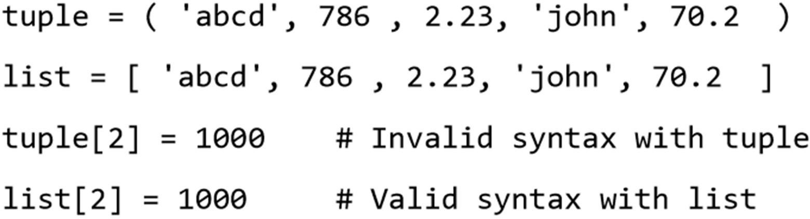
Python Tuples
A tuple consists of a number of values separated by commas and enclosed within parenthesis.
Unlike List Tuples can not be updated.
– They are read only

Slide 19
Common Operations/Functions on List, String, and Tuple
Slicing: To get substrings, subLists ,or a single element the slice operator ([ ] and [:] ) is used
indexes starts at 0 in the beginning
[inclusive:exclusive]
The plus (+) sign is the concatenation operator
The asterisk (*) is the repetition operator
len() function returns the length

Slide 20
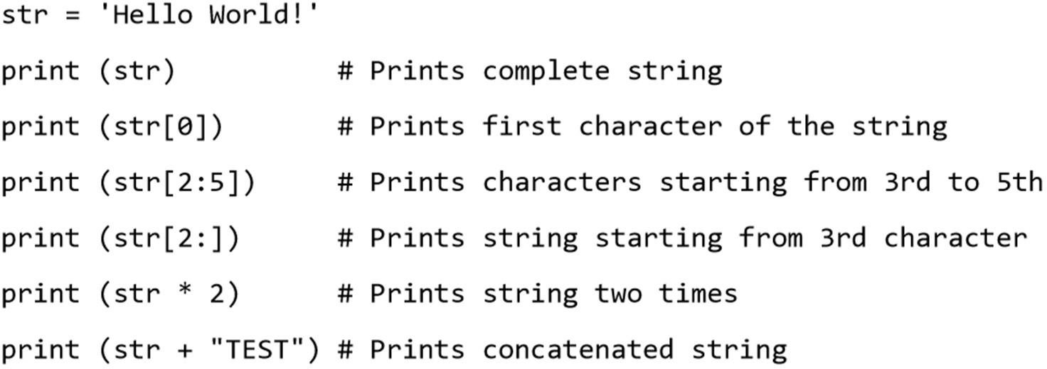
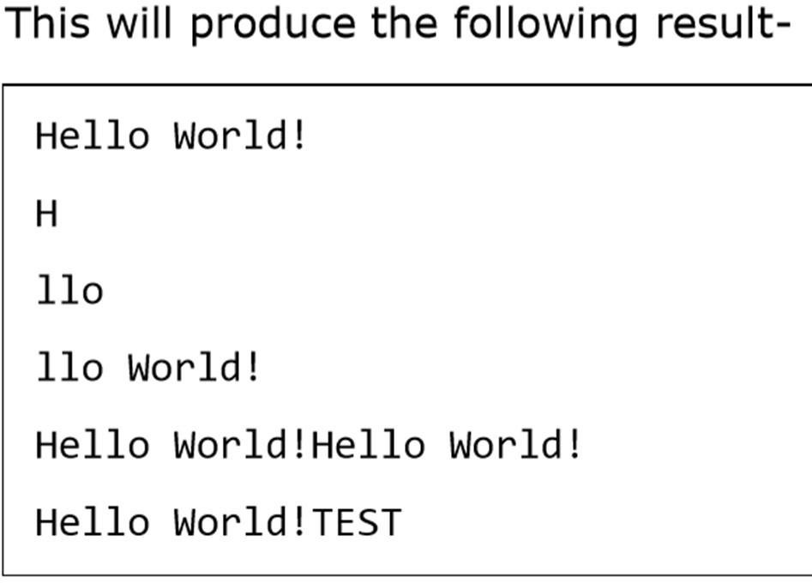
Example

Slide 21
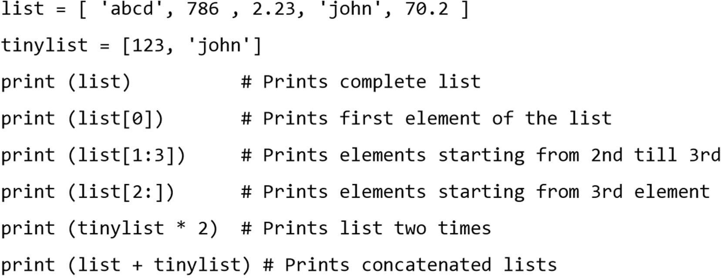
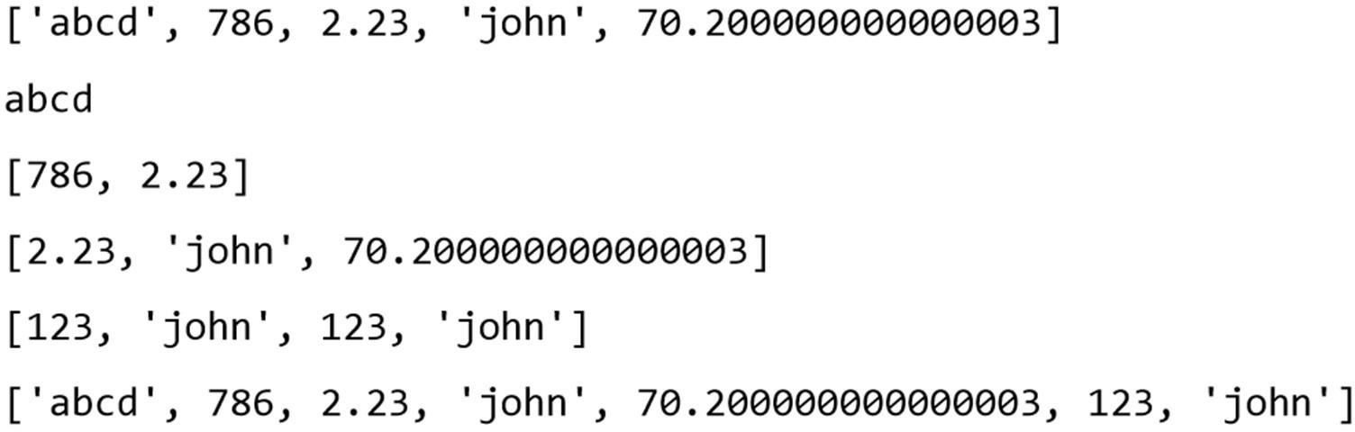
Example
Output

Slide 22
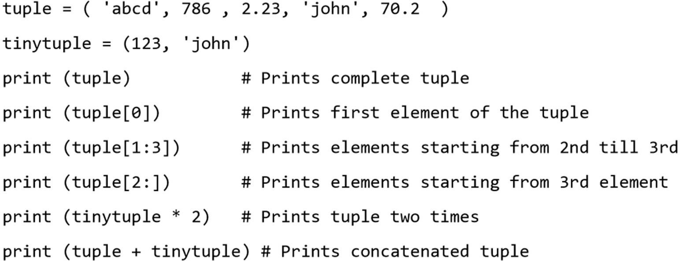
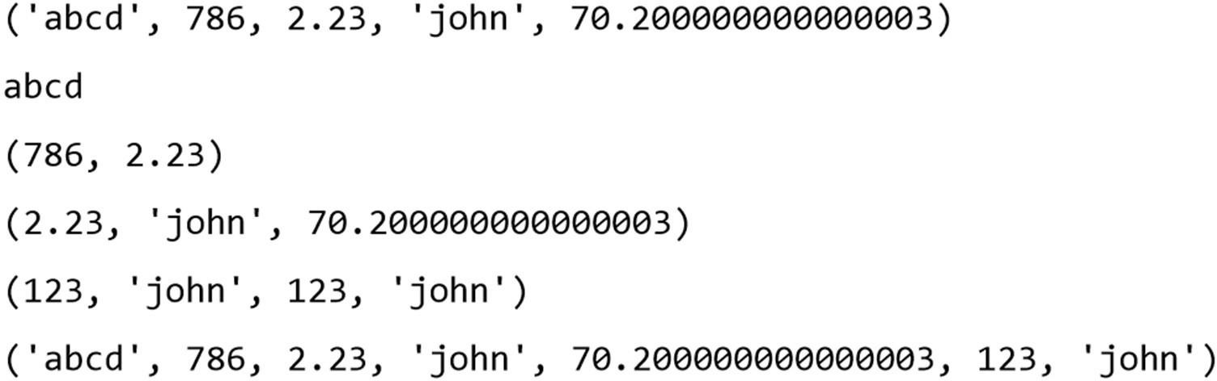
Example
Output

Slide 23
Python Dictionary
Dictionaries can hold key-value pairs.
Similar to Map
A dictionary key can be almost any Python type, but are usually numbers or strings.
Values, on the other hand, can be any arbitrary Python object
Have no notion of order in data
Dictionaries are enclosed by curly braces ({ })
Values can be assigned and accessed using square braces ([])

Slide 24
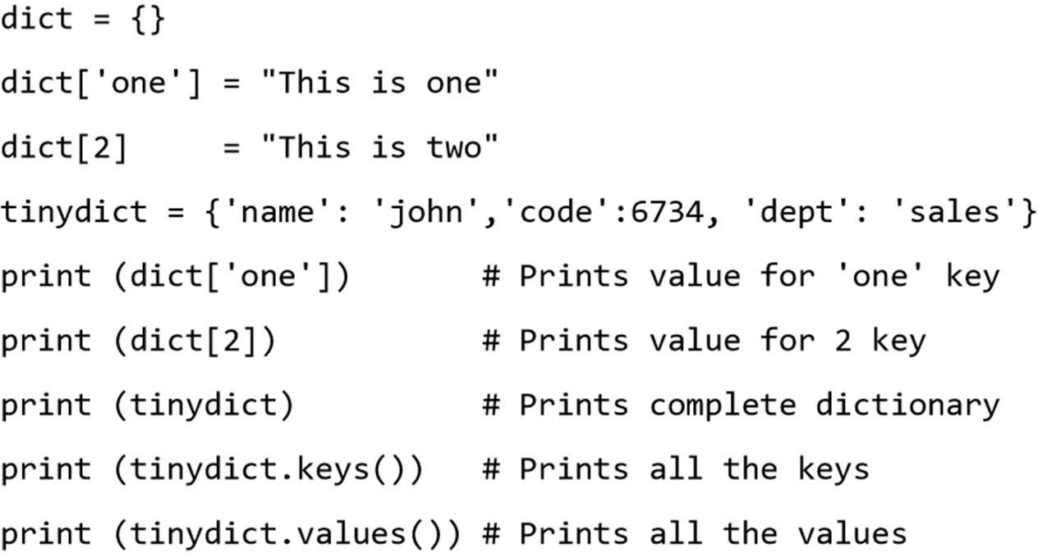
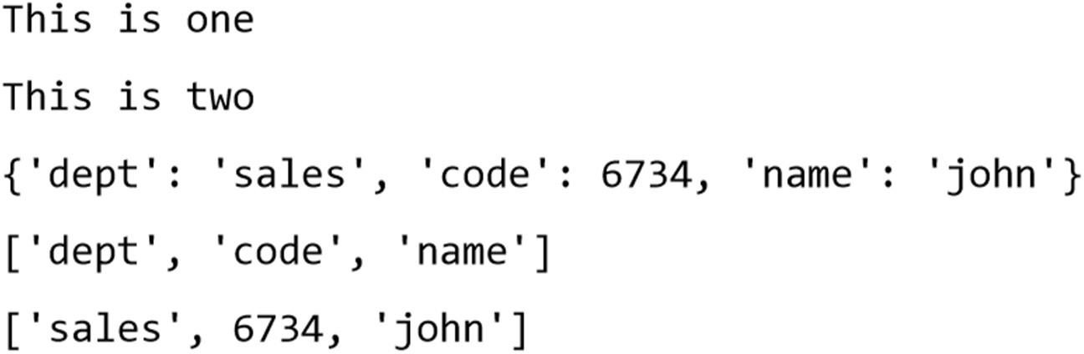
Example
Output

Slide 25
Data Type Conversion
To convert between the built-in types, simply use the type-name as a function.
int(x [,base])
– Converts x to an integer. The base (optional) specifies the base if x is a string.
float(x), complex(real [,imag]), str(), chr()
tuple(), list(), dict(), set()

Slide 26
BASIC OPERATORS

Slide 27
Operator Types
Arithmetic Operators
Comparison (Relational) Operators
Assignment Operators
Logical Operators
Bitwise Operators
Membership Operators
Identity Operators
Most are similar to C/Java
– except Logical Operators

Slide 28
Arithmetic Operators
• + - * / %
** : power/ exponent
– 3**2 == 9
// : integer/floor division
– 9//2 = 4, 9.0//2.0 = 4.0
no x++ or x--

Slide 29
Comparison Operators
• ==
!=
>
<
>=
<=

Slide 30
Assignment Operators
• =
• +=
-=
*=
/=
%=
**=
//=

Slide 31
Bitwise Operators
&
|
^
~
<<
>>

Slide 32
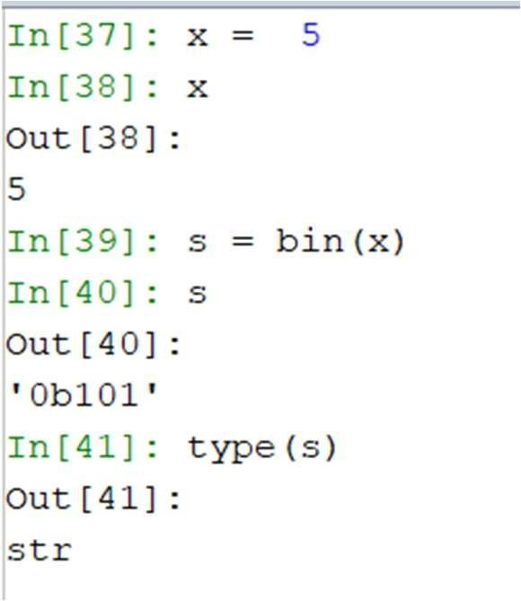
Bitwise Operators
bin()
– used to obtain binary representation of an integer number.

Slide 33
Logical Operators
and
or
not
These operators are UNLIKE C, C++ or Java

Slide 34
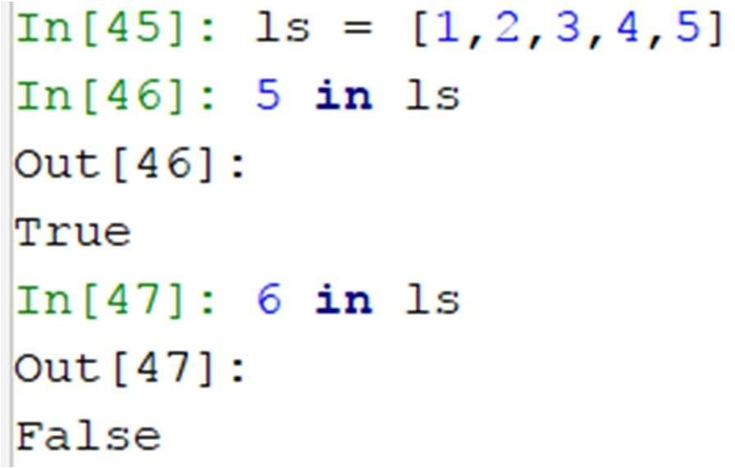
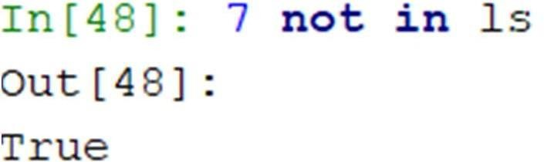
Python Membership Operators
Python’s membership operators test for membership in a sequence, such as strings, lists, or tuples.
in
not in

Slide 35
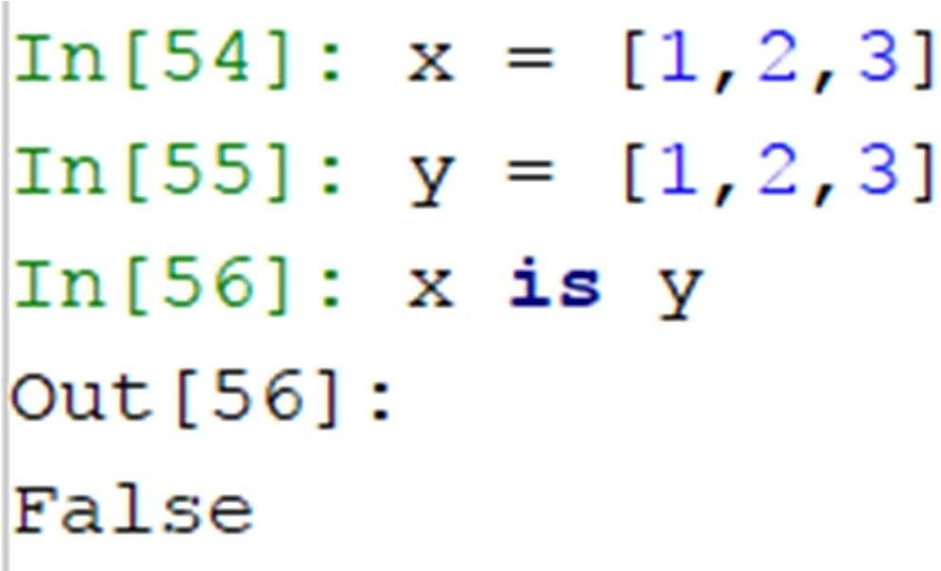
Python Identity Operators
Identity operators compare the memory locations of two objects
is
not is

Slide 36
CONDITIONAL STATEMENTS

Slide 37
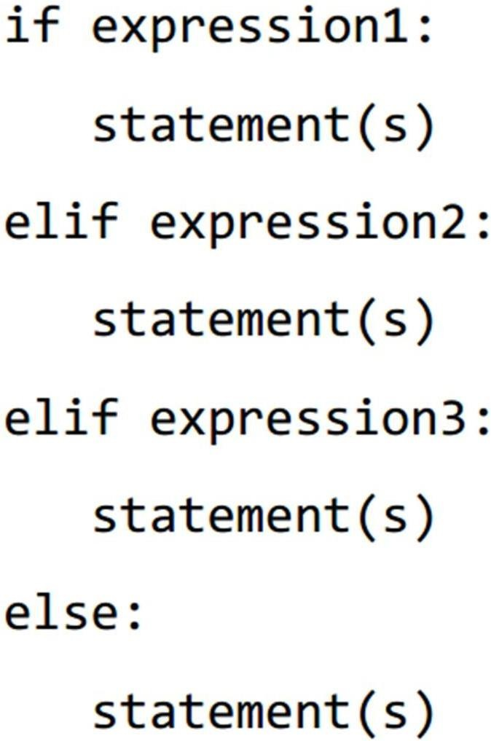
If - Else

Slide 38
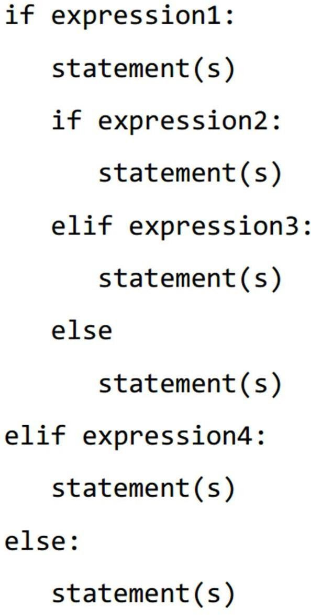
Nested If
:

Slide 39
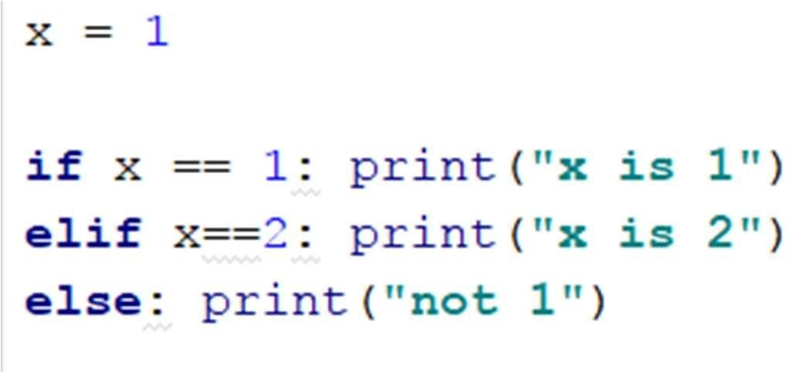
Single Line If-Else

Slide 40
LOOPS

Slide 41
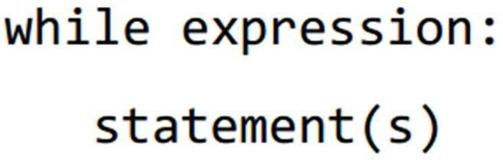
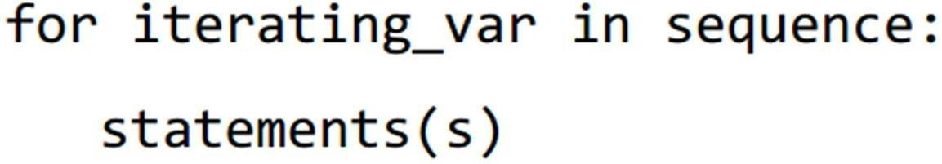
Loops
while

Slide 42
Range
The built-in function range() is used to iterate over a sequence of numbers.
range() generates an iterator to progress integers starting with 0 upto n-1
– memory efficient
To obtain a list object of the sequence, it is typecasted to list()

Slide 43
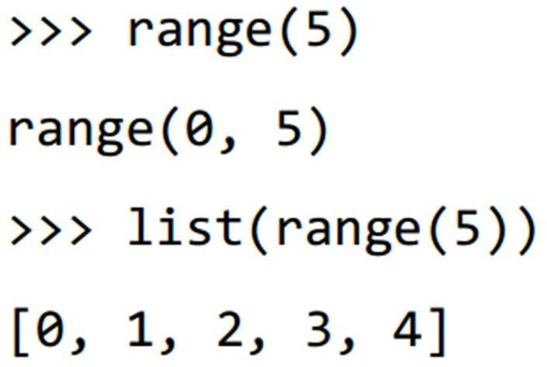
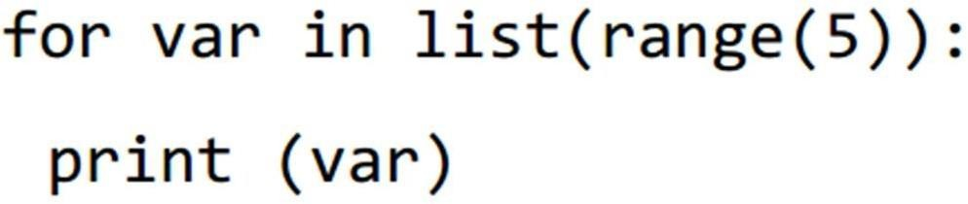
Range

Slide 44
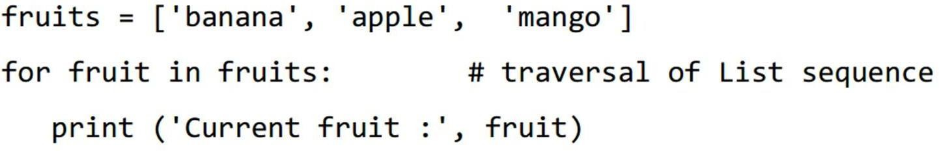
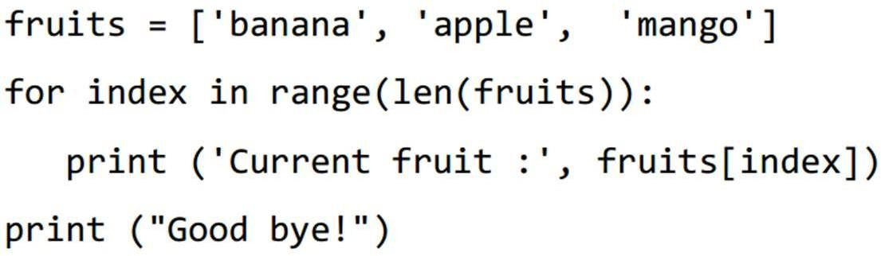
Range

Slide 45
Else in Loops
Python supports having an else statement associated with a loop statement.
If the else statement is used with a for loop, the else block is executed only if for
loops terminates normally (and not by
encountering break statement)
If the else statement is used with a while loop, the else statement is executed when the condition becomes false

Slide 46
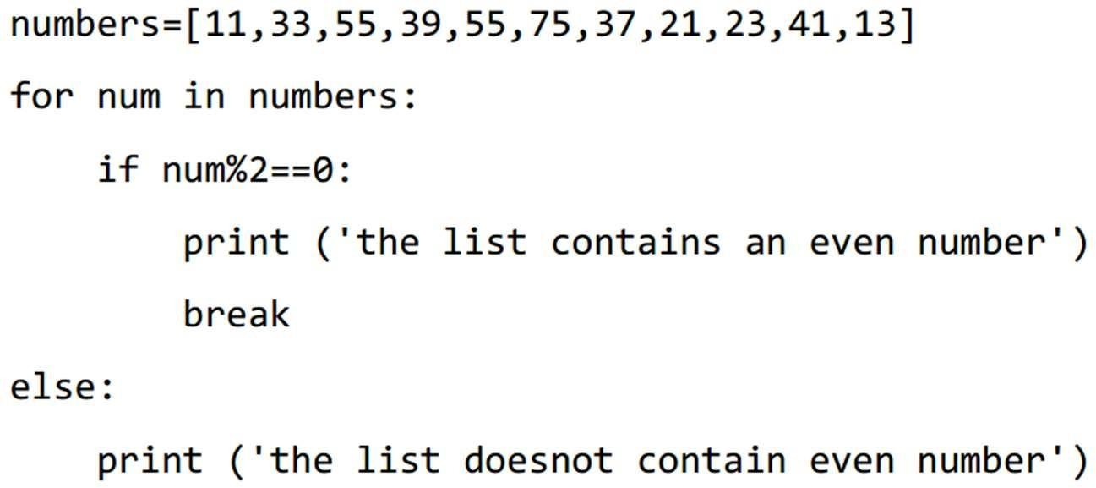
Loops

Slide 47
Loop Control Statements
break
continue
pass
The pass statement is a null operation; nothing happens when it executes.
The pass statement is also useful in places where your code will eventually go, but has not been written yet i.e. in stubs)

Slide 48
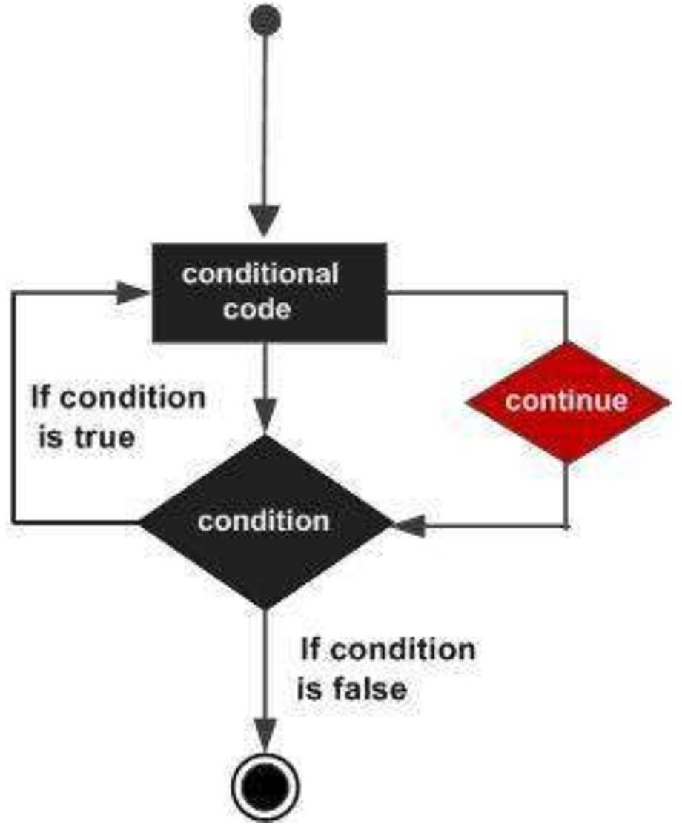
Continue

Slide 49
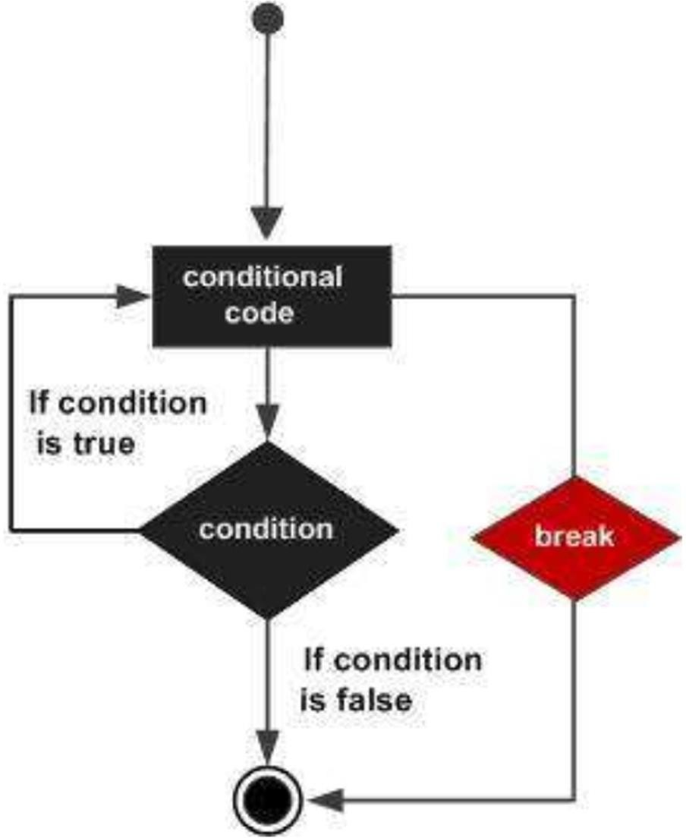
Break

Slide 50
FUNCTIONS

Slide 51
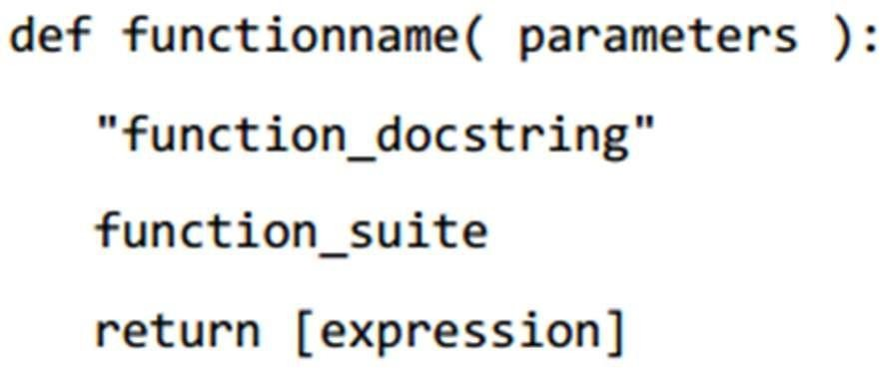
Structure
parameters can also be defined inside the parentheses
The first statement of a function can be an optional statement - the documentation string of the function or docstring.
A return statement with no arguments is the same as return None
Can also be eliminated

Slide 52
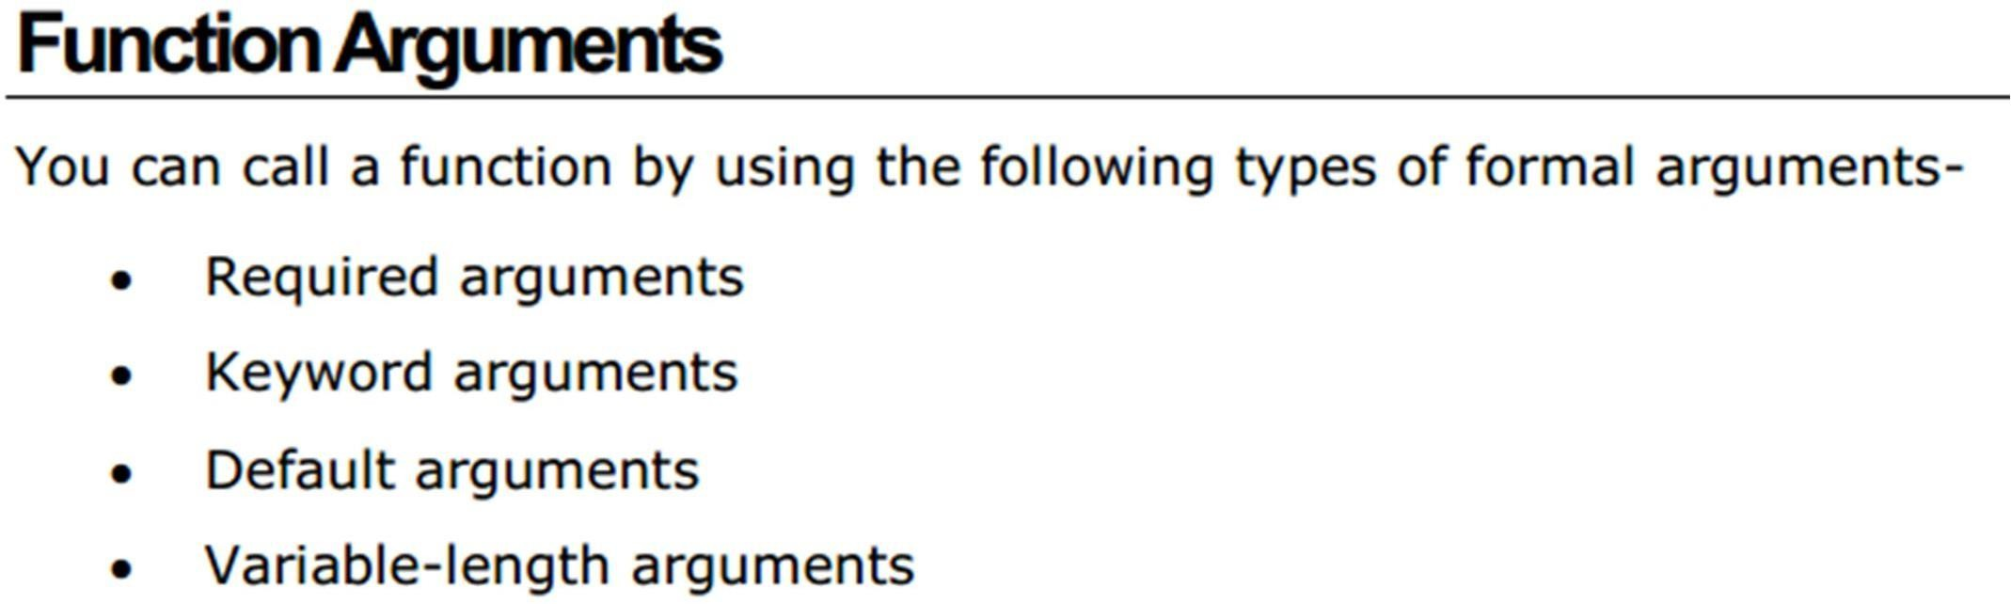

Slide 53
Required Arguments
Required arguments are the arguments passed to a function in correct positional order.
– typical parameters like C
The number of arguments and their order in the function call should match exactly with the function definition.

Slide 54
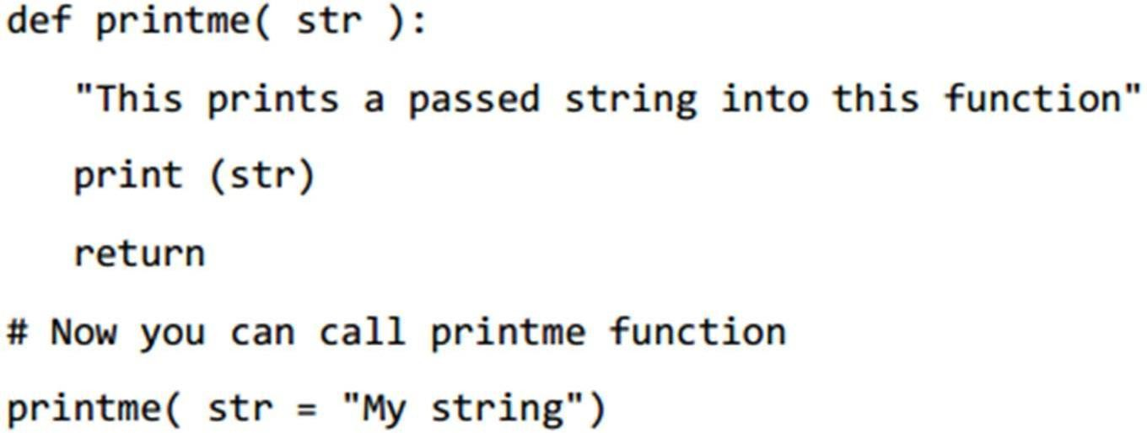
Keyword Arguments
Used to pass arguments by the parameter name.
This allows to skip arguments or place them out of order

Slide 55
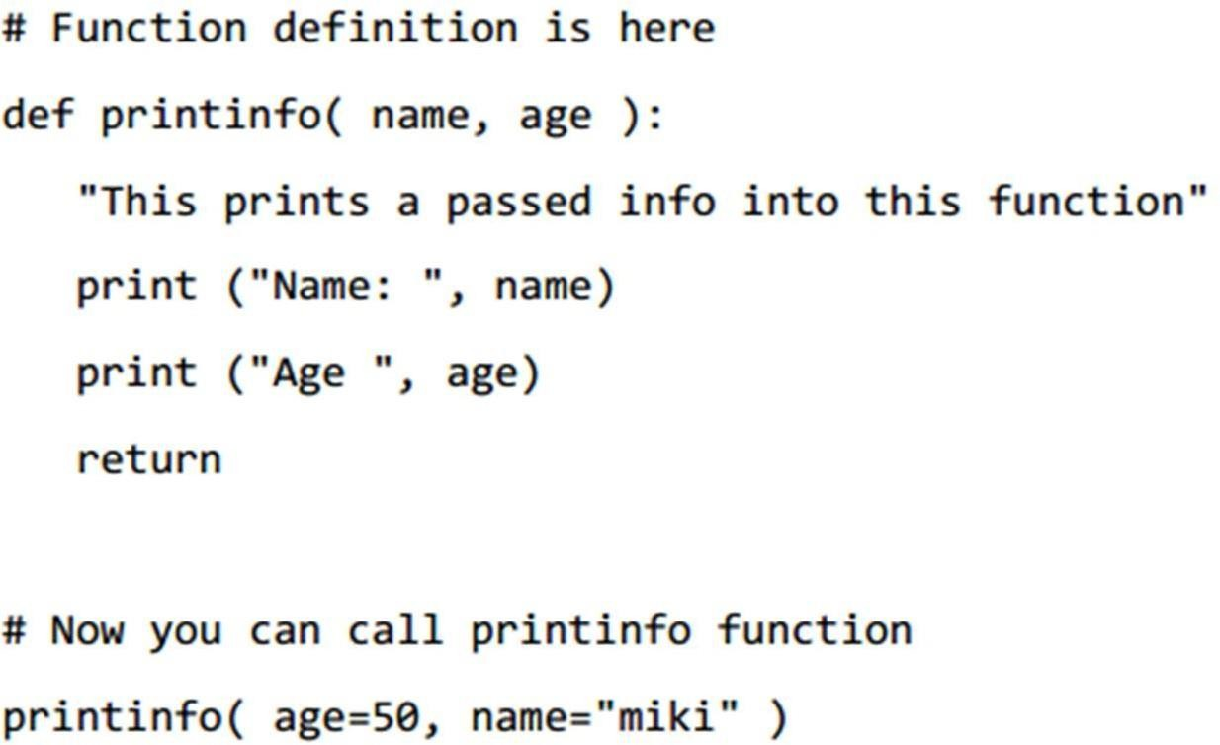

Slide 56
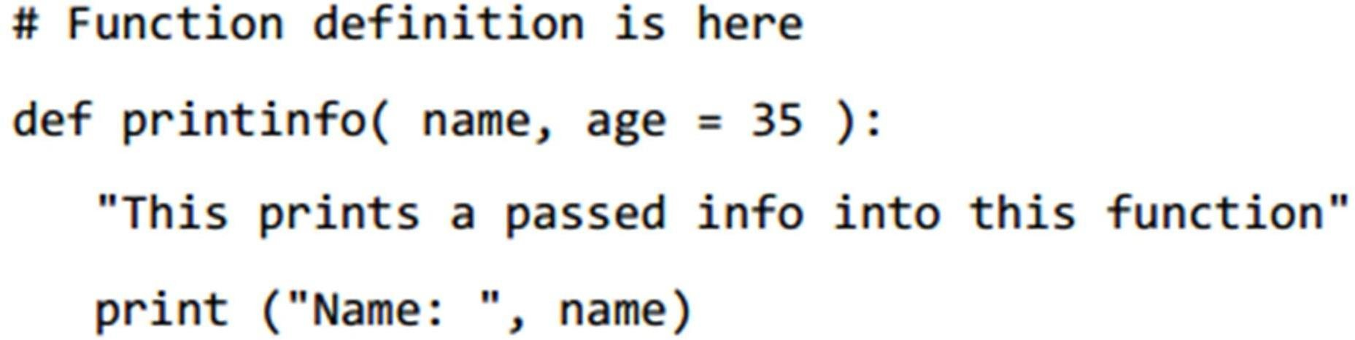
Default Arguments

Slide 57
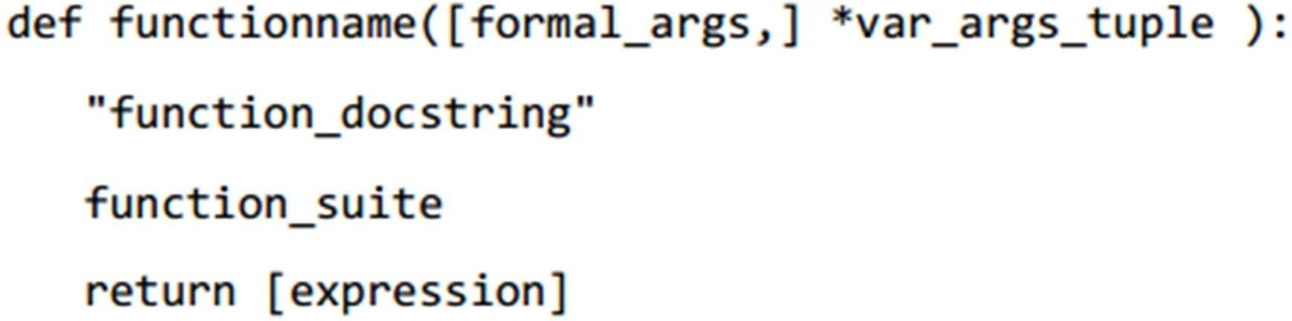
Variable-length Arguments
variable-length arguments and are not named in the function definition, unlike required and default arguments.

Slide 58
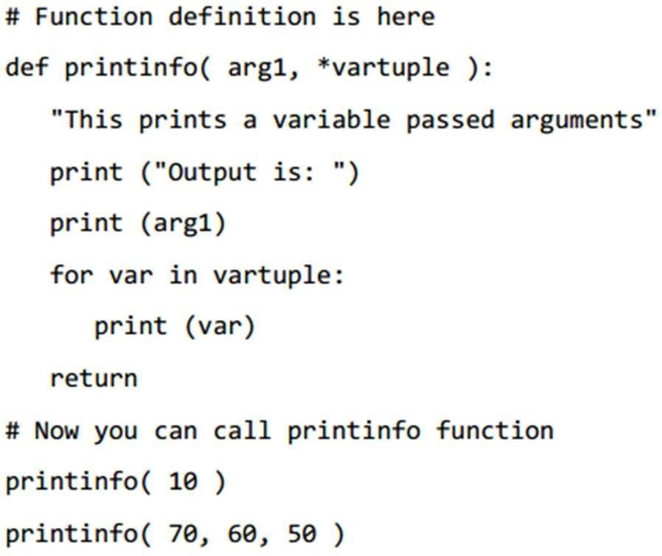
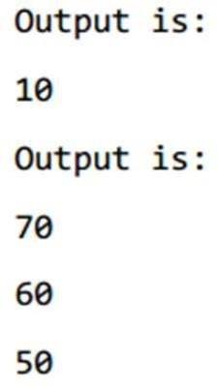
Example

Slide 59
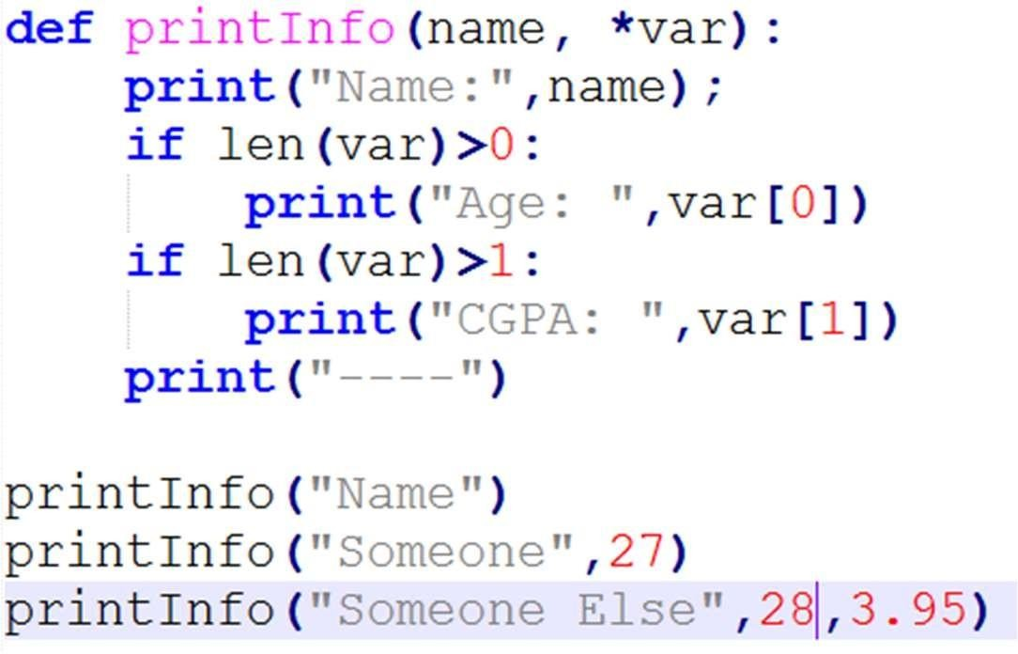
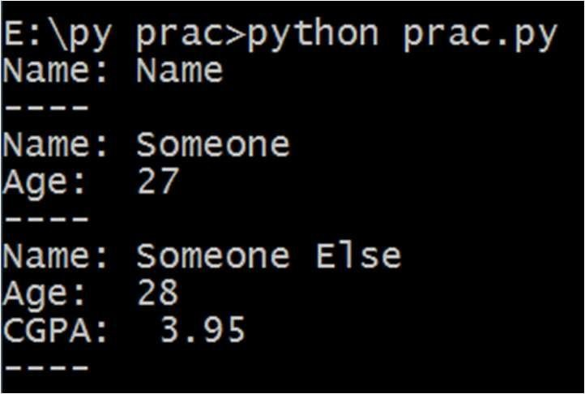
Example

Slide 60
Scope of Variables
There are two basic scopes of variables in Python-
global variables
local variables
Variables that are defined inside a function body have a local scope, and those defined outside have a global scope.

Slide 61
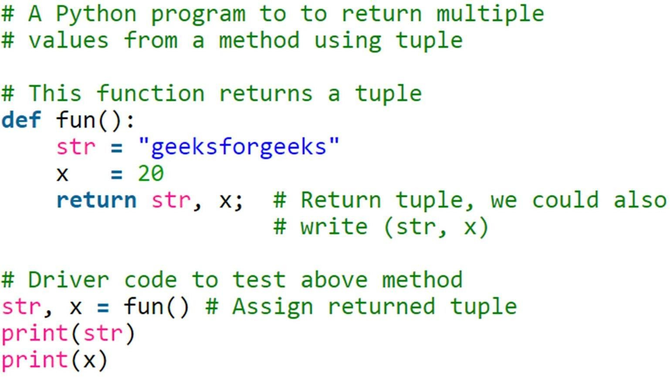
Returning Multiple Values
Can be done using class, tuples, list, or dictionary
Most convenient by tuples

Slide 62
Modules
import <module_name>
import <module_name> as <name>
from <module_name> import <func>

Slide 63
Examples
import math as mt
a= 10
print(mt.sqrt(10))
from math import sqrt
a= 10
print(sqrt(10))

