Slide 1
PROJECT TITLE
CAPSTONE PROJECT
Presented By:
1. DIPSIKHA BHAUMIK – HERITAGE INSTITUTE OF TECHNOLOGY (CSE-DATA SCIENCE DEPARTMENT)

Slide 2
OUTLINE
Problem Statement (Should not include solution)
Proposed System/Solution
System Development Approach (Technology Used)
Algorithm & Deployment
Result
Conclusion
Future Scope
References

Slide 3
Problem Statement
A Superstore sales data provides insights into customer behavior and sales trends across various product categories and regions. This dataset contains information on order dates, shipping modes, customer segments, product categories, and sales across states and cities. By analyzing this data, we aim to crack the code on peak sales times, best-selling products, and the most loyal customer segments. This will help us predict trends, optimize promotions, and streamline shipping, ensuring customers get what they want when they want it. Our goal? Keep sales high, customers happy, and make shopping at Superstore a fantastic experience!

Slide 4
Proposed Solution
The proposed system aims to address the challenge of optimizing sales strategies and customer satisfaction at Superstore by leveraging data analysis techniques to understand sales trends, identify top-selling products, and analyze customer loyalty. The solution will consist of the following components:
Data Collection:
Gathered the sales data from Kaggle, including order dates, shipping modes, customer segments, product categories, sales amounts, and geographic information.
Data Preprocessing:
Cleaned and preprocessed the collected data to handle missing values, outliers, and inconsistencies.
Performed feature engineering to extract relevant features from the data that might impact sales, such as seasonality, customer demographics, and promotional periods.
Data Analysis:
Analyzed sales trends, seasonality, and top-performing products and segments through time-series analysis.
Evaluated customer loyalty, repeat purchase patterns, and regional sales performance to identify high and low-performing areas.
Insights and Recommendations:
Leverage peak sales periods with targeted promotions and marketing campaigns, and implement customer loyalty programs focusing on high-value segments like the home office.
Increase marketing efforts for top-selling products, expand high-performing sub-categories, and create product bundles to boost average order value.
Deployment:
Ensure the solution is accessible and easy to interpret for decision-makers, considering factors like visualizations, interactive elements, and clear summaries.
Evaluation:
Continuously monitor and evaluate the impact of implemented strategies on sales performance using appropriate metrics such as sales growth, customer retention rates, and average order value.
Adjust and refine strategies based on ongoing analysis and feedback to ensure optimal performance.

Slide 5
System Approach
System requirements :
Windows 11 operating system , 8GB RAM, I3 Processor
IBM Cloud Account to access Watson Studio
Library required to build the model:
Pandas: For data manipulation and preprocessing tasks.
NumPy: For numerical operations and array manipulations.
Matplotlib and Seaborn: For data visualization and creating insightful plots.

Slide 6
Algorithm & Deployment
Data Cleaning and Preprocessing
Handle missing values, outliers, and inconsistencies in the sales dataset.
Exploratory Data Analysis (EDA)
Analyzing seasonal sales patterns: Identifying the dips in sales? Checking whether the dips are consistent in particular months through all the years?
Visualizing top-selling products and segments.
Statistical Analysis
Conducting regional insights: California or New York or Washington, who leads in sales? Which District has lowest sales?
Analyzing shipping preferences and provide any improvements required in that sector.
Segmentation and Customer Insights
Identifying which customer segment drives sales and which segment has the highest loyalty.
Recognizing top-selling sub-categories driving revenue.
Deployment
Used charts and graphs to present findings effectively.
Ensured clear communication of insights to stakeholders.
Planned for ongoing monitoring and refinement of analytics models.

Slide 7
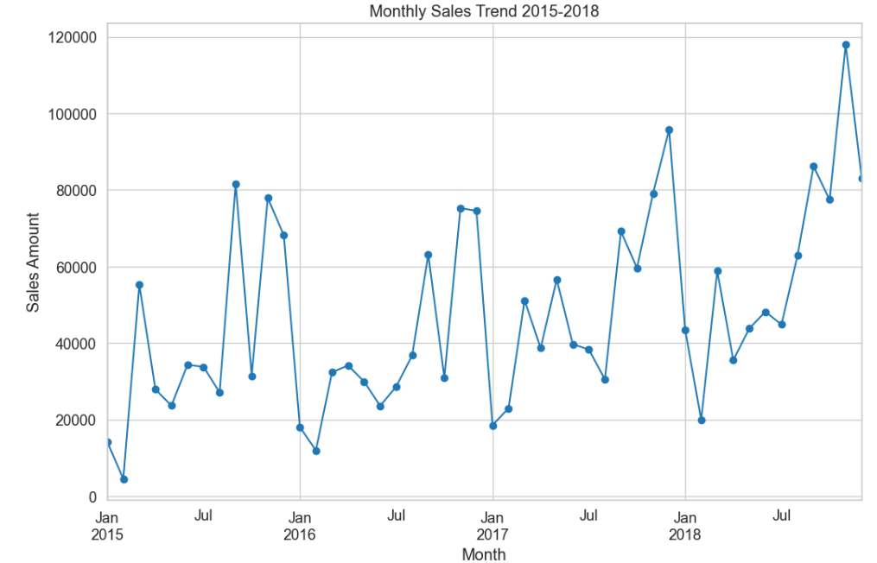
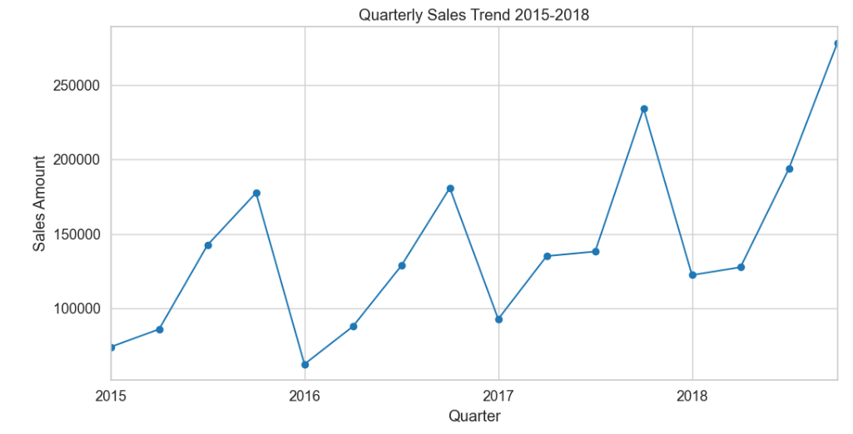
Result
Months with Consistently Lower Sales: January, February, April, May June, July, August Probable causes:
Post-Holiday Slowdown (January and February)
April may experience lower sales due to tax season in the United States.
May to August can be influenced by vacation periods and summer breaks. People may prioritize spending on travel and leisure activities rather than on office supplies and furniture.
Months with Consistently High Sales: March and September, October to December.
Probable causes:
These months often mark the end of fiscal quarters, prompting businesses to make purchases(March and September).
The holiday season drives consumer spending in October to December

Slide 8
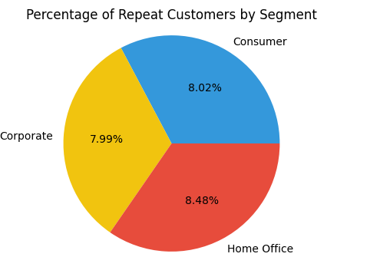
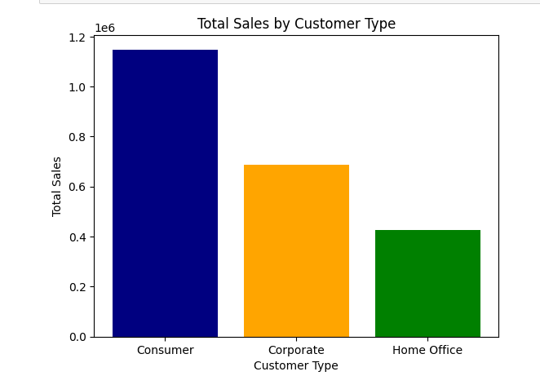
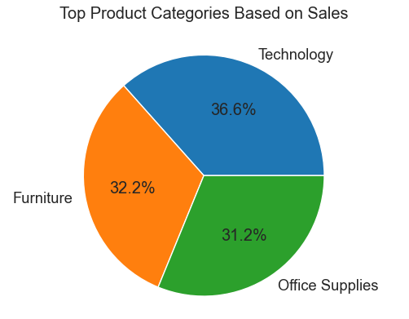
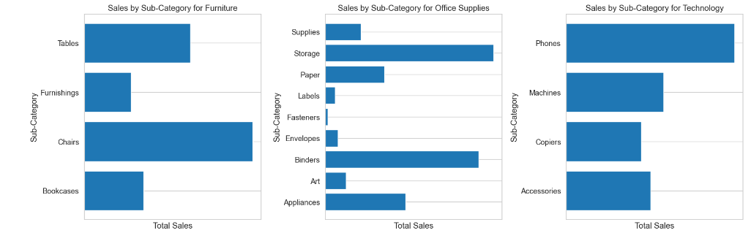
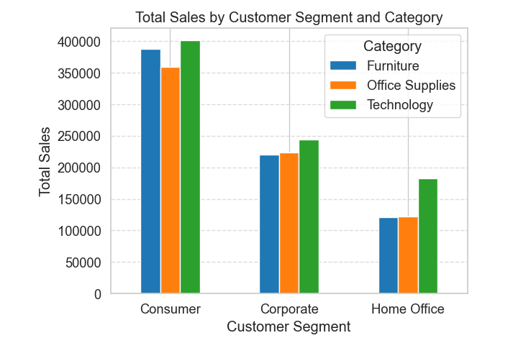
Result
Though the highest number of customers are from the "Consumer" segment, the maximum number of repeat customers are from the "Home office" segment.
Technology is the leading product category.
Highest selling sub-category is phones and lowest selling sub-category is Fasteners.
Technology product segment drives the major sales in all the customer segments. However the Furniture product segment finds a relatively higher demand in Consumer segment.

Slide 9
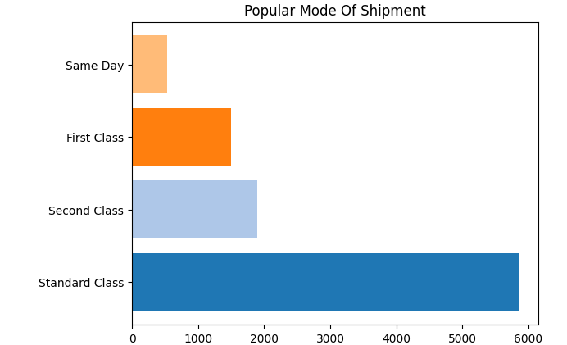
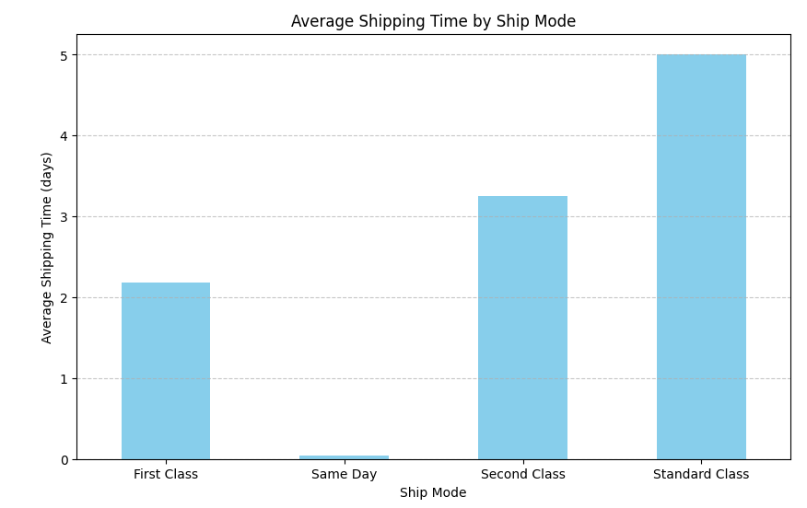
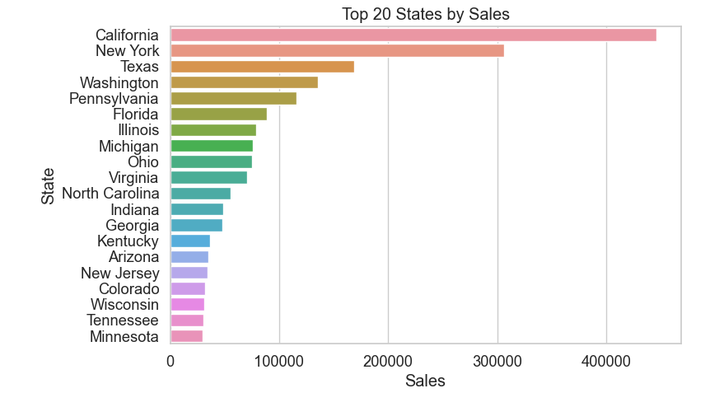
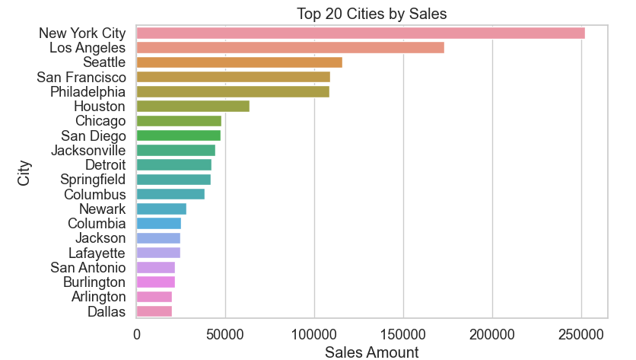
Result
Standard Class is the most preferred mode of shipment but takes the maximum time.
Bar graph that shows the representation of top 20 states and cities with high sales.

Slide 10
Project link
https://github.com/dipsie13/Superstore_Sales_Analysis.git

Slide 11
Conclusion
Findings:
Seasonal Sales: Sales slump after holidays in January and February, pick up in March, September, and during the holiday season.
Top Sellers: Technology rules the sales charts, followed by Office Supplies and Furniture. Phones, Chairs and Copiers, and Binders, Paper, and Storage are customer favorites.
Regional Insights: California, New York, and Washington lead in sales; District of Columbia trails behind. Customers prefer Standard Class shipping for their orders.
Proposed Solution:
Seasonal Promotions: Targeted promotions during peak sales periods (e.g., November and December) can boost revenue and offset slower months.
Customer Loyalty Programs: Implementing tailored loyalty programs for the Home Office segment enhances retention and stimulates repeat purchases, driving sustained sales growth.
Product and Shipping Strategy: Focus on best-selling products like Technology and Furniture, expand within high-performing sub-categories, and optimize Standard Class shipping times to improve customer satisfaction and increase sales conversion rates.

Slide 12
Future scope
Advanced Analytics: Incorporating advanced predictive analytics to forecast demand more accurately and optimize inventory management.
Operational Efficiency: Continuous improvement in logistics and supply chain operations to streamline shipping processes and reduce costs.
Enhanced Customer Insights: Further segmentation of customer data to personalize marketing strategies and promotions.

Slide 13
References
Dataset link: https://www.kaggle.com/datasets/rohitsahoo/sales-forecasting

Slide 14
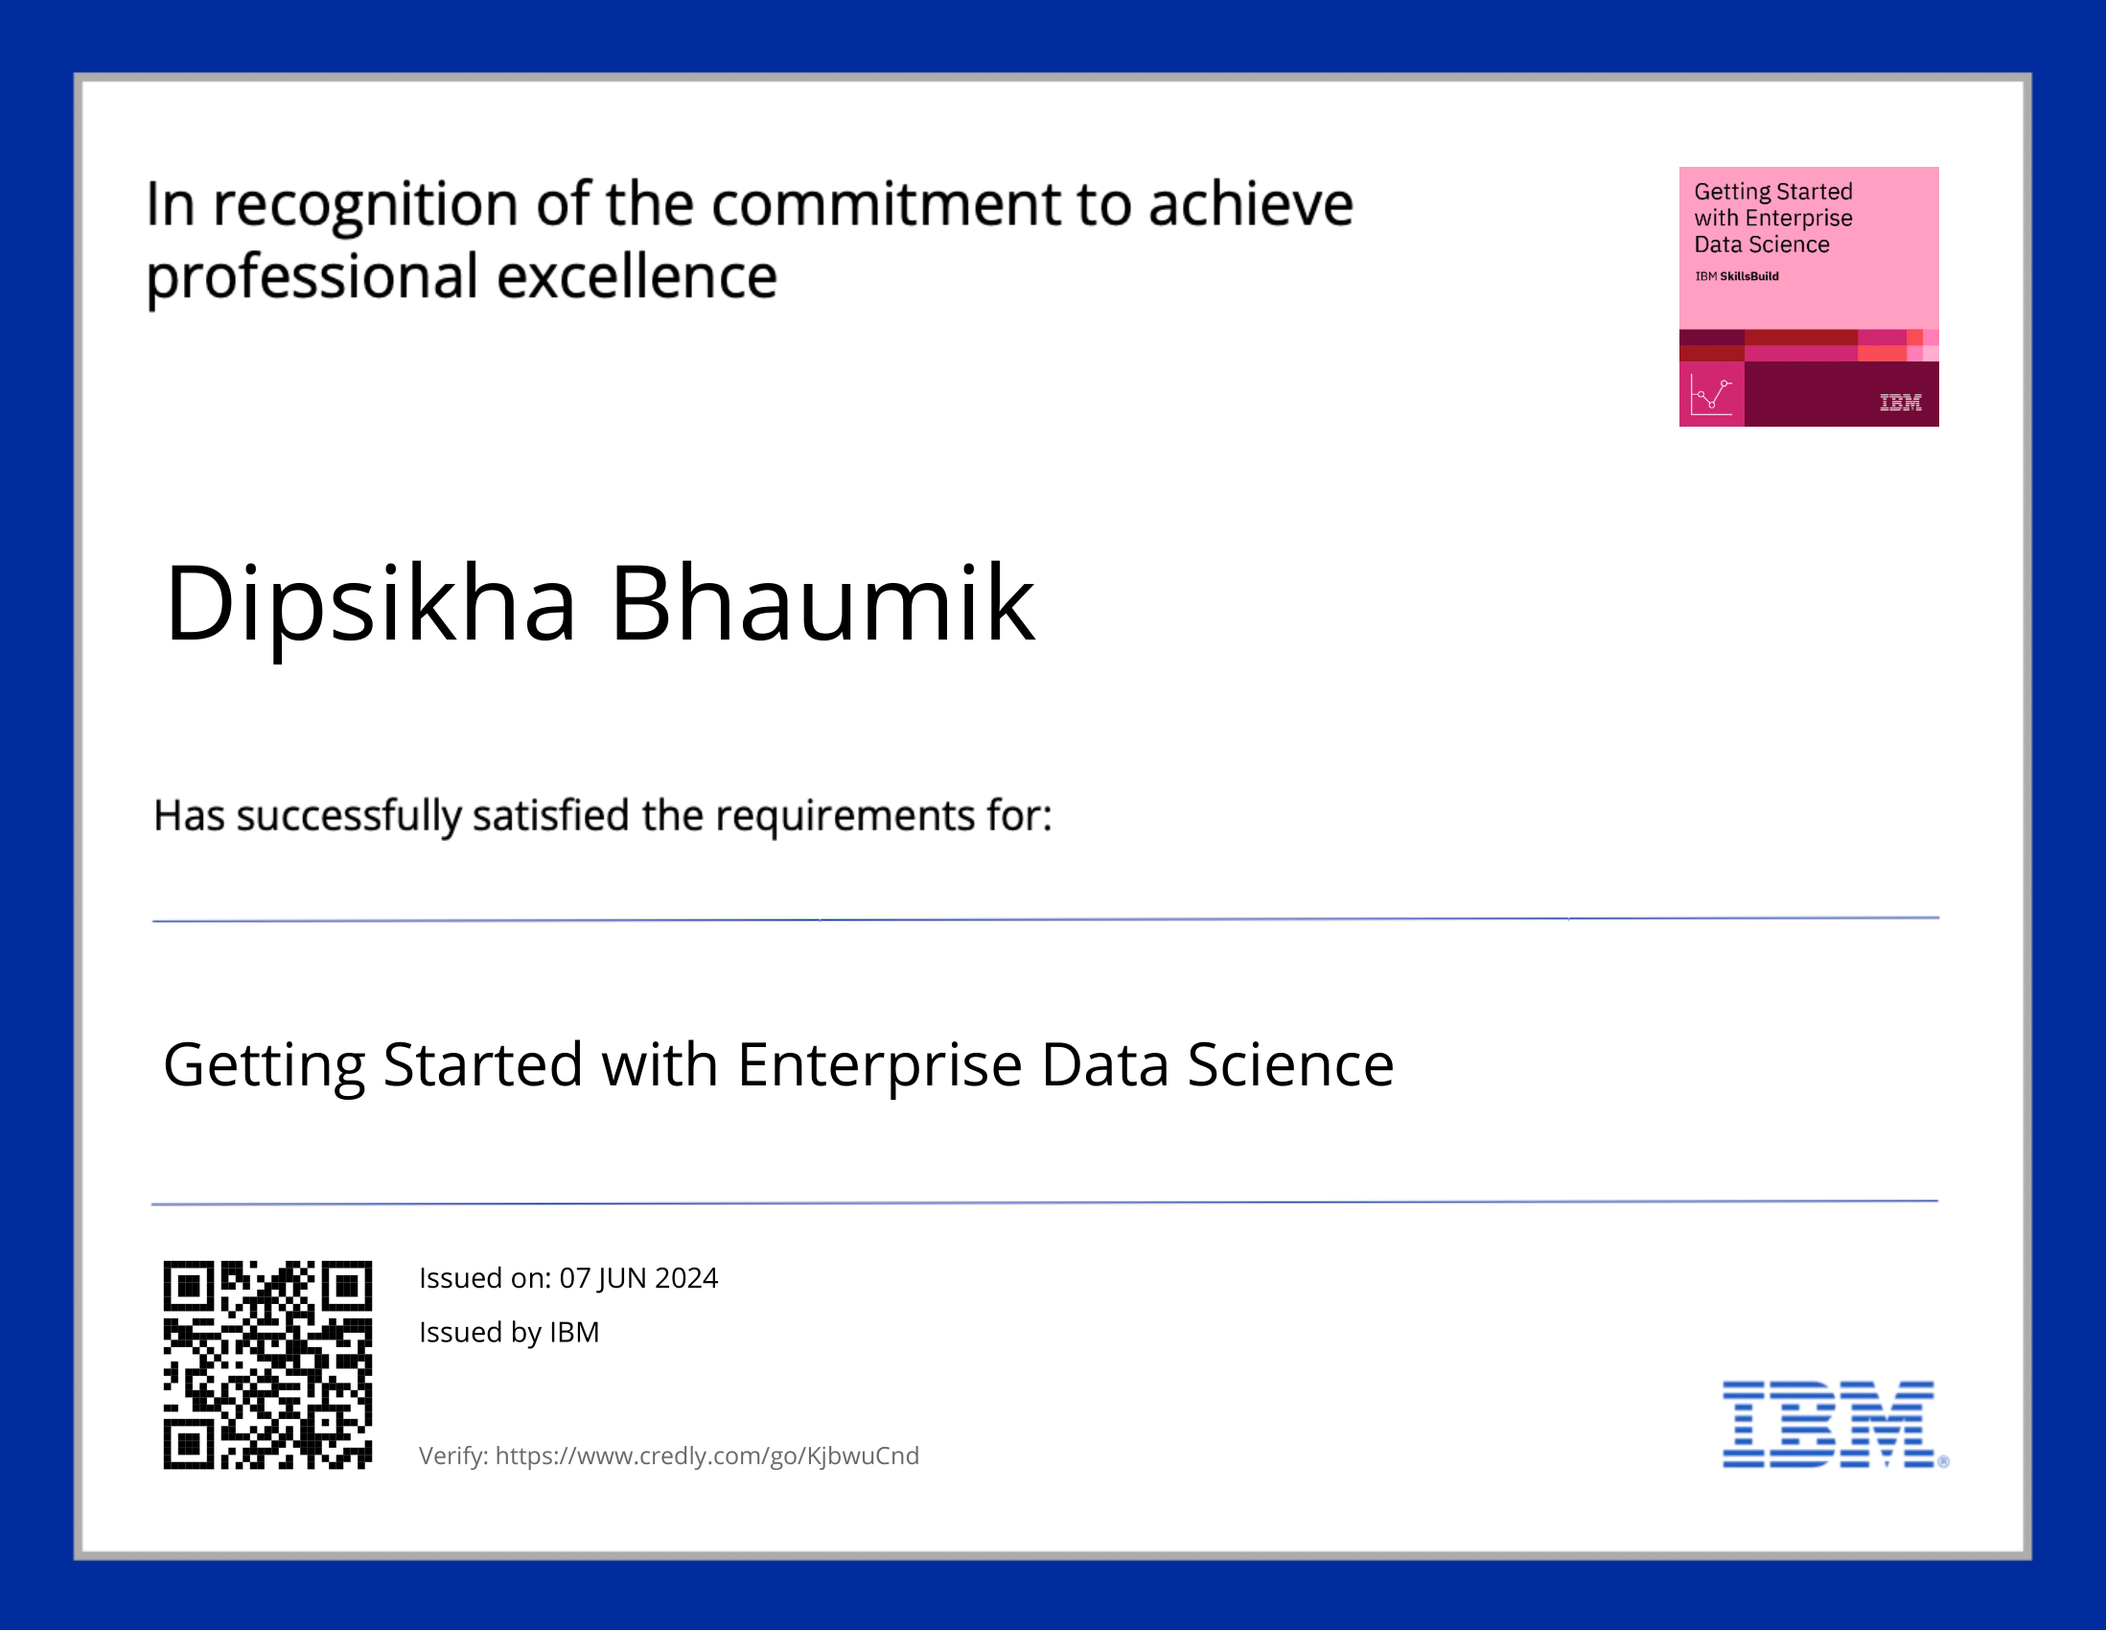
course certificate 1

Slide 15
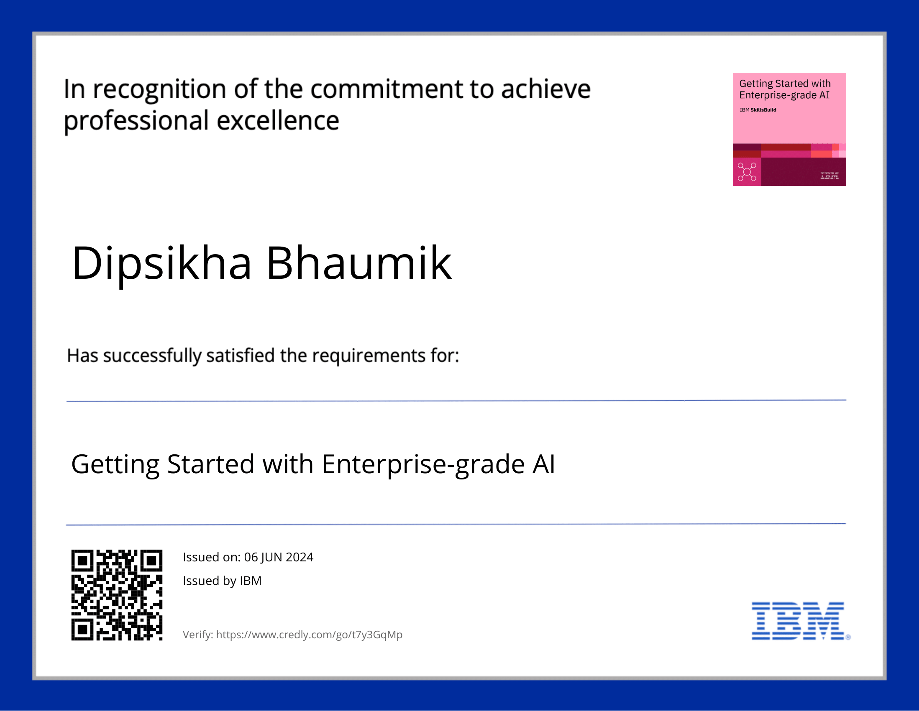
course certificate 2

Slide 16
THANK YOU

