Slide 1
e-Panjeeyan
Android Application
MCA 6th Semester Major Project

Slide 2
Introduction
Currently the interaction with e-Panjeeyan has been carried out through a web portal. As the usage of mobile applications has been growing tremendously, there is a need for a mobile application which can communicate with e-Panjeeyan and facilitate the registration process right from Android phones.
e-Panjeeyan of Revenue & Disaster Management Department, Govt. of Assam, is a user registration system for online deed and marriage registration.
Moreover, users can calculate the fee needed for registration process prior taking an appointment and can also check their appointment status after an appointment is made.

Slide 3
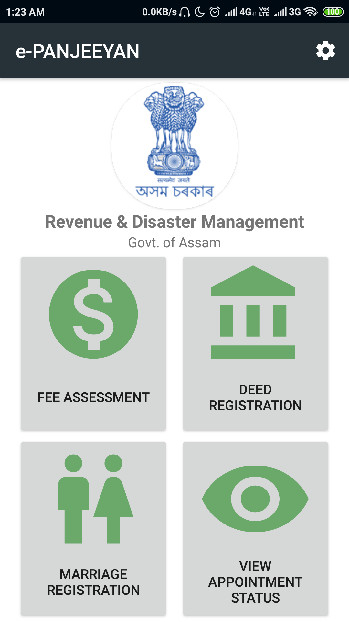
Home Screen
There are mainly four functionalities associated with this app:
Fee Assessment : Check fee prior a deed registration is made
Deed Registration : Make Deed registration
Marriage Registration : Make Marriage registration
View Appointment Status : Check appointment status after a registration is made

Slide 4
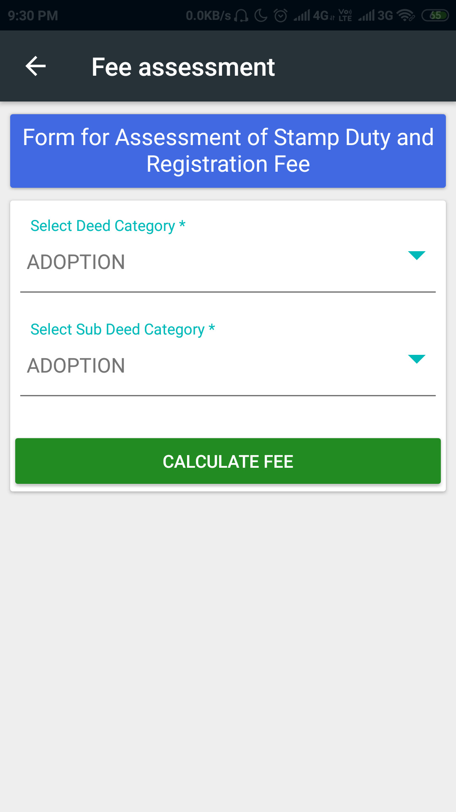
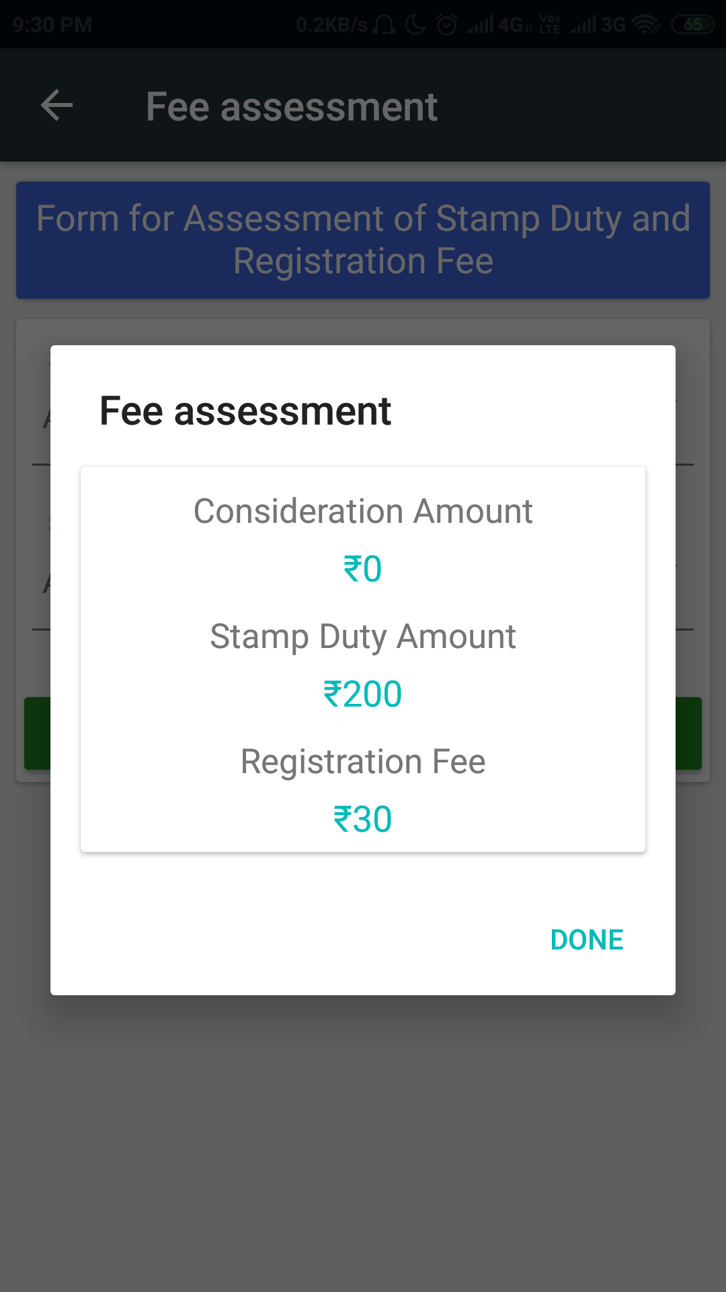
Fee Assessment :

Slide 5
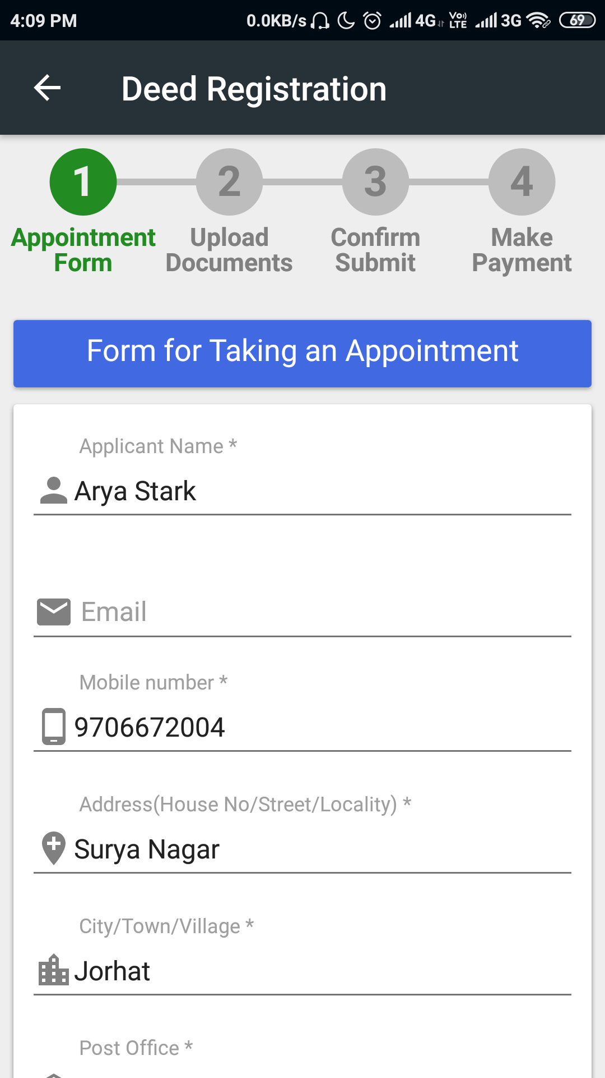
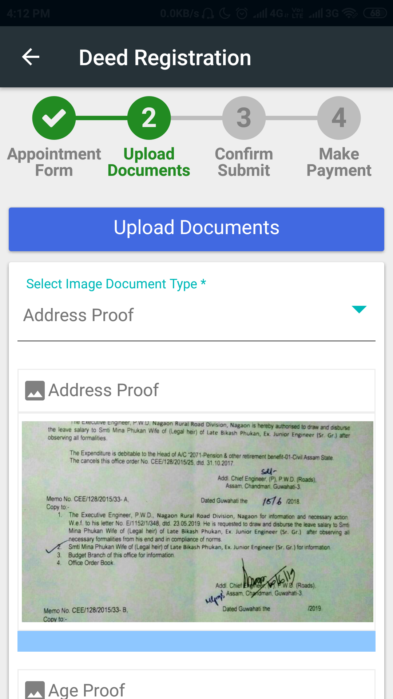
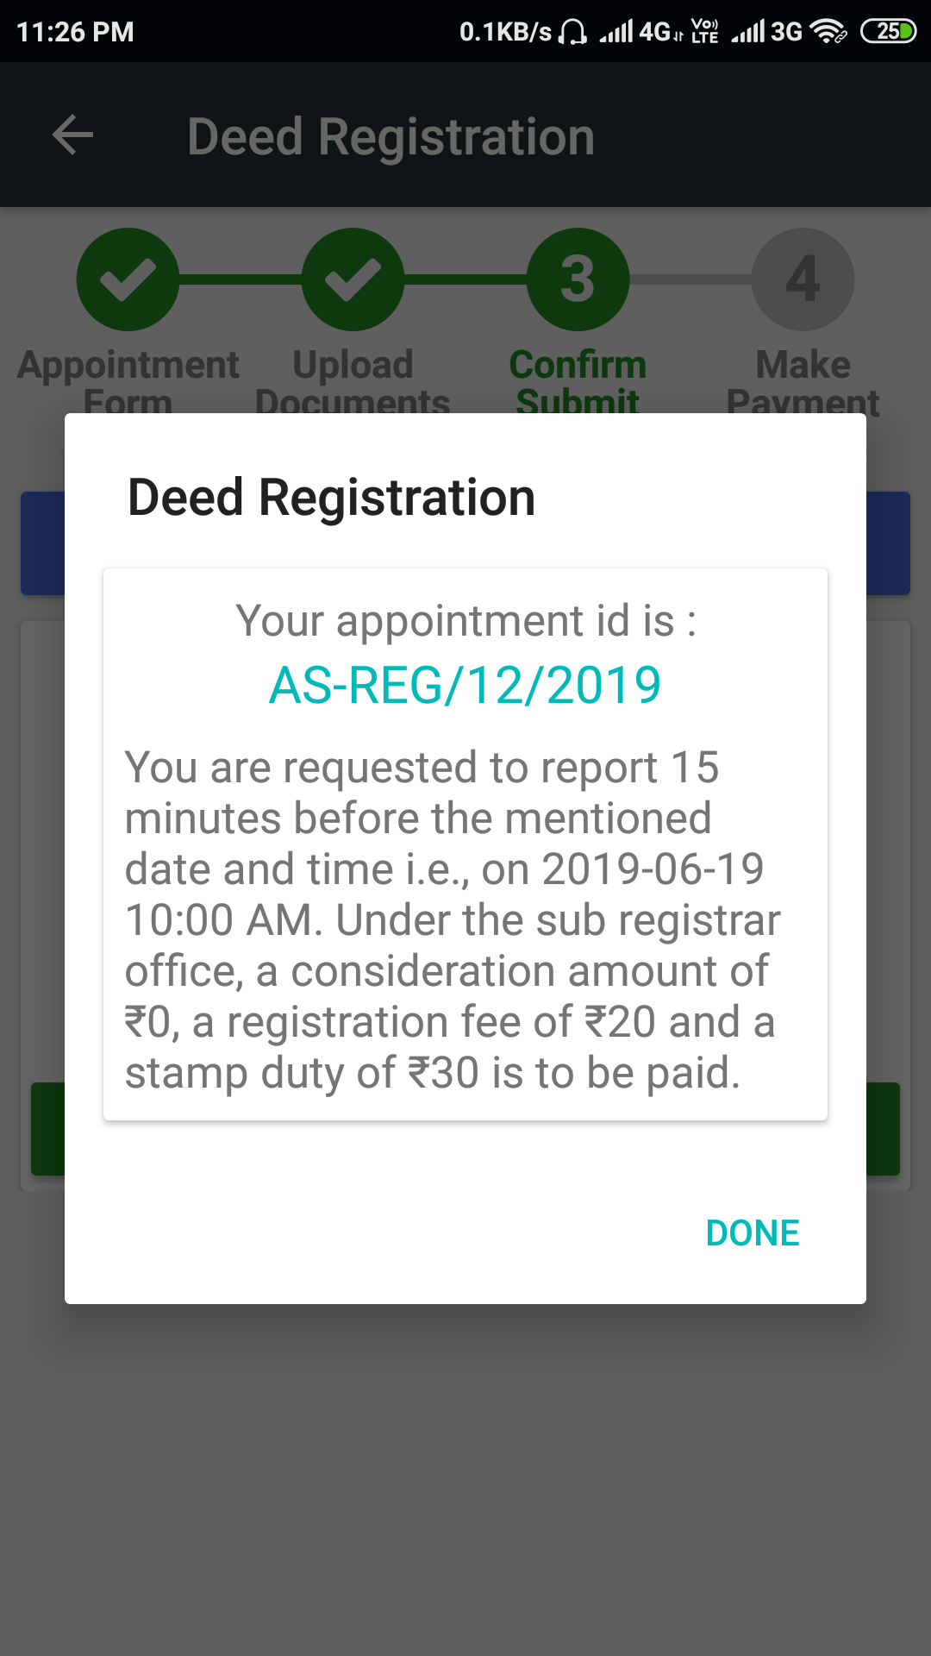
Deed Registration :

Slide 6
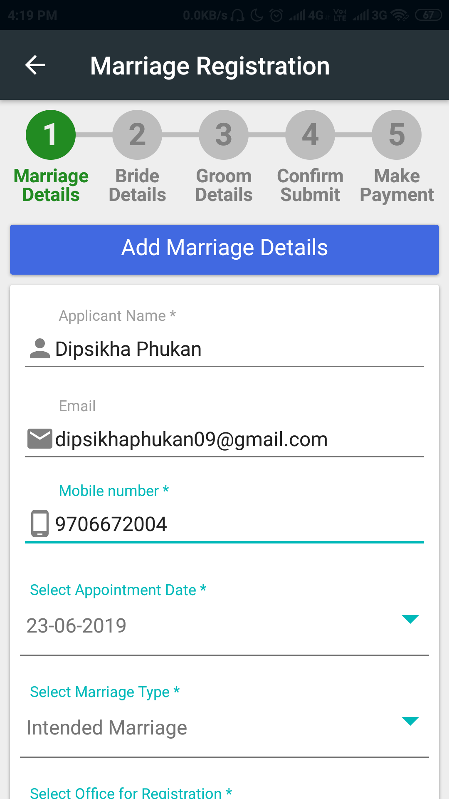
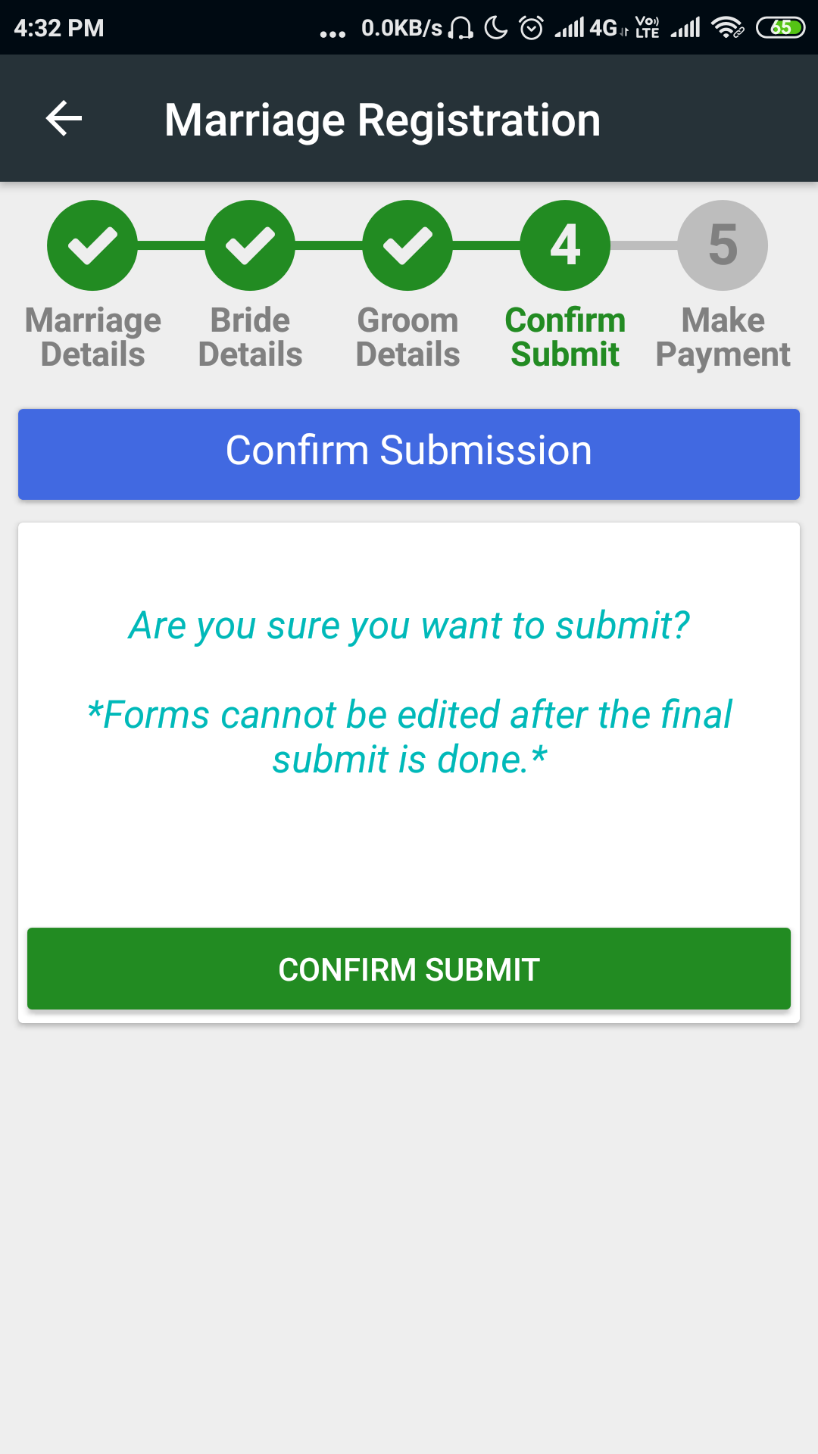
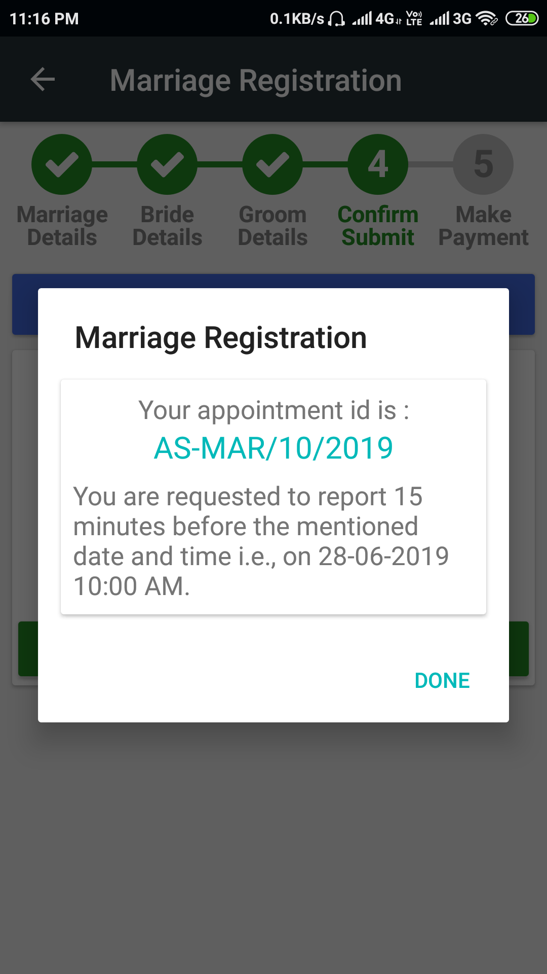
Marriage Registration :

Slide 7
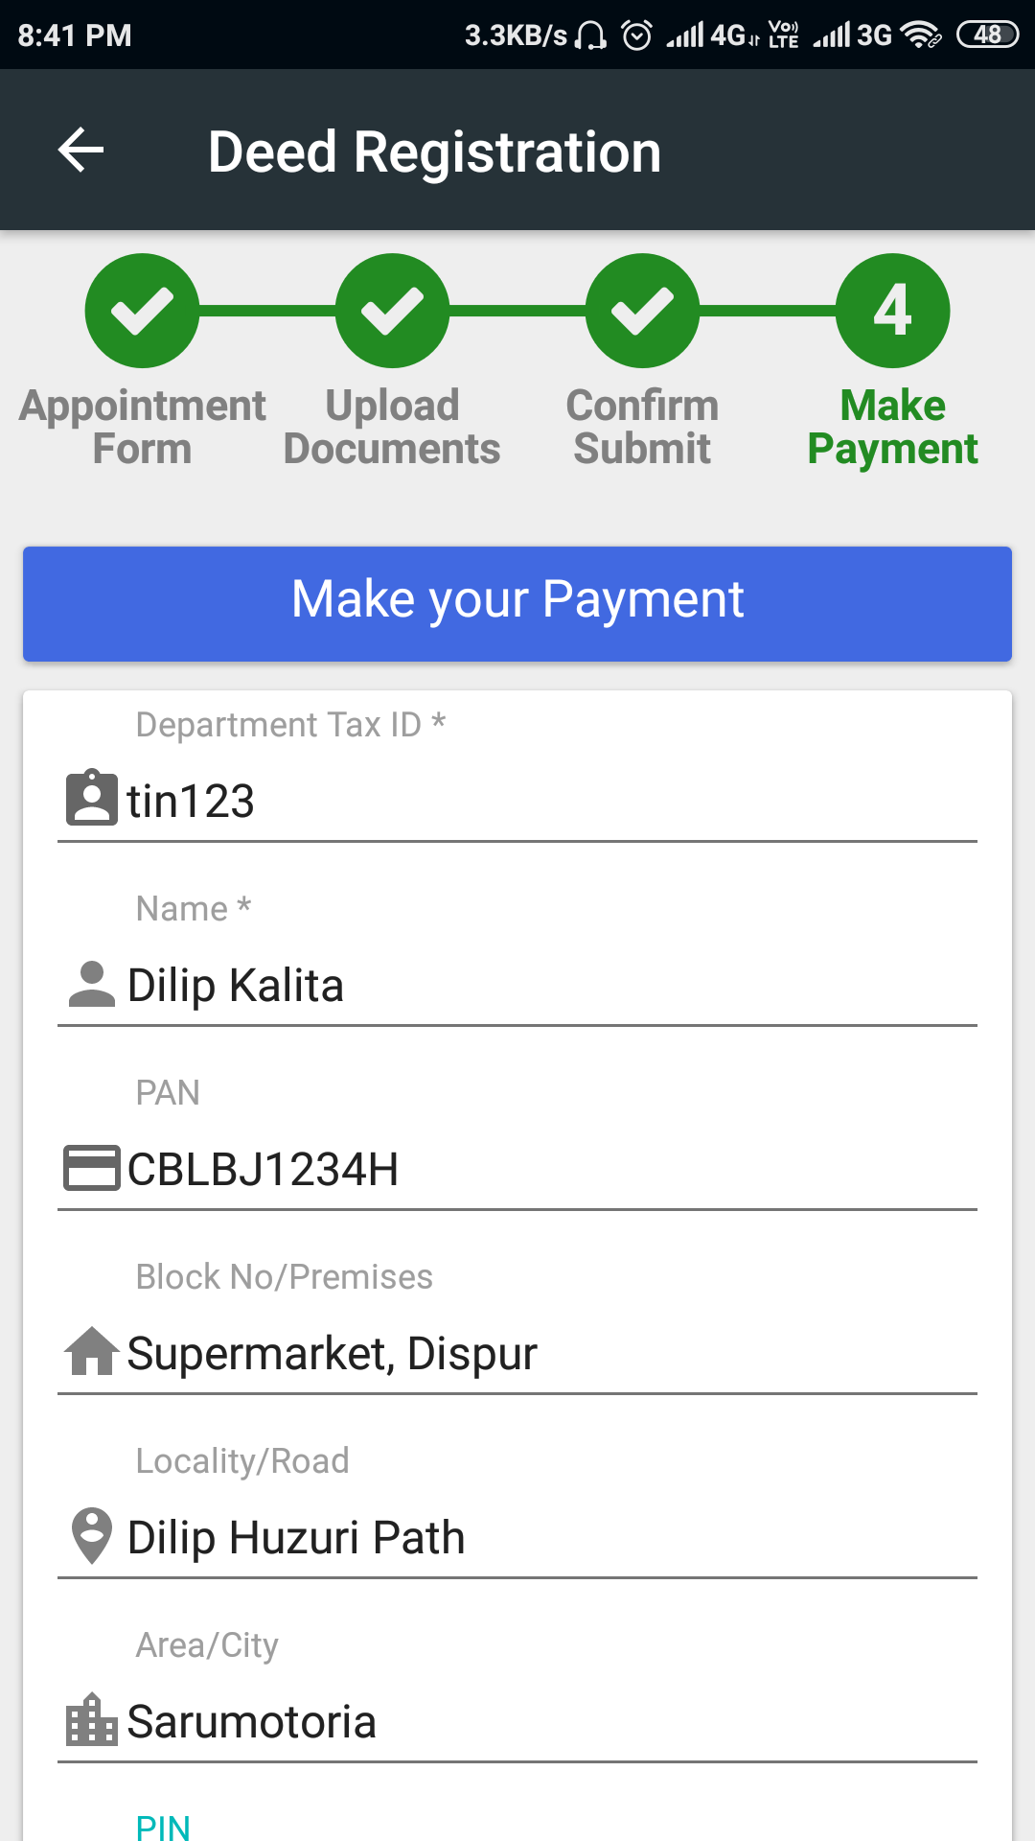
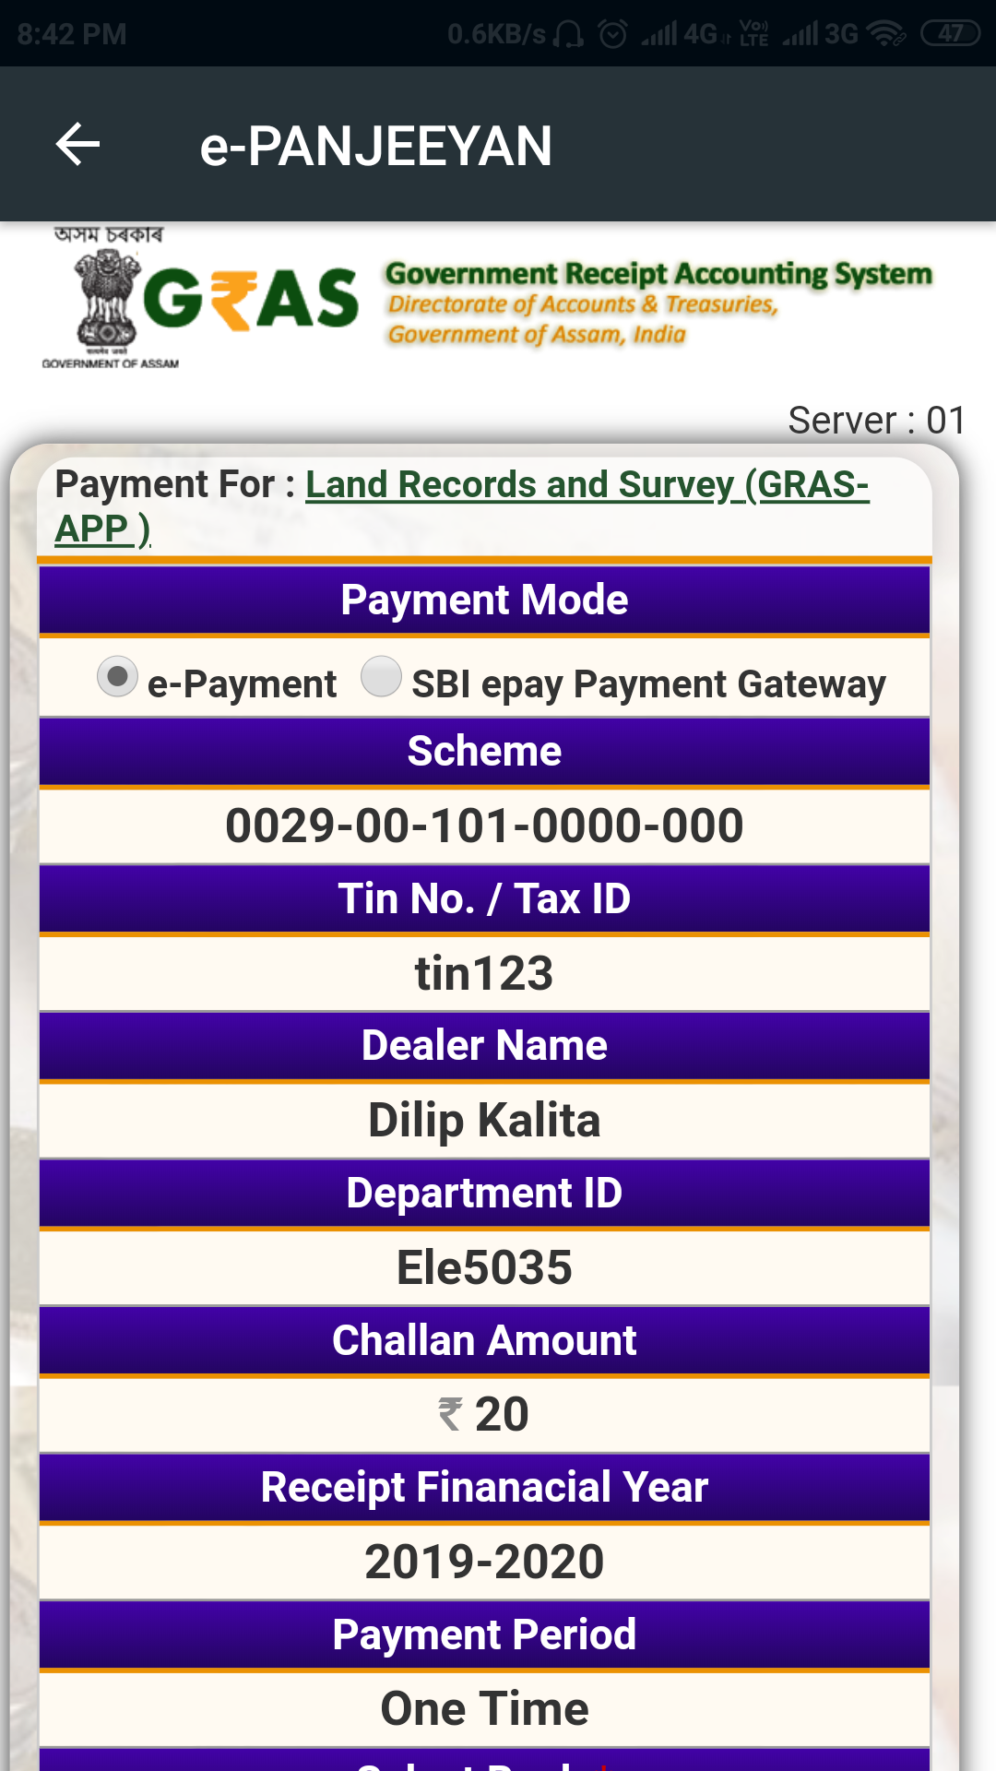
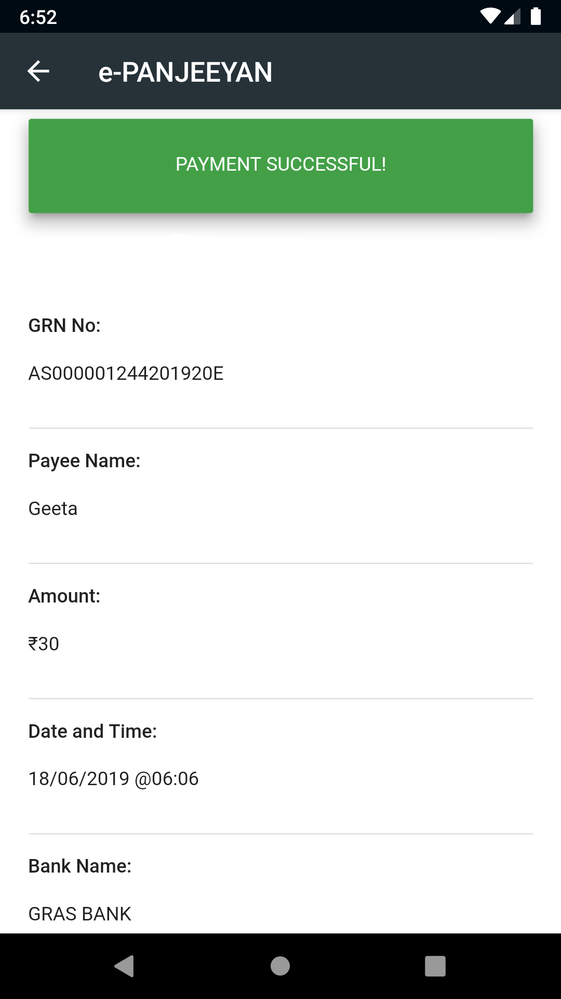
Make Payment :

Slide 8
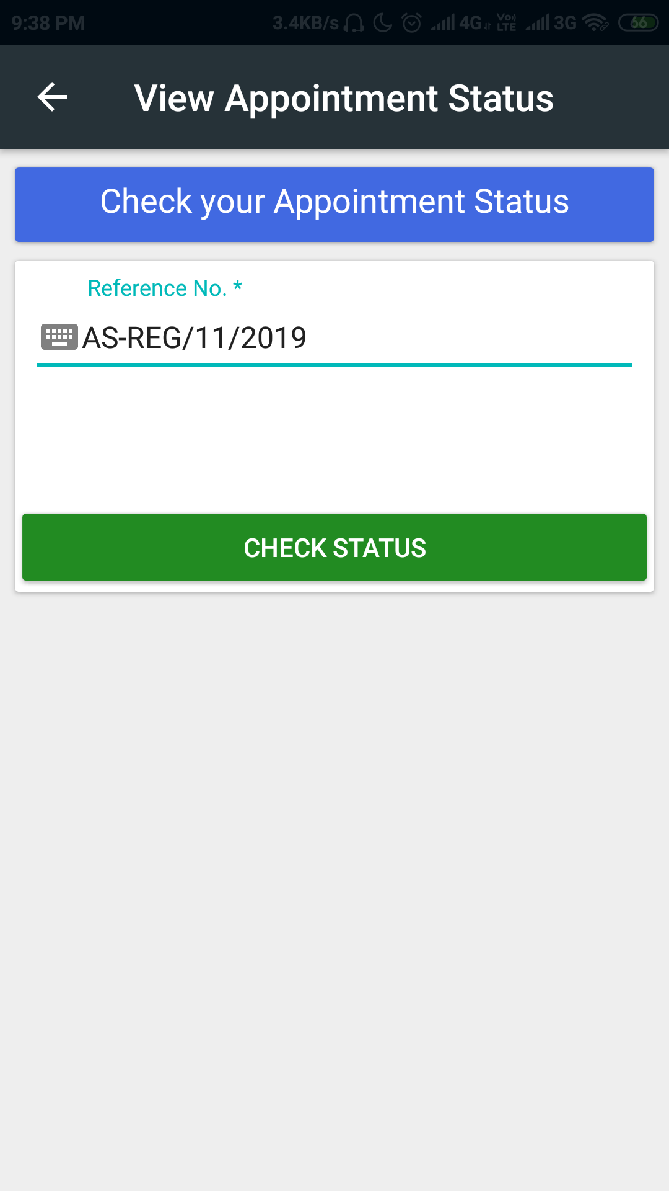
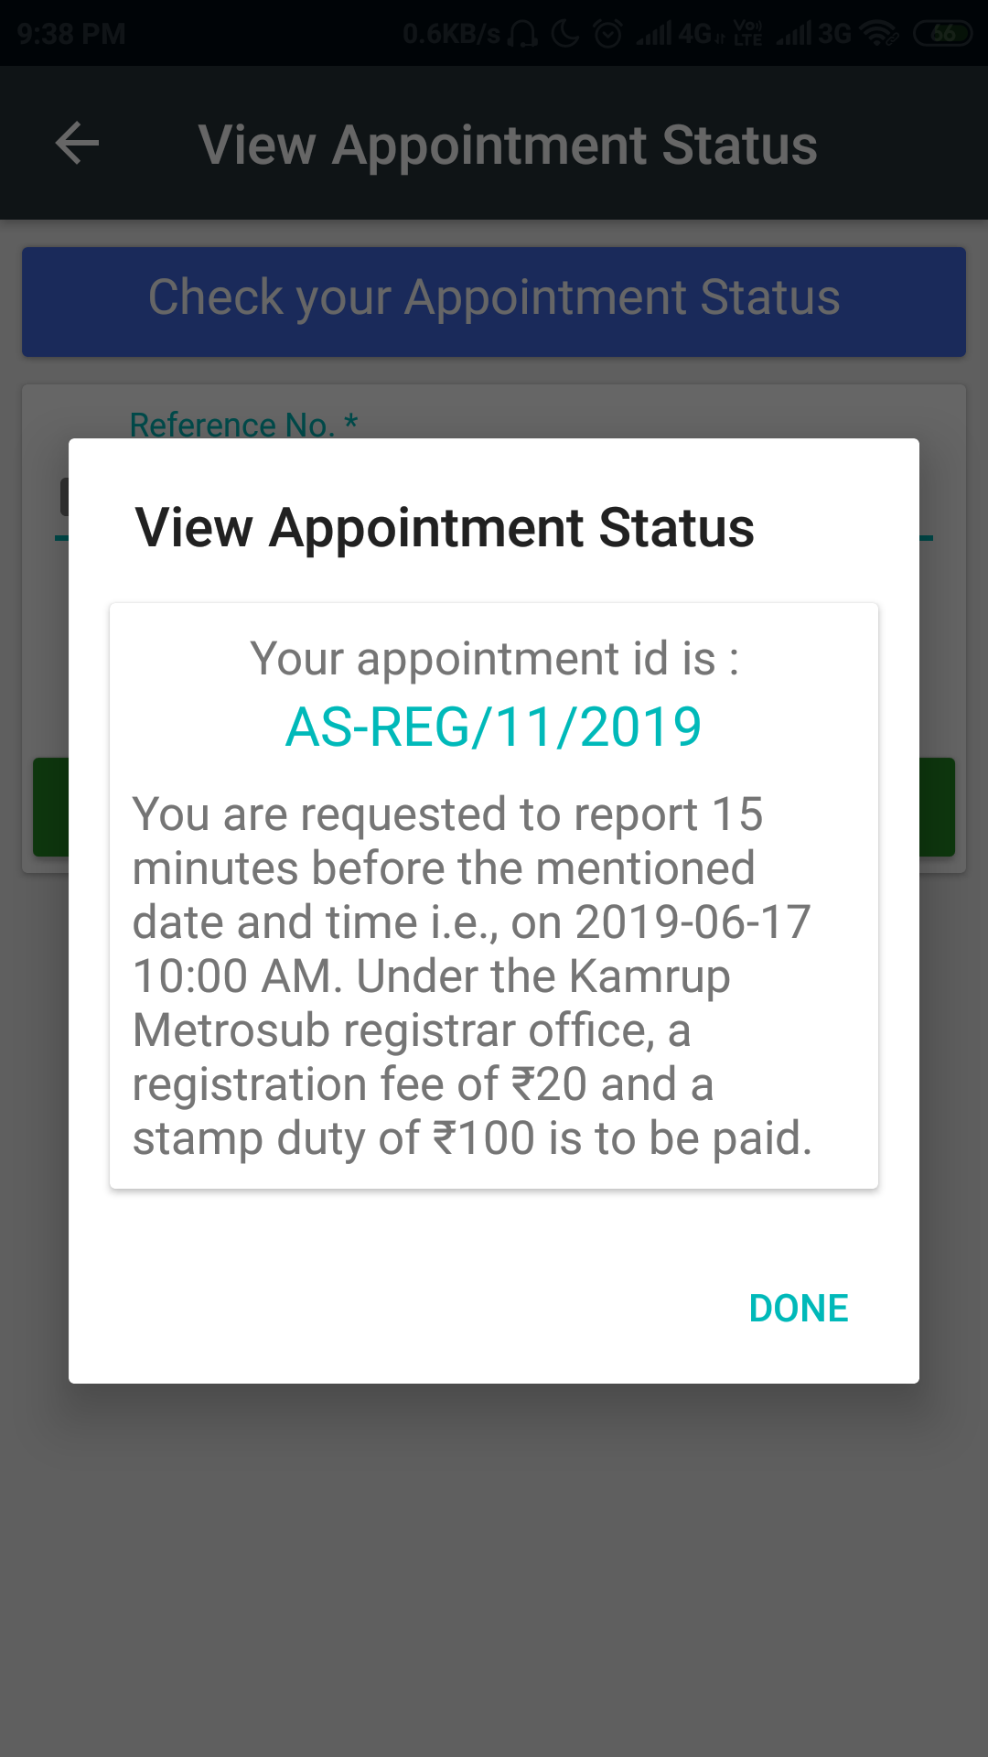
View Appointment Status :

Slide 9
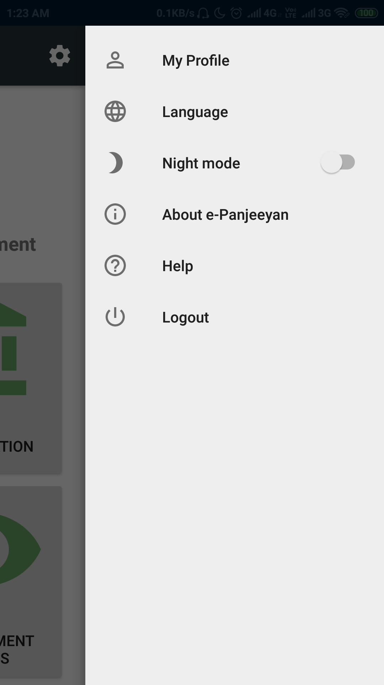
Settings
My Profile : Users can view their profile and also update it once they create an account and log into the app, which includes updating username, email, passwords, etc.
Language : The app supports two languages: English, which is the default language of the app, and Hindi.
Night Mode : The toggle button is just needed to be clicked to change the app's default mode i.e., "Light“ to “Night” mode.
About e-Panjeeyan : Information about the e-Panjeeyan app is described here.
Help : It consist the user manual, which shall guide the user throughout the utilization of the app.
Logout : User can logout of the app at anytime they want to.

Slide 10
Thank You!

