Slide 1
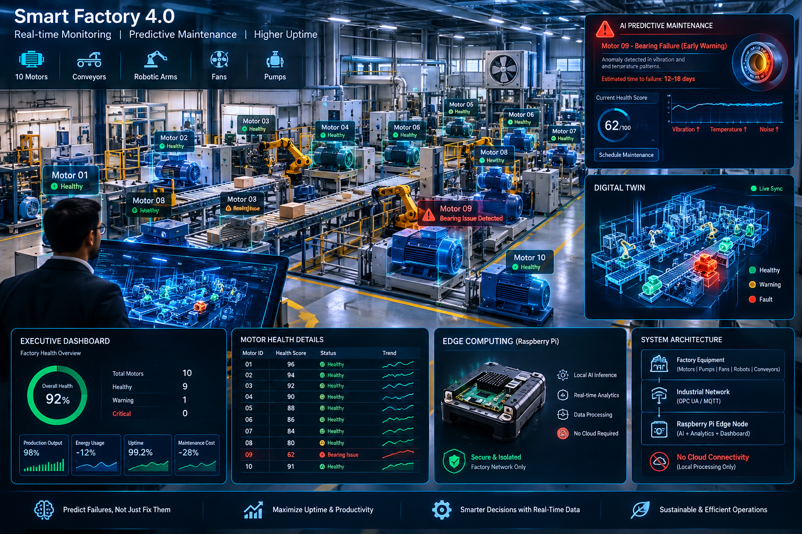
MOTORPULSE / INDUSTRIAL EDGE AI
Turn motor signals
into planned action
A practical condition-monitoring pitch for rotating assets: detect deviations, prioritize inspection, and test the value with real plant data.
SENSE -> TRIAGE -> PLAN
Client scenario figures are modeled assumptions, not MotorPulse customer results.
FACTORY UPTIME | HUMAN-LED MAINTENANCE | EDGE-FIRST PILOT

Slide 2
MOTORPULSE / CLIENT DISCUSSION
PRODUCT TODAY
What clients can see in the application
The localhost dashboard is a working UI prototype with six operational views; telemetry and outcomes shown in Demo Mode are synthetic.
FLEET OVERVIEW
MOTOR DETAIL
ALERTS & MAINTENANCE
10 sample assets, online / health states, status tiles and an at-a-glance fleet view.
Vibration, temperature, current, RPM, health cards, trend / FFT-style visuals and an event log.
Acknowledge alerts, view a maintenance calendar, create demo work orders and review history.
Useful for triage; current asset readings are seeded demo data.
Charts and diagnostic statements are illustrative; not real streaming signals.
Useful workflow concept; actions stay in local React state.
ENERGY
CONTROL & AUDIT
ROI SAVINGS
Power, kWh, tariff and efficiency views with a per-motor cost breakdown.
Speed/mode controls, confirmation dialogs, emergency-stop UI and an audit-style log.
Editable downtime, repair, replacement, energy-tariff and technician-rate inputs.
Energy values are derived from sample motor values, not meter data.
UI simulation only; the app is not wired to a PLC or physical motor.
Current headline savings are hard-coded; calculator formula is a prototype.
PITCH SAFEGUARD
Do not present $242.5K saved, 156 hours avoided, 4.8x ROI, 94% confidence or days-to-failure as measured outcomes: those are fixed demo copy, not connected customer data.
ILLUSTRATIVE BUSINESS CASE | VERIFY AGAINST CLIENT CMMS, PRODUCTION AND COST DATA
02 / 07

Slide 3
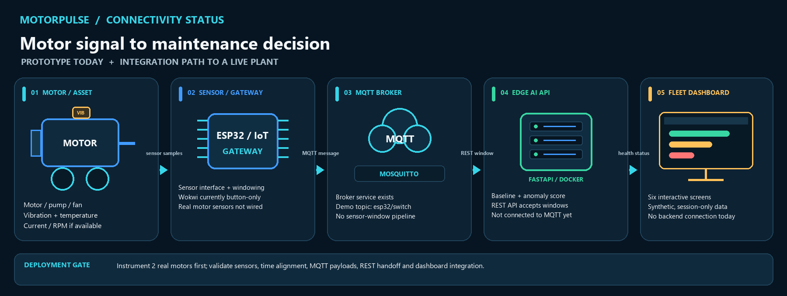
MOTORPULSE / CLIENT DISCUSSION
CURRENT ARCHITECTURE
What is connected today ? and what is not
The labeled components show what exists and the integration steps needed for a live plant feed.
TARGET: real sensor window -> MQTT ingestion -> edge analysis -> dashboard / work-order integration. Today only the MQTT broker and separate REST anomaly API are implemented.
ILLUSTRATIVE BUSINESS CASE | VERIFY AGAINST CLIENT CMMS, PRODUCTION AND COST DATA
03 / 07

Slide 4
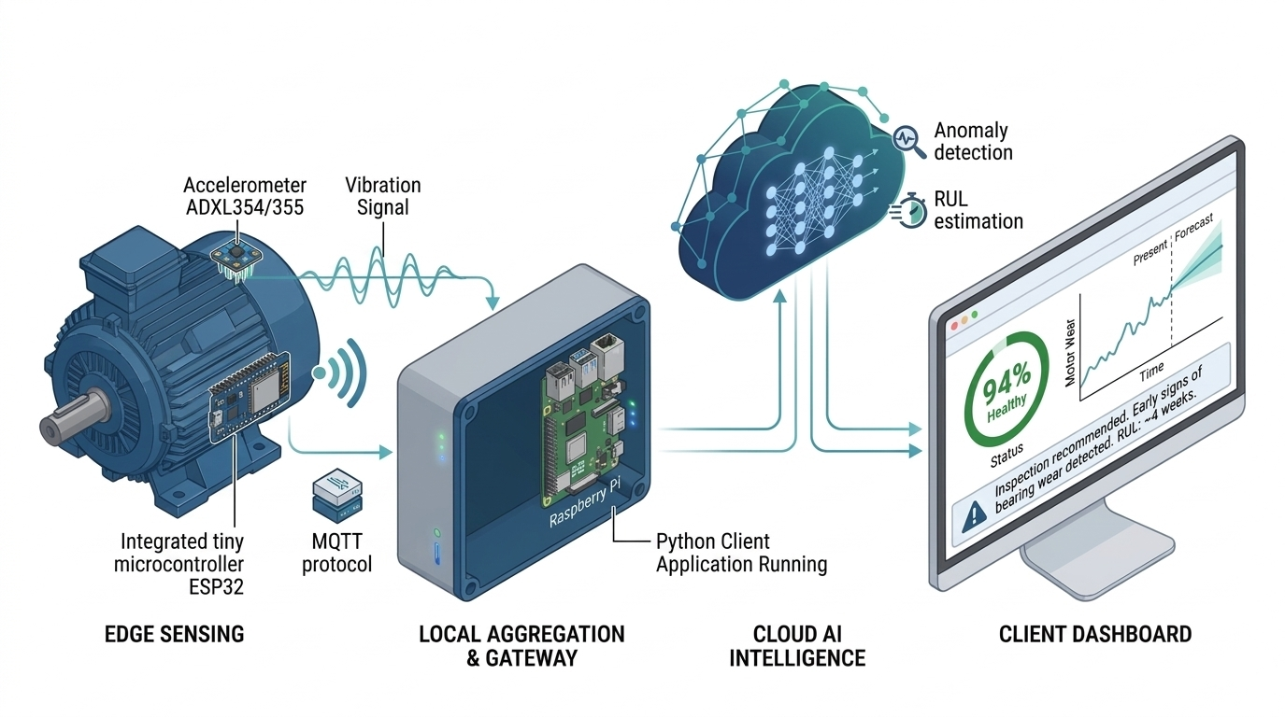
CONCEPT TARGET | NOT CURRENT STATE
Concept vision only: cloud AI, RUL and the on-screen health / forecast figures are not current. MVP is a local baseline anomaly API; no RUL model or live dashboard integration.

Slide 5
MOTORPULSE / CLIENT DISCUSSION
USE CASES
Where the workflow can create value
Start with assets where the maintenance team can verify an alert and production / repair costs can be reconstructed.
BEARING / MISALIGNMENT
EFFICIENCY DRIFT
FLEET MAINTENANCE
Pump, fan or conveyor drive
Compressor, pump or HVAC motor
Packaging / discrete manufacturing / utilities
Trend a motor-specific vibration baseline -> inspect coupling / bearing -> schedule work before an unplanned stop.
Compare current / temperature with the healthy operating range -> check load, alignment or friction -> confirm with a meter / technician.
Prioritize alerts, acknowledge them, plan work and track labor / parts using CMMS history.
Value levers: hours of constrained production protected; emergency repair premium avoided.
Value levers: kWh and tariff only after load-normalized meter data; no energy credit in base case.
Value levers: fewer urgent callouts; better planned-vs-reactive technician allocation.
PITCH FIRST
Discrete manufacturing, packaging / food & beverage, water / wastewater, and facilities with critical rotating assets. Qualify on repeated downtime, accessible sensor mounting, an accountable maintenance owner, and usable CMMS / production records.
ILLUSTRATIVE BUSINESS CASE | VERIFY AGAINST CLIENT CMMS, PRODUCTION AND COST DATA
05 / 07

Slide 6
MOTORPULSE / CLIENT DISCUSSION
IMPACT MODEL
Illustrative annual value: 25 critical motors
A transparent what-if built from the ROI page defaults plus explicit operating assumptions. This is not a forecast or measured result.
BASE CASE INPUTS: 6 unplanned events / year x 8 lost hours | 30% converted to planned work | $1,500 / lost hour | $4,500 emergency vs $850 planned repair
PRODUCTION CONTRIBUTION AT RISK
EMERGENCY REPAIR PREMIUM
GROSS ANNUAL OPPORTUNITY
$21,600
$6,570
$28,170
14.4 hours avoided x $1,500 / hour
1.8 expected repairs x ($4,500 - $850)
Before program cost; excludes energy & labor cash value
BASE-CASE BRIDGE / NOT TOP-LINE REVENUE
CAPTURE-RATE SENSITIVITY / $18K YEAR-1 COST ASSUMPTION
Baseline: 6 x 8h = 48h unplanned downtime / year.
Case
Gross
Net
ROI
Payback
At 30% early conversion: 14.4h recovered capacity.
Low / 20%
$18,780
$780
4%
11.5 mo
$21.6K = 14.4h x $1.5K contribution / downtime hour.
Base / 30%
$28,170
$10,170
57%
7.7 mo
$6.57K = 1.8 x ($4.5K emergency - $850 planned repair).
High / 40%
$37,560
$19,560
109%
5.8 mo
If production demand is recovered, $21.6K is contribution protected, not automatically booked revenue.
ROI = (gross - $18K) / $18K; simple steady-state payback.
Model assumptions, not product pricing: $12K setup + $6K service; 12h emergency vs 4h planned technician effort; internal labor excluded from repair-cost differential. Base saves 14.4 labor-hours = 20% of 72 reactive hours (not monetized). No energy savings included.
ILLUSTRATIVE BUSINESS CASE | VERIFY AGAINST CLIENT CMMS, PRODUCTION AND COST DATA
06 / 07

Slide 7
MOTORPULSE / CLIENT DISCUSSION
PILOT & PROOF
Turn the scenario into evidence before selling a percentage
A short shadow-mode pilot can validate signal quality and workflow; annual avoided-failure value needs historical CMMS data and longer follow-up.
01 / QUALIFY
02 / BASELINE
03 / SHADOW
Weeks 0-2
Weeks 2-4
Weeks 5-12
Pick 2 critical motors; confirm sensor mounting, operating modes, owners, downtime definition and lost contribution / hour. Export 12 months of work orders and stops.
Wire real vibration / temperature / current windows. Learn >=5 known-healthy windows per real motor as prototype requires; verify timestamps, missing data and operating state.
Run alerts read-only; technician labels each as actionable / not actionable, records lead time, diagnosis effort and planned vs emergency work. No automated control.
PILOT SCORECARD / CAPTURE SITE BASELINE FIRST
GO / NO-GO BEFORE SCALE
Signal quality
coverage, sensor faults, operating-state context
Scale only when data is reliable, maintenance staff trust alert evidence, the site confirms avoided-cost calculations, and the customer-specific ROI stays positive after quoted deployment costs.
Alert usefulness
actionable alerts / reviewed alerts; false positives
Maintenance effort
diagnosis + response labor hours per event
Business outcome
unplanned stop hours, repair cost and capacity recovered
The 20 / 30 / 40% cases are sensitivity inputs, not promised outcomes.
ILLUSTRATIVE BUSINESS CASE | VERIFY AGAINST CLIENT CMMS, PRODUCTION AND COST DATA
07 / 07

