Slide 1
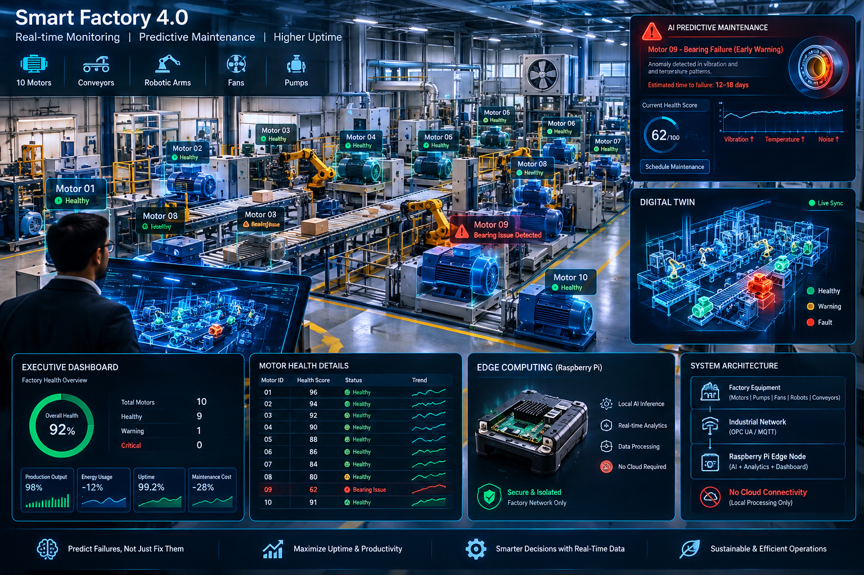
MOTORPULSE / INDUSTRIAL EDGE AI
Physical AI
for factory uptime
Turn machine signals into earlier, explainable maintenance decisions ? at the edge.
SENSE ? DETECT ? DECIDE
Concept visual ? dashboard values are illustrative artwork
SMART FACTORY 4.0 ? CONDITION MONITORING ? HUMAN-LED ACTION

Slide 3
MOTORPULSE / PHYSICAL AI
ARCHITECTURE
From physical signals to an actionable alert
A practical edge-first path: learn each asset?s healthy behavior, then surface meaningful deviations.
01 / SENSE
02 / MOVE
03 / INFER
04 / RESPOND
Asset signals
Plant connectivity
Edge intelligence
Operator workflow
?
?
?
Motor, pump or fan
Vibration ? temperature
Current ? RPM
Sensor / gateway
MQTT over plant LAN
Time-windowed readings
Motor-specific baseline
RMS ? peak ? frequency
Explainable anomaly score
Fleet health & alert
Inspect ? plan work
Human approves action
PROTOTYPE NOW
Edge anomaly API + local baseline storage + MQTT broker are present.
NEXT INTEGRATION
Wire real sensor telemetry to the model and connect the live dashboard. No autonomous machine control.
EDGE INTELLIGENCE FOR INDUSTRIAL RELIABILITY
02 / 04

Slide 4
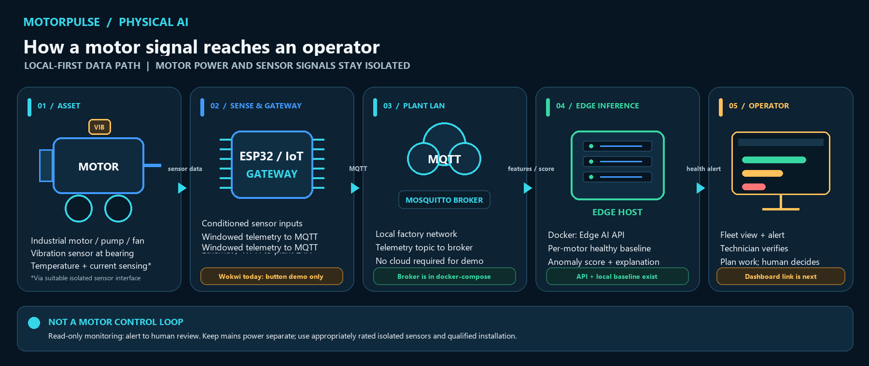
MOTORPULSE / PHYSICAL AI
CONNECTIONS
How the motors connect to the AI
A proposed, local-first telemetry path. The diagram distinguishes current prototype components from integrations still to wire.
EDGE INTELLIGENCE FOR INDUSTRIAL RELIABILITY
03 / 05

Slide 5
MOTORPULSE / PHYSICAL AI
USE CASES
Start where rotating assets make downtime expensive
The repeatable pattern is asset health ? prioritized inspection ? maintenance scheduled around operations.
PHYSICAL AI USE CASES
PITCHABLE DOMAINS
Discrete manufacturing
01
02
03
Motors, presses, machine tools
MOTOR / BEARING
PUMP / FAN
CONVEYOR / DRIVE
Packaging & food / beverage
Conveyors, fillers, pumps
Spot drift in vibration, heat or current.
Compare live behavior with its own healthy baseline.
Watch multiple assets for changing signatures.
Water & wastewater
Pump stations, blowers
Prioritize an inspection before a disruption.
Route a condition alert to the right team.
Focus maintenance effort where risk is rising.
Facilities & logistics
HVAC fans, sortation drives
Best first customer: a plant with repeat downtime + maintenance logs.
EDGE INTELLIGENCE FOR INDUSTRIAL RELIABILITY
04 / 05

Slide 6
MOTORPULSE / PHYSICAL AI
IMPACT & PILOT
Put a number on the opportunity
A transparent, illustrative 10-asset scenario. Replace every input with plant data before making a savings claim.
EXAMPLE ANNUAL BENEFIT MODEL / ASSUMPTIONS, NOT MEASURED RESULTS
DOWNTIME COST AVOIDED
REPAIR COST AVOIDED
GROSS ANNUAL BENEFIT
$36,000
$2,500
$38,500
24 recovered hours x $1,500 / lost production hour
25% fewer emergency repairs x $10,000 annual spend
Avoided downtime cost + avoided repair spend
WHAT THE EXAMPLE ASSUMES
ILLUSTRATIVE YEAR-ONE ECONOMICS
10 monitored assets; 120 lost-production hours per year
$38,500 gross annual benefit
20% downtime reduction = 24 hours recovered
-$18,000 setup + first-year service
$1,500 production impact per lost hour
4 emergency repairs x $2,500 each; assume 25% avoided
$20,500 illustrative net benefit
Year-one costs: $12,000 setup + $6,000 annual service
114% simple year-one ROI | ~5.6-month payback
Pilot gate: 2 real motors, >=5 healthy baseline windows per motor, observe-only. Validate inputs and alert quality with plant data; savings, ROI and payback are not yet proven.
EDGE INTELLIGENCE FOR INDUSTRIAL RELIABILITY
05 / 05

