Slide 1
HIJING Study for High pT constituents in Jets

Slide 2
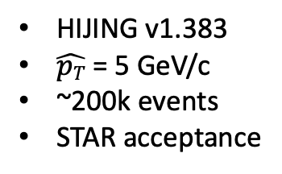
Lead and Sub-leading pT
HIJING v1.383
$\hat{pT}$ = 5 GeV/c
~200k events
STAR acceptance

Slide 3
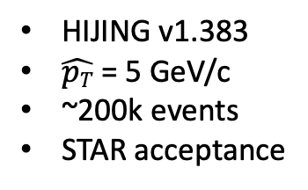
Lead and Sub-leading pT in Leading Jet
HIJING v1.383
$\hat{pT}$ = 5 GeV/c
~200k events
STAR acceptance
Anti-k_{T} Jets with constituents > 2.0 GeV/c

Slide 4
Lead and Sub-leading pT in Sub-Leading Jet
HIJING v1.383
$\hat{pT}$ = 5 GeV/c
~200k events
STAR acceptance
Anti-k_{T} Jets with constituents > 2.0 GeV/c

Slide 5
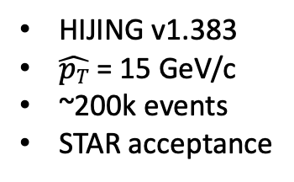
Lead and Sub-leading pT
HIJING v1.383
$\hat{pT}$ = 15 GeV/c
~200k events
STAR acceptance

Slide 6
Lead and Sub-leading pT in Leading Jet
Anti-k_{T} Jets with constituents > 2.0 GeV/c
HIJING v1.383
$\hat{pT}$ = 15 GeV/c
~200k events
STAR acceptance

Slide 7
Lead and Sub-leading pT in Sub-Leading Jet
Anti-k_{T} Jets with constituents > 2.0 GeV/c
HIJING v1.383
$\hat{pT}$ = 15 GeV/c
~200k events
STAR acceptance

