Slide 1
Charge Correlation in Au-Au 200 GeV
Diptanil Roy

Slide 2
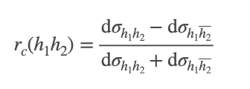
Dataset:
Au + Au 200 GeV Run14 Low and Mid Lumi MinBias Dataset
HFT present in tracking
Detailed PID efficiency studies available for this dataset
Jet p_{T} > 10 GeV/c, Constituent p_{T} > 2 GeV/c → Hard Core Jets
Anti-kT jets, R = 0.4, |eta| < 1 - R
Usually, no background subtraction done for such jets
We can also look at the subsets of HT events

Slide 3
Charge Correlation Without PID

Slide 4
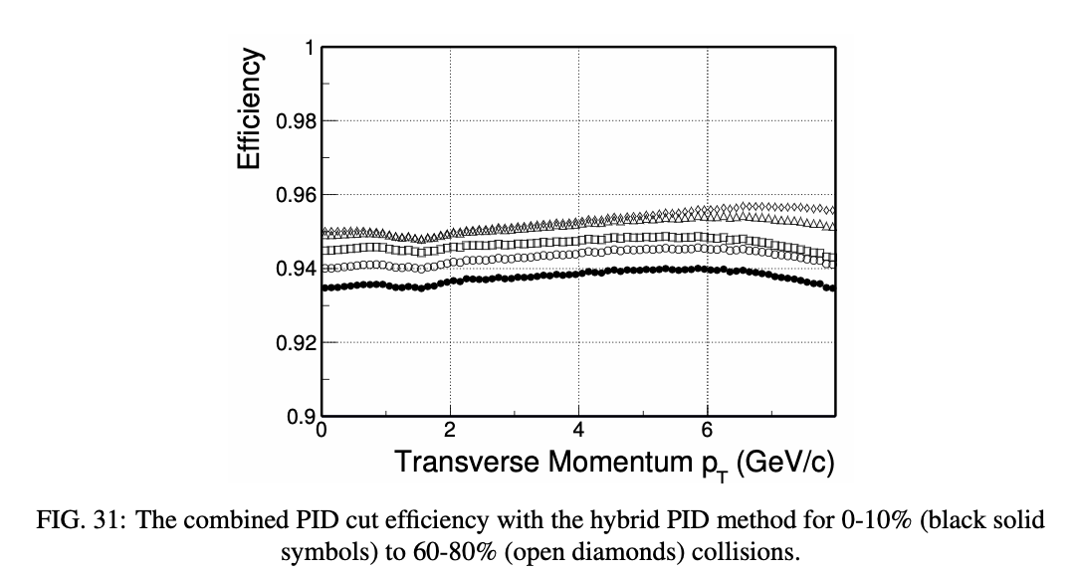
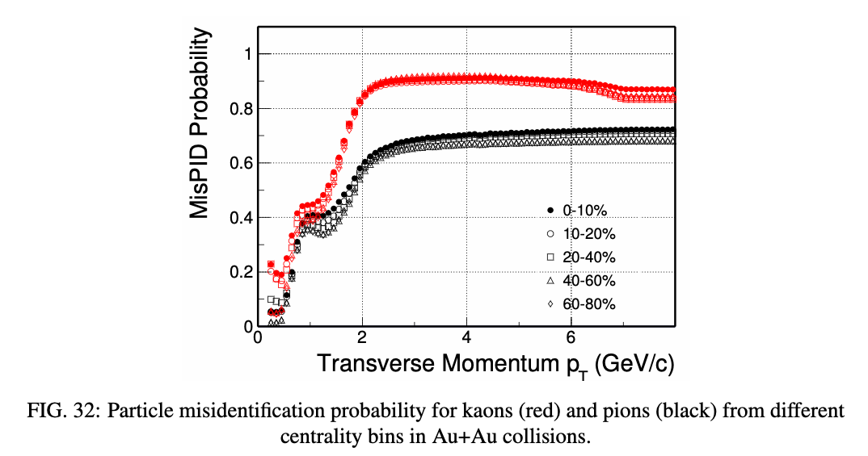
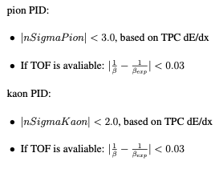
PID Inefficiencies

