Slide 1
Measurement of D0 and D0* in p+p collisions at $√s$ = 200 GeV

Slide 2
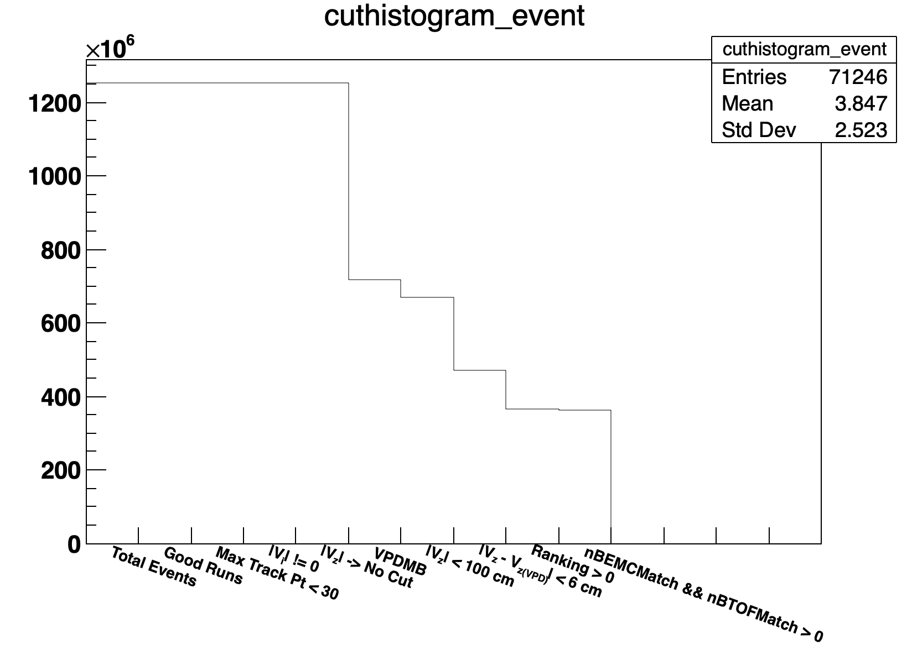
Event Selection
Vertex Rank > 0
VPDMB Triggers: 370001, 370011
|Vz| < 100 cm; |Vz –VzVPD| < 6 cm
365 Million Events

Slide 3
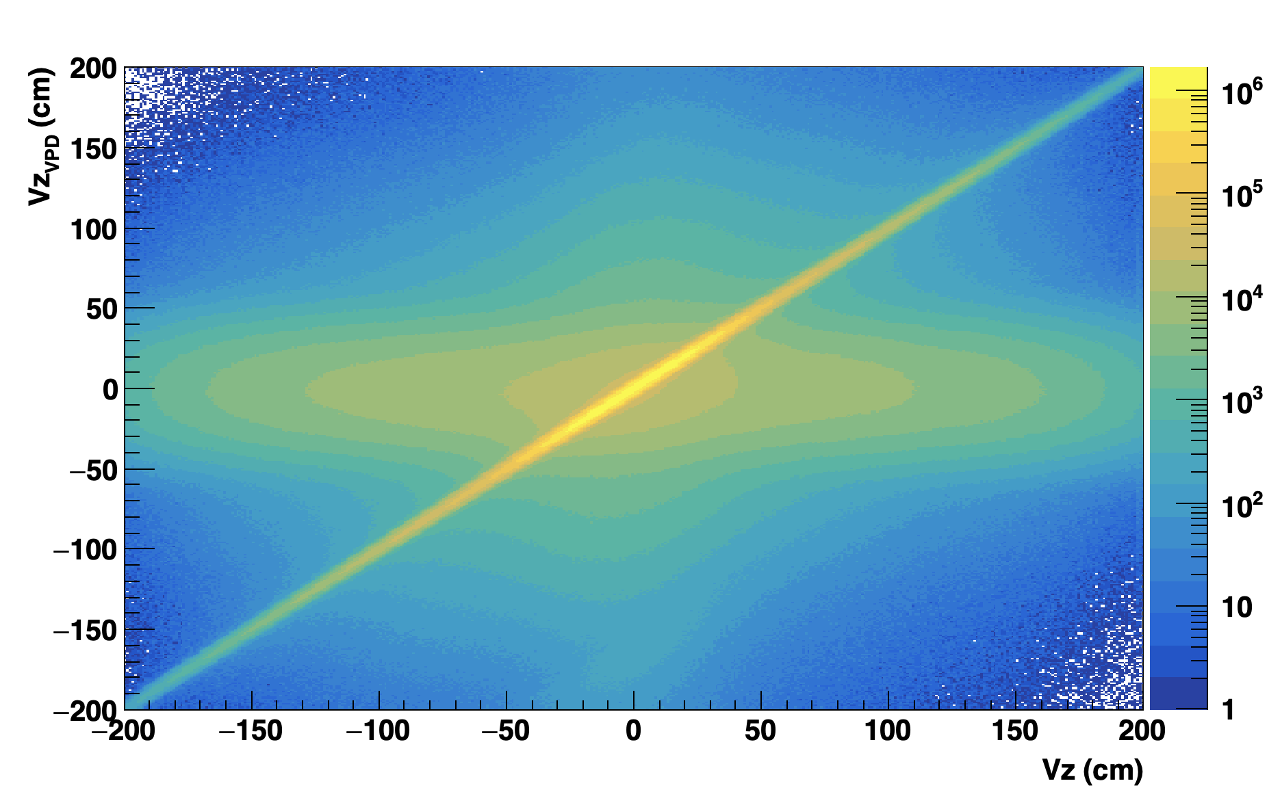
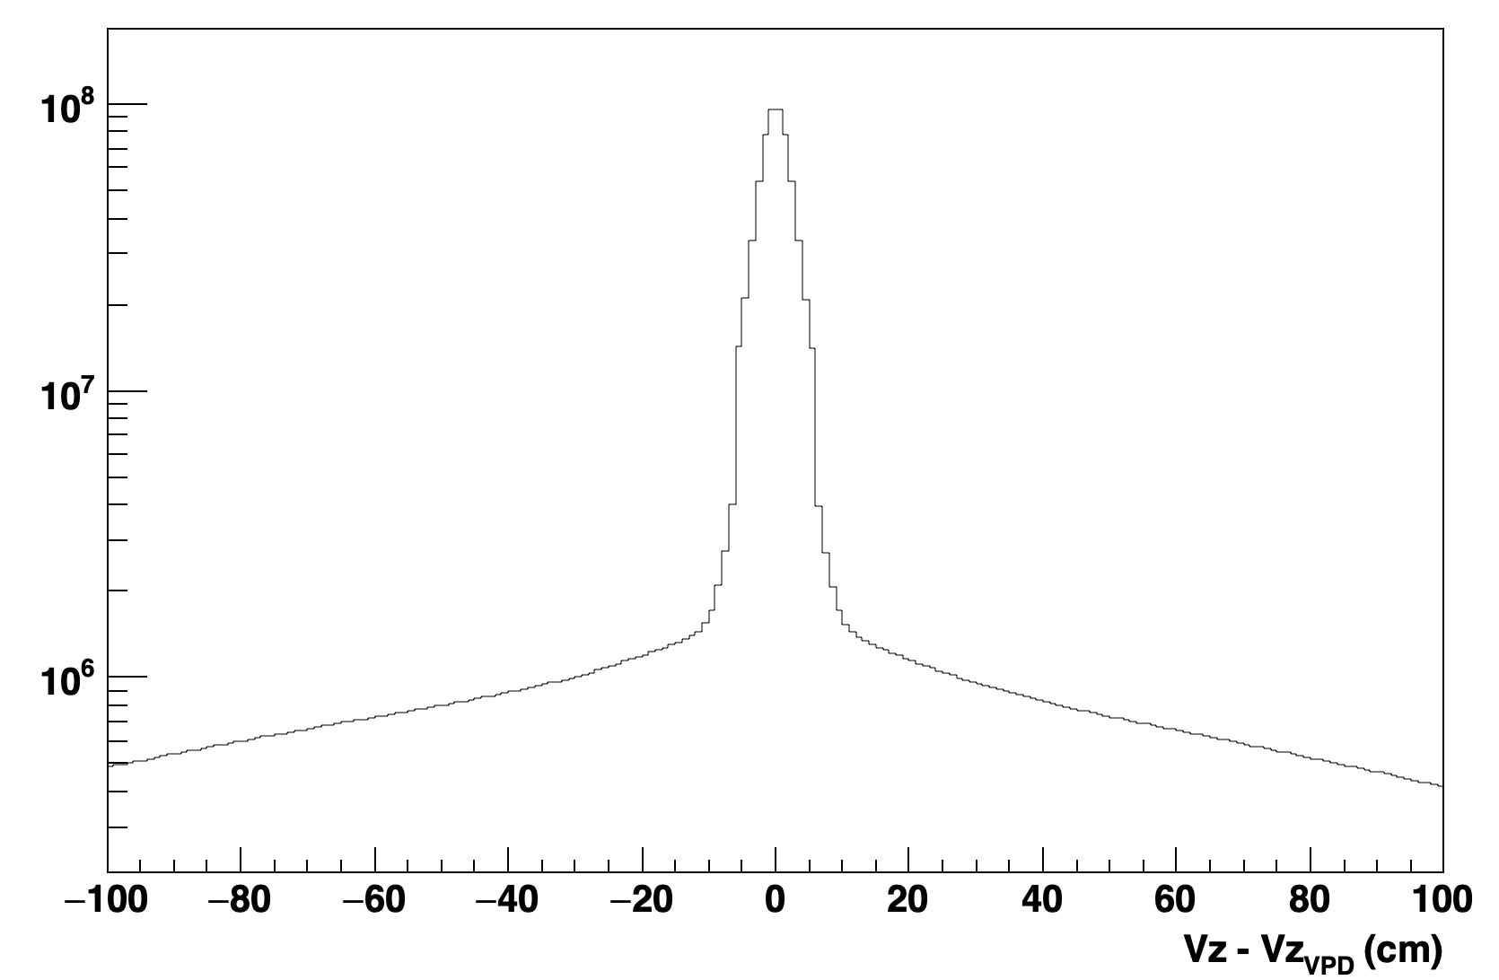
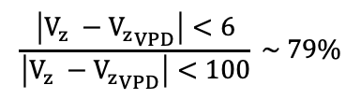
Event Selection
Vertex Rank > 0
VPDMB Triggers: 370001, 370011
|Vz| < 100 cm; |Vz –VzVPD| < 6 cm
$$\frac{\left|V_{z} −{V_{z}}_{VPD}\right|<6}{\left|V_{z} −{V_{z}}_{VPD}\right|<100} \sim 79\%$$

Slide 4
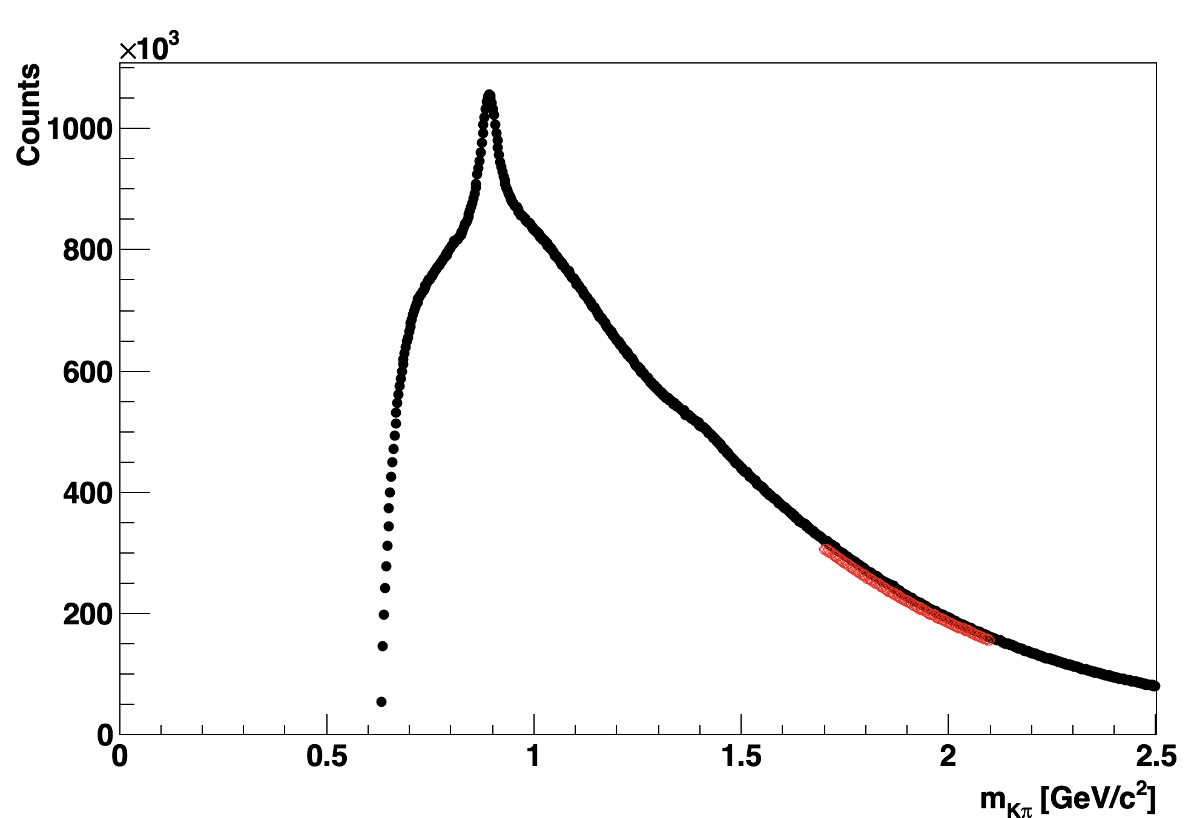
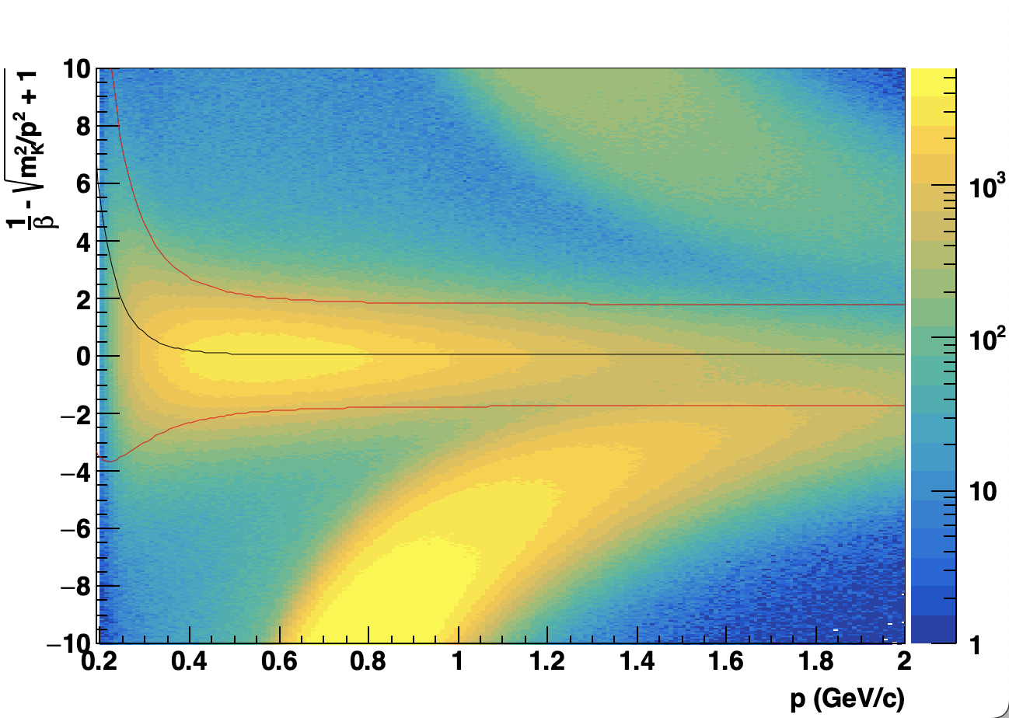
Track Selection
gDCA < 2 cm
nHitsFit > 15 && nHitsFit/nHitsMax > 0.52
pT > 0.2 GeV
|eta| < 1
Dirty background
Pion Selection
Kaon Selection
|nSigmaPion| < 2
|ylocal| < 1.8 cm
Beta > 0

Slide 5
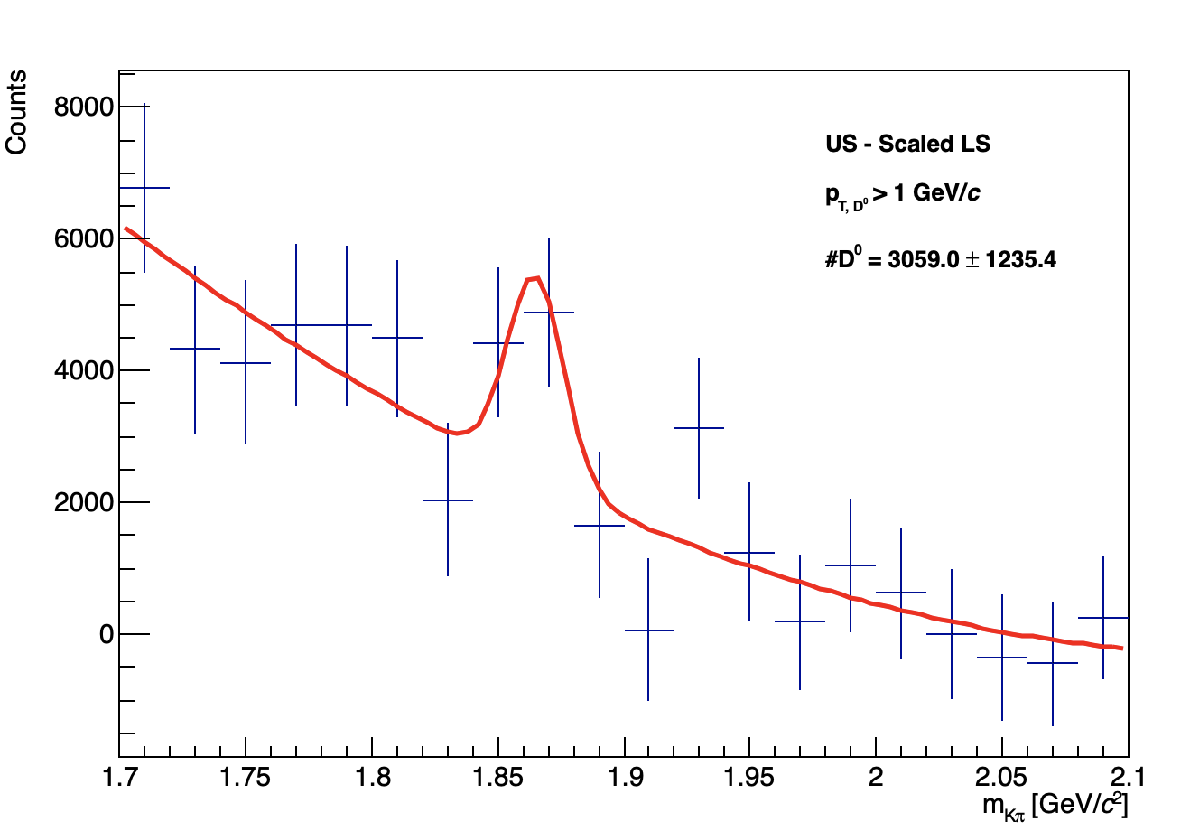
Track Selection
gDCA < 2 cm
nHitsFit > 15 && nHitsFit/nHitsMax > 0.52
pT > 0.2 GeV
|eta| < 1
Pion Selection
Kaon Selection
|nSigmaPion| < 2
|ylocal| < 1.8 cm
Beta > 0

Slide 6
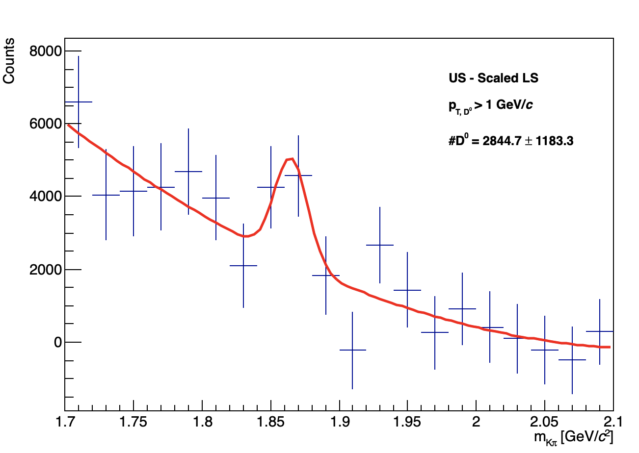
Track Selection
gDCA < 2 cm
nHitsFit > 20 && nHitsFit/nHitsMax > 0.52
pT > 0.2 GeV
|eta| < 1
Pion Selection
Kaon Selection
|nSigmaPion| < 2
|ylocal| < 1.8 cm
Beta > 0

Slide 7
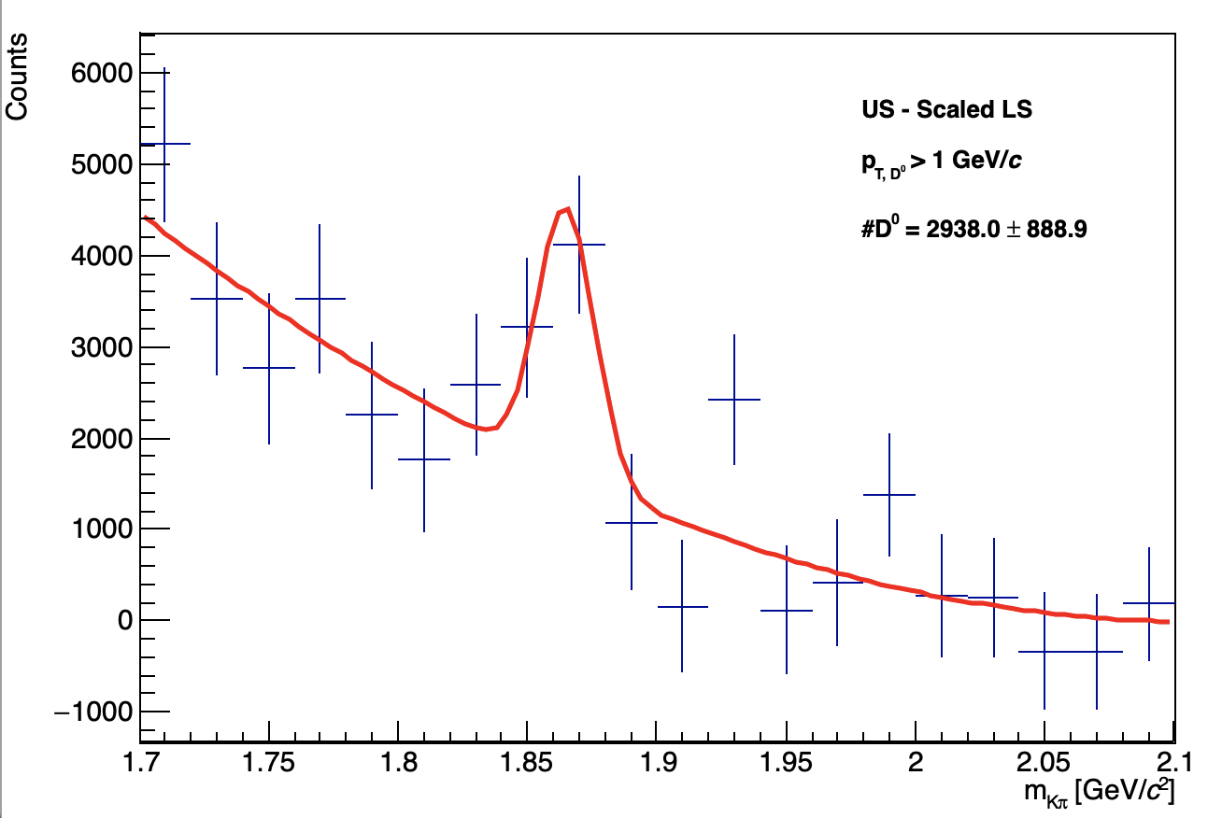
Track Selection
gDCA < 2 cm
nHitsFit > 15 && nHitsFit/nHitsMax > 0.52
pT > 0.2 GeV
|eta| < 1
Pion Selection
Kaon Selection
|ylocal| < 1.8 cm
Beta > 0
-1.9 < TOF Pion Res < 2.1
|ylocal| < 1.8 cm
Beta > 0

Slide 8
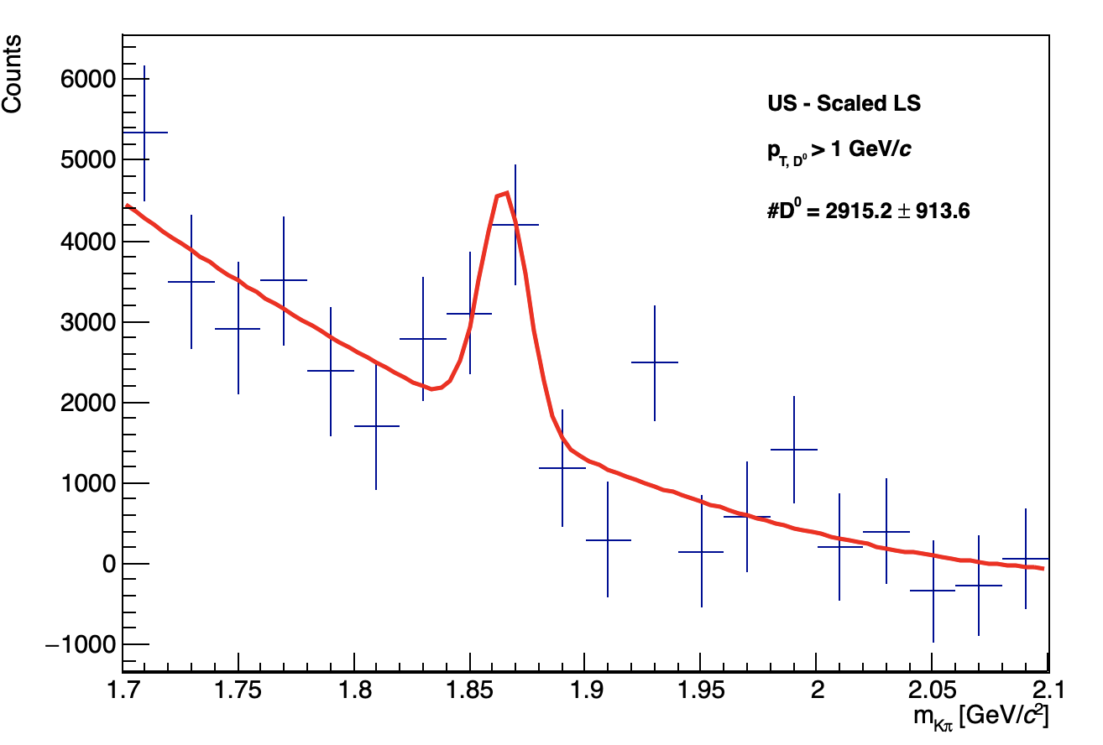
Track Selection
gDCA < 2 cm
nHitsFit > 20 && nHitsFit/nHitsMax > 0.52
pT > 0.2 GeV
|eta| < 1
Pion Selection
Kaon Selection
|ylocal| < 1.8 cm
Beta > 0
-1.9 < TOF Pion Res < 2.1
|ylocal| < 1.8 cm
Beta > 0

Slide 9
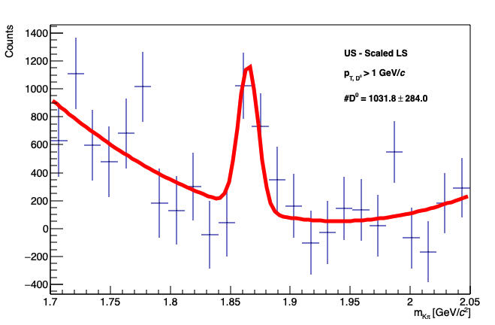
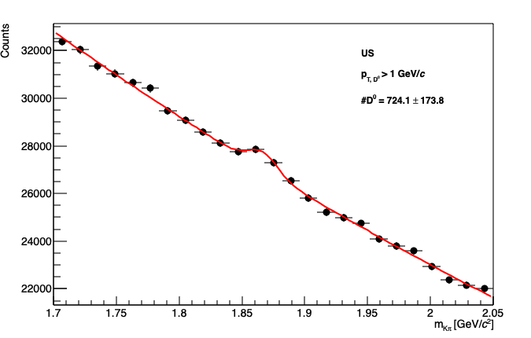
Event Selection
Like Sign Subtraction
Vertex Rank > 0
VPDMB Triggers: 370001, 370011
|Vz| < 100 cm; |Vz –VzVPD| < 6 cm
Track Selection
gDCA < 2 cm
nHitsFit > 15 && nHitsFit/nHitsMax > 0.52
pT > 0.2 GeV
|eta| < 1
Pion Selection
Kaon Selection
|ylocal| < 1.8 cm
Beta > 0
-1.9 < TOF Pion Res < 2.1
|ylocal| < 1.8 cm
Beta > 0
Sideband Subtraction
Jet Selection
Constituents pT > 0.2 GeV/c
Jet pT > 3 GeV/c
D0 pT > 1 GeV/c

Slide 10
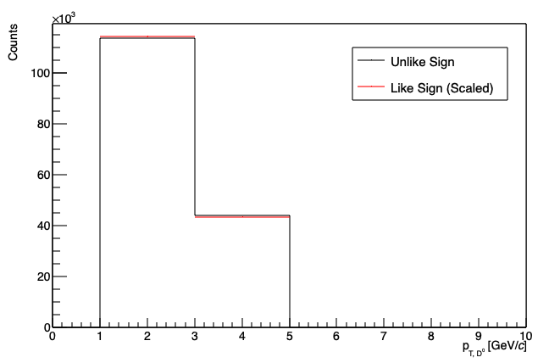
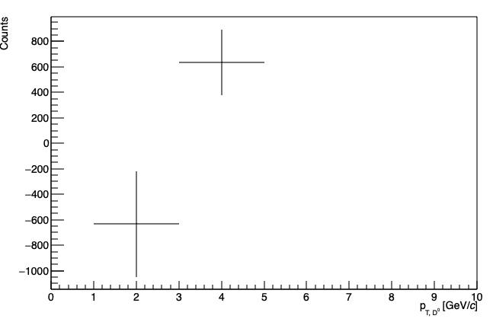
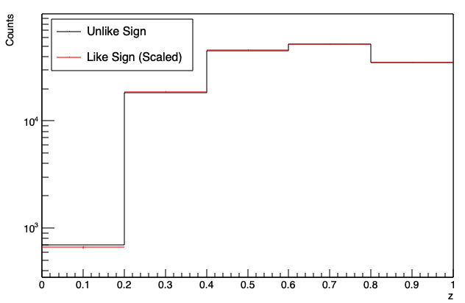
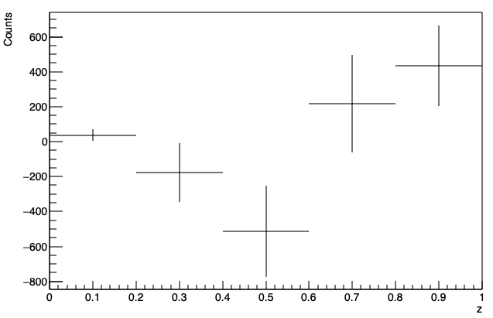
Event Selection
Sideband Subtraction
Vertex Rank > 0
VPDMB Triggers: 370001, 370011
|Vz| < 100 cm; |Vz –VzVPD| < 6 cm
Sideband
Track Selection
gDCA < 2 cm
nHitsFit > 15 && nHitsFit/nHitsMax > 0.52
pT > 0.2 GeV
|eta| < 1
Pion Selection
Kaon Selection
|ylocal| < 1.8 cm
Beta > 0
-1.9 < TOF Pion Res < 2.1
|ylocal| < 1.8 cm
Beta > 0
Sideband
Jet Selection
Constituents pT > 0.2 GeV/c
Jet pT > 3 GeV/c
D0 pT > 1 GeV/c

Slide 11
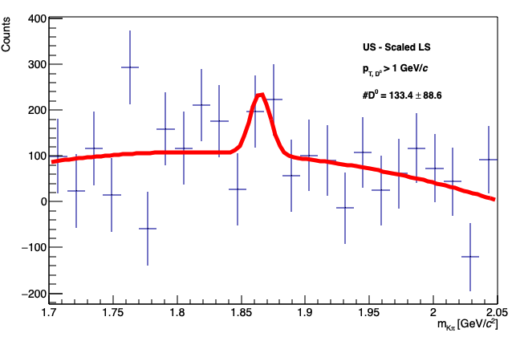
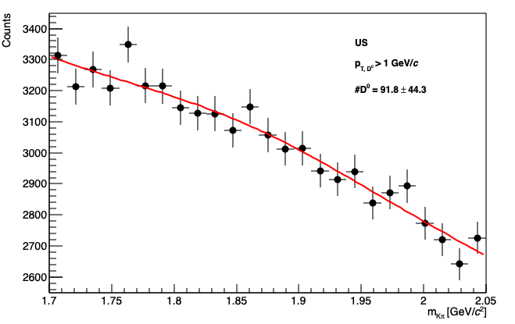
Event Selection (Half the Data Sample)
Vertex Rank > 0
HT1 & HT2 Triggers: 370511, 370546, 370521, 370522, 370531, 370980
|Vz| < 100 cm; |Vz –VzVPD| < 6 cm
Track Selection
gDCA < 2 cm
nHitsFit > 15 && nHitsFit/nHitsMax > 0.52
pT > 0.2 GeV
|eta| < 1
Pion Selection
Kaon Selection
|ylocal| < 1.8 cm
Beta > 0
-1.9 < TOF Pion Res < 2.1
|ylocal| < 1.8 cm
Beta > 0
Jet Selection
Constituents pT > 0.2 GeV/c
Jet pT > 3 GeV/c
D0 pT > 1 GeV/c

