Slide 1
PYTHIA Comparison With POWHEG

Slide 2
PYTHIA + POWHEG
POWHEG -> NLO Hard Event Generator
For heavy flavor, I use POWHEG-hvq, which is specific for heavy quark production
Interfaced to PYTHIA from this point
No pThard cuts in PYTHIA
Event Cuts:
Jets with pT > 3 GeV containing a D0
D0 pT > 1 GeV
Kinematic acceptance cuts
The PDF used for POWHEG is cteq6m. (Different variations need to be tried out)

Slide 3
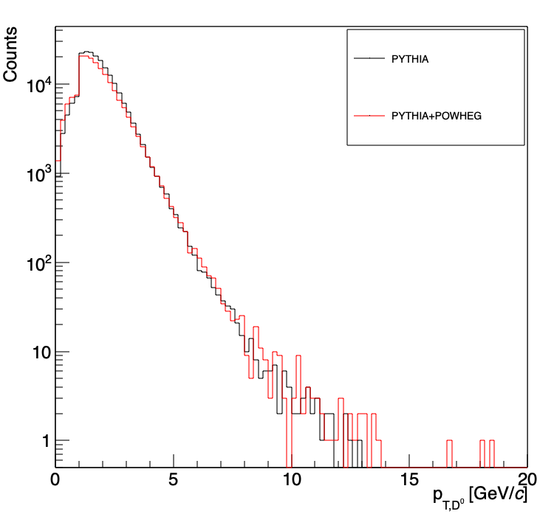
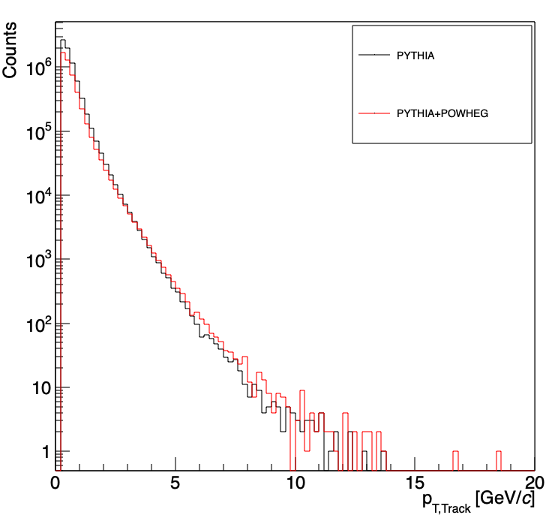
D0 Spectra
Track Spectra
Minimal changes in the particle level spectra

Slide 4
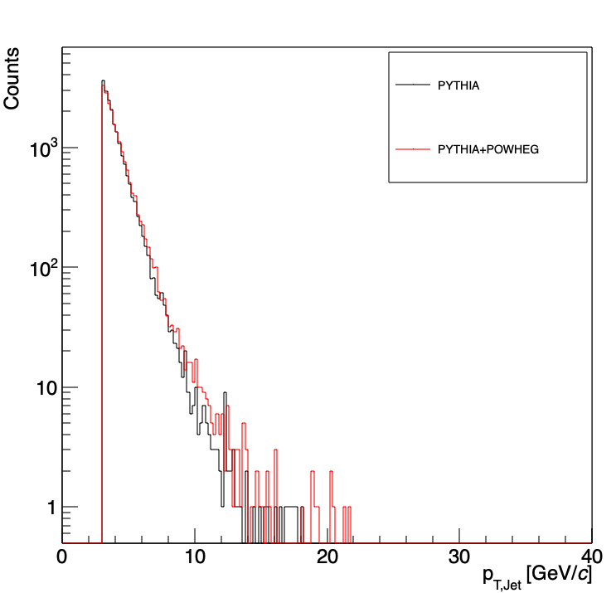
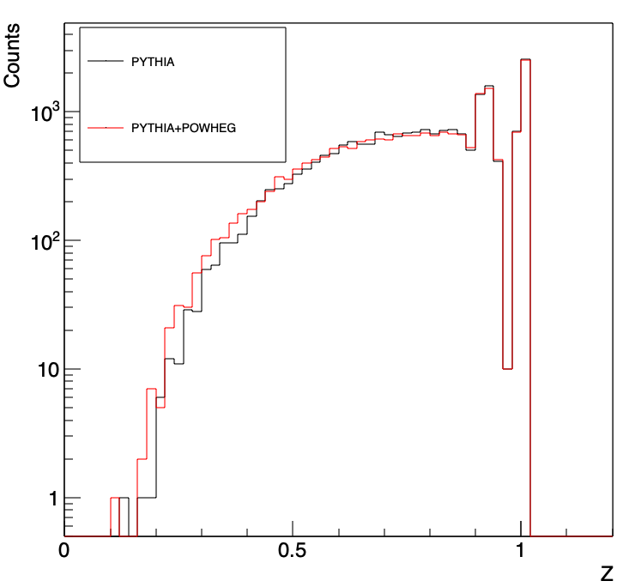
Jet Spectra
Fragmentation Function
Minimal changes in the jet level spectra

Slide 5
Heavy Ion Overlay on PYTHIA D0 Jets

Slide 6
Workflow:
Get a minimum bias event
Get a random file with PYTHIA events containing D0 jets
Sample ~10 random events from the PYTHIA file for each minimum bias event
Run jet maker on the PYTHIA events ‘embedded’ in the minimum bias event -> This is PARTICLE level
Run jet maker on the combined PYTHIA+Minbias event -> This is DETECTOR level
Minimum Bias Event (x1)
Process MB + PYTHIA tracks together
Detector Level Jets
Background Subtraction on combined tracks from MB + PYTHIA
Compare Particle Level Jets with Detector Level Jets
PYTHIA + GEANT3 Event (x10)
Particle Level Jets

Slide 7
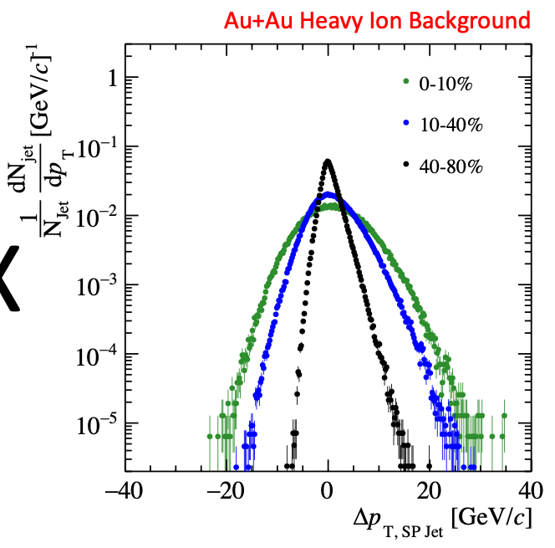
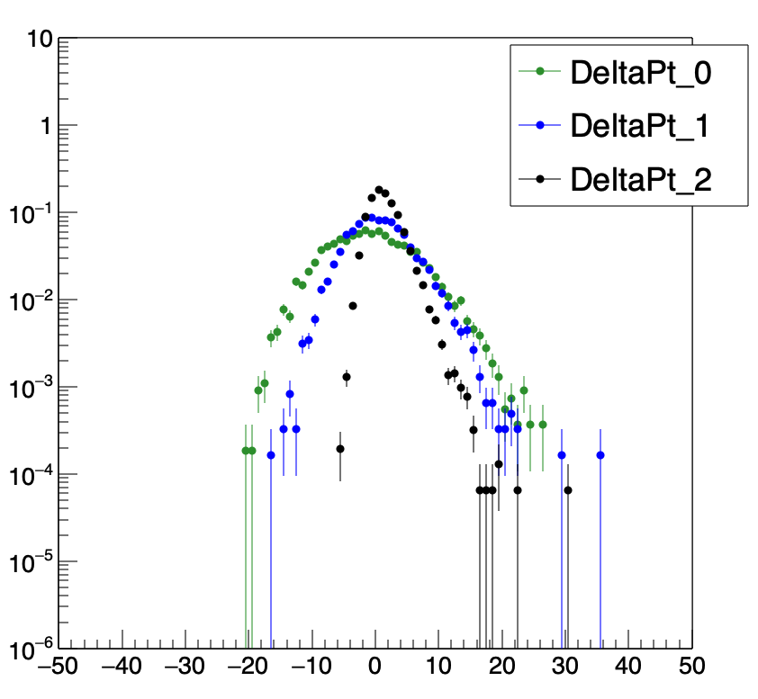
Similar background smearing in the presence of HI background

Slide 8
No cuts on z-vertex for MC and Real Event
 | Mean | RMS
Central | -1.84 | 6.69
Mid-Central | -0.28 | 4.60
Peripheral | 0.15 | 2.16

Slide 9
Cut on z-vertex for MC and Real Event = 3 cm
 | Mean | RMS
Central | -1.7 | 6.77
Mid-Central | -0.16 | 4.69
Peripheral | 0.25 | 2.31

Slide 10
Cut on z-vertex for MC and Real Event = 6 cm
 | Mean | RMS
Central | -1.81 | 6.71
Mid-Central | -0.25 | 4.62
Peripheral | 0.18 | 2.19

Slide 11

Cut on z-vertex for MC and Real Event $∈$ [3,6] cm
 | Mean | RMS
Central | -1.99 | 6.61
Mid-Central | -0.39 | 4.50
Peripheral | 0.07 | 2.01

Slide 12
Response Matrices from Pure Pythia [pthatbin 3-inf]
Centrality [0-10]
Centrality [10-40]
Centrality [40-80]

Slide 13
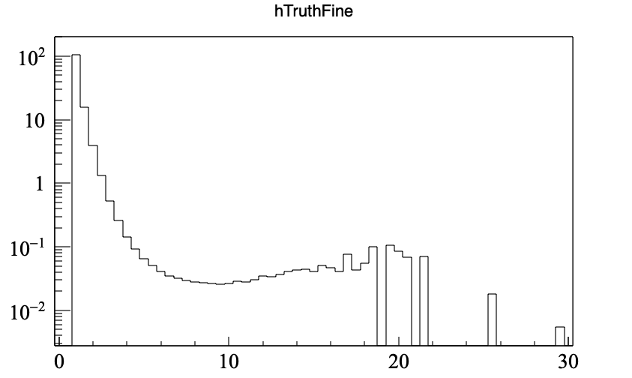
Response Matrices weighed by FONLL
Centrality [0-10]
Centrality [10-40]
Centrality [40-80]
FONLL weights
FONLL weighting artificially destroys the diagonal nature of the response matrices
A more complete way to build the response matrix is to have events in the lower pt hat bin

Slide 14
Response Matrices After Combining pthatbin
Centrality [0-10]
Centrality [10-40]
Centrality [40-80]

Slide 15
pT hat bins -> [0, 3], [3, inf]
Cross section values (mb):
[0-inf] = 0.109
[0-3] = 0.103
[3-inf] = 0.006

Slide 16
Checking PYTHIA and FONLL

Slide 17
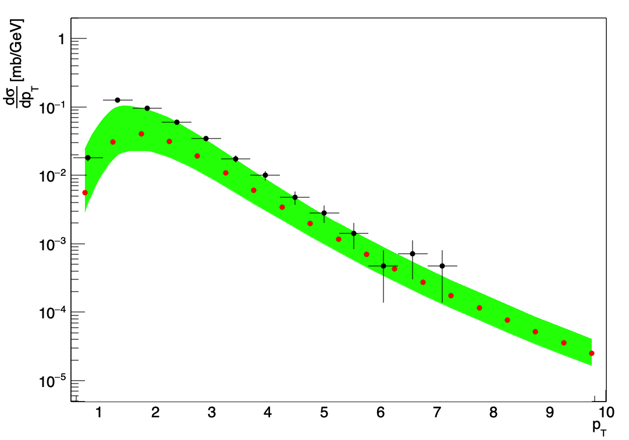
With all HardQCD processes on:

Slide 18
With ccbar and bbbar processes on:

Slide 19
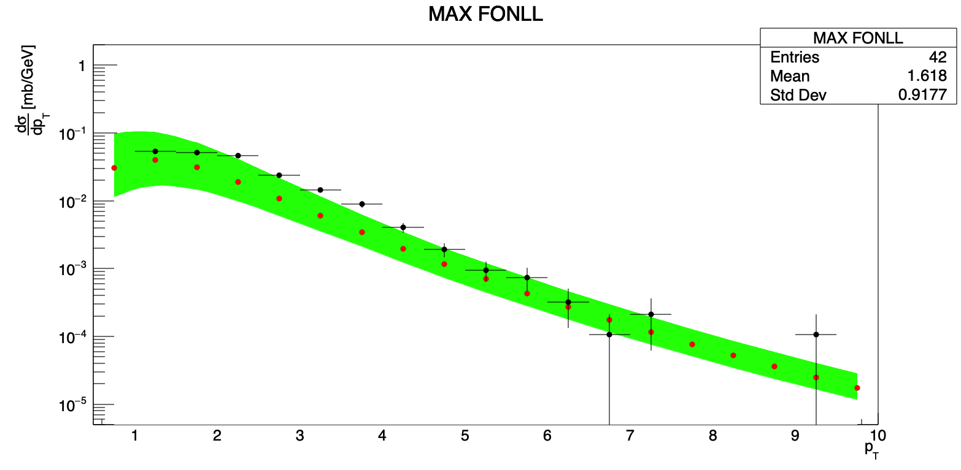
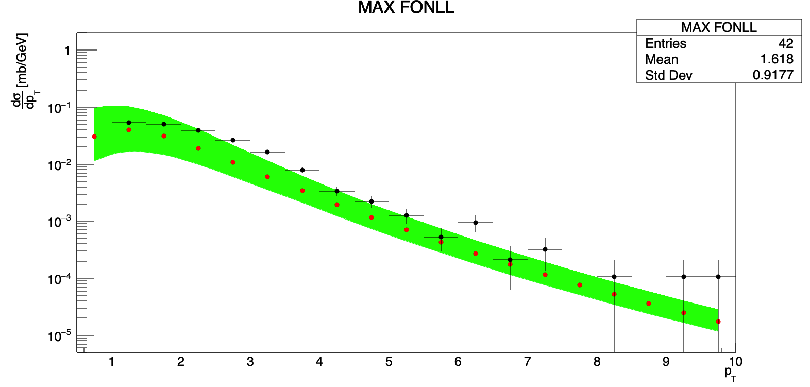
STAR ORIGINAL
SOFT QCD Minbias

Slide 20
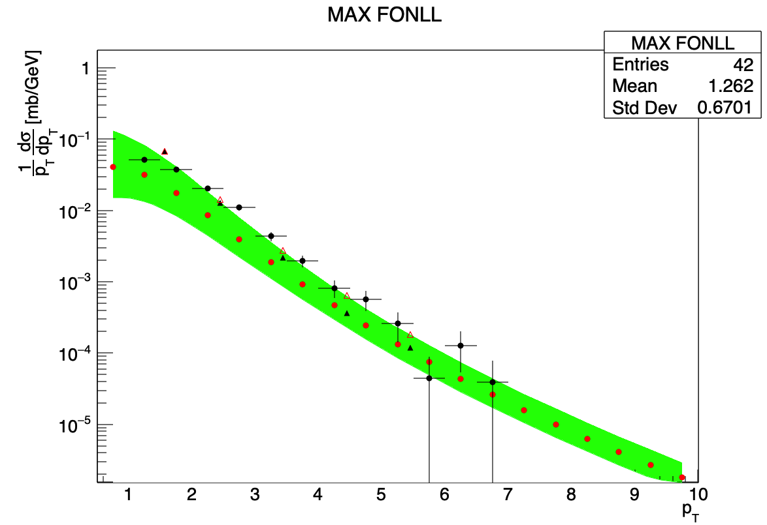
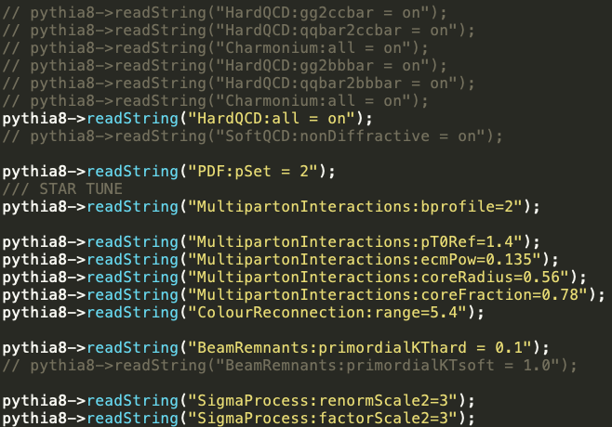
CTEQ5L

Slide 21
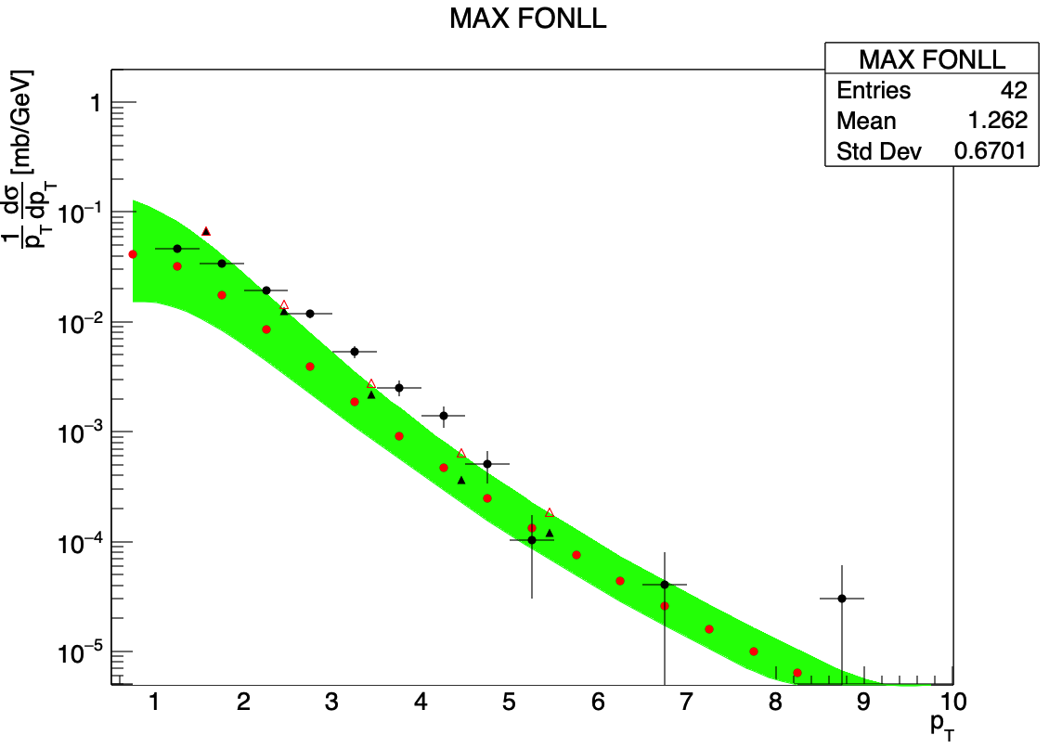
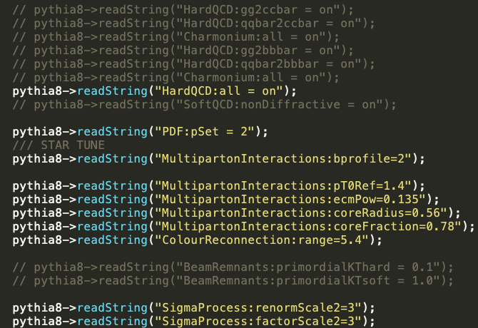

Slide 22
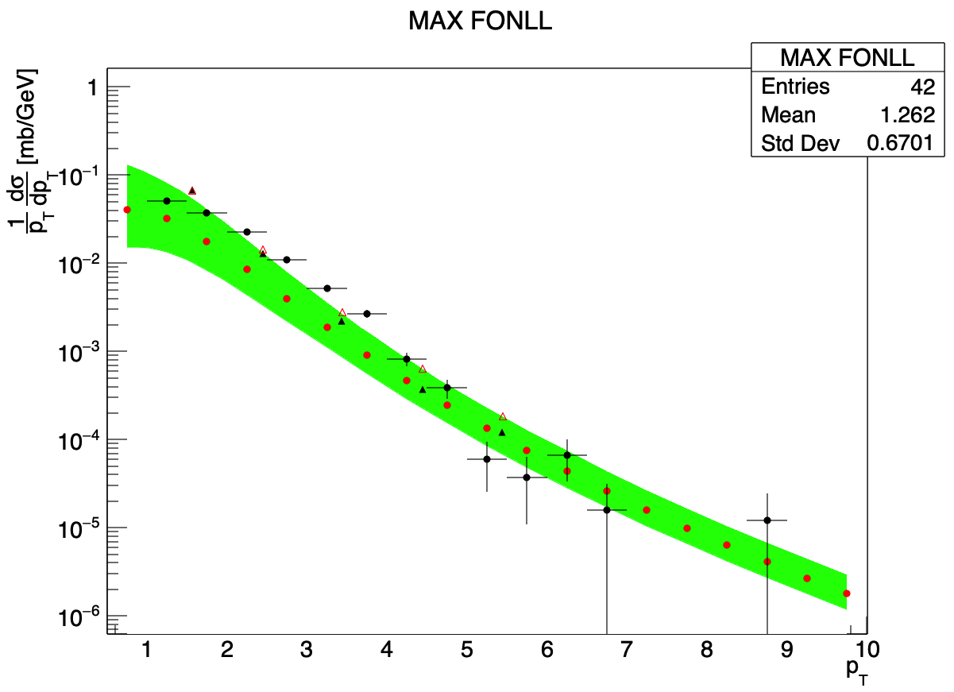
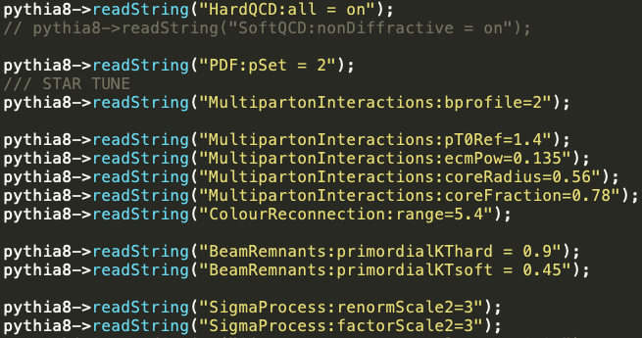
CTEQ5L

Slide 23
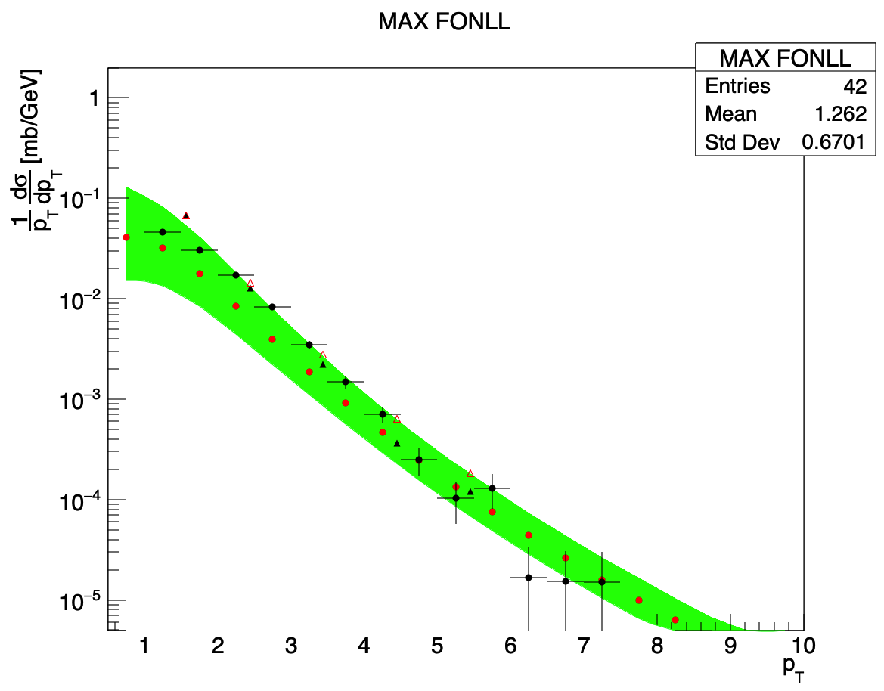
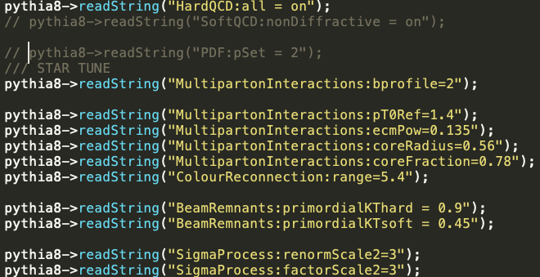

Slide 24
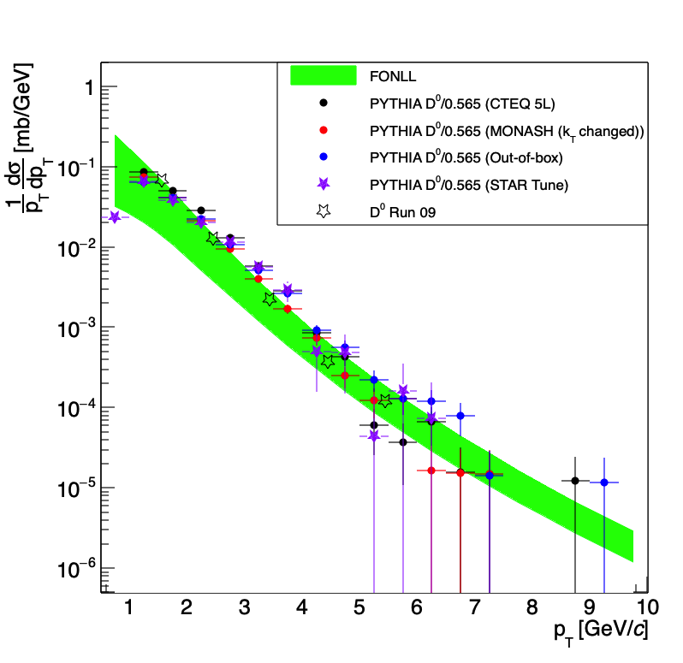
Comparison between all tunes

Slide 25
Performance of Response Matrix from HIOverlay: Effect of Z
N-Dimensional Histogram with Z, MC D0 Pt, MC Jet Pt, Reco D0 Pt, Reco Jet Pt, MC Jet Eta, Reco Jet Eta
Sample Z from different toy distributions ~ (1-z)^{*something*}
Sample an (N-1) dimensional histogram corresponding to Z value : MC D0 Pt, MC Jet Pt, Reco D0 Pt, Reco Jet Pt, MC Jet Eta, Reco Jet Eta
See the effect of the change of Z on the spectra/RCP

Slide 26
Performance of Response Matrix from HIOverlay
Z From Pythia

Slide 27
Performance of Response Matrix from HIOverlay
(1-z)^0

Slide 28
Performance of Response Matrix from HIOverlay
(1-z)^1

Slide 29
Performance of Response Matrix from HIOverlay
(1-z)^2

Slide 30
Performance of Response Matrix from HIOverlay
(1-z)^3

Slide 31
Performance of Response Matrix from HIOverlay
(1-z)^4

Slide 32
Performance of Response Matrix from HIOverlay
(1-z)^-0.5

Slide 33
Performance of Response Matrix from HIOverlay
(1-z)^-1.0

Slide 34
Performance of Response Matrix from HIOverlay
(1-z)^-1.5

Slide 35
Performance of Response Matrix from HIOverlay
(1-z)^-2.0

Slide 36
Effect of Z

Slide 37
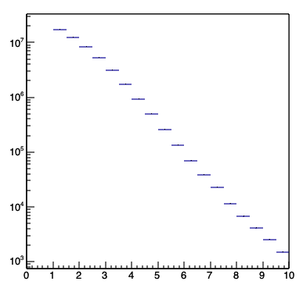
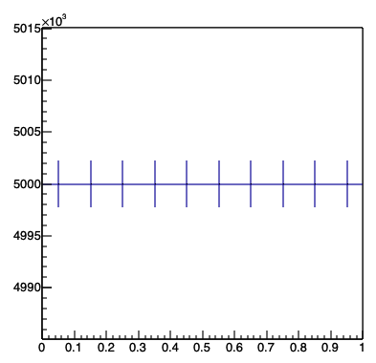
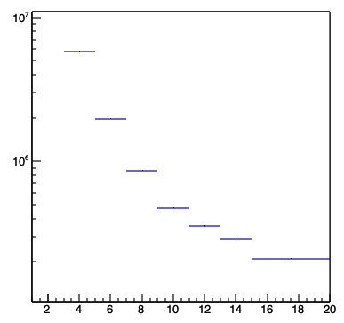
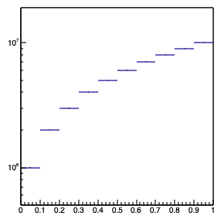
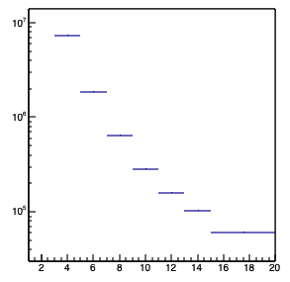
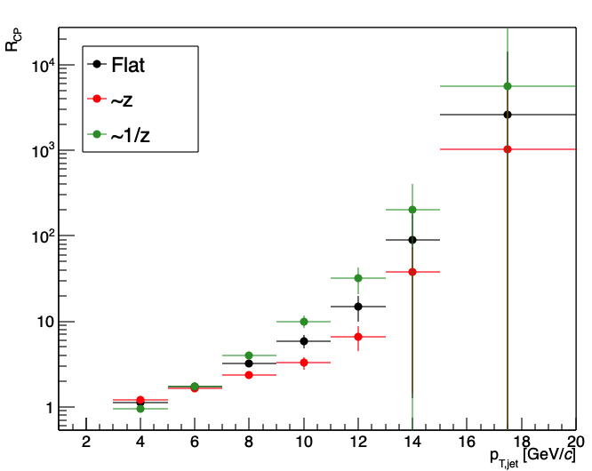
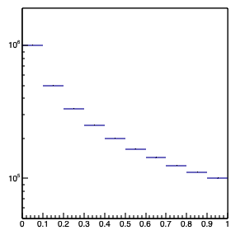
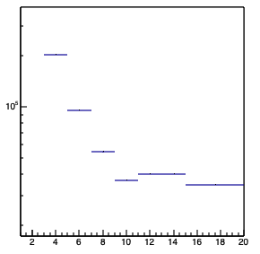
Toy Z Distribution
Generate Toy Z Distribution: Flat, ~z, ~1/z
Sample D0 pT from PYTHIA(pp) for each Z bin
Generate MC Jet pT Distribution corresponding to the sampled D0 pT and Z
Smear MC Jet Pt with smearing factors from single particle embedding for response matrix
D0 pT
Flat Z
Jet pT for Flat Z
Jet pT for ~ Z
~ Z
~1/z
Jet pT for ~ 1/Z

Slide 38
Reweighting with uncorrected detector-level distributions
Unfolding procedure changed slightly
Make a response matrix within fiducial cuts for MC and Reco (no fakes and misses due to fiducial cuts)
Have a separate MC Jet pT and centrality dependent efficiency to account for jets lost to fiducial cuts → This is applied after unfolding
Particle Level
|Jet eta| < 0.6
1 < D0 pT (GeV/c) < 10
1 < Jet pT (GeV/c) < 30
Central
MidCentral
Peripheral
Detector Level
|Jet eta| < 0.6
1 < D0 pT (GeV/c) < 10
1 < Jet pT (GeV/c) < 30
0 < z < 1

Slide 39
Reweighting with uncorrected detector-level distributions
Particle
Detector
Data
Central
MidCentral
Peripheral
Z
Z distribution from data scaled to Z distribution integral from detector level jets
Central
MidCentral
Peripheral
Data/Detector Level
Z

Slide 40
Reweighting with uncorrected detector-level distributions
No reweight
Central
MidCentral
Peripheral
Z distribution is sampled from the corresponding centrality class in each case
Central
MidCentral
Peripheral

Slide 41
Reweighting with uncorrected detector-level distributions
Central
MidCentral

