Slide 1
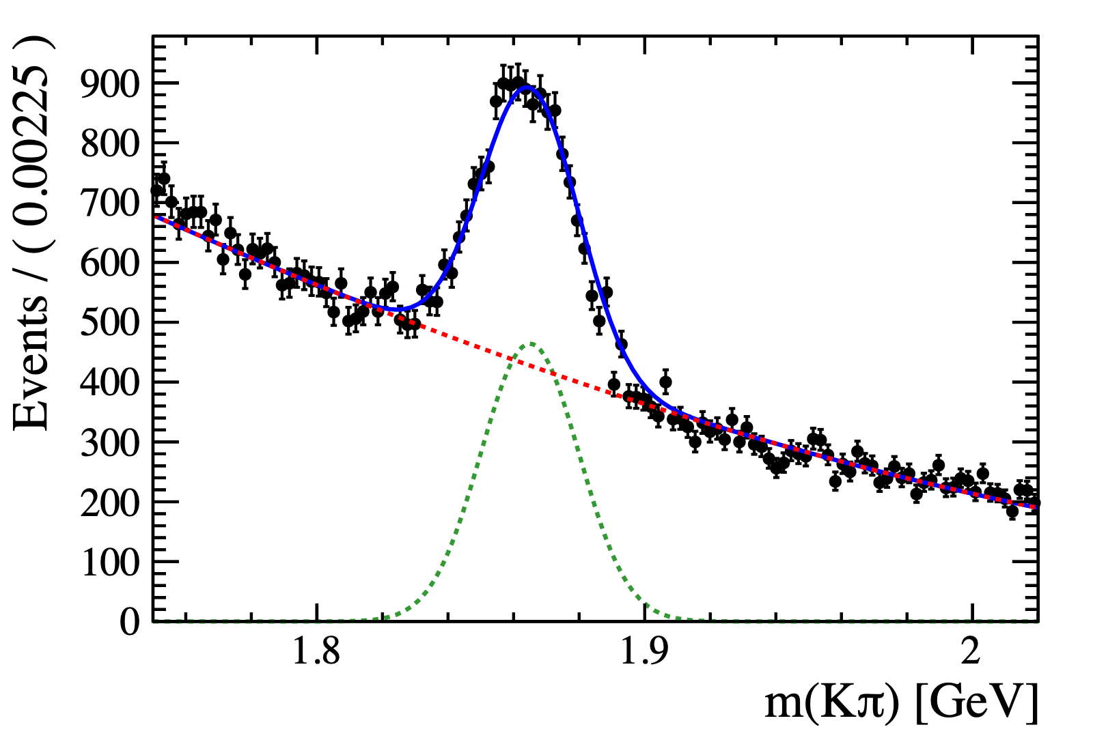
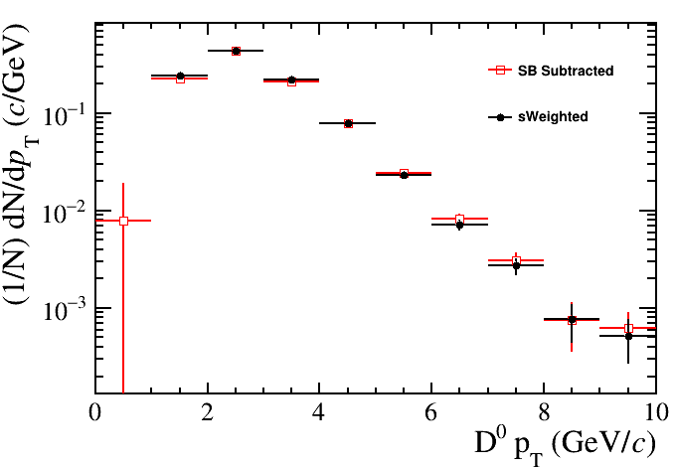
D0-Jet Yield Extraction
Yields are determined in bins of Jet pT, D0 pT, and D0 Delta R using two methods:
1) Fit to the invariant mass in bins of D0 pT, scale jet pT/Delta R
-
2) sPlot method:
- Native class in RooStats + widely used in HEP
- Unbinned maximum likelihood fit to invariant mass integrated over all kinematics; bin jet pT and Delta R histograms with all D0-jet candidates using sWeights
- Trivial to include reconstruction efficiencies versus D0 kinematics
$${}_{s}P_{n}(m_{Kπ,i})=\frac{∑_{j=1}^{N_{T}}{\text{V}}_{nj}f_{j}(m_{Kπ,i})}{∑_{k=1}^{N_{T}}N_{k}f_{k}(m_{Kπ,i})}$$
$${}_{s}P_{n}(m_{Kπ,i})→\frac{{}_{s}P_{n}(m_{Kπ,i})}{ε(m_{Kπ,i})}$$
Unbinned max. likelihood fit
n = n-th fit component(sig/bkg)
Nk = k-th yield (T=2)
fk(mKπ,i) = per-event PDF value with k-th hypothesis
V = cov. matrix
BKG
Signal
BKG
Consistent results with SB subtracted data
doi.org/10.1016/j.nima.2005.08.106

