Slide 1
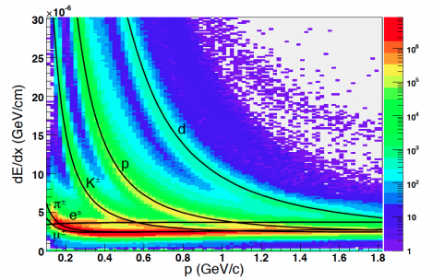
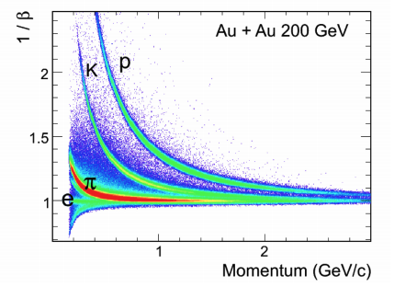






TPC
TOF
Au+Au $√s_{NN}$ = 200 GeV, Run14
Au+Au $√s_{NN}$ = 200 GeV, Run14
$−\left\langle \frac{dE}{dx}\right\rangle$ $∝\frac{m^{2}}{p^{2}}$
$$β=\frac{L}{cτ}$$
$|\frac{1}{β} − \frac{1}{β_{exp}}|$ < 0.03
|n$σ_{π}$| < 3.0; |n$σ_{K}$| < 2.0

Slide 2
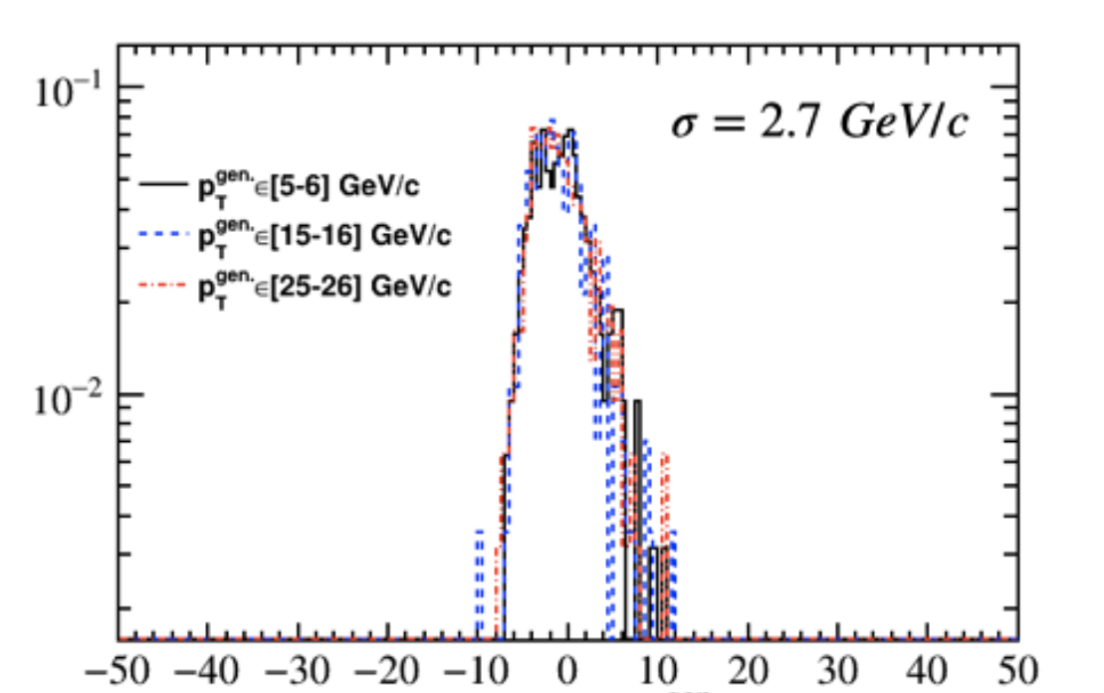








Closure for Unfolding Jet Spectrum
Centrality 40 – 80 %
anti-k_{T} jets with D⁰, R = 0.4
$$\left|η_{jet}\right|<0.6$$
$p_{T,const}>0.2$ GeV/c
$p_{T,jet}>3$ GeV/c
1 <${ p}_{T, Kπ }$< 15 (GeV/c)
$\sqrt{s}=200$ GeV p+p
PYTHIA 8 + GEANT 3
Au+Au $√s_{NN}$ = 200 GeV
Simulation
X
$\sqrt{s}=200$ GeV p+p
PYTHIA 8 + GEANT 3
Au+Au Heavy Ion Background
anti-k_{T} jets with D⁰, R = 0.4
$$\left|η_{jet}\right|<0.6$$
$p_{T,const}>0.2$ GeV/c
$p_{T,jet}>3$ GeV/c
1 <${ p}_{T, Kπ }$< 15 (GeV/c)
anti-k_{T} jets with D⁰, R = 0.4
$$\left|η_{jet}\right|<0.6$$
$p_{T,const}>0.2$ GeV/c
$p_{T,jet}>3$ GeV/c
1 <${ p}_{T, Kπ }$< 15 (GeV/c)
$\sqrt{s}=200$ GeV p+p
PYTHIA 8 + GEANT 3
Au+Au Heavy Ion Background
Detector Effect
Background Fluctuation
PLACEHOLDER
Closure test shows that we can reproduce the particle level p_{T,jet} spectrum using unfolding

Slide 3
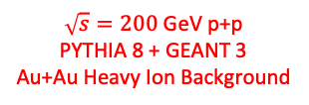
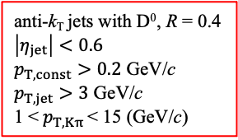
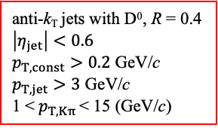
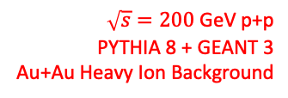



Closure for Unfolding Radial Distribution of D⁰ Mesons in Jets
anti-k_{T} jets with D⁰, R = 0.4
$$\left|η_{jet}\right|<0.6$$
$p_{T,const}>0.2$ GeV/c
$p_{T,jet}>3$ GeV/c
1 <${ p}_{T, Kπ }$< 15 (GeV/c)
Radial distribution is unfolded along with the p_{T,jet}
$\sqrt{s}=200$ GeV p+p
PYTHIA 8 + GEANT 3
Au+Au Heavy Ion Background
Simulation
$\sqrt{s}=200$ GeV p+p
PYTHIA 8 + GEANT 3
Au+Au Heavy Ion Background
anti-k_{T} jets with D⁰, R = 0.4
$$\left|η_{jet}\right|<0.6$$
$p_{T,const}>0.2$ GeV/c
$p_{T,jet}>3$ GeV/c
1 <${ p}_{T, Kπ }$< 15 (GeV/c)
$$ΔR^{Particle}$$
PLACEHOLDER
Closure test shows that we can reproduce the radial distribution of D⁰ mesons for low and mid $ΔR$ using 2D unfolding
$$ΔR^{Detector}$$

Slide 4
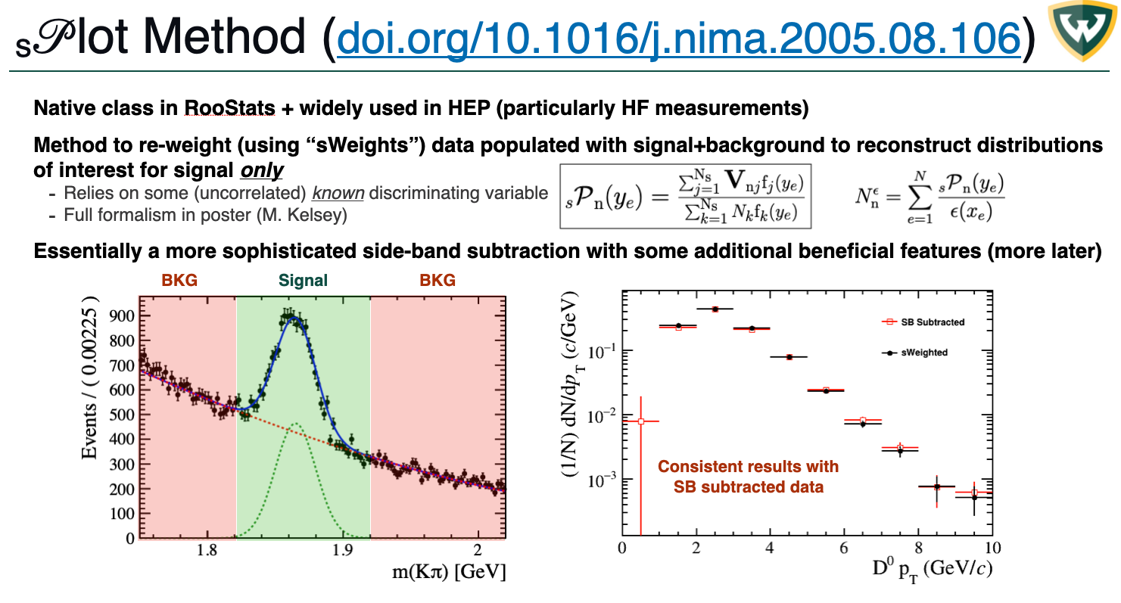

Slide 5
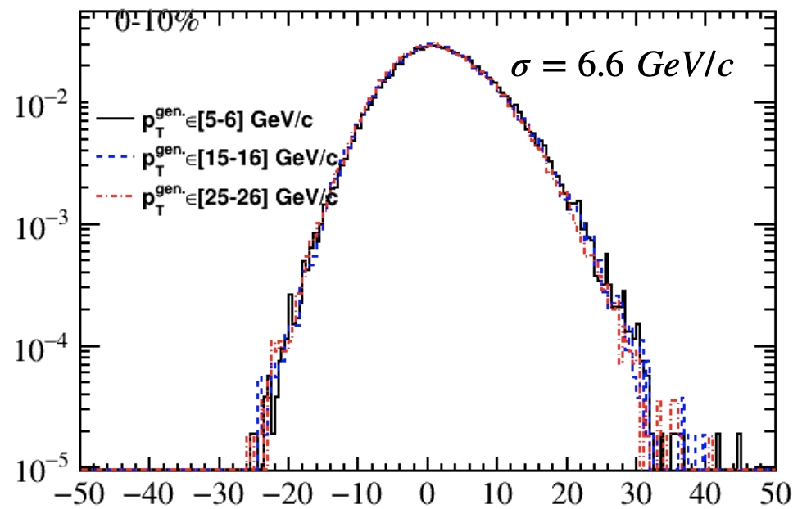
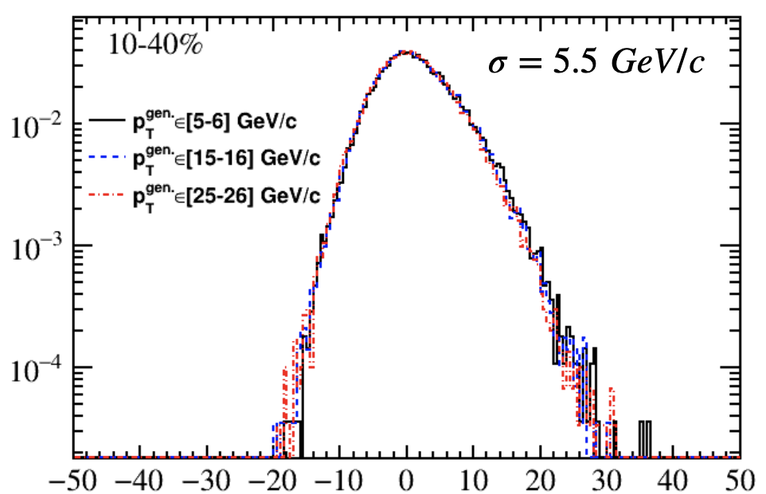
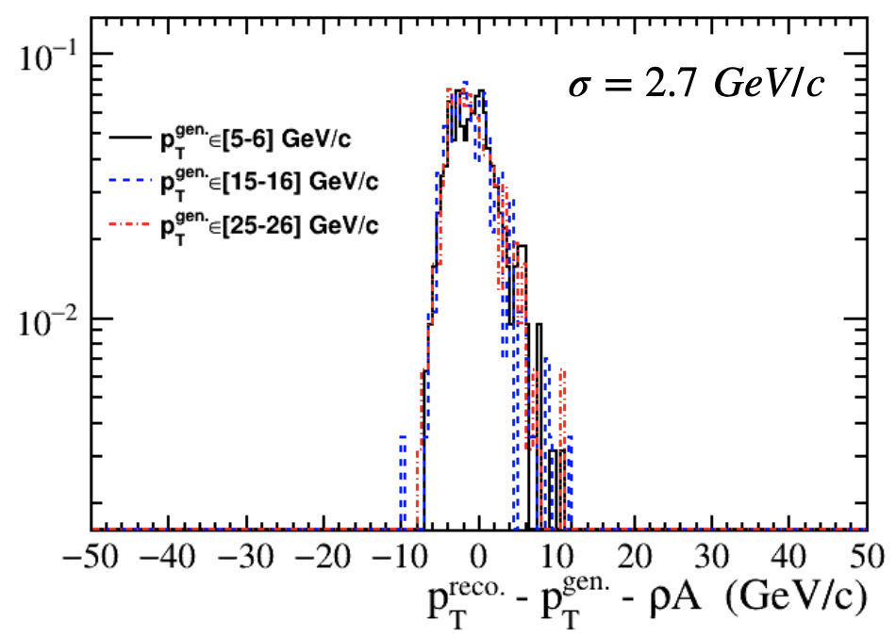
Unfolding for jet reconstruction inefficiencies
Instead of a full embedding sample, existing fast simulation method along with a PYTHIA 8 simulation to estimate detector effects.
HI background fluctuation estimated by embedding a hard track in min-bias events
Background fluctuation is independent of p_{T} of hard track

Slide 6
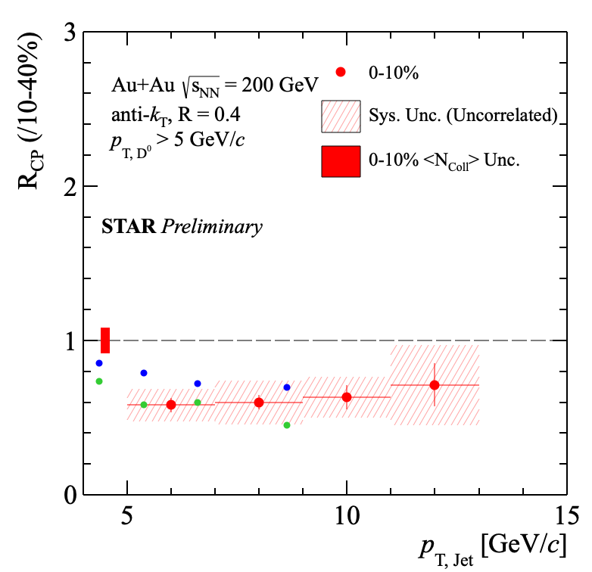
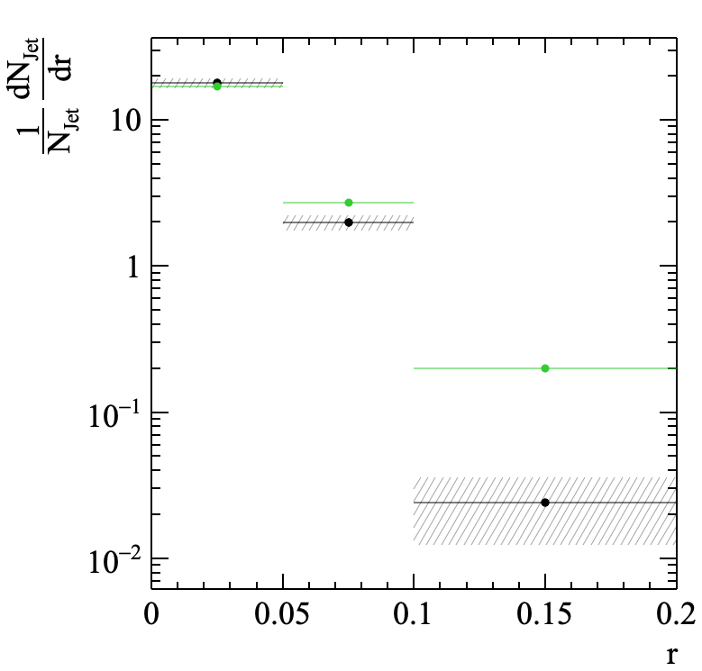
RCP with 10-40
Peripheral v Pythia for delta R

Slide 8
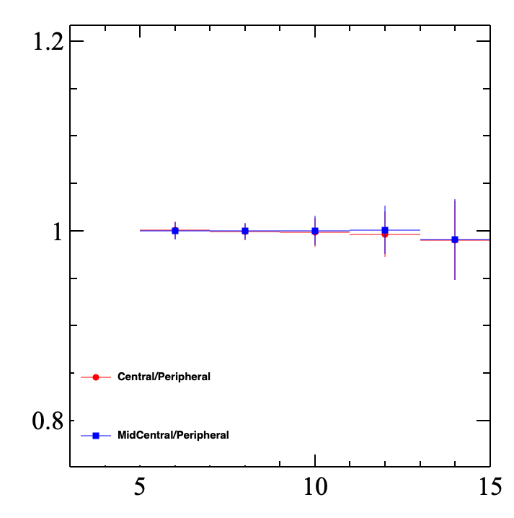
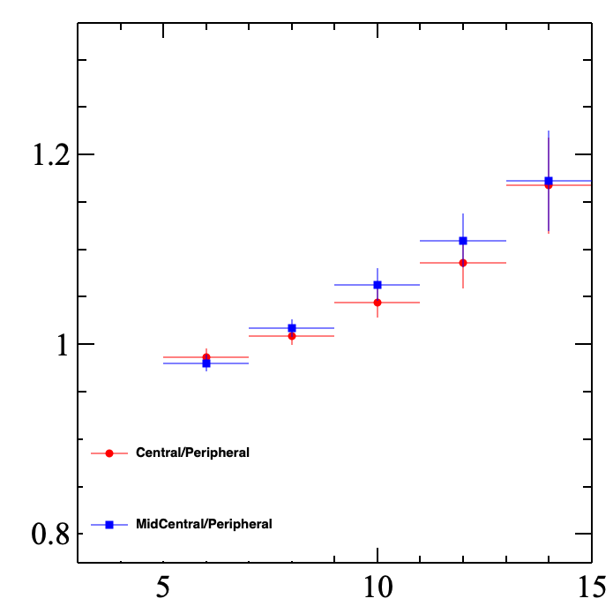
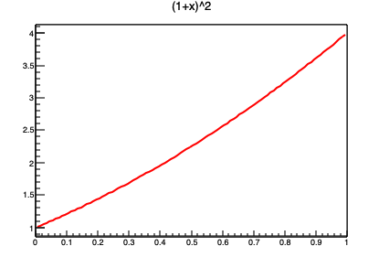
Response Matrix built without z weights
Distribution to be unfolded doesn’t include z weights
Response Matrix built without z weights
Distribution to be unfolded includes z weights
z-weight

