Slide 1
Updates on HIOverlay
Diptanil Roy
December 7, 2022

Slide 2
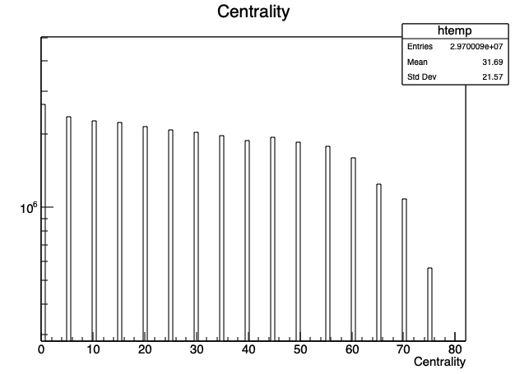
Changes to HIOverlay
Bugs:
Events with 2 D0s were not treated properly
The MC D0 Jet Spectra was not identical to the QM method
Other minor bugs
Ensured that the centrality distribution of overlaid events doesn’t change from data
The issues still exist
QM Method
HI Method
Centrality Distribution for Overlaid Events

Slide 3
HIOverlay vs Single Particle Embedding

