Slide 1
D0 Jets in AuAu 200 GeV
Diptanil Roy
Rutgers University
roydiptanil@gmail.com
May 18, 2023
Hard Probes

Slide 2
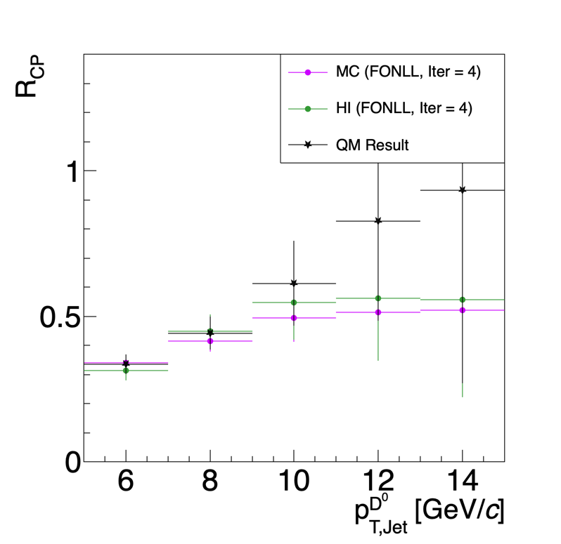
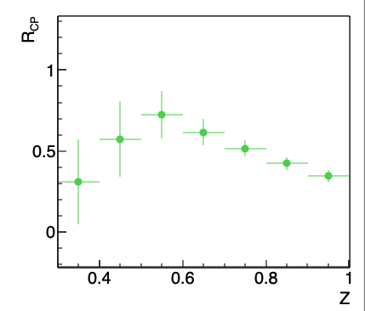

Current Status: Unfolded Distributions for pT,D0 > 5 GeV/c
STAR, Au + Au $√s_{NN}$ = 200 GeV
Using Heavy Ion Overlay Method
More details here

Slide 3
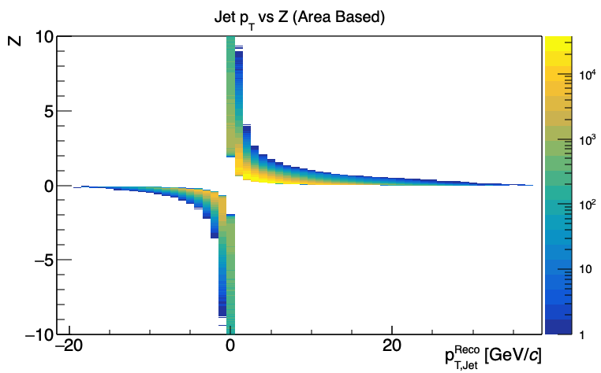
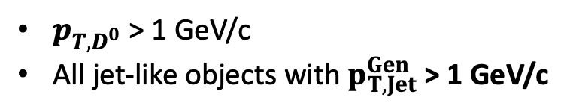
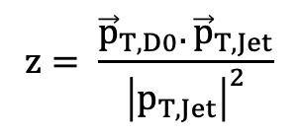

Problem with Area Based Background Subtraction
$$z= \frac{{\vec{p}}_{T,D0}. {\vec{p}}_{T,Jet}}{{\left|p_{T,Jet}\right|}^{2}}$$
$p_{T,D^{0}}$ > 1 GeV/c
All jet-like objects with $p_{T,Jet}^{Gen}$ > 1 GeV/c
HI Overlay, Au + Au $√s_{NN}$ = 200 GeV
Unphysical regions of z < 0 and z > 1
z depends on uncorrected jet pT
Unfolding difficult with disjoint regions
Since we are dealing with low pT jets, can’t ignore the low end completely.
Smearing: Central ~ 6-7 GeV, Peripheral ~ 2-3 GeV

Slide 4
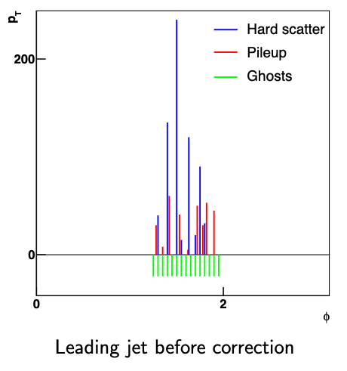
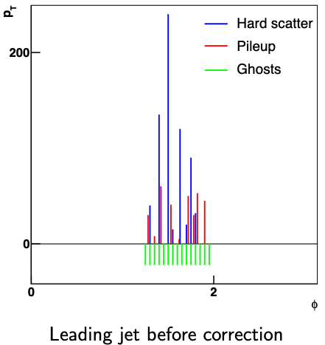
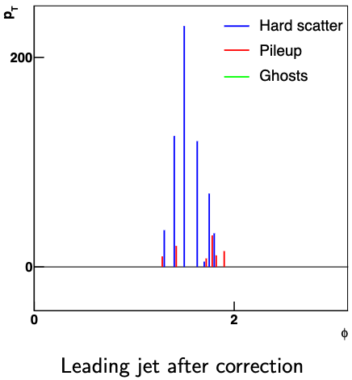
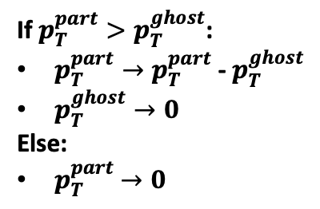



Constituent Background Subtraction
arXiv:1403.3108
Background density calculated as: $ρ=Median\left(\frac{p_{T,Jet}}{A_{Jet}}\right)$.
Jets considered for above calculation are k_{T}-jets with the two hardest jets dropped in the event.
Step 1: Add ghost particles to the event and cluster jets
Step 2: Set ghost particles pT to negative value corresponding to $ρ$
Step 3: Match particles to ghosts and correct pT of constituents
$$R_{part}^{ghost} = \sqrt{∆y^{2}+ ∆φ^{2}}$$
If $p_{T}^{part}>p_{T}^{ghost}$:
$p_{T}^{part}→p_{T}^{part}$ - $p_{T}^{ghost}$
$p_{T}^{ghost}→0$
Else:
$p_{T}^{part}$ $→0$
More details here (Presentation by P. Berta)

Slide 5
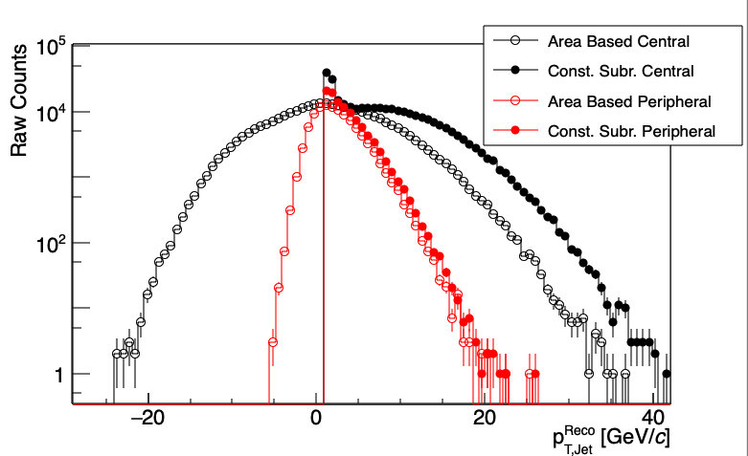

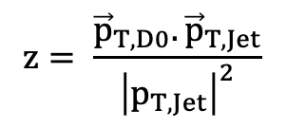
Constituent Background Subtraction
$$z= \frac{{\vec{p}}_{T,D0}. {\vec{p}}_{T,Jet}}{{\left|p_{T,Jet}\right|}^{2}}$$
D⁰ candidates p_{T} well determined from Kaon Pion with HFT hits
Constituent subtraction done only on the non-D⁰ portion of the jet
Median background density estimated with D⁰ candidate instead of KPi
1 < p_{T, D0 Candidate} GeV/c < 10
STAR, Au + Au $√s_{NN}$ = 200 GeV
Low Jet p_{T} end populated with single constituent jets
By definition, z is bounded between 0 and 1

Slide 6

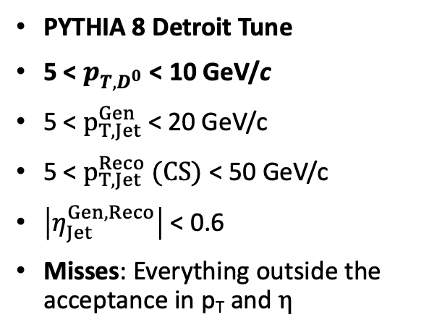
Closure with Constituent Background Subtraction
HI Overlay, Au + Au $√s_{NN}$ = 200 GeV
PYTHIA 8 Detroit Tune
5 < $p_{T,D^{0}}$ < 10 GeV/c
5 < $p_{T,Jet}^{Gen}$ < 20 GeV/c
5 < $p_{T,Jet}^{Reco} (CS)$ < 50 GeV/c
$\left|η_{Jet}^{Gen, Reco}\right|$ < 0.6
Misses: Everything outside the acceptance in p_{T} and $η$
Good closure with Constituent Subtraction

Slide 7
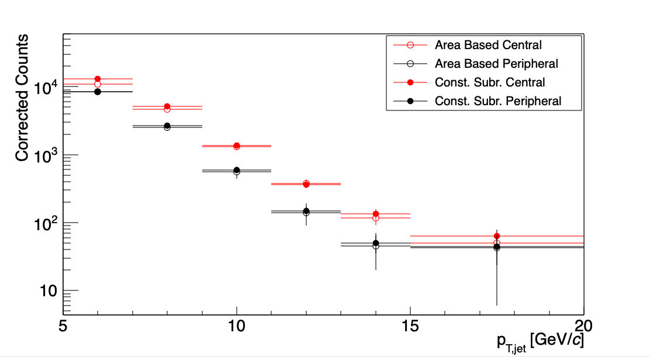
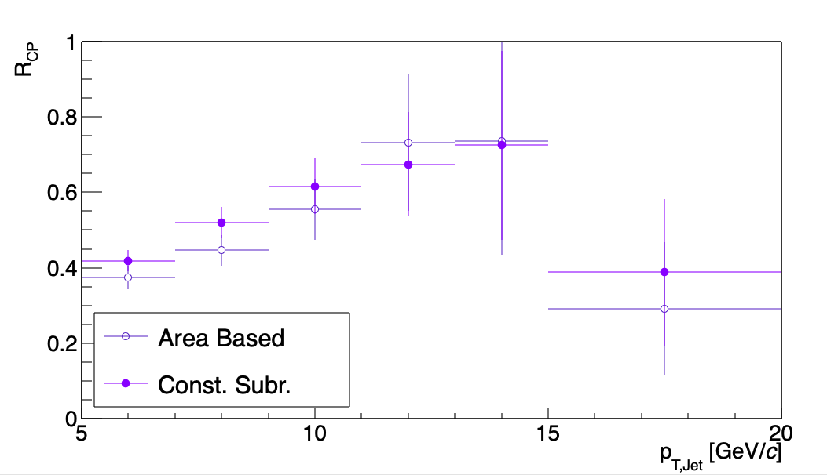

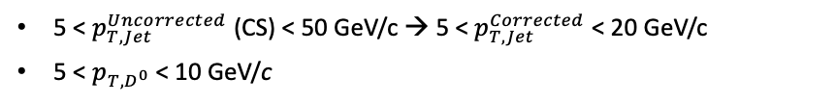
Unfolding with Constituent Background Subtraction
5 < $p_{T,Jet}^{Uncorrected}$ (CS) < 50 GeV/c → 5 < $p_{T,Jet}^{Corrected}$ < 20 GeV/c
5 < $p_{T,D^{0}}$ < 10 GeV/c
STAR, Au + Au $√s_{NN}$ = 200 GeV
Similar Spectra Compared to Area Based Method

Slide 8
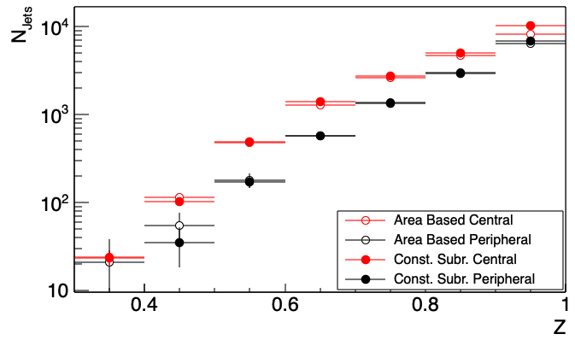
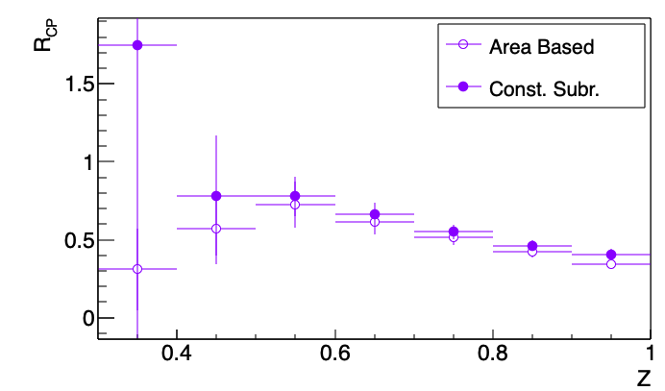
Unfolding with Constituent Background Subtraction
5 < $p_{T,Jet}^{Uncorrected}$ (CS) < 50 GeV/c → 5 < $p_{T,Jet}^{Corrected}$ < 20 GeV/c
5 < $p_{T,D^{0}}$ < 10 GeV/c
Similar Spectra Compared to Area Based Method

Slide 9
Next Steps
Using CS Background Subtraction to go down to pT,D0 > 1 GeV/c
Average background subtracted from D0 might give us a lower bound of D0 pT we can access.
Varying Fragmentation Function for the low pT range

Slide 10
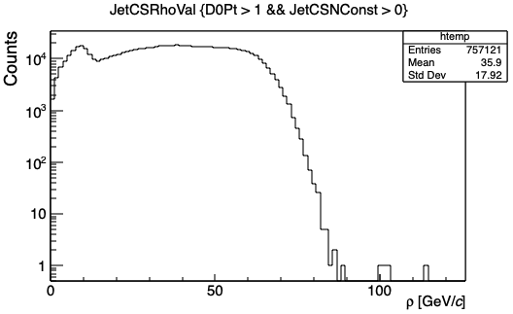
Background Density From D0 Candidate Tagged Events

