Slide 1
Heavy Flavor Tagged Jets in Au+Au 200 GeV
Diptanil Roy
Rutgers University
roydiptanil@gmail.com
STAR Collaboration Meeting
September 14, 2022
Brookhaven National Laboratory

Slide 2
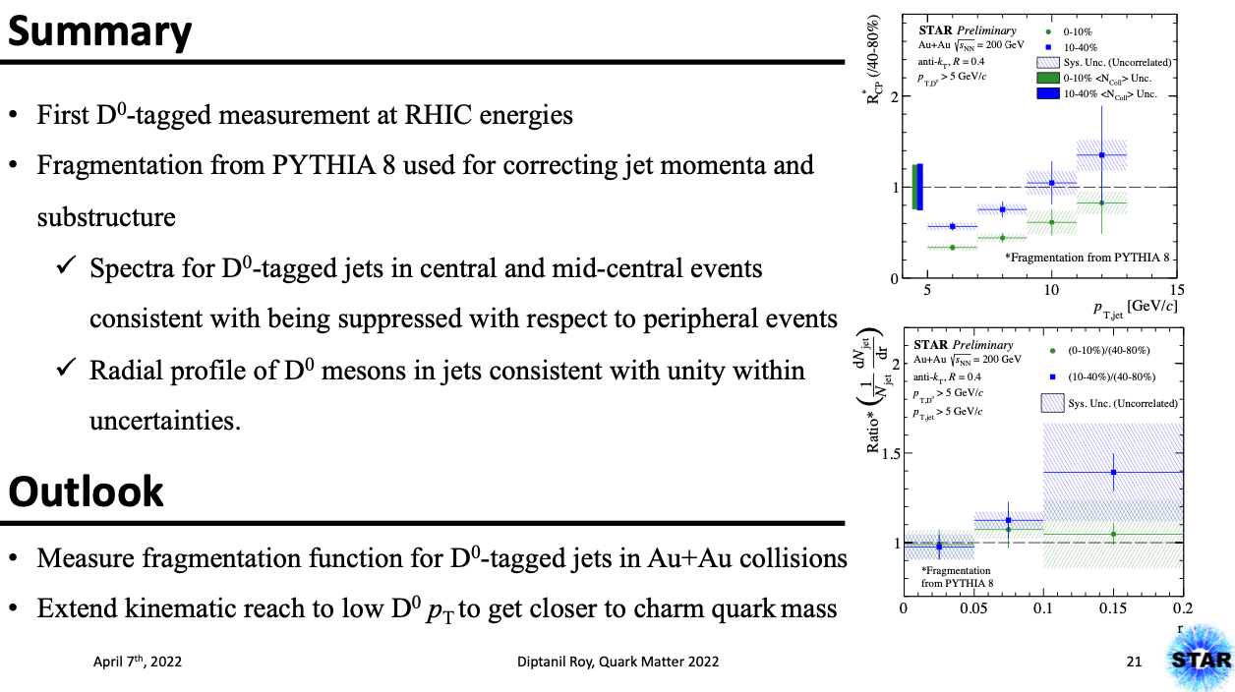
RECAP From QM ’22
ISSUES
1. Fragmentation function for PYTHIA is ‘too’ hard
2. For low D⁰ p_{T} in jets, unfolding is dependent on the fragmentation function
Details here: https://drupal.star.bnl.gov/STAR/system/files/Kelsey_JetCorr_17Mar2022.pdf

Slide 3
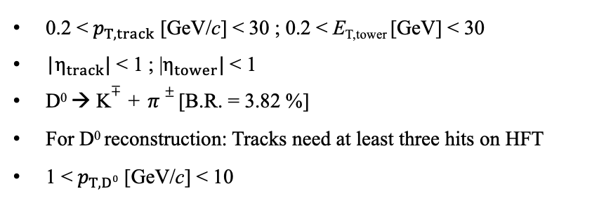
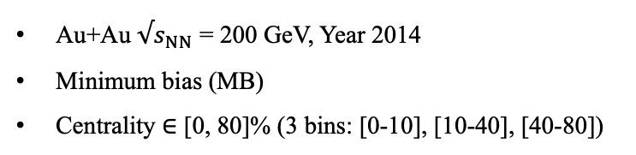
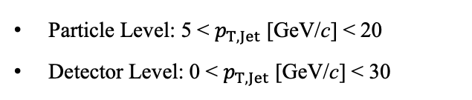
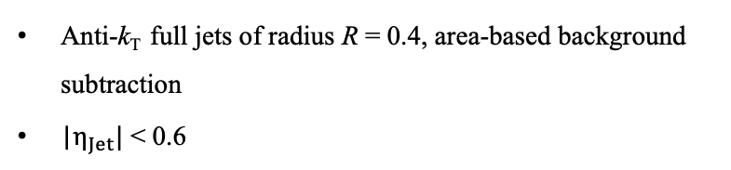
Analysis Details
Event Selection:
Au+Au $√s_{NN}$ = 200 GeV, Year 2014
Minimum bias (MB)
Centrality $∈$ [0, 80]% (3 bins: [0-10], [10-40], [40-80])
Constituent Selection:
0.2 < $p_{T,track }$[GeV/c] < 30 ; 0.2 < E_{T,tower} [GeV] < 30
|$η_{track}|$ < 1 ; |$η_{tower}|$ < 1
D⁰ → K$∓$ + $π±$ [B.R. = 3.82 %]
For D⁰ reconstruction: Tracks need at least three hits on HFT
1 < $p_{T,D0 }$[GeV/c] < 10
Response Matrix Definition
Particle Level: 5 < $p_{T,Jet }$[GeV/c] < 20
Detector Level: 0 < $p_{T,Jet }$[GeV/c] < 30
D⁰ Jet Selection:
Anti-k_{T} full jets of radius R = 0.4, area-based background subtraction
|$η_{Jet}|$ < 0.6

Slide 4
Updating the simulation
Earlier, single particle embedded in minimum bias event to determine background fluctuation
Minimum Bias Event (x1)
Process MB + PYTHIA tracks together
Detector Level Jets
Background Subtraction on combined tracks from MB + PYTHIA
Compare Particle Level Jets with Detector Level Jets
PYTHIA + GEANT3 Event
Particle Level Jets
Get a minimum bias event
Sample ~10 random PYTHIA events for each minimum bias event
Run jet maker on the PYTHIA events ‘embedded’ in the minimum bias event -> This is PARTICLE level
Run jet maker on the combined PYTHIA+Minbias event -> This is DETECTOR level

Slide 5
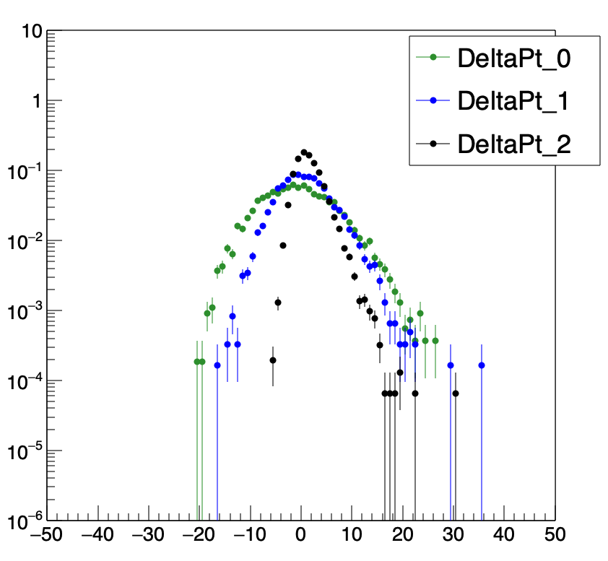
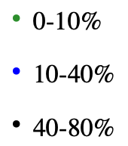

Comparing the background fluctuations
Au+Au Heavy Ion Background
 | Widths [GeV/c]
Central | 6.69
Mid-Central | 4.60
Peripheral | 2.16
$Δp_{T,Embed}$ [GeV/c]
Similar background fluctuation in the two cases

Slide 6
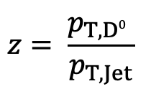
Pythia z
Fragmentation Function (z)
$$z= \frac{p_{T,D0} }{p_{T,Jet}}$$
Flat z
z close to folded data
Depending on the z distribution, the spectra can look wildly different

Slide 7
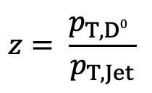
Looking for a different idea: SUPER-ITERATION
Details in these papers: https://arxiv.org/pdf/2106.13235.pdf ; https://arxiv.org/pdf/1701.05116.pdf
$$z= \frac{p_{T,D0} }{p_{T,Jet}}$$
PYTHIA Z
Flatten Z distribution
Unfold the 2D jet p_{T} vs Z from data with flat Z distribution
Use unfolded Z distribution as prior for new response matrix
Call this ‘SUPER-ITERATION’
Unfold the 2D jet p_{T} vs Z from data with new response matrix
Allows us to avoid using the inaccurate shape of ‘z’ distribution from PYTHIA simulation

Slide 8
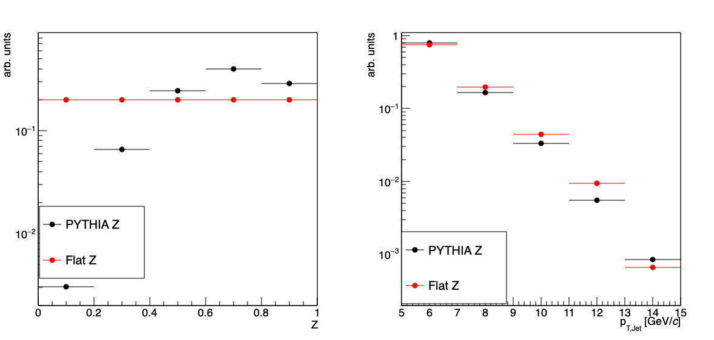
SUPER-ITERATION: Step-by-step
Step 1: Flattening PYTHIA Z
Step 3: Unfolded Z distribution used as “Prior”
Jet p_{T}
Jet p_{T}
Z
Z
Step 2: Unfold the distribution from data
Step 4: Use response matrix from Step 3 to unfold
SUPER-ITERATION
Jet p_{T}
Jet p_{T}
Z
Z

Slide 9

SUPER-ITERATION: Self Closure
$χ2$ vs Super-iteration
(For different regularization parameters)
Regularisation Parameter = 3
Regularisation Parameter = 3
Regularisation Parameter = 7
Regularisation Parameter = 3
Self-Closure can be established after ~20 superiterations

Slide 10
SUPER-ITERATION: Test-Train Split
$χ2$ vs Super-iteration
(For different regularization parameters)
Regularisation Parameter = 3
Regularisation Parameter = 3
Regularisation Parameter = 7
Regularisation Parameter = 3
Closure is retained with a test sample after ~20 superiterations

Slide 11
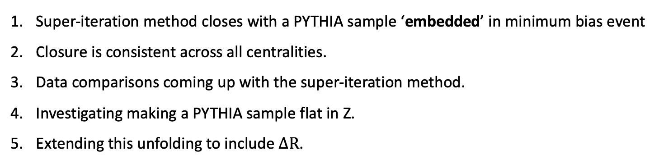
Summary and Outlook
Super-iteration method closes with a PYTHIA sample ‘embedded’ in minimum bias event
Closure is consistent across all centralities.
Data comparisons coming up with the super-iteration method.
Investigating making a PYTHIA sample flat in Z.
Extending this unfolding to include $∆R$.

