Slide 1
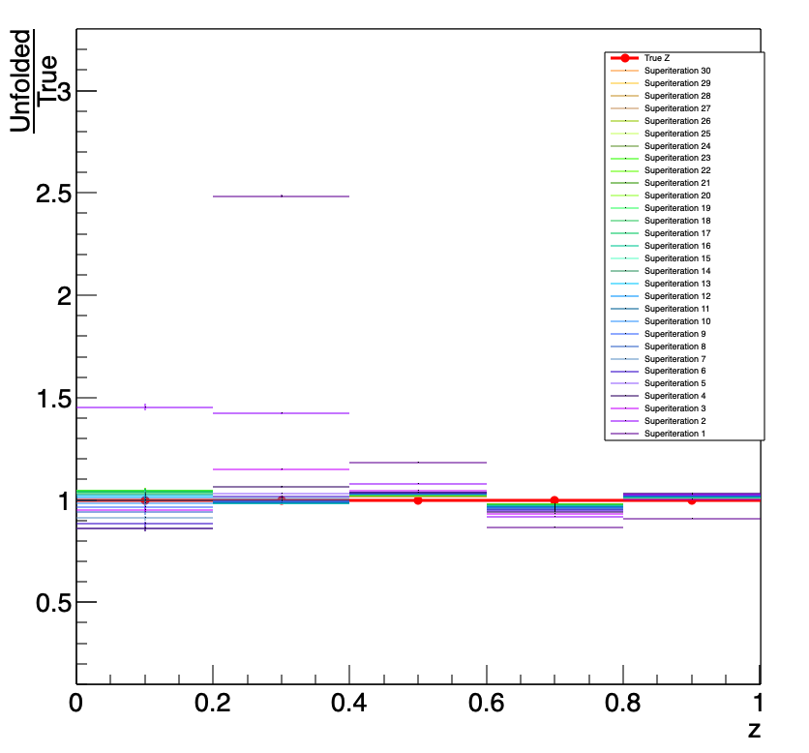
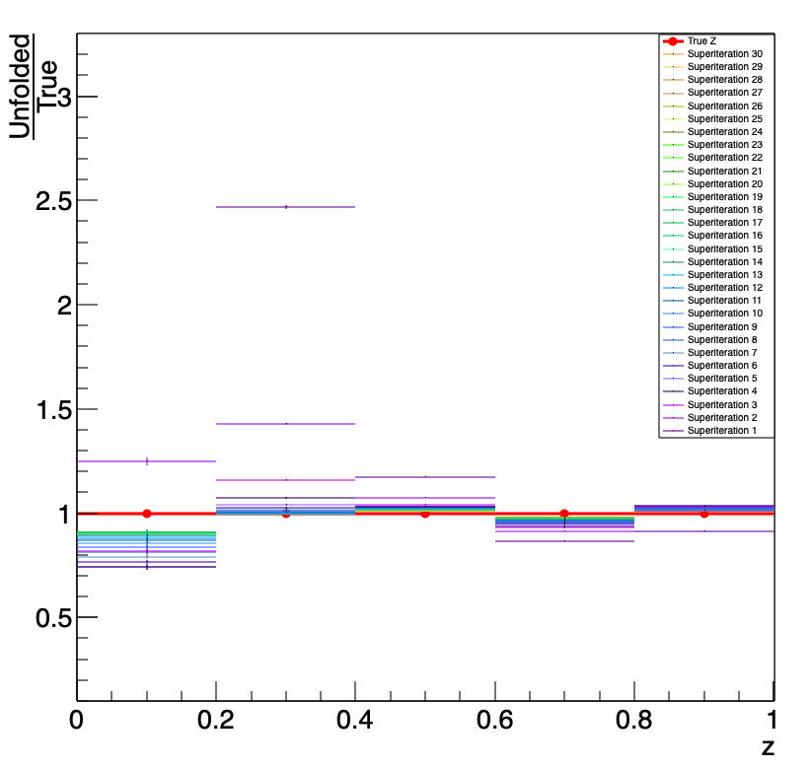
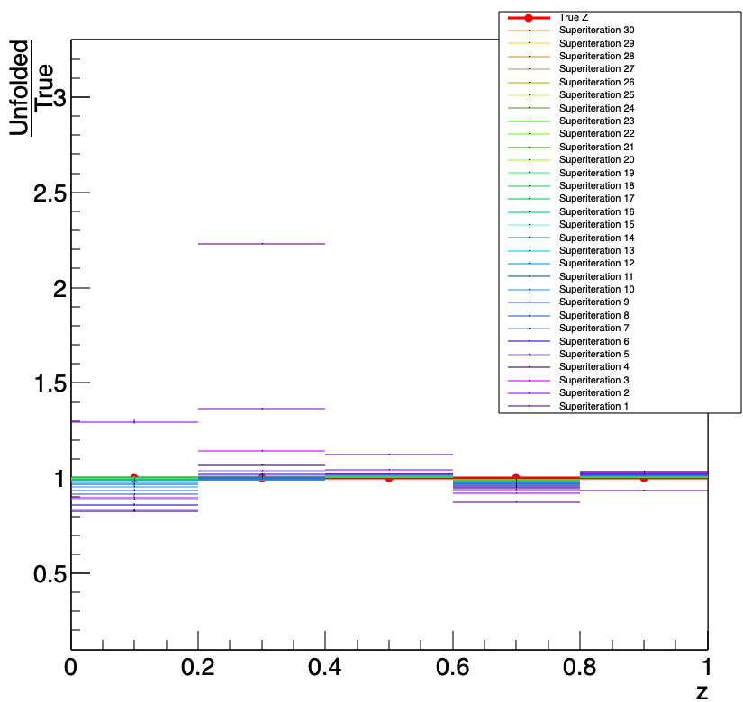
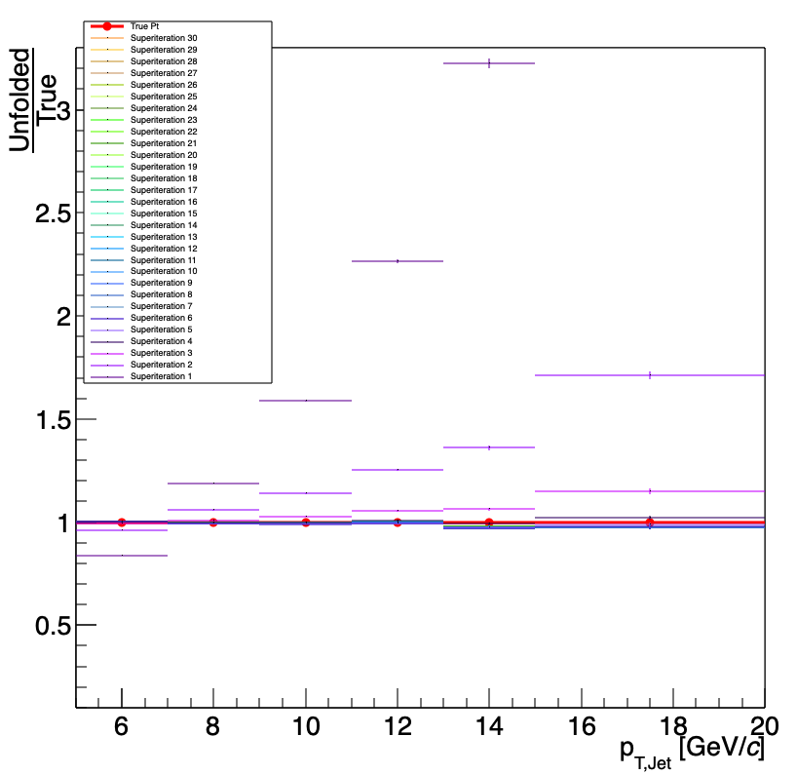
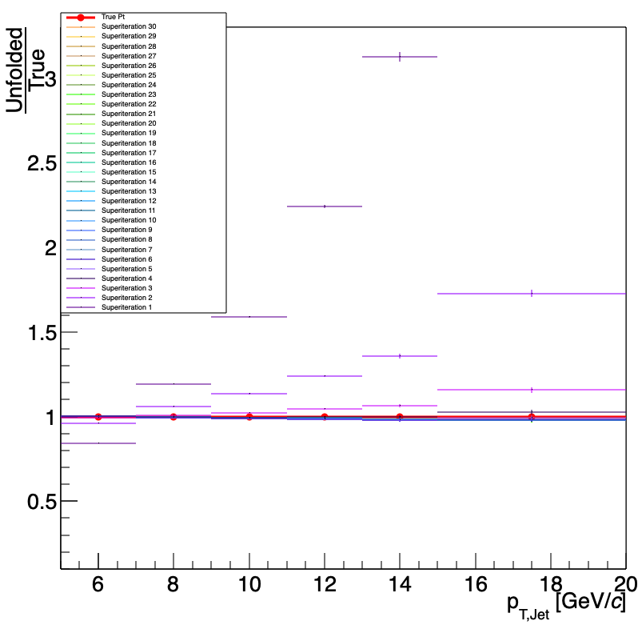
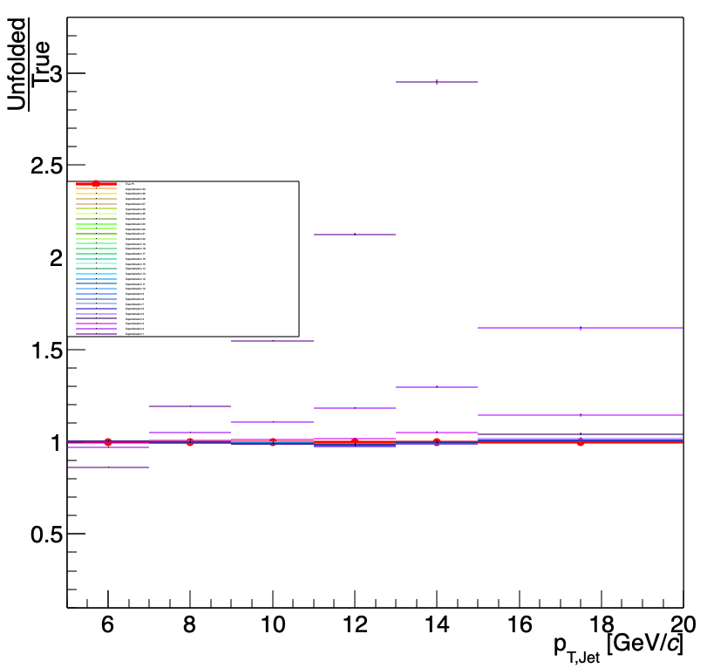
Closure:
1 < D0 pT [GeV] < 10
Jet pT > 5 GeV

Slide 2
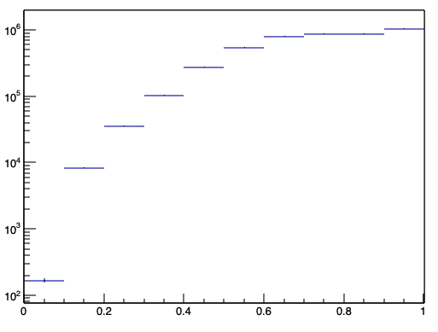
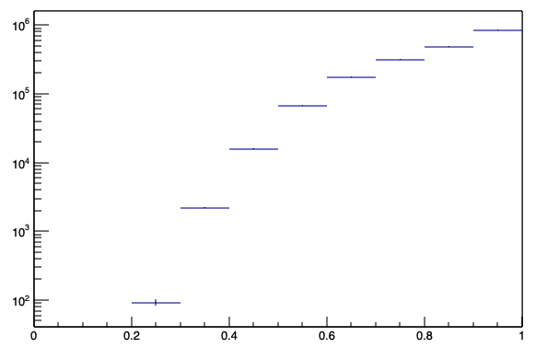
1 < D0 pT [GeV] < 10
5 < D0 pT [GeV] < 10
MC Z
MC Z

Slide 3
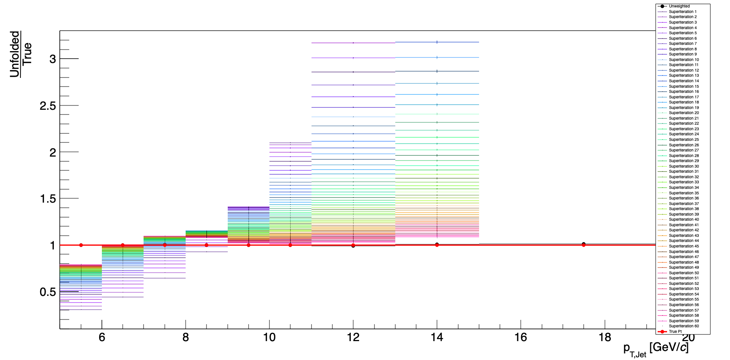
5 < D0 pT [GeV] < 10
Gen Jet pT > 5 GeV
Reco Jet pT > 0 GeV

