Slide 1

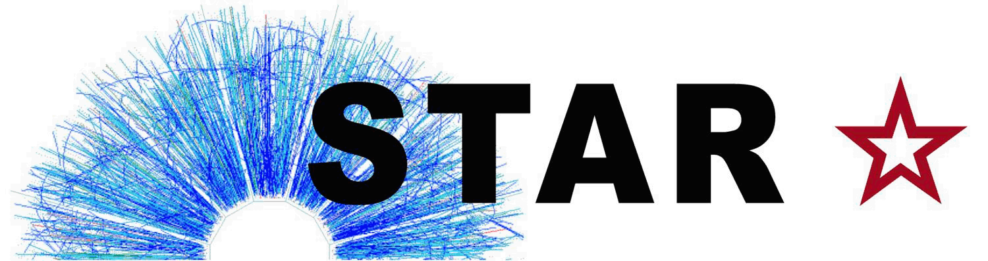



Charm Quark Jets in Au+Au Collisions at $\sqrt{s_{NN}}$ = 200 GeV
QM 2023 Talk Proposal and Analysis Status
April 11, 2023
Diptanil Roy
Rutgers University
roydiptanil@gmail.com
Supported in part by

Slide 2
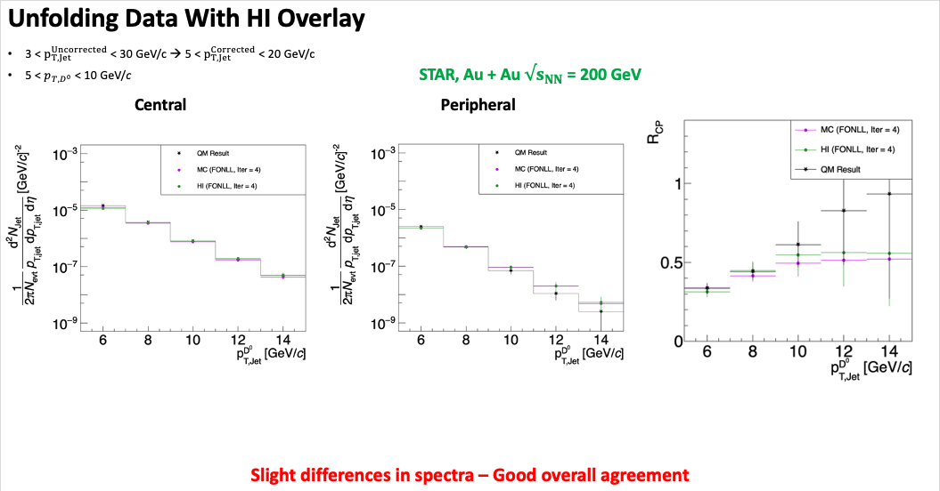
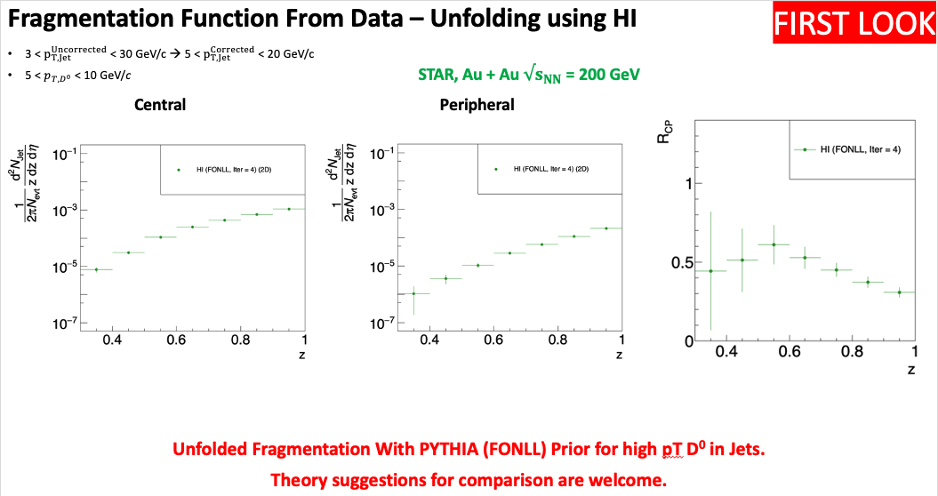
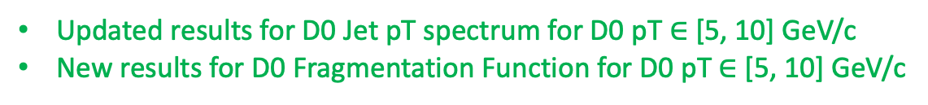
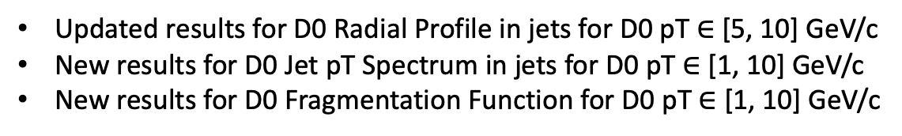
What is your analysis status?
Available
Updated results for D0 Jet pT spectrum for D0 pT $∈$ [5, 10] GeV/c
New results for D0 Fragmentation Function for D0 pT $∈$ [5, 10] GeV/c
Updated results for D0 Radial Profile in jets for D0 pT $∈$ [5, 10] GeV/c
New results for D0 Jet pT Spectrum in jets for D0 pT $∈$ [1, 10] GeV/c
New results for D0 Fragmentation Function for D0 pT $∈$ [1, 10] GeV/c
To be done:
Issues with unfolding being addressed currently

Slide 3
Have you presented your analysis in hp-pwg yet?
Yes, the last update was during the STAR Collaboration Meeting.
https://drupal.star.bnl.gov/STAR/system/files/Diptanil_Roy_STAR_Collaboration_Meeting_2023.pdf
Are your plots "STAR preliminary”? When is paper proposal estimated?
Some plots like the jet pT and radial profile for D0 pT [5,10] GeV/c are STAR preliminaries, but they have been updated.
Need new preliminaries for fragmentation function for jets with D0 pT [5,10] GeV/c → By end of May 2023
Need new preliminaries for all observables for jets with D0 pT [1,10] GeV/c → By end of July 2023
Paper Proposal around the end of July to allow for enough time for review before QM 2023
Is there any change in your data points/physics message compared with your last "STAR preliminary" results? And have you presented these changes at hp-pwg?
Yes, the jet pT and radial profile for D0 pT [5,10] GeV/c have been updated. The presentation was made at the Collaboration Meeting available above.
I will make the presentation again in PWG for those who missed the update, or had questions during the meeting.
The physics message for the jet pT plots and RCP are unchanged for D0 pT [5, 10] GeV/c.

