Slide 1

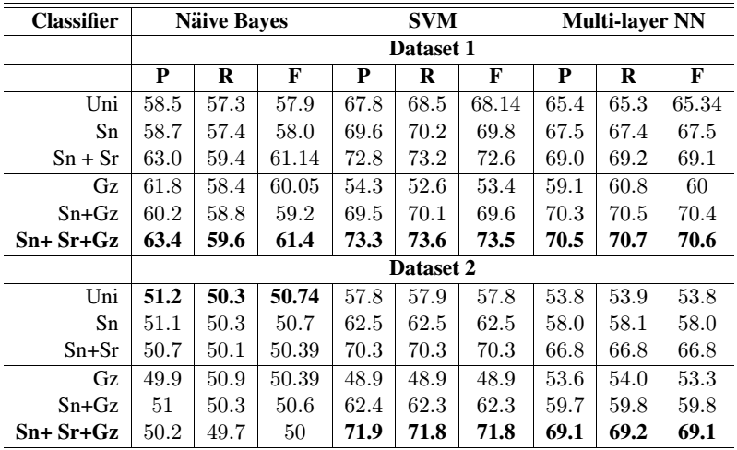
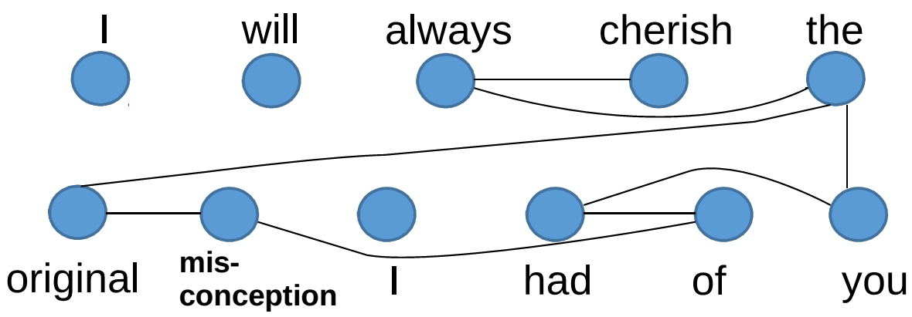
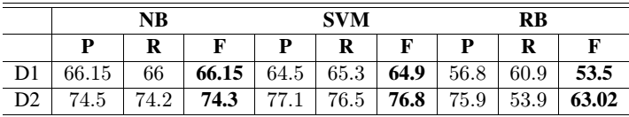
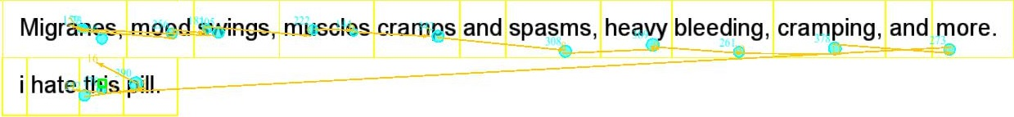

Leveraging Cognitive Features for Sentiment Analysis
Diptesh Kanojia
IITB-Monash Research Academy, Mumbai, India
Under the supervision of
Prof. Pushpak Bhattacharyya (IITB) and Prof. Reza Haffari (Monash)
abjure
Outline
Sentiment Analysis
Challenges
ML – ‘features’
Eye Tracking
Results
Conclusion
word unpredictable being positive in case of unpredictable movie in movie domain and,
negative in case of unpredictable steering in car domain
Dataset | Improvement (%)
D1 | 3.7
D2 | 9.3
His face ‘fell’
The boy ‘fell’
impetuous

