Slide 1


Statistical Machine Translation between Related Languages
Pushpak Bhattacharyya
Indian Institute of Technology Bombay
pb@cse.iitb.ac.in
Anoop Kunchukuttan
Indian Institute of Technology Bombay
anoopk@cse.iitb.ac.in
Mitesh M. Khapra
IBM India Research Lab
mikhapra@in.ibm.com
NAACL 2016 Tutorial
San Diego, California
12th June 2016
You can download the slides from: https://www.cse.iitb.ac.in/~anoopk/publications/presentations/naacl-2016-tutorial.pdf

Slide 2
Tutorial Outline
Introduction & Motivation
Language Relatedness
Translation within related languages
Translation from related languages to another language
Summary

Slide 3
Tutorial Outline
Introduction & Motivation
Language Relatedness
Translation within related languages
Translation from related languages to another language
Summary

Slide 4
Parallel Corpus
A boy is sitting in the kitchen
Un garçon est assis dans la cuisine
A boy is playing tennis
Un garçon joue au tennis
Machine Learning
A boy sitting on a round table
Un garçon assis sur une table ronde
Some men are watching tennis
Certains hommes regardent le tennis
A girl is holding a black book
Une jeune fille tient un livre noir
Two men are watching a movie
Deux hommes regardent un film
A woman is reading a book
Une femme est en train de lire un livre
A woman is sitting in a red car
Une femme est assise dans une voiture rouge
Lets begin with a simplistic view of Statistical Machine Translation (SMT) !!!

Slide 5
Parallel Corpus
A boy is sitting in the kitchen
Un garçon est assis dans la cuisine
A boy is playing tennis
Un garçon joue au tennis
Machine Learning
Learn word/phrase alignments
A boy sitting on a round table
Un garçon assis sur une table ronde
Some men are watching tennis
Certains hommes regardent le tennis
A girl is holding a black book
Une jeune fille tient un livre noir
Two men are watching a movie
Deux hommes regardent un film
A woman is reading a book
Une femme est en train de lire un livre
A woman is sitting in a red car
Une femme est assise dans une voiture rouge
Lets begin with a simplistic view of Statistical Machine Translation (SMT) !!!

Slide 6
Parallel Corpus
A boy is sitting in the kitchen
Un garçon est assis dans la cuisine
A boy is playing tennis
Un garçon joue au tennis
Machine Learning
Learn word/phrase alignments
Learning to reorder
A boy sitting on a round table
Un garçon assis sur une table ronde
Some men are watching tennis
Certains hommes regardent le tennis
A girl is holding a black book
Une jeune fille tient un livre noir
Two men are watching a movie
Deux hommes regardent un film
A woman is reading a book
Une femme est en train de lire un livre
A woman is sitting in a red car
Une femme est assise dans une voiture rouge
Lets begin with a simplistic view of Statistical Machine Translation (SMT) !!!

Slide 7









SMT is by far the most popular machine translation paradigm

Slide 8
Why is SMT so popular?
… because it is a language independent technology
What do we mean by language independent technology?

Slide 9
“If technology developed for one language can be ported to another merely by amassing appropriate training data in the second language, then the effort put into the development of the technology in the first language can be leveraged to more efficiently create technology for other languages.”
- Emily Bender (2011)
Indeed, by the above definition, SMT is a language independent technology, but….

Slide 10
“If technology developed for one language can be ported to another merely by amassing appropriate training data in the second language, then the effort put into the development of the technology in the first language can be leveraged to more efficiently create technology for other languages.”
- Emily Bender (2011)
but….need to focus on two practical considerations:

Slide 11
“If technology developed for one language can be ported to another merely by amassing appropriate training data in the second language, then the effort put into the development of the technology in the first language can be leveraged to more efficiently create technology for other languages.”
- Emily Bender (2011)
but….need to focus on two practical considerations:
Not just ported, it should work well!!
How much is ‘appropriate’ ?

Slide 12
Even though in theory SMT is language independent, in practice
the situation is different ….

Slide 13
HTER | assessment | language pairs and domains
0%
 | publishable | French-English restricted domain
10% |  | French-English technical document localization
 | editable | French-English news stories
20%
 |  | English-German news stories
30% | gistable | English-Czech open domain
40% | triagable
50%
Source: Philip Koehn, Course slides
Very few languages have high quality SMT systems!!

Slide 14
Lets consider the case of English → Malayalam SMT to understand
a few reasons for this ….

Slide 15
Malayalam is a highly agglutinative, predominantly S-O-V language
Even if it does
not rain
mazhA p.eyyutil.e~Ngillu.m
rain_NN rain_VB+not+even_if
harder reordering problem
too many word forms
leads to data sparsity
(not enough counts for all word forms)
bad word/phrase alignments
Solution
Add more parallel data
More linguistic processing (morphological analysis, parsing, etc.)
Not possible for all languages
Notes:
mazhA p.eyyutil.e~Ngillu.m
Even if it does not rain
മഴാ പെയ്യുതിലെങ്ങിലും
rain_noun rain_verb+not+even_if

Slide 16
A more practical definition of language independent technology should include:
appropriate less or reusable data
appropriate less or portable linguistic resources
Obviously, this cannot be achieved when porting SMT to arbitrary language pairs
But can this be achieved for some language pairs?
Yes, for “related” languages
The focus of this tutorial

Slide 17
Lets consider the case of Marathi → Hindi SMT to motivate this ….

Slide 18
What’s so special about this language pair
Related by evolution
Belong to the same language family
(Indo-Aryan branch of the IE language family)
Related by contact
Constant exchange between these languages
(Both are spoken in the Indian subcontinent)
… leading to linguistic similarities and prior knowledge that can be used
Lexical: share significant vocabulary (cognates & loanwords)
Morphological: correspondence between suffixes/post-positions
Syntactic: share the same basic word order

Slide 19
En: On the occasion of India’s Independence day, a program was organized in American city of Los Angeles
India+of
Independence_day+on_occasion_of
America_in
Los
Angeles
city+in
program
organized
+verbalizer
come+past
भारताच्या
स्वातंत्र्यदिनानिमित्त
अमेरिकेतील
लॉस
एन्जल्स
शहरात
कार्यक्रम
आयोजित
करण्यात
आला

Slide 20
En: On the occasion of India’s Independence day, a program was organized in American city of Los Angeles
भारता
च्या
स्वातंत्र्य
दिना
निमित्त
अमेरिके
तील
लॉस
एन्जल्स
शहरा
त
कार्यक्रम
आयोजित
करण्यात
आला
India
+of
Independence
Day
+on_occasion_of
America
in
Los
Angeles
city
in
program
organized
+verbalizer
come+past
1. Segment the Marathi input

Slide 21
En: On the occasion of India’s Independence day, a program was organized in American city of Los Angeles
भारता
च्या
स्वातंत्र्य
दिना
निमित्त
अमेरिके
तील
लॉस
एन्जल्स
शहरा
त
कार्यक्रम
आयोजित
करण्यात
आला
भारत
अमरीका
लॉस
एन्जल्स
India
+of
Independence
Day
+on_occasion_of
America
in
Los
Angeles
city
in
program
organized
+verbalizer
come+past
Segment the Marathi input
Transliterate Named Entities

Slide 22
En: On the occasion of India’s Independence day, a program was organized in American city of Los Angeles
भारता
च्या
स्वातंत्र्य
दिना
निमित्त
अमेरिके
तील
लॉस
एन्जल्स
शहरा
त
कार्यक्रम
आयोजित
करण्यात
आला
भारत
स्वतंत्रता
अमरीका
लॉस
एन्जल्स
शहर
कार्यक्रम
आयोजित
Segment the Marathi input
Transliterate Named Entities
Transliterate Cognates and Loan words
India
+of
Independence
Day
+on_occasion_of
America
in
Los
Angeles
city
in
program
organized
+verbalizer
come+past

Slide 23
En: On the occasion of India’s Independence day, a program was organized in American city of Los Angeles
India
+of
Independence
Day
+on_occasion_of
America
in
Los
Angeles
city
in
program
organized
+verbalizer
come+past
भारत
स्वतंत्रता
दिवस
अमरीका
लॉस
एन्जल्स
शहर
कार्यक्रम
आयोजित
किया
Segment the Marathi input
Transliterate Named Entities
Transliterate Cognates and Loan words
Some more loan words
भारता
च्या
स्वातंत्र्य
दिना
निमित्त
अमेरिके
तील
लॉस
एन्जल्स
शहरा
त
कार्यक्रम
आयोजित
करण्यात
आला

Slide 24
En: On the occasion of India’s Independence day, a program was organized in American city of Los Angeles
India
+of
Independence
Day
+on_occasion_of
America
in
Los
Angeles
city
in
program
organized
+verbalizer
come+past
Segment the Marathi input
Transliterate Named Entities
Transliterate Cognates and Loan words
Some more loan words
Translate function words
भारता
च्या
स्वातंत्र्य
दिना
निमित्त
अमेरिके
तील
लॉस
एन्जल्स
शहरा
त
कार्यक्रम
आयोजित
करण्यात
आला
भारत
के
स्वतंत्रता
दिवस
के [ ] पर
अमरीका
के
लॉस
एन्जल्स
शहर
में
कार्यक्रम
आयोजित
किया

Slide 25
En: On the occasion of India’s Independence day, a program was organized in American city of Los Angeles
India
+of
Independence
Day
+on_occasion_of
America
in
Los
Angeles
city
in
program
organized
+verbalizer
come+past
Segment the Marathi input
Transliterate Named Entities
Transliterate Cognates and Loan words
Some more loan words
Translate function words
Translate remaining content words
भारता
च्या
स्वातंत्र्य
दिना
निमित्त
अमेरिके
तील
लॉस
एन्जल्स
शहरा
त
कार्यक्रम
आयोजित
करण्यात
आला
भारत
के
स्वतंत्रता
दिवस
के अवसर पर
अमरीका
के
लॉस
एन्जल्स
शहर
में
कार्यक्रम
आयोजित
किया
गया

Slide 26
Why is SMT between Marathi-Hindi different from English-Malayalam?
Machine Learning
Learn word/phrase alignments
Learning to reorder
Almost One-One correspondence between words
(cognates, loan words, function words)
Transformations at the sub-word level
Level of representation different
They have the same basic word order
The reordering problem is almost non-existent
No parsing is required
Learning at this level requires lesser data

Slide 27
What language divergences still have to be resolved?
“almost” one-to-one correspondence
Function words ←→ suffixes e.g. Hindi ←→ Marathi
Function word mappings may not be unique
1) ghara + ca (of) → ghar + ka (of)
ghara + tIla (in) → ghar + ka (of)
2) hi: raama ko aama pasanda hai
bn: raamera aama pachanda aache
Still need to resolve ambiguity for some content words
Translations aren’t orthographically similar: hair: kesa
False Friends: pAnI, panI

Slide 28
Most translation requirements also involves related languages
Between related languages
Related languages ⇐⇒ Link languages (English, French, Spanish, Hindi, etc.)

Slide 29
Focus of this tutorial:
Define relatedness between languages
Exploit relatedness between languages for SMT
Between related languages
Between a bunch of related languages and another language

Slide 30
Tutorial Outline
Introduction & Motivation
Language Relatedness
Translation within related languages
Translation from related languages to another language
Summary

Slide 31
Let’s start by understanding …
Language Relatedness

Slide 32
How are languages related?
Genetic Relation → Language Families
Contact Relation → Linguistic Area
Linguistic Typology → Linguistic Universal

Slide 33
How are languages related?
Genetic Relation → Language Families
Contact Relation → Linguistic Area
Linguistic Typology → Linguistic Universal

Slide 34
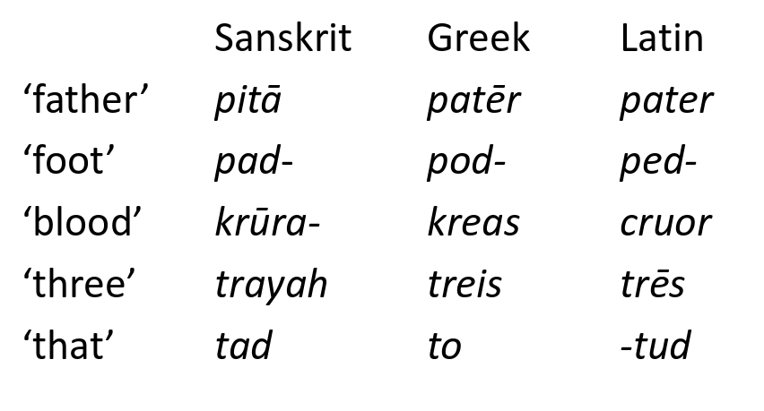
Language Families
Group of languages related through descent from a common ancestor, called the proto-language of that family

Slide 35
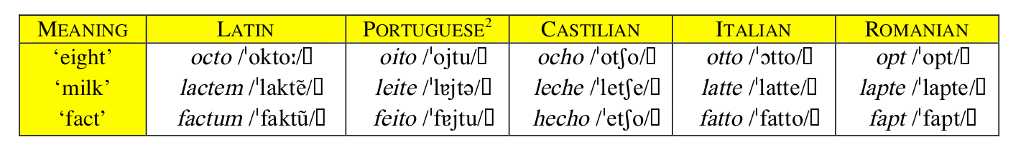
Basis of classification
Regularity of sound change is the basis of studying genetic relationships
Source: Eifring & Theil (2005)

Slide 36
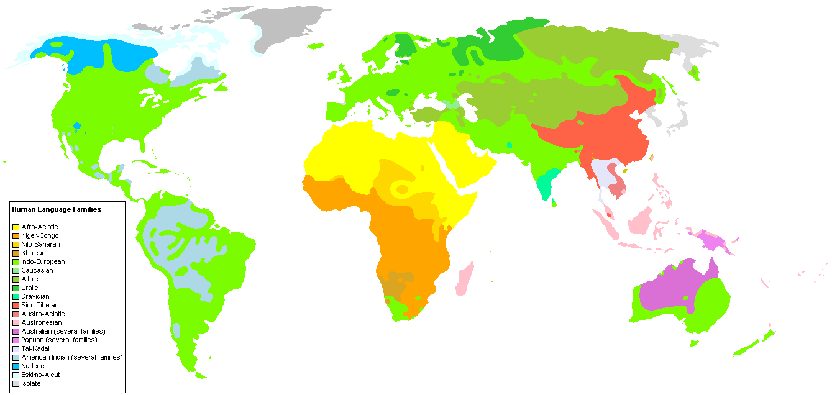
Source: Wikipedia
Genetically related languages are also geographically contiguous

Slide 37
Languages are also related due to contact over a long period of time
Notes:
https://upload.wikimedia.org/wikipedia/en/archive/8/8c/20051110071124!Human_Language_Families_Map_(Wikipedia_Colors_.PNG

Slide 38
Consequences of language contact
Borrowing of vocabulary → loanwords
Adoption of features from other languages
Stratal influence
Language shift

Slide 39
Mechanisms for borrowing words (Eifring & Thiel, 2005)
Borrowing phonetic form vs semantic content
 | form | content | example
Direct loan | Yes | Yes | Avatar, Guru (English) < Sanskrit/Hindi Music (English) < musique (French)
Loanblend | Partly | Yes | double kamrA (Hindi) < double room (Eng) rajasva bajaTa (Hindi) < revenue budget (English)
Loan translation | No | Yes | rajasva ghaTA (Hindi) < revenue budget (English)
Loan creation | No | Yes | prashikshaNArthi (hindi) < trainee (English)
Loanshift | No | Yes | Vidyut (org. lightning) < electricity (English)

Slide 40
Adoption of Features from other languages
Over a long period of sustained exchange, languages can come closer
Creation of a Linguistic Area
Linguistic Area: A group of languages (at least 3) that have common structural features due to geographical proximity and language contact (Thomason 2000)
India | Balkans
Standard Average European | South East Asia

Slide 41
An example: India (Emeneau, 1956; Subbarao, 2012; Abbi, 2012)
Retroflex sounds: Not found in Indo-European outside Indo-Aryan family
Vocabulary exchanges: IA → Dravidian as well as Dravidian → IA
Echo words
Generally meaning etc or things like this
Hindi: cAya-vAya (cAya → tea)
Telugu: puli-guli (puli → tiger)
and many more: Dative Subjects, Compound & Conjunct Verbs, etc.
To the layperson, Dravidian & Indo-Aryan languages would seem closer to each other than English & Indo-Aryan

Slide 42
What does language relatedness imply for MT?
Cognates (words of the same origin)
Similar phoneme set, makes transliteration easier
Similar grammatical properties
morphological and word order symmetry makes MT easier
Cultural similarity leading to shared idioms and multiwords
hin: दाल में कुछ काला होना (dAla me.n kuCha kAlA honA )
guj: दाळ मा काईक काळु होवु (dALa mA kAIka kALu hovu)
Literal meaning: something black in the lentils
Idiomatic meaning: something fishy

Slide 43
Tutorial Outline
Introduction & Motivation
Language Relatedness
Translation within related languages
Translation from related languages to another language
Summary

Slide 44
Translation within related languages

Slide 45
Let’s see how we can use the relatedness between languages to improve translation quality
X
Y
X and Y are related to each other

Slide 46
In this section, we focus on one key characteristic of related languages - Lexical Similarity

Slide 47
Roadmap for this section
What is Lexical Similarity?
How to identify lexically similar words?
Grapheme based metrics
Phoneme based metrics
Putting these metrics to use
Why focus on lexical similarity?
(Or Adapting SMT for leveraging lexical similarity)
Why adapt?
Augmenting Parallel corpus with lexically similar words
Use orthographic features for Word Alignment
Transliterate lexically similar OOV words
A different paradigm – character-level SMT

Slide 48
Roadmap for this section
What is Lexical Similarity?
How to identify lexically similar words?
Grapheme based metrics
Phoneme based metrics
Putting these metrics to use
Why focus on lexical similarity?
(Or Adapting SMT for leveraging lexical similarity)
Why adapt?
Augmenting Parallel corpus with lexically similar words
Use orthographic features for Word Alignment
Transliterate lexically similar OOV words
A different paradigm – character-level SMT

Slide 49
Lexically Similar Languages (Many words having similar form and meaning)
Cognates
Loan Words
Named Entities
Fixed Expressions/Idioms
a common etymological origin
do not change across languages
roTI (hi) | roTlA (pa) | bread
bhai (hi) | bhAU (mr) | brother
mu.mbaI (hi) | mu.mbaI (pa) | mu.mbaI (pa)
keral (hi) | k.eraLA (ml) | keraL (mr)
borrowed without translation
MWE with non-compositional semantics
matsya (sa) | matsyalu (te) | fish
pazha.m (ta) | phala (hi) | fruit
dAla me.n kuCha kAlA honA | (hi) | Something fishy
dALa mA kAIka kALu hovu | (gu)
Let’s just call such words ‘orthographically similar’

Slide 50
But, be warned of ……
False Friends: Similar spelling ; different meaning
Different origin: pAnI (hi) [water] → panI (ml) [fever]
Semantic shift: bala means hair (hi, frequent sense) and baLa means child (mr)
Short words:
jaLa ← → jAla

Slide 51
Roadmap for this section
What is Lexical Similarity?
How to identify lexically similar words?
Grapheme based metrics
Phoneme based metrics
Putting these metrics to use
Why focus on lexical similarity?
(Or Adapting SMT for leveraging lexical similarity)
Why adapt?
Augmenting Parallel corpus with lexically similar words
Use orthographic features for Word Alignment
Transliterate lexically similar OOV words
A different paradigm – character-level SMT

Slide 52
Compare similarity of grapheme sequences
Hindi → अ ं ध ा प न Marathi → आ ं ध ळ े प ण ा
a.mdhApana A.mdhLepNA
OR
Compare similarity of phoneme sequences
ə n dʱ a p ə n a n dʱ ɭ e p ə ɳ a

Slide 53
Roadmap for this section
What is Lexical Similarity?
How to identify lexically similar words?
Grapheme based metrics
Phoneme based metrics
Putting these metrics to use
Why focus on lexical similarity?
(Or Adapting SMT for leveraging lexical similarity)
Why adapt?
Augmenting Parallel corpus with lexically similar words
Use orthographic features for Word Alignment
Transliterate lexically similar OOV words
A different paradigm – character-level SMT

Slide 54
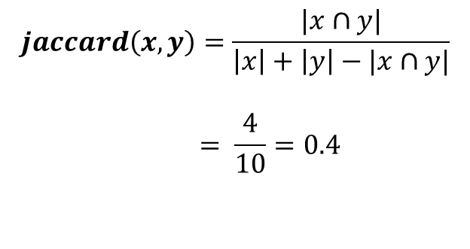
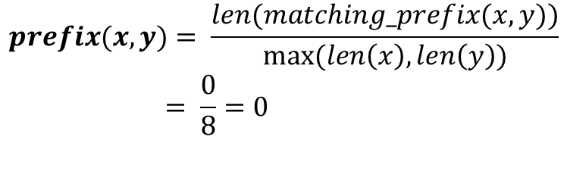
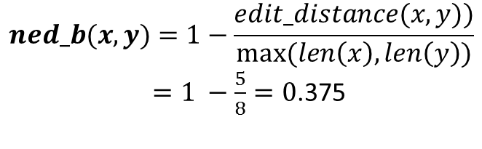
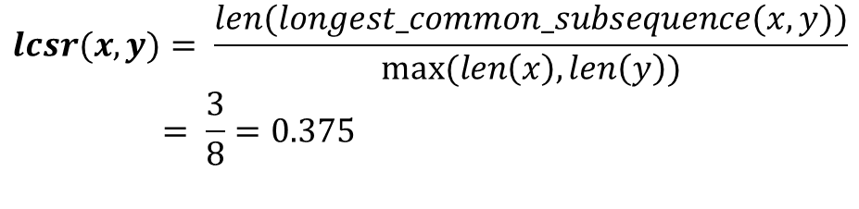
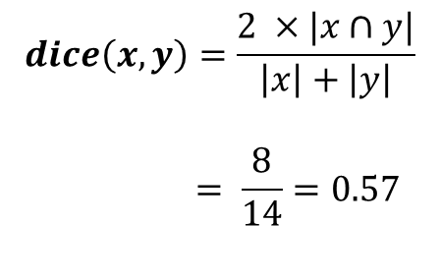
x: a.mdhApana (Hindi)
y: A.mdhLepNA (Marathi)
$$prefix(x,y)= \frac{len(matching_prefix(x,y))}{max⁡(len\left(x\right), len\left(y\right))}$$
$$= \frac{0}{8}=0$$
$$lcsr(x,y)= \frac{len(longest_common_subsequence(x,y))}{max⁡(len\left(x\right), len\left(y\right))}$$
$$= \frac{3}{8}=0.375$$
$$jaccard\left(x,y\right)=\frac{|x∩y|}{\left|x\right|+\left|y\right|−|x∩y|}$$
$$= \frac{4}{10}=0.4$$
$$ned_b(x,y)=1−\frac{edit_distance(x,y))}{max⁡(len\left(x\right), len\left(y\right))}$$
$=1 −\frac{5}{8}=0$.375
Variants:
Use n-gram as basic unit (Inkpen et al,2005)
Skip-gram based metric (Inkpen et al,2005)
Similarity matrix to encode character similarity
(Ristad, 1999; Yarowsky, 2001)
LCSF metrics to fix LCSR preference for short words
(Kondrak, 2005)
$$dice\left(x,y\right)=\frac{2 ×|x∩y|}{\left|x\right|+\left|y\right|}$$
$$= \frac{8}{14}=0.57$$

Slide 55
Roadmap for this section
What is Lexical Similarity?
How to identify lexically similar words?
Grapheme based metrics
Phoneme based metrics
Putting these metrics to use
Why focus on lexical similarity?
(Or Adapting SMT for leveraging lexical similarity)
Why adapt?
Augmenting Parallel corpus with lexically similar words
Use orthographic features for Word Alignment
Transliterate lexically similar OOV words
A different paradigm – character-level SMT

Slide 56
Grapheme → Phoneme conversion
x = अ ं ध ा प न → a n dh A p a n
y = आ ं ध ळ े प ण ा → A n dh a L e p a N A
Map phonemes to phonetic features
v(‘a’) =(vowel, long , back, open, not_rounded)
v(‘A’) =(vowel, short, back, open, not_rounded)
Define phonetic similarity function
phonetic_sim(‘a’, ‘A’) = cosine(v(‘a’), v(‘A’))
Align phoneme sequences
a n dh A _ e p a n _
A n dh a L e p a N A sim(x,y)=6.6

Slide 57
Grapheme → Phoneme conversion
Some scripts are near phonetic (Brahmi-derived scripts in India) making grapheme → phoneme conversion straightforward
Map phonemes to phonetic features
Define phonetic similarity function
Align phoneme sequences

Slide 58
Feature | Values
Basic Character Type | vowel , consonant, nukta, halanta, anusvaara
Vowel Length | short, long
Vowel Strength | weak (a,aa,i,ii,u,uu), medium (e,o), strong (ai,au)
Vowel Status | Independent, Dependent
Vowel – horizontal position | front, back
Vowel – vertical position | open, open-mid, close,close-mid
Vowel – Roundedness | True, False
Consonant Type | plosive, fricative, central approximant, lateral approximant, flap
Place of Articulation | velar,palatal, retroflex, dental, labial
Aspiration | True, False
Voicing | True, False
Nasal | True, False
Grapheme → Phoneme conversion
Map phonemes to phonetic features
Define phonetic similarity function
Align phoneme sequences

Slide 59
Grapheme → Phoneme conversion
Map phonemes to phonetic features
Cosine similarity, Hamming, Distance, Handcrafted similarity matrices
Define phonetic similarity function
Align phoneme sequences

Slide 60
Grapheme → Phoneme conversion
Map phonemes to phonetic features
Define phonetic similarity function
Align phoneme sequences
Dynamic Programming, ALINE (Kondrak, 2000)

Slide 61
Roadmap for this section
What is Lexical Similarity?
How to identify lexically similar words?
Grapheme based metrics
Phoneme based metrics
Putting these metrics to use
Why focus on lexical similarity?
(Or Adapting SMT for leveraging lexical similarity)
Why adapt?
Augmenting Parallel corpus with lexically similar words
Use orthographic features for Word Alignment
Transliterate lexically similar OOV words
A different paradigm – character-level SMT

Slide 62
Thresholding based on similarity metrics
Classification with similarity & other features
Cognates/False Friends v/s Unrelated
Cognates v/s False Friends
Competitive Linking
Similarity based greedy bipartite matching of source words to target cognate candidates

Slide 63
Cognates/False Friends v/s Unrelated (Inkpen et al 2005)
Similarity measure | Threshold | Accuracy
IDENT | 1 | 43.90
PREFIX | 0.03845 | 92.70
DICE | 0.29669 | 89.40
LCSR | 0.45800 | 92.91
NED | 0.34845 | 93.39
SOUNDEX | 0.62500 | 85.28
TRI | 0.0476 | 88.30
XDICE | 0.21825 | 92.84
XXDICE | 0.12915 | 91.74
BI-SIM | 0.37980 | 94.84
BI-DIST | 0.34165 | 94.84
TRI-SIM | 0.34845 | 95.66
TRI-DIST | 0.34845 | 95.11
Classifier | Accuracy
Baseline | 63.75
OneRule | 95.66
Naïve Bayes | 94.84
Decision Trees | 95.66
Dec Tree (pruned) | 95.66
IBK | 93.81
Ada Boost | 95.66
Perceptron | 95.11
SVM (SMO) | 95.46
LCSR, NED are simple, effective measures
n-gram measures perform well
Classification gives modest improvement over individual measures on this simple task
Results of classification
Performance of individual measures
Thresholds were learnt using single feature classifier

Slide 64
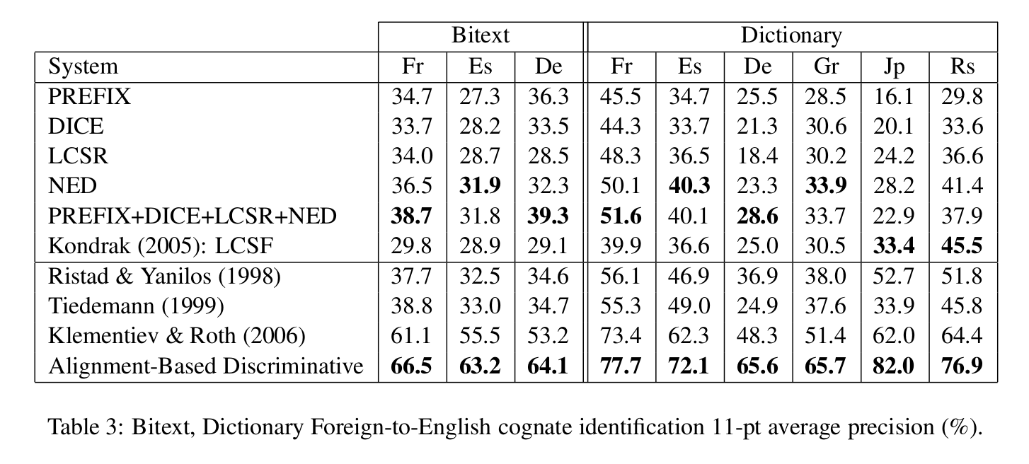
Cognates v/s False Friends (Bergsma & Kondrak (2007))
Individual measures
Learning Similarity
Classification
More difficult task
LCSR, NED are amongst the best measures
Learning similarity matrices improves performance
Classification based methods outperform other methods

Slide 65
Roadmap for this section
What is Lexical Similarity?
How to identify lexically similar words?
Grapheme based metrics
Phoneme based metrics
Putting these metrics to use
Why focus on lexical similarity?
(Or Adapting SMT for leveraging lexical similarity)
Why adapt?
Augmenting Parallel corpus with lexically similar words
Improve Word Alignment
Transliterate lexically similar OOV words

Slide 66
Roadmap for this section
What is Lexical Similarity?
How to identify lexically similar words?
Grapheme based metrics
Phoneme based metrics
Putting these metrics to use
Why focus on lexical similarity?
(Or Adapting SMT for leveraging lexical similarity)
Why adapt?
Augmenting Parallel corpus with lexically similar words
Improve Word Alignment
Transliterate lexically similar OOV words
A different paradigm – character-level SMT

Slide 67
Limitations of SMT
No explicit notion of cognates, loanwords and named entities
All morphological variants of words generally not found in parallel corpus
Cannot decompose compounds
Consequences
Sub-optimal word alignment
Cannot translate unseen cognates and named entities
Cannot translate morphological variants

Slide 68
Roadmap for this section
What is Lexical Similarity?
How to identify lexically similar words?
Grapheme based metrics
Phoneme based metrics
Putting these metrics to use
Why focus on lexical similarity?
(Or Adapting SMT for leveraging lexical similarity)
Why adapt?
Augmenting Parallel corpus with lexically similar words
Use orthographic features for Word Alignment
Transliterate lexically similar OOV words
A different paradigm – character-level SMT

Slide 69
Parallel Corpus
How does it help?
A boy is sitting in the kitchen
Un garçon est assis dans la cuisine
A boy is playing tennis
Un garçon joue au tennis
A boy sitting on a round table
Un garçon assis sur une table ronde
Some men are watching tennis
Certains hommes regardent le tennis
A girl is holding a black book
Une jeune fille tient un livre noir
Two men are watching a movie
Deux hommes regardent un film
abundance
abondance
acrobatic
acrobatique
cabin
cabine
tennis
tennis

Slide 70
Parallel Corpus
How does it help?
Improves word alignment
(10% reduction in word alignment error rate)
Improves vocabulary coverage
Improves translation quality
(2% improvement in BLEU score as well qualitative improvement)
A boy is sitting in the kitchen
Un garçon est assis dans la cuisine
A boy is playing tennis
Un garçon joue au tennis
A boy sitting on a round table
Un garçon assis sur une table ronde
Some men are watching tennis
Certains hommes regardent le tennis
A girl is holding a black book
Une jeune fille tient un livre noir
Two men are watching a movie
Deux hommes regardent un film
abundance
abondance
acrobatic
acrobatique
cabin
cabine
tennis
tennis

Slide 71
Some tips
Focus on high recall in cognate extraction
(Kondrak et al, 2003; Onaizan, 1999)
Replication of cognate pairs improves alignment quality marginally (Kondrak et al, 2003; Och & Ney, 1999; Brown et al, 1993)
Add multiple cognate pairs per line (Kondrak et al, 2003)
Parallel Corpus
A boy is sitting in the kitchen
Un garçon est assis dans la cuisine
A boy is playing tennis
Un garçon joue au tennis
A boy sitting on a round table
Un garçon assis sur une table ronde
Some men are watching tennis
Certains hommes regardent le tennis
A girl is holding a black book
Une jeune fille tient un livre noir
Two men are watching a movie
Deux hommes regardent un film
abundance
abondance
acrobatic
acrobatique
cabin
cabine
tennis
tennis
pAnI jala nIra ←→ pANI jaLa nIra

Slide 72
Limitations
Cannot align unseen cognate pairs
Cannot translate unseen words
Knowledge locked in cognate corpus is underutilized
Parallel Corpus
A boy is sitting in the kitchen
Un garçon est assis dans la cuisine
A boy is playing tennis
Un garçon joue au tennis
A boy sitting on a round table
Un garçon assis sur une table ronde
Some men are watching tennis
Certains hommes regardent le tennis
A girl is holding a black book
Une jeune fille tient un livre noir
Two men are watching a movie
Deux hommes regardent un film
abundance
abondance
acrobatic
acrobatique
cabin
cabine
tennis
tennis

Slide 73
Lets see if we can overcome some of these limitations pertaining to unseen words
There will still be some unseen words which need to be handled

Slide 74
Roadmap for this section
What is Lexical Similarity?
How to identify lexically similar words?
Grapheme based metrics
Phoneme based metrics
Putting these metrics to use
Why focus on lexical similarity?
(Or Adapting SMT for leveraging lexical similarity)
Why adapt?
Augmenting Parallel corpus with lexically similar words
Use orthographic features for Word Alignment
Transliterate lexically similar OOV words
A different paradigm – character-level SMT

Slide 75
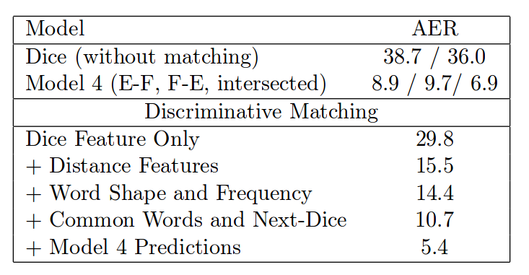
Using orthographic features for Word Alignment
Discriminative models allow incorporation of arbitrary features (Moore, 2005)
Orthographic features for English-French word alignment: (Taskar et al, 2005)
exact match of words
exact match ignoring accents
exact matching ignoring vowels
LCSR
short/long word
Similar features can be designed for other writing systems
Word Error Rates of English-French word alignment task (Taskar et al, 2005)
7% reduction in alignment error rate

Slide 76
There will still be some unseen words which need to be handled

Slide 77
Roadmap for this section
What is Lexical Similarity?
How to identify lexically similar words?
Grapheme based metrics
Phoneme based metrics
Putting these metrics to use
Why focus on lexical similarity?
(Or Adapting SMT for leveraging lexical similarity)
Why adapt?
Augmenting Parallel corpus with lexically similar words
Use orthographic features for Word Alignment
Transliterate lexically similar OOV words
A different paradigm – character-level SMT

Slide 78
Transliterating OOV words
OOV words can be:
Cognates
Loan words
Named entities
Other words
Cognates, loanwords and named entities are orthographically similar
Transliteration achieves translation
Orthographic mappings can be learnt from a parallel transliteration/cognate corpus
Can be mined from the parallel corpus (Sajjad et al., 2012; Kunchukuttan et al, 2015)

Slide 79
Transliterating OOV words
Two options
Transliteration as a post-translation step
Integrating transliteration into the decoder

Slide 80
Transliteration as Post-translation step
Durrani et al (2014), Kunchukuttan et al (2015)
Option 1: Replace OOVs in the output with their best transliteration
But first transliteration may not be correct!
Option 2: Generate top-k candidates for each OOV. Each regenerated candidate sentence is scored using an LM and the original features
Option 3: 2-pass decoding, where OOV are replaced by their transliterations in second pass input
Rescoring with LM & second pass use LM context to disambiguate among transliterations

Slide 81
Integrate Transliteration into the Decoder
Durrani et al (2010), Durrani et al (2014)
In addition to translation candidates, decoder considers all transliteration candidates for each word
Assumption: 1-1 correspondence between words in the two languages
monotonic decoding
Translation and Transliteration candidates compete with each other
The features used by the decoder (LM score, factors, etc.) help make a choice between translation and transliteration options

Slide 82
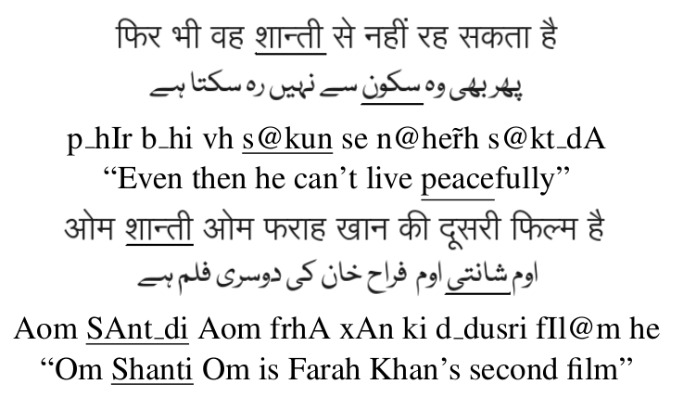
Results (Hindi-Urdu Translation)
Durrani et al (2010)
Phrase-Based (1) | (1) + Post-edit Xlit | (1) + PB with in-decoder Xlit (3)
14.3 | 16.25 | 18.6
Hindi and Urdu are essentially literary registers of the same language.
We can see a 31% increase in BLEU score
Word shaanti → means peace → translate
Word shaanti → named entity → transliterate

Slide 83
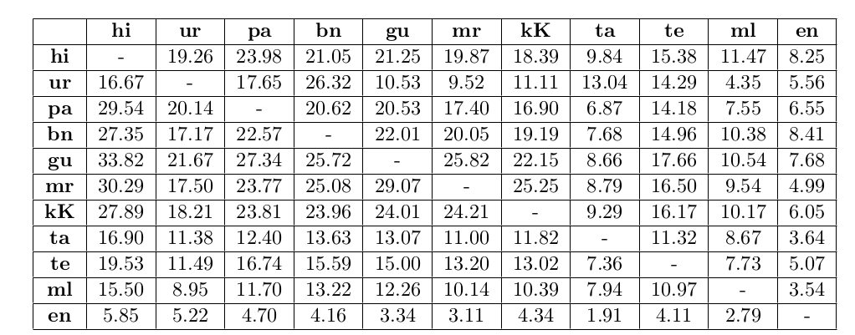
Transliteration Post-Editing for Indian languages
Kunchukuttan et al (2015)
Indo-Aryan
Dravidian
Indo-Aryan
Dravidian
% OOV decrease after transliterating untranslated words
Transliterate untranslated words & rescore with LM and LM-OOV features (Durrani, et al. 2014)
BLEU scores improve by up to 4%
OOV count reduced by up to 30% for Indo-Aryan languages, 10% for Dravidian languages
Nearly correct transliterations: another 9-10% decrease in OOV count can potentially be obtained

Slide 84
The story so far….
Leverage Lexical Similarity by Adapting Word Level SMT…
So far so good….
But there are some shortcomings…

Slide 85
Shortcomings of Adapting word-based methods
Additional resources and tools required
Cognate corpus
Transliteration corpus
Word aligned corpus
Morphological analyzers
Not directly optimized for improving SMT performance
We are “retrofitting” a word-level system to incorporate lexical similarity

Slide 86
Is word the right level of representation for translation?
Explore sub-word units of representation for translation

Slide 87
Roadmap for this section
What is Lexical Similarity?
How to identify lexically similar words?
Grapheme based metrics
Phoneme based metrics
Putting these metrics to use
Why focus on lexical similarity?
(Or Adapting SMT for leveraging lexical similarity)
Why adapt?
Augmenting Parallel corpus with lexically similar words
Use orthographic features for Word Alignment
Transliterate lexically similar OOV words
A different paradigm – character-level SMT

Slide 88
Basic unit of translation → CHARACTER
Transliteration for translation
 | Word-level | Character-level (unigram characters)
hi | राम ने श्याम को पुस्तक दी | र ा म _ न े _ श ् य ा म _ क ो _ प ु स ् त क _ द ी
 | rAma ne shyAma ko pustaka dI | r A ma _ n e _ sh y A ma _ k o _ p u s ta ka _ d I
mr | रामाने श्यामला पुस्तक दिली | र ा म ा न े _ श ् य ा म ल ा _ प ु स ् त क _ द ि ल ी
 | rAmAne shyAmalA pustaka dilI | r A m A n e _ sh y A ma l A _ p u s ta ka _ d i l I
Gloss | Ram+nom Shyam+acc book gave
English Translation | Ram gave a/the book to Shyam

Slide 89
Why character-level SMT?
High degree of character-level similarity between related languages
Konkani – Marathi | 54.51
Punjabi – Hindi | 68.00
Bulgarian – Macedonian | 62.85
Danish – Swedish | 63.39
Indonesian – Malay | 73.54
LCSR as a measure of language relatedness
(computed at sentence level on a parallel corpus)
Primary language divergences can be bridged by sub-word transformations
Spelling/pronunciation differences (Cognates, Loan words)
Suffix sets & function words: mappings can be learnt for short sequences
cA → kA madhye → me.m (for Marathi → Hindi)
An integrated framework tackling cognates, named entities, inflection, agglutination

Slide 90
Training Character level SMT
Use the same discriminative log-linear framework as Phrase-based SMT
… with some modifications …

Slide 91
Modification 1: Handling sentence length issues during training
Long sentences at character level → Inefficient Word alignment
(a) Limit sentence length → Loss of training corpus (Tiedemann, 2009)
(b) Phrase pairs from word-based model as corpus → Larger models (Vilar, 2007)
No distinct advantage of one model over another (Tiedemann, 2009)
Modification 2: Monotone decoding (Tiedemann, 2009)
Modification 3: Tuning at word-level (Tiedemann, 2012)
Decode at
char level
Convert to
word level
Evaluate at
word level
Adjust
Feature weights
MERT Tuning

Slide 92
Further improvements to character-based SMT …
(Tiedemann, 2009; Nakov & Tiedemann, 2012; Tiedemann & Nakov, 2013)
Longer units of translation: character n-grams
n>2 has not been useful
Capturing larger context information → higher order LM and longer phrase-pairs
Data sparsity a lesser issue
Improves translation quality
Combining word and character models useful
System combination
Merging phrase tables
Filtering noisy entries in phrase tables improves quality

Slide 93
Can suffixes & function words be translated?
Function words (which differ across related languages) can be learnt
kok: ह्या किड्याचें खाशेलपण कळ्ळे उपरांत दिसता तांचो संवसारूय कितलो मजेशीर आसा .
hyA kiDyAce.n khAshelapaNa kaLLe uparA.nta disatA tA.nco sa.nvasAruuya kitalo majeshIra AsA
mar: ह्या किड्याची विशेषता कळल्यानंतर दिसते त्यांचे विश्वरदेखील किती मजेदार आहे .
hyA kiDyAcI visheShatA kaLalyAna.ntara disate tyA.nce vishvaradekhIla kitI majedAra Ahe .
gloss: these insects_of uniqueness knowing_after see their world_also how funny is
eng: After knowing the uniqueness of these insects, <we> realize how funny their world is.
Even content words which are not orthographically similar can be learnt

Slide 94
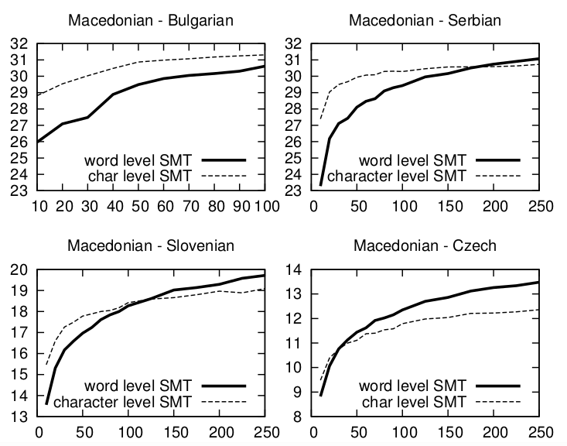
Is character-level SMT good for small corpora?
Character-level SMT can outperform word-level when very little corpus is available
With increased parallel corpus, the performance gap narrows
The similarity between the source and target languages is also important
(Czech is not as close to Macedonian as others)
Notes:
It would be interesting to study effect of pivot-based model

Slide 95
Tutorial Outline
Introduction & Motivation
Language Relatedness
Translation within related languages
Translation from related languages to another language
Summary

Slide 96
E
X
Y
How can resources for a resource-rich language Y, which is related to a resource-poor language X, help translation between X, and an unrelated language E?

Slide 97
Scenarios based on corpus availability….
Y: bridge/pivot language
Sufficient Parallel Corpus
No or little Parallel Corpus
Y
Y
X
E
X
E
Scenario can occur between unrelated languages too
Does not necessarily leverage relatedness between languages
Relatedness between X and Y will have to be leveraged

Slide 98
Roadmap for this section
Pivot based SMT
Pseudo-Corpus Synthesis
Cascading Direct Systems
Model Triangulation
Case Study I
Leveraging relatedness in Pivot based SM
Small X→Y corpus is available (Case Study II)
No X→Y corpus is available (Case Study III)
Augmenting Direct system with Pivot Based System
Combine corpus
Combine models
Choice of pivot language

Slide 99
Roadmap for this section
Pivot based SMT
Pseudo-Corpus Synthesis
Cascading Direct Systems
Model Triangulation
Case Study I
Leveraging relatedness in Pivot based SM
Small X→Y corpus is available (Case Study II)
No X→Y corpus is available (Case Study III)
Augmenting Direct system with Pivot Based System
Combine corpus
Combine models
Choice of pivot language

Slide 100
src-pvt Corpus
pvt-tgt Corpus
Direct Sys: src-pvt
Direct Sys: pvt-tgt
Composition
in
out
Pivot Sys: src-tgt

Slide 101
Roadmap for this section
Pivot based SMT
Pseudo-Corpus Synthesis
Cascading Direct Systems
Model Triangulation
Case Study I
Leveraging relatedness in Pivot based SM
Small X→Y corpus is available (Case Study II)
No X→Y corpus is available (Case Study III)
Augmenting Direct system with Pivot Based System
Combine corpus
Combine models
Choice of pivot language

Slide 102
Goal: Create a Pseudo Source-Target training corpus
(Gispert & Marino, 2006)
Source-Pivot
Corpus
Pivot sentences
Pivot-Target
MT System
Target sentences
concat
Source sentences
Corpus A
Synthetic
Corpus
Target sentences
Corpus B
Pivot-Target
Corpus
Pivot sentences
Pivot-Source
MT System
Source sentences
Generated corpus will be noisy; quality would depend on:
(i) language divergence (ii) parallel corpus size

Slide 103
Roadmap for this section
Pivot based SMT
Pseudo-Corpus Synthesis
Cascading Direct Systems
Model Triangulation
Case Study I
Leveraging relatedness in Pivot based SM
Small X→Y corpus is available (Case Study II)
No X→Y corpus is available (Case Study III)
Augmenting Direct system with Pivot Based System
Combine corpus
Combine models
Choice of pivot language

Slide 104
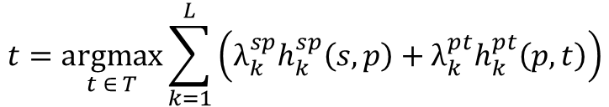
Top-n candidates
(Utiyama & Isahara, 2007)
P₁
T_{i,1}
P₂
T_{i,2}
S
Source-Pivot
MT System
Pivot-Target
MT System
T
P_{n-1}
T_{n,m-1}
P_{n}
T_{n,m}
Re-rank the m.n target language candidates
by interpolating scores
$$t=\underset{t ∈ T}{argmax}{\sum_{k=1}^{L}{\left(λ_{k}^{sp}h_{k}^{sp}\left(s,p\right)+λ_{k}^{pt}h_{k}^{pt}\left(p,t\right)\right)}}$$
(i) L is number of features
(ii) λ’s are feature weights
(iii) h’s are feature values
(iv) sp, pt: src-pvt & pvt-tgt models

Slide 105
Roadmap for this section
Pivot based SMT
Pseudo-Corpus Synthesis
Cascading Direct Systems
Model Triangulation
Case Study I
Leveraging relatedness in Pivot based SM
Small X→Y corpus is available (Case Study II)
No X→Y corpus is available (Case Study III)
Augmenting Direct system with Pivot Based System
Combine corpus
Combine models
Choice of pivot language

Slide 106
(Utiyama & Isahara, 2007; Wu & Wang, 2007)
src-pivot phrase table
A | X | 0.4 | 0.4
B | X | 0.6 | 0.8
B | Y | 0.8 | 0.9
C | Y | 0.2 | 0.1
Source-Pivot
Model
Pivot-Target
Model
A | P | ? | ?
B | P | ? | ?
B | Q | ? | ?
C | Q | ? | ?
C | P | ? | ?
X | P | 0.5 | 0.4
Y | P | 0.5 | 0.6
Y | Q | 1.0 | 1.0
Z | R | 1.0 | 1.0
Intermediate
Source-Target
Model
Source-Target
Model
Tune
pivot-tgt phrase table

Slide 107
Comparison
Criteria | Pseudo-corpus | Cascaded | Triangulation
Ease of implementation | Easy | Easy | Involved
Training Time | Depends on time to decode time to created pseudo-parallel corpus | No separate training | High, due to the time required for merging
Decoding Time | Low, just as much as a baseline PBSMT system | Very high, due to multiple decoding | High due to increase in model size
Model Size | same order as PBSMT model of this size training corpus size <=2*max(src-pvt,pvt-tgt) corpus | No new model created | Blow-up due to the join during merge
Translation Accuracy | could be comparable to cascaded model | taking top-n candidates better than top-1 | best method

Slide 108
Roadmap for this section
Pivot based SMT
Pseudo-Corpus Synthesis
Cascading Direct Systems
Model Triangulation
Case Study I
Leveraging relatedness in Pivot based SM
Small X→Y corpus is available (Case Study II)
No X→Y corpus is available (Case Study III)
Augmenting Direct system with Pivot Based System
Combine corpus
Combine models
Choice of pivot language

Slide 109
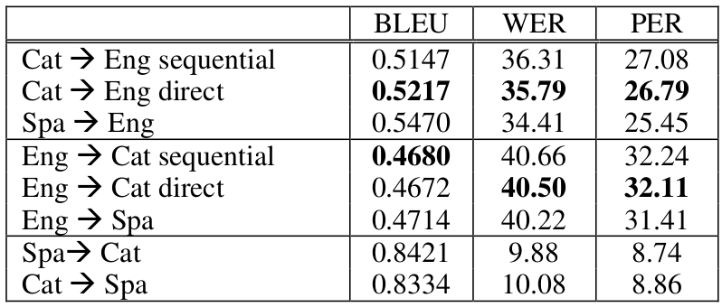
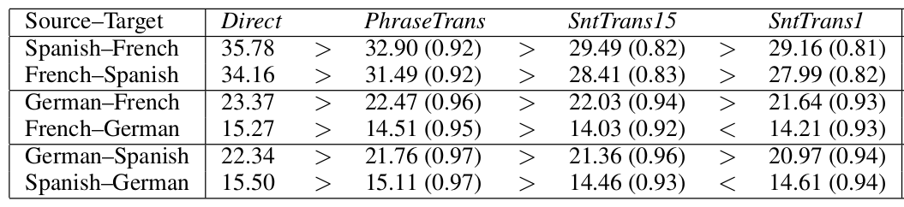
Case Study I
Catalan-English with Spanish as pivot
(cascaded)
(synthetic)
(cascaded)
(synthetic)
Marino & Gispert, 2006
English as Pivot
Source-Targe Direct Triangulation Cascading (n=15) Cascading(n=1)
Utiyama & Isahara, 2007

Slide 110
Roadmap for this section
Pivot based SMT
Pseudo-Corpus Synthesis
Cascading Direct Systems
Model Triangulation
Case Study I
Leveraging relatedness in Pivot based SM
Small X→Y corpus is available (Case Study II)
No X→Y corpus is available (Case Study III)
Augmenting Direct system with Pivot Based System
Combine corpus
Combine models
Choice of pivot language

Slide 111
Scenarios based on corpus availability….
Y: bridge/pivot language
Sufficient Parallel Corpus
No or little Parallel Corpus
Y
Y
X
E
X
E
Scenario can occur between unrelated languages too
Does not necessarily leverage relatedness between languages
Relatedness between X and Y will have to be leveraged

Slide 112
Roadmap for this section
Pivot based SMT
Pseudo-Corpus Synthesis
Cascading Direct Systems
Model Triangulation
Case Study I
Leveraging relatedness in Pivot based SM
Small X→Y corpus is available (Case Study II)
No X→Y corpus is available (Case Study III)
Augmenting Direct system with Pivot Based System
Combine corpus
Combine models
Choice of pivot language

Slide 113
Character based SMT for X → Y
Case Study II
(Tiedemann, 2012)
 |  |  | X→ E (% BLEU) |  |  | X→ Y (% BLEU) |  | OOV % char level
X | E | Y | Direct | Pivot-word | Pivot-char | word-level | char-level
mk | en | bs | 20.74 | 12.48 | 18.64 | 14.22 | 24.82 | 1.00
 |  | bg |  | 19.74 | 21.10 | 14.77 | 17.28 | 0.77
gl | en | es | 5.76 | 13.2 | 16.02 | 43.22 | 50.70 | 1.36
ca | en | es | 27.86 | 38.65 | 40.73 | 59.34 | 65.14 | 0.48
Word-based SMT for Y → E
Char-based SMT effective with small corpora
X → Y leg of pivot SMT may generate non-words
- Macedonian (X) is related to Bulgarian (Y) and Bosnian (Y)
- Galician (X) and Catalan (X) are related to resource rich Spanish (Y)
- X-Y corpus in thousands, while Y-E (English) corpus in millions

Slide 114
Roadmap for this section
Pivot based SMT
Pseudo-Corpus Synthesis
Cascading Direct Systems
Model Triangulation
Case Study I
Leveraging relatedness in Pivot based SM
Small X→Y corpus is available (Case Study II)
No X→Y corpus is available (Case Study III)
Augmenting Direct system with Pivot Based System
Combine corpus
Combine models
Choice of pivot language

Slide 115
Y → E Parallel Corpus
For each word in Y
No knowledge sources
Do Nothing: Pretend Y is X
Transliteration or cognate pairs between Y and X
Transliterate Y into X
Word and/or Phrase dictionary between Y and X
Parallel corpus with a third language Z
Induce a word and/or phrase dictionary by pivoting via a third language
Morphological analyzer for Y and X
Generate morphological variants of X from stems in Y
Y₁ | E₁
Y₂ | E₂
Y₃ | E₃
Rewrite Y sentences into X
X₁ | E₁
X₂ | E₂
X₃ | E₃
X → E Pseudo-Parallel Corpus

Slide 116
Case Study III (Wang 2012)
X: Indonesian Bahasa, Y: Malay, E: English
System | BLEU %
Direct X → E (baseline) | 18.67
Pretend Y is X | 14.50
Rewriting of Y → X
CN: word dictionary from pivot | 19.50
(A) CN: word dictionary from pivot + morph | 20.06
(B) CN: phrase dictionary from pivot + morph | 20.89
System Combination (A) + (B) | 21.24
Adaptation of X → Y (decode time)
CN: word dictionary from pivot | 17.22
Source rewriting performs better than system trained on a small X → E parallel corpus
Rewriting of X→Y does not perform
Done at decode time
Training corpus more robust to noise

Slide 117
Roadmap for this section
Pivot based SMT
Pseudo-Corpus Synthesis
Cascading Direct Systems
Model Triangulation
Case Study I
Leveraging relatedness in Pivot based SM
Small X→Y corpus is available (Case Study II)
No X→Y corpus is available (Case Study III)
Augmenting Direct system with Pivot Based System
Combine corpus
Combine models
Choice of pivot language

Slide 118
Now suppose we have a parallel corpus between X and E as well
Y: bridge/pivot language
Sufficient Parallel Corpus
No or little Parallel Corpus
Y
Y
X
E
X
E
How do we augment direct system with the pivot system?

Slide 119
Can the pivot system improve the direct system?
Improve lexical coverage
Unknown words
More translation options
Direct
a
S → T
?
a
S → T
c
Pivot
c
a
b
d
a
S → P
b
P → T
S → P
P → T
Such combination may be useful for translation between related languages too
Improve Probability estimates
by combining feature values from both tables

Slide 120
Roadmap for this section
Pivot based SMT
Pseudo-Corpus Synthesis
Cascading Direct Systems
Model Triangulation
Case Study I
Leveraging relatedness in Pivot based SM
Small X→Y corpus is available (Case Study II)
No X→Y corpus is available (Case Study III)
Augmenting Direct system with Pivot Based System
Combine corpus
Combine models
Choice of pivot language

Slide 121
Case Study IV (Wang et al., 2012)
X: Indonesian Bahasa, Y: Malay, E: English
Adaptation Method | Simple Concat | Balanced Concat | Sophisticated Comb.
Pretend Y is X | 18.49 | 19.79 | 20.10
CN: word dictionary from pivot + morph | 20.60 | 21.15 | 21.05
CN: word dictionary from pivot + morph | 21.01 | 21.31 | 20.98
System Combination | 21.55 | 21.64 | 21.62
Is concatenating corpora better than pivoting in this scenario?
Nakov & Tiedemann, 2009 experiment when no adaptation is done:
Simple concatenation cannot be shown to be better
Sophisticated concatenation is better
No study for the case of adaptation

Slide 122
Roadmap for this section
Pivot based SMT
Pseudo-Corpus Synthesis
Cascading Direct Systems
Model Triangulation
Case Study I
Leveraging relatedness in Pivot based SM
Small X→Y corpus is available (Case Study II)
No X→Y corpus is available (Case Study III)
Augmenting Direct system with Pivot Based System
Combine corpus
Combine models
Choice of pivot language

Slide 123
Model 1: Direct model Model 2: Pivot based model
Combining Model 1 & 2
Fillup interpolation - Create a unified phrase table – start filling entries from models in order of priority (Dabre et al, 2015)
Linear interpolation – Weighted combination of models (Wu & Wang,2009)
Multiple decoding paths – Decoder searches over all phrase tables (Nakov & Ng, 2009 ; Dabre et al, 2015)

Slide 124
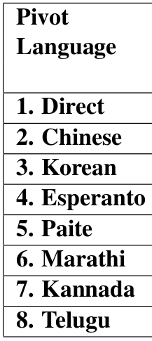
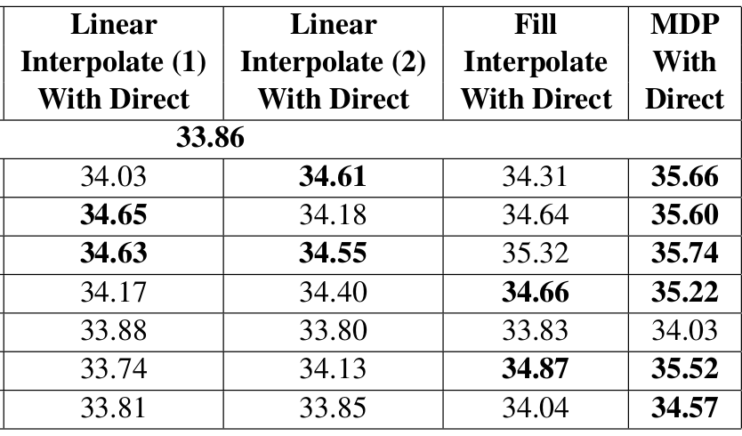
Case Study V (Dabre et al., 2015)
Not clear if any of the linear interpolation is better than other
Performance of Fillup and linear interpolation cannot be distinguished
MDP is clearly better than all interpolation schemes
(1): Priority (9:1 ratio for Direct:Bridge table), (2) Priority by BLEU score
Japanese-Hindi translation using various pivots

Slide 125
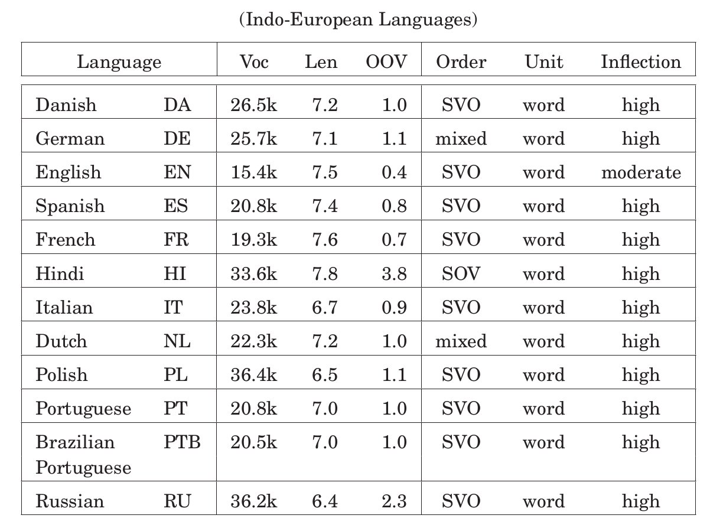
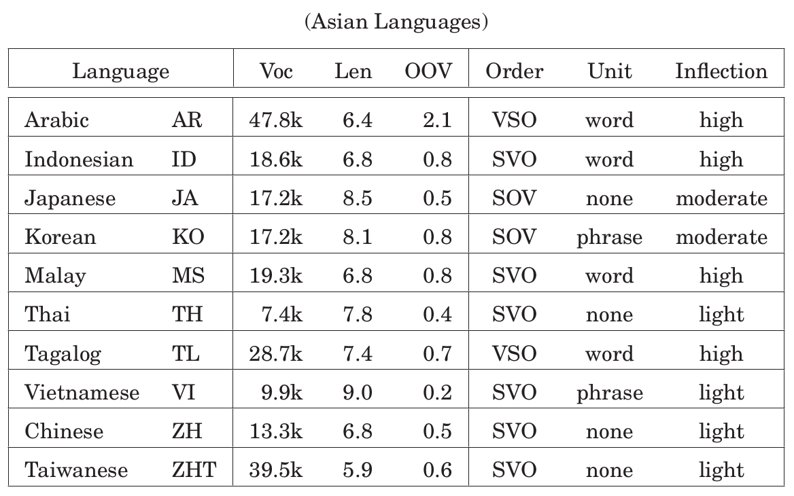
Case Study VI (Paul et al., 2013)
Study Involving 22 diverse Europoean and Asian languages

Slide 126
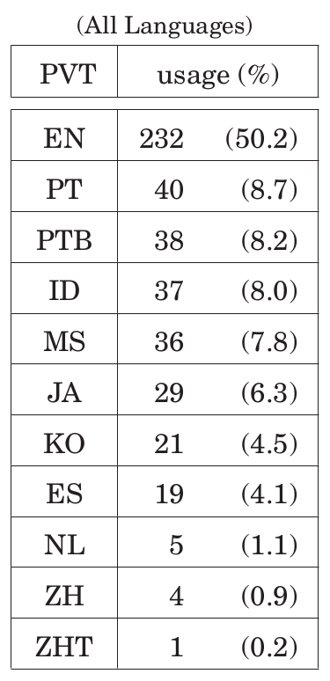
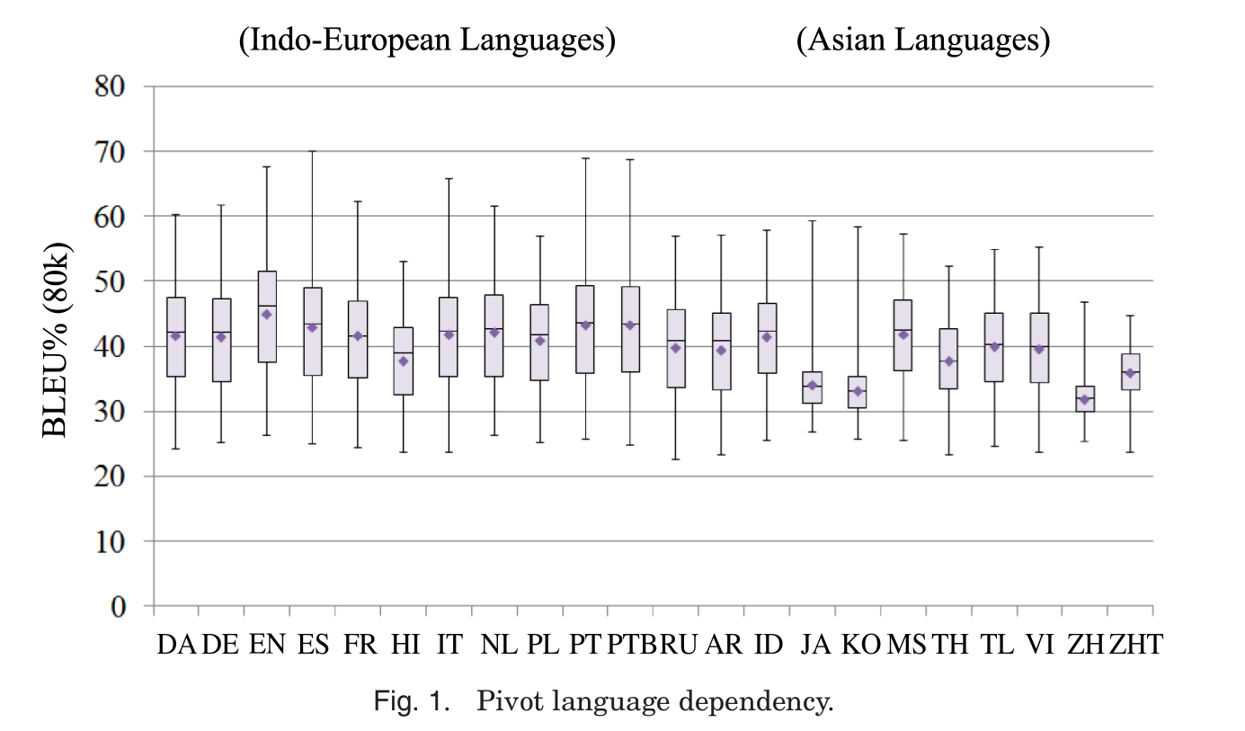
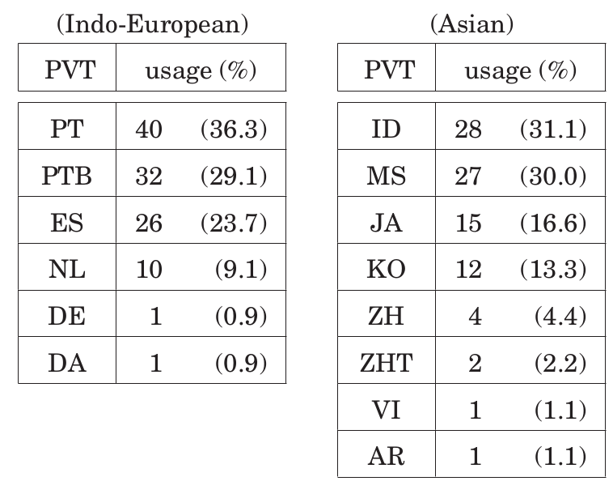
Case Study VI (Paul et al., 2013)
Non-English pivots
There is no single “best” pivot language
English good for 50.2% of language pairs
Closely related languages are generally good pivots
86% cases pivot language independent of data size

Slide 127
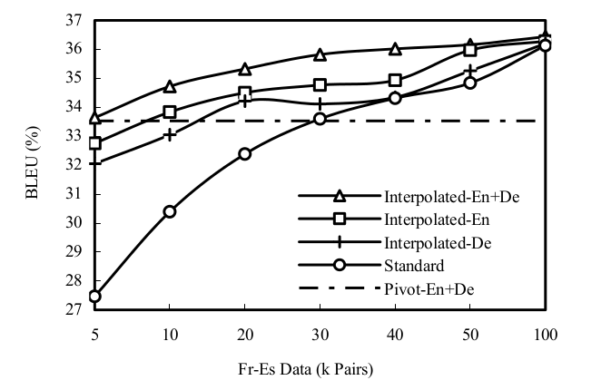
What if we use Multiple Pivots ?
Fr-Es translation using 2 pivots
Hi ←→ Ja translation using 7 pivots
Source: Wu & Wang (2007)
Source: Dabre et al (2015)
System | Ja→Hi | Hi→Ja
Direct | 33.86 | 37.47
Direct+best pivot | 35.74 (es) | 39.49 (ko)
Direct+Best-3 pivots | 38.22 | 41.09
Direct+All 7 pivots | 38.42 | 40.09
Adding a pivot increases vocabulary coverage
The more the better, especially when the training corpora are small

Slide 128
E
X
Y
How can resources for a resource-rich language Y, which is related to a resource-poor language X, help translation between X, and an unrelated language E?
Can Y also help reduce structural divergence between X and E?

Slide 129
Consider English → Marathi translation
Word order divergence: English is SVO Marathi is SOV
The President of America visited India in June
amarIkece rAShTrapati jUnamadhye bhArata aale
America+of President June+in India came
Hindi and Marathi are Indo-Aryan languages with the same word order
Dravidian languages also have the same word order
Can reordering solutions for English → Hindi translation be reused for:
English → Marathi translation?
English → Telugu translation ?

Slide 130
Source Reordering
Standard PBSMT cannot handle long-distance reordering
Source Reordering: Change the word order of source side of the training corpus to match the target language word order prior to SMT training
Source Reordering improves PBSMT:
Longer phrases can be learnt
Decoder cannot evaluate long distance reorderings by search in a small window
English | The President of America visited India in June
Reordered | America of The President June in India visited
Marathi | amarIkece rAShTrapati jUnamadhye bhAratat aale America+of President June+in India+to came

Slide 131
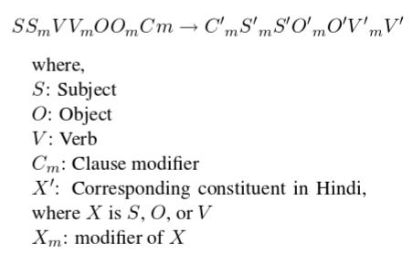
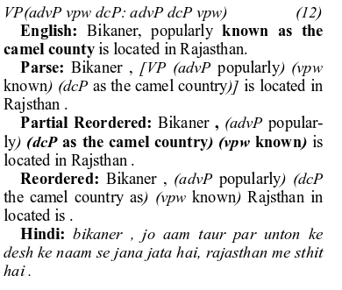
Rule Based Source Reordering
Generic reordering (Ramanathan et al 2008)
Basic reordering transformation for English→ Indian language translation
Hindi-tuned reordering (Patel et al 2013)
Improvement over the basic rules by analyzing En→ Hi translation output

Slide 132
Portable rules for En→ IL pairs
(Kunchukuttan, et al. 2014)
 | Indo-Aryan |  |  |  |  |  |  | Dravidian
System | hin | urd | pan | ben | guj | mar | kok | tam | tel | mal
PBSMT | 26.53 | 18.07 | 22.86 | 14.85 | 17.36 | 10.17 | 13.01 | 4.17 | 6.43 | 4.85
+generic reordering (S₁) | 29.63 | 20.42 | 26.06 | 16.85 | 20.11 | 11.46 | 15.01 | 4.97 | 7.83 | 5.53
+Hindi tuned reordering (S₂) | 30.86 | 21.54 | 27.52 | 18.20 | 21.33 | 12.68 | 15.73 | 5.09 | 8.29 | 5.68
Source reordering improves BLEU scores for 15% and 21% for source reordering system systems S₁ and S₂ respectively for all language pairs
A single rule-base serves all major Indian languages
Even Hindi-tuned rules perform well for other Indian languages as target

Slide 133
Tutorial Outline
Introduction & Motivation
Language Relatedness
Translation within related languages
Translation from related languages to another language
Summary

Slide 134
Summary

Slide 135
We discussed the following questions …
What is language relatedness & when is it useful for MT?
Can translation between related languages be made more accurate?
Can multiple languages help each other in translation?
Can we reduce resource requirements?
What concepts & tools are required for solving the above questions?

Slide 136
What does it mean to say languages are related?
Genetic relation → Language Families
Contact relation → Linguistic Area
Linguistic typology → Linguistic Universals

Slide 137
Key characteristics of related languages
Lexical Similarity
Morphological correspondence
Monotonic word-order
Leverage these similarities to
improve translation quality
reduce resource requirements

Slide 138
Orthographic and Phonetic Similarity to measure word similarity
Properties & similarities of the scripts involved useful for measuring orthographic similarity
Identification of loan words, cognates, false friends and named entity pairs

Slide 139
Translation between related languages
Adapting word-level SMT to improve word alignments, lexical coverage, OOV handling
Use sub-word level units of representation
Implicit use of morphological correspondence and monotonic word order
Assistance from multiple languages via use of pivot languages
Food for thought
Translation between related languages is not just transliteration (Tsvetkov etal., 2015; Tsvetkov & Dyer, 2015)
Relation between lexical similarity and translation accuracy
Evaluation Metrics for sub-word level transformations

Slide 140
Translation between related languages & another language
Assisting language to improve vocabulary coverage & translation confidence
Pivot based SMT to use corpus from a resource rich related language
Source/Target rewriting: useful for related languages with little corpora
Divergence between languages has to bridged
Linguistic resources can be re-used among related languages

Slide 141
Can we reduce resource requirements?
Lesser parallel corpora required for learning sub-word transformations
Shared representation can be a powerful mechanism
Resources can be re-used/ported between related languages

Slide 142
Key Tools and Concepts
Language Typology
Phonetic Properties
Phonetic & Orthographic similarity
Cognate Identification
Transliteration
Confusion networks & Word lattices representations
Pivot-based MT
Combining SMT models/outputs

Slide 143
Related Work that might be of interest
Study of Linguistic Typology
Historical/Comparative Linguistics
Mining bilingual dictionaries, named entities & parallel corpora
Word alignment using bridge languages
Rule-based and Example-based MT in the light of linguistic similarities
Multilingual Neural Machine Translation
Character-level Neural Machine Translation

Slide 144
Tools & Resources

Slide 145
Language & Variation
Ethnologue: Catalogue of all the world’s living languages (www.ethnologue.com)
World Atlas of Linguistic Structures: Large database of structural (phonological, grammatical, lexical) properties of languages (wals.info)
Comrie, Polinsky & Mathews. The Atlas of Languages: The Origin and Development of Languages Throughout the World
Daniels & Bright. The World’s Writing systems

Slide 146
Tools
Pivot-based SMT: https://github.com/tamhd/MultiMT
System Combination: MEMT
Moses contrib has tools for combining phrase tables
Moses can take confusion network as input
Multiple Decoding Paths is implemented in Moses

Slide 147
Classification of Reading Material
Language Relatedness: | 1,7,15,16,49,53,56
Lexical Similarity: | 9,18,20,22,23,24,29,31,32,46,63
Adapting word-level SMT | 8,12,13,14,24,26,28,34,41,47,55,59,60
Character-level SMT | 36,37,38,39,57,58
Pivot-based SMT | 5,10,11,25,30,33,35,37,43,44,61,62,64,65,66
List of papers at the end

Slide 148
Thank You!
Questions?

Slide 149
References
Anvita Abbi. Languages of India and India and as a Linguistic Area. 2012. Retrieved November 15, 2015, from http://www.andamanese.net/Languages of India and India as a linguistic area.pdf
Y. Al-Onaizan, J. Curin, M. Jahr, K. Knight, J. Lafferty, D. Melamed, F. Och, D. Purdy, N. Smith, and D. Yarowsky. Statistical machine translation. Technical report, Johns Hopkins University. 1999
Emily Bender. On achieving and evaluating language-independence in NLP. Linguistic Issues in Language Technology. 2011.
Shane Bergsma, Grzegorz Kondrak. Alignment-based discriminative string similarity. Annual meeting-Association for Computational Linguistics. 2007.
N. Bertoldi, M. Barbaiani, M. Federico, R. Cattoni. Phrase-based statistical machine translation with pivot languages. IWSLT. 2008.
Alexandra Birch, Miles Osborne, and Philipp Koehn. Predicting success in machine translation. Proceedings of the Conference on Empirical Methods in Natural Language Processing. Association for Computational Linguistics, 2008.
Peter Daniels and William Bright. The world's writing systems. Oxford University Press, 1996.
Peter Brown, Vincent J. Della Pietra, Stephen A. Della Pietra, and Robert L. Mercer. The mathematics of statistical machine translation: Parameter estimation. Computational linguistics. 1993.
Michael Covington. An algorithm to align words for historical comparison. Computational linguistics. 1996.
Raj Dabre, Fabrien Cromiers, Sadao Kurohashi, and Pushpak Bhattacharyya. Leveraging small multilingual corpora for SMT using many pivot languages. Proceedings of the 2015 Conference of the North American Chapter of the Association for Computational Linguistics: Human Language Technologies. 2015.
Adri`a De Gispert, Jose B Marino. Catalan-english statistical machine translation without parallel corpus: bridging through spanish. In Proc. of 5th International Conference on Language Resources and Evaluation (LREC). 2006.

Slide 150
References
Nadir Durrani, Hassan Sajjad, Hieu Hoang and Philipp Koehn. Integrating an unsupervised transliteration model into statistical machine translation. EACL. 2014.
Nadir Durrani, Hassan Sajjad, Alexander Fraser, and Helmut Schmid. Hindi-to-Urdu machine translation through transliteration. In Proceedings of the 48th Annual meeting of the Association for Computational Linguistics. 2010.
Nadir Durrani, Barry Haddow, Phillip Koehn, Kenneth Heafield. Edinburgh’s phrase-based machine translation systems for WMT-14. Proceedings of the ACL 2014 Ninth Workshop on Statistical Machine Translation. 2014.
Halvor Eifring, Bøyesen Rolf Theil. Linguistics for students of Asian and African languages. Institutt for østeuropeiske og orientalske studier. 2005. Retrieved November 15 2015, from https://www.uio.no/studier/emner/hf/ikos/EXFAC03-AAS/h05/larestoff/linguistics/
Murray Emeneau. India as a linguistic area. Language. 1956.
Kenneth Heafield, Alon Lavie. Combining Machine Translation Output with Open Source: The Carnegie Mellon Multi-Engine Machine Translation Scheme. The Prague Bulletin of Mathematical Linguistics. 2010.
Diana Inkpen, Oana Frunza, and Grzegorz Kondrak. Automatic identification of cognates and false friends in French and English. Proceedings of the International Conference Recent Advances in Natural Language Processing. 2005.
Mitesh Khapra, A. Kumaran and Pushpak Bhattacharyya. Everybody loves a rich cousin: An empirical study of transliteration through bridge languages. Human Language Technologies: The 2010 Annual Conference of the North American Chapter of the Association for Computational Linguistics. Association for Computational Linguistics. 2010.
Alexandre Klementiev, Dan Roth. Weakly supervised named entity transliteration and discovery from multilingual comparable corpora. Proceedings of the 21st International Conference on Computational Linguistics and the 44th annual meeting of the Association for Computational Linguistics. 2006.
Philipp Koehn. Statistical machine translation. Cambridge University Press. 2009.

Slide 151
References
Greg Kondrak. Cognates and word alignment in bitexts. MT Summit. 2005.
Grzegorz Kondrak. A new algorithm for the alignment of phonetic sequences. Proceedings of the 1st North American chapter of the Association for Computational Linguistics conference. 2000.
Greg Kondrak, Daniel Marcu and Kevin Knight. Cognates can improve statistical translation models. In Proceedings of the Conference of the North American Chapter of the Association for Computational Linguistics on Human Language Technology. 2003.
S. Kumar, Och, F. J., Macherey, W. Improving word alignment with bridge languages. In Proceedings of the Joint Conference on Empirical Methods in Natural Language Processing and Computational Natural Language Learning. 2007.
Anoop Kunchukuttan, Ratish Puduppully, and Pushpak Bhattacharyya. Brahmi-Net: A transliteration and script conversion system for languages of the Indian subcontinent. Conference of the North American Chapter of the Association for Computational Linguistics: Demonstrations. 2015.
Anoop Kunchukuttan, Abhijit Mishra, Rajen Chatterjee, Ritesh Shah, Pushpak Bhattacharyya. Sata-Anuvadak: Tackling Multiway Translation of Indian Languages. Language Resources and Evaluation Conference. 2014.
Anoop Kunchukuttan, Ratish Pudupully, Rajen Chatterjee, Abhijit Mishra, Pushpak Bhattacharyya. 2014. The IIT Bombay SMT System for ICON 2014 Tools Contest . NLP Tools Contest at ICON 2014.
G. Mann, David Yarowsky. Multipath translation lexicon induction via bridge languages. In Proceedings of the second meeting of the North American Chapter of the Association for Computational Linguistics on Language technologies. 2001.
Evgeny Matusov, Nicola Ueffing, and Hermann Ney. Computing Consensus Translation for Multiple Machine Translation Systems Using Enhanced Hypothesis Alignment. EACL. 2006.

Slide 152
References
Dan Melamed. Automatic Evaluation and Uniform Filter Cascades for Inducing N-best Translation Lexicons. Third Workshop on Very Large Corpora. 1995.
Dan Melamed. Models of translational equivalence among words. Computational Linguistics. 2000.
Akiva Miura, Graham Neubig, Sakriani Sakti, Tomoki Toda, Satoshi Nakamura. Improving Pivot Translation by Remembering the Pivot. Association for Computational Linguistics. 2015.
Robert Moore. A discriminative framework for bilingual word alignment. Proceedings of the conference on Human Language Technology and Empirical Methods in Natural Language Processing. Association for Computational Linguistics, 2005.
Rohit More, Anoop Kunchukuttan, Raj Dabre, Pushpak Bhattacharyya. Augmenting Pivot based SMT with word segmentation. International Conference on Natural Language Processing. 2015.
Preslav Nakov, Hwee Tou Ng. Improving statistical machine translation for a resource-poor language using related resource-rich languages. Journal of Artificial Intelligence Research. 2012.
Preslav Nakov, and Jörg Tiedemann. Combining word-level and character-level models for machine translation between closely-related languages. Proceedings of the 50th Annual Meeting of the Association for Computational Linguistics. 2012.
Preslav Nakov, Hwee Tou Ng. Improved statistical machine translation for resource-poor languages using related resource-rich languages. Proceedings of the 2009 Conference on Empirical Methods in Natural Language Processing. 2009.
Graham Neubig, Taro Watanabe, Shinsuke Mori, Tatsuya Kawahara. Machine Translation without Words through Substring Alignment. Proceedings of the 50th Annual Meeting of the Association for Computational Linguistics. 2012.

Slide 153
References
Franz Och and Hermann Ney. Statistical multi-source translation. In Proceedings of MT Summit VIII. Machine Translation in the Information Age , MT Summit. 2001.
Franz Och, and Hermann Ney. A systematic comparison of various statistical alignment models." Computational linguistics. 2003.
Raj Nath Patel, Rohit Gupta, and Prakash B. Pimpale. Reordering rules for English-Hindi SMT. HYTRA. 2013.
Deepak Patil, Harshad Chavan and Pushpak Bhattacharyya. Triangulation of Reordering Tables: An Advancement Over Phrase Table Triangulation in Pivot-Based SMT. International Conference on Natural Language Processing. 2015.
Michael Paul, Andrew Finch, and Eiichrio Sumita. How to choose the best pivot language for automatic translation of low-resource languages. ACM Transactions on Asian Language Information Processing (TALIP). 2013.
R. Ananthakrishnan, Jayprasad Hegde, Pushpak Bhattacharyya and M. Sasikumar, Simple Syntactic and Morphological Processing Can Help English-Hindi Statistical Machine Translation, International Joint Conference on NLP. 2008.
E. Ristad, P. Yianilos. Learning string-edit distance. IEEE Trans. Pattern Anal. Mach. Intell., 20(5):522–532, 1998.
Hassan Sajjad, Alexander Fraser, and Helmut Schmid. A statistical model for unsupervised and semi-supervised transliteration mining. Proceedings of the 50th Annual Meeting of the Association for Computational Linguistics. 2012.
J. Schroeder, Cohn, T., and Koehn, P. Word lattices for multi-source translation. In Proceedings of the 12th Conference of the European Chapter of the Association for Computational Linguistics. 2009.
Anil Kumar Singh. A Computational Phonetic Model for Indian Language Scripts. In proceedings of Constraints on Spelling Changes: Fifth International Workshop on Writing Systems. 2006.

Slide 154
References
Harshit Surana and Anil Kumar Singh. A More Discerning and Adaptable Multilingual Transliteration Mechanism for Indian Languages. In proceedings of the Third International Joint Conference on Natural Language Processing. 2008.
R. Sinha, Sivaraman, K., Agrawal, A., Jain, R., Srivastava, R., and Jain, A.. ANGLABHARTI: a multilingual machine aided translation project on translation from English to Indian languages. In IEEE International Conference on Systems, Man and Cybernetics. 1995.
David Steele, Lucia Specia. WA-Continuum: Visualising Word Alignments across Multiple Parallel Sentences Simultaneously. ACL-IJCNLP. 2015.
Karumuri Subbarao. South Asian languages : a syntactic typology. Cambridge University Press. 2012.
Anil Kumar Singh and Harshit Surana. Multilingual Akshar Based Transducer for South and South East Asian Languages which Use Indic Scripts. In Proceedings of the Seventh International Symposium on Natural Language Processing. Pattaya, Thailand. 2007.
Ben Taskar, Simon Lacoste-Julien, and Dan Klein. A discriminative matching approach to word alignment. Proceedings of the conference on Human Language Technology and Empirical Methods in Natural Language Processing. Association for Computational Linguistics. 2005.
Sarah Thomason. Linguistic Areas and Language History. Studies in Slavic and General Linguistics. 2000.
Jorge Tiedemann. Character-based PSMT for closely related languages. In Proceedings of the 13th Annual Conference of the European Association for Machine Translation. 2009.
Jörg Tiedemann. Character-based pivot translation for under-resourced languages and domains. Proceedings of the 13th Conference of the European Chapter of the Association for Computational Linguistics. 2012.
Yulia Tsvetkov, Waleed Ammar, and Chris Dyer. Constraint-Based Models of Lexical Borrowing. In Proc. NAACL'15.

Slide 155
References
Yulia Tsvetkov and Chris Dyer. Lexicon Stratification for Translating Out-of-Vocabulary Words. In Proc. ACL'15.
Masao Utiyama, Hitoshi Isahara. A comparison of pivot methods for phrase-based statistical machine translation. In HLT-NAACL, pages 484–491, 2007.
D. Vilar, Peter, J.-T., & Ney, H.. Can we translate letters?. In Proceedings of the Second Workshop on Statistical Machine Translation. 2007.
Robert Wagner, Michael J. Fischer. The string-to-string correction problem. Journal of the ACM. 1974.
Haifeng Wang, Hua Wu, and Zhanyi Liu. Word alignment for languages with scarce resources using bilingual corpora of other language pairs. COLING-ACL. 2006.
Hua Wu, Haifeng Wang. Pivot language approach for phrase-based statistical machine translation. Machine Translation. 2007.
Robert Östling. Bayesian word alignment for massively parallel texts. 14th Conference of the European Chapter of the Association for Computational Linguistics. 2014.

