Slide 1
Micro Services
Microservices are an architectural and organizational approach to software development where software is composed of small independent services that communicate over well-defined APIs. These services are owned by small, self-contained teams.
Microservices architectures make applications easier to scale and faster to develop, enabling innovation and accelerating time-to-market for new features.

Slide 2
Characteristics of Microservices
Autonomous
Specialized
Benefits of Microservices
Agility
Flexible Scaling
Easy Deployment
Technological Freedom
Reusable Code
Resilience

Slide 3
The principles used to design Microservices are as follows
Independent & Autonomous Services
Scalability
Decentralization
Resilient Services
Real-Time Load Balancing
Availability
Continuous delivery through DevOps Integration
Seamless API Integration and Continuous Monitoring
Isolation from Failures
Auto -Provisioning

Slide 4
Design Patterns of Microservices
1. Aggregator
2. API Gateway
3. Chained or Chain of Responsibility
4. Asynchronous Messaging
5. Database or Shared Data
6. Event Sourcing
7. Branch
8. Command Query Responsibility Segregator
9. Circuit Breaker
10. Decomposition

Slide 5
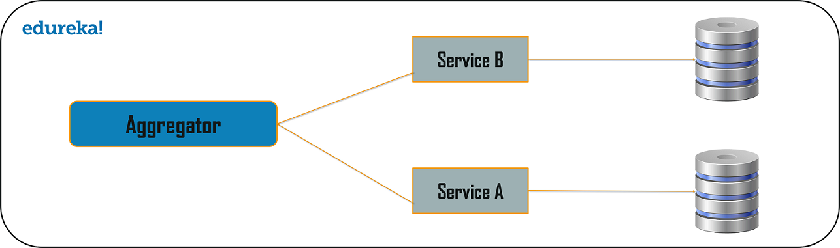
Aggregator

Slide 6
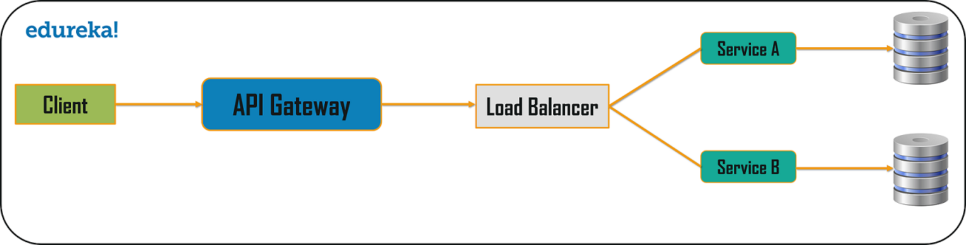
API Gateway

Slide 7
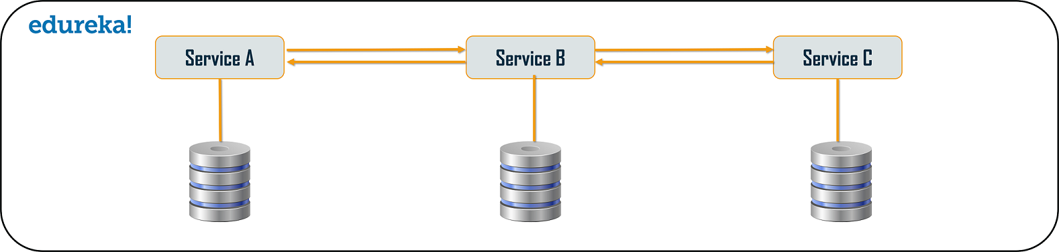
Chain or Chained of Responsibility

Slide 8
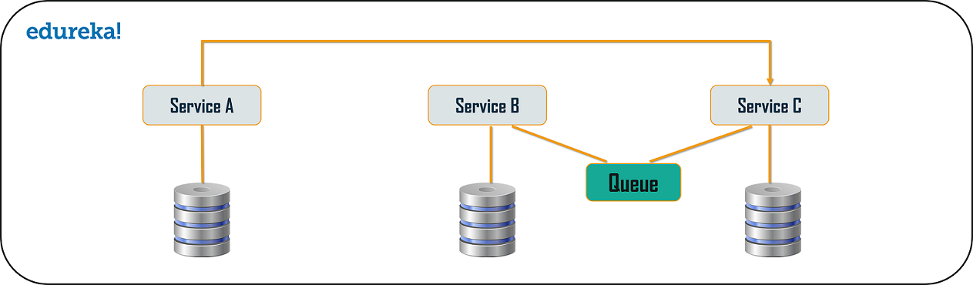
Asynchronous Messaging

Slide 9
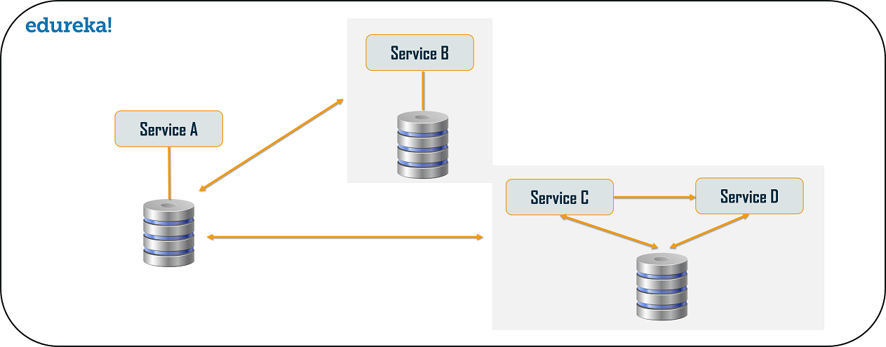
Database or Shared Database

Slide 10
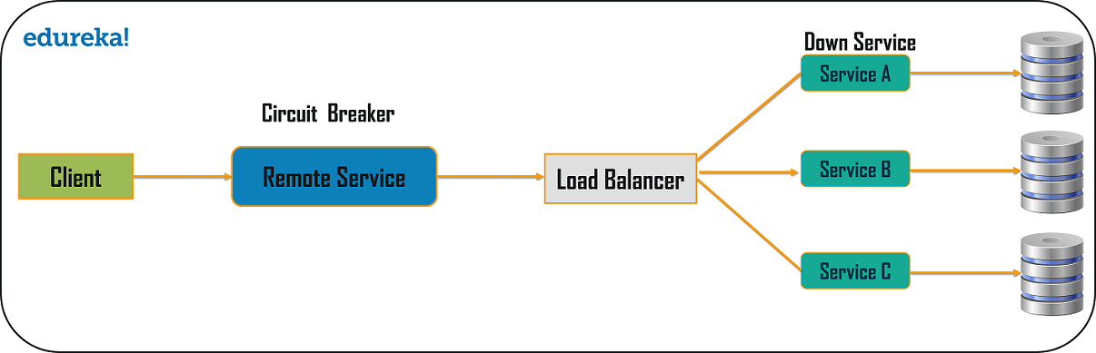
Circuit Breaker

Slide 11
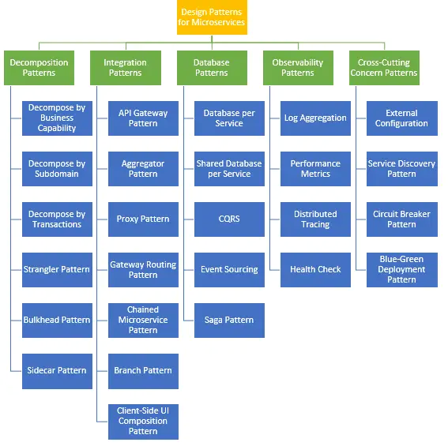

Slide 12
Localhost:8080
Cloud Gateway
Discover Server
Localhost:8761
Comment Service
Load Balancer
Comment Service
Localhost:8888
Localhost:8081
Localhost:8082
Note Service

