Slide 1
Best Coding Practices(Java)
Sumeet Shukla
18th Jan 2016
Notes:
This template can be used as a starter file for presenting training materials in a group setting.
Sections
Right-click on a slide to add sections. Sections can help to organize your slides or facilitate collaboration between multiple authors.
Notes
Use the Notes section for delivery notes or to provide additional details for the audience. View these notes in Presentation View during your presentation.
Keep in mind the font size (important for accessibility, visibility, videotaping, and online production)
Coordinated colors
Pay particular attention to the graphs, charts, and text boxes.
Consider that attendees will print in black and white or grayscale. Run a test print to make sure your colors work when printed in pure black and white and grayscale.
Graphics, tables, and graphs
Keep it simple: If possible, use consistent, non-distracting styles and colors.
Label all graphs and tables.

Slide 2
A good computer program should have following characteristics:
Readability
Portability
Efficiency
Structural
Flexibility
Generality
Documentation

Slide 3
Best Coding Practices
Coding convention– Syntax and layout
Readability
Structural
Documentation
Coding Technique – Efficacy Of the Code
Portability
Efficiency
Flexibility
Generality

Slide 4
Coding Convention
Code conventions are important to programmers for a number of reasons:
• 80% of the lifetime cost of a piece of software goes to maintenance.
• Hardly any software is maintained for its whole life by the original author.
• Code conventions improve the readability of the software, allowing engineers to understand new code more quickly and thoroughly.
• If you ship your source code as a product, you need to make sure it is as well packaged and clean as any other product you create.

Slide 5
Coding Convention
Coding Standards lead to greater consistency within your code and the code of your teammates.
Easier to understand
Easier to develop
Easier to maintain
Reduces overall cost of application

Slide 6
Components of Java Source File
/*
* Copyright notice
*/
package java.awt;
import java.awt.peer.CanvasPeer;
/**
* class description
*
* @version 1.10 04 Oct 1996
*
* @author First name Last name
*/
public class ColorPickerPanel {
/* A class implementation comment can go here. */
/**
*class variables – doc comment
*/
public static Integer colorVariant;
/**
*instance variables – doc comment
*/
private String colorCode;
Beginning Comments
Package and Import Statements
Class/interface documentation comment (/**...*/)
class or interface statement
Class/interface implementation comment (/*...*/), if necessary
Class (static) variables
Instance variables

Slide 7
Components of Java Source File continued…
/**
*default constructor
*/
public ColorPickerPanel() {
colorVariant = 11;
colorCode = #FFFFFF;
}
/**
*two argument constructor
*/
public ColorPickerPanel(Integer colorVariant, String colorCode) {
this.colorVariant = colorVariant;
this.colorCode = colorCode;
}
/**
*@retrun the color code
*/
public String getColorCode() {
return colorCode;
}
/**
*@param Integer the color variant
*/
public void setColorVariant(Integer colorVariant) {
………
………
}
}
Indentation
Constructors
Blank line
Documentation comments
Methods

Slide 8
Comments
/**
* class description
* @version 1.10 04 Oct 1996
* @author First name Last name
*/
public class ColorPickerPanel {
/* A class implementation comment can go here. */
/*
private static final String DEFAULT_COLOR = “#FFFFFF”
private static final int DEFAULT_VARIANT = 0;
*/
/**
*class variables – doc comment
*/
public static Integer colorVariant;
/**
*instance variables – doc comment
*/
private String colorCode;
/**
*@param Integer the color variant
*/
public void setColorVariant(Integer colorVariant) {
if (colorVariant == 0) {
colorCode = “#000000”; /* set the color to black*/
} else {
colorCode = “#FFFFFF”; // set the color to while
}
}
}
Documentation Comments
Implementation Comments
Single Line Comments
Block Comments
Trailing Comments
End-of-Line Comments

Slide 9
Naming Conventions
What Makes Up a Good Name?
Use full English descriptors
For example, use names like firstName, grandTotal, or CorporateCustomer
Use terminology applicable to the domain
Banking domain - Customer, Software services domain - Client
Use mixed case to make names readable
Avoid long names (< 15 characters is a good idea)
User abbreviations sparingly
Capitalize the first letter of standard acronym

Slide 10
Naming Conventions Continued…
Classes / Interfaces –
Class names should be nouns, in mixed case with the first letter of each internal word capitalized.
Methods –
Methods should be verbs, in mixed case with the first letter lowercase, with the first letter of each internal word capitalized.
Variables –
Variables should be nouns, in mixed case with the first letter lowercase, with the first letter of each internal word capitalized.
Class Constants –
Class Constants should be all uppercase with words separated by underscores (“_”).

Slide 11
Blank Spaces
Before / After Parenthesis –
A keyword followed by a parenthesis should be separated by a space.
while_(true)_{
...
}
A blank space should appear after commas in argument lists.
All binary operators except . should be separated from their operands by spaces.
a = (a + b) / (c * d);
The expressions in a for statement should be separated by blank spaces.
for (expr1; expr2; expr3)
Casts should be followed by a blank.
User x = (User) anObject;
blank spaces

Slide 12
Returning Values
Try to make the structure of your program match the intent.
Example:
if (booleanExpression) {
return TRUE;
} else {
return FALSE;
}
should instead be written as
return booleanExpression;

Slide 13
Ternary Operator (?:)
Use Ternary Operator for conditional assignment
Example:
Int x;
If (expression) {
x = 9;
} else {
x = 0;
}
can be written as
x = (expression) ? 9 : 0;

Slide 14
Static Code Analysis
Static code analysis is the analysis of computer software that is performed without actually executing programs built from that software.
(analysis performed on executing programs is known as dynamic analysis)
In most cases the analysis is performed on some version of the source code and in the other cases some form of the object code.
The term is usually applied to the analysis performed by an automated tool, with human analysis being called program understanding, or code review.
Some of automated SCA Tools –
PMD, AppPerfect, FindBugs, IntelliJ IDEA etc.

Slide 15
Coding Techniques…
Prefer returning Empty Collections instead of Null
public class getLocationName {
return (null==cityName ? "":cityName);
}
Use Strings carefully
//Slower Instantiation
String bad = new String("Yet another string object");
//Faster Instantiation
String good = "Yet another string object"
Notes:
Give a brief overview of the presentation. Describe the major focus of the presentation and why it is important.
Introduce each of the major topics.
To provide a road map for the audience, you can repeat this Overview slide throughout the presentation, highlighting the particular topic you will discuss next.

Slide 16
Coding Techniques(Contd…)
Avoid unnecessary Objects
import java.util.ArrayList;
import java.util.List;
public class Employees
{
private List Employees;
public List getEmployees()
{
//initialize only when required
if(null == Employees) {
Employees = new ArrayList();
}
return Employees;
}
}

Slide 17
Dilemma between Array and ArrayList
import java.util.ArrayList;
public class arrayVsArrayList {
public static void main(String[] args) {
int[] myArray = new int[6];
// ArraysOutOfBoundException
myArray[7]= 10;
//Declaration of ArrayList. Add and Remove of elements is easy.
ArrayList<Integer> myArrayList = new ArrayList<>();
myArrayList.add(1);
myArrayList.add(2);
myArrayList.add(3);
myArrayList.add(4);
myArrayList.add(5);
myArrayList.remove(0);
for(int i = 0; i < myArrayList.size(); i++) {
System.out.println("Element: " + myArrayList.get(i));
}
//Multi-dimensional Array
int[][][] multiArray = new int [3][3][3];
}
}

Slide 18
When Finally does not get executed with Try
public class shutDownHooksDemo {
public static void main(String[] args) {
for(int i=0;i<5;i++) {
try {
if(i==4) {
System.out.println("Inside Try Block.Exiting without executing Finally block.");
System.exit(0);
}
} finally {
System.out.println("Inside Finally Block.");
}
}
}
}

Slide 19
Check Oddity
public boolean oddOrNot(int num) {
return num % 2 == 1;
}
public boolean oddOrNot(int num) {
return (num & 1) != 0;
}

Slide 20
Difference between single quotes and double quotes
public class Haha {
public static void main(String args[]) {
System.out.print("H" + "a");
System.out.print('H' + 'a');
}
}
it would seem return “HaHa” is returned, but it actually returns Ha169

Slide 21
Avoiding Memory leaks by simple tricks
Always release database connections when querying is complete.
Try to use Finally block as often possible.
Release instances stored in Static Tables.

Slide 22
Reserve memory for Java
export JAVA_OPTS="$JAVA_OPTS -Xms5000m -Xmx6000m -XX:PermSize=1024m -XX:MaxPermSize=2048m“
Xms = Minimum memory allocation pool
Xmx = Maximum memory allocation pool
XX:PermSize = Initial size that will be allocated during startup of the JVM
XX:MaxPermSize = Maximum size that can be allocated during startup of the JVM

Slide 23
Computation of power
To compute power (^), java performs Exclusive OR (XOR). In order to compute power, Java offers two options:
Multiplication: double square = double a * double a; // Optimized
double cube = double a * double a * double a; // Non-optimized
double cube = double a * double square; // Optimized
double quad = double a * double a * double a * double a; // Non-optimized
double quad = double square * double square; // Optimized
pow(double base, double exponent):
‘pow’ method is used to calculate where multiplication is not possible (base^exponent)
double cube = Math.pow(base, exponent);
Math.pow should be used ONLY when necessary. For example, exponent is a fractional value. That is because Math.pow() method is typically around 300-600 times slower than a multiplication.

Slide 24
How to handle Null Pointer Exceptions
int noOfStudents = school.listStudents().count;
private int getListOfStudents(File[] files) {
if (files == null) throw new NullPointerException("File list cannot be null");
}

Slide 25
Use Collections
Use of collections makes the code reusable and interoperable.
Collections make the code more structured, easier to understand and maintainable.
Out of the box collection classes are well tested so the quality of code is good.

Slide 26
10-50-500 Rule
10: No package can have more than 10 classes.
50: No method can have more than 50 lines of code.
500: No class can have more than 500 lines of code.

Slide 27

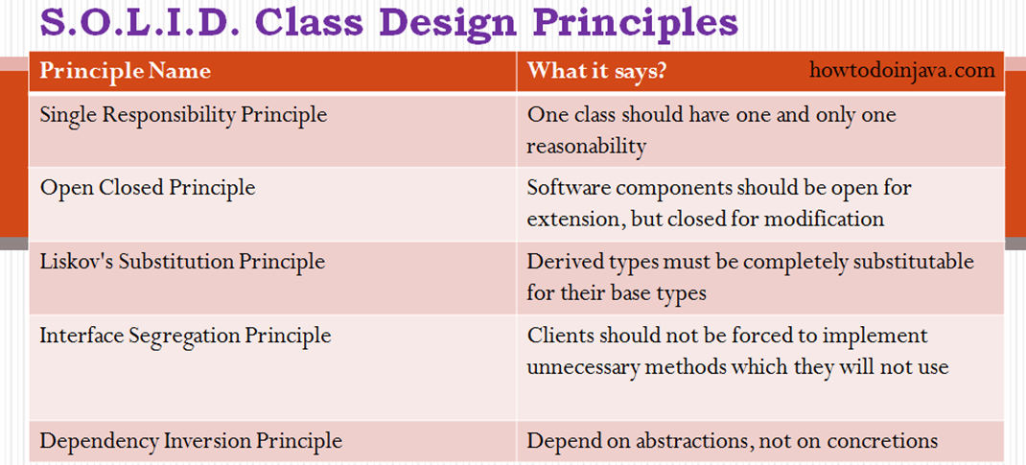
Notes:
This is another option for an Overview slides using transitions.

