Slide 1

Topic : SDLC Under Guidance of : By: Er.Vipul sir Arpit ku. Singh Er.Nisha maam Rohit K Saurav N

Slide 2
Agile s/w development
Agile software development is a set of principles for software developments in which requirements and solutions evolve through collaboration b/w self organizing, cross-functional teams.

Slide 3
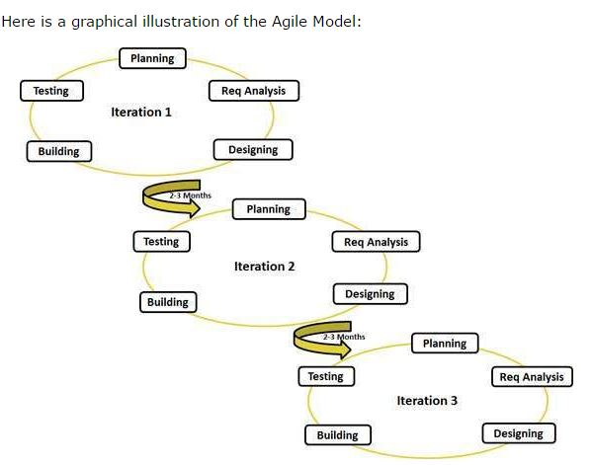

Slide 4
Agil Manufesto

Slide 5
principles

