Slide 1
CodeIgniter and MVC
Enterprise class web application development
Dienstag, 4. Mai 2010

Slide 2
Motivation
• You have worked with PHP, for small sites this works very well. HTML files
can be easily extended with dynamic content from the database, form
processing, etc.
• When sites grow, you might have realized that across multiple pages lots of
code repetition occurs. This is a problem when you need to change certain
parts of a page, that affects many or all pages.
• Furthermore, its hard to introduce new developers to code someone else
has written. It takes a long time to get familar with the code.
Dienstag, 4. Mai 2010

Slide 3
Motivation
• Enterprise class (big) web applications need structure, one HTML file per
page with PHP code is not optimal => things get confusing, hard to work in
teams, etc.
• Web Application Frameworks provide such a structure wich introduce
seperation of concern, etc.
• Most common for Web application development are frameworks that are
based on the Model-View-Controller design pattern
•
Dienstag, 4. Mai 2010

Slide 4
Model-View-Controller
• „Seperation of concerns“ of Logic and Presentation
• Controller: Handles all incoming HTTP requests, passes data to the views
• View: Renders the HTML output
• Models: Encapsulate Business Logic, such as interaction with the database
• For PHP we introduce CodeIgniter
Dienstag, 4. Mai 2010

Slide 5

CodeIgniter
• CodeIgniter is a PHP-based MVC framework that helps structure your code
and make redundant tasks less tedious.
• There are countless similar PHP frameworks, the most popular ones being
CakePHP and symfony. Ruby on Rails is famous in the Ruby world.
• CodeIgniter is very light weight. It doesn‘t force any convention but provides
many commonly required features through a set of build in libraries.
• CodeIgniter has a low learning curve and is one of the best documented PHP
web frameworks.
Dienstag, 4. Mai 2010

Slide 6
CodeIgniter is right for you if:
You want a framework with a small footprint.
You need exceptional performance.
You need broad compatibility with standard hosting accounts that run a variety of PHP versions and configurations.
You want a framework that requires nearly zero configuration.
You want a framework that does not require you to use the command line.
You want a framework that does not require you to adhere to restrictive coding rules.
You are not interested in large-scale monolithic libraries like PEAR.
You do not want to be forced to learn a templating language (although a template parser is optionally available if you desire one).
You eschew complexity, favoring simple solutions.
You need clear, thorough documentation.

Slide 7
CodeIgniter: Features
CodeIgniter is Free
CodeIgniter is licensed under the MIT license so you can use it however you please.
CodeIgniter is Light Weight
Truly light weight. The core system requires only a few very small libraries. This is in stark contrast to many frameworks that require significantly more resources. Additional libraries are loaded dynamically upon request, based on your needs for a given process, so the base system is very lean and quite fast.
Dienstag, 4. Mai 2010

Slide 8
CodeIgniter: Features
CodeIgniter is Fast
Really fast.
CodeIgniter Uses M-V-C
CodeIgniter uses the Model-View-Controller approach, which allows great separation between logic and presentation. This is particularly good for projects in which designers are working with your template files, as the code these files contain will be minimized.
CodeIgniter is Extensible
The system can be easily extended through the use of your own l ibraries, helpers, or through class extensions or system hooks.
Dienstag, 4. Mai 2010

Slide 9
CodeIgniter: Features
CodeIgniter Generates Clean URLs
The URLs generated by CodeIgniter are clean and search-engine friendly. Rather than using the standard “query string” approach to URLs that is synonymous with dynamic systems, CodeIgniter uses a segment-based approach:
example.com/news/article/345
CodeIgniter Packs a Punch
CodeIgniter comes with full-range of libraries that enable the most commonly needed web development tasks, like accessing a database, sending email, validating form data, maintaining sessions, manipulating images, working with XML-RPC data and much more.
Dienstag, 4. Mai 2010

Slide 10
CodeIgniter: Features List
Extremely Light Weight
Full Featured database classes with support for several platforms.
Query Builder Database Support
Form and Data Validation
Security and XSS Filtering
Session Management
Email Sending Class. Supports Attachments, HTML/Text email, multiple protocols (sendmail, SMTP, and Mail) and more.
Image Manipulation Library (cropping, resizing, rotating, etc.). Supports GD, ImageMagick, and NetPBM
File Uploading Class
FTP Class
Localization
Pagination
Dienstag, 4. Mai 2010

Slide 11
CodeIgniter: Features List
Data Encryption
Benchmarking
Full Page Caching
Error Logging
Application Profiling
Calendaring Class
User Agent Class
Zip Encoding Class
Template Engine Class
Trackback Class
XML-RPC Library
Unit Testing Class
Search-engine Friendly URLs
Flexible URI Routing
Support for Hooks and Class Extensions
Large library of “helper” functions
Dienstag, 4. Mai 2010

Slide 12
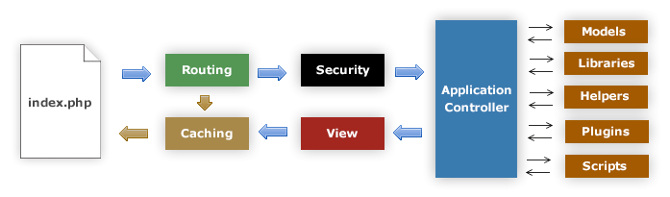
Application Flow Chart
1. The index.php serves as the front controller, initializing the base resources needed
to run CodeIgniter.
2. The Router examines the HTTP request to determine what should be done with it.
3. If a cache file exists, it is sent directly to the browser, bypassing the normal
system execution.
4. Security. Before the application controller is loaded, the HTTP request and any
user submitted data is filtered for security.
5. The Controller loads the model, core libraries, plugins, helpers, and any other
resources needed to process the specific request.
6. The finalized View is rendered then sent to the web browser to be seen. If caching
is enabled, the view is cached first so that on subsequent requests it can be
served.
Dienstag, 4. Mai 2010

Slide 13
Installing CodeIgniter
1) Download CodeIgniter from its official website.
https://www.codeigniter.com
2) Unzip CodeIgniter package.
Downloaded CodeIgniter will be in zip format.
Unzip it
Create folder named CodeIgniter in C>xampp>htdocs
Copy content of unzip folder inside CodeIgniter folder.

Slide 14
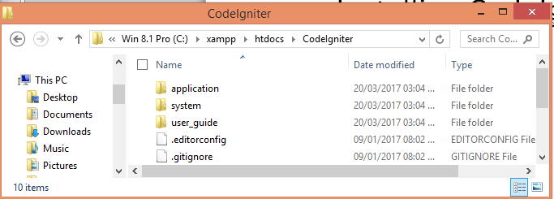
Installing CodeIgniter

Slide 15
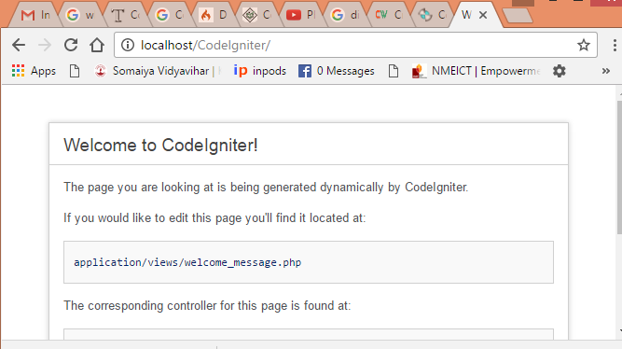
Installing CodeIgniter
Open browser and type: localhost/CodeIgniter

Slide 16
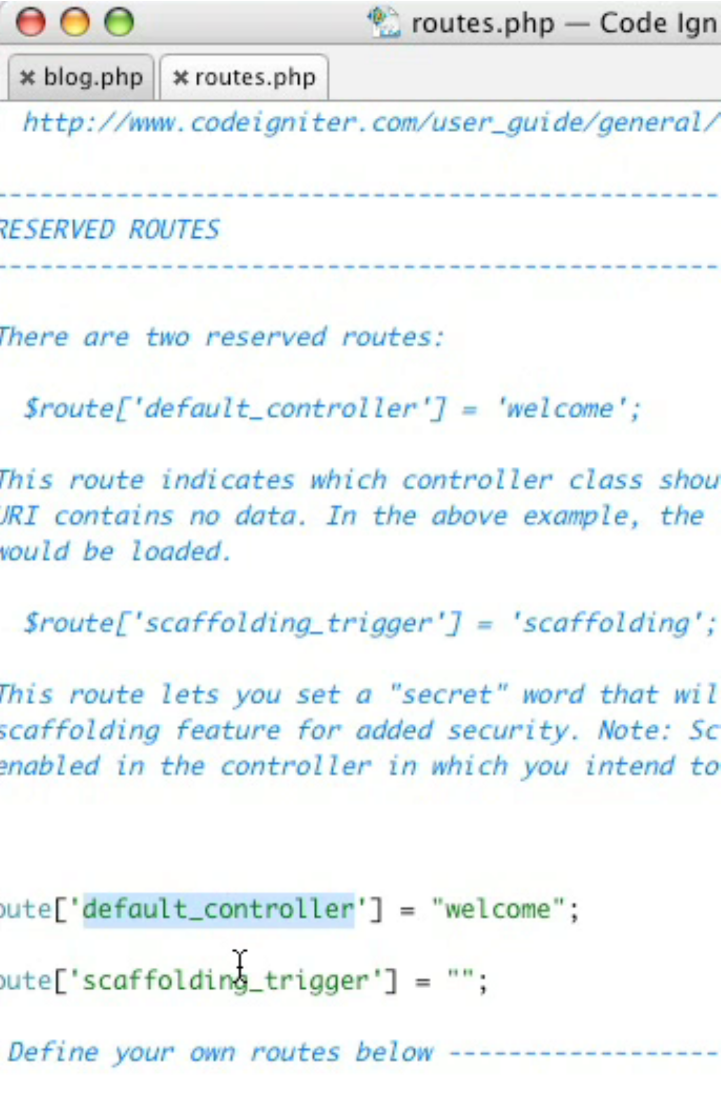
Routing Requests
• Per default CodeIgniter maps URL to
controller actions:
/index.php/controller/action
• The default controller is "welcome“
and the default action is "index“.
• Custom routing can be configured
through:
/application/config/routes.php
Dienstag, 4. Mai 2010

Slide 17
Installing CodeIgniter
Set the base URL in application/config/config.php file with any text editor
Ex. $config['base_url'] = 'http:localhost/CodeIgniter';

Slide 18
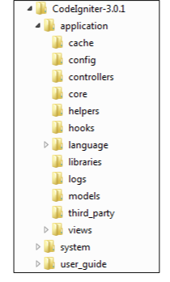
Directory Structure
CodeIgniter directory structure is divided into 3 folders:
Application
System
User_guide
And one imp file
Index.php

Slide 19
Directory Structure : Application
Application - this is where your application code is located, including the model, view and controller classes. This is the folder where you will develop your project. The Application folder contains several other folders, which are explained below:
Cache: This folder contains all the cached pages of your application. These cached pages will increase the overall speed of accessing the pages.
Config: This folder contains various files to configure the application. With the help of config.php file, user can configure the application. Using database.php ile, user can configure the database of the application.
Controllers: This folder holds the controllers of your application.

Slide 20
Directory Structure : Application
Core: CodeIgniter has some core class, these class make up the CodeIgniter framework and are saved in core file.
Generally, there will be no need to change these classes, but in case if you are modifying a class, create a class in "application/core" folder having same name as the core class file name in "system" folder.
Helpers: In this folder, you can put own helper class of your application.
Hooks: The files in this folder provide a means to tap into and modify the inner workings of the framework without hacking the core files.
Language: This folder contains language related files.
Libraries: store libraries developed by you for your application.

Slide 21
Directory Structure : Application
Logs: contains files related to the log of the system. If your CodeIgniter application is displaying some error or exception handling messages and if you are not getting what they are, you can look for their explanation in this folder.
Models: Models are used to load database queries. Controllers request model to load database query, model respond it back and then controller use it.
Third_party: In this folder, you can place any plugins, which will be used for your application.
Views: It contains all your view files. Controller load file from view and then gives the output.

Slide 22
Directory Structure : System
System
All action of CodeIgniter application happens here. Contains all CodeIgniter classes and libraries provided by the framework.
Core - It contains CodeIgniter core class. Do not make any changes in this folder.
Database - It contains database drivers and other utilities.
Fonts - It contains font related information.
Helpers - It contains default helpers such as URL, date and cookie.
Language - CodeIgniter supports multilingual web applications. It contains default language file.
Libraries - It contain libraries like calendars, file upload, email, etc. libraries created by you will be saved in "application/libraries". Here, only standard libraries will be stored.

Slide 23
Directory Structure
User_guide
It is the offline CodeIgniter guide.Core - It contains CodeIgniter core class. Do not make any changes in this folder.
Index.php
In this file, we can set the application environment and error level and we can define system and application folder name.
recieves all requests and routes to the right controllers classes and actions, parameters are included in the URL

Slide 24
MVC
Models are objects, which represent the underlying data. They hover above the database and access it as required. They can also perform operations on data to add meaning to it.
Views show the state of the model. They are responsible for displaying information to the end user.
Controllers offer options to change the state of the model. They are responsible for consulting models. They provide the dynamic data to views.

Slide 25
MVC
CI has subfolders for models, views, and controllers. Each file within them is a .php file, usually in the form of a class that follows certain naming conventions.
CI MVC is based on
Loose Coupling: Coupling is the degree to which the components of a system rely on each other. The less the components depend on each other, the more re-usable and flexible the system becomes.
Component Singularity: Singularity is the degree to which components have a narrowly focused purpose. In CodeIgniter, each class and its functions are highly autonomous in order to allow maximum usefulness.

Slide 26
Controller
A controller is the intermediary between models and views to process HTTP request and generates a web page.
Must extend the main Controller class of CodeIgniter (CI_Controller)
Each class function represents an controller action, which is redering a HTML page
index() is the default action
The name of the controller class must start with an uppercase letter.
The controller must be called with lowercase letter.
Default Controller: The file specified in default controller will be loaded by default when no file name is mentioned in the URL. By default, it is Welcome.php which is the first page to be seen after installing CodeIgniter.

Slide 27
Controller
Default Controller
To specify own default controller, open your application/config/routes.php file and set this variable:
$route['default_controller'] = ‘Test';
Where ‘Test’ is the name of the controller class you want used

Slide 28
Controller Example
<?php
defined('BASEPATH') OR exit('No direct script access allowed');
class Test extends CI_Controller // controller class
{
public function index() //default method of controller
{
$this->load->view('hello_world'); //load view (hello_world.php)
echo ‘I am inside controller test’s index Method';
}
}
?>
save this file as test.php in C:\xampp\htdocs\CodeIgniter\application\controllers
Now visit the your site using a URL similar to this:
localhost/CodeIgniter/index.php/Test

Slide 29
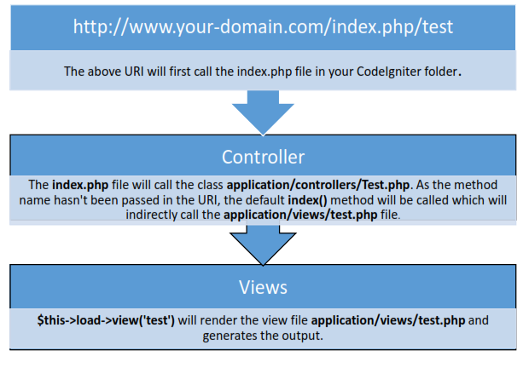

Slide 30
Controller: Creating own Method
Since your controller classes will extend the main application controller you must be careful not to name your functions identically to the ones used by that class, otherwise your local functions will override them.

Slide 31
Controller: Method Example
<?php
defined('BASEPATH') OR exit('No direct script access allowed');
class Test extends CI_Controller // controller class
{
public function myfunction()
{
$this->load->view('hello_world'); //load view (hello_world.jsp)
echo ‘I am inside controller test’s my function Method';
}
}
?>
save this file as test.php in C:\xampp\htdocs\CodeIgniter\application\controllers
Now visit the your site using a URL similar to this:
localhost/CodeIgniter/index.php/Test/myfunction

Slide 32
Controller: Loading Multiple Views
<?php
defined('BASEPATH') OR exit('No direct script access allowed');
class MyHello extends CI_Controller {
public function hi()
{
$this->load->view('hello_function');
$this->load->view('hello_world');
$this->load->view('hello_framework');
}
}
?>

Slide 33
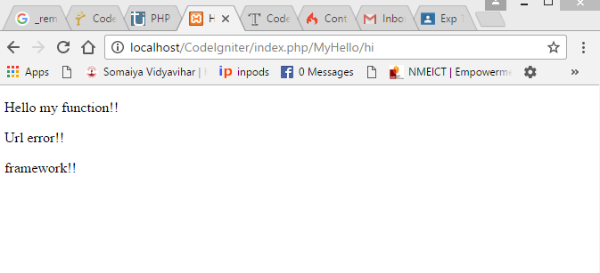

Slide 34
Remapping Function Calls
The second segment of the URI typically determines which function in the controller gets called. CodeIgniter permits you to override this behavior through the use of the _remap() function
If your controller contains a function named _remap(), it will always get called regardless of what your URI contains. It overrides the normal behavior in which the URI determines which function is called, allowing you to define your own function routing rules.

Slide 35
Remapping Function Calls
<?php
defined('BASEPATH') OR exit('No direct script access allowed');
class Hello extends CI_Controller {
public function defacult_function() {
$this->load->view(‘Error_Page');}
public function myfunction() {
$this->load->view('hello_function'); }
public function framefunction() { $this->load>view('hello_framework'); }
function _remap($method)
{
// $method contains the function //name from URI ,that is second //segment.
switch($method)
{
case 'function':
$this->myfunction();
break;
case 'framework':
$this->framefunction();
break;
default:
$this->defacult_function();
break; } } }
?>

Slide 36
Class Constructors
If you intend to use a constructor in any of your Controllers, you MUST place the following line of code in it:
parent::__construct();
The reason this line is necessary is because your local constructor will be overriding the one in the parent controller class so we need to manually call it.

Slide 37
Class Constructors
<?php class Blog extends CI_Controller { public function __construct() { parent::__construct(); // Your own constructor code } } ?>

Slide 38
VIEW
A view is simply a web page, or a page fragment, like a header, footer, sidebar, etc. In fact, views can flexibly be embedded within other views (within other views, etc., etc.) if you need this type of hierarchy.

Slide 39
Creating a View
Using your text editor, create a file called hello_world.php, and put this in it:
<html> <head> <title>My Blog</title> </head> <body> <h1>Welcome to my Blog!</h1> </body> </html>
Then save the file in application/views/ folder.

Slide 40
Loading View
To load a particular view file you will use the following function:
$this->load->view('name');
Where name is the name of your view file. Note: The .php file extension does not need to be specified unless you use something other than .php.
Ex: $this->load->view('hello_world');
Above code need to be included in function of controller

Slide 41
Loading multiple views
<?php
defined('BASEPATH') OR exit('No direct script access allowed');
class MyHello extends CI_Controller {
public function hi()
{
$this->load->view('hello_function');
$this->load->view('hello_world');
$this->load->view('hello_framework');
}
} ?>

Slide 42
Storing Views within Sub-folders
Your view files can also be stored within sub-folders if you prefer that type of organization. When doing so you will need to include the folder name loading the view.
Example:
$this->load->view('folder_name/file_name');

Slide 43
Adding Dynamic Data to the View
Data is passed from the controller to the view by way of an array or an object in the second parameter of the view loading function
If you use an object, the class variables will be turned into array elements.

Slide 44
Adding Dynamic Data to the View:Array
Controller: ViewArray.php
View: firsthome.php
<?php
class ViewArray extends CI_Controller
{
function index()
{
$data=array(
'title'=>'Homepage', 'content'=>'Welcome Here‘
);
$this->load->view('firsthome',$data);
}
}
?>
<html>
<head>
<title><?php echo $title;?></title>
</head>
<body>
<h1><?php echo $content;?></h1>
</body>
</html>

Slide 45
Adding Dynamic Data to the View:Object
Controller: ViewObj.php
View: sechome.php
<?php
class ViewObj extends CI_Controller
{
function index()
{
$data['title'] = "Homepage";
$data['content'] ="Frameworks !!";
$this->load->view('sechome', $data);
}
}
?>
<html>
<head>
<title><?php echo $title;?></title>
</head>
<body>
<h1><?php echo $content;?></h1>
</body>
</html>

Slide 46
Creating Loops (Controller: Comp.php)
<?php
class Comp extends CI_Controller
{
function index()
{
$data=array(
'title'=>'Company Homepage',
'content'=>'Welcome to kJSCE',
'projects'=>array('library management system','online shopping system','provident fund statutory returns system','hotel management system')
);
$this->load->view('home',$data);
}
}
?>

Slide 47
Creating Loops (View: home.php)
<html>
<head>
<title><?php echo $title;?></title>
</head>
<body>
<br>
<h1><?php echo $content;?></h1>
<br><hr>
<h2>Projects done:<h2>
<ul>
<?php foreach($projects as $item){?>
<li><?php echo $item;?></li>
<?php }?>
</ul>
</body>
</html>

Slide 48
Model
In any application you need to call a function to retrieve some information from the database.
Models responsibility is to handle all data logic and representation and load data in the views.
Model classes are stored in your application/models/ folder.
They can be nested within sub-folders if you want this type of organization.

Slide 49
Model
Basic Prototype
Example
class Model_name extends CI_Model { function __construct() { parent::__construct(); } }
class User_model extends CI_Model { function __construct() { parent::__construct(); } }
Where Model_name is the name of your class.
Class names must have the first letter capitalized with the rest of the name lowercase.
Make sure your class extends the base Model class.
The file name will be a lower case version of your class name.

Slide 50
Loading Model
Your models will typically be loaded and called from within your controller functions.
To load a model you will use the following function:
$this->load->model('Model_name');
If your model is located in a sub-folder, include the relative path from your models folder.
For example, if you have a model located at application/models/blog/queries.php you'll load it using:
$this->load->model('blog/queries');
Once loaded, you will access your model functions using an object with the same name as your class:
$this->Model_name->function();

Slide 51
Loading Model
If you would like your model assigned to a different object name you can specify it via the second parameter of the loading function:
EX:
$this->load->model('Model_name', 'fubar'); $this->fubar->function();

Slide 52
Connecting Models to Database
Loading a model doesn't mean it will automatically connect to your database. There are different methods to connect a database.
.Auto-connect feature will automatically load your database with every page load. To enable it, add word 'database' in the array library in autoload.php file.
Manually connect database by adding this code in the page where needed.
$this->load->database();

Slide 53
Helper
Helpers help you with tasks.
Each helper file is simply a collection of functions in a particular category.
There are
URL Helpers, that assist in creating links,
Form Helpers that help you create form elements,
Text Helpers perform various text formatting routines
Cookie Helpers set and read cookies,
File Helpers help you deal with files, etc

Slide 54
Helper
Helpers are simple, procedural functions.
Each helper function performs one specific task, with no dependence on other functions.
CodeIgniter does not load Helper Files by default, so the first step in using a Helper is to load it.
Once loaded, it becomes globally available in your controller and views.
Helpers are typically stored in your system/helpers, or application/helpers directory.
CodeIgniter will look first in your application/helpers directory. If the directory does not exist or the specified helper is not located there CI will instead look in your global system/helpers folder.

Slide 55
Helper
To load multiple helpers, specify them in an array,
$this->load->helper( array('helper1', 'helper2', 'helper3') );

Slide 56
HTML Helper: heading()
Heading() returns HTML heading tag
Parameters:
$data (string) – Content
$h (string) – Heading level
$attributes (mixed) – HTML attributes
Lets you create HTML heading tags. The first parameter will contain the data, the second the size of the heading. Example:
echo heading('Welcome!', 3);
The above would produce: <h3>Welcome!</h3>

Slide 57
HTML Helper: heading()
Additionally, in order to add attributes to the heading tag such as HTML classes, ids or inline styles, a third parameter accepts either a string or an array:
echo heading('Welcome!', 3, 'class="pink"');
echo heading('How are you?', 4, array('id' => 'question', 'class' => 'green'));
The above code produces:
<h3 class="pink">Welcome!<h3> <h4 id="question" class="green">How are you?</h4>

Slide 58
HTML Helper: br()
br() Returns HTML line break tag
Parameters:
$count (int) – Number of times to repeat the tag
Generates line break tags (<br />) based on the number you submit.
Example: echo br(3);
The above would produce:
<br /><br /><br />

Slide 59
HTML Helper: ul()
ul() Returns: HTML-formatted unordered list
Parameters:
$list (array) – List entries
$attributes (array) – HTML attributes
Permits you to generate unordered HTML lists from simple or multi-dimensional arrays.
Example:
$list = array( 'red', 'blue', 'green', 'yellow' ); $attributes = array( 'class' => 'boldlist', 'id' => 'mylist' );
echo ul($list, $attributes);

Slide 60
HTML Helper: ol()
ol() Returns: HTML-formatted ordered list
Parameters:
$list (array) – List entries
$attributes (array) – HTML attributes
Permits you to generate ordered HTML lists from simple or multi-dimensional arrays.
Example:
$list = array( 'red', 'blue', 'green', 'yellow' ); $attributes = array( 'class' => 'boldlist', 'id' => 'mylist' );
echo ol($list, $attributes);

Slide 61

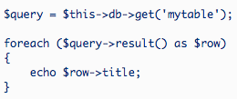
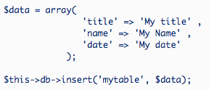
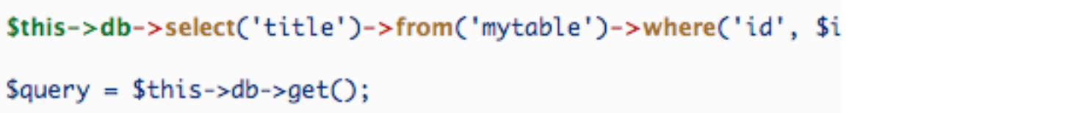
Active Records
• CodeIgniter uses a modified version of ^{Selecting Data}
the Active Record Database Pattern.
• This pattern allows information to be
retrieved, inserted, and updated in
your database with minimal scripting.
Inserting Data
Method Chaining
Dienstag, 4. Mai 2010

Slide 62
CI Database

Slide 63
Database Configuration
Initializing the Database Class
The following code loads and initializes the database class based on your configuration settings:
$this->load->database();
Once loaded the class is ready to be used

Slide 64
Database Configuration
CodeIgniter has a config file that lets you store your database connection values (username, password, database name, etc.). The config file is located at application/config/database.php

Slide 65
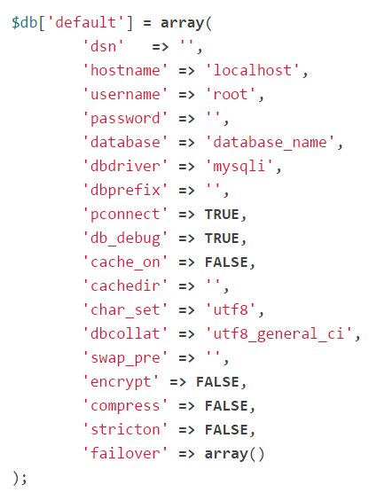
The config settings are stored in a multi-dimensional array with this prototype

Slide 66
Connecting to your Database
There are two ways to connect to a database:
Automatically Connecting
Manually Connecting

Slide 67
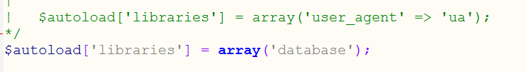
Automatically Connecting
The “auto connect” feature will load and instantiate the database class with every page load. To enable “auto connecting”, add the word database to the library array, as indicated in the following file:
application/config/autoload.php

Slide 68
Manually Connecting
If only some of your pages require database connectivity you can manually connect to your database by adding this line of code in any function where it is needed, or in your class constructor to make the database available globally in that class.
$this->load->database();

Slide 69
If helpers are used then one need to configure the following file:
application/config/autoload.php
Ex:
$autoload[‘helper’]=array(‘html’, ‘form’, ‘url’)

