Slide 1
MongoDB

Slide 2
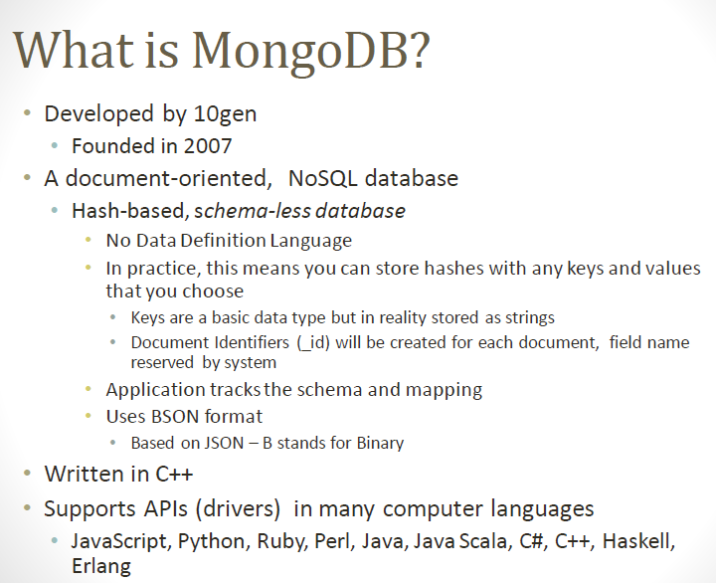

Slide 3
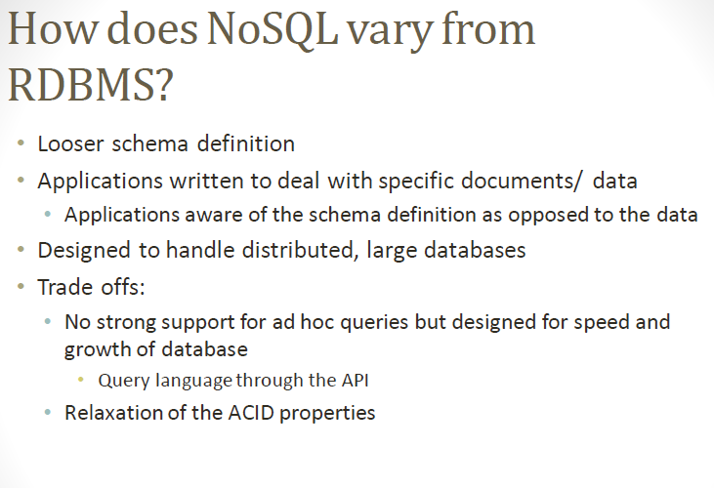

Slide 4
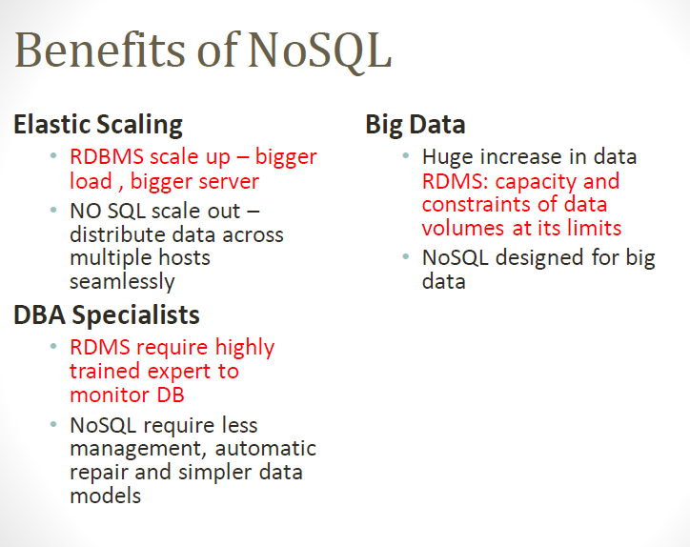

Slide 5
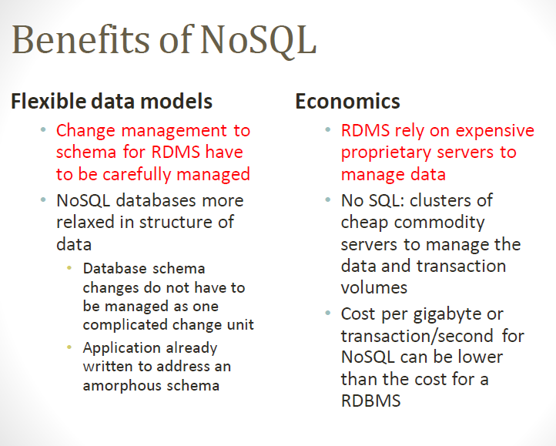

Slide 6
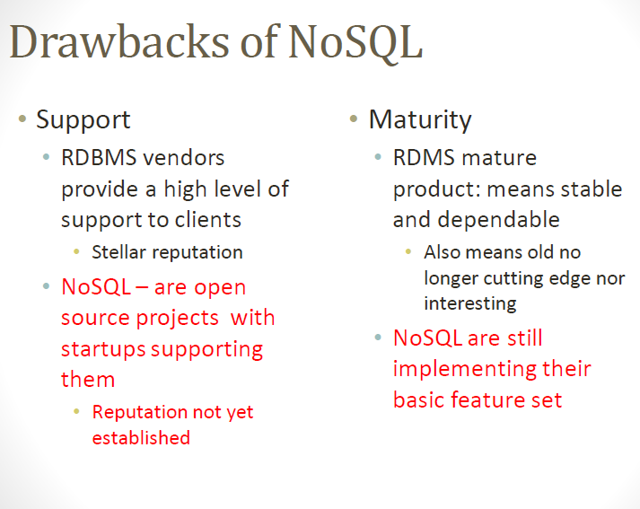

Slide 7
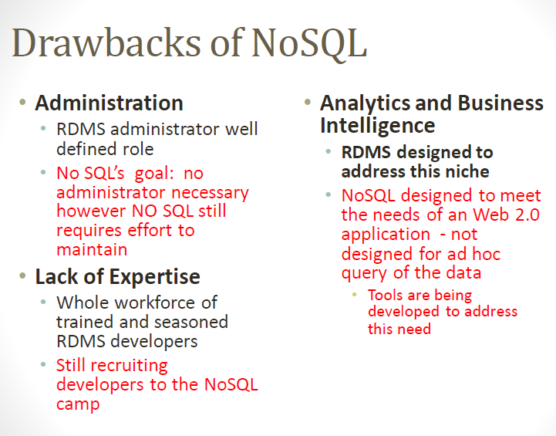

Slide 8
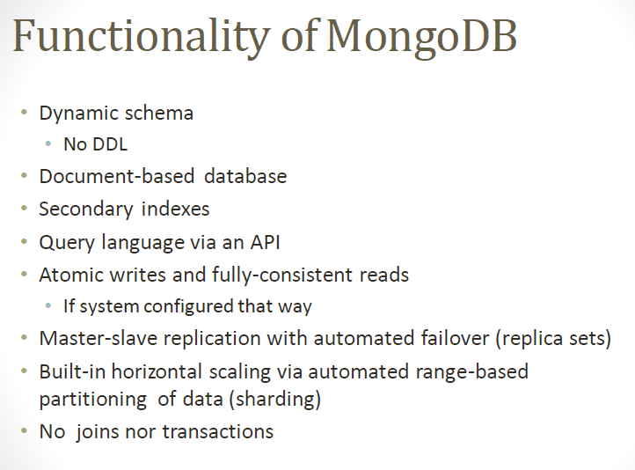

Slide 9
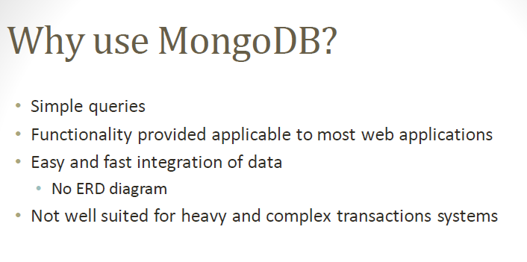

Slide 10
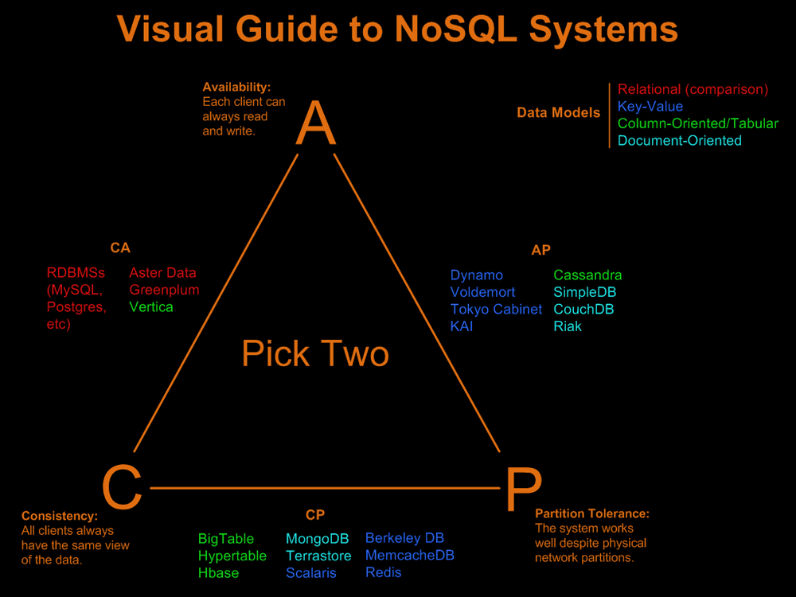

Slide 11
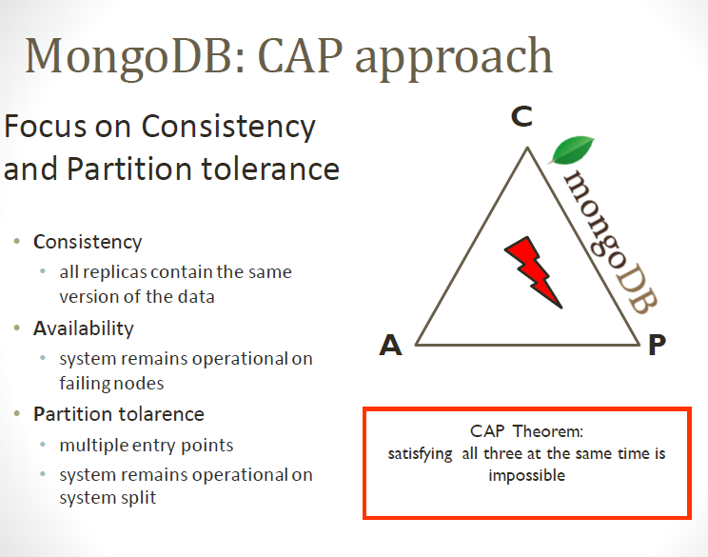

Slide 12
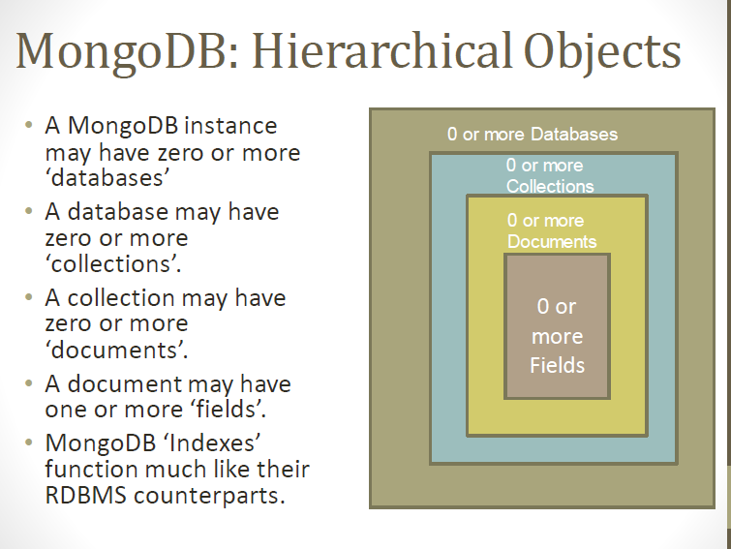

Slide 13
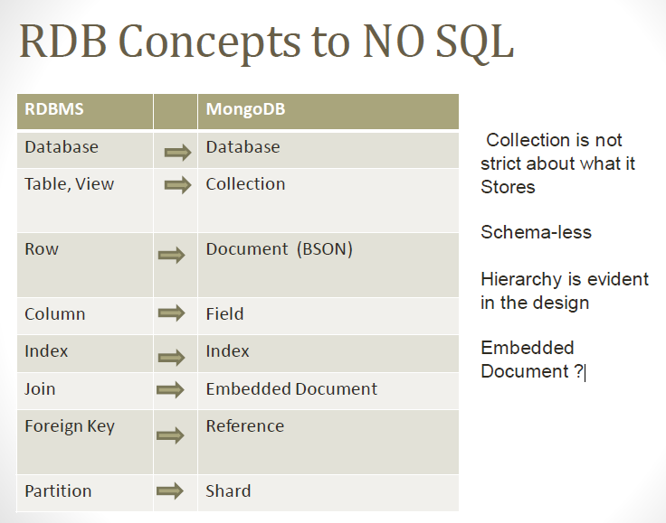

Slide 14
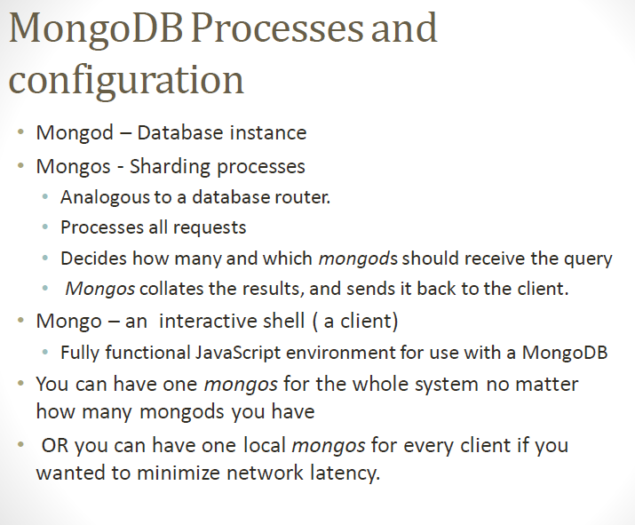

Slide 15
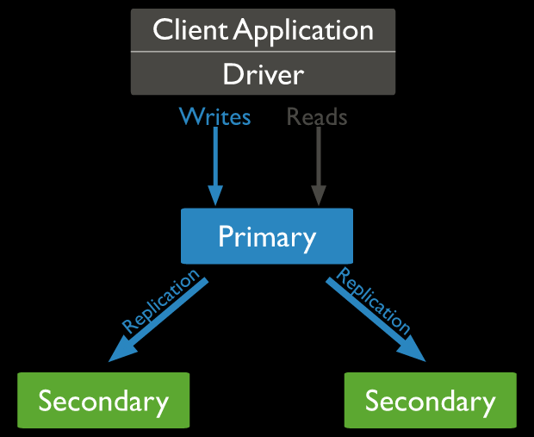
Replication Set

Slide 16
A replica set is a group of mongod instances that maintain the same data set.
The primary node receives all write operations. A replica set can have only one primary capable of confirming writes.
The secondaries replicate the primary and apply the operations to their data sets such that the secondaries’ data sets reflect the primary’s data set.
If the primary is unavailable, an eligible secondary will hold an election to elect itself the new primary.

Slide 17
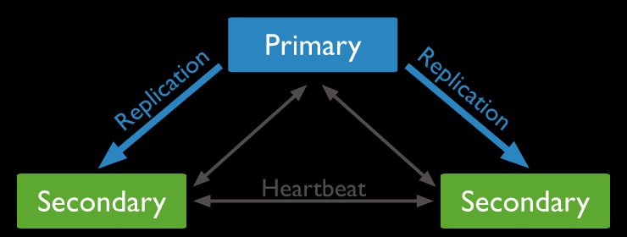

Slide 18
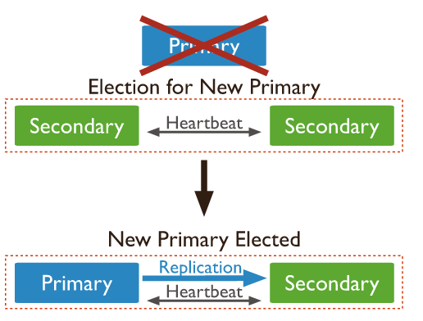
Automatic Failover

Slide 19
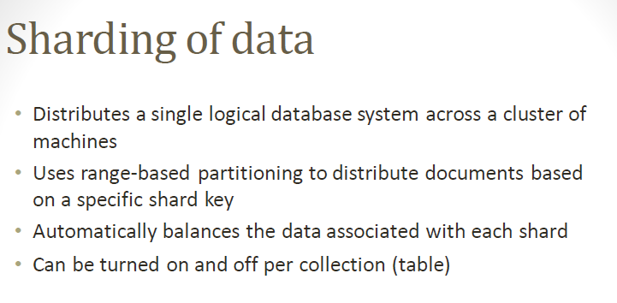

Slide 20
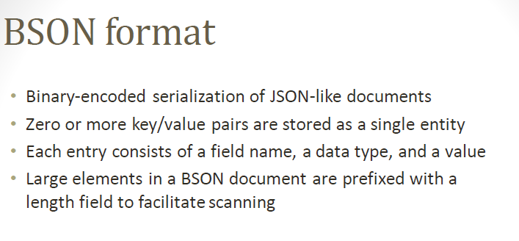

Slide 21
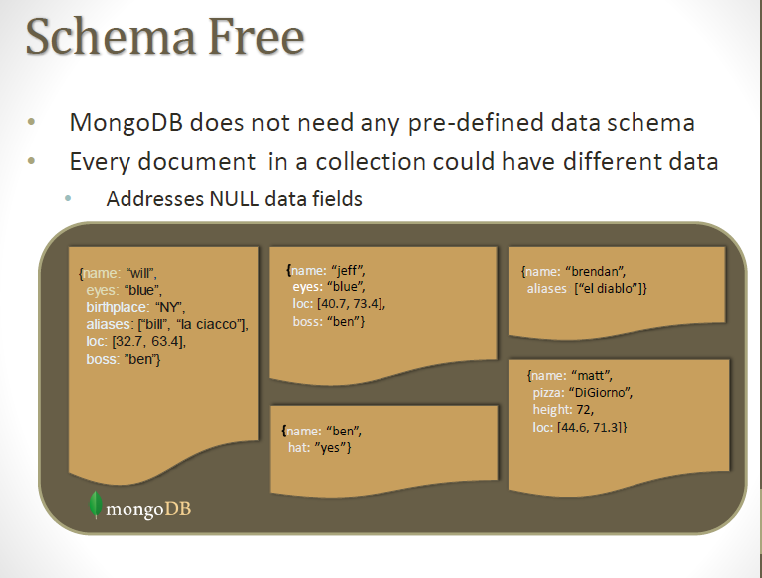

Slide 22
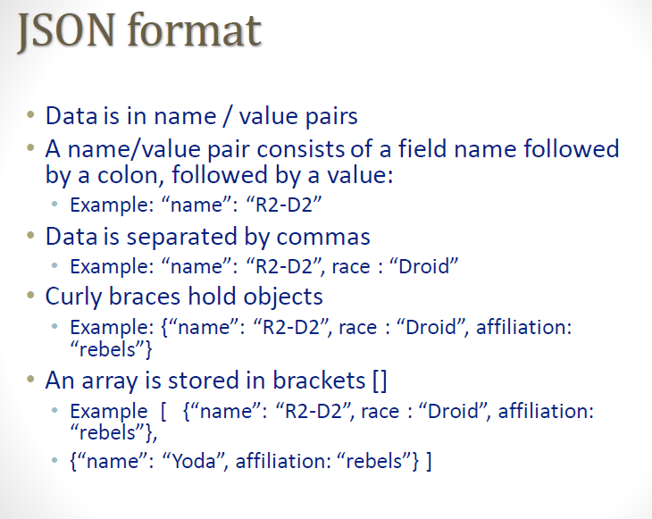

Slide 23
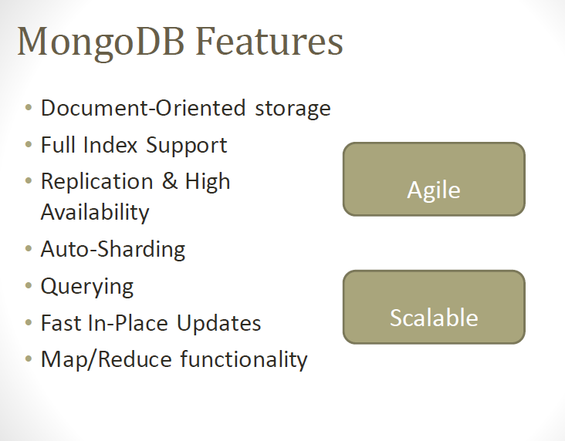

Slide 24
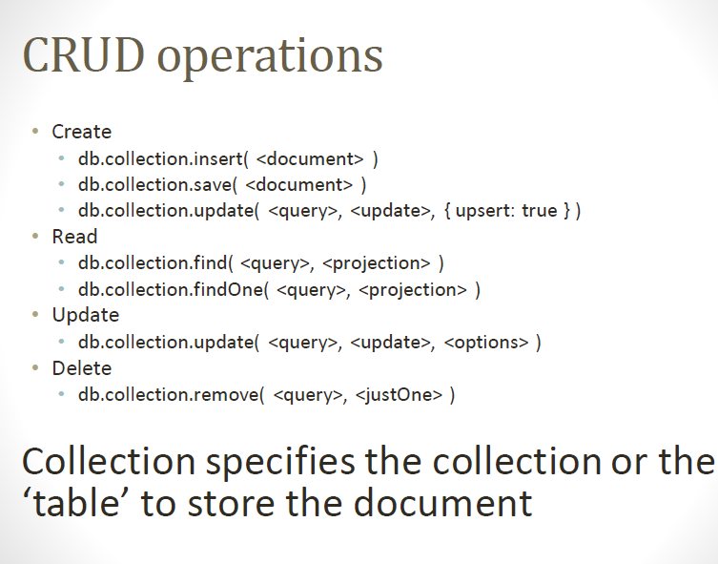

Slide 25
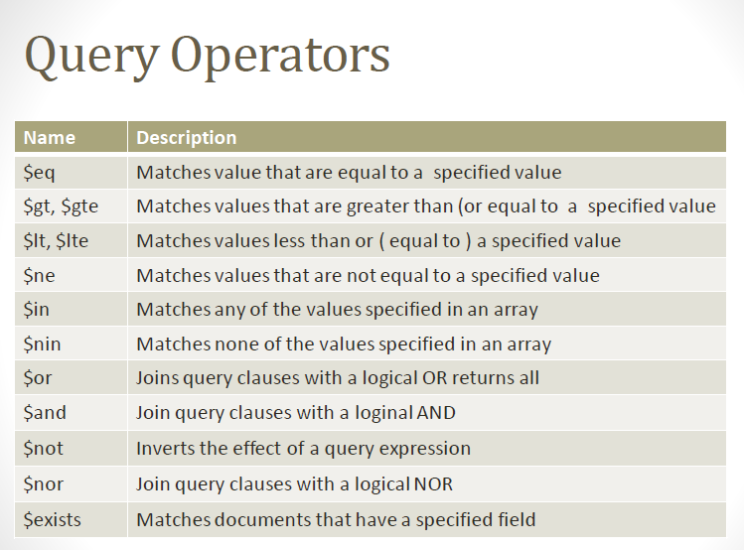

Slide 26
MongoDB Commands
show dbs - display all available databases.
db- to display current database
use database_name- create and switch database
Eg: use mydb
Your created database (mydb) is not present in list. To display database, you need to insert at least one document into it.
db.movie.insert({name: “dangal”})
>show dbs
local 0.78125GB
mydb 0.23012GB
test 0.23012GB

Slide 27
MongoDB functions
db.dropDatabase() – delete the selected database. If you have not selected any database, then it will delete default database
db.createCollection(name) - create collection.
db.collection_name.drop()- drop a collection from the database.

Slide 28
Insert Document
To insert data into MongoDB collection, you need to use:
MongoDB's insert() or save() method.
db.COLLECTION_NAME.insert(document)
db.COLLECTION_NAME.save(document)
db.users.insert( { name: 'riya', age: 12, gender: ‘f' })

Slide 29
db.users.insert( {
name: 'roshan',
age: 17,
gender: 'm‘,
sports: [“cricket”,”football”,”hockey”]
})

Slide 30
Query Document
To query data from MongoDB collection, you need to use MongoDB's find() method.
db.COLLECTION_NAME.find()
To display the results in a formatted way, you can use pretty() method.
db.COLLECTION_NAME.find().pretty()
findOne() method, returns only one(first) document.

Slide 31
db.users.find({age:{$gt:15}})
>show collections() : show all collection for that database
getCollectionNames():
db.getCollectionNames()Returns an array containing the names of all collections and views in the current database.
meteor:PRIMARY> db.getCollectionNames()
[ "ft", "st", "system.indexes", "tt" ]
meteor:PRIMARY> db.system.indexes.find()
{ "v" : 1, "key" : { "_id" : 1 }, "name" : "_id_", "ns" : "teb.st" }
{ "v" : 1, "key" : { "_id" : 1 }, "name" : "_id_", "ns" : "teb.tt" }
{ "v" : 1, "key" : { "_id" : 1 }, "name" : "_id_", "ns" : "teb.ft" }

Slide 32
Update Document
MongoDB's update() and save() methods are used to update document into a collection. The update() method updates the values in the existing document while the save() method replaces the existing document with the document passed in save() method.

Slide 33
The update() method updates the values in the existing document.
db.COLLECTION_NAME.update(SELECTION_CRITERIA, UPDATED_DATA)
db.users.update(
{_id : ObjectId("58c13cf649ab9ac1cb75bc06")},
{$set:{age:}})

Slide 34
remove() Method
remove() method is used to remove a document from the collection. remove() method accepts two parameters.
deletion criteria − (Optional) deletion criteria according to documents will be removed.
justOne − (Optional) if set to true or 1, then remove only one document.
db.COLLECTION_NAME.remove(DELLETION_CRITTERIA)

Slide 35
Remove Only One and Remove All
db.COLLECTION_NAME.remove(DELETION_CRITERIA,1)
Remove All Documents - db.users.remove({})

Slide 36
find() Method
MongoDB's find() method, explained in MongoDB Query Document accepts second optional parameter that is list of fields that you want to retrieve. In MongoDB, when you execute find() method, then it displays all fields of a document. To limit this, you need to set a list of fields with value 1 or 0. 1 is used to show the field while 0 is used to hide the fields.

Slide 37
db.COLLECTION_NAME.find({},{KEY:1})
db.users.find({},{name:1,_id:0})

Slide 38
Limit() Method
db.COLLECTION_NAME.find().limit(NUMBER)
To limit the records in MongoDB, you need to use limit() method. The method accepts one number type argument, which is the number of documents that you want to be displayed.

Slide 39
sort() Method
o sort documents in MongoDB, you need to use sort() method. The method accepts a document containing a list of fields along with their sorting order. To specify sorting order 1 and -1 are used. 1 is used for ascending order while -1 is used for descending order.
db.COLLECTION_NAME.find().sort({KEY:1})

Slide 40
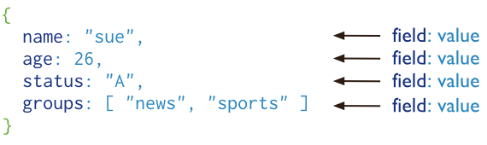
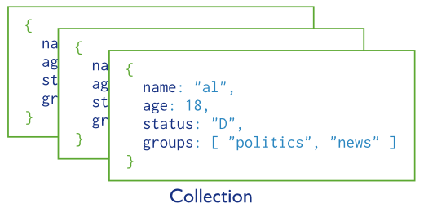
Basic operations
users

Slide 41
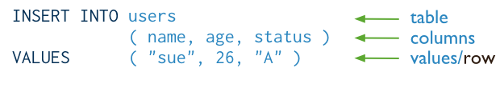
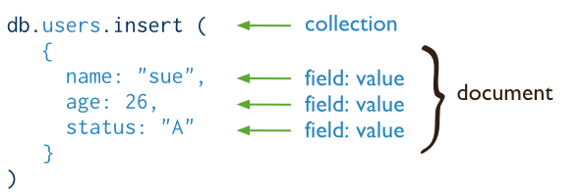
CRUD operations - create
Insert a new user.
SQL
MongoDB

Slide 42
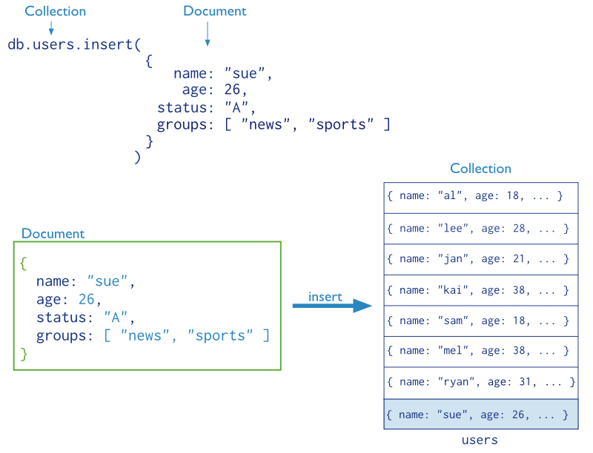
CRUD operations – create (cont’d)

Slide 43
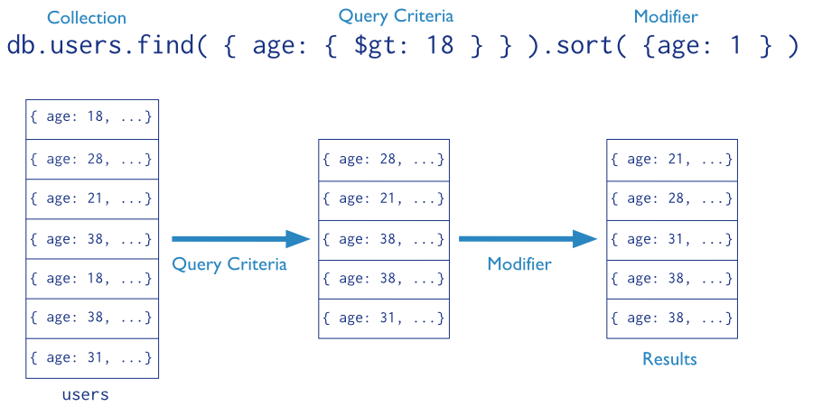
CRUD operations - read
Find the users of age greater than 18 and sort by age.(ascending (1) or descending (-1) sort order.)

Slide 44

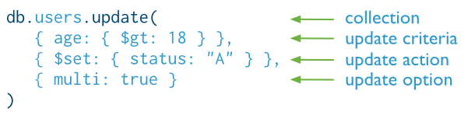
CRUD operations - update
Update the users of age greater than 18 by setting the status field to A.
SQL
MongoDB

Slide 45

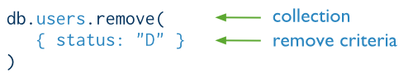
CRUD operations - delete
Delete the users with status equal to D.
SQL
MongoDB

