Slide 2
Sharding
Sharding is the process of storing data records across multiple machines and it is MongoDB's approach to meeting the demands of data growth.
As the size of the data increases, a single machine may not be sufficient to store the data nor provide an acceptable read and write throughput.
Sharding solves the problem with horizontal scaling. With sharding, you add more machines to support data growth and the demands of read and write operations.

Slide 3
Sharding
There are two methods for addressing system growth: vertical and horizontal scaling.
Vertical Scaling involves increasing the capacity of a single server, such as using a more powerful CPU, adding more RAM, or increasing the amount of storage space.
Limitations in available technology may restrict a single machine from being sufficiently powerful for a given workload.

Slide 4
Sharding
There are two methods for addressing system growth: vertical and horizontal scaling.
Vertical Scaling involves increasing the capacity of a single server, such as using a more powerful CPU, adding more RAM, or increasing the amount of storage space.
Limitations in available technology may restrict a single machine from being sufficiently powerful for a given workload.

Slide 5
Sharding
Horizontal Scaling involves dividing the system dataset and load over multiple servers, adding additional servers to increase capacity as required.
While the overall speed or capacity of a single machine may not be high, each machine handles a subset of the overall workload, potentially providing better efficiency than a single high-speed high-capacity server.
Expanding the capacity of the deployment only requires adding additional servers as needed, which can be a lower overall cost than high-end hardware for a single machine.
The trade off is increased complexity in infrastructure and maintenance for the deployment.

Slide 6
Sharding
MongoDB supports horizontal scaling through sharding.

Slide 7
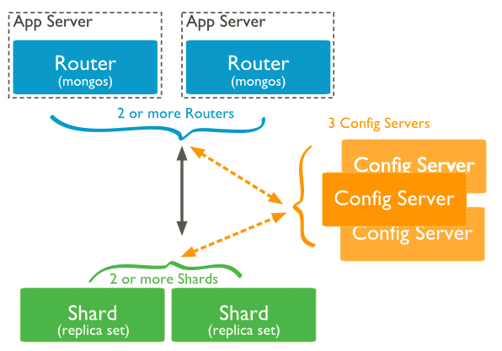

Slide 8
Sharding
In the following diagram, there are three main components −
Shards − Shards are used to store data. They provide high availability and data consistency. In production environment, each shard is a separate replica set.
Config Servers − Config servers store the cluster's metadata. This data contains a mapping of the cluster's data set to the shards. The query router uses this metadata to target operations to specific shards. In production environment, sharded clusters have exactly 3 config servers.

Slide 9
Sharding
Query Routers − Query routers are basically mongo instances, interface with client applications and direct operations to the appropriate shard. The query router processes and targets the operations to shards and then returns results to the clients. A sharded cluster can contain more than one query router to divide the client request load. A client sends requests to one query router. Generally, a sharded cluster have many query routers.

Slide 10
Advantages of Sharding
Reads / Writes
MongoDB distributes the read and write workload across the shards in the sharded cluster, allowing each shard to process a subset of cluster operations. Both read and write workloads can be scaled horizontally across the cluster by adding more shards.

Slide 11
Advantages of Sharding
Storage Capacity
Sharding distributes data across the shards in the cluster, allowing each shard to contain a subset of the total cluster data. As the data set grows, additional shards increase the storage capacity of the cluster.

Slide 12
Advantages of Sharding
High Availability
A sharded cluster can continue to perform partial read / write operations even if one or more shards are unavailable. While the subset of data on the unavailable shards cannot be accessed during the downtime, reads or writes directed at the available shards can still succeed.

