Slide 1
Budget Wise AI Based Forecasting Tool
Presented by: Dipty
Date: October 2025

Slide 2
CONTENT:-
1.Project Overview
2.Tools and Technologies used
3.Milestone1
3.1:Overview
3.2:Function Module
3.3:Outcomes
3.4:Screenshots
4.Milestone2
4.1:Overview
4.2:Function Module
4.3:Outcomes
4.4:Screenshots
5.Milestone2
5.1:Overview
5.2:Function Module
5.3:Outcomes
5.4:Screenshots

Slide 3
CONTENT:-
6.Milestone3
6.1:Overview
6.2:Function Module
6.3:Outcomes
6.4:Screenshots
7.Milestone4
7.1:Overview
7.2:Function Module
7.3:Outcomes
7.4:Screenshots
8.Future Enhancement
9.Conclusion

Slide 4
Project Overview
Objective: Design a smart tool for tracking and categorizing user financial transactions
Core Purpose: Help users manage income and expenses effectively
Framework: Streamlit (UI), Python (Backend), Matplotlib/Seaborn (Visualization)
Approach: Multiple milestones for phased delivery

Slide 5
Tools & Technologies Used
Frontend: Streamlit
Backend: Python,Flask
Database: SQLite
Libraries: Pandas, NumPy, Matplotlib, Seaborn,nltk packages, OS
Model: Prophet Model

Slide 6
Milestone 1 – Overview
Focus: User Authentication & Basic Transaction Input
Duration: Weeks 1–2
Key Objectives:
- Secure registration/login with JWT
- Profile management
- Streamlit interface for manual transaction input
- Secure database storage

Slide 7
Milestone 1 – Functional Modules
User Registration: Secure signup with hashed passwords
Login System: JWT token-based authentication
Profile Management: Update name, email, password securely
Transaction Input: Streamlit form for adding income/expenses
Output: Registration & Login pages, Transaction dashboard

Slide 8
Milestone 1 – Outcomes
Implemented secure authentication with JWT
Designed data input modules in Streamlit
Profile management enabled
Database schema for users and transactions ready

Slide 9
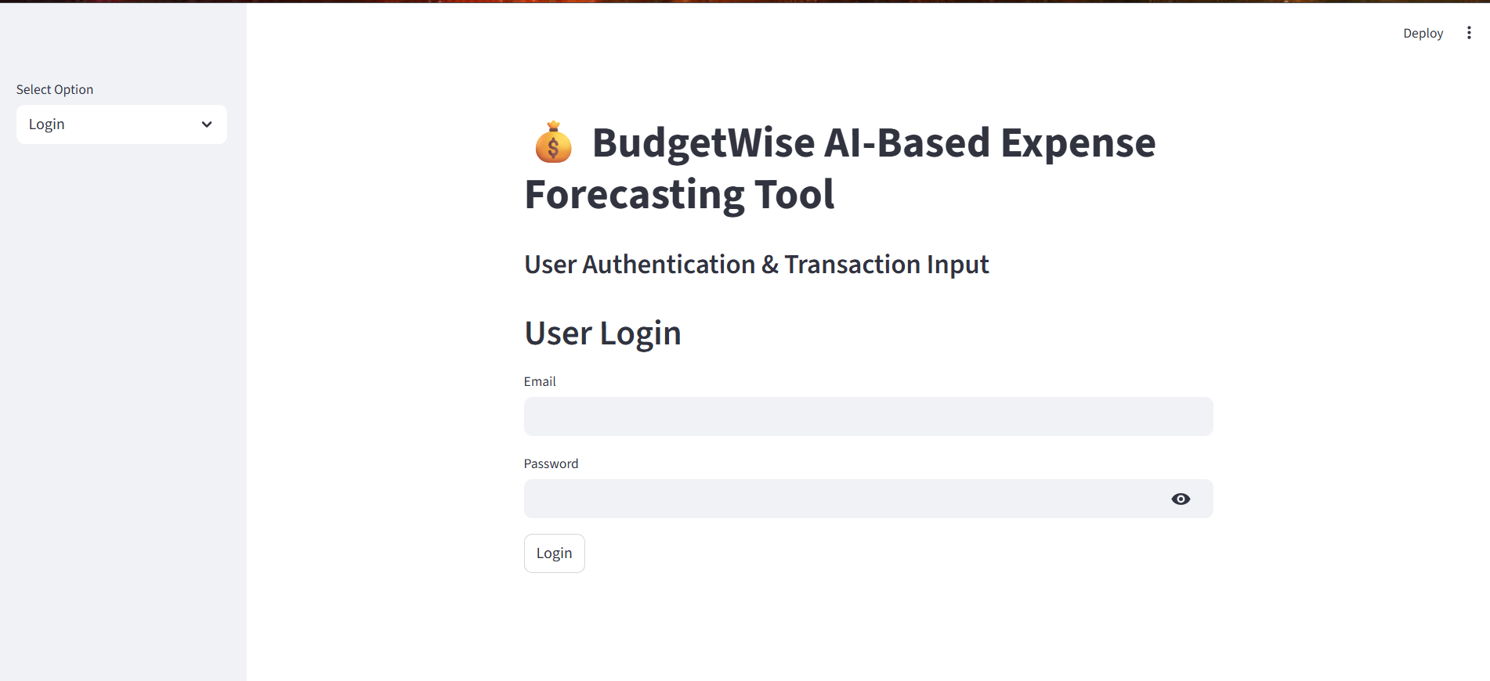
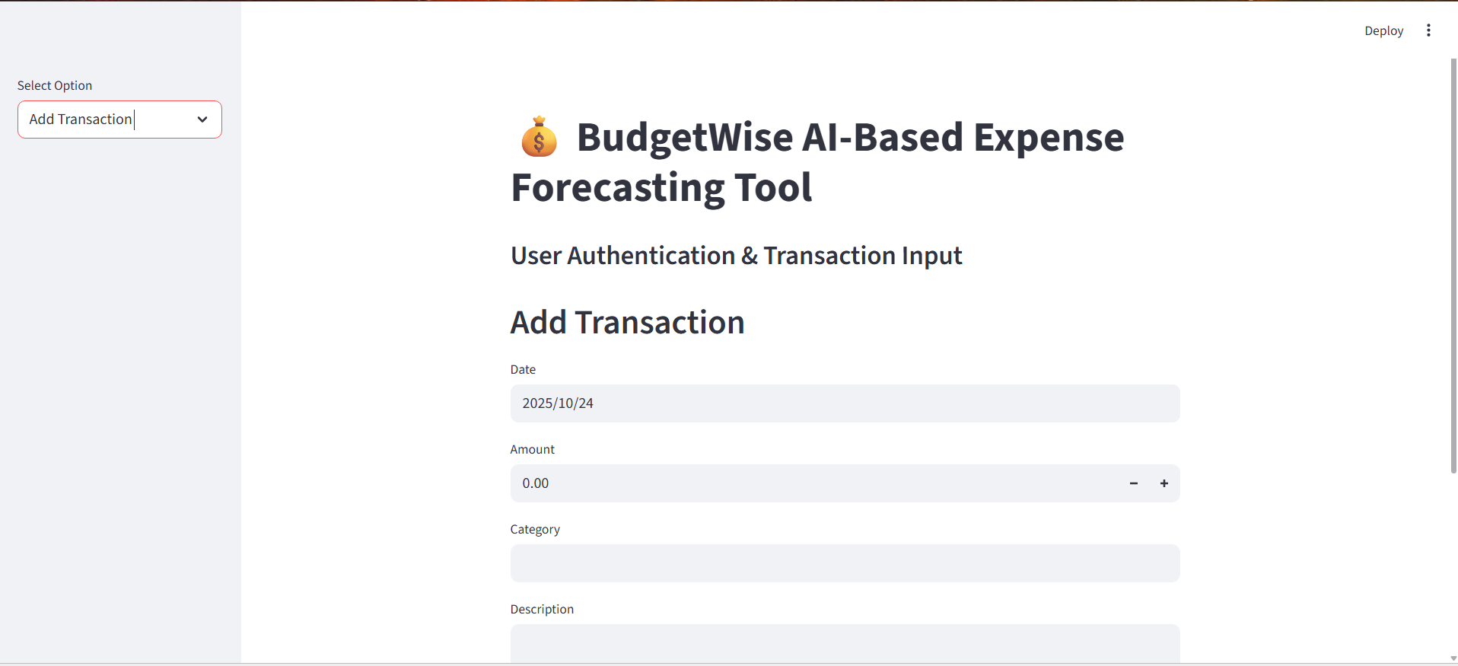
Screenshot Image:-

Slide 10
Milestone 2 – Overview
Focus: Transaction Categorization & Basic Reporting
Duration: Weeks 3–4
Key Objectives:
- Rule-based transaction categorization
- Financial summaries with Pandas
- Visual reports using Matplotlib/Seaborn
- Interactive dashboard in Streamlit

Slide 11
Milestone 2 – Functional Modules
Automated Categorization: Categories like Groceries, Rent, Transport
Summary Reports: Income vs Expense, category spending, monthly trends
Data Visualization: Pie charts, bar charts
Dashboard: Real-time summaries with filtering options
(Add visuals: Categorized table, pie chart, dashboard)

Slide 12
Milestone 2 – Outcomes
Rule-based Python categorization model built
Interactive summary reports via Streamlit
Graphical insights developed using Matplotlib/Seaborn
User-friendly dashboard delivered

Slide 13
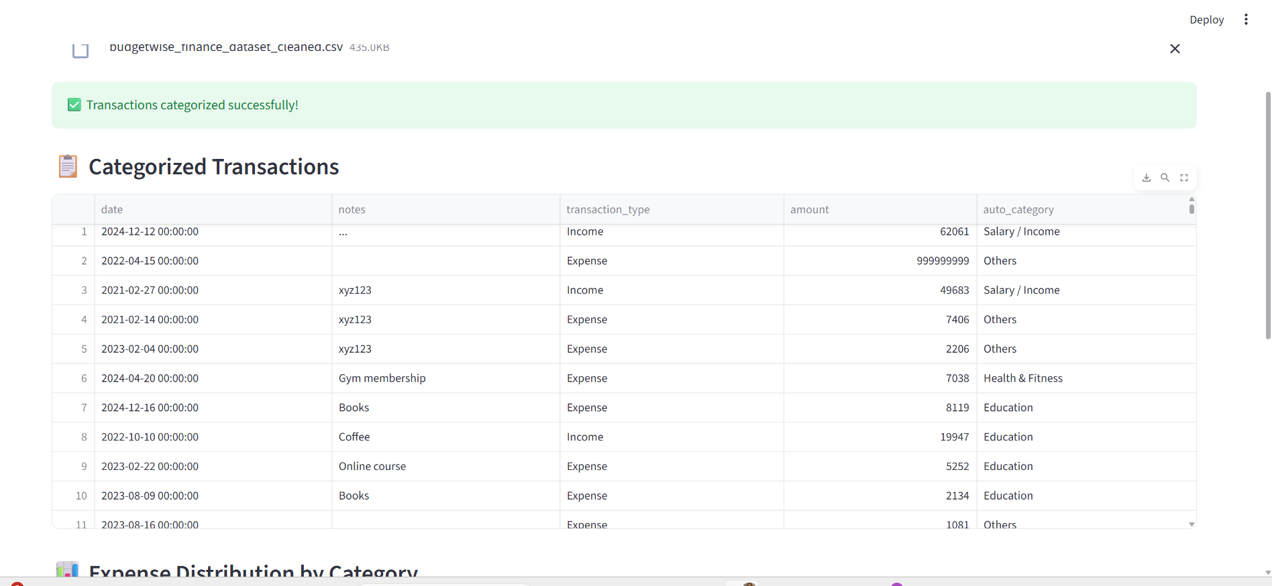
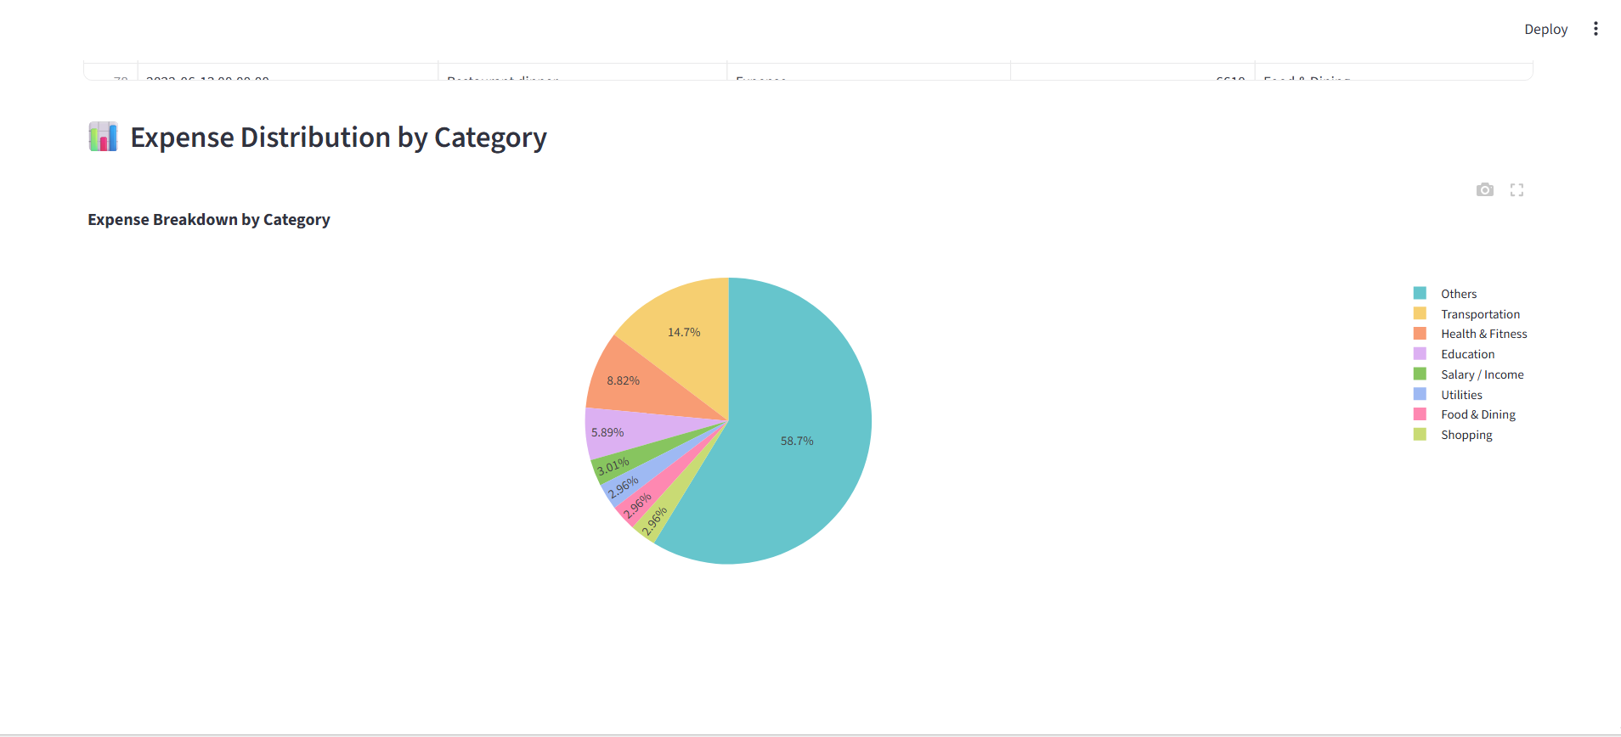
Screenshot Image:-

Slide 14
Milestone 3 – Overview
Focus: Forecasting Data And Goal Setting
Duration: Weeks 5-6
Key Objectives:
- Rule-based Forecast Result and Goal Setting
- Financial summaries with Pandas
-Visual reports using Matplotlib/Seaborn/plot.py.
- Interactive dashboard in Streamlit

Slide 15
Milestone 3 – Function Module
Upload an CSV file it will forecast the expense for future plan.
It show the Preview of the dataset.
Summary Reports: Income vs Expense Lien chart show the future forecast.
Data Visualization: line chart for actual and forcast result.
Create a goal form for the future goal and set the expense.
Dashboard: Real-time summaries with filtering options.
Download the forecast csv file for future reference.

Slide 16
Milestone 3 – Outcomes
It show forecast result chart and goal form.
Interactive summary reports via Streamlit.
Graphical insights developed line chart using Matplotlib/Seaborn.
User-friendly dashboard for goal setting for the future goals.

Slide 17
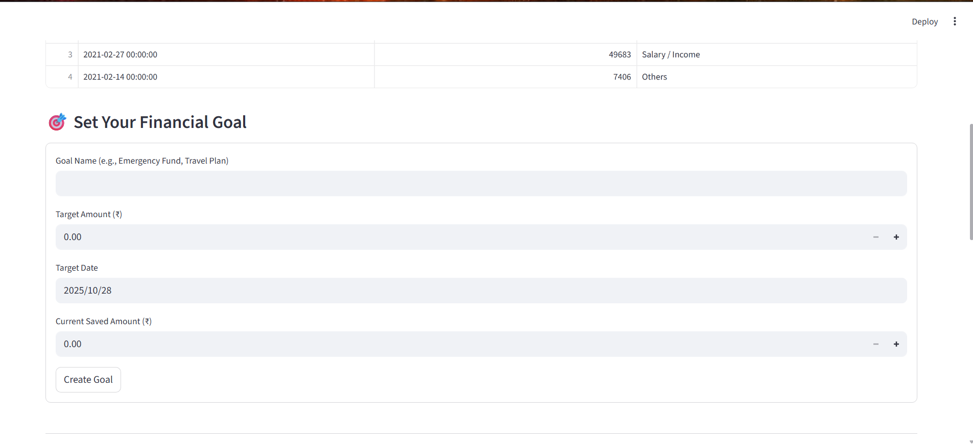
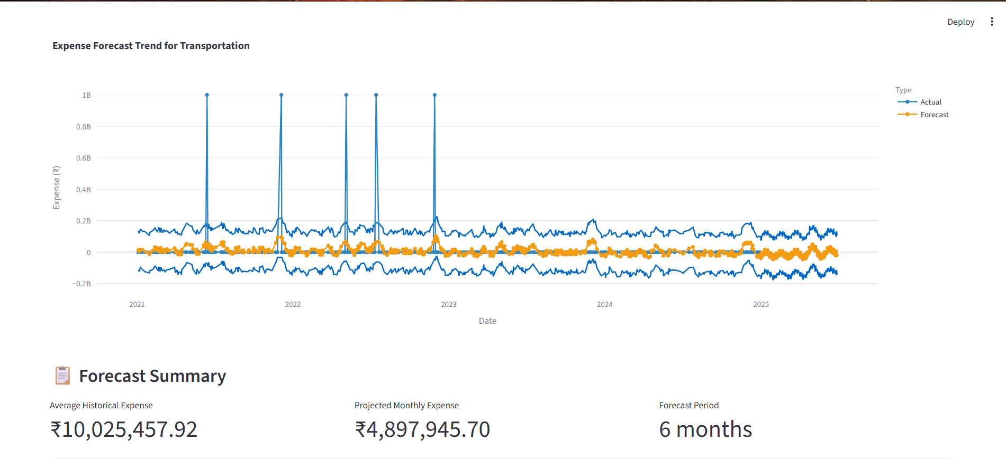
Screenshot Image:-

Slide 18
Milestone 4 – Overview
Focus: Interactive Dashboard for Expense and Admin Dashboard
Duration: Weeks 7-8
Key Objectives:
- Interactive Dashboard.
-Visual reports using Matplotlib/Seaborn/plot.py.
-Admin Dashboard for the User interaction.
- Interactive dashboard in Streamlit

Slide 19
Milestone 4– Function Module
Upload an CSV file it will show the Detail Expenses chart.
It show the Preview of the dataset.
Summary Reports: Income vs Expense Line chart.
Data Visualization: line chart for actual and forcast result.
It Show the all Expense in a donut chart.
Keep Track the goal for the future reference.
Dashboard: Real-time summaries with filtering options.
Admin Dashboard for the user interaction for the future enhancement.

Slide 20
Milestone 4 – Outcomes
It show interactive charts and admin dashboard.
Interactive summary reports via Streamlit.
Graphical insights developed line chart using Matplotlib/Seaborn.
Goal Tracking features.
User interaction for future forecast.

Slide 21
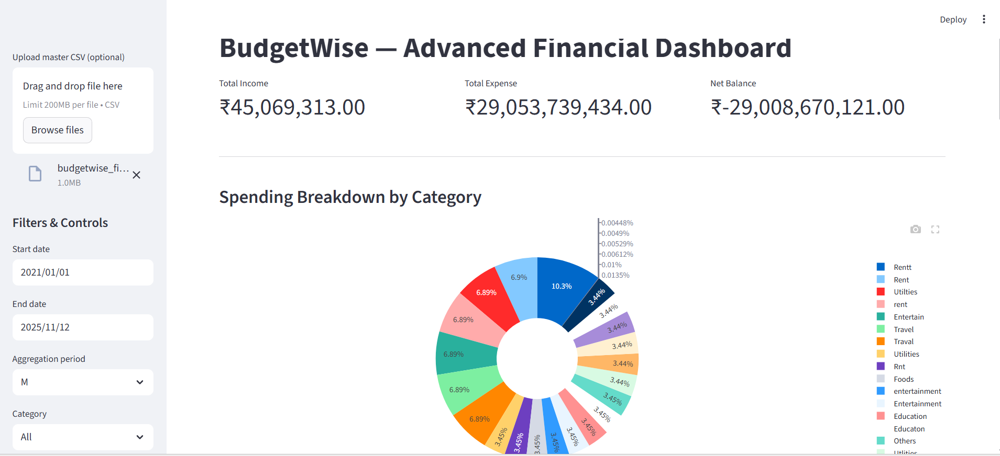
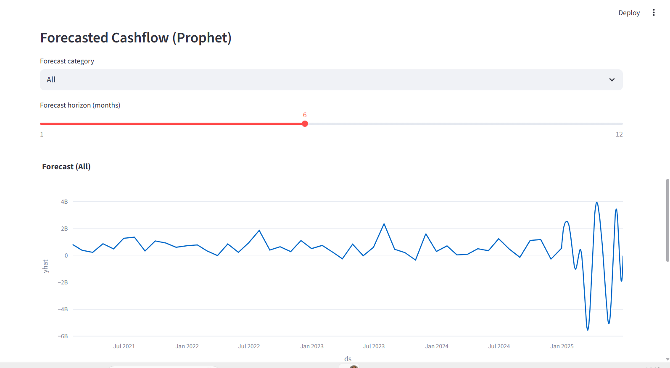
Screenshot Image:-

Slide 22
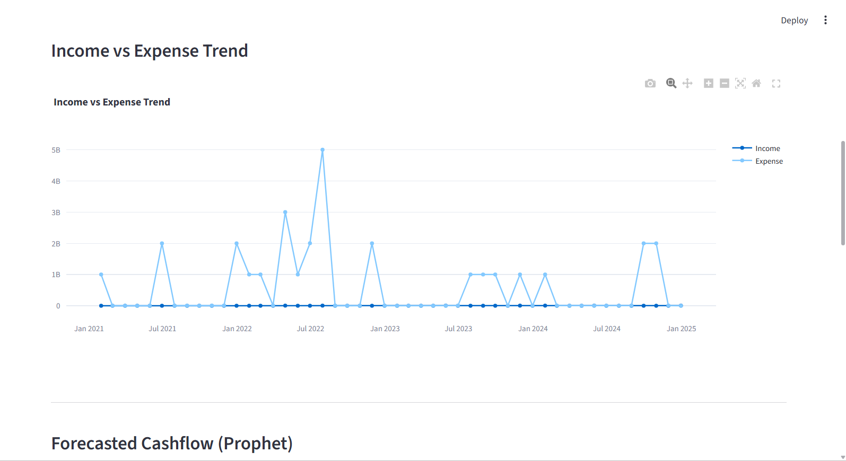
Screenshot Image:-

Slide 23
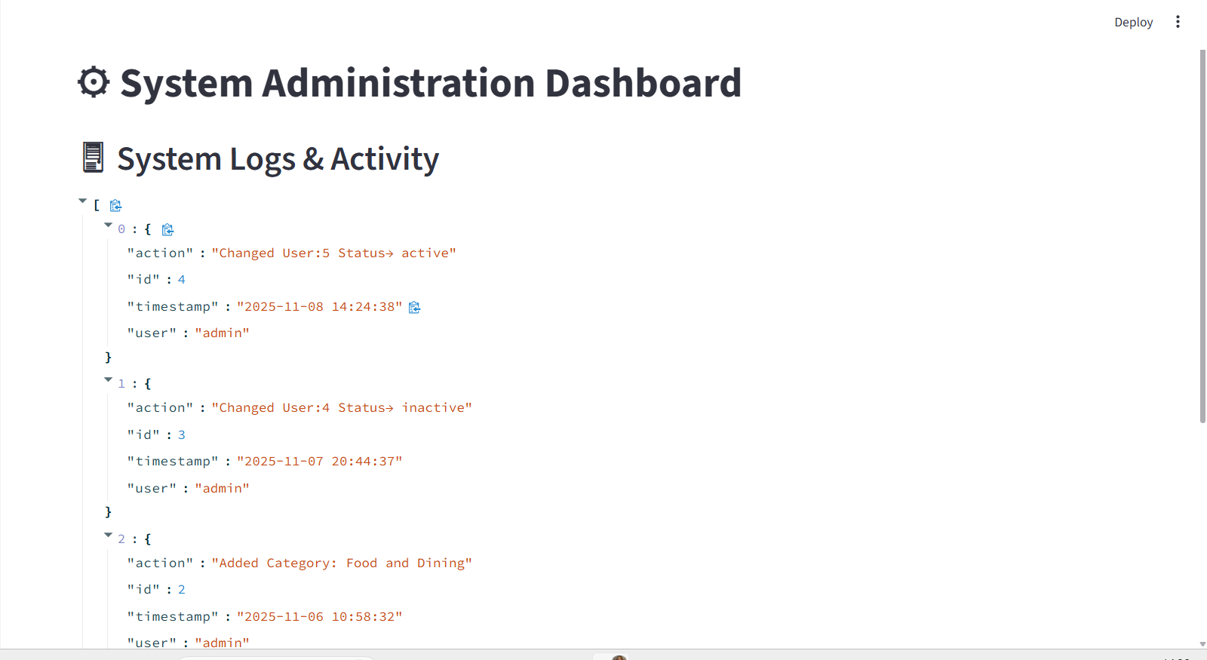
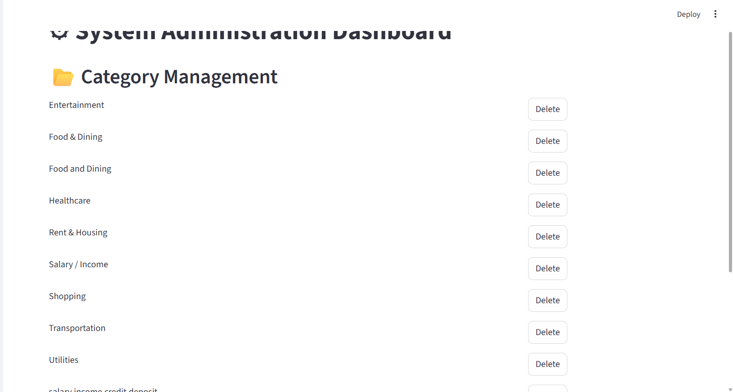
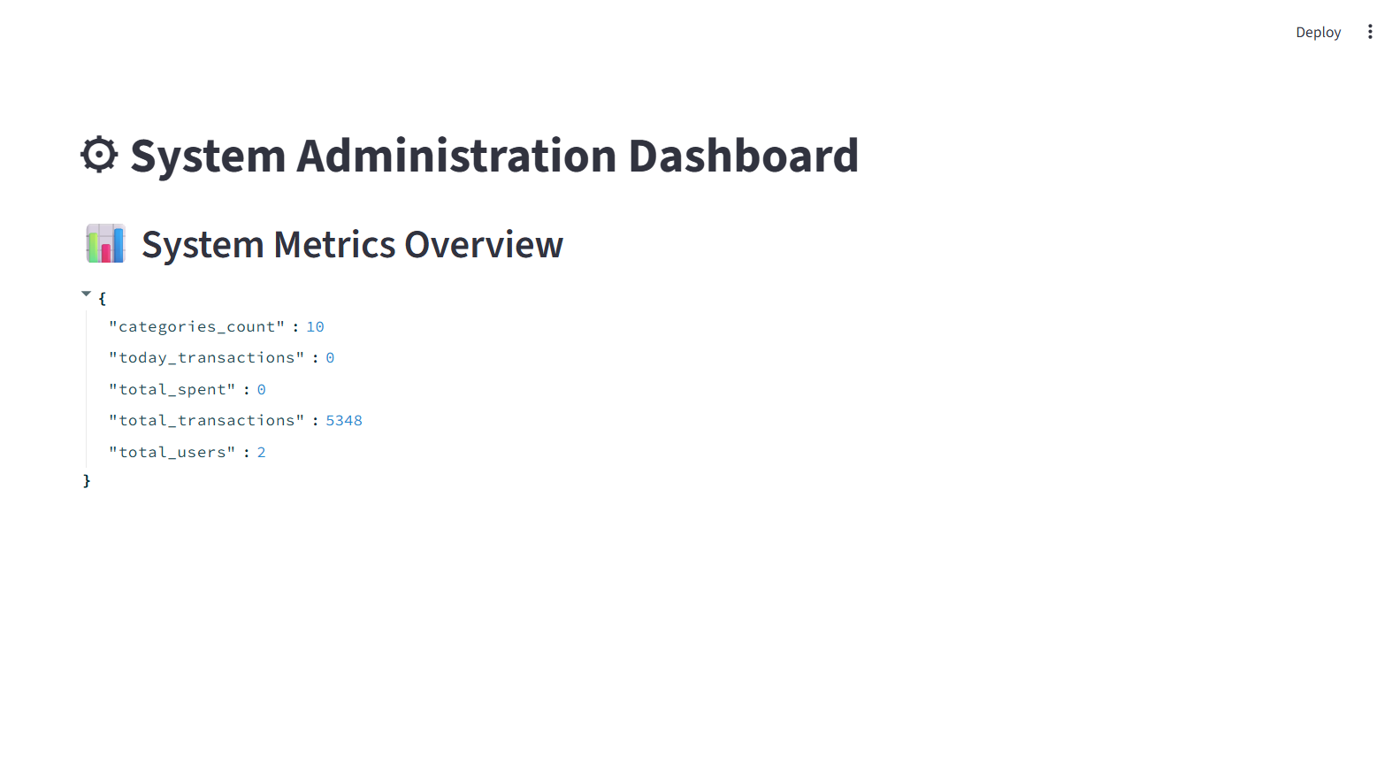
Screenshot Image:-

Slide 24
Future Enhancement:-
AI-Driven Expense Prediction Optimization
Secure Multi Device & Cloud Sync Support.
Multi-Tenant Role-Based Admin Control.
Intelligent Fraud / Anomaly Detection.
Integrations with External Financial Institutions

Slide 25
Conclusion:-
The Budget Wise Expense Management System successfully integrates secure authentication, automated transaction processing, intelligent expense forecasting, and an interactive visualization dashboard.
The admin panel further enables oversight of user activity and category management, ensuring operational transparency.
The solution provides users with clear financial insights and supports smarter budgeting decisions.
The system is scalable and can be extended with advanced AI recommendations, mobile app integration, and real-time financial alerts to enhance long-term usability and impact.

Slide 26
THANK YOU

