Slide 1


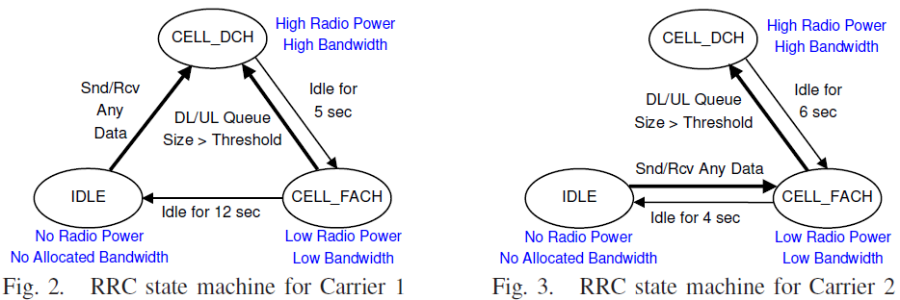
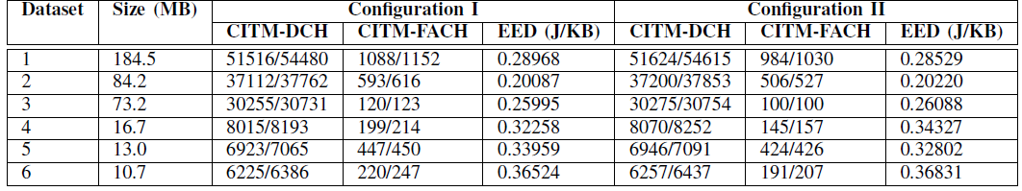
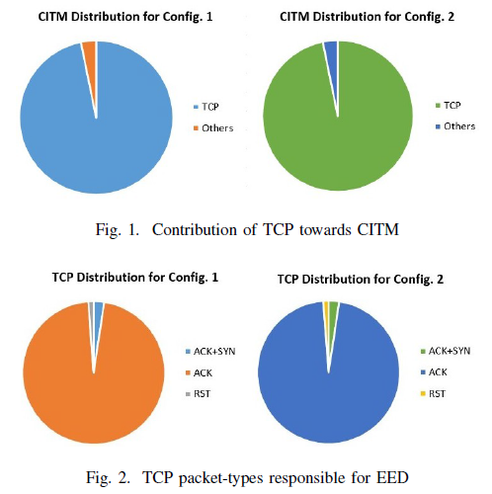
Role of Network Control Packets in Smartphone Energy Drainage Chander Govindarajan*, Satadal Sengupta*, Pradipta De#, Bivas Mitra*, Sandip Chakraborty* *Indian Institute of Technology Kharagpur, India #State University of New York (SUNY), Korea
OBJECTIVES
EVALUATION STRATEGY
Energy drainage in smart-phones via communication interfaces – an important area of research in the past few years.
Understand the role of network control packets in excess energy consumption.
Identify the types of control packets contributing to this wastage, and point out areas in the design of traditional protocols which may need rethinking keeping in mind the nature of mobile data access.
Fit the traffic traces in the cellular energy state transition model.
Compute the number of FACH→IDLE or DCH→IDLE state transition misses due to control packets.
Such a transition miss by a “rogue” control packet is termed as a Control Initiated Transition Miss (CITM).
CITM indicates that the network interface needs to be in high power state for additional time, resulting in excess energy drainage (EED).
Configurations used:
Config. I: DCH tail time = 3s, FACH tail time = 10s
Config. II: DCH tail time = 5s, FACH tail time = 12s
MOTIVATION
Energy model (figures below are representative):
Adaptive data scheduling (packet aggregation) & tail time optimization strategies have been developed, to minimize transitions and maximize IDLE time.
Data packets come in bursts; control packets are mostly unregulated – possibility of energy state ramp-up only to serve a control packet.
Data packets can tolerate bounded delay; control packets may not be externally scheduled – will hamper general network management activities.
RESULTS – I
Evaluated Parameter: Transition Miss and Excess Energy Drainage Due to Network Control Packets
Observations:
A large number of transition misses are due to control packets, resulting in EED in the range of 0.2—0.4 Joule/KB (from Table-I) – significantly high.
A majority of the control packets that result in energy state transition miss are the TCP control packets (evident from Fig. 1).
RESULTS – II
EXPERIMENTAL SETUP
Evaluated Parameter: Transition Miss due to TCP Control Packets
Observations:
TCP acknowledgement (ACK) & reset (RST) packets cause majority of the transition misses (from Fig. 2).
Misses mostly in the regions where TCP re-transmi-ssion occurs due to timeout/congestion control.
During TCP re-transmissions, TCP sends dup- ACKs & RST pkts for some duration after transmission of last data pkt – out-of-sync pkts result in excess drainage.
4 Moto X2 Smartphones, 2 volunteers, 1 month.
Android tcpdump, Terminal Emulator app.
2 GB packet trace data.
Large number of apps used by volunteers.
User activity logged during different times of the day, under various conditions of user mobility (such as, walking, driving, etc.) and user practices.
RESULTS (Continued)
TABLE-I: CITM and corresponding excess energy drainage (CITM is given in the form TP/T, where TP denotes
TCP control packets and T stands for total number of control packets which result in a transition miss)

