Slide 1
A Qualitative Survey on Multicast Routing in Delay Tolerant Networks
Presenter & Co-author: Mr. Sujoy Saha
Department of Computer Application
National Institute of Technology
Durgapur -713209
India

Slide 2
Properties of Delay Tolerant Networks
Intermediate Connectivity
Sparseness of Locality
Disconnected Network Graph
Challenged Network

Slide 3
In This Paper, We Have..
Identified the reasons of considering multicasting an essential tool for routing in DTNs.
Presented a taxonomy for the various multicast routing schemes proposed till date.
Performed a comparative survey on their performances pointing out advantages & disadvantages.
Identified areas for future work.

Slide 4
Issues and Challenges of DTN Routing
Minimization of Overhead
Smaller Latency
Maximization of Delivery Ratio
Less hop count
Load Balancing
Scalability
Intermittent Connectivity and Long Delay

Slide 5
Applications of DTN Multicasting
Many potential DTN applications operate in a group-based manner and require efficient network support for group communication.
Group communication through multiple unicast operation suffers from poor performance.
Efficient multicast services are necessary when connectivity among nodes, available bandwidth and storage are severely limited.

Slide 6
Proposed Taxonomy for Multicast Routing Schemes in DTN
Multicast Routing Strategies in DTN
Multicast Flooding
Tree Based Multicast
Probability Based Multicast
Intelligent Multicast

Slide 7
Proposed Taxonomy (Continued..)
Multicast Flooding: Multiple copies of messages.
Tree Based Multicast: Like Diffusion Computation Based Algorithm where Source is the root.
Probability Based Multicast: Probability of successful message delivery plays pivotal role.
Intelligent Multicast: Network knowledge used to decide between flooding and forwarding.

Slide 8
Proposed Taxonomy (Continued..)
Multicast Flooding
Unicast Based
Routing (UBR)
Broadcast Based Routing (BBR)

Slide 9
Proposed Taxonomy (Continued..)
Tree Based Multicast
Static Tree Based Routing (STBR)
On-demand Situation-aware Multicast
(OS Multicast)
Dynamic Tree Based Routing (DTBR)

Slide 10
Proposed Taxonomy (Continued..)
Probability Based Multicast
Encounter Based Multicast Routing (EBMR)
Context Aware Multicast Routing (CAMR)

Slide 11
Proposed Taxonomy (Continued..)
Intelligent Multicast
Forwarding Group Based Routing (FGBR)
A-SMART
SMART
Relay Cast

Slide 12
Performance Comparison based on:
Delivery Ratio
Delivery Latency
Buffer Usage

Slide 13
Multicast Flooding
Unicast Based Routing (UBR)
Multicast bundles are sent via multiple unicast operations from source to each destination; achieved by adding additional group information in the bundle-headers.
Delivery Ratio: Low - A separate unicast message is sent to each receiver, resulting in message drops.
Delivery Latency: High since separate copies of a multicast message are sent to receivers.
Buffer Usage: High but lower than BBR.

Slide 14
Multicast Flooding (Continued…)
Broadcast Based Routing (BBR)
Messages are flooded throughout the network with the aim of reaching the intended receivers.
Delivery Ratio: Highest; delivery ratio increases with increase in the level of available knowledge.
Delivery Latency: Low since flooding takes place.
Buffer Usage: Very high since a large number of redundant messages are generated.

Slide 15
Multicast Flooding (Continued…)
Remarks
Higher delivery ratio is achieved at the cost of high buffer overhead and low efficiency.
Should work well in Random Walk/Waypoint mobility models since we know flooding techniques perform better in such models.

Slide 16
Tree Based Multicast
Static Tree Based Routing (STBR)
A smallest cost tree is constructed at the source at the start of a multicast session. Messages are forwarded along this tree. Route from the source to an intended receiver remains static.
Delivery Ratio: Low but improves when network disruptions occur periodically in a scheduled manner.
Delivery Latency: High in case of frequent and irregular link disruptions.
Buffer Usage: Much lower due to the effectively forwarding nature.

Slide 17
Tree Based Multicast (Continued..)
Dynamic Tree Based Routing (DTBR)
It is assumed that each DTN node has the knowledge oracle containing the schedule of link up/down information in DTN overlay. Each bundle constructs an associated tree that may change hop-by-hop depending upon these link up/down variations.
Delivery Ratio: Low but improves when network disruptions occur periodically in a scheduled manner.
Delivery Latency: Higher than STBR due to shortest path tree computation after each hop.
Buffer Usage: Higher than STBR.

Slide 18
Tree Based Multicast (Continued..)
On-demand Situation-aware (OS) Multicast
It builds up a dynamic multicast tree just like DTBR. It doesn’t rely on any global knowledge of the network, such as node positions or link up/down schedule. Unlike DTBR, it always contains a full list of all the intended receivers.
Delivery Ratio: Slightly higher than DTBR; performs better in case of random disruptions.
Delivery Latency: Slightly higher than DTBR due to lack of global knowledge.
Buffer Usage: Higher than DTBR since each bundle always contains a full list of intended receivers.

Slide 19
Tree Based Multicast (Continued..)
Remarks
Buffer usage significantly reduced.
Delivery ratio and latency are compromised with.
Should be compatible with most mobility models.

Slide 20
Probability Based Multicast
Encounter Based Multicast Routing (EBMR)
Message is passed only if next hop node has delivery prob. Higher than a threshold. Each node transfers message to all the next hop nodes with highest probability.
Delivery Ratio: Very high when node mobility is periodic and predictable.
Delivery Latency: High for irregular disruptions; decreases with predictability as no of hops reduces.
Buffer Usage: Higher than tree-based but lower than flooding-based techniques.

Slide 21
Prob. Based Multicast(Continued..)
Context Aware Multicast Routing (CAMR)
Nodes are allowed to use high power transmissions when the local node density drops below a certain threshold. Each node maintains 2-hop neighbourhood information, and is allowed to act as a message ferry.
Delivery Ratio: Much higher than tree-based schemes due to high power route discovery and message ferrying processes.
Delivery Latency: Low; almost identical to DTBR and OS Multicast.
Buffer Usage: Similar to EBMR.

Slide 22
Prob. Based Multicast(Continued..)
Remarks
Ideal for networks where node mobility is periodic and/or predictable.
CAMR compromises heavily with power usage.
Should work best with Working Day mobility model due to the predictability feature implemented in these schemes.

Slide 23
Intelligent Multicast
Forwarding Group Based Routing (FGBR)
A shortest path tree is computed for each message and then all the nodes in the tree are set as members of a forwarding group meant for that message. The message is then delivered by flooding within this forwarding group.
Delivery Ratio: Best among all strategies that use knowledge since messages reach via multiple paths.
Delivery Latency: Lower than forwarding-based techniques but higher than flooding-based ones.
Buffer Usage: Slightly larger than tree-based multicast routing strategies.

Slide 24
Intelligent Multicast (Continued..)
SMART
In phase-1, a fixed no. of message copies are put into the network to reach companions of destination; in phase-2, a companion only propagates message to other companions until destination is reached. Both phases use Binary Spray.
Delivery Ratio: Slightly higher than A-SMART since both stages implement binary spray.
Delivery Latency: Lower than A-SMART due to the 2-stage spraying technique.
Buffer Usage: Slightly lower than the flooding techniques due to the partial flooding implementation.

Slide 25
Intelligent Multicast (Continued..)
A-SMART
Consists of 2 phases though they may run simultaneously: In phase-1, nodes use ‘anycast’ scheme to forward message to a companion of destination; in phase-2, the message is Binary Sprayed in the destination group only.
Delivery Ratio: Lower than SMART but utilization of resources is better.
Delivery Latency: Higher than SMART due to the first phase being “any cast” instead of binary spraying.
Buffer Usage: Lower than SMART since binary spray is implemented in just one phase.

Slide 26
Intelligent Multicast (Continued..)
Relay Cast
It is based on 2-hop DTN relay. In each time slot, a connected pair of nodes is selected and either of these is performed: In phase-1(Relay), source sends a new packet to a relay node (which may be a receiver); in phase-2(Delivery), if all receivers haven’t received packet, a relay node delivers the packet.
Delivery Ratio: Higher than EBMR.
Delivery Latency: High in case of sparse networks since receivers may not be found within 2-hop neighborhood.
Buffer Usage: Less; comparable to A-SMART.

Slide 27
Intelligent Multicast (Continued..)
Remarks:
Highly efficient, since it uses intelligent combination of flooding and forwarding techniques to achieve maximal performance.
Designed to work well with most mobility models.

Slide 28
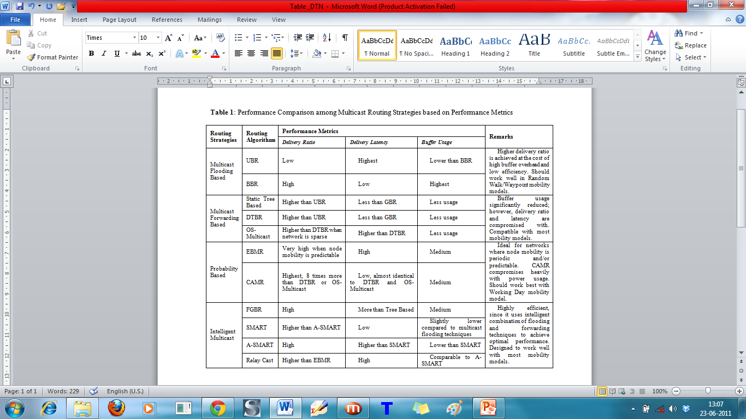
Tabular Representation of Comparison Data

Slide 29
Open Issues for Future Work
Network Security: Networks where personal and/or classified information is shared.
Power Efficiency: High power leads to high cost; power usage should be minimized.
Dynamic Buffer Management: Provision for dynamic addition/reduction in buffer size depending upon data packet size.
Scalability: Sustainability of a particular routing strategy with increasing node density in DTN environment.

Slide 30
References
A. Keränen, J. Ott, and T. Kärkkäinen “The ONE Simulator for DTN Protocol Evaluation”, in Simutools '09 Proceedings of the 2nd International Conference on Simulation Tools and Techniques, Belgium, 2009.
K. Fall, “A Delay Tolerant Network Architecture for Challenged Internets”, in Proc. ACM SIGCOMM, pp. 27-34, 2003.
Evan P.C. Jones, Paul A.S. Ward, “Routing Strategies for Delay Tolerant Networks”, in Proc. WDTN '05 Proceedings of the 2005 ACM SIGCOMM workshop on Delay-tolerant networking ACM, New York, USA, 2005.
J. Santiago, A. Casaca, and P.R. Pereira, “Multicast in Delay Tolerant Networks using Probabilities and Mobility Information”, in Ad-hoc and sensor wireless networks, an international journal, vol. 7, no. 1-2, pp. 51-68, 2009.
Z. Narmawala, S. Srivastava, “MIDTONE: Multicast in Delay Tolerant Networks”, in Proceedings of Fourth International Conference on Communications and Networking in China, (CHINACOM 2009), Xi'an, China, Aug. 26-28, 2009, pp. 1-8
J. Santiago, A. Casaca, and P.R. Pereira, “Non-Custodial Multicast over the DTN-Prophet Protocol” in International Federation for Information Processing Digital Library, Wireless Sensor and Actor Network.
Q. Ye, L. Cheng, M. Chuah, B.D. Davison, “Performance comparison of different multicast routing strategies in disruption tolerant networks,” in Journal Computer Communication, vol. 32, no. 16, pp. 1731-1741, February 2009.
Y. Xi, and M. Chuah, “Performance Evaluation of An Encounter-Based Multicast Scheme for DTN”, in 5th IEEE International Conference on Mobile Ad-hoc and Sensor System, pp. 353-358, 2008.

Slide 31
References (Continued..)
S.H. Bae, S.J. Lee, W. Su, and M. Gerla, “The design, implementation, and performance evaluation of the on-demand multicast routing protocol in multi-hop wireless networks”, in IEEE Network, vol. 14, pp. 70-77, 2000.
M. Chuah, Y. Xi, “An Encounter-Based Multicast Scheme for Disruption Tolerant Networks,” in Journal Computer Communications, vol. 32, issue 16, Butterwoth-Helnemann, Newton, MA, USA, October 2009, April 1955.
P. Yang, and M. Chuah, “Context-Aware Multicast Routing Scheme for DTNs” in Proc. Of ACM workshop on PE-WASUN, August, 2006.
J. Wu and N. Wang, “A-SMART: An Advanced Controlled-Flooding Routing with Group Structures for Delay Tolerant Networks,” in Second International Conference on Networks Security, Wireless Communications and Trusted Computing, 2010.
U. Lee, S.Y. Oh, K.W. Lee, M. Gerla, “RelayCast: Scalable Multicast Routing in Delay Tolerant Networks”, in IEEE Int. Conf. on Network Protocols (ICNP'08), Orlando, FL, October. 2008
W. Zhao, M. Ammar, and E. Zegura, “Multicasting in Delay Tolerant Networks: Semantic Models and Routing Algorithms,” in WDTN’05 proceedings of 2005 ACM SIGCOMM workshop on Delay-tolerant Networking, ACM, New York, USA, 2005.
T. Spyropoulos, K. Psounis, and C.S. Raghavendra, “Spray and Wait: An Efficient Routing Scheme for Intermittently Connected Mobile Networks”, in WDTN '05 Proceedings of the 2005 ACM SIGCOMM workshop on Delay-tolerant networking, ACM, New York, USA, 2005.
V. Cerf et al., “Delay Tolerant Network Architecture", IETF, RFC 4838, April 2007.
K. Scott and S. Burleigh, "Bundle Protocol Specification", IETF, RFC 5050, November 2007.
A. Vahdat, and D. Becker, “Epidemic Routing for partially-connected ad hoc networks”, Duke Technical Report CS-2000-06, July 2000.

Slide 32
Thank You!!

