Slide 1
Predicting Social Dynamics Based on Network Traffic Analysis For CCN/ICN Management Satadal Sengupta IIT Kharagpur, India Supervisor: Dr. Sandip Chakraborty

Slide 2
Traffic Management in CCN/ICN
Proliferation of online social networks (OSNs) – unprecedented demand for data
Emergence of Content/Information-Centric Networking (CCN/ICN)
Supports named-content access as opposed to traditional host-resolution approach
CCNs employ in-network management for content storage and distribution
Intermediate routers or base stations apply storage and distribution policies
Decisions generally based on history of content access
Is history of accesses a sufficiently good measure?

Slide 3
Social Dynamics: Role in CCN/ICN Management
Social Dynamics: Relationship among users in a OSN
Example: “Friends” on Facebook, “Followers” on Twitter
Especially important in light of embedded videos – “autoplay” on FB
Viral content more likely to get generated by active (hub) users
Early pattern of accesses indicative of future virality
Intelligent decisions: popularity of content + popularity of user
Unfortunately, cellular base-stations have no information of social dynamics
Social dynamics instrumental in predictive caching. How to achieve?
Notes:
CAGR - Compound Annual Growth Rate

Slide 4
The Problem
Premise:
Direct correlation between social dynamics among OSN users and predictive popularity of content
Objectives:
Infer social dynamics using network traffic data at the cellular base station (Facebook is taken as an example OSN)
Identify metric/s to compute probabilistic content popularity
Analyze the role of said metric/s in a real (preferably) or simulation-based CCN deployment
Inference of social dynamics from base-station data

Slide 5
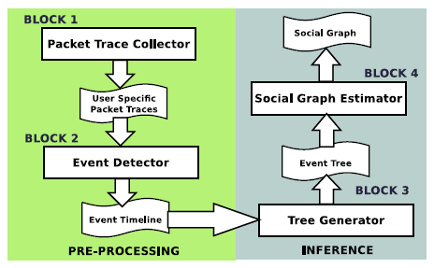
Social Dynamics Inference: System Architecture
Building Blocks
Packet Trace Collector – collect raw packet traces
Event Detector – generates event (view/share) signatures
Tree Generator – generate cascades from list of events
Social Graph Estimator – estimate social graph
How are the system components implemented?

Slide 6
Block 1: Packet Trace Collector
Runs on the cellular base-station as a background service
Implemented using tcpdump – standard tool
Operator can attribute every packet to a unique user (cellphone number)
Raw trace collection

Slide 7
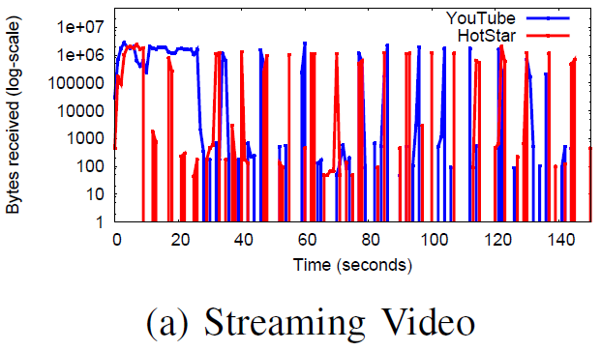
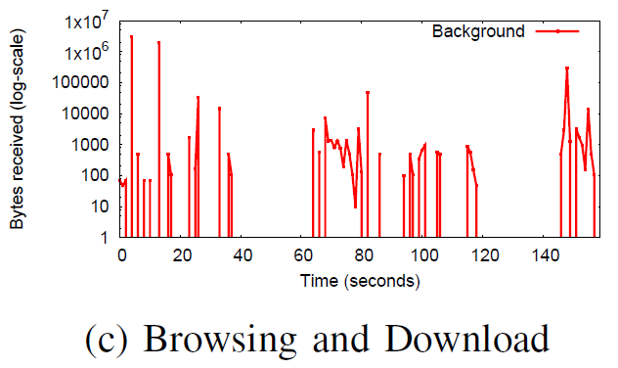
Block 2: Event Detector
View event:
Traffic pattern used for identifying launch of a video
Bursty pattern of video v/s other activities
Share event:
Call to graph.facebook.com
Unique ID of the video content
Example: https%3A%2F%2Fvideo.fbom1-1.fna.fbcdn.net%2Fhvideo-xtp1%2Fv%2Ft42.1790- 2%2F11158692_367216400134622_1667525658_n.mp4
Event quadruplet: (user_id; content _id; event_type; timestamp)
Detection of view and share events

Slide 8
Block 3: Cascade (Tree/Forest) Generator
First user (in current cycle) who views and then shares is the “root” node
A user who views after a share is a “child” of the sharing “parent”
Reconstruction of the cascade based on event information and share-view relationships
Challenge: Whose “share” am I “view”-ing?
Ad-hoc solution: Latest share – introduces false relationships
Cascade reconstruction

Slide 9
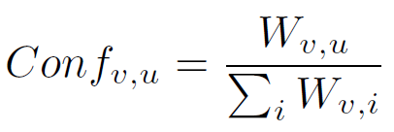
Block 4: Social Graph Estimator
Aggregation of cascades – directed, weighted graph
Weights: No. of times an edge appears in the aggregated graph
Presence of coincidental edges
Edges filtered based on confidence value associated with edge:
Estimates the final social graph – preserves social dynamics
Social Graph estimation

Slide 10
Simulation Framework
Lack of real data – help?
Simulation framework:
Real-world social network: Facebook graph – ~4k nodes, ~88k edges
Influence propagation: Random prob. for view and share
Content popularity: Randomly assigned popularity level
Content introduction: Randomly selected origin nodes
Content propagation: Based on prob. values
Base-station cluster: Community detection algo. to detect cluster
Simulation framework for analysis

Slide 11
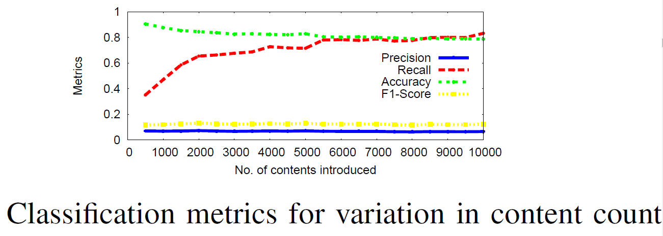
(Very) Preliminary Results
Observed factors: (1) No. of contents, (2) Prob. Values, (3) Popularity levels, (4) Confidence threshold
Low precision
Not impressive!

Slide 12
Future Directions
Mathematical analysis?
Test on real-world data
Expand to other OSNs
Other suggestions?

Slide 13
Thank You!

