Slide 1
Candid with YouTube Adaptive Streaming Behavior and Implications on Data Consumption Speaker: Sandip Chakraborty Indian Institute of Technology Kharagpur, India
Co-authors:
Abhijit Mondal (IIT Kharagpur) Satadal Sengupta (IIT Kharagpur) Bachu Rikith Reddy (IIIT Guwahati) M.J.V. Koundinya (IIIT Guwahati) Chander Govindarajan (IIT Kharagpur) Pradipta De (Georgia Southern Univ.)
Niloy Ganguly (IIT Kharagpur)

Slide 2
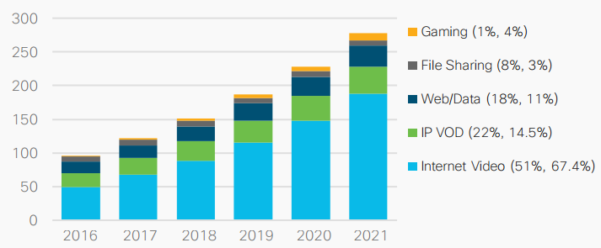
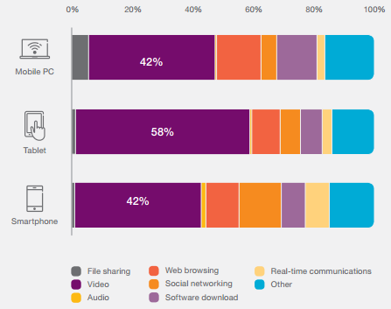
Why Study Streaming Behaviour of YouTube?
Exabytes per month
Global IP Traffic Forecast – Video on the rise (Source: Cisco VNI Report ’17)
YouTube is the largest player, accounting for between 40–70% of total video traffic across most networks.
Mobile data-traffic volumes by application category & device type (Source: Ericsson Mobility Report ’16)
How does YouTube streaming work?

Slide 3
YouTube Streaming: Evolution
Adobe Flash plug-in period – since inception in 2005.
HTML5 period – launched in January 2010
Experimental version for only a section of available videos
Available to users on a trial basis
Required browser supporting HTML5 video using WebM/H.264
DASH (Dynamic Adaptive Streaming over HTTP) period
Experimental version, started around 2013
DASH made default playback mechanism on January 27, 2015
What is DASH like?

Slide 4
DASH: Overview
DASH or MPEG-DASH – adaptive bit-rate solution
Breaking down video content into small segments
Alternative versions of each segment available on server at various bit-rates
Client typically requests for highest bit-rate chunk feasible under current network conditions
DASH not a protocol – only defines an architecture; clients free to define their own implementation
What is the DASH architecture?

Slide 5
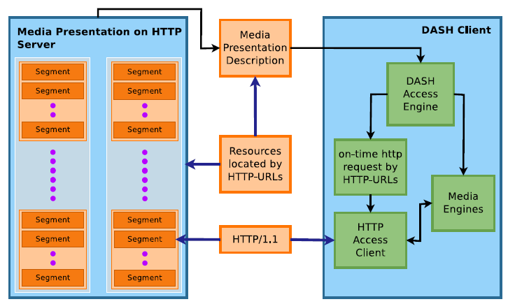
DASH: Architecture
Our focus: How does YouTube implement this?
How do we explore YouTube’s implementation?

Slide 6
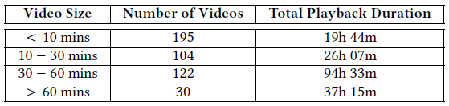
Experimental Setup
Link throttling enabled using Unix library NetFilterQueue
Progressive bandwidth changes in range of 200 – 2400 Kbps
Packet traces collected during playback using tcpdump
Developed automated tool AutoHARExporter using Selenium and har_export_trigger plugin to capture Http Archive (HAR) files from browser.
HTTP request/ response pairs (from HAR) collected for ~500 videos
What does the data reveal?

Slide 7
Parameters Involved in YouTube Streaming
A total of 35 parameters (and their values) identified
Parameters constant across multiple videos over multiple sessions (device and OS-related information): alr , c, gir , iptbits, keepalive, key, mm, mn, ms, mv, pcm2cms, pl , playretry, ratebypass, requiressl, source, sver
Parameters constant for the same video across multiple sessions (video-specific parameters): cpn, cver , ei, expire, fexp, id, initcwndbps, ip, lmt , rbuf , rn, signature, sparams, upn, range
Static parameters w.r.t. adaptive streaming. Which are the dynamic ones?

Slide 8
YouTube Streaming: Dynamic Parameters
Parameters changing within a single video session (in response to link bandwidth variation): clen, dur , itag, lmt , mime, rbuf , rn, signature, range
mime, signature: related to audio/video channels
dur: video duration – minor sensitivity to encoding technique
Parameters of interest for adaptive streaming: clen, itag, lmt , range, rbuf , rn
Let’s look at these params in detail!

Slide 9
YouTube Adaptive Streaming – Critical Params
itag – numeric quality level, differentiated on the basis of resolution, bit-rate, encoding technique
lmt – datetime (epoch) when chunk was created at YouTube server; probably used to avoid playing stale chunks
rn – request number to uniquely identify a DASH video playback request
rbuf – indicated the receive buffer at the client
range – byte-range parameter in HTTP request header
clen – length of video chunk for a particular itag value
How do rbuf and itag respond to bandwidth?

Slide 10
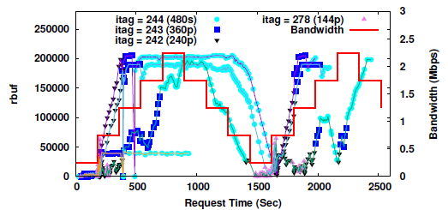
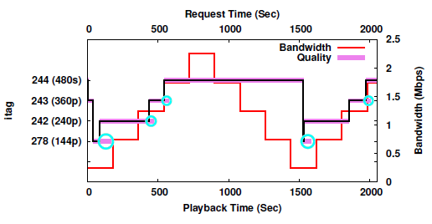
Evolution of rbuf and itag parameters
itag evolution
rbuf evolution
What are the implications?

Slide 11
Youtube Adaptive Streaming: Insights
Parameters
range and itag are parameters responsible for adaptiveness
rbuf is the client-side indicator of channel quality
YouTube can choose to download lesser data per request than the max. length of a segment (defined by clen), using range parameter
Conservative downscale vs. opportunistic upscale of quality
When bandwidth drops, immediate switch to lower quality
When bandwidth improves, segments of both qualities (current and higher) downloaded in parallel – reason for data wastage
How does YouTube’s flexibility with range parameter impact data wastage?

Slide 12
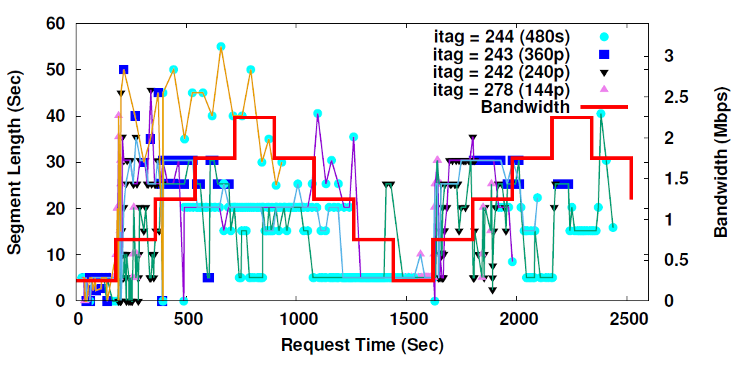
Segment Length Adaptation
On improvement of link bandwidth (indicated by rbuf), YouTube increases segment length of lower quality video, buffers some video data
Switches to higher quality with smaller segment lengths
Progressively increases segment len. until max., through higher qualities too if feasible
Similar for bandwidth drop – segment len. decrease followed by switch to lower quality
What does this imply for data wastage?

Slide 13
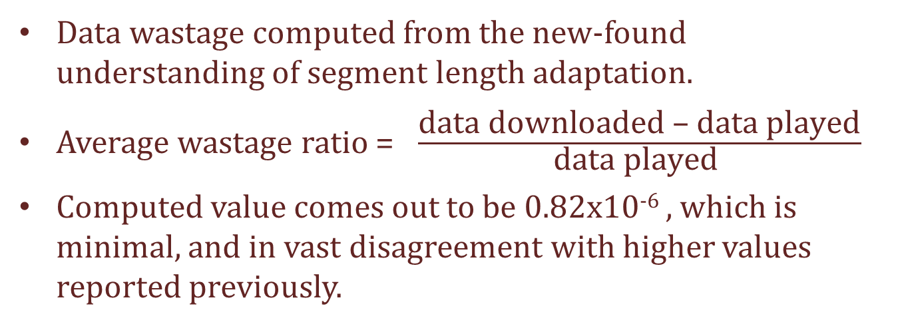
Data Wastage during YouTube Streaming
Data wastage computed from the new-found understanding of segment length adaptation.
Average wastage ratio = $\frac{\text{data} \text{downloaded}\text{ – }\text{data} \text{played}}{\text{data} \text{played} }$
Computed value comes out to be 0.82x10⁻⁶ , which is minimal, and in vast disagreement with higher values reported previously.
Can we predict data consumption?

Slide 14
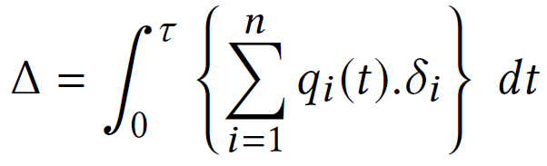
Predictive Model for Data Consumption
Total amount of data consumed during a playback session is given by:
Parameters except q_{i}(t) can be deterministically computed. q_{i}(t) is an indicator variable denoting presence of segment of itag value i.
Determining q_{i}(t) based on bandwidth at previous and current instance, itag at previous instance, and encoding features.
Binary classification problem – we achieve avg. precision of 0.86, avg. recall of 0.85, and avg. accuracy of 85.75%, using a Random Forest Classifier.
Early prediction of data consumption possible!

Slide 15


