Slide 1
Supply Chain Management
Parthib Takitazwar 18-36345-1
Abdur Rahman 18-36340-1
Tabassum, Anika 18-37604-1
Dipu hasan 18-36364-1

Slide 2
Introduction
A garments factory is a place where clothing is produced on an industrial scale using (usually) mass production processes and standard sized pattern pieces to make many items to a set design. •
RMG plays a very important role in our economy
We visited Ferdous Fashion LTD to better understand how a Garments factory operate and what materials they use to produce goods.

Slide 3
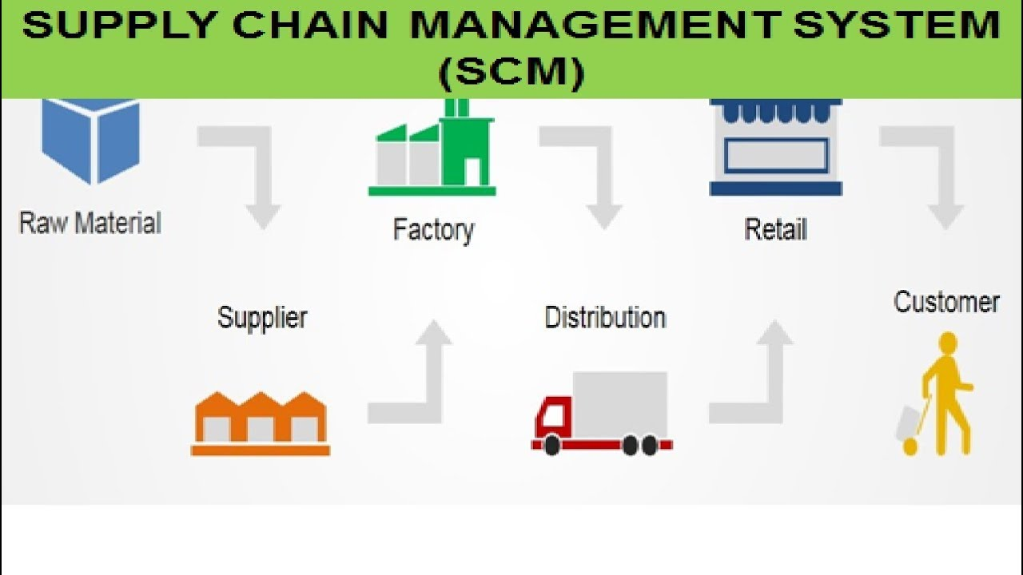
A STANDARD CHAIN OF A GARMENTS FACTORY
RAW METERIALS
SUPPLIER
MANUFACTURING
DISTRIBUTION
RETAILER
CUSTOMER

Slide 4

Raw materials of garments factory
Raw material is the primary substance which is used as an input to a production process for subsequent modification and finally modified into a finished good.
Raw material is a unique substance for textile fabrics, lining and garment materials, shirts, denim, functional materials etc.

Slide 5
Supplier
Supplier supplies and delivers raw materials to production plants
These materials are used by manufacturers to produce goods and sell them.
With the increase demand, suppliers have to increase the supply of raw material.

Slide 6
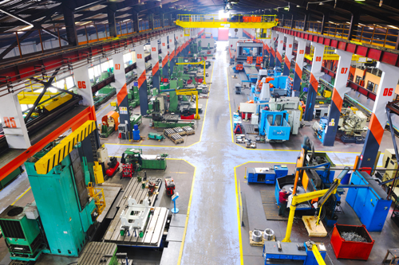
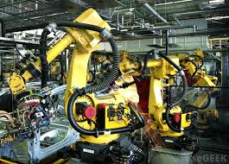
Manufacturing
The transformation of raw materials into finished products, usually on a large scale.
Finished goods may be used for manufacturing other, more complex products.
Types of manufacturers are: Made to Stock (MTS), Made to Order (MTO) and Made to Assemble (MTA)
Modern manufacturing includes all intermediate processes required for the production.

Slide 7
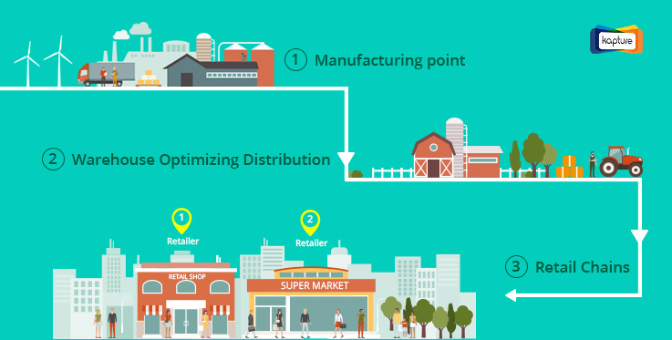
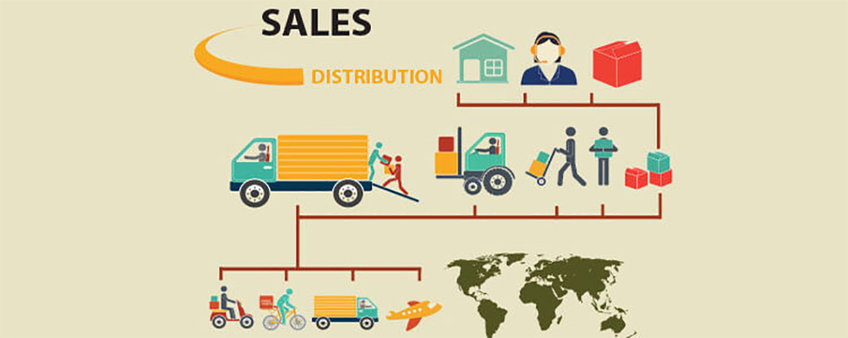
Distribution
Distribution is an integral part of the larger universe of logistics and supply chain management.
It refers to the process of overseeing the movement of goods from manufacturer to point of sale.
There are basically two types of distribution: commercial distribution and physical distribution.
Successful distribution management system is important for businesses to remain competitive and customers satisfied.

Slide 8
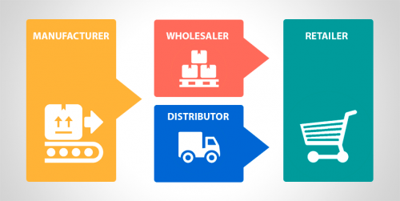
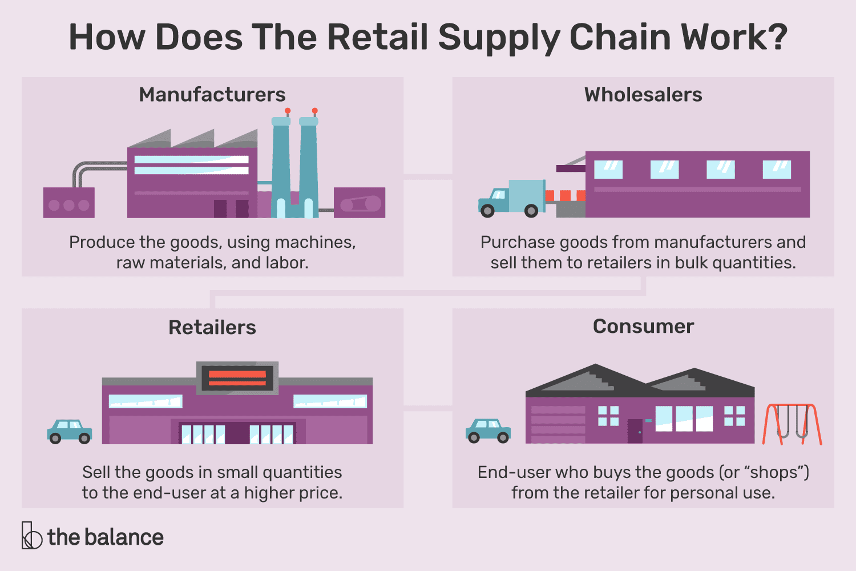
Retailer
A retailer is a company that sells goods to consumers for a profit.
Traditionally, retailers needed to have a physical location such as a shop, a vending machine, or a market stall.
Retailers are the final link in the supply chain between manufacturers and consumers.
Retailing is important because it allows manufacturers to focus on producing goods more.

Slide 9


Customer
A person who buys goods or services from a shop or business.
Usually more is the number of customers, more is the business thriving and vice versa.
Customers can be of various types depending upon their ability to buy products or services such as potential customer, loyal customers, new customer etc.
It is very important for a business to manage the customer.

Slide 10
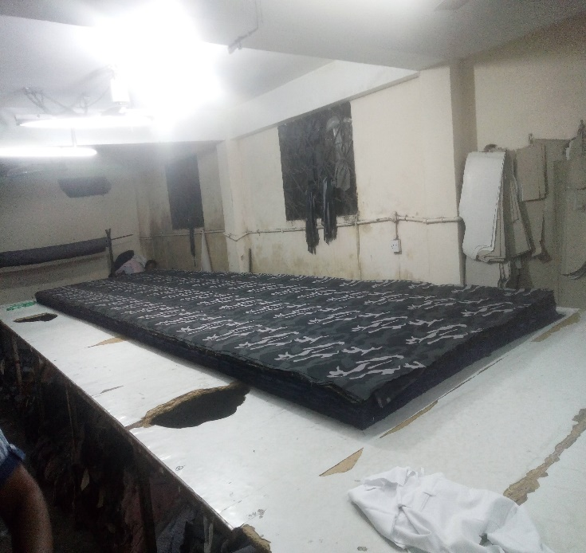
Supply of Raw materials
Raw Materials
Design of product
Fabrics
Threads
Types of supplier:
Foreign
Local

Slide 11
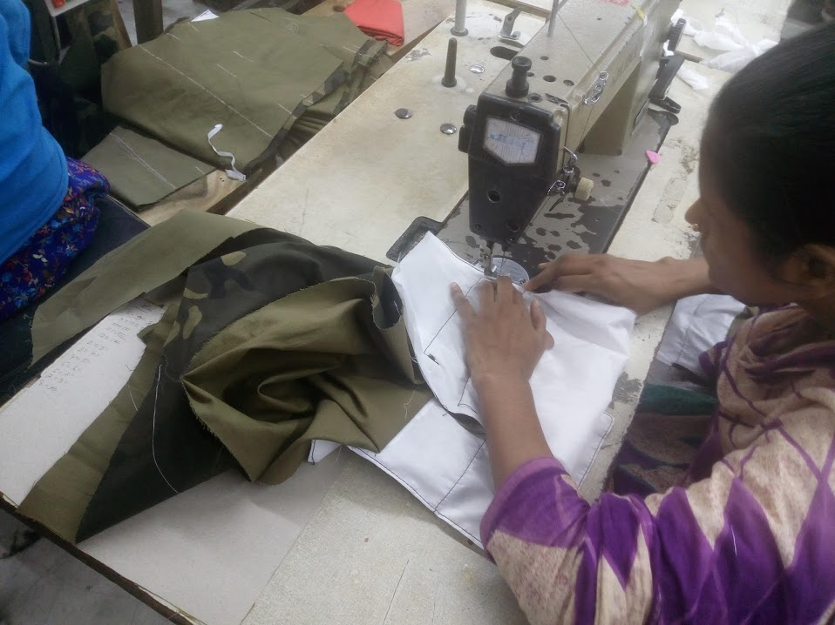
Product Manufacturing
Softline Manufacturer
Two flood dedicated for sewing
3rd floor sew basic part
4th floor sew accessories
Extra Threads Removed
Distributed in column

Slide 12
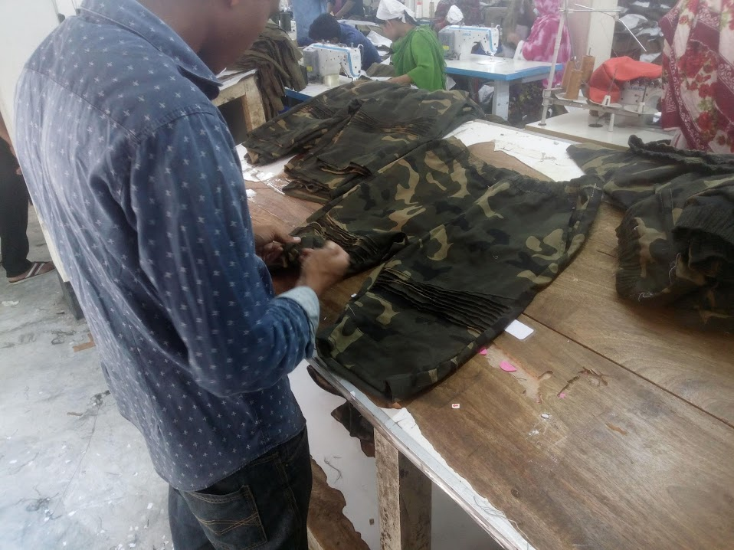
Quality and Inventory
Metal Detector checking
Discard Sticker
Individual product checking

Slide 13
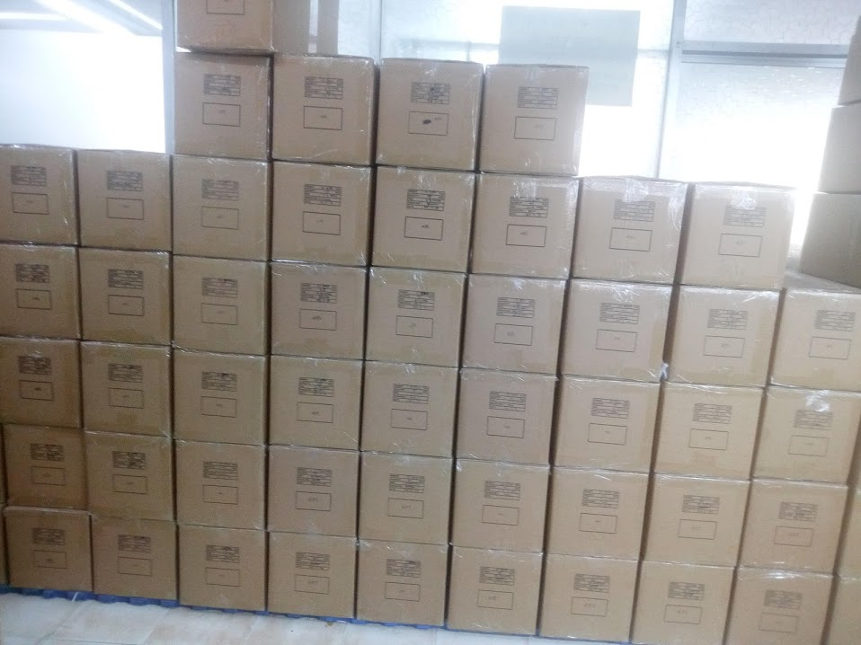
Inventory
Wrapped with bags
Stacked with cartoon

Slide 14
Distribution and Retail
Type of distributor:
Buyer
Mid-tier
Low-tier
Type of Retailers:
Branded Shop
Hawkers

Slide 15
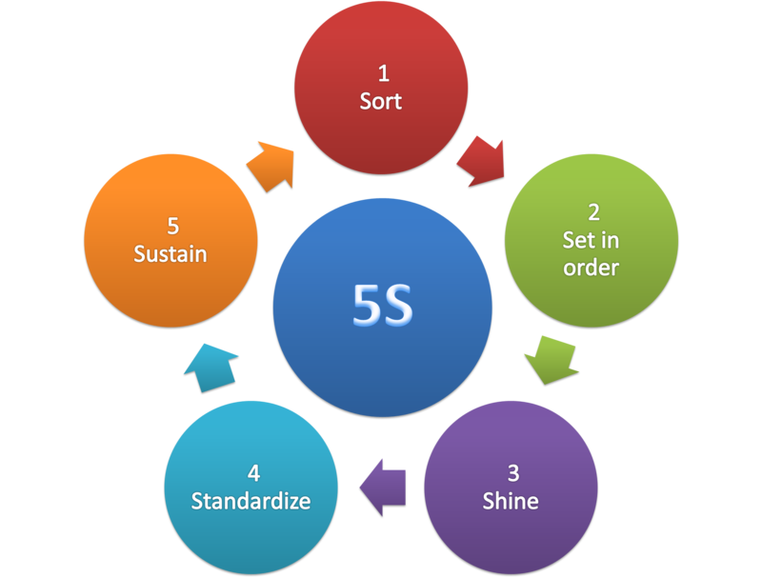
5S
Seiri
Seiton
Seiso
Seiketsu
Shitsuke

Slide 16
ENVIROMENTAL ISSUES
Garments industry is associated with some environmental issues some of them are:
Large volumes of water.
Usage of complex chemicals.
Discharge of untreated effluent.
Water pollution.
Air pollution.
Labours concern.

Slide 17
RECOMMENDATIONS
Removal of Energy Crisis.
Exploration of new Export Markets.
Reducing the cost of doing Business in Bangladesh.
Need for improving Garment Productions.
Improvement in productivity.
Awareness of International Quality Standards.
Introducing concept on the job-training.
Introducing efficient management techniques.
Focus on value addiction.
Electricity & Gas Tariff.

Slide 18
CONCLUSION
The industry plays a key role in employment generation and in the provision of income to the poor. To remain competitive in the post-MFA phase, Bangladesh needs to remove all the structural impediments in the transportation facilities, telecommunication network, and power supply, management of seaport, utility services and in the law and order situation. The government and the RMG sector would have to jointly work together to maintain competitiveness in the global RMG market.

