Slide 1
Network Intrusion Detection with Different ML Algorithms
Shahidullah Kaiser

Slide 2
Network Intrusion Detection
Notes:
Network security is a big concern nowadays and machine learning can be a useful tool to detect network attacks and protect the network.

Slide 3
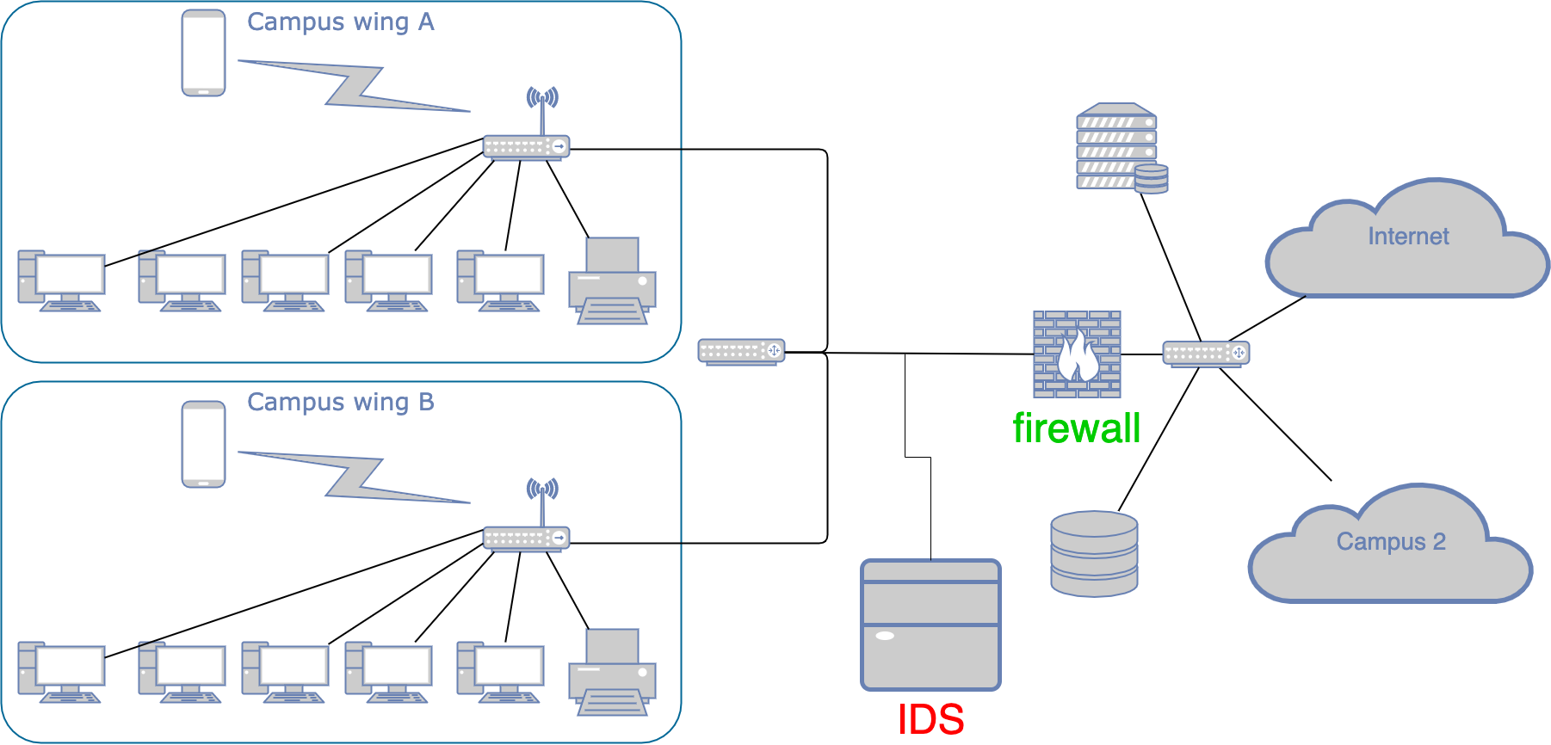
﻿A Network Intrusion Detection System (NIDS) is developed in a network to detect threats from monitoring packets transmitted though.
Notes:
Firewalls limit access between networks to prevent intrusion and do not signal an attack from inside the network. An IDS evaluates a suspected intrusion (attack happen from&to intranet and from/to internet) once it has taken place and signals an alarm

Slide 4
ML based NIDS - classification
Train
Classify
Report
Supervised algorithm
For each data packet, we classify it to normal or malicious
unsupervised algorithm
Detect 1-cluster outliers
When there are only few malicious packets – works but not for dataset
Divide packets into two clusters, one for normal and one for malicious
With little knowledge, we can decide which cluster normal and which is malicious.
Notes:
E.g. we send a normal/malicious packet and mark it, or experts choose a packet randomly and decide it is malicious or not. Then the cluster with that packet will be normal/malicious

Slide 5
Dataset

Slide 6
NSL-KDD dataset is used
Contains list of Attacks and types of attacks

Slide 7
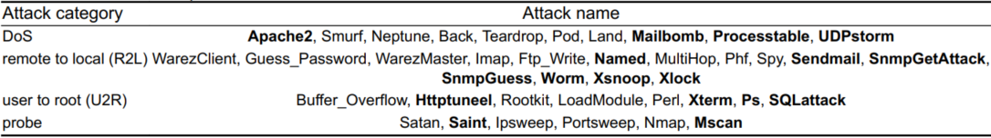

Slide 8
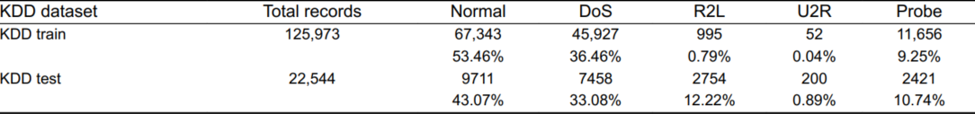

Slide 9
Classification Algorithms

Slide 10
K-Means (n partitions into k clusters)
Random Forest (Decision trees)

Slide 11
3. SVM (Support Vector Machine)
4. MLP (Multi layer Perceptron)

Slide 12
Thank you
Q&A

