Slide 1

Churn Analysis – Bank Customer Data
Analysing Why Customers Leave

Slide 2
Our Objectives
Understand Churn Behavior
Identify Churn Drivers
Deep dive into customer departure patterns to identify underlying reasons.
Pinpoint key factors contributing to customer attrition using data-driven insights.
Segment High-Risk Customers
Recommend Retention Strategies
Develop profiles of customers most likely to churn for proactive retention efforts.
Formulate actionable strategies to enhance customer loyalty and reduce churn.

Slide 3
Key Metrics Overview
10,000
20.37%
100%
Total Customers
Overall Churn Rate
Focus on Churned Segment
Our comprehensive analysis covers a substantial customer base.
This represents the percentage of customers who have ceased their relationship with us.
Our in-depth analysis is specifically concentrated on customers who have churned.

Slide 4

Churn by Demographics
Gender-Based Churn:
Age Group Analysis:
55.92%
Female Customers
Highest Churn (51-60)
Higher churn observed among female clientele.
This age bracket shows the most significant attrition, requiring targeted strategies.
44.08%
Male Customers
Comparatively lower churn rate.
Lowest Churn (<30)
Younger demographics exhibit robust loyalty and lower churn.

Slide 5


Churn by Customer Behavior & Geography
Behavioral Insights
Geographical Variations
Inactive Customers: 63.92% of churn
Germany and France: 39.96% churn
Highest churn rate observed, indicating a critical area for focus.
Lack of engagement significantly contributes to attrition.
Non-Credit Card Owners: 30.91% churn
Spain: 20.27% churn
Exhibits the lowest churn, suggesting effective retention factors.
Customers without credit cards show a higher propensity to churn.

Slide 6
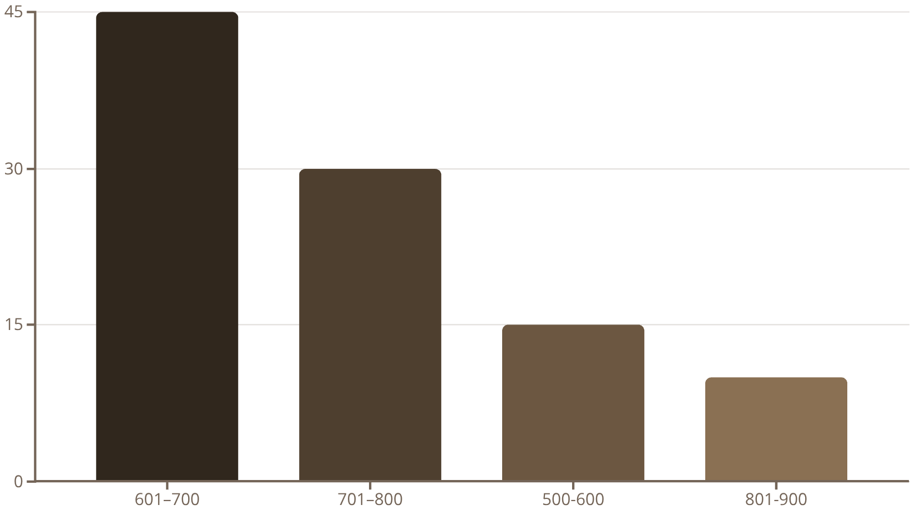
Churn by Product & Credit Score
Product-Specific Churn
Credit Score Impact on Churn
Product 1: 69.17% churn
1
This product shows an alarmingly high churn, demanding immediate review and improvement.
2
Products 3 & 4: Very low churn
These products demonstrate strong customer stickiness, serving as benchmarks.

Slide 7
Key Insights & Recommendations
Talk to inactive customers earlier
1
Develop campaigns to reactivate dormant accounts and boost customer engagement.
Improve Product 1 or offer alternatives
2
Conduct a thorough review of Product 1 to identify and address its pain points.
Encourage more customers to use credit cards
3
Incentivise credit card adoption to reduce churn among non-owners.
Loyalty Rewards for Mid-Range Balances
4
Implement programs to reward customers with balances between 100k-200k to foster loyalty.
Target High-Churn Segments
5
Focus retention efforts on customers in Spain and the 50-61 age group with tailored interventions.

Slide 8
Conclusion
Key Takeaways
Our project helped us understand why some customers are leaving
We looked at thing like : age, gender, where they live, which bank product they use.
main reasons why people leave : being inactive, not having a credit card, or being in a certain age group
Thank You! Questions?
“This helps the bank create better plans to keep customers happy and loyal.”

