Slide 1


Slide 2
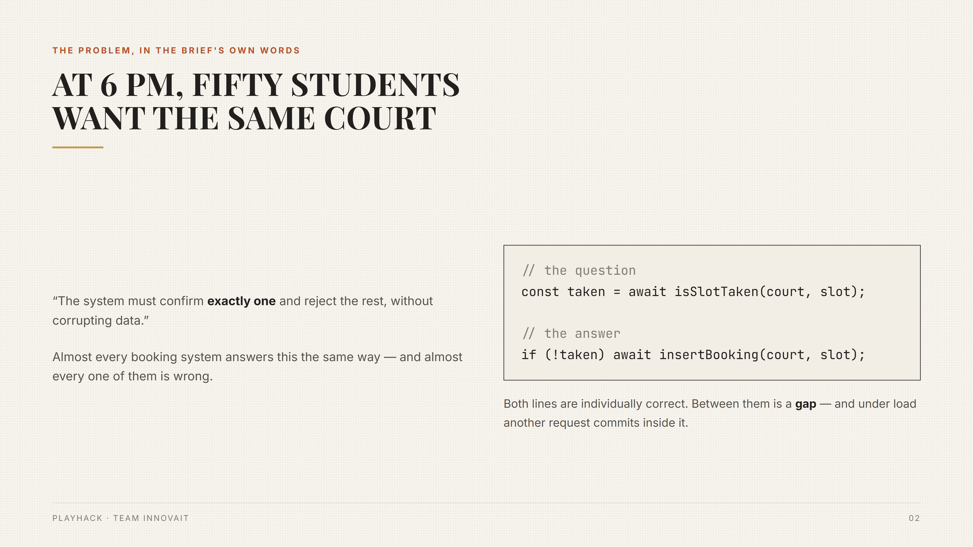

Slide 3
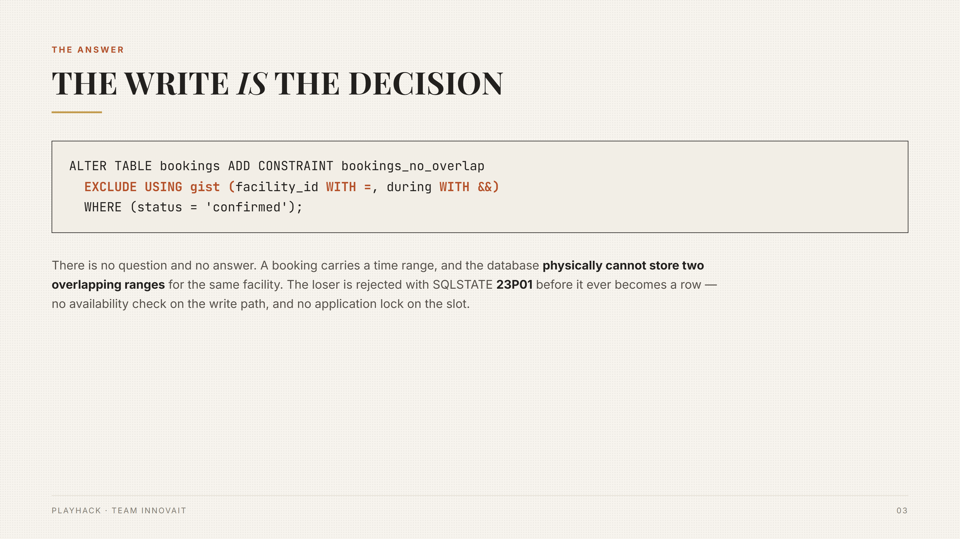

Slide 4
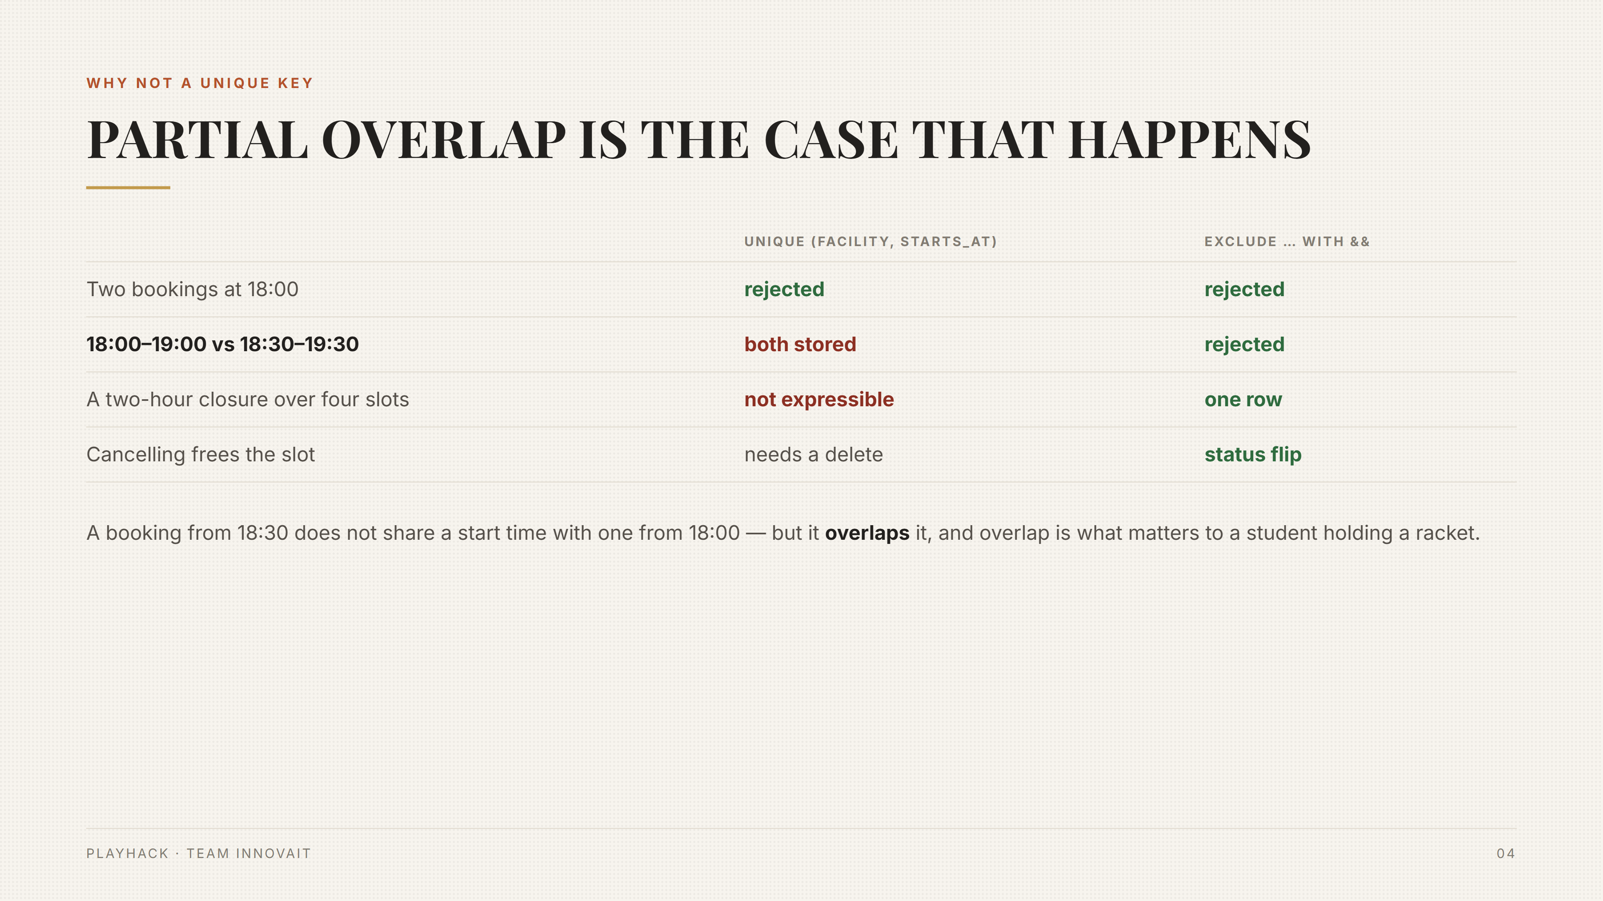

Slide 5
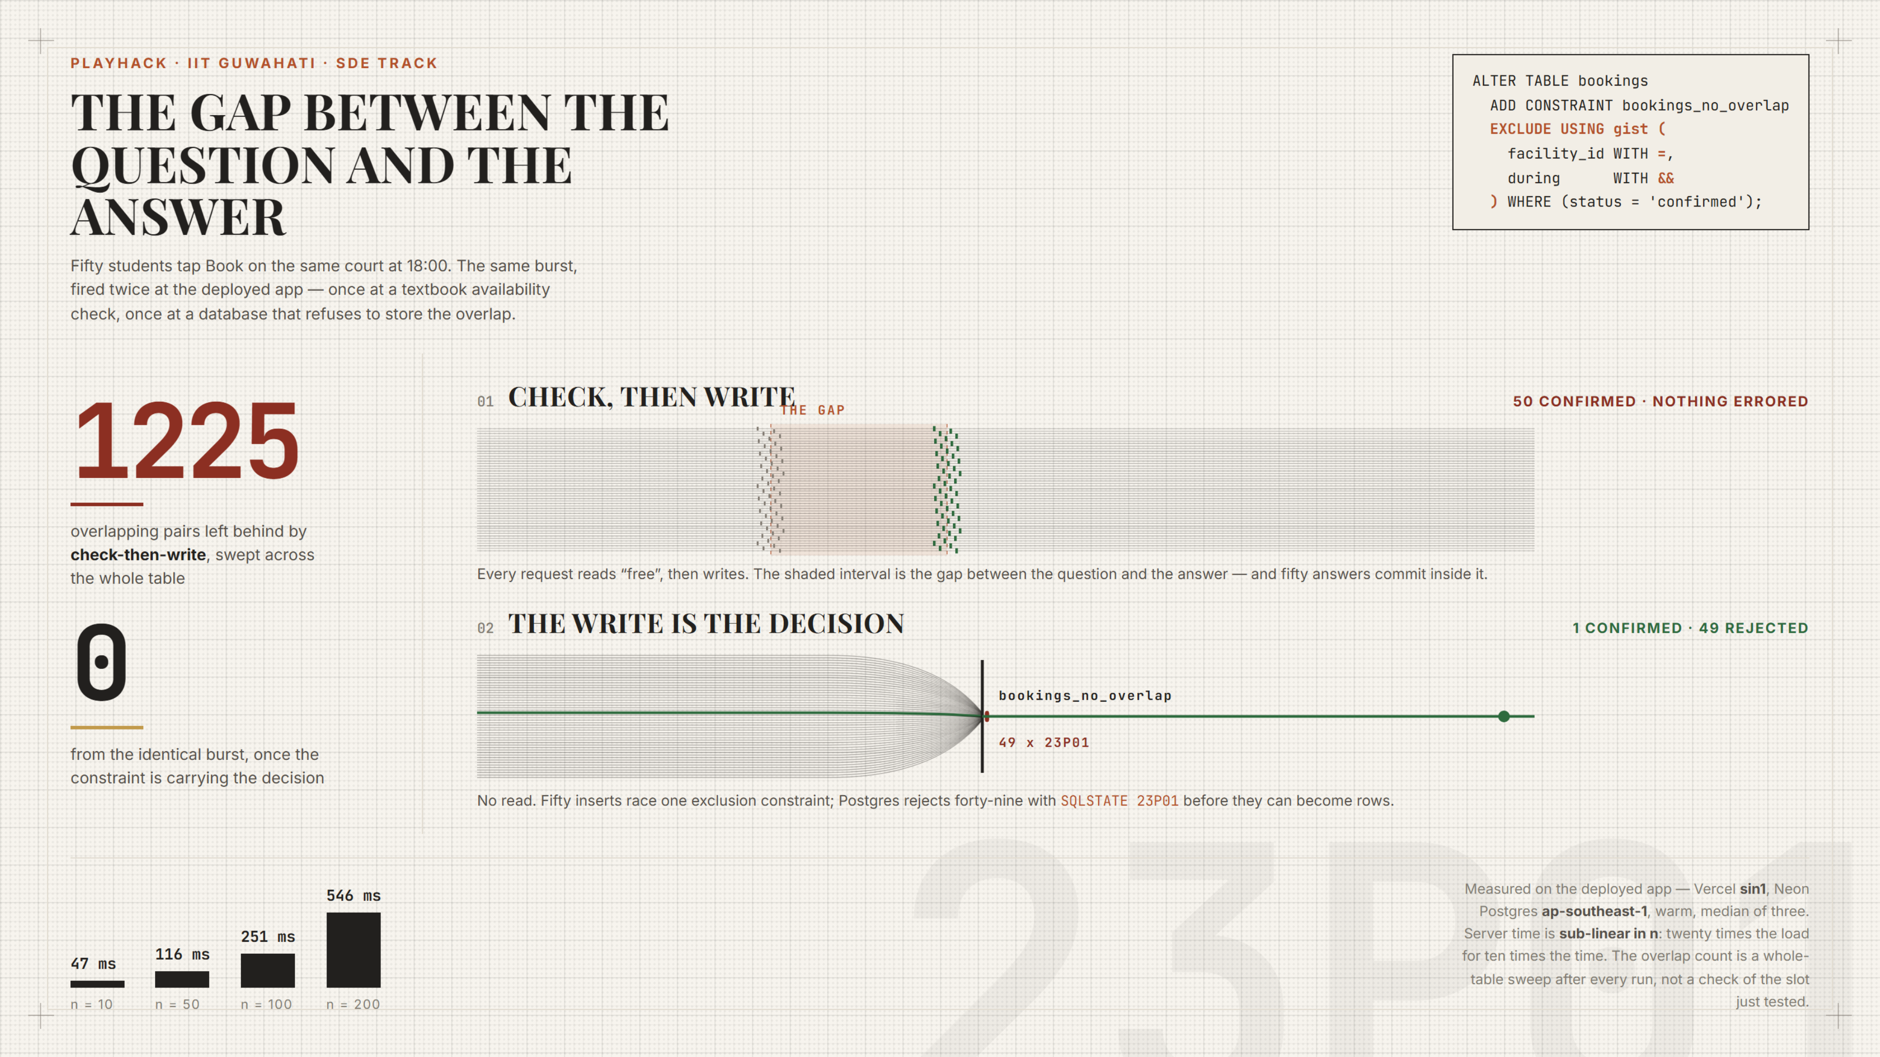

Slide 6
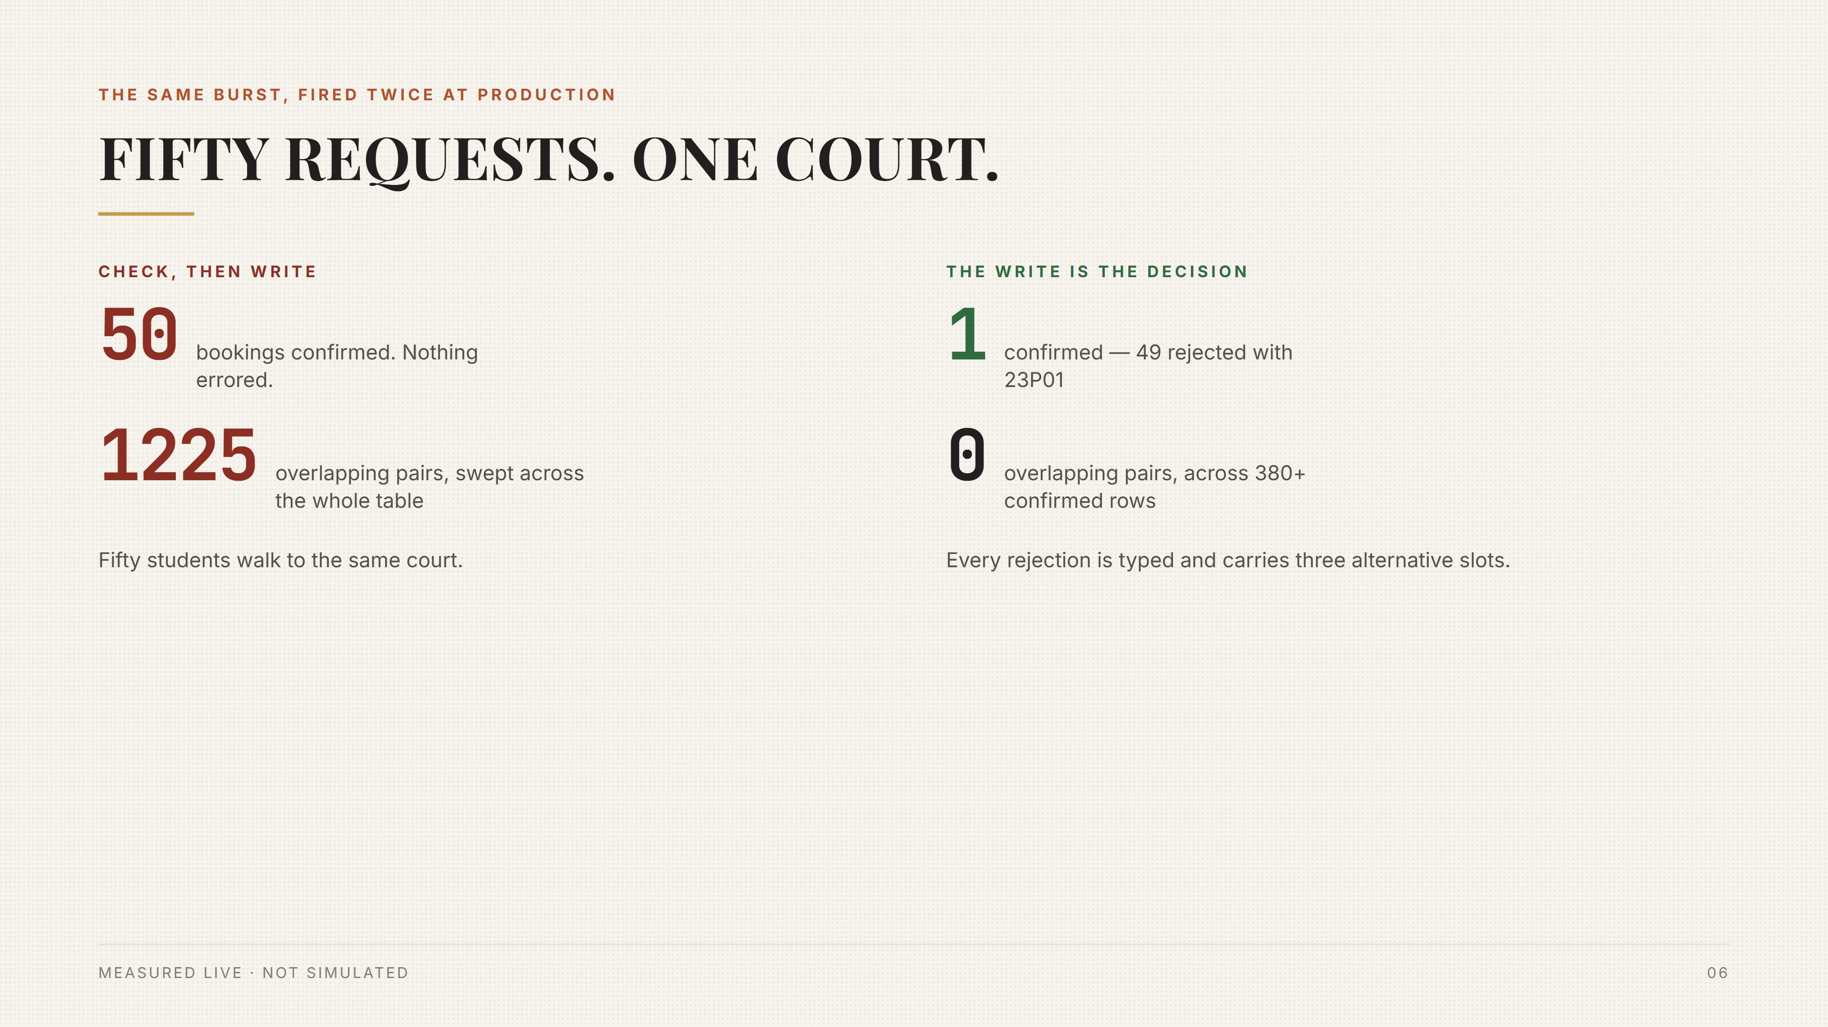

Slide 7
NOTHING IS SIMULATED
The same burst, fired twice at production
Naive first — 50 confirmed, 1225 overlapping pairs. Then the identical burst at the constrained path: exactly one survives. Plays in slideshow mode.

Slide 8
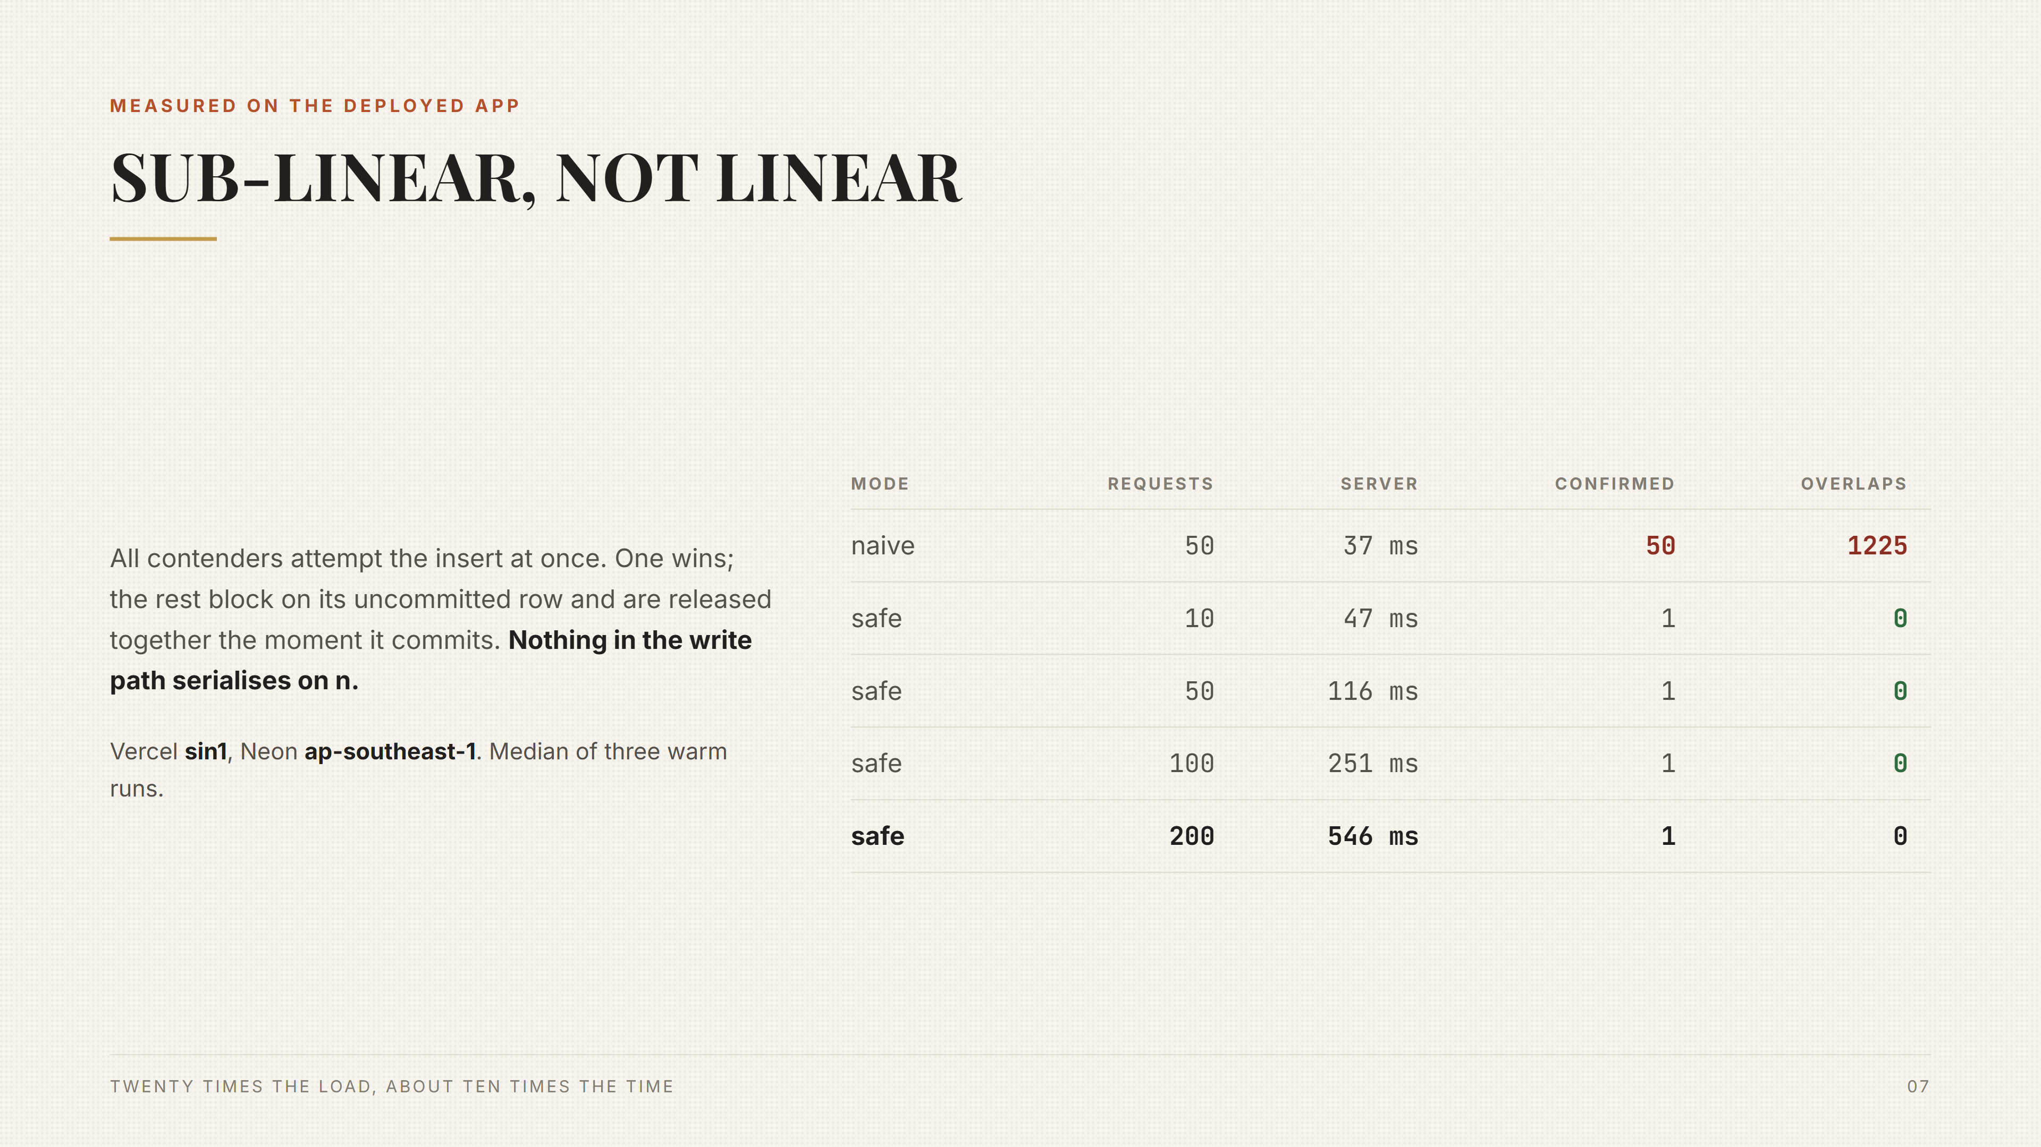

Slide 9
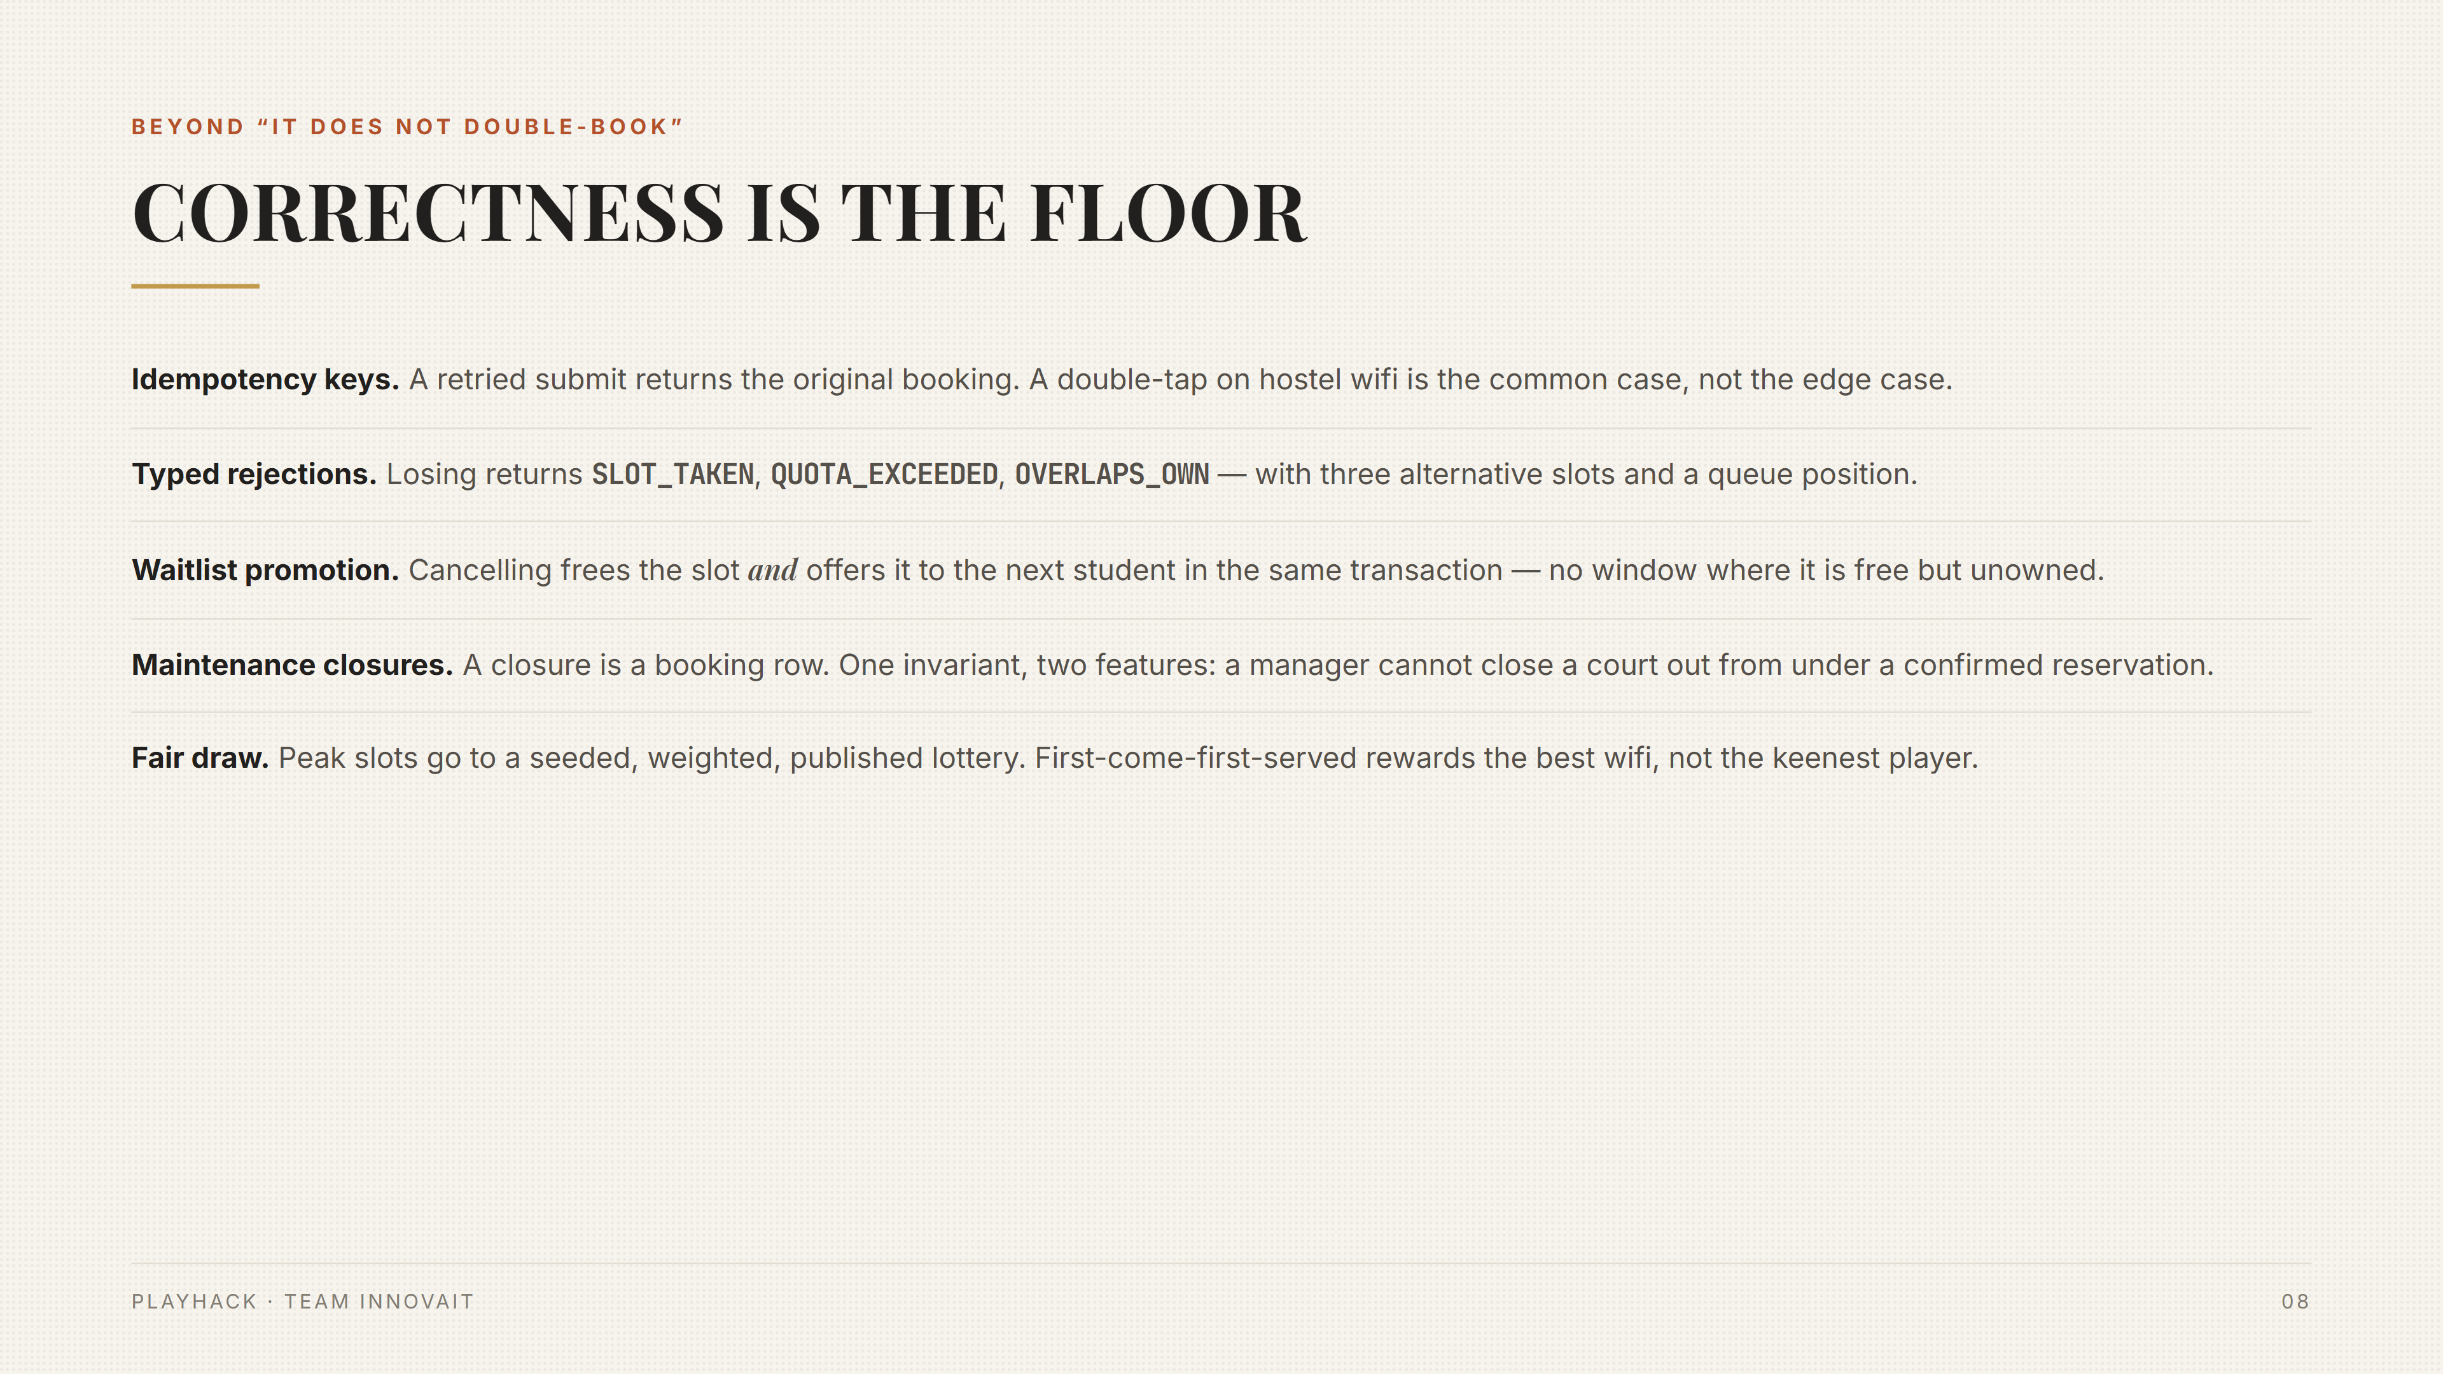

Slide 10
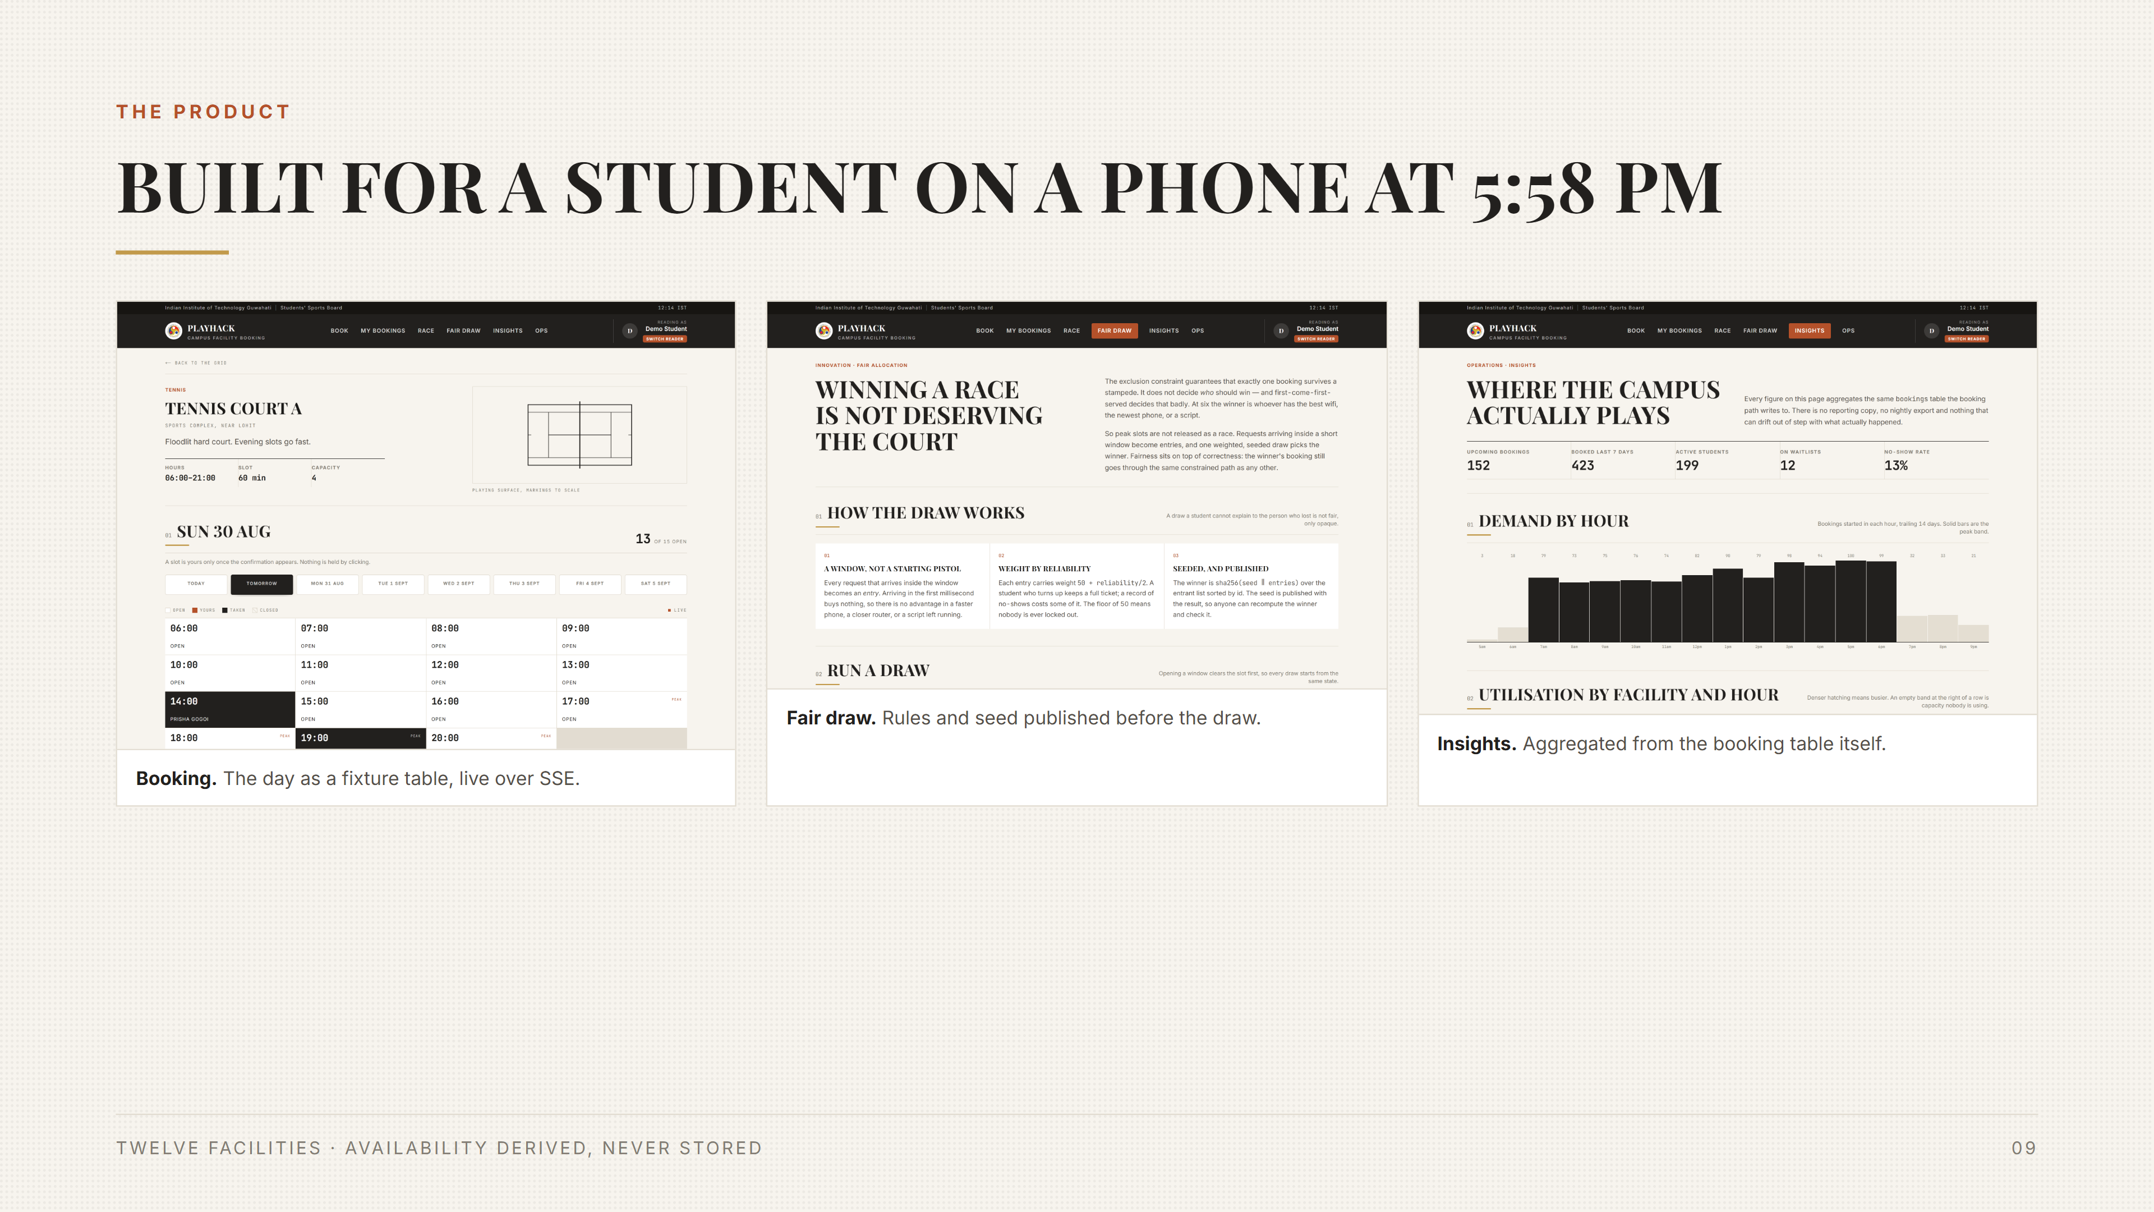

Slide 11
INSIGHTS
Every figure aggregates the bookings table itself
Demand by hour, utilisation by facility and hour, no-show rate, under-used prime slots. No reporting copy and no nightly export to drift out of step.

Slide 12
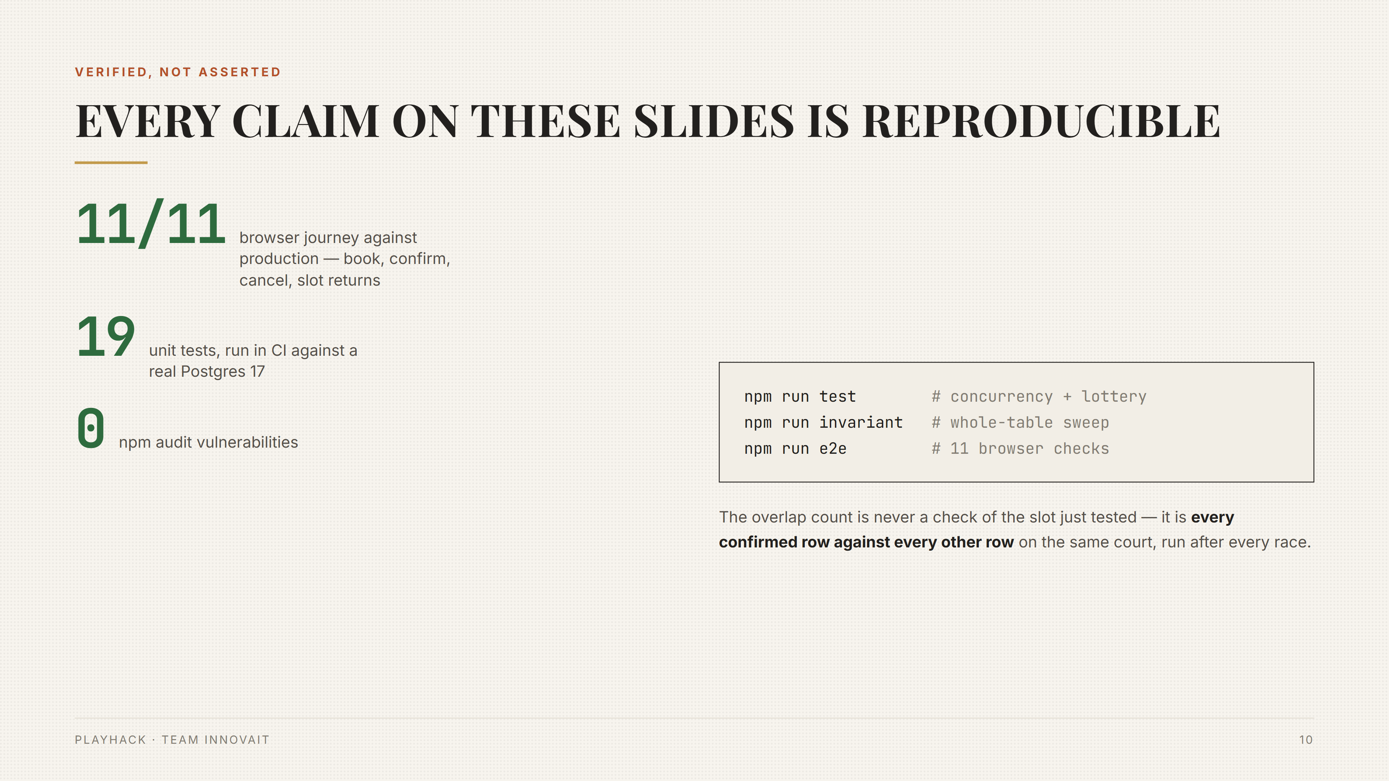

Slide 13
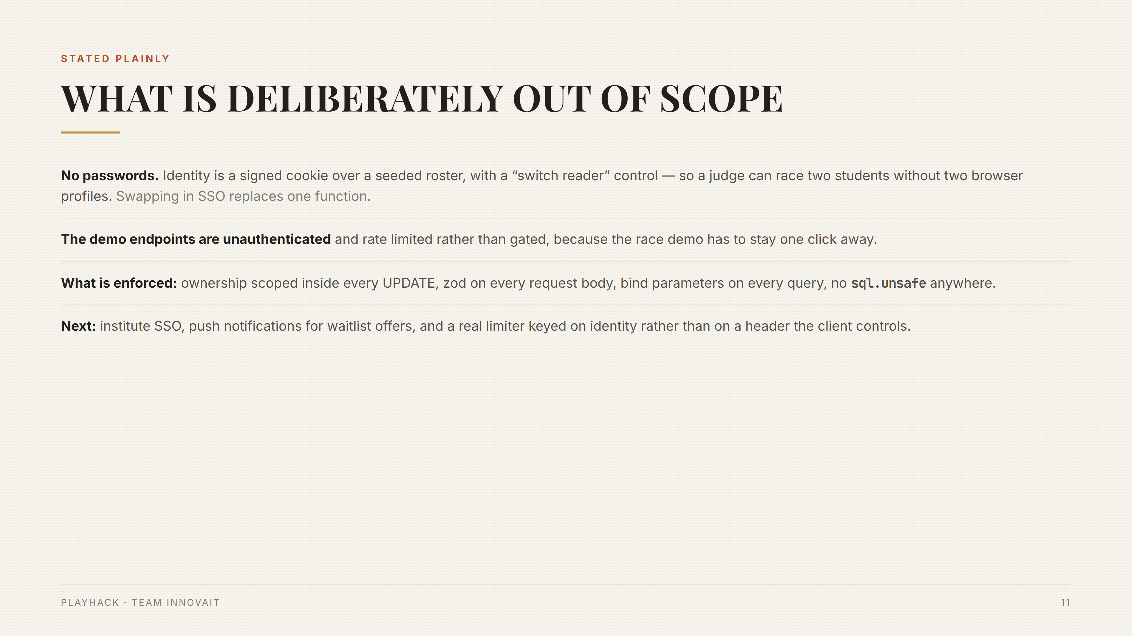

Slide 14
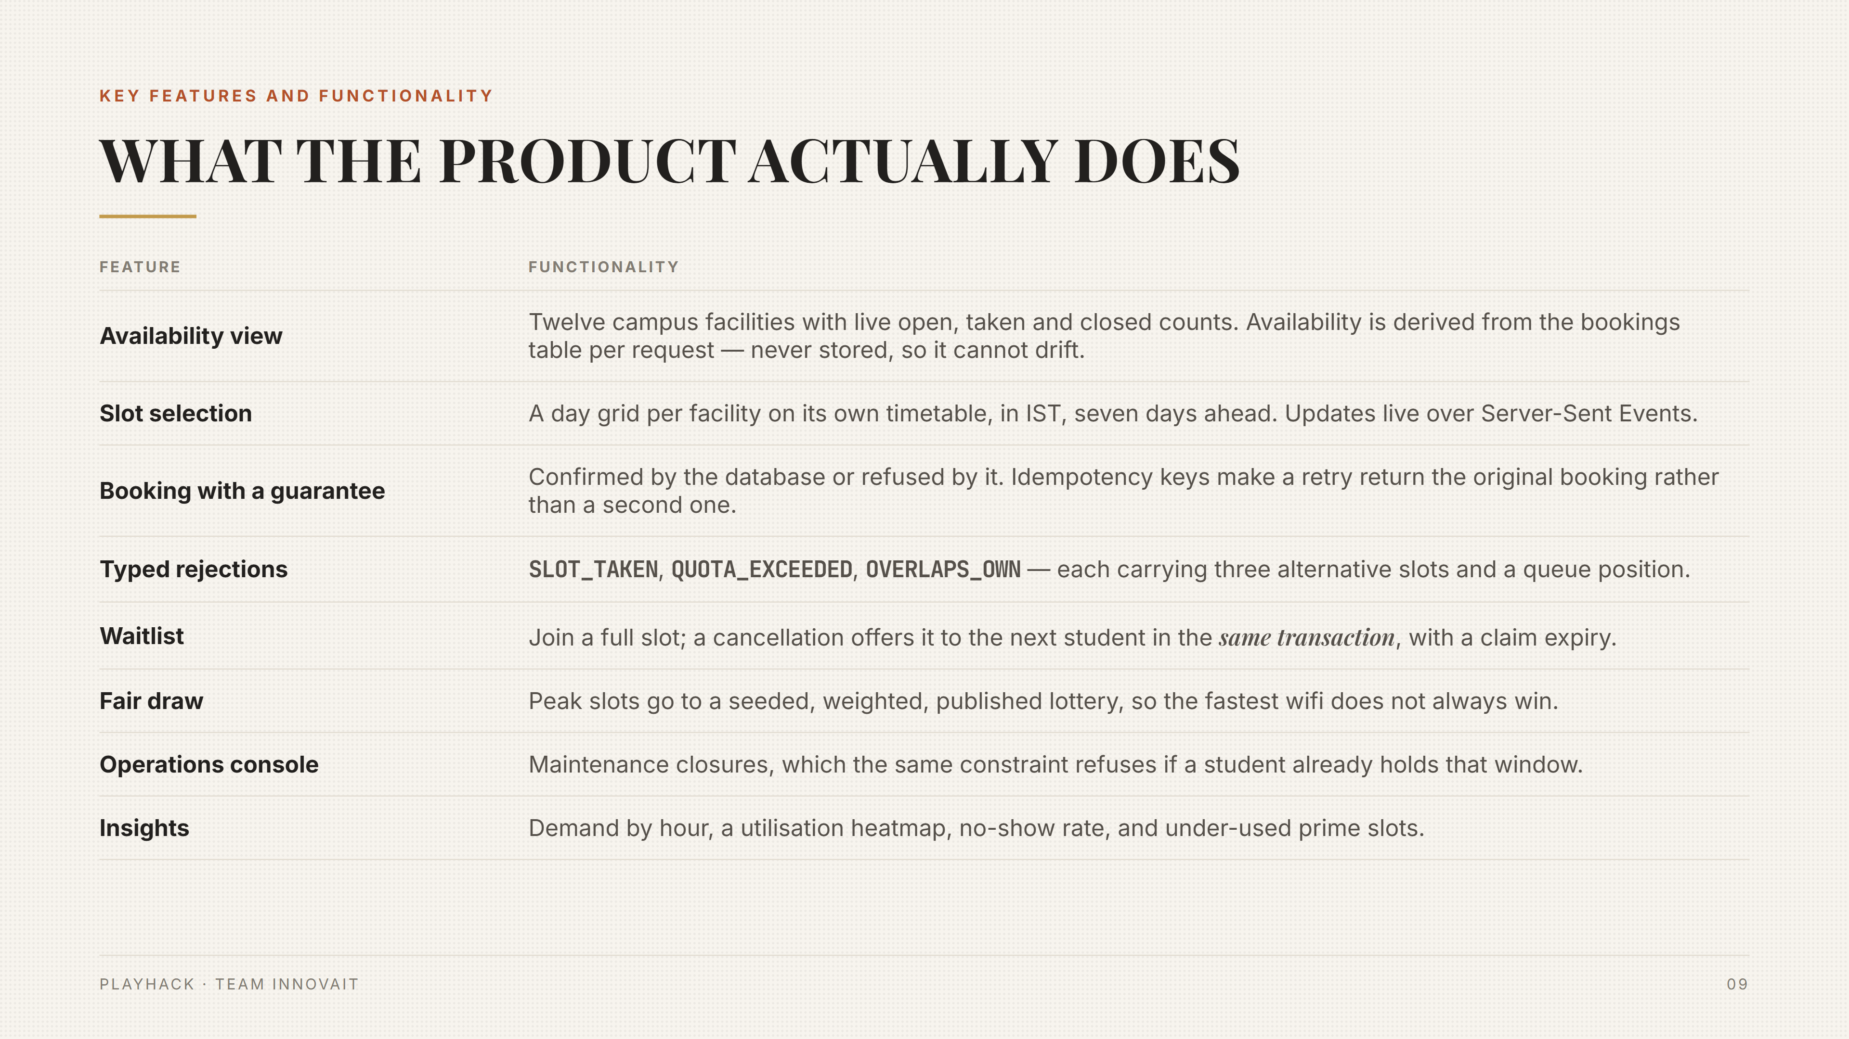

Slide 15
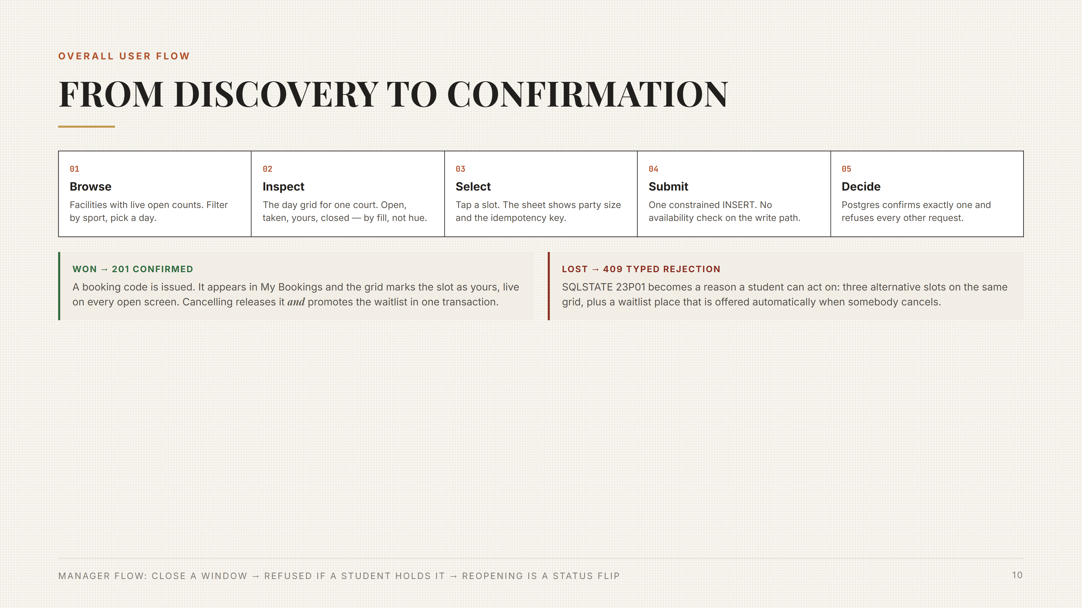

Slide 16
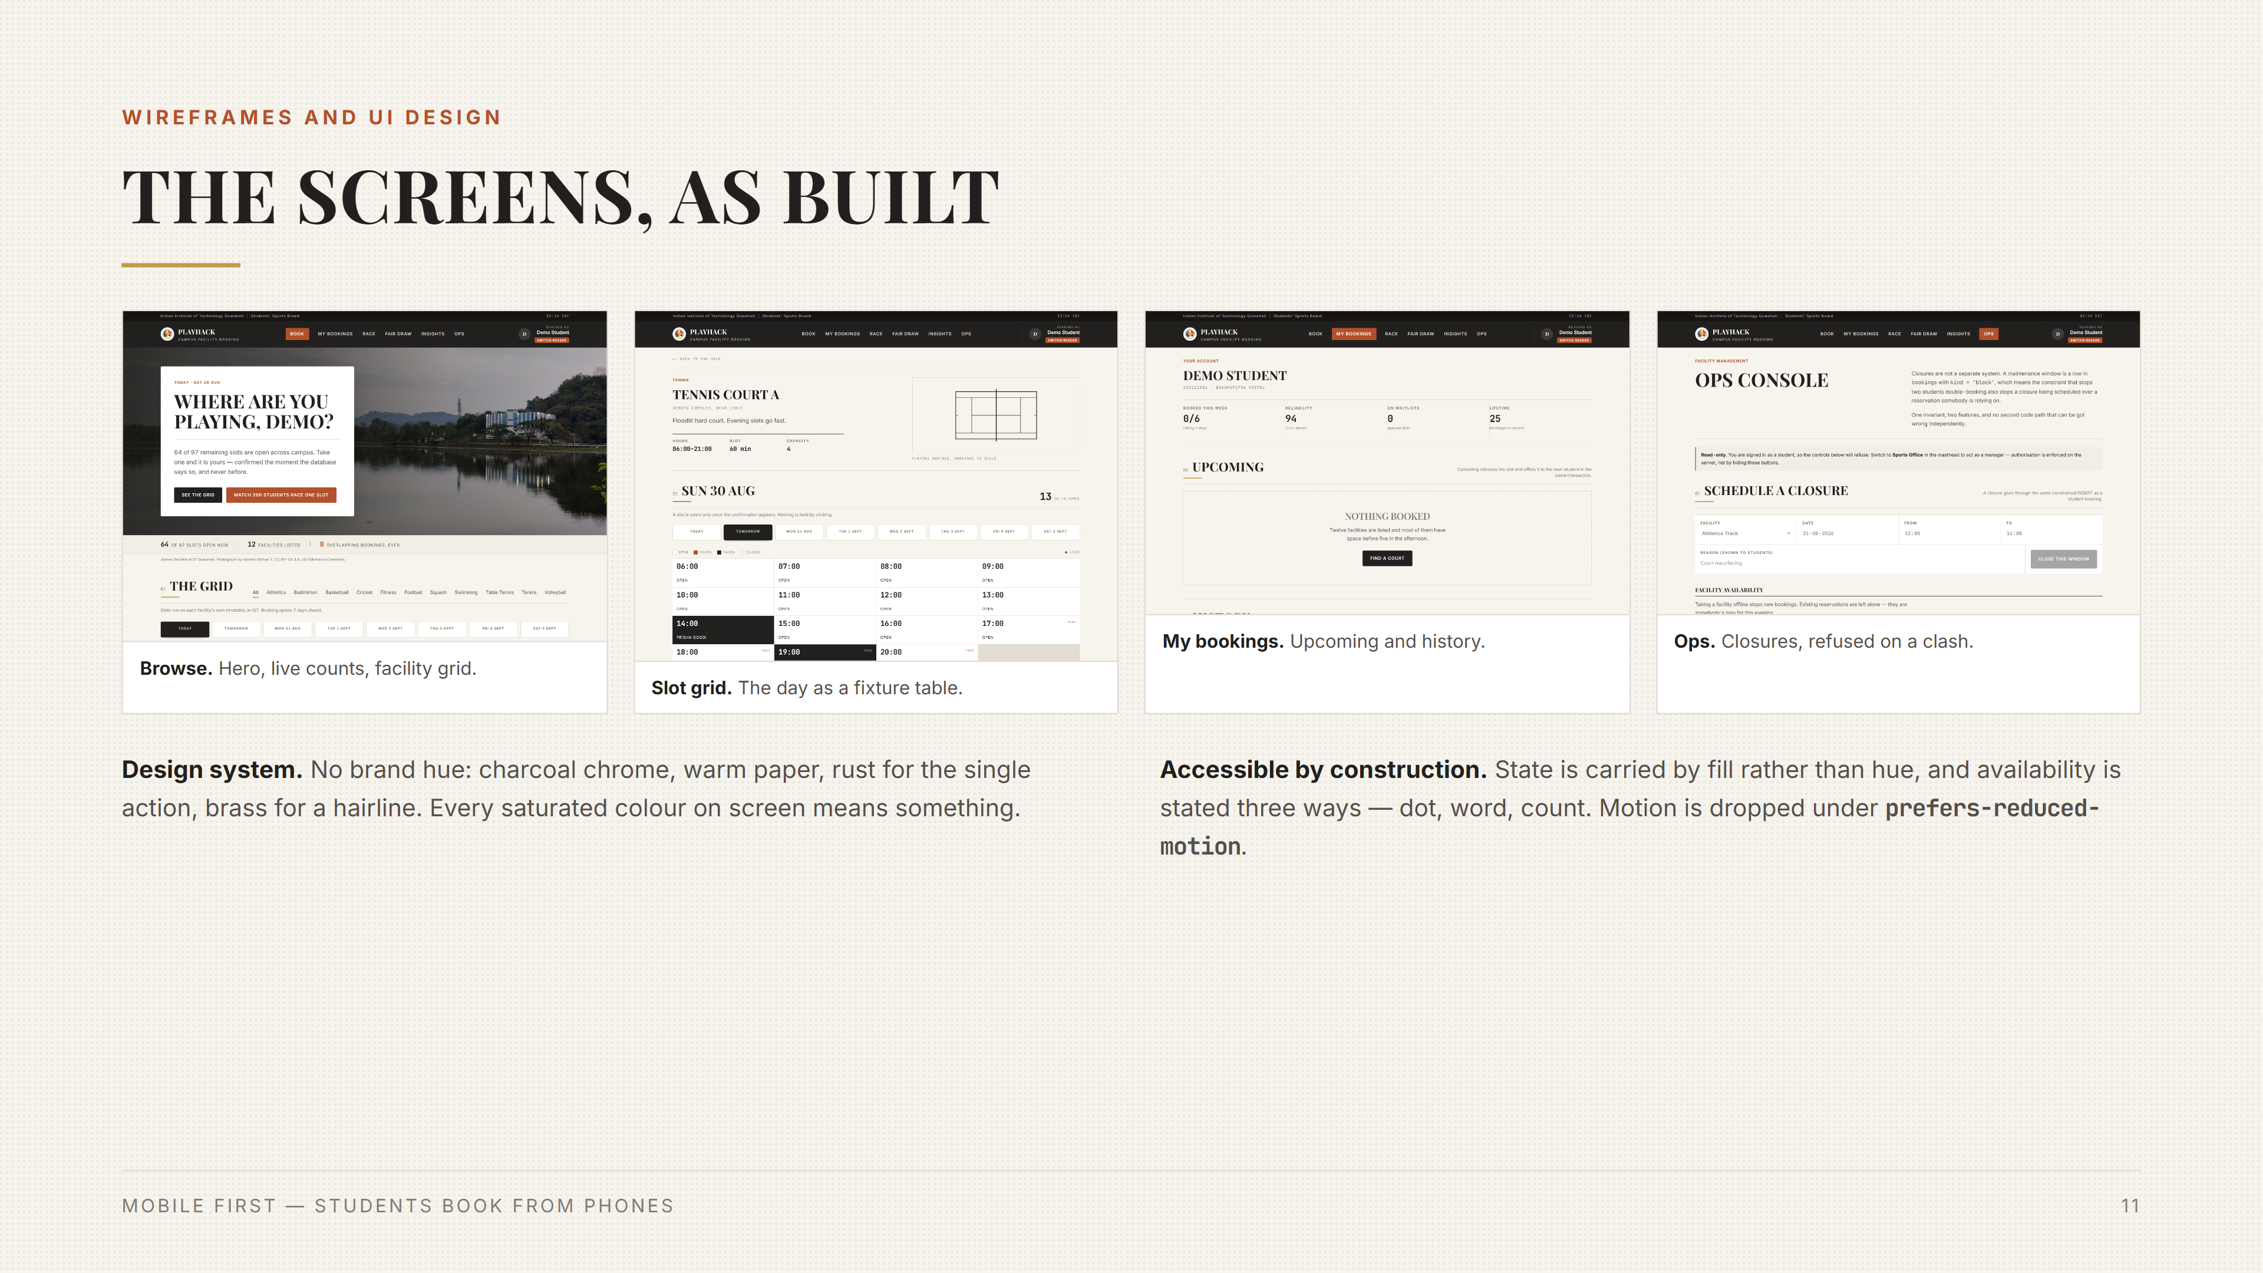

Slide 17
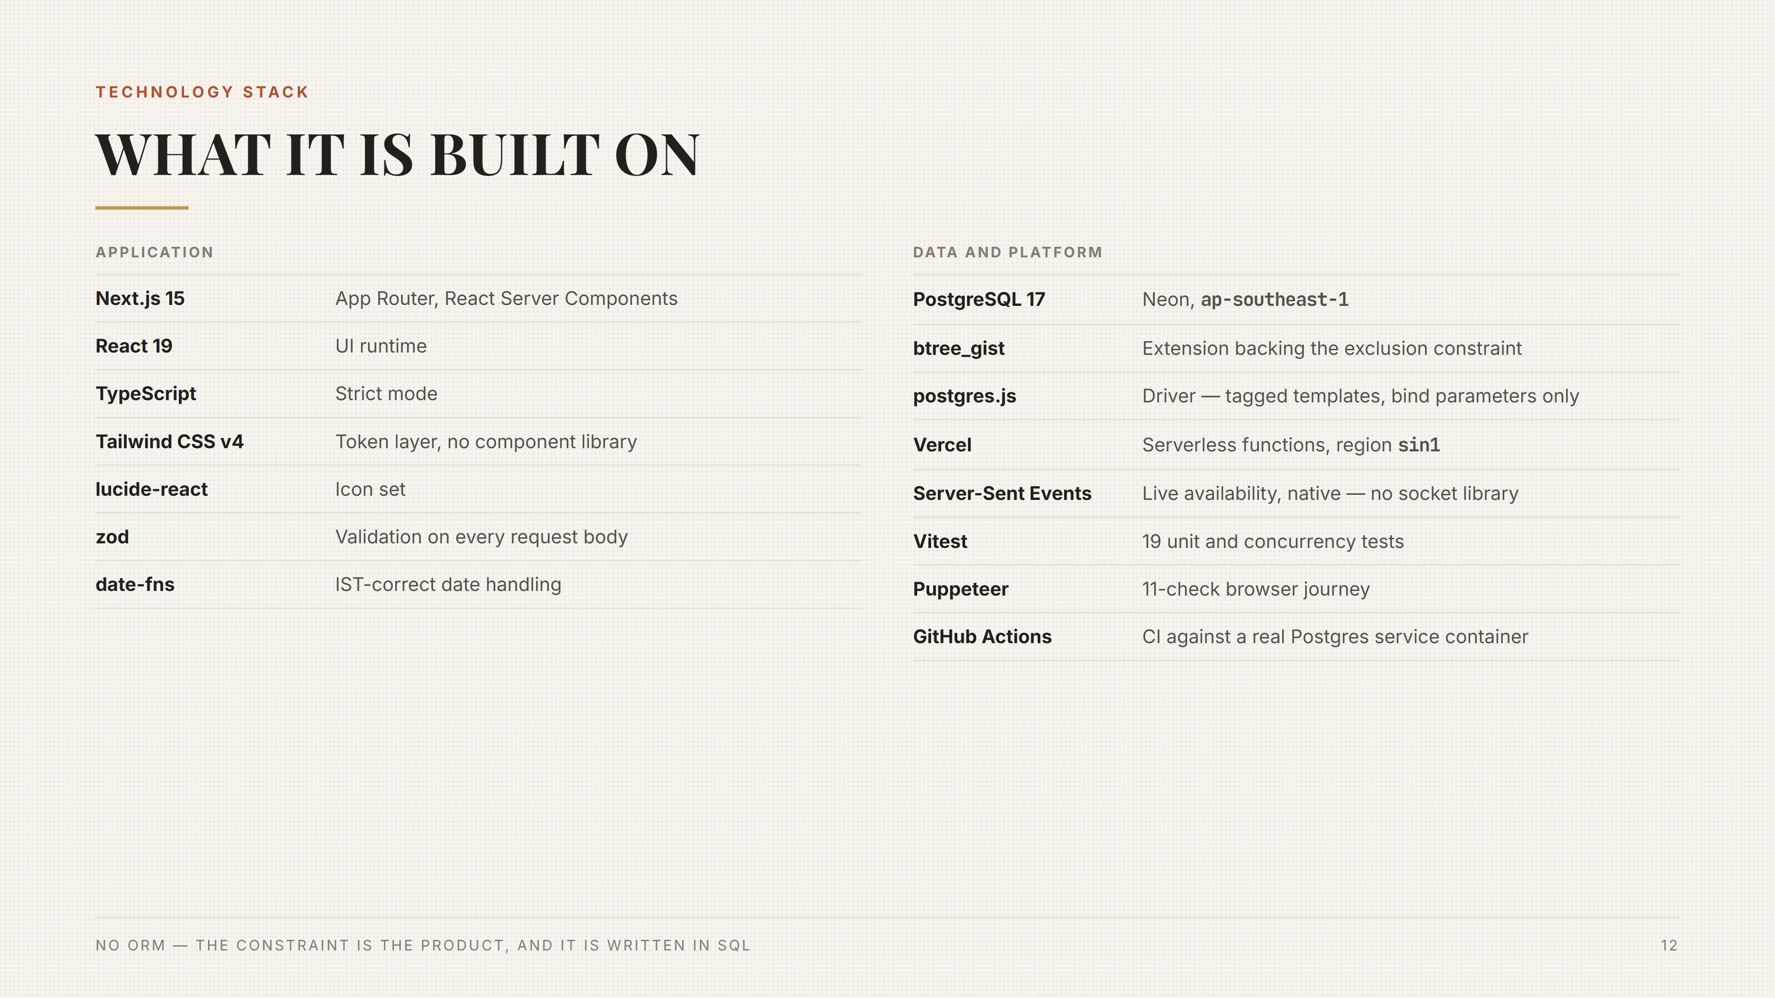

Slide 18
