Slide 1

PLAYHACK · SDE TRACK · IIT GUWAHATI
PLAYHACK
Campus sports facility booking where the winner of a race for one court is decided by Postgres, not by our code.
TEAM INNOVAIT · INNOVAIT-HACKATHON.VERCEL.APP · 0 OVERLAPPING BOOKINGS, EVER

Slide 2
THE PROBLEM, IN THE BRIEF'S OWN WORDS
AT 6 PM, FIFTY STUDENTS WANT THE SAME COURT
"The system must confirm exactly one and reject the rest, without corrupting data."
Almost every booking system answers this the same way — and almost every one of them is wrong.
// the question
const taken = await isSlotTaken(court, slot);
// the answer
if (!taken) await insertBooking(court, slot);
Both lines are individually correct. Between them is a gap — and under load another request commits inside it.
PLAYHACK · TEAM INNOVAIT
02

Slide 3
THE ANSWER
THE WRITE IS THE DECISION
ALTER TABLE bookings ADD CONSTRAINT bookings_no_overlap
EXCLUDE USING gist (facility_id WITH =, during WITH &&)
WHERE (status = 'confirmed');
There is no question and no answer. A booking carries a time range, and the database physically cannot store two overlapping ranges for the same facility. The loser is rejected with SQLSTATE 23P01 before it ever becomes a row — no availability check on the write path, and no application lock on the slot.
PLAYHACK · TEAM INNOVAIT
03

Slide 4
WHY NOT A UNIQUE KEY
PARTIAL OVERLAP IS THE CASE THAT HAPPENS
 | UNIQUE (facility, starts_at) | EXCLUDE … WITH &&
Two bookings at 18:00 | rejected | rejected
18:00–19:00 vs 18:30–19:30 | both stored | rejected
A two-hour closure over four slots | not expressible | one row
Cancelling frees the slot | needs a delete | status flip
A booking from 18:30 does not share a start time with one from 18:00 — but it overlaps it, and overlap is what matters to a student holding a racket.
PLAYHACK · TEAM INNOVAIT
04

Slide 5
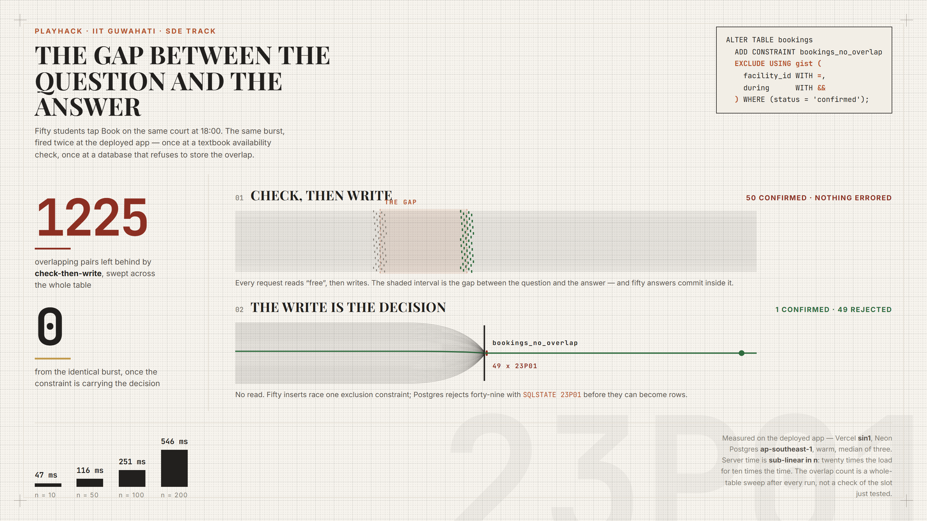

Slide 6
THE SAME BURST, FIRED TWICE AT PRODUCTION
FIFTY REQUESTS. ONE COURT.
CHECK, THEN WRITE
THE WRITE IS THE DECISION
50
1
bookings confirmed. Nothing errored.
confirmed — 49 rejected with SQLSTATE 23P01
1225
0
overlapping pairs, swept across the whole table
overlapping pairs, across 380+ confirmed rows
MEASURED LIVE · NOT SIMULATED
06

Slide 7
MEASURED ON THE DEPLOYED APP
SUB-LINEAR, NOT LINEAR
All contenders attempt the insert at once. One wins; the rest block on its uncommitted row and are released together the moment it commits. Nothing in the write path serialises on n.
Vercel sin1, Neon ap-southeast-1. Median of three warm runs.
Mode | Requests | Server | Confirmed | Overlaps
naive | 50 | 37 ms | 50 | 1225
safe | 10 | 47 ms | 1 | 0
safe | 50 | 116 ms | 1 | 0
safe | 100 | 251 ms | 1 | 0
safe | 200 | 546 ms | 1 | 0
TWENTY TIMES THE LOAD, ABOUT TEN TIMES THE TIME
07

Slide 8
BEYOND "IT DOES NOT DOUBLE-BOOK"
CORRECTNESS IS THE FLOOR
Idempotency keys. A retried submit returns the original booking. A double-tap on hostel wifi is the common case, not the edge case.
Typed rejections. Losing returns SLOT_TAKEN, QUOTA_EXCEEDED or OVERLAPS_OWN — with three alternative slots and a queue position.
Waitlist promotion. Cancelling frees the slot and offers it to the next student in the same transaction — no window where it is free but unowned.
Maintenance closures. A closure is a booking row. One invariant, two features: a manager cannot close a court out from under a confirmed reservation.
Fair draw. Peak slots go to a seeded, weighted, published lottery. First-come-first-served rewards the best wifi, not the keenest player.
PLAYHACK · TEAM INNOVAIT
08

Slide 9
KEY FEATURES AND FUNCTIONALITY
WHAT THE PRODUCT ACTUALLY DOES
Feature | Functionality
Availability view | Twelve facilities with live open, taken and closed counts. Derived from the bookings table per request — never stored, so it cannot drift.
Slot selection | A day grid per facility on its own timetable, in IST, seven days ahead. Live over Server-Sent Events.
Booking guarantee | Confirmed by the database or refused by it. Idempotency keys make a retry return the original booking.
Typed rejections | Each carries a reason, three alternative slots, and a queue position.
Waitlist | A cancellation offers the slot to the next student in the same transaction, with a claim expiry.
Fair draw | Peak slots go to a seeded, weighted, published lottery.
Operations console | Maintenance closures, refused by the same constraint if a student holds that window.
Insights | Demand by hour, utilisation heatmap, no-show rate, under-used prime slots.
PLAYHACK · TEAM INNOVAIT
09

Slide 10
OVERALL USER FLOW
FROM DISCOVERY TO CONFIRMATION
01
02
03
04
05
Browse
Inspect
Select
Submit
Decide
Facilities with live open counts. Filter by sport, pick a day.
The day grid for one court: open, taken, yours, closed.
Tap a slot. The sheet shows party size and the idempotency key.
One constrained INSERT. No availability check on the write path.
Postgres confirms exactly one and refuses every other request.
WON → 201 CONFIRMED
LOST → 409 TYPED REJECTION
A booking code is issued. It appears in My Bookings and the grid marks the slot as yours, live on every open screen. Cancelling releases it and promotes the waitlist in one transaction.
SQLSTATE 23P01 becomes a reason a student can act on: three alternative slots on the same grid, plus a waitlist place offered automatically when somebody cancels.
MANAGER FLOW: CLOSE A WINDOW → REFUSED IF A STUDENT HOLDS IT → REOPENING IS A STATUS FLIP
10

Slide 11
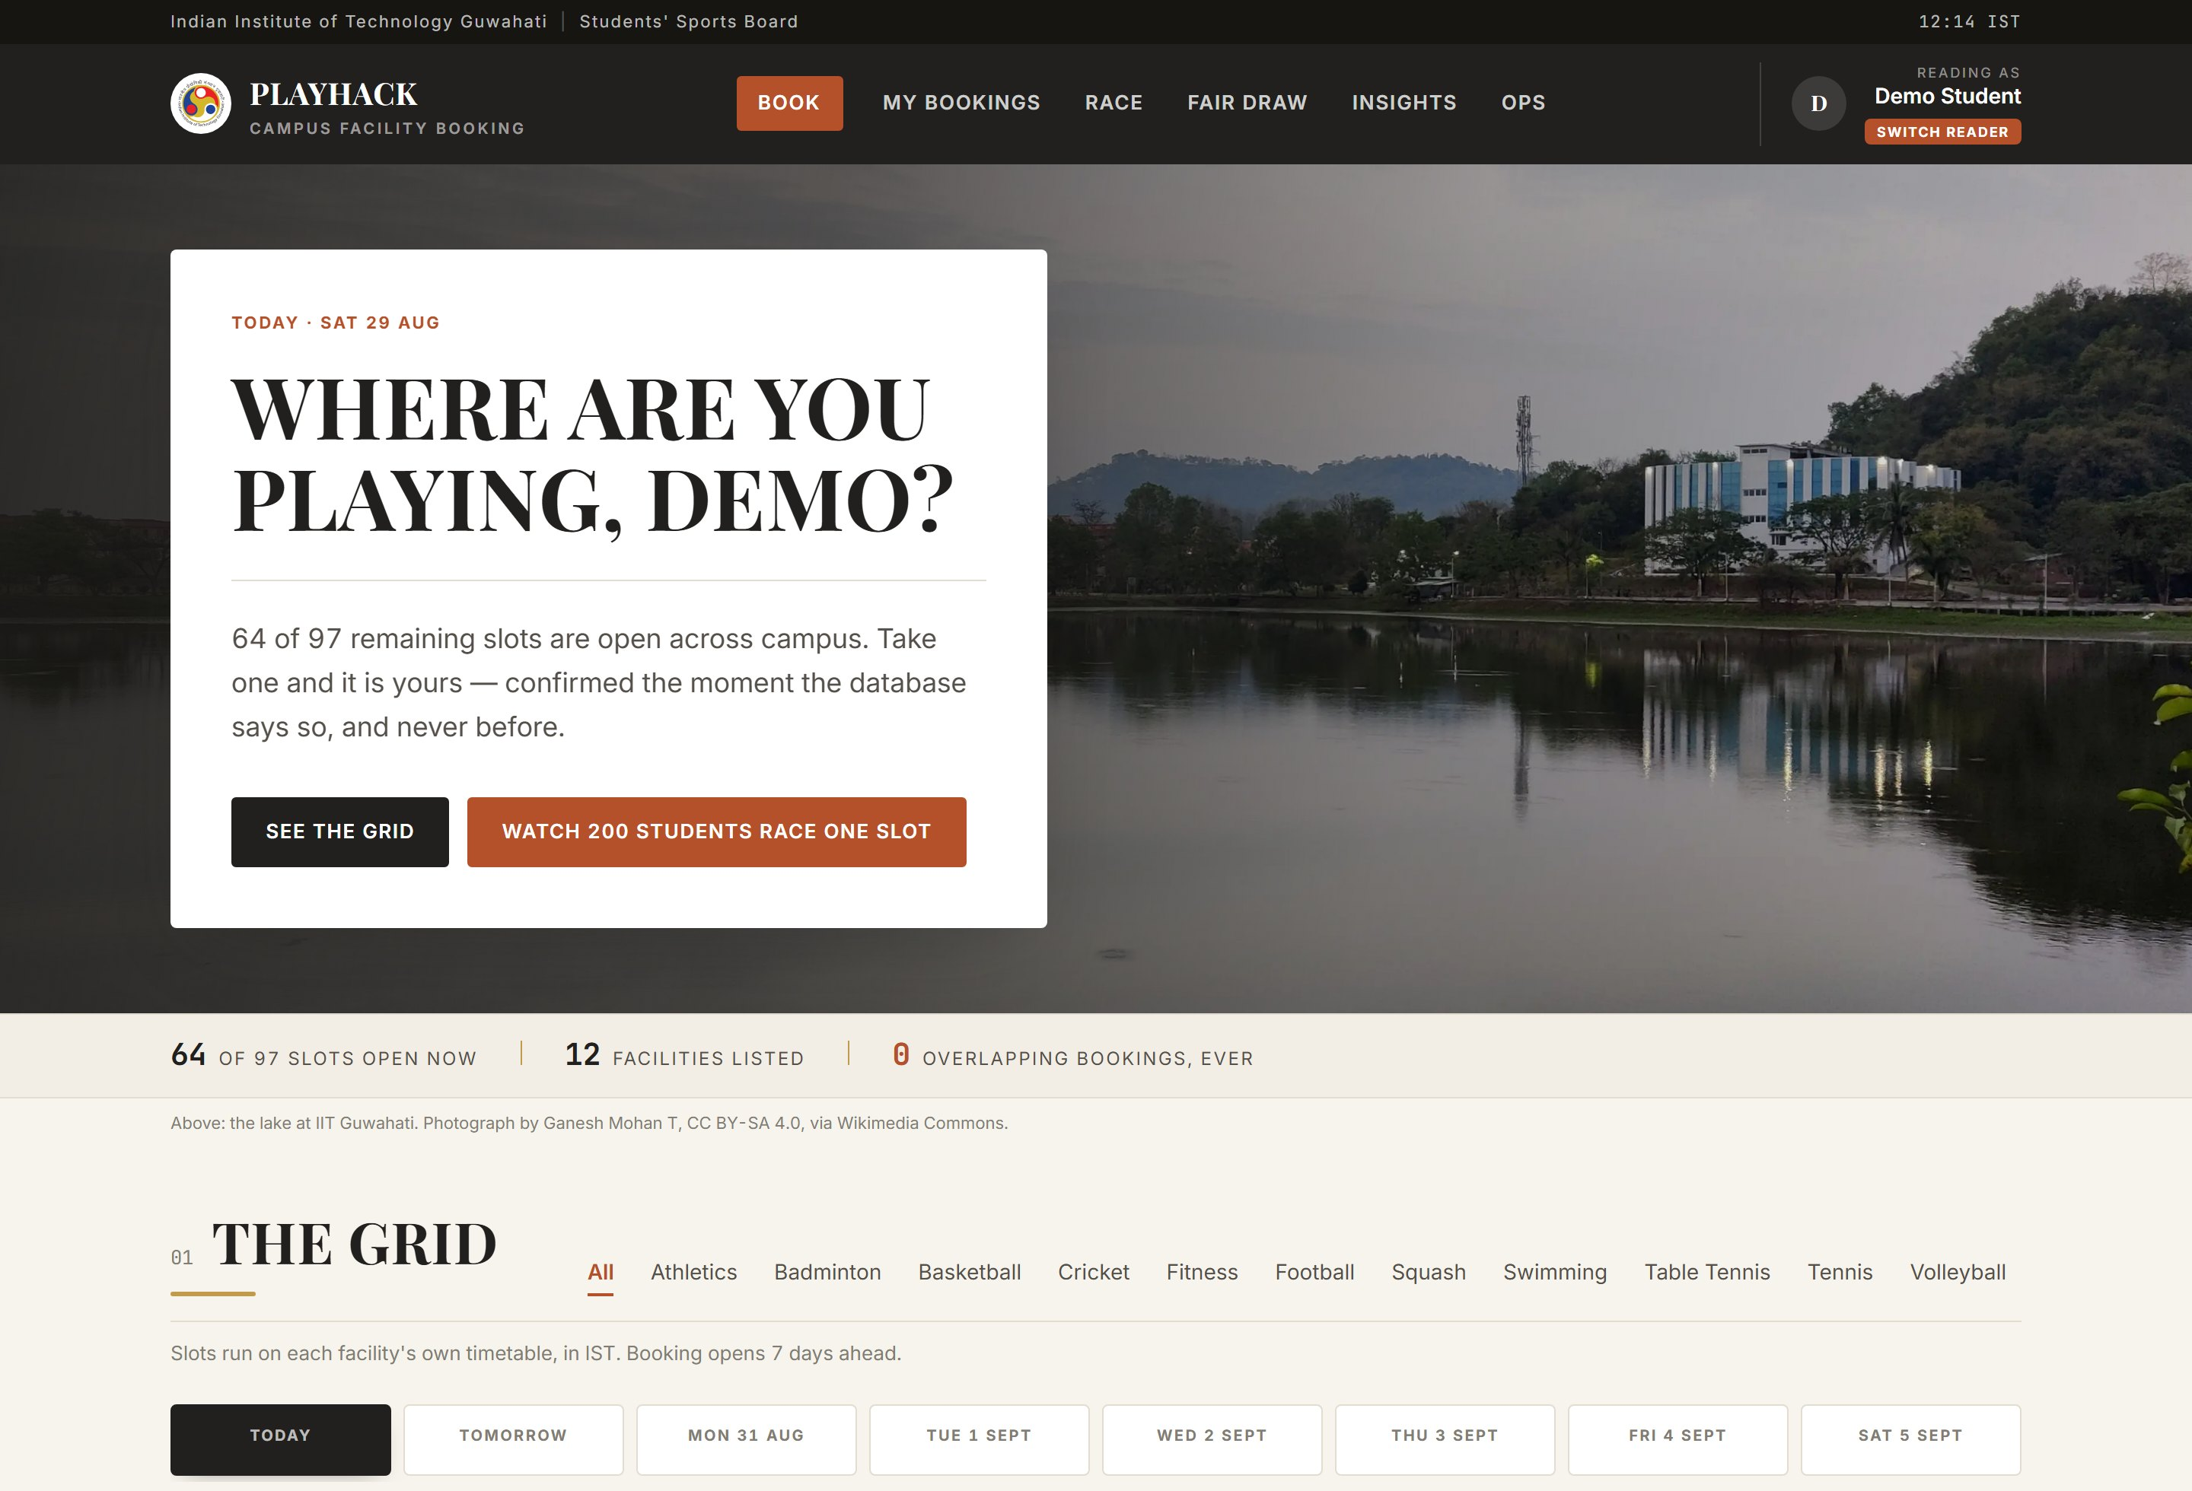
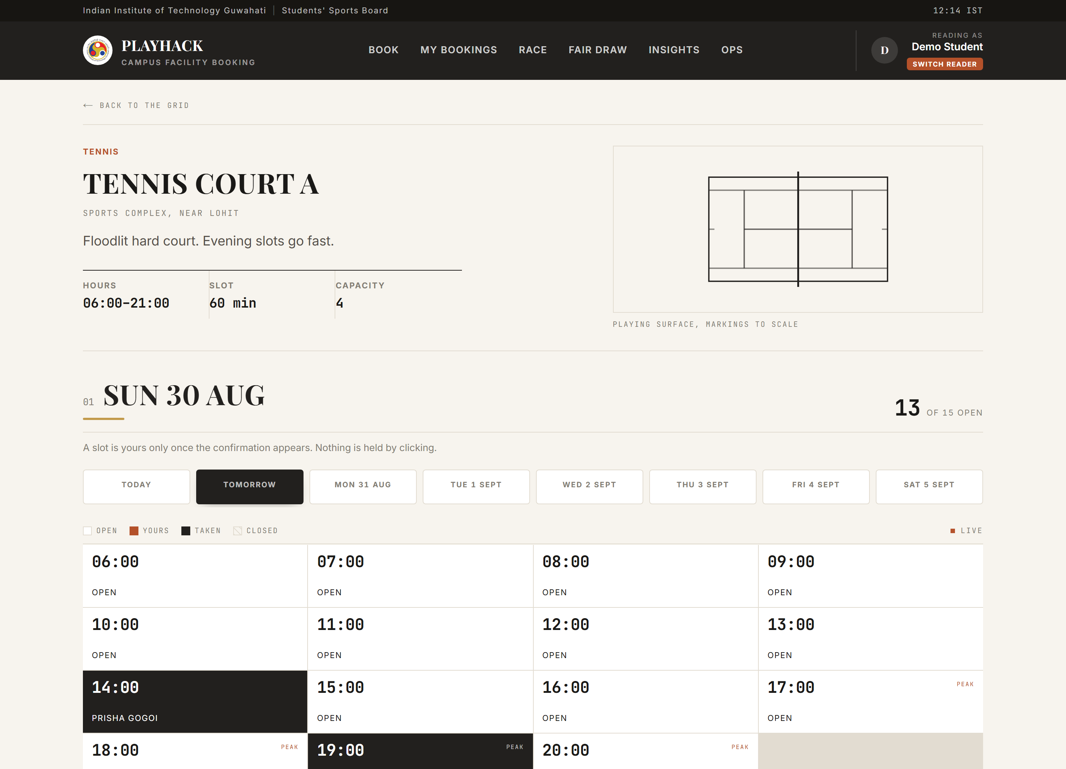
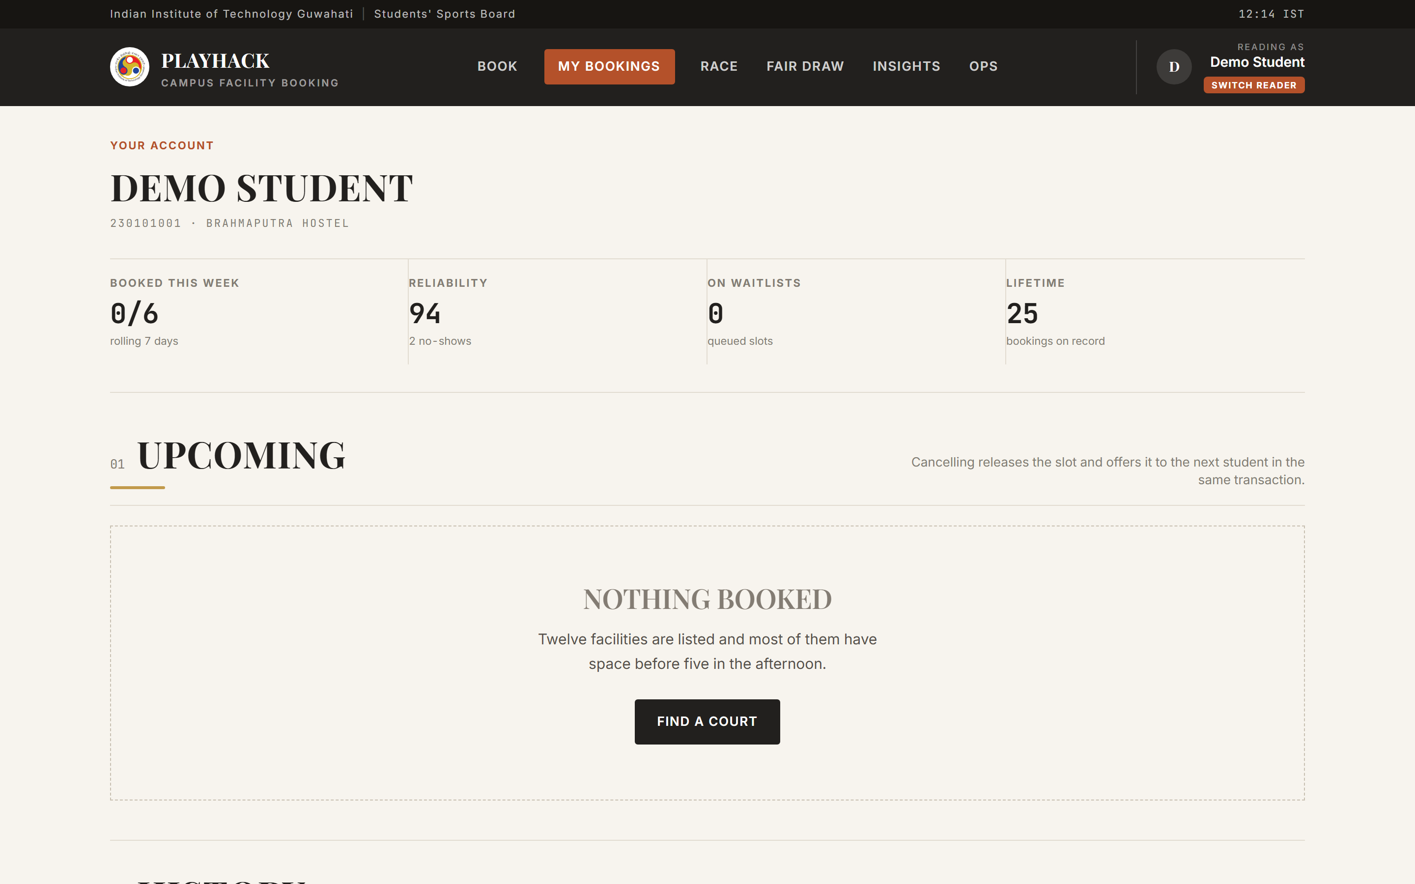
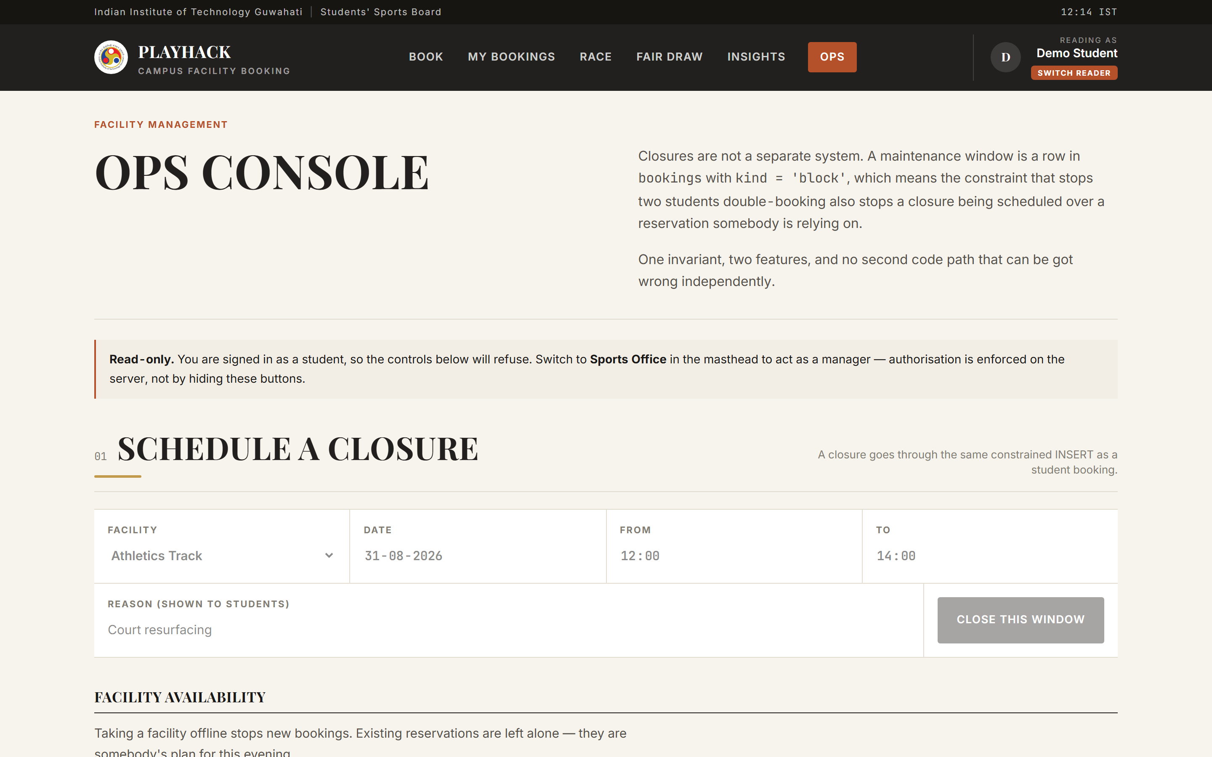
WIREFRAMES AND UI DESIGN
THE SCREENS, AS BUILT
Browse. Hero, live counts, facility grid.
Slot grid. The day as a fixture table.
My bookings. Upcoming and history.
Ops. Closures, refused on a clash.
Design system. No brand hue: charcoal chrome, warm paper, rust for the single action, brass for a hairline. Every saturated colour on screen means something.
Accessible by construction. State is carried by fill rather than hue, and availability is stated three ways — dot, word, count. Motion is dropped under prefers-reduced-motion.
MOBILE FIRST — STUDENTS BOOK FROM PHONES
11

Slide 12
TECHNOLOGY STACK
WHAT IT IS BUILT ON
Application
Next.js 15 | App Router, React Server Components
React 19 | UI runtime
TypeScript | Strict mode
Tailwind CSS v4 | Token layer, no component library
zod | Validation on every request body
lucide-react / date-fns | Icons; IST-correct date handling
NO ORM — THE CONSTRAINT IS THE PRODUCT, AND IT IS WRITTEN IN SQL
12
Data and platform
PostgreSQL 17 | Neon, ap-southeast-1
btree_gist | Extension backing the exclusion constraint
postgres.js | Driver — tagged templates, bind parameters
Vercel | Serverless functions, region sin1
Server-Sent Events | Live availability, native
Vitest / Puppeteer / CI | 19 unit tests, 11 browser checks, real Postgres

Slide 13
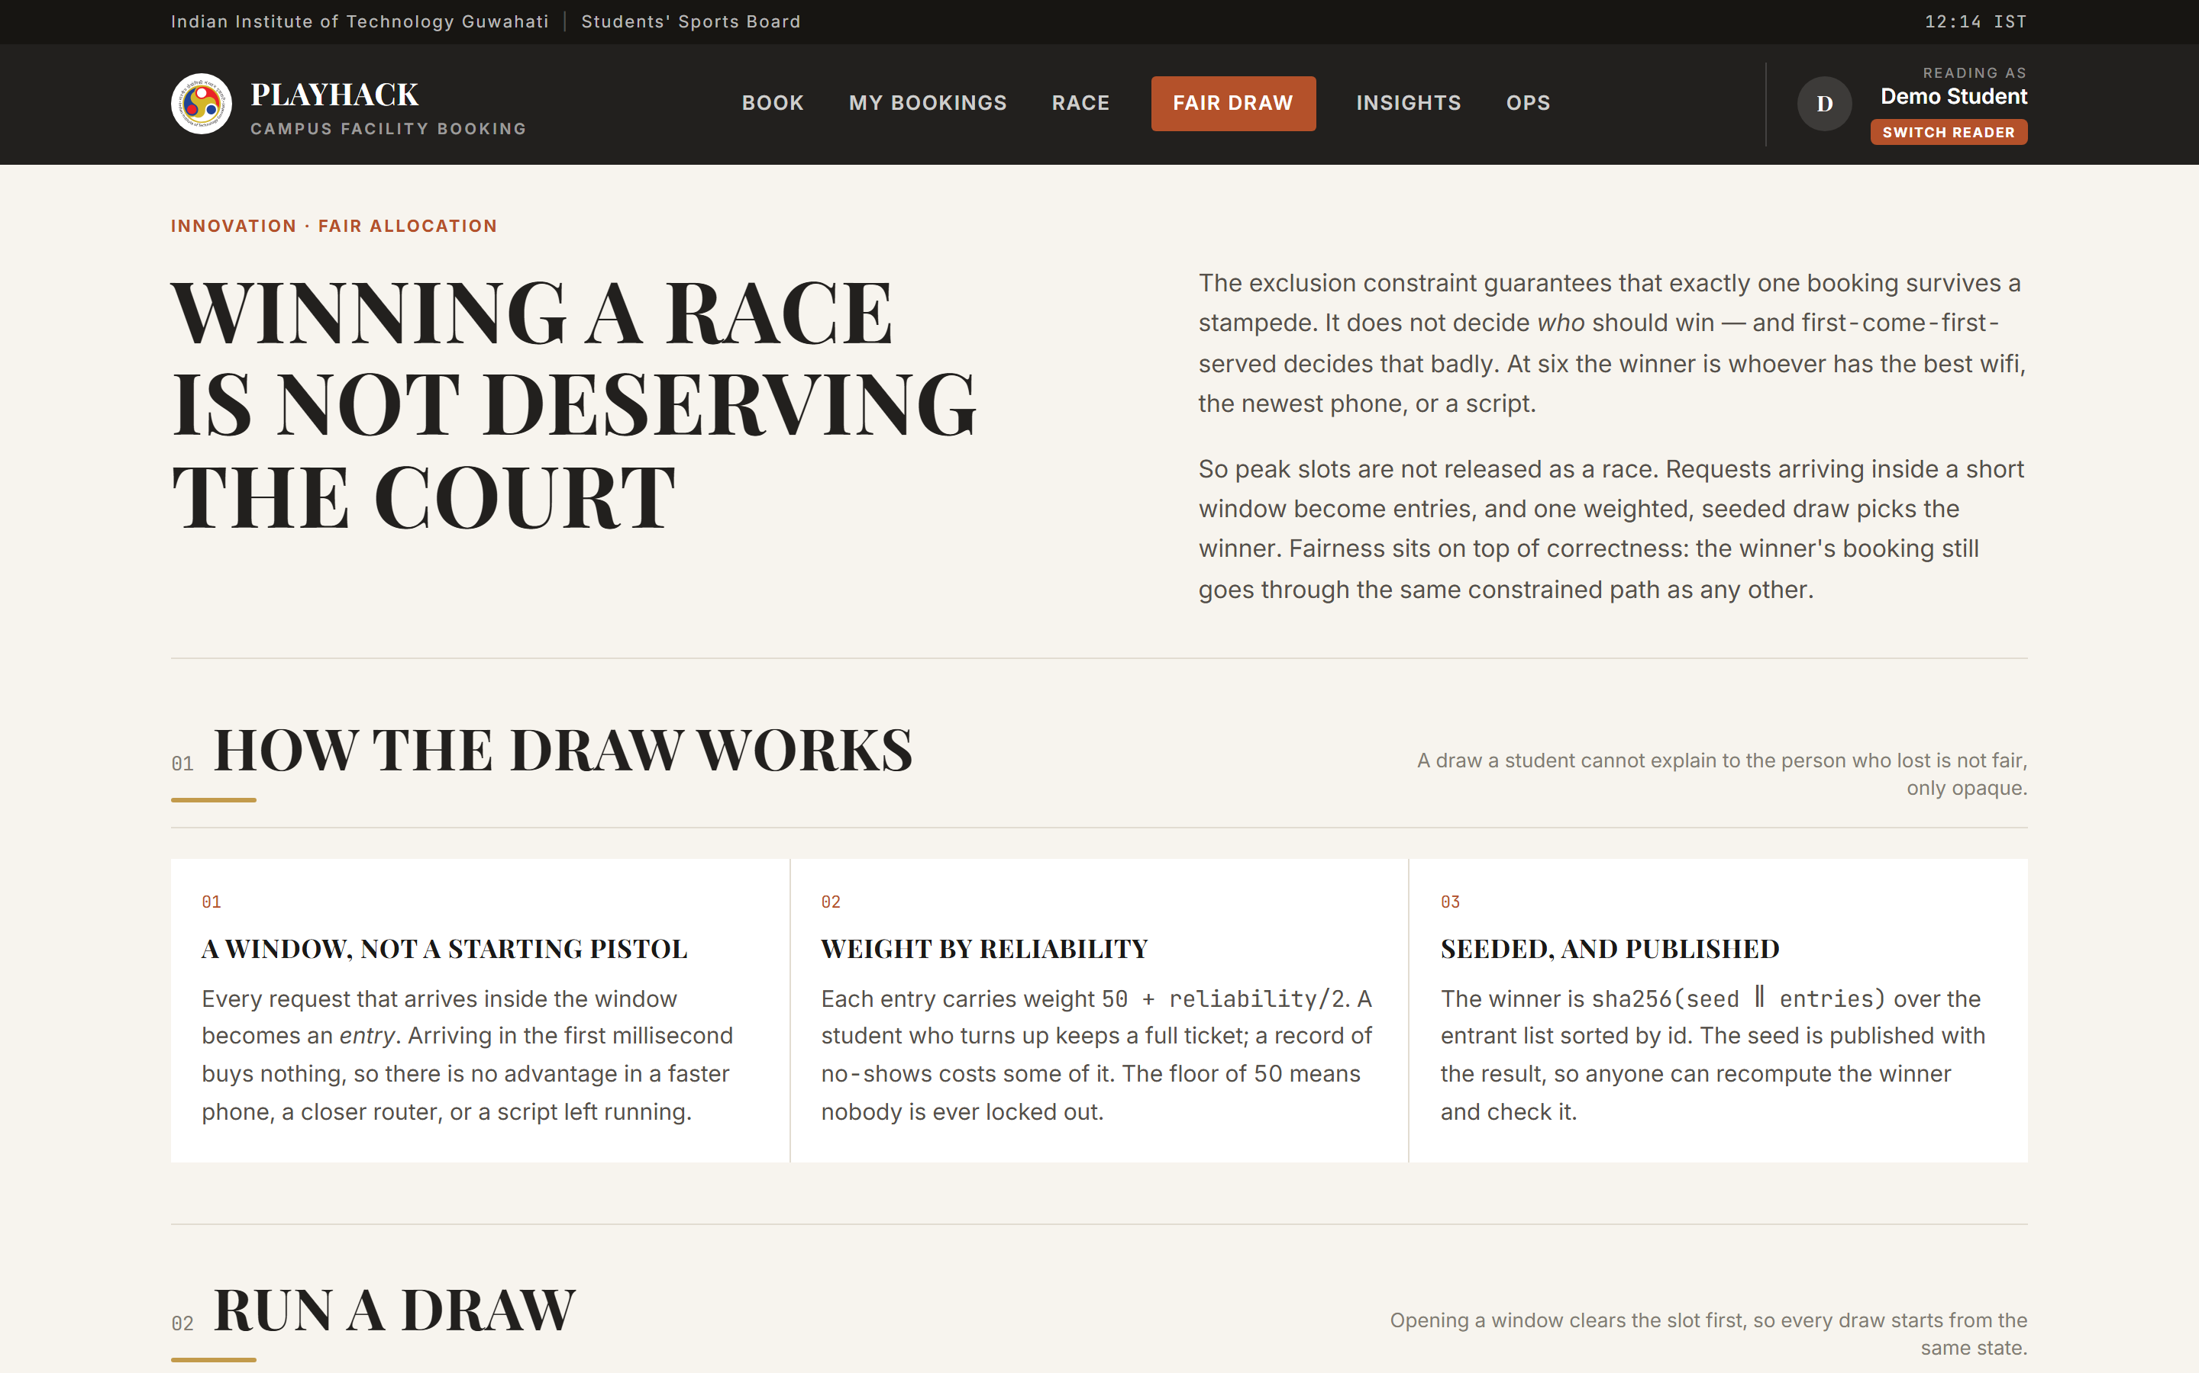
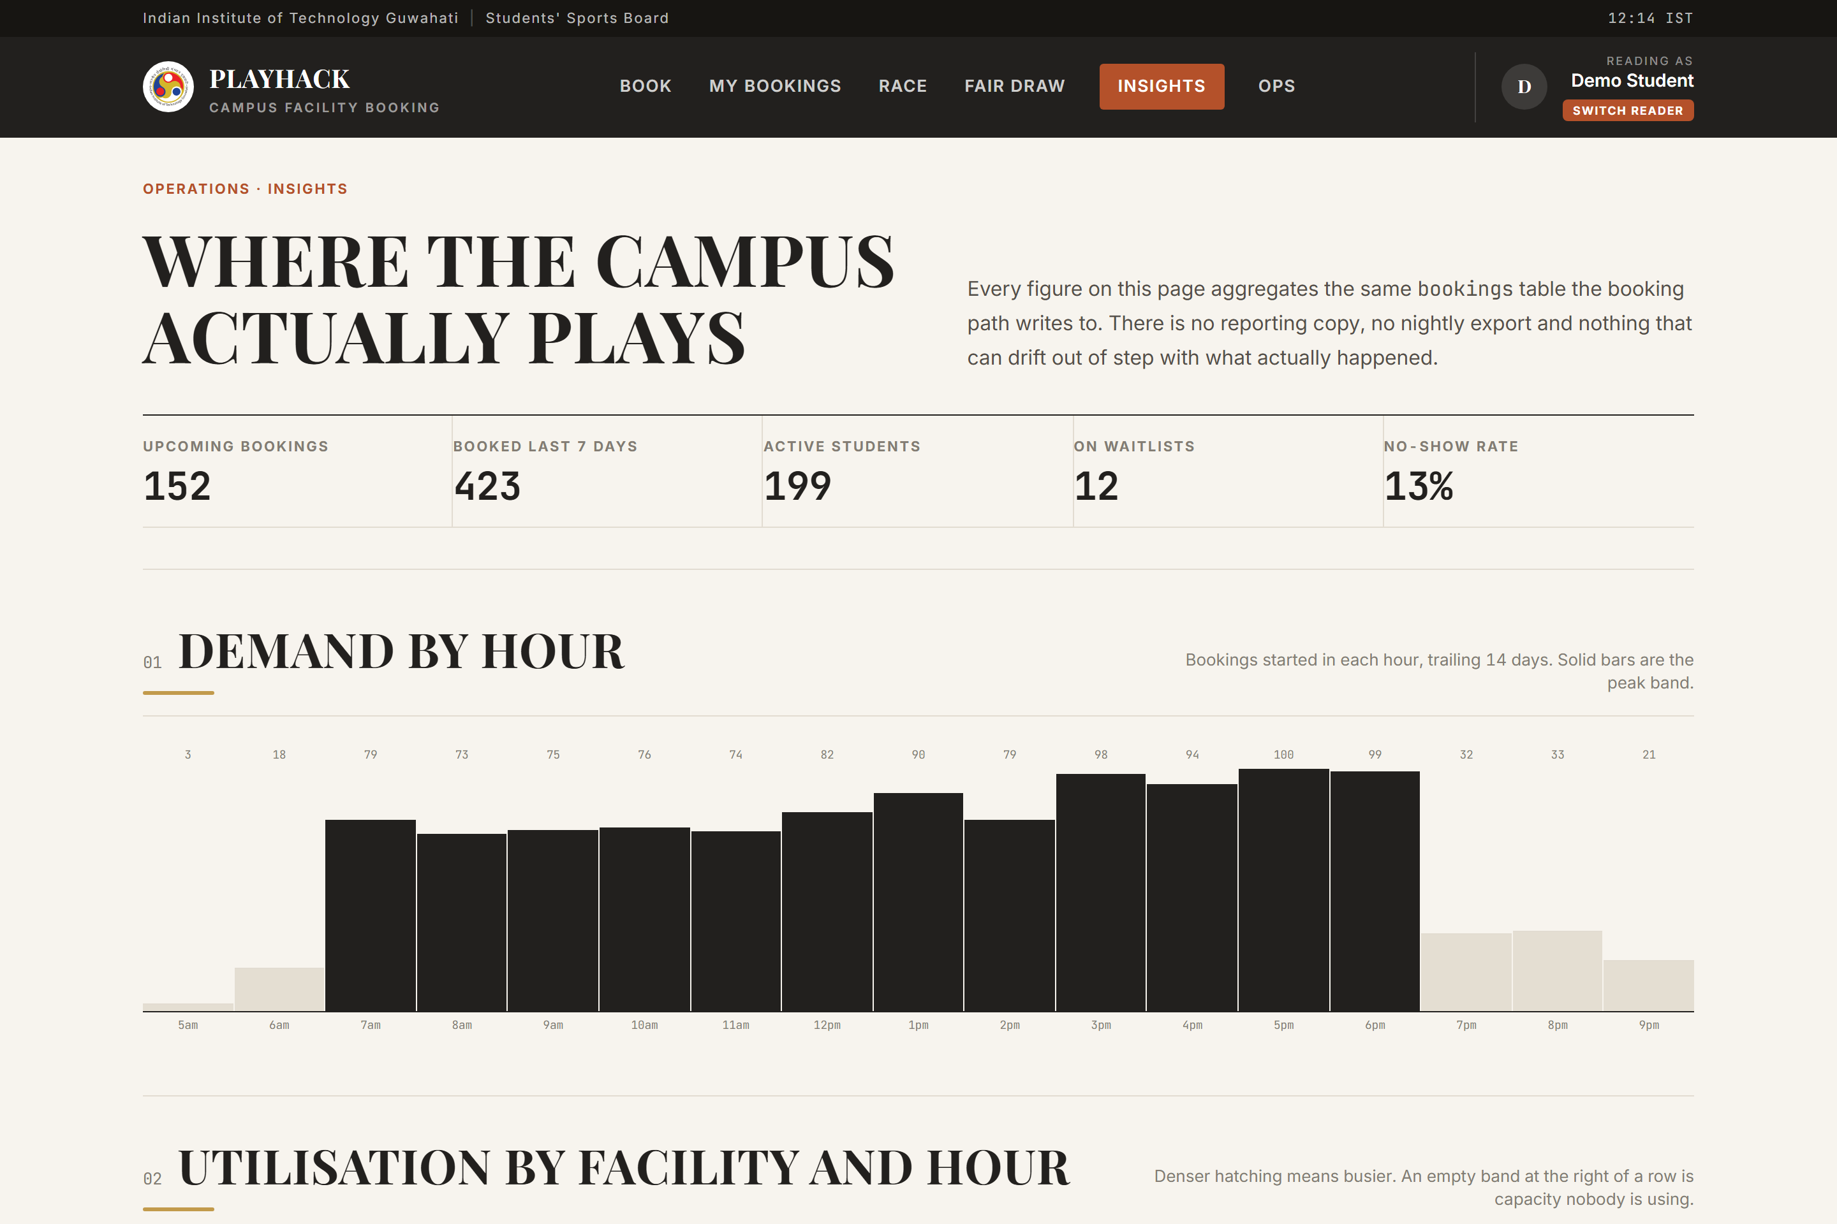
THE PRODUCT
BUILT FOR A STUDENT ON A PHONE AT 5:58 PM
Booking. The day as a fixture table, live over SSE.
Fair draw. Rules and seed published before the draw.
Insights. Aggregated from the booking table itself.
TWELVE FACILITIES · AVAILABILITY DERIVED, NEVER STORED
13

Slide 14
VERIFIED, NOT ASSERTED
EVERY CLAIM IS REPRODUCIBLE
11/11
npm run test # concurrency + lottery
npm run invariant # whole-table sweep
npm run e2e # 11 browser checks
browser journey against production — book, confirm, cancel, slot returns
19
The overlap count is never a check of the slot just tested — it is every confirmed row against every other row on the same court, run after every race.
unit tests, run in CI against a real Postgres 17
0
npm audit vulnerabilities
PLAYHACK · TEAM INNOVAIT
14

Slide 15
STATED PLAINLY
WHAT IS DELIBERATELY OUT OF SCOPE
No passwords. Identity is a signed cookie over a seeded roster with a switch-reader control, so a judge can race two students without two browser profiles. Swapping in SSO replaces one function.
The demo endpoints are unauthenticated and rate limited rather than gated, because the race demo has to stay one click away.
What is enforced: ownership scoped inside every UPDATE, zod on every request body, bind parameters on every query, no sql.unsafe anywhere.
Next: institute SSO, push notifications for waitlist offers, and a rate limiter keyed on identity rather than on a header the client controls.
PLAYHACK · TEAM INNOVAIT
15

Slide 16
ONE PLATFORM. ZERO CLASHES.
Fifty students. One court. One winner.
Run the race yourself — the burst is fired at a real Postgres table through a real HTTP endpoint, and the whole table is swept afterwards.
innovait-hackathon.vercel.app/race
TEAM INNOVAIT · PLAYHACK SDE TRACK

