Slide 1
어드밴텍
AIoT Developer Innoworks
공모전 예선 제안서
Team name

Slide 2

Summary
Name of Work | Golden Touch System
Application | Golden Touch System
Features & Summary on Solutions | Provide location of residents and How to act in case of fire
Name of Team | Kiwi
Personal information | Team leader | Chang Hyungpil
 | Staff member | Seo Younseok
 | Staff member | Yun Taeil
 | Staff member | Lee Minyoung

Slide 3
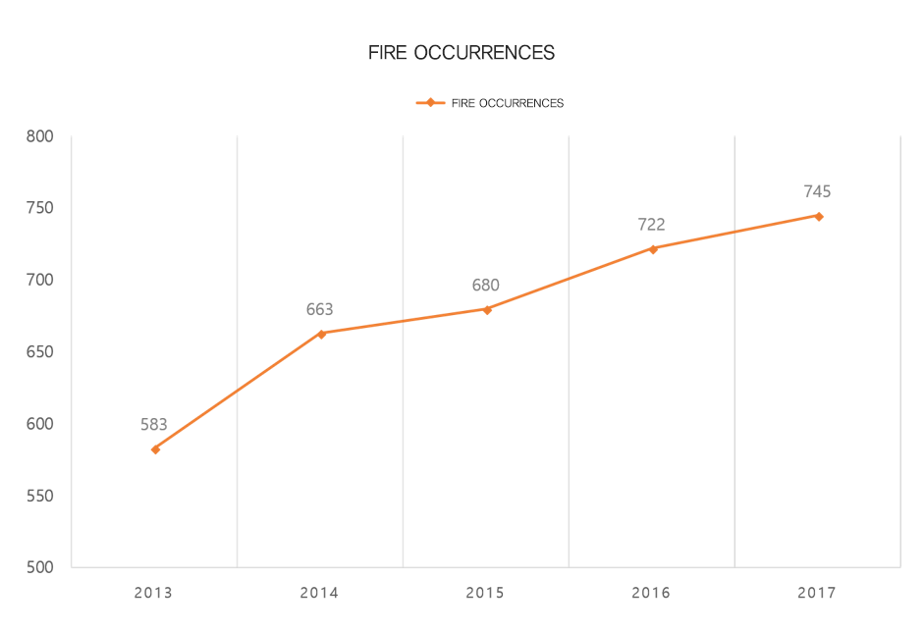
Solution Idea
＂Provide location of residents and
How to act in case of fire “
In case of fire, Unable to determine the number of people in the room and an unskilled action
▶ 2013 ~ 2017 Number od fire
▶ Intention of the plan
location of the occupants can be real-time and put out the fire
1
-In case of fire, reduced additional damage due to unable to number of occupants
In case of fire, provide how to act
2
Lotte World Tower (123floor, 555m)
Fire escape training was conducted, but it took about an hour.
- Panic situation due to lack of knowhow and emergency situation in case of fire

Slide 4
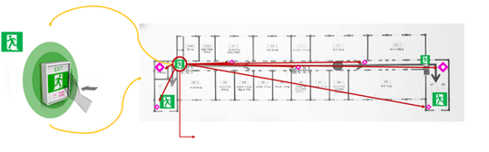

Solution Idea
▶ Using Golden Touch
Provide Residents Location at Server
In case of fire, provide how to act as voice
1
2
▶ Using DashBoard
Find Residents location at realtime
We start saving lives from the fire layer.
If, in advance,
can figure out how many people were there.
I think it'll help us a little bit more.
Interview with Seongbuk fireman (2019.01.14)
1
After fire, reduced additional human damage
2
Possible to Quick Fire Suppression
3

Slide 5
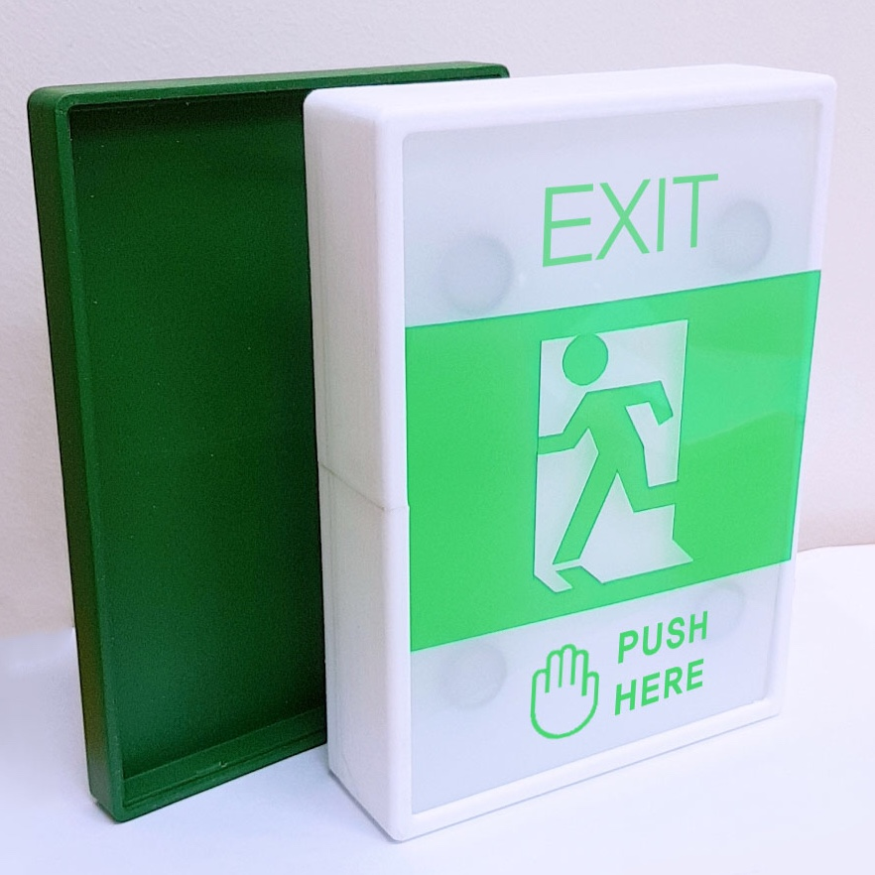


Solution Idea
Main Function of Golden Touch System
▶ Shape of Golden touch
Main
function
In case of fire, occupant detecting
- occupant detecting by deep-learning
Transmission occupants location
-Send the location of the occupant and the location of the fire to the fireman
Wireless RF communication
- Between Golden touch and manager’s dashboard
How to act in case of fire
- Provide the most appropriate fire action to left behind occupant
Use emergency power
- Install the MCU on the existing emergency light.
Dashboard for manager
- Role to show the dashboard where the fire occurred
▶ Using WISE-PaaS
▶ Using RFID module

Slide 6




App Development Plan
App Basic Function
WISE PaaS SCADA
Provide how to act, until rescure
Display data to dashboard
Monitoring fire detection with stored
video information
IoT module maintenance
IoT module
WISE PaaS CNC
Camera sensor / fire detection through deeplearing
Accurate fire detection process by using deeplearing
RFID communication / Save Golden Touch Information in RFID Card
Pressure sensor / DB transmission of the location of the occupant stored on the RFID card
speaker / in case of fire provide how to act
IoT network / data transmisson to DB
Check Golden touch Status
Operation count record
Preparation of a preliminary management report

Slide 7
Go Together,
We Go Far and Grow Big

