Slide 1


Comprehensive Analysis for Social Buzz

Slide 2


Today's agenda
Project recap
Problem
The Analytics team
Process
Insights
Summary

Slide 3

Project Recap
Social Buzz is a social media company that has been running for over 5 years now with nearly 500 million active users.
Planning to complete IPO by the end of next year.
Being a small company, they don’t have access to resources to manage the extensive data.

Slide 4

Problem
Social Buzz is unable to categorize the best top 5 categories due to massive data set traffic, which is unstructured in nature.
They don’t have any better tools to handle the problems or to manage the data.

Slide 5
Andrew Fleming
(Chief Technical Architect)
The Analytics team
Marcus Rompton
(Senior Principle)
Sahil C Dhiman
(Data Analyst)

Slide 6
Referred to elicit documents to understand the underlying problems.
Process
1
Collected the provided data and identified some flaws; performed data cleaning
2
Data modeling and Data analysis
3
Identified the top 5 categories of content grouped by their respective scores
4

Slide 7

Insights
Based on research and analysis, the familiar trendline follows is that the sum exists between 50000 – 60000 scores for each category.
It is interesting to see cooking and travel content have nearly 59174 and 59358 scores respectively which is more than the contents like studying
Nevertheless, Categories like Animals, science, healthy eating, technology and food made their mark under top category following descending order mentioned above.

Slide 8
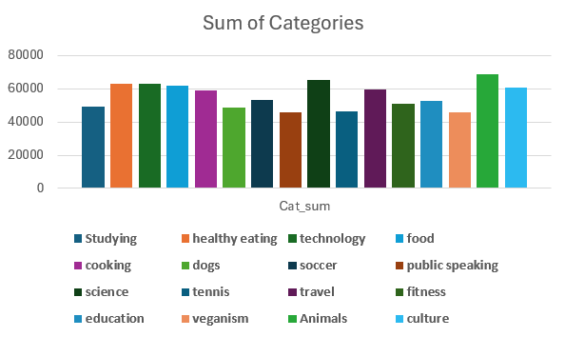
Bar Chart showing the total sum of each category

Slide 9
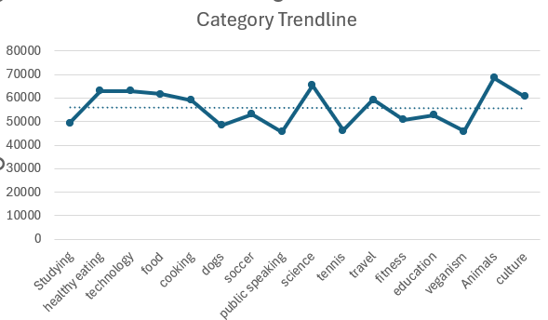
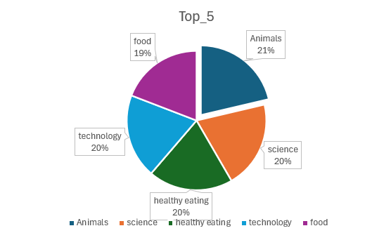

Slide 10

In summary, we identified the content categories posted on Social Buzz.
We identified the potential content which is proliferating and making the company gain the best place in the market.
Based on this analysis, we will practically manage and implement best business practices.
Summary

Slide 11
Thank you!
ANY QUESTIONS?

